Slide 1
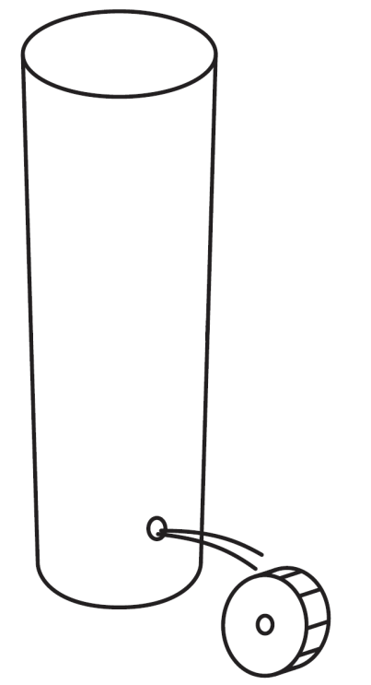
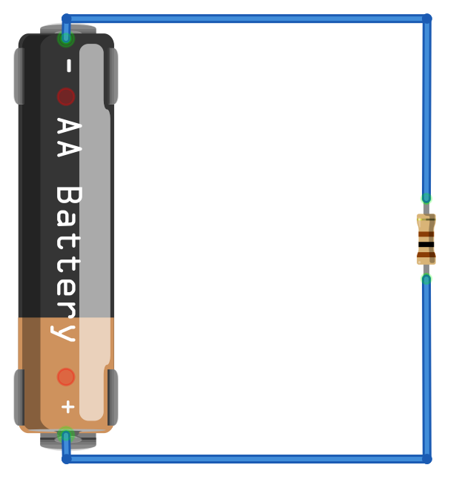
Hydraulic–electric analogy
Water level
As the water level increases, so too does the “pressure” of the water at the bottom of the tank (due to increasing amounts of weight), which will “push” more water out of the tank (increasing flow)
Lowest pressure
(negative terminal of battery)
0 volts
The resistor causes an electrical pressure (voltage) drop. So, the voltage is back to 0V here.
Lowest pressure
(at top of water level)
I = 15mA
R = 100Ω
Water Pressure ≈ Voltage (V) (measured in volts)
Hole width ≈ Resistance (R) (measured in ohms Ω)
Current (I) flows from high to low pressure
The resistor resists the flow of current and the voltage (pressure) drops. The larger the resistor, the less current.
Highest pressure
(positive terminal of battery)
1.5 volts
Highest pressure
(at bottom of tank)
Water Flow ≈ Current (I) (measured in amps or A)
Based on figures from: Platt, Make: Electronics, 1st Edition

