Slide 1
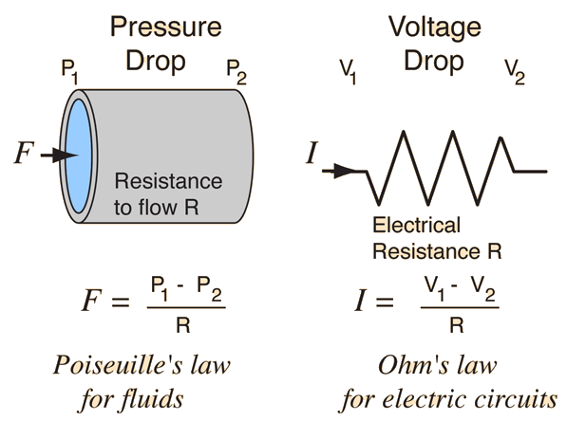
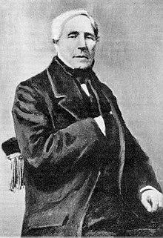
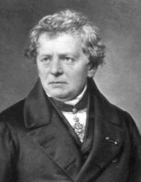
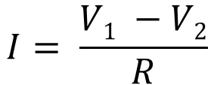
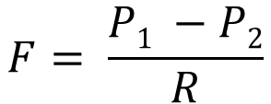
ohm’s law
Ohm’s law
Current is linearly proportional to the amount of voltage and resistance in circuit
Pressure Drop
P₁
P₂
V₁
V₂
F
I
F = flow rate in cm³ / sec
I = charge flow rate in coloumbs/sec
$$F= \frac{P1 −P2}{R}$$
$$I= \frac{V1 −V2}{R}$$
Poiseuille’s Law for fluids
Ohm’s Law for electric circuits
circa ~1838
circa ~1825
Based on: Scherz & Monk, Practical Electronics for Inventors, 3rd Edition; http://en.wikipedia.org/wiki/Hagen%E2%80%93Poiseuille_equation; http://hyperphysics.phy-astr.gsu.edu/hbase/electric/watcir2.html
Notes:
See also: https://youtu.be/HXOok3mfMLM?t=142 for an animation

Slide 2
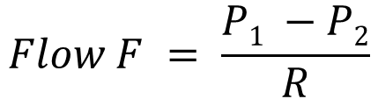
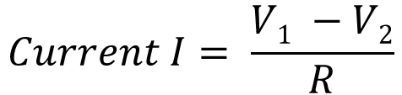
Poiseuille’s Law and Ohm’s law
Poiseuille’s Law for smooth flow (laminar flow) of fluids
Ohm’s Law for electric circuits
circa ~1825
circa ~1838
Pressure Drop
Voltage Drop
P₁
P₂
High potential
V₁
V₂
High pressure
Low pressure
Low potential
I
F
Resistance to flow R
I = charge flow rate in coulombs/sec
F = flow rate in cm³ / sec
Electrical resistance R
$$Flow F = \frac{P1 −P2}{R}$$
⬄
$$Current I= \frac{V1 −V2}{R}$$
Based on: Scherz & Monk, Practical Electronics for Inventors, 3rd Edition; http://en.wikipedia.org/wiki/Hagen%E2%80%93Poiseuille_equation; http://hyperphysics.phy-astr.gsu.edu/hbase/electric/watcir2.html
Notes:
See also: https://youtu.be/HXOok3mfMLM?t=142 for an animation

Slide 3
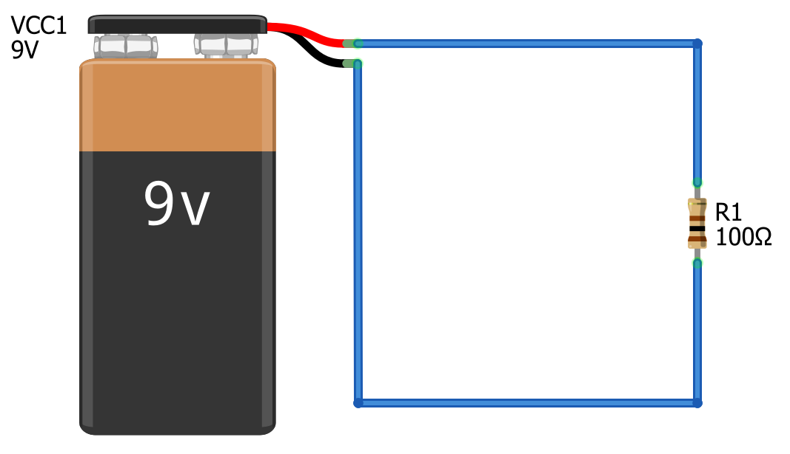
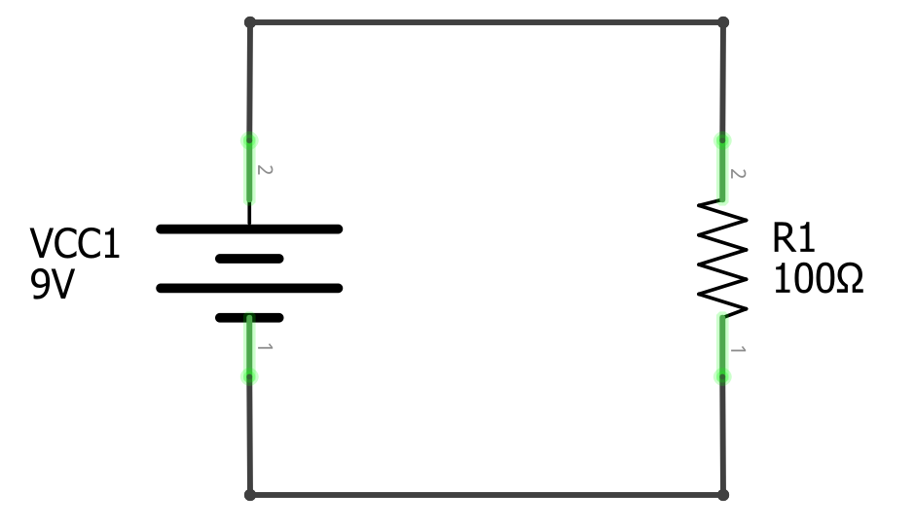

Slide 4
How much current I is flowing through this circuit.
How much current I is flowing through this circuit.

Slide 5
How much current I is flowing through this circuit.

Slide 6
How much current I is flowing through this circuit.

Slide 7
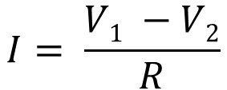
Solve for current I
$$I= \frac{V1 −V2}{R}$$
How much current I is flowing through this circuit.
How much current I is flowing through this circuit.

Slide 8
Step 1: Identify knowns
This entire wire is 9V because it directly touches the positive terminal of the battery.
This entire wire is 9V because it directly touches the positive terminal of the battery.
$$I= \frac{V1 −V2}{R}$$
This entire wire is 0V because it directly touches the negative terminal of the battery.
This entire wire is 0V because it directly touches the negative terminal of the battery.

Slide 9
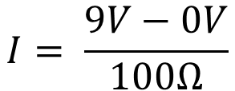
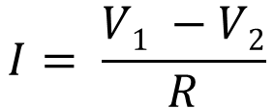
Step 2: Apply knowns
This entire red wire is 9V, let’s represent it as node V₁
This entire red wire is 9V, let’s represent it as node V₁
V₁
V₁
$$I= \frac{V1 −V2}{R}$$
$$I= \frac{9V−0V}{100Ω}$$
V₂
V₂
This entire black wire is 0V, let’s represent it as node V₂
This entire black wire is 0V, let’s represent it as node V₂

Slide 10

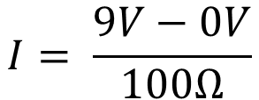
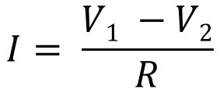
Step 3: Solve for Current I
This entire red wire is 9V, let’s represent it as node V₁
This entire red wire is 9V, let’s represent it as node V₁
V₁
V₁
$$I= \frac{V1 −V2}{R}$$
I = 90mA
I = 90mA
$$I= \frac{9V−0V}{100Ω}$$
V₂
V₂
$$I=0.09A⇒90mA$$
This entire black wire is 0V, let’s represent it as node V₂
This entire black wire is 0V, let’s represent it as node V₂

Slide 11
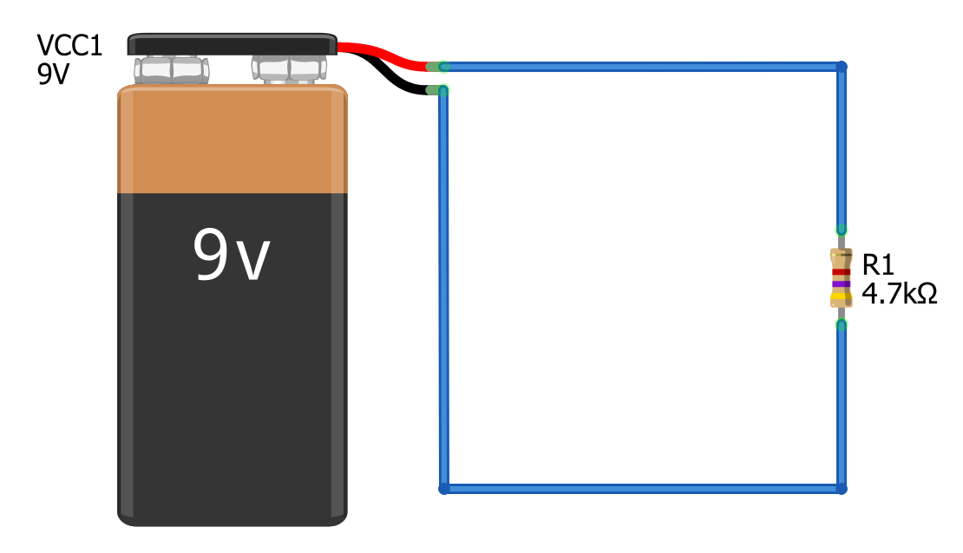
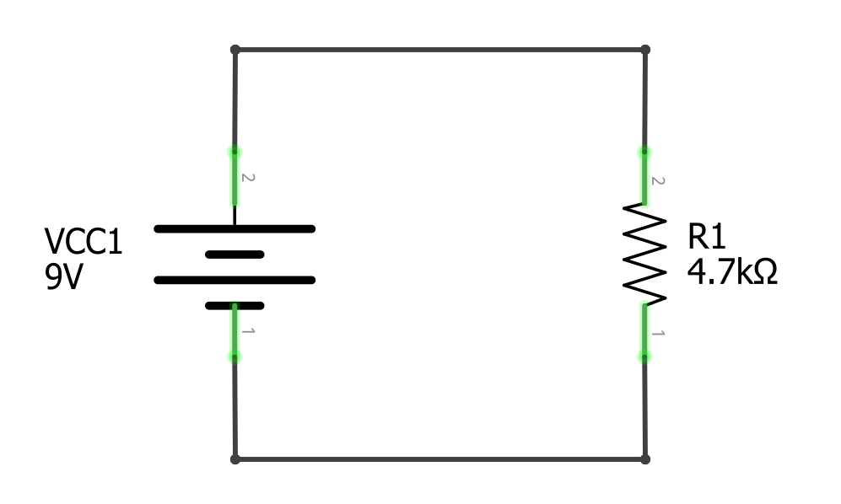

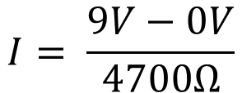
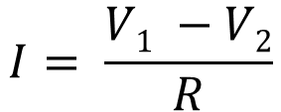
Solve for current I
$$I= \frac{V1 −V2}{R}$$
How much current I is flowing through this circuit.
How much current I is flowing through this circuit.
$$I= \frac{9V−0V}{4700Ω}$$
$$I=0.0019A⇒1.9mA$$

Slide 12


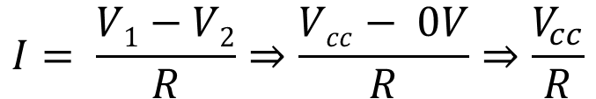
Solve for Voltage Vcc
V_{cc}
$$I= \frac{V1−V2}{R}⇒\frac{Vcc− 0V}{R}⇒\frac{V_{cc}}{R}$$
V_{cc} = ?
?
I = 50mA
I = 50mA
$$V_{cc}=I∗R$$
0V
$$V_{cc}=0.05A∗100 Ω⇒5V$$

Slide 13
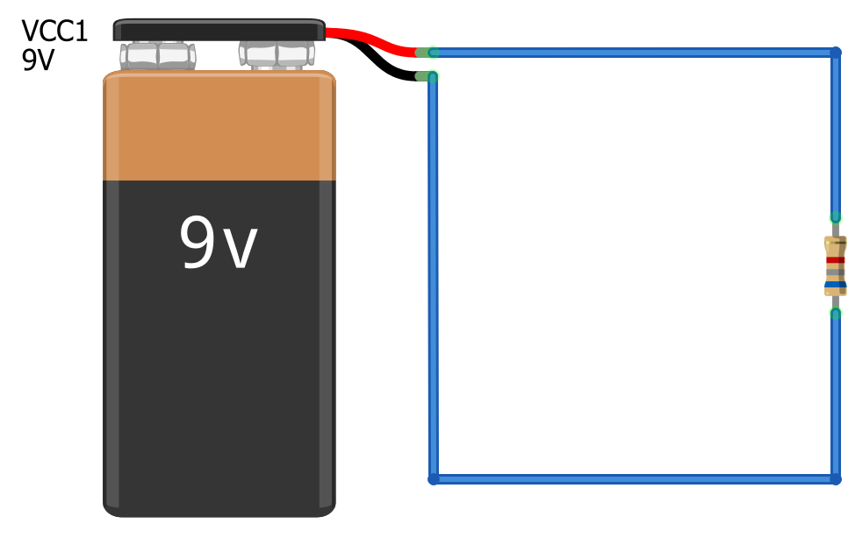



Solve for Resistance R
$$I= \frac{V1−V2}{R}⇒\frac{9V− 0V}{R}⇒\frac{9V}{R}$$
9V
I = 1.32mA
R=?
I = 1.32mA
R=?
$$R= \frac{9V}{I}⇒\frac{9V}{0.00132A}$$
0V
$$R=6818.2Ω⇒6.82kΩ$$

Slide 14
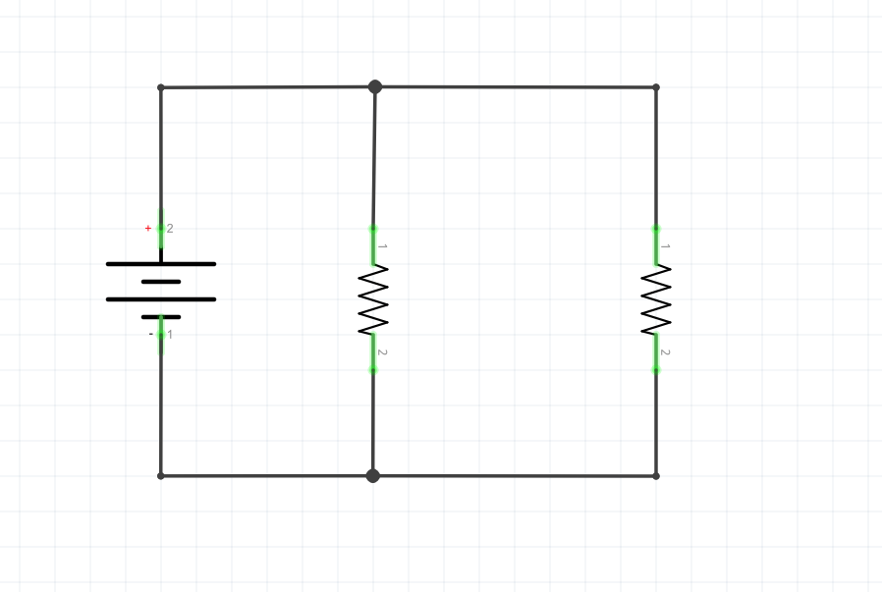
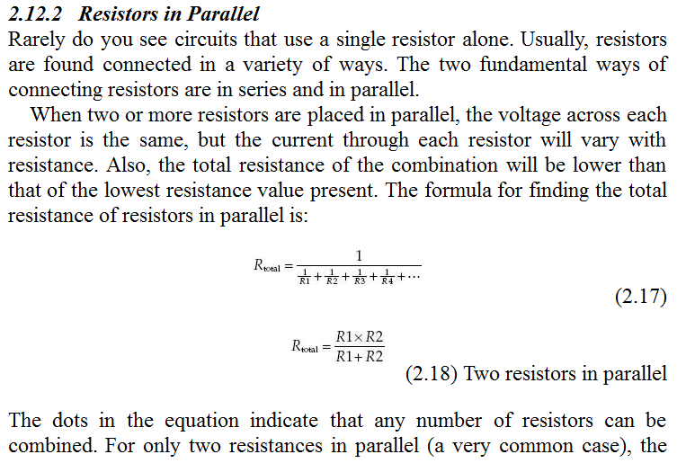
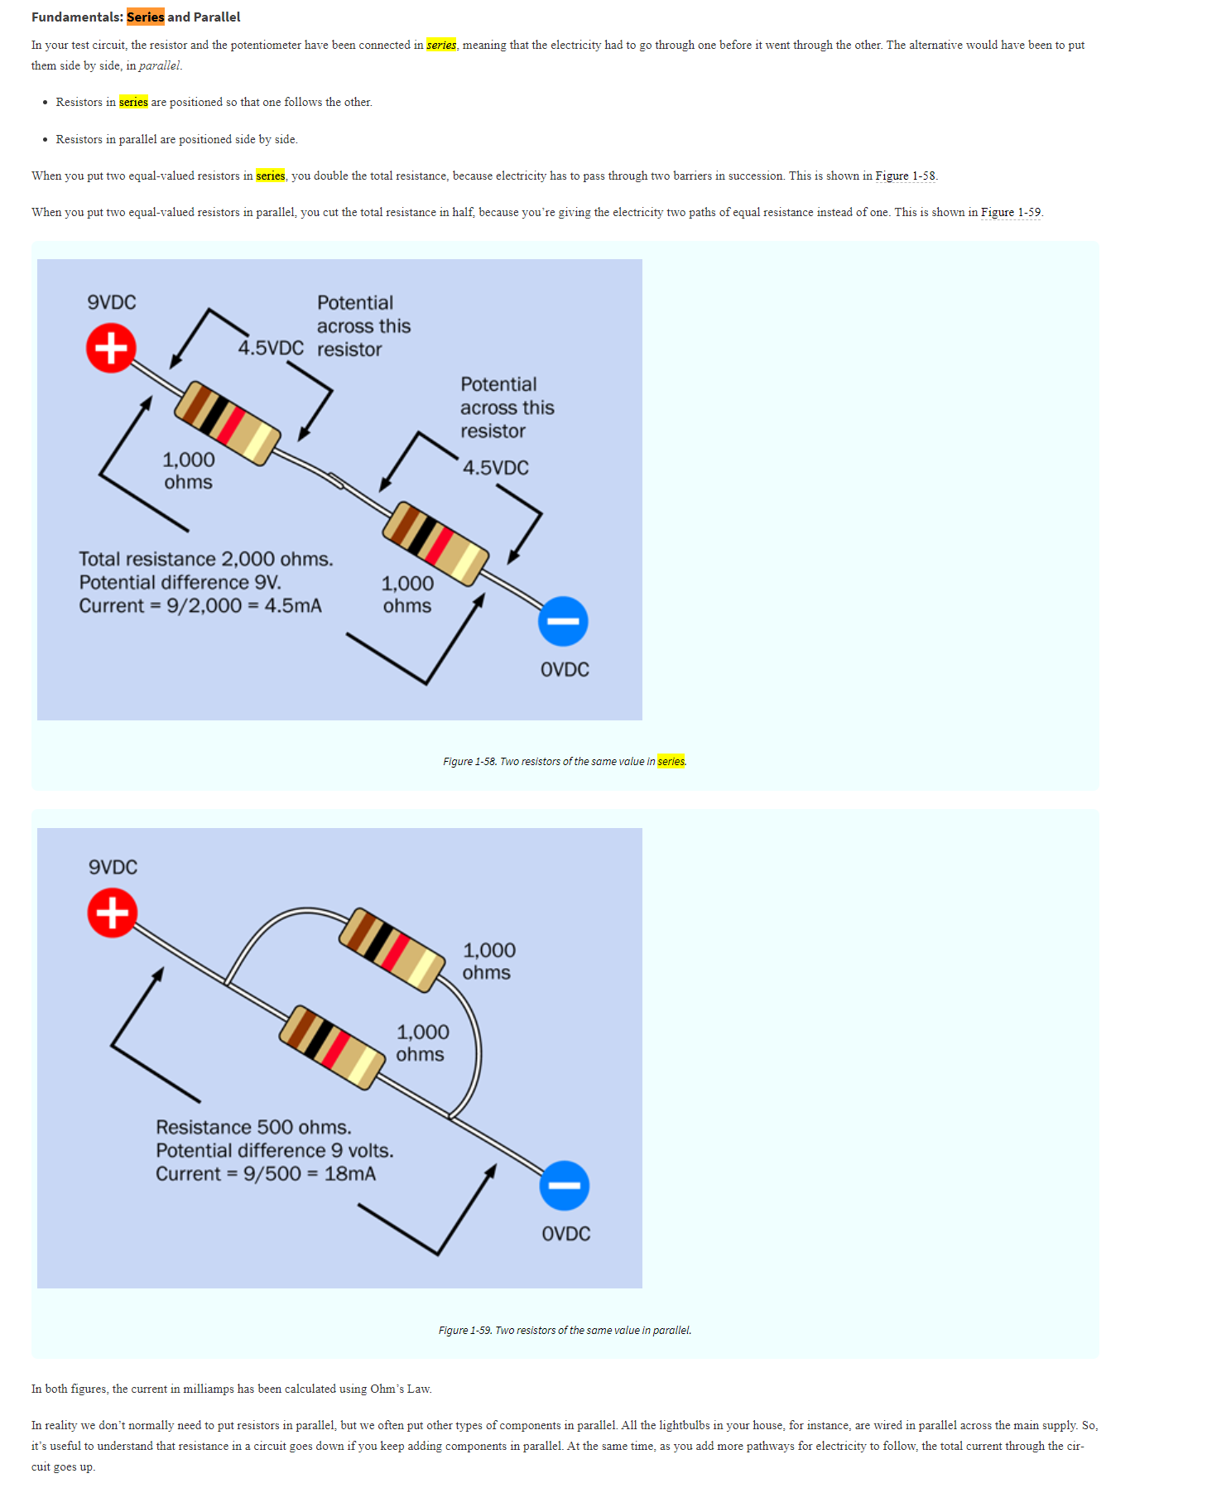
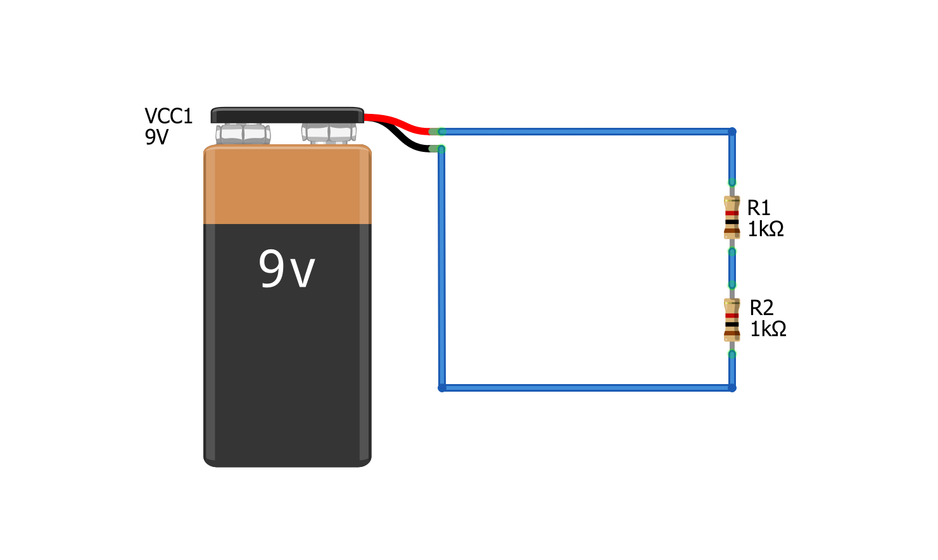
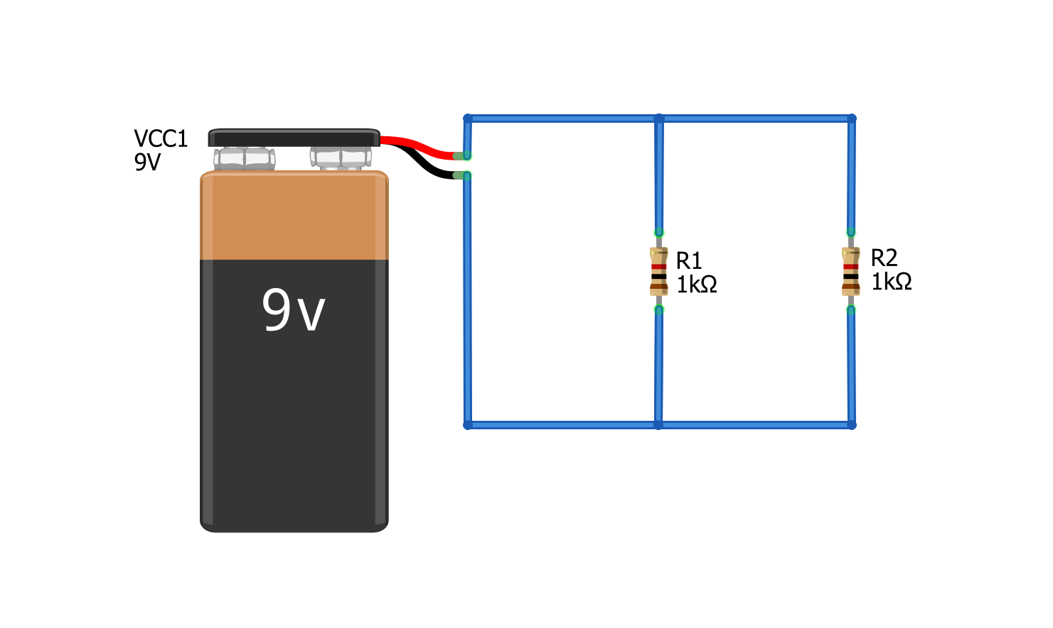


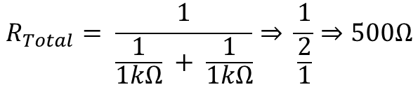


I = 1.32mA
Resistors in series vs. Parallel
Resistors in Series
Resistors in series divide voltage
Resistors in Parallel
Resistors in parallel divide current
R_{Total} = 2kΩ
I = 4.5mA
We sum resistors in series:
Formula for the total resistance of parallel resistors:
$$R_{Total}= R_{1}+ R_{2}$$
$R_{Total}= \frac{1}{\frac{1}{R_{1}}+ \frac{1}{R_{2}}+…+ \frac{1}{R_{N−1}}+ \frac{1}{R_{N}}}$
$$R_{Total}=2kΩ$$
$$R_{Total}= \frac{1}{\frac{1}{1kΩ} + \frac{1}{1kΩ}}⇒ \frac{1}{\frac{2}{1}}⇒500Ω$$
$$I= \frac{9V}{2kΩ}⇒4.5ma$$

Slide 15

Series Resistors
Parallel Resistors
Current is the same across each resistor. Voltage is divided.
Voltage is the same across each resistor. Current is divided.
R₁
R₂
R₃
R₁
R₂
R₃
$$R_{Equivalent}= R_{1}+ R_{2}+ …+R_{N−1}+R_{N}$$
$R_{Equivalent}= \frac{1}{\frac{1}{R_{1}}+ \frac{1}{R_{2}}+…+ \frac{1}{R_{N−1}}+ \frac{1}{R_{N}}}$

Slide 16
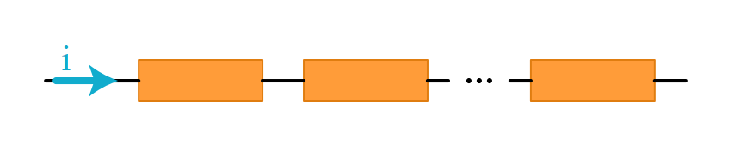
Resistors in Series
Components are in series if they are joined end-to-end (or head-to-tail) in sequence like this.
R₁
R₂
R₃
I

Slide 17
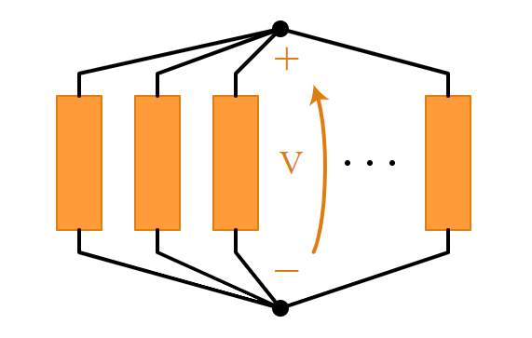
Resistors in Parallel
Components are in parallel if their head’s share a node and their tail’s share a node.
Node 1
Node 1
R₁
R₂
R₃
Node 2
Node 2

Slide 18








Resistors in series vs. Parallel
Series Resistors
Parallel Resistors
Current is the same across each resistor. Voltage is divided.
Voltage is the same across each resistor. Current is divided.
V_{A} = 9V
I_{Total}
I = 4.5mA
Voltage drop over R₁
I₁
I₂
V_{B} = 4.5V
R_{Total} = 2kΩ
Voltage drop over R₂
I_{Total}
I = 4.5mA
V_{C} = 0V
$$R_{Total}= R_{1}+ R_{2}⇒2kΩ$$
$$I_{1}= \frac{9V}{1kΩ}⇒9mA$$
$$I_{2}= \frac{9V}{1kΩ}⇒9mA$$
$$I= \frac{9V}{2kΩ}⇒4.5ma$$
$$I_{Total}= I_{1}+ I_{2}⇒18mA$$
In this circuit, there are no branches and thus, we have the same current everywhere (there is no where else for the current to go). But we do get a voltage drop across each resistor.
In this circuit, we have a branch so the current gets divided. Both branches have the same resistance so current is divided evenly. We can calculate the current through each branch and sum.
We sum resistors in series:
$$R_{Total}= R_{1}+ R_{2}$$
$$R_{Total}=2kΩ$$
$$I= \frac{9V}{2kΩ}⇒4.5ma$$

Slide 19
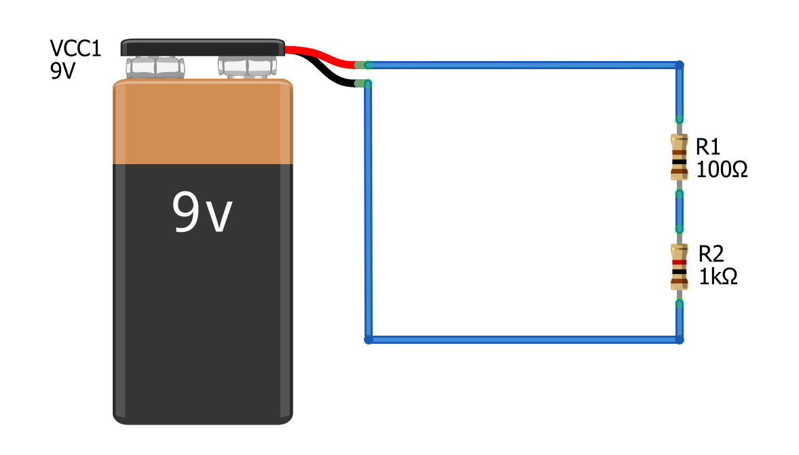
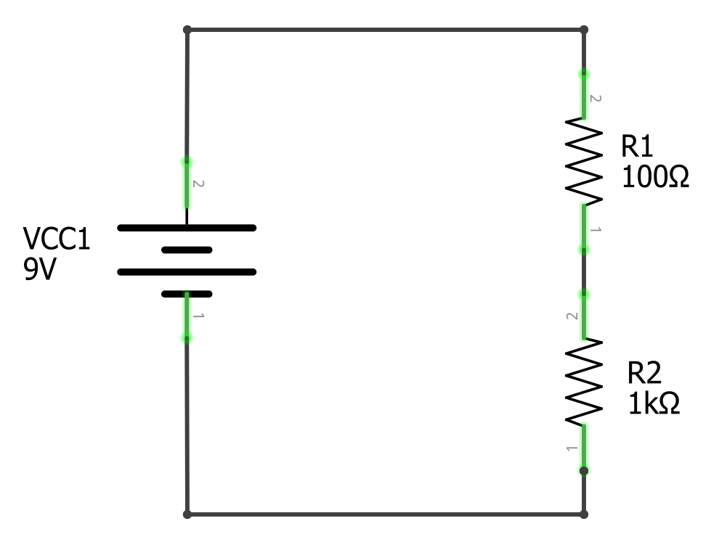

Slide 20

Solve for current I
$$I= \frac{V}{R_{Total}}$$
How much current I is flowing through this circuit.
How much current I is flowing through this circuit.

Slide 21

Step 1: Solve for total resistance
With series resistors, we sum resistances
$$I= \frac{V}{R_{Total}}$$
How much current I is flowing through this circuit.
How much current I is flowing through this circuit.
R_{Total}
1100Ω
$$R_{Total}= R_{1}+ R_{2}⇒1100Ω$$
R_{Total}
1100Ω

Slide 22

Step 2: Solve for Current I with aggregate resistance R_{Total}
$$I= \frac{V}{R_{Total}}$$
I = 8.2mA
R_{Total}
1100Ω
$$R_{Total}= R_{1}+ R_{2}⇒1100Ω$$
I = 8.2mA
R_{Total}
1100Ω
$$I= \frac{9V}{1100Ω}⇒8.2mA$$

Slide 23
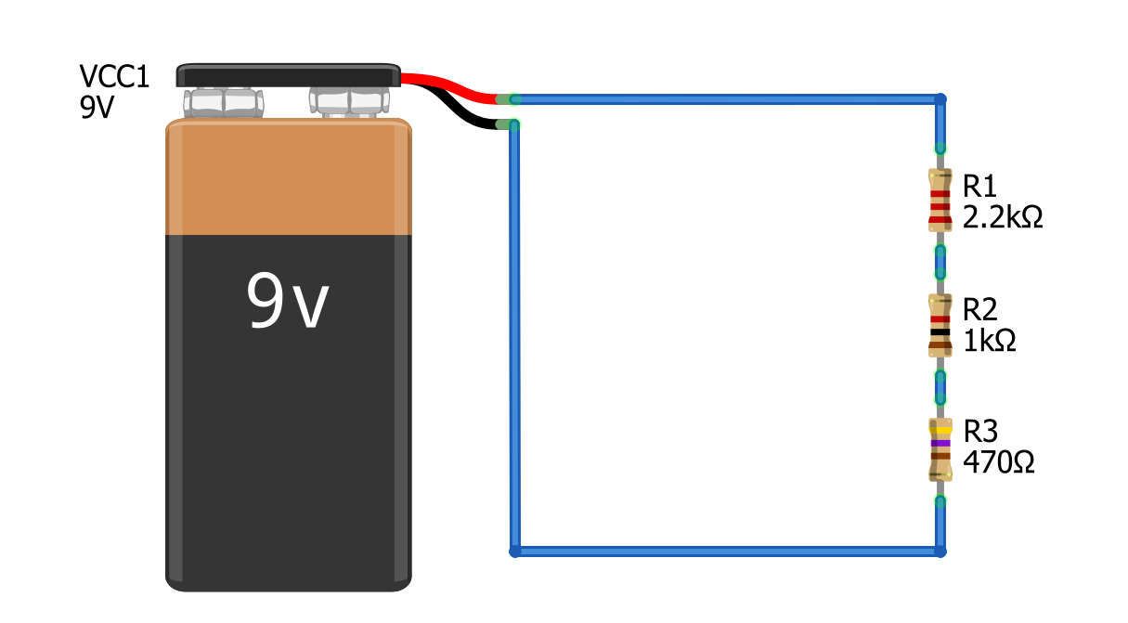
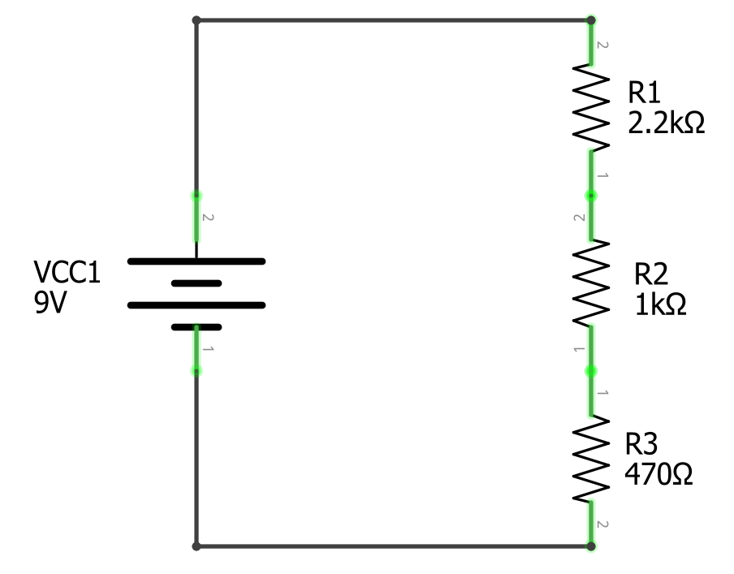


Solve for Current I
$$I= \frac{V}{R_{Total}}$$
$$R_{Total}= R_{1}+ R_{2 }{+ R}_{2}⇒3670Ω$$
I = 8.2mA
R_{Total}
3670Ω
I = 8.2mA
R_{Total}
3670Ω
$$I= \frac{9V}{3670Ω}⇒2.5mA$$

Slide 24
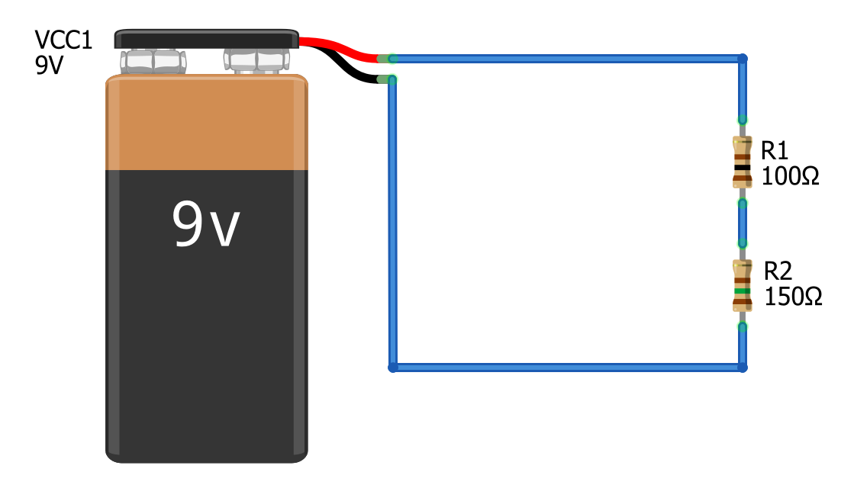
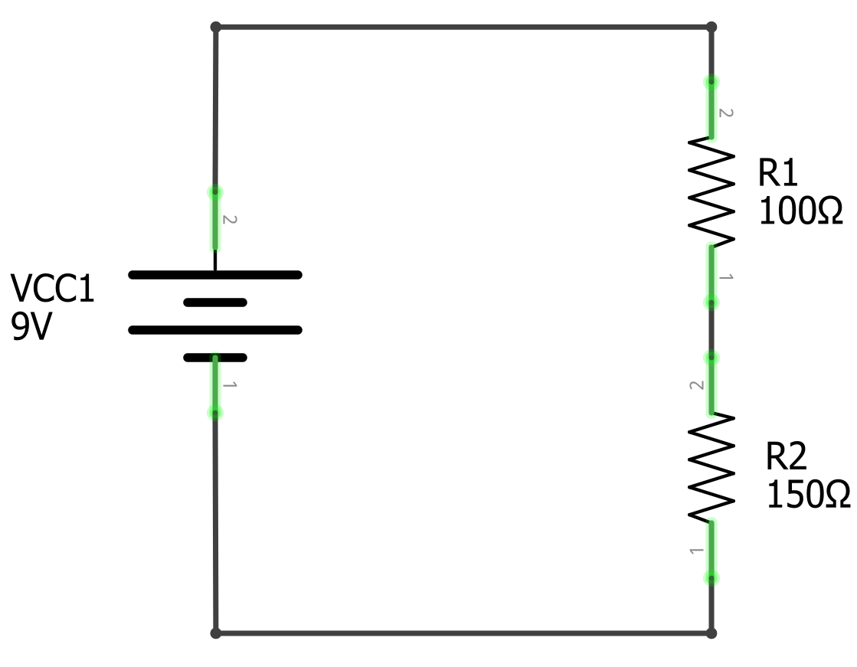
Solve for voltage at V_{B}
V_{A}
V_{A}
What is the voltage here?
What is the voltage here?
V_{B}
V_{B}
V_{C}
V_{C}

Slide 25



Step I: solve for current through circuit
V_{A} = 9V
V_{A} = 9V
$$I= \frac{V}{R_{Total}}$$
How much current I is flowing through this circuit.
How much current I is flowing through this circuit.
V_{B}
V_{B}
$$R_{Total}= R_{1}+ R_{2}⇒250Ω$$
$$I= \frac{9V}{250Ω}⇒36mA$$
V_{C} = 0V
V_{C} = 0V

Slide 26

Step 2: Use current to calculate voltage drop across resistors
I = 36mA
I = 36mA
$$V=I∗R$$
V₁
Voltage drop over R₁
$$V_{1}=I∗R_{1}⇒0.036A ∗100Ω⇒3.6V$$
V₁
Voltage drop over R₁
$$V_{2}=I∗R_{2}⇒0.036A ∗150Ω⇒5.4V$$
V_{B}
V_{B}
V₂
Voltage drop over R₁
V₂
Voltage drop over R₁
I = 36mA
V_{C}
I = 36mA

Slide 27
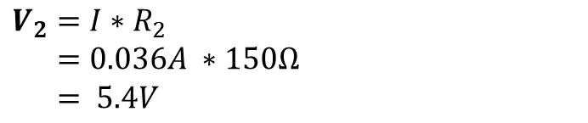


Step 2: Use current to calculate voltage drop across resistors
I = 36mA
I = 36mA
V_{A} = 9V
$$V=I∗R$$
V_{A} = 9V
V₁
Voltage drop over R₁
$$V_{1}=I∗R_{1}$$
$$V_{1}= 0.036A ∗100Ω$$
$$V_{1}= 3.6V$$
V₁
Voltage drop over R₁
V_{B}
V_{B}
V₂
Voltage drop over R₂
V₂
Voltage drop over R2
$$V_{2}=I∗R_{2}$$
$$V_{2}=0.036A ∗150Ω$$
$$V_{2}= 5.4V$$
V_{C} = 0V
I = 36mA
V_{C} = 0V
I = 36mA

Slide 28

Step 3: Now Calculate V_{B}
I = 36mA
I = 36mA
V_{A} = 9V
V_{B} is equal to the battery’s positive terminal voltage minus the voltage drop over V₁
V_{A} = 9V
V₁=3.6V
Voltage drop over R₁
V₁=3.6V
Voltage drop over R₁
V_{B}
V_{B}
$$V_{B}=9V−3.6V=5.4V$$
V₂ =5.4V
Voltage drop over R₂
V₂ =5.4V
Voltage drop over R₂
V_{C} = 0V
I = 36mA
V_{C} = 0V
I = 36mA

Slide 29






$$I=\frac{V_{A}}{R_{Total}}⇒ \frac{V_{A}}{R_{1}+R_{2}}$$
$$V_{B}= V_{A}− V_{1}$$
$$V_{1}=I ∗ R_{1}$$
$V_{B}= V_{A}−\frac{V_{A}}{R_{1}+R_{2}} ∗R_{1}$
Voltage divider pattern
I = 36mA
$$V_{1}=I ∗R_{1}$$
I = 36mA
V_{A} = 9V
V_{A} = 9V
V₁=3.6V
Voltage drop over R₁
V₁=3.6V
Voltage drop over R₁
V_{B}
V_{B}
V₂ =5.4V
Voltage drop over R₂
$$V_{B}= V_{A}∗ \frac{R_{2}}{R_{1}+R_{2}}$$
V₂ =5.4V
Voltage drop over R₂
V_{C} = 0V
I = 36mA
V_{C} = 0V
I = 36mA

Slide 30
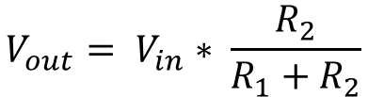
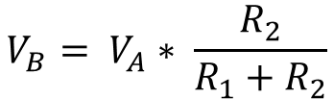
Voltage divider pattern
I = 36mA
I = 36mA
V_{A} = 9V
$$V_{B}= V_{A}∗ \frac{R_{2}}{R_{1}+R_{2}}$$
V_{A} = 9V
V₁=3.6V
Voltage drop over R₁
V₁=3.6V
Voltage drop over R₁
V_{B}
V_{B}
$$V_{out}= V_{in}∗ \frac{R_{2}}{R_{1}+R_{2}}$$
V₂ =5.4V
Voltage drop over R₂
V₂ =5.4V
Voltage drop over R₂
V_{C} = 0V
I = 36mA
V_{C} = 0V
I = 36mA

Slide 31
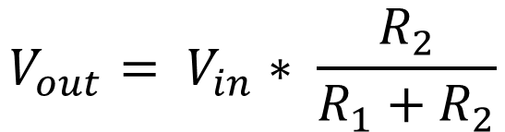
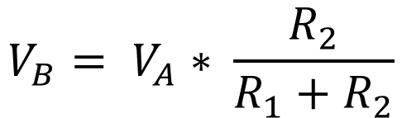
Voltage divider pattern
9V
V+
V_{A}
V_{in}
R1
R1
$$V_{B}= V_{A}∗ \frac{R_{2}}{R_{1}+R_{2}}$$
V_{out}
$$V_{out}= V_{in}∗ \frac{R_{2}}{R_{1}+R_{2}}$$
V_{B}
R2
R2
V_{C}
GND
GND

Slide 32
Step 3: Deterimine
I = 36mA
I = 36mA
V_{A}
$$V=I∗R$$
V_{A}
V₁
Voltage drop over R₁
$$V_{1}=I∗R_{1}$$
$$V_{1}= 0.036A ∗100Ω$$
$$V_{1}= 3.6V$$
V₁
Voltage drop over R₁
V_{B}
V_{B}
V₂
Voltage drop over R₁
V₂
Voltage drop over R₁
$$V_{2}=I∗R_{2}$$
$$V_{2}=0.036A ∗150Ω$$
$$V_{2}= 5.4V$$
V_{C}
I = 36mA
V_{C}
I = 36mA

Slide 33
Step I: solve for current through circuit
V_{A}
V_{A}
$$I= \frac{V}{R_{Total}}$$
How much current I is flowing through this circuit.
How much current I is flowing through this circuit.
V_{B}
V_{B}
V_{C}
V_{C}

Slide 34

V
V_{A}
V_{A}
$$I= \frac{V}{R_{Total}}$$
How much current I is flowing through this circuit.
V_{B}
V_{B}
$$R_{Total}= R_{1}+ R_{2}⇒1100Ω$$
I = 4.5mA
$$I= \frac{9V}{1100Ω}⇒8.2mA$$
V_{C}
V_{C}

Slide 35
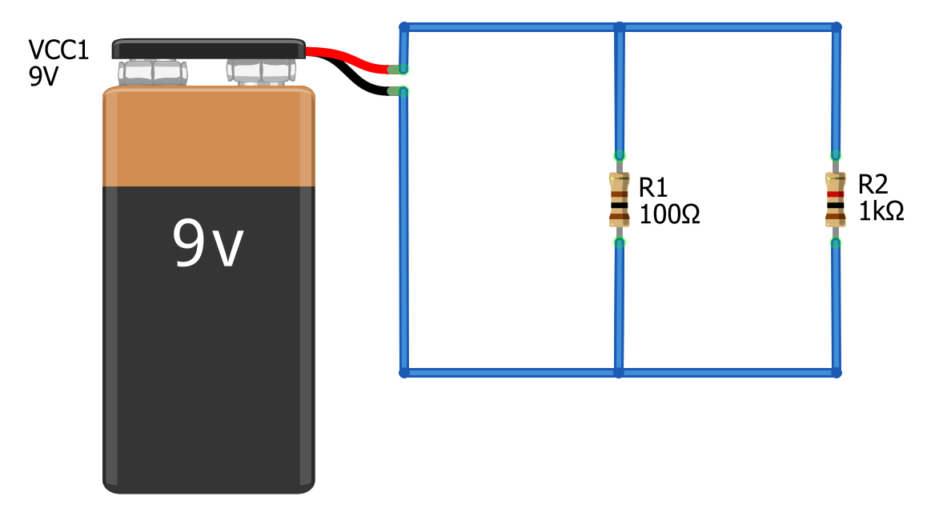
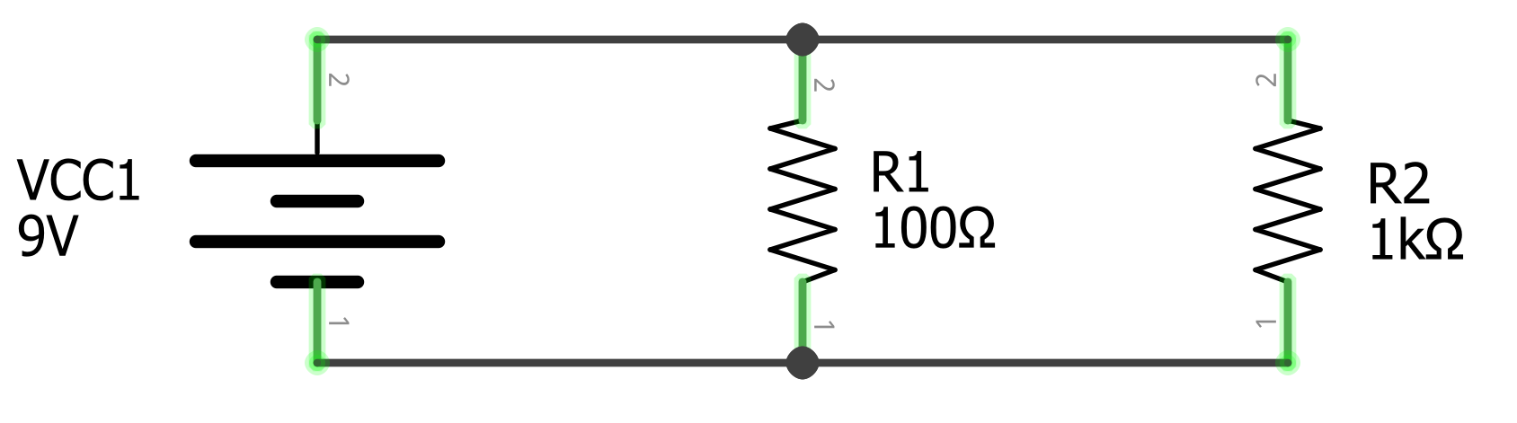
Solve for I_{Total}
I_{Total}
I_{Total}
I_{Total}
I_{Total}

Slide 36
Step 1: Observe that I_{Total} Splits into branches
I_{Total}
I_{Total}
I₁
I₂
I₁
I₂
I_{Total}
I_{Total}

Slide 37
Step 2: Identify and name the nodes (junction points)
This red area is the same node, let’s call it Node A
This red area is the same node, let’s call it Node A
I_{Total}
I_{Total}
I₁
I₂
I₁
I₂
I_{Total}
I_{Total}
This black area is the same node, let’s call it Node B
This black area is the same node, let’s call it Node B

Slide 38
Step 3: Define V_{A}
This red area is the same node, let’s call it Node A
This red area is the same node, let’s call it Node A
I_{Total}
I_{Total}
I₁
I₂
V_{A} = 9V
I₁
I₂
V_{A} = 9V
I_{Total}
I_{Total}
This black area is the same node, let’s call it Node B
This black area is the same node, let’s call it Node B

Slide 39


Step 3: Solve for I₁ and I₂
I_{Total}
I_{Total}
$$I_{1}=\frac{V_{A}}{R_{1}}⇒\frac{9V}{100Ω}⇒90mA$$
I₁
V_{A}
9V
I₁
I₂
V_{A}
9V
I₂
$$I_{2}=\frac{V_{A}}{R_{1}}⇒\frac{9V}{1kΩ}⇒9mA$$
I_{Total}
I_{Total}

Slide 40
Step 3: Solve for I₁ and I₂
I_{Total}
I_{Total}
$$I_{1}=\frac{V_{A}}{R_{1}}⇒\frac{9V}{100Ω}⇒90mA$$
I₁
V_{A}
9V
I₁
I₂
V_{A}
9V
I₂
$$I_{2}=\frac{V_{A}}{R_{1}}⇒\frac{9V}{1kΩ}⇒9mA$$
I_{Total}
I_{Total}

Slide 41



Step 3: Solve for I₁ and I₂
This red area is the same node, let’s call it V_{A}
This red area is the same node, let’s call it V_{A}
I_{Total}
I_{Total}
I₁
I₂
I₁
I₂
I_{Total}
I_{Total}
This black area is the same node, let’s call it V_{B}
This black area is the same node, let’s call it V_{B}
$$I_{1}=\frac{V_{A}}{R_{1}}⇒\frac{9V}{100Ω}⇒90mA$$
$$I_{Total}= I_{1}+ I_{2}⇒18mA$$
$$I_{2}= \frac{9V}{1kΩ}⇒9mA$$

