Slide 1
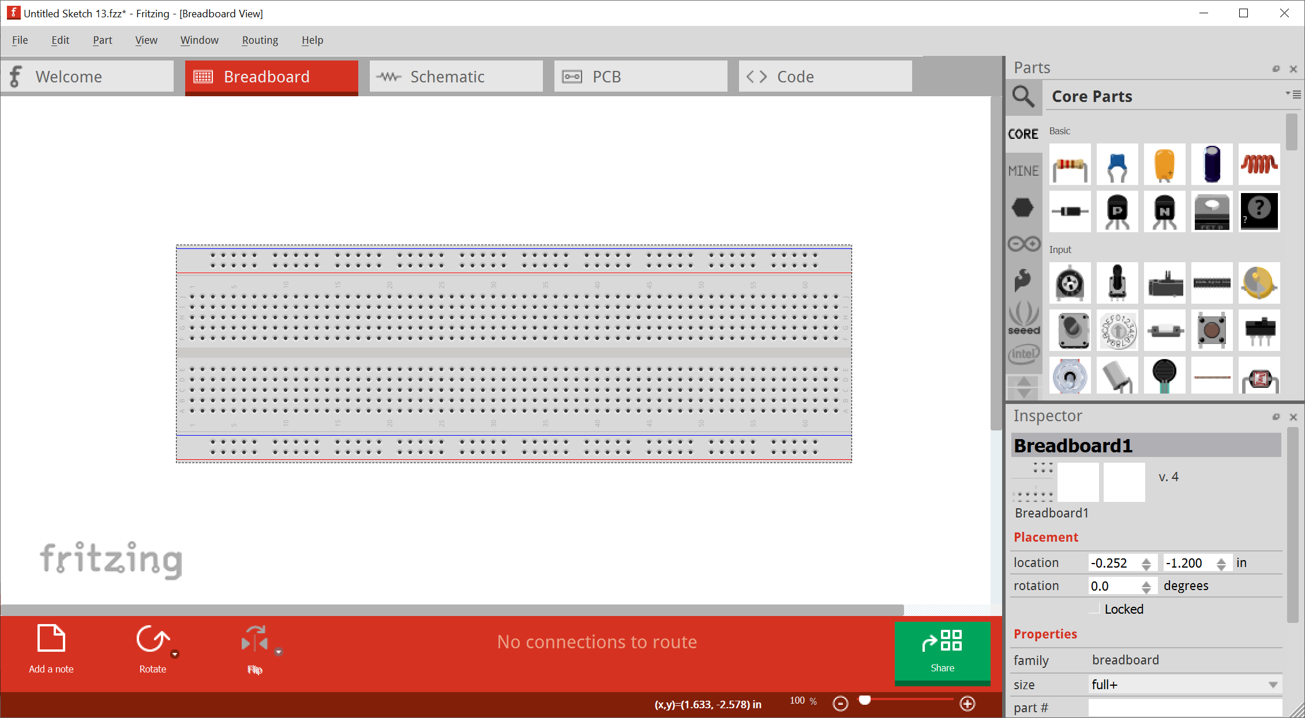
When you first open Fritzing, it will look like this. Since we’re not yet using breadboards, just click on this and delete it.

Slide 2
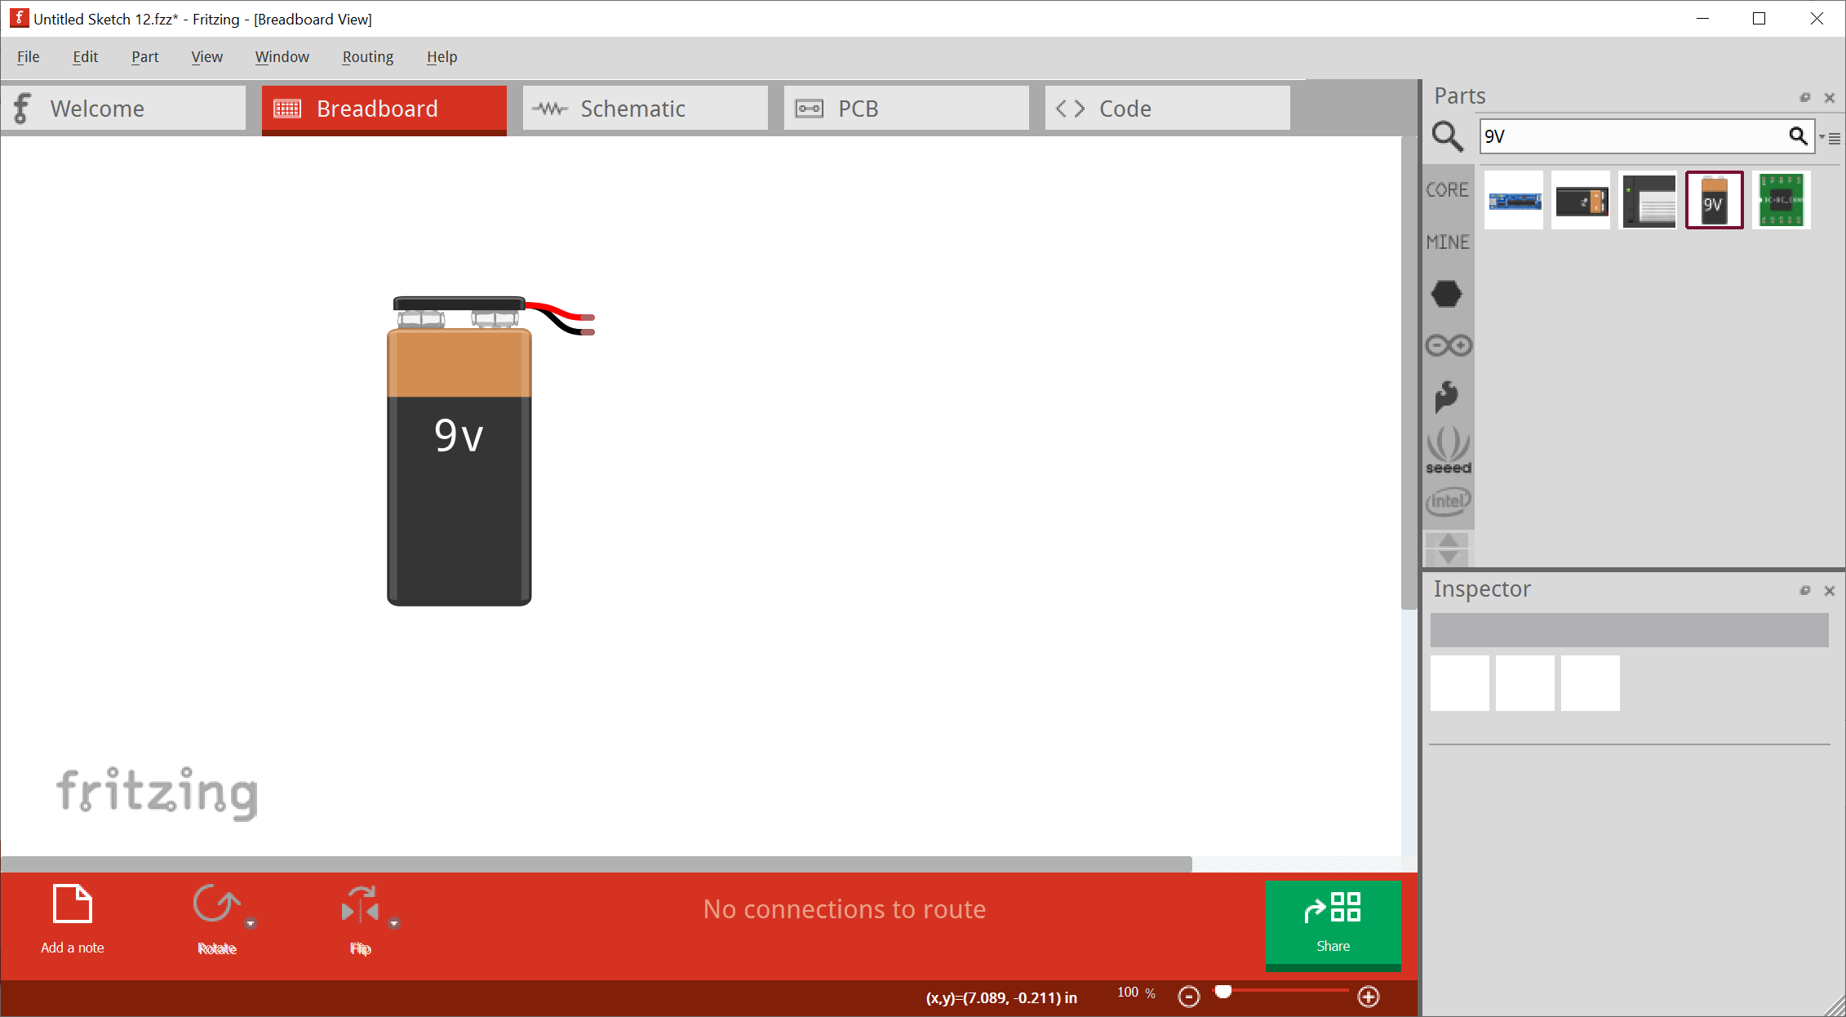
Search for parts on the right side in the “Parts” panel.

Slide 3
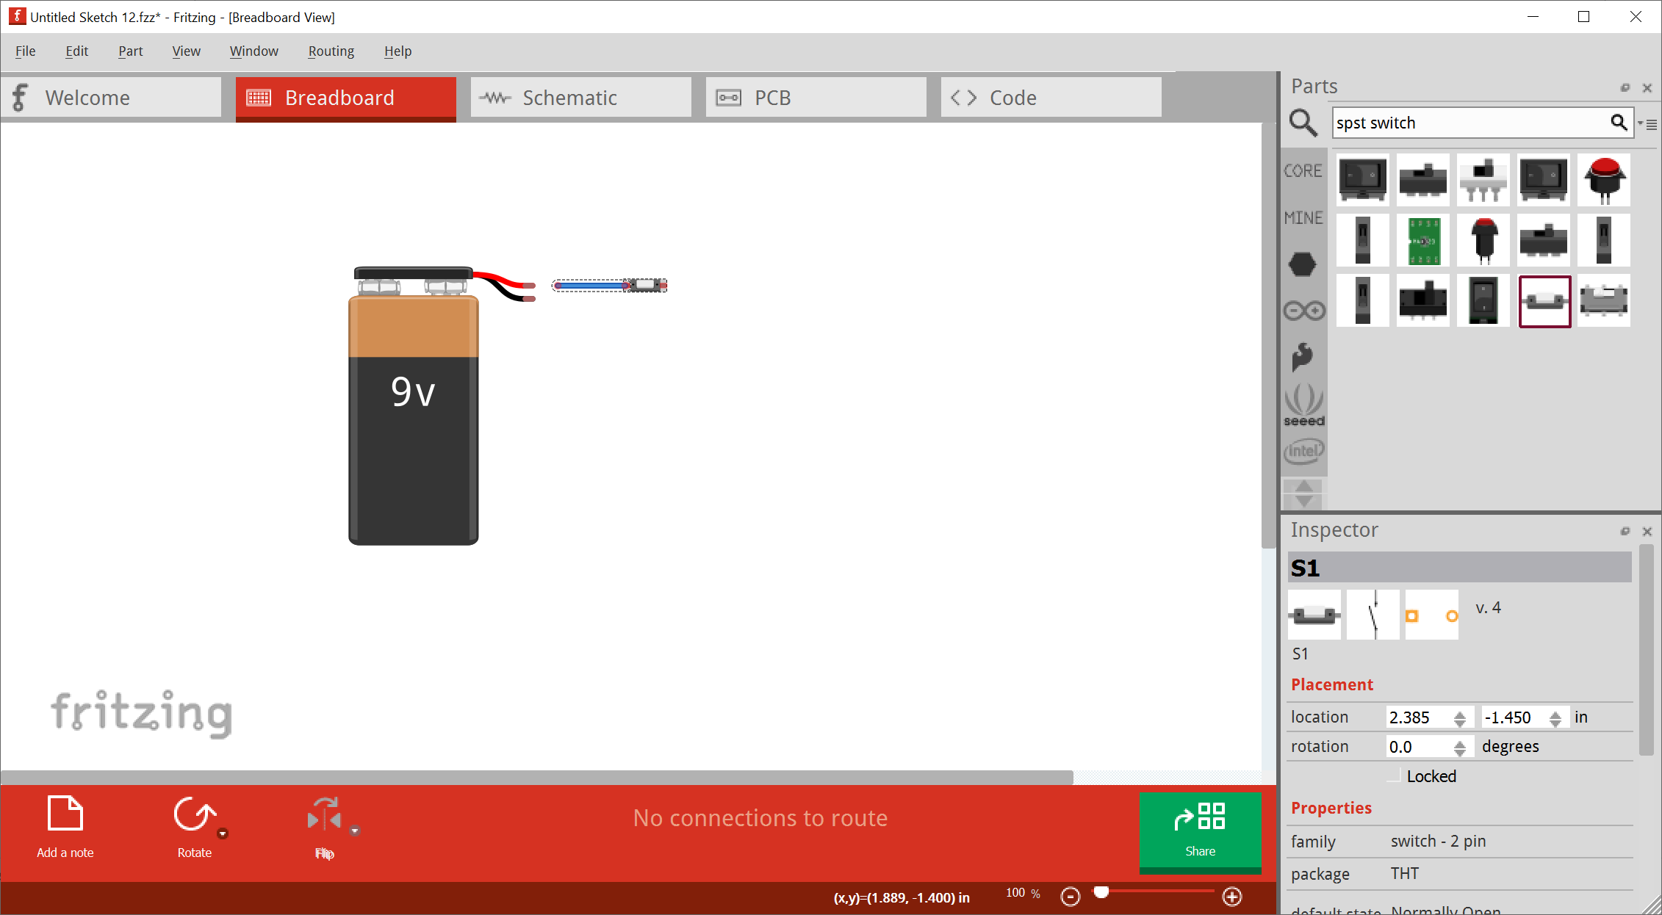
To place parts, drag and drop them from parts panel. Once placed, click and drag on a part’s “highlighted” points to create and connect wires.

Slide 4
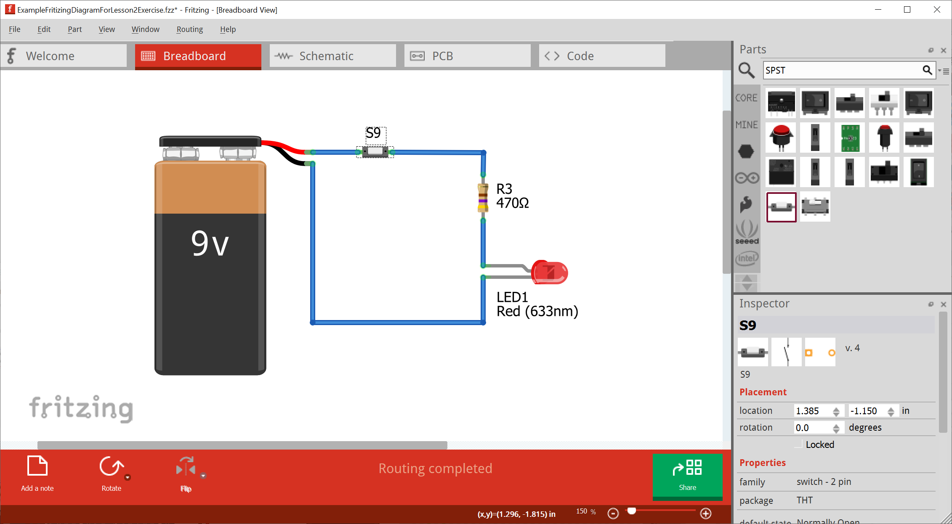
Right click on components and select “Show part label” to show labels.

Slide 5
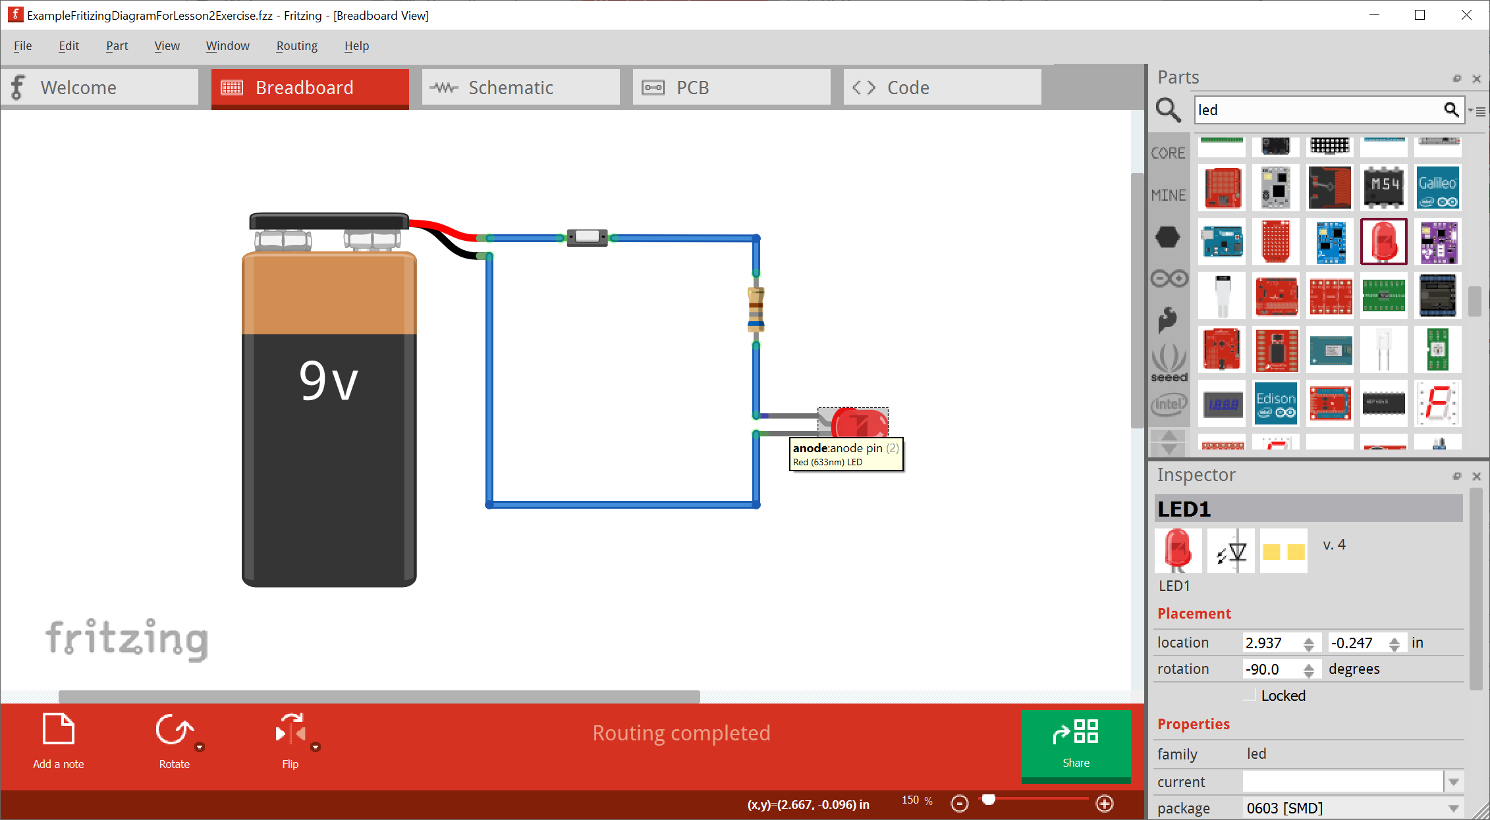
Make sure LED anode is connected to higher electric potential side of circuit. Current will only flow from anode to cathode in an LED.

Slide 6
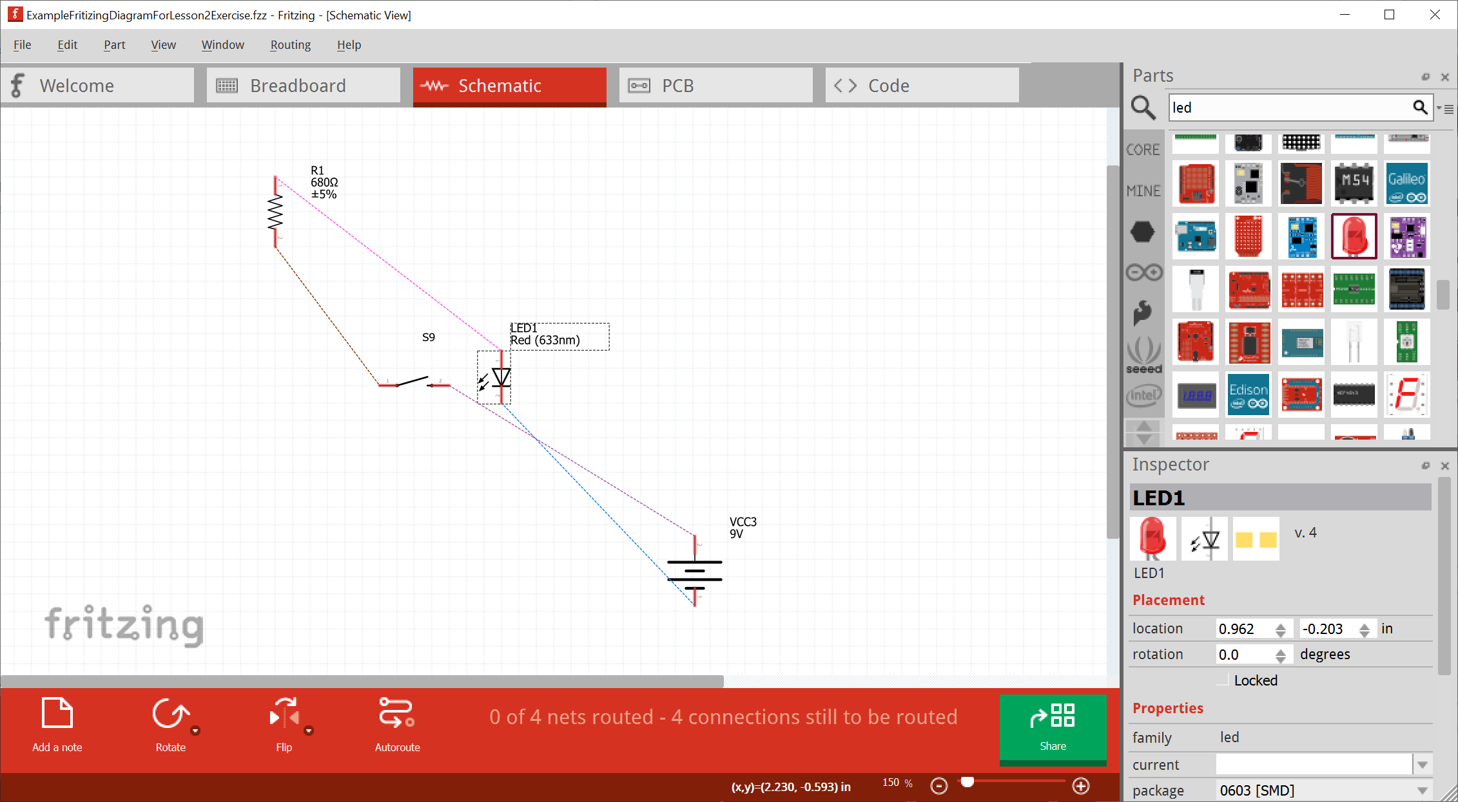
Once you’re happy with the “Breadboard” version, move over to the Schematic tab and clean it up.

Slide 7
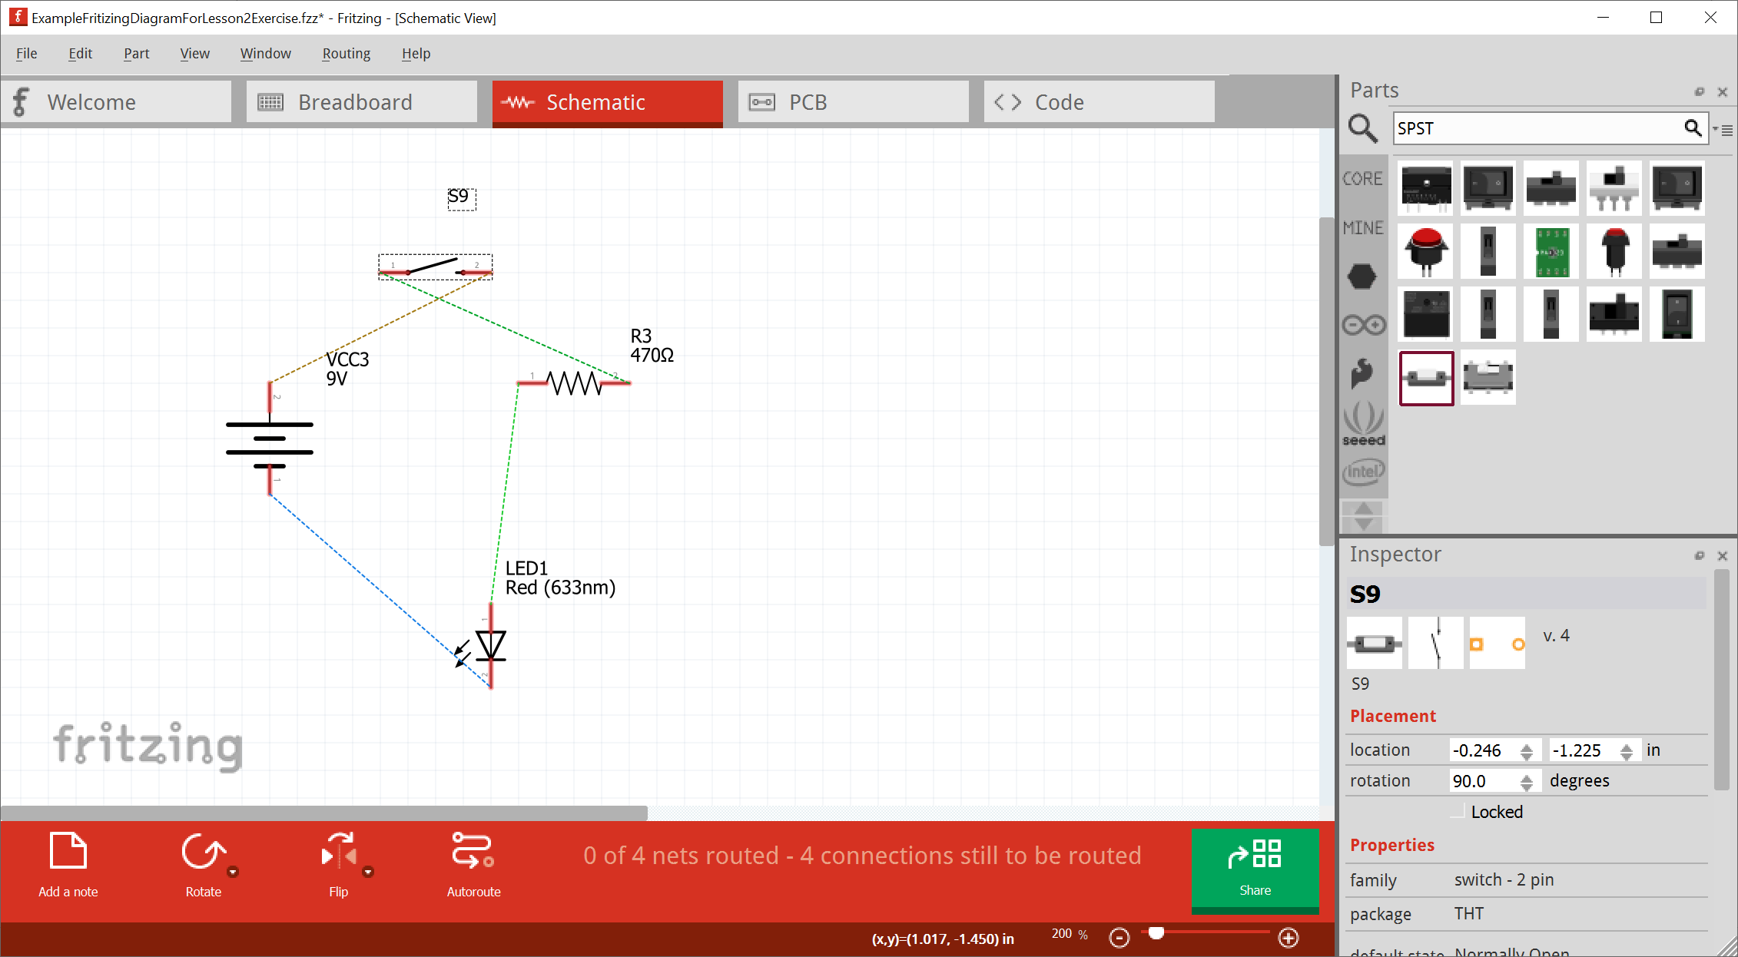
Click on components to select them and then you can use the “Rotate” and “Flip” command to orient them correctly.

Slide 8
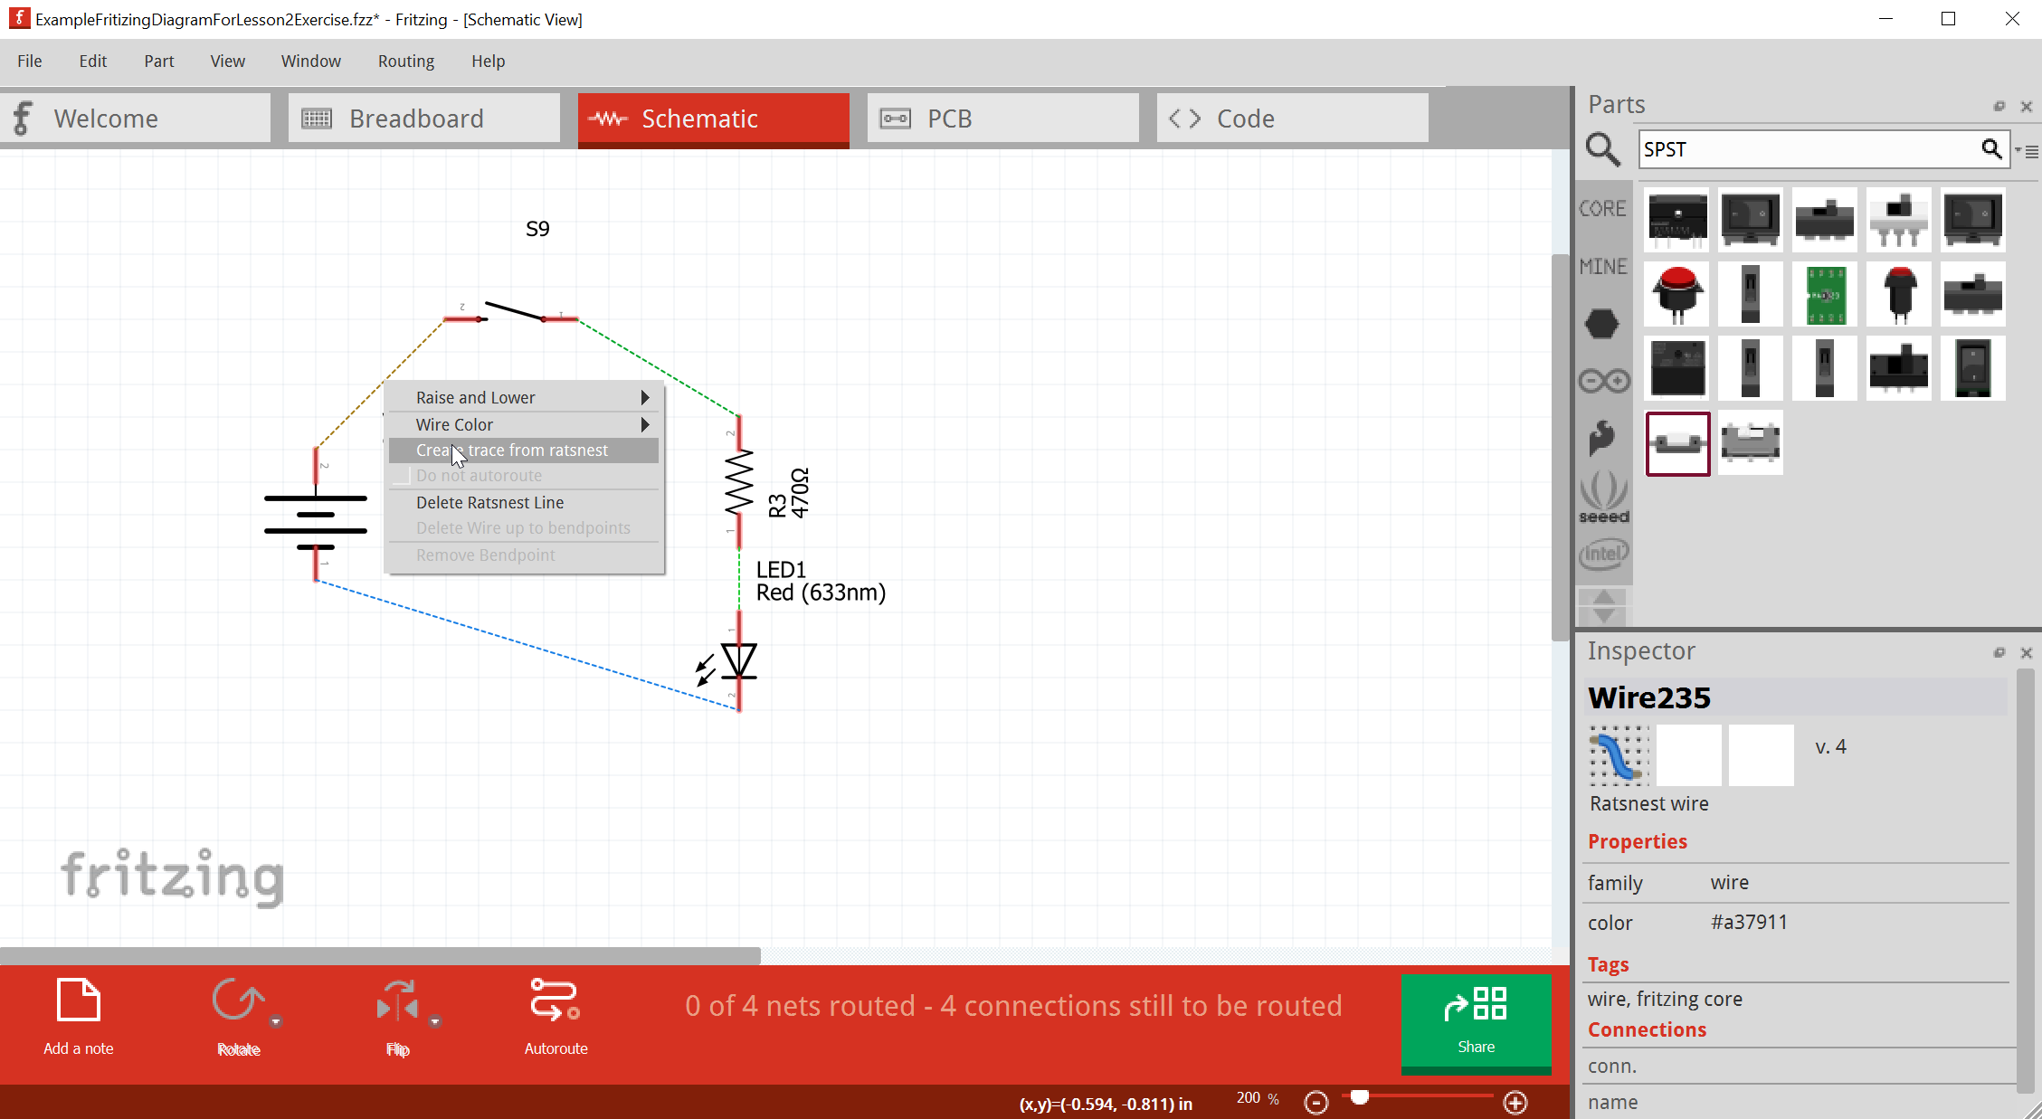
These dotted lines need to be converted to actual “wires” or “traces”. Right click on them and select “Create trace from ratsnest”

Slide 9
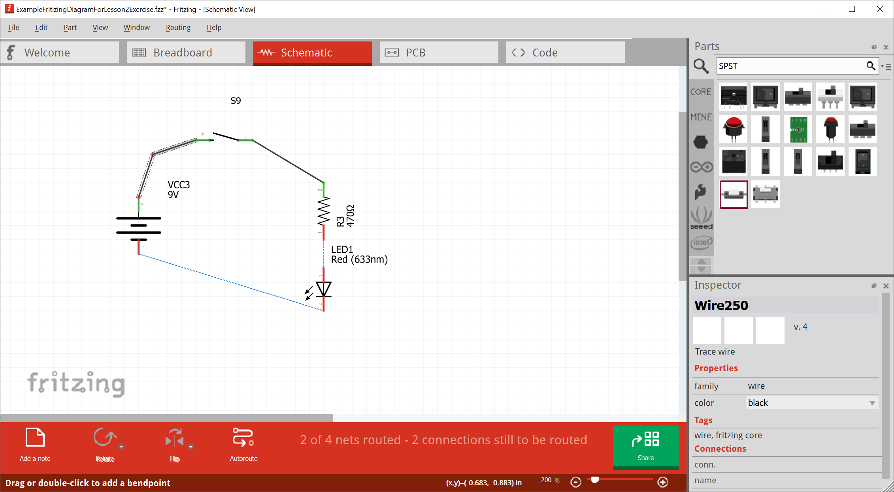

You can click-and-drag in the middle of a wire to create a bend point.

Slide 10

We did it!

Slide 11

If you want to try and auto-generating traces, you can use “Auto-route”

Slide 12
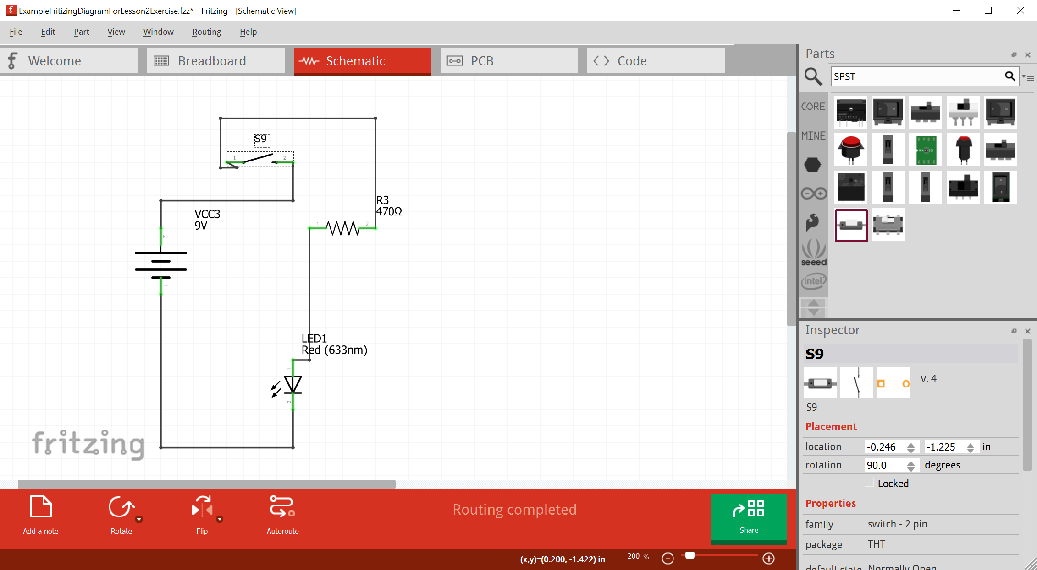
But the auto-generated wiring does not always look so elegant

