Slide 1
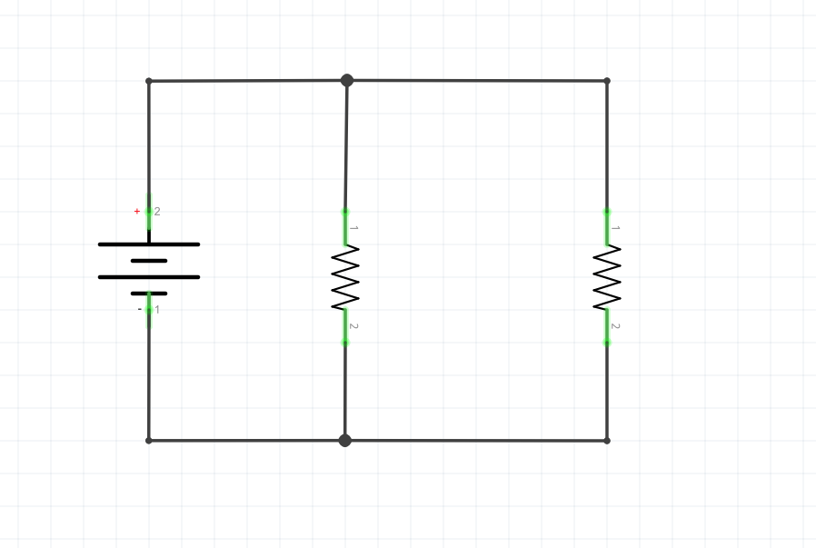
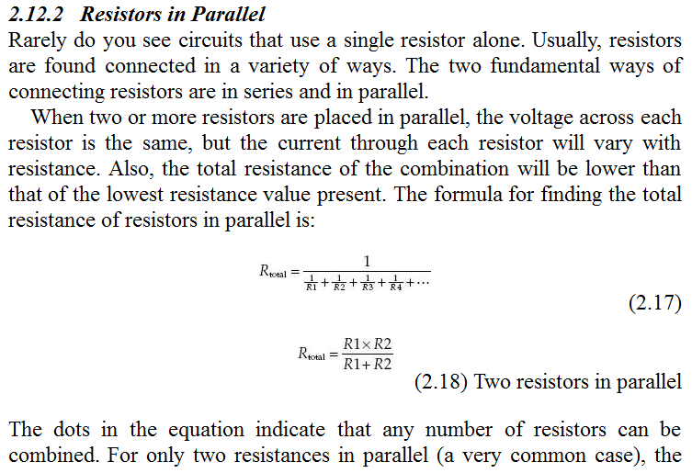
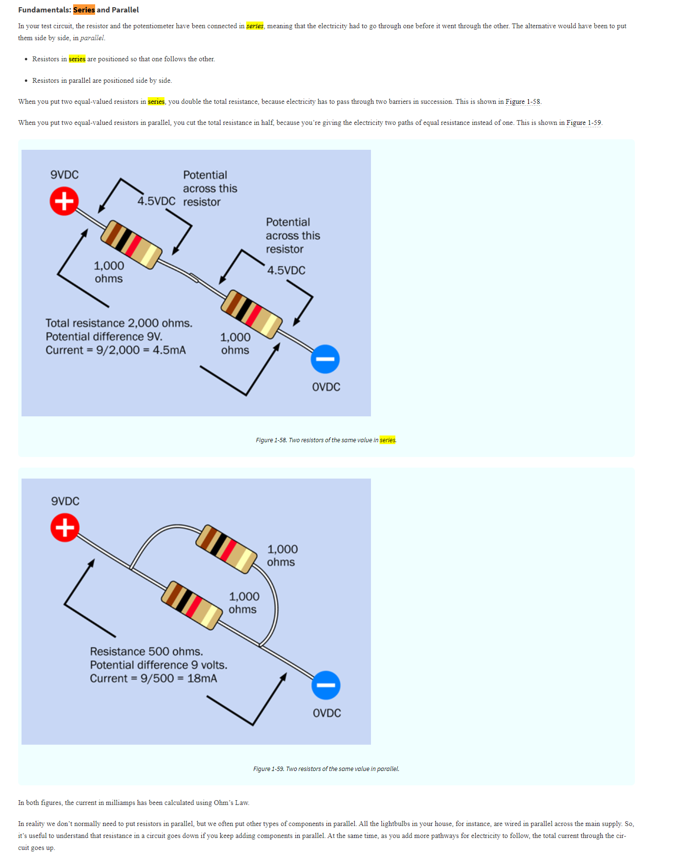
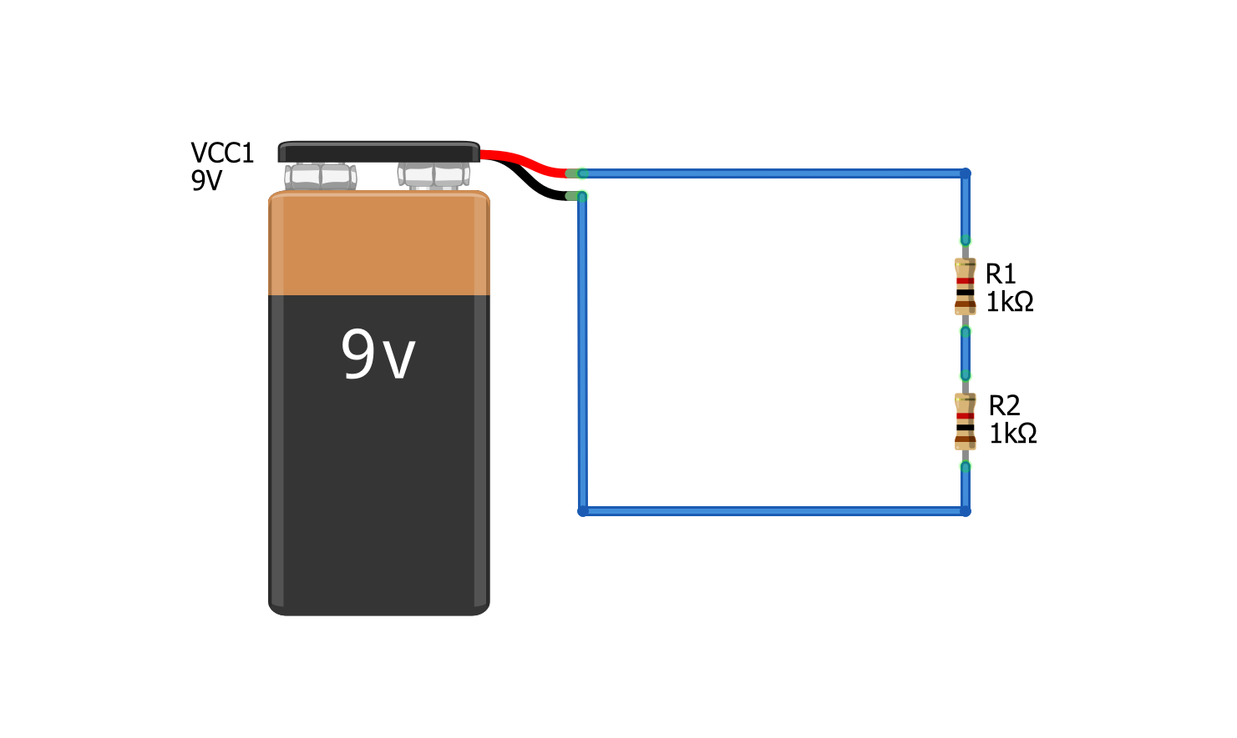
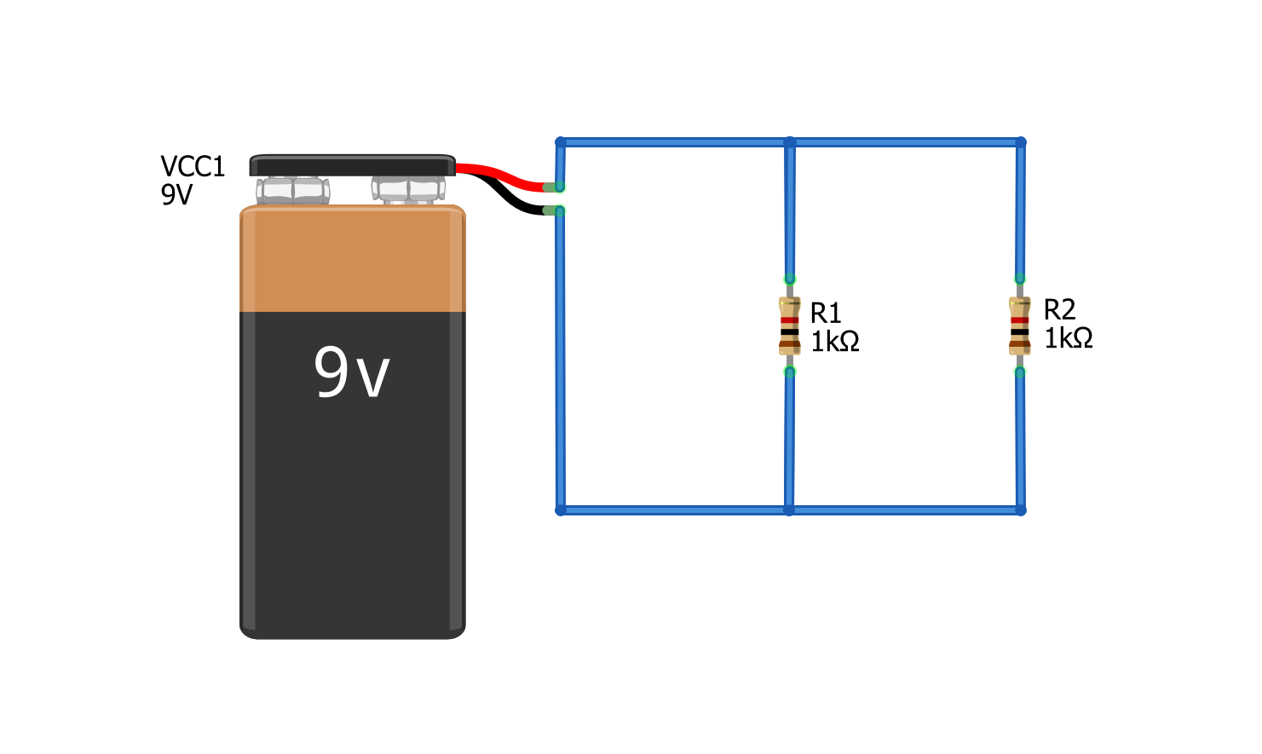


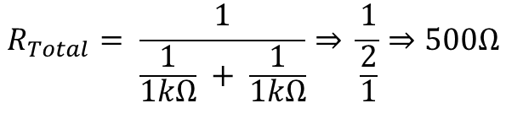


I = 1.32mA
Resistors in series vs. Parallel
Resistors in Series
Resistors in series divide voltage
Resistors in Parallel
Resistors in parallel divide current
R_{Total} = 2kΩ
I = 4.5mA
We sum resistors in series:
Formula for the total resistance of parallel resistors:
$$R_{Total}= R_{1}+ R_{2}$$
$R_{Total}= \frac{1}{\frac{1}{R_{1}}+ \frac{1}{R_{2}}+…+ \frac{1}{R_{N−1}}+ \frac{1}{R_{N}}}$
$$R_{Total}=2kΩ$$
$$R_{Total}= \frac{1}{\frac{1}{1kΩ} + \frac{1}{1kΩ}}⇒ \frac{1}{\frac{2}{1}}⇒500Ω$$
$$I= \frac{9V}{2kΩ}⇒4.5ma$$

Slide 2

Series Resistors
Parallel Resistors
Current is the same across each resistor. Voltage is divided.
Voltage is the same across each resistor. Current is divided.
R₁
R₂
R₃
R₁
R₂
R₃
$$R_{Equivalent}= R_{1}+ R_{2}+ …+R_{N−1}+R_{N}$$
$R_{Equivalent}= \frac{1}{\frac{1}{R_{1}}+ \frac{1}{R_{2}}+…+ \frac{1}{R_{N−1}}+ \frac{1}{R_{N}}}$

Slide 3
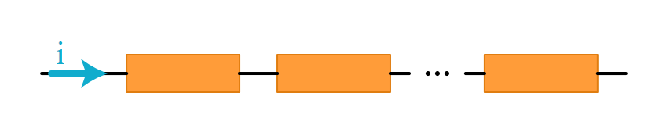
Resistors in Series
Components are in series if they are joined end-to-end (or head-to-tail) in sequence like this.
R₁
R₂
R₃
I

Slide 4
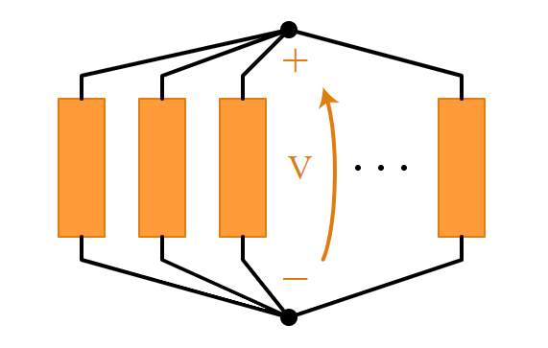
Resistors in Parallel
Components are in parallel if their head’s share a node and their tail’s share a node.
Node 1
Node 1
R₁
R₂
R₃
Node 2
Node 2

Slide 5








Resistors in series vs. Parallel
Series Resistors
Parallel Resistors
Current is the same across each resistor. Voltage is divided.
Voltage is the same across each resistor. Current is divided.
V_{A} = 9V
I_{Total}
I = 4.5mA
Voltage drop over R₁
I₁
I₂
V_{B} = 4.5V
R_{Total} = 2kΩ
Voltage drop over R₂
I_{Total}
I = 4.5mA
V_{C} = 0V
$$R_{Total}= R_{1}+ R_{2}⇒2kΩ$$
$$I_{1}= \frac{9V}{1kΩ}⇒9mA$$
$$I_{2}= \frac{9V}{1kΩ}⇒9mA$$
$$I= \frac{9V}{2kΩ}⇒4.5ma$$
$$I_{Total}= I_{1}+ I_{2}⇒18mA$$
In this circuit, there are no branches and thus, we have the same current everywhere (there is no where else for the current to go). But we do get a voltage drop across each resistor.
In this circuit, we have a branch so the current gets divided. Both branches have the same resistance so current is divided evenly. We can calculate the current through each branch and sum.
We sum resistors in series:
$$R_{Total}= R_{1}+ R_{2}$$
$$R_{Total}=2kΩ$$
$$I= \frac{9V}{2kΩ}⇒4.5ma$$

Slide 6
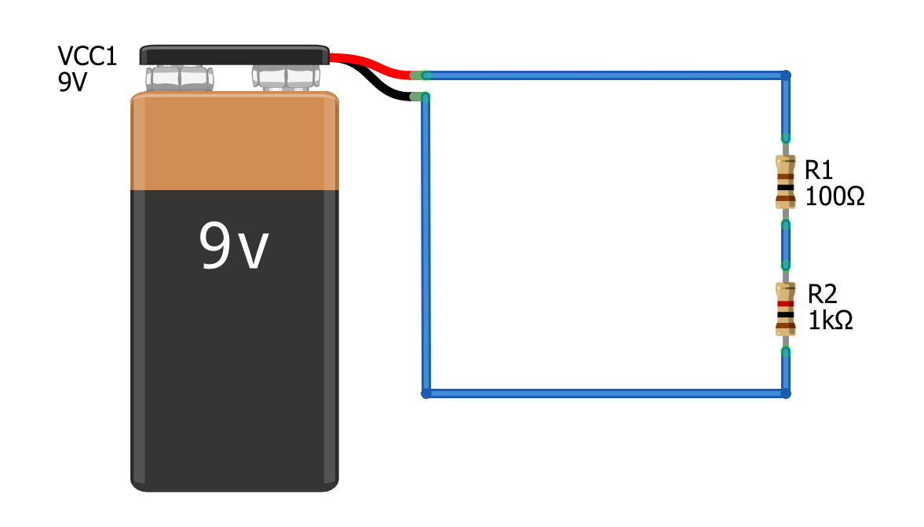
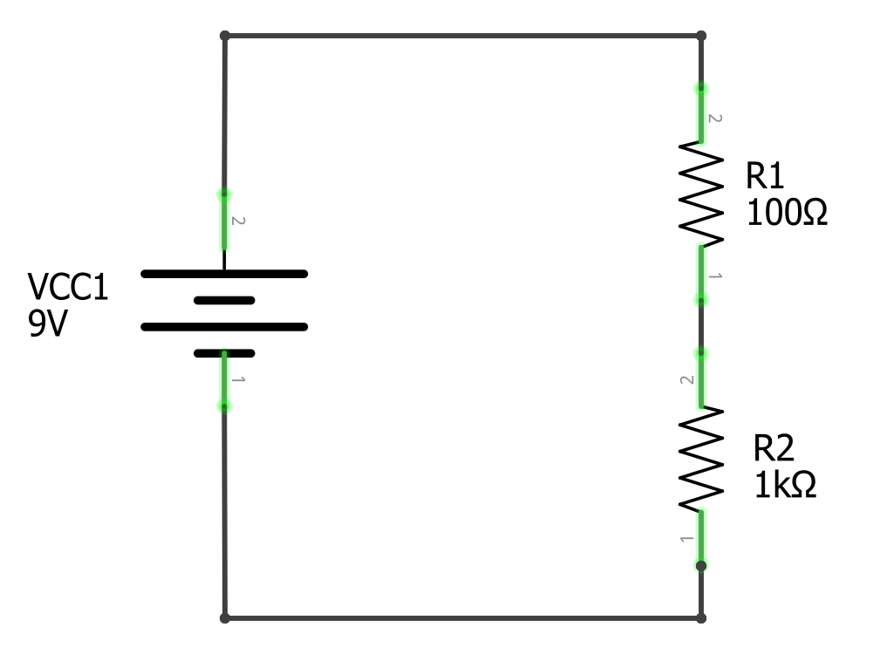

Slide 7

Solve for current I
$$I= \frac{V}{R_{Total}}$$
How much current I is flowing through this circuit.
How much current I is flowing through this circuit.

Slide 8

Step 1: Solve for total resistance
With series resistors, we sum resistances
$$I= \frac{V}{R_{Total}}$$
How much current I is flowing through this circuit.
How much current I is flowing through this circuit.
R_{Total}
1100Ω
$$R_{Total}= R_{1}+ R_{2}⇒1100Ω$$
R_{Total}
1100Ω

Slide 9

Step 2: Solve for Current I with aggregate resistance R_{Total}
$$I= \frac{V}{R_{Total}}$$
I = 8.2mA
R_{Total}
1100Ω
$$R_{Total}= R_{1}+ R_{2}⇒1100Ω$$
I = 8.2mA
R_{Total}
1100Ω
$$I= \frac{9V}{1100Ω}⇒8.2mA$$

Slide 10
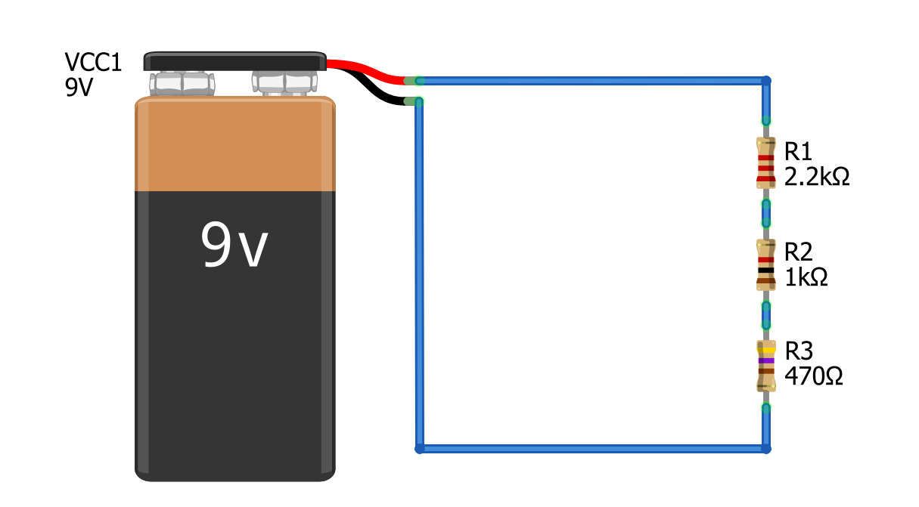
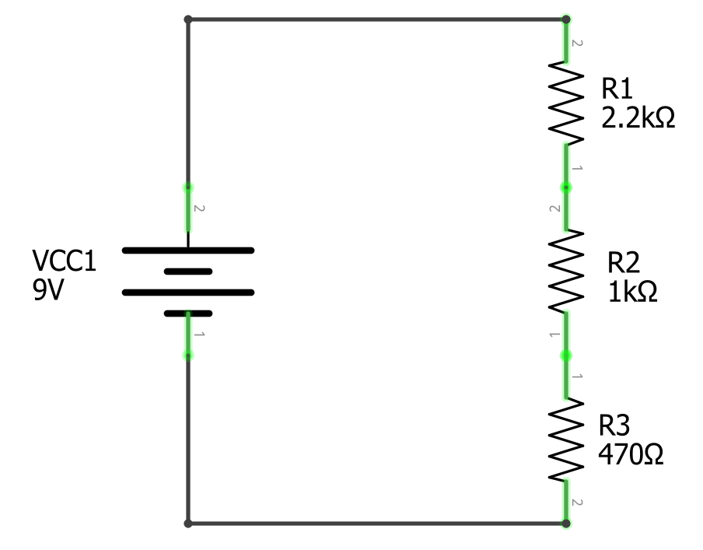


Solve for Current I
$$I= \frac{V}{R_{Total}}$$
$$R_{Total}= R_{1}+ R_{2 }{+ R}_{2}⇒3670Ω$$
I = 8.2mA
R_{Total}
3670Ω
I = 8.2mA
R_{Total}
3670Ω
$$I= \frac{9V}{3670Ω}⇒2.5mA$$

Slide 11
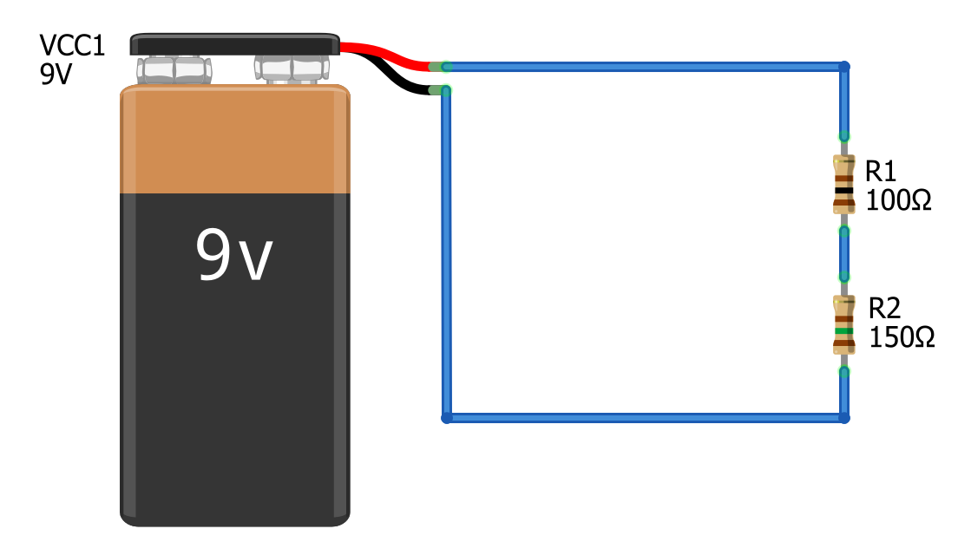
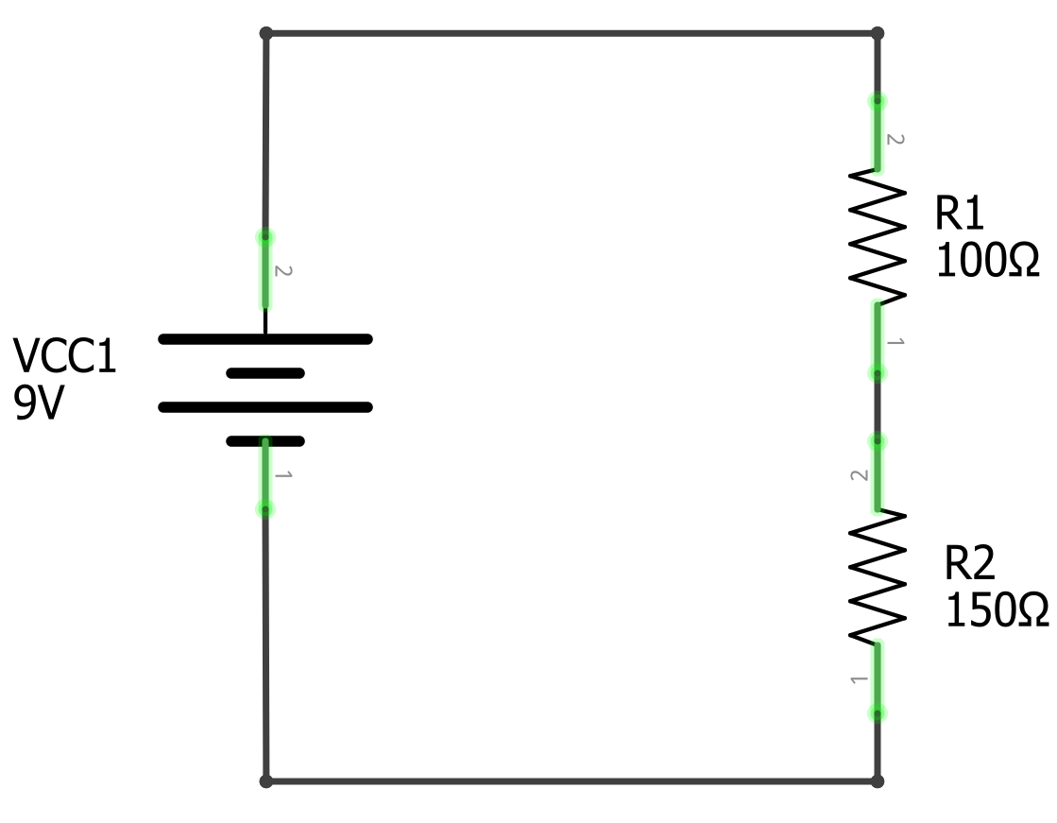
Solve for voltage at V_{B}
V_{A}
V_{A}
What is the voltage here?
What is the voltage here?
V_{B}
V_{B}
V_{C}
V_{C}

Slide 12



Step I: solve for current through circuit
V_{A} = 9V
V_{A} = 9V
$$I= \frac{V}{R_{Total}}$$
How much current I is flowing through this circuit.
How much current I is flowing through this circuit.
V_{B}
V_{B}
$$R_{Total}= R_{1}+ R_{2}⇒250Ω$$
$$I= \frac{9V}{250Ω}⇒36mA$$
V_{C} = 0V
V_{C} = 0V

Slide 13

Step 2: Use current to calculate voltage drop across resistors
I = 36mA
I = 36mA
$$V=I∗R$$
V₁
Voltage drop over R₁
$$V_{1}=I∗R_{1}⇒0.036A ∗100Ω⇒3.6V$$
V₁
Voltage drop over R₁
$$V_{2}=I∗R_{2}⇒0.036A ∗150Ω⇒5.4V$$
V_{B}
V_{B}
V₂
Voltage drop over R₁
V₂
Voltage drop over R₁
I = 36mA
V_{C}
I = 36mA

Slide 14
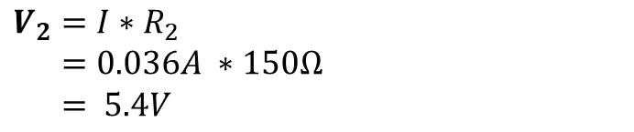


Step 2: Use current to calculate voltage drop across resistors
I = 36mA
I = 36mA
V_{A} = 9V
$$V=I∗R$$
V_{A} = 9V
V₁
Voltage drop over R₁
$$V_{1}=I∗R_{1}$$
$$V_{1}= 0.036A ∗100Ω$$
$$V_{1}= 3.6V$$
V₁
Voltage drop over R₁
V_{B}
V_{B}
V₂
Voltage drop over R₂
V₂
Voltage drop over R2
$$V_{2}=I∗R_{2}$$
$$V_{2}=0.036A ∗150Ω$$
$$V_{2}= 5.4V$$
V_{C} = 0V
I = 36mA
V_{C} = 0V
I = 36mA

Slide 15

Step 3: Now Calculate V_{B}
I = 36mA
I = 36mA
V_{A} = 9V
V_{B} is equal to the battery’s positive terminal voltage minus the voltage drop over V₁
V_{A} = 9V
V₁=3.6V
Voltage drop over R₁
V₁=3.6V
Voltage drop over R₁
V_{B}
V_{B}
$$V_{B}=9V−3.6V=5.4V$$
V₂ =5.4V
Voltage drop over R₂
V₂ =5.4V
Voltage drop over R₂
V_{C} = 0V
I = 36mA
V_{C} = 0V
I = 36mA

Slide 16






$$I=\frac{V_{A}}{R_{Total}}⇒ \frac{V_{A}}{R_{1}+R_{2}}$$
$$V_{B}= V_{A}− V_{1}$$
$$V_{1}=I ∗ R_{1}$$
$V_{B}= V_{A}−\frac{V_{A}}{R_{1}+R_{2}} ∗R_{1}$
Voltage divider pattern
I = 36mA
$$V_{1}=I ∗R_{1}$$
I = 36mA
V_{A} = 9V
V_{A} = 9V
V₁=3.6V
Voltage drop over R₁
V₁=3.6V
Voltage drop over R₁
V_{B}
V_{B}
V₂ =5.4V
Voltage drop over R₂
$$V_{B}= V_{A}∗ \frac{R_{2}}{R_{1}+R_{2}}$$
V₂ =5.4V
Voltage drop over R₂
V_{C} = 0V
I = 36mA
V_{C} = 0V
I = 36mA

Slide 17
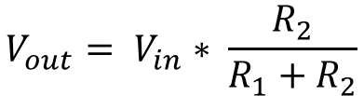
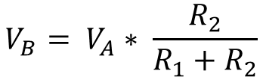
Voltage divider pattern
I = 36mA
I = 36mA
V_{A} = 9V
$$V_{B}= V_{A}∗ \frac{R_{2}}{R_{1}+R_{2}}$$
V_{A} = 9V
V₁=3.6V
Voltage drop over R₁
V₁=3.6V
Voltage drop over R₁
V_{B}
V_{B}
$$V_{out}= V_{in}∗ \frac{R_{2}}{R_{1}+R_{2}}$$
V₂ =5.4V
Voltage drop over R₂
V₂ =5.4V
Voltage drop over R₂
V_{C} = 0V
I = 36mA
V_{C} = 0V
I = 36mA

Slide 18
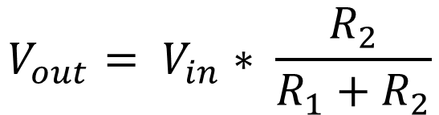
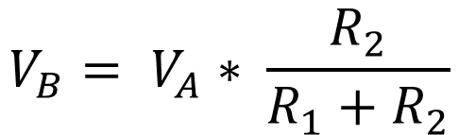
Voltage divider pattern
9V
V+
V_{A}
V_{in}
R1
R1
$$V_{B}= V_{A}∗ \frac{R_{2}}{R_{1}+R_{2}}$$
V_{out}
$$V_{out}= V_{in}∗ \frac{R_{2}}{R_{1}+R_{2}}$$
V_{B}
R2
R2
V_{C}
GND
GND

Slide 19
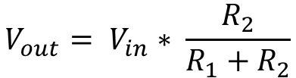

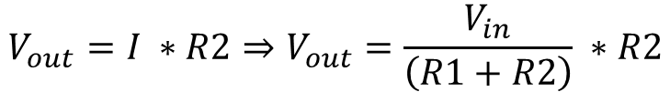
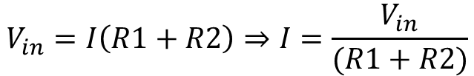


Deriving the voltage divider equation
We know the voltage drop over R2 is equal to V_{out} , which is also equal to I * R2
V+
$$V_{out}= V_{R2}=I ∗R2$$
V_{in}
We also know that V_{in} is equal to V_{R1} + V_{R2}
R1
$$V_{in}= V_{R1}+V_{R2}$$
V_{out}
V_{in}
Using Ohm’s Law, we can substitute V_{R1} + V_{R2} with I * R1 + I * R2
$$V_{in}=I∗R1+I ∗R2$$
R2
V_{out}
Rearrange equation using algebra
$$V_{in}=I\left(R1+R2\right)⇒I=\frac{V_{in}}{(R1+R2)}$$
GND
Now substitute for I in V_{out} = I * R2
$$V_{out}=I ∗R2⇒V_{out}=\frac{V_{in}}{\left(R1+R2\right)} ∗R2$$
Rearrange to popular formulation:
$$V_{out}= V_{in}∗ \frac{R_{2}}{R_{1}+R_{2}}$$
Notes:
https://www.khanacademy.org/science/electrical-engineering/ee-circuit-analysis-topic/ee-resistor-circuits/a/ee-voltage-divider

Slide 20
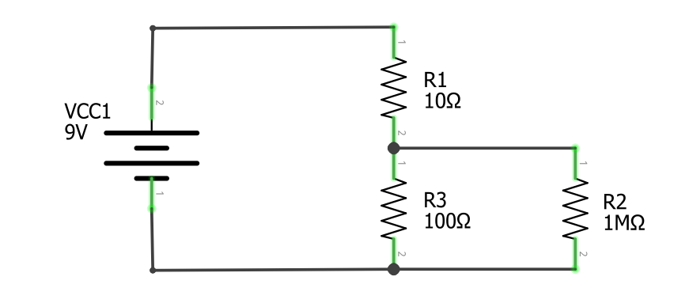
V_{in}
R₁
V_{out}
R₂
R_{Load}

Slide 21
Step 3: Deterimine
I = 36mA
I = 36mA
V_{A}
$$V=I∗R$$
V_{A}
V₁
Voltage drop over R₁
$$V_{1}=I∗R_{1}$$
$$V_{1}= 0.036A ∗100Ω$$
$$V_{1}= 3.6V$$
V₁
Voltage drop over R₁
V_{B}
V_{B}
V₂
Voltage drop over R₁
V₂
Voltage drop over R₁
$$V_{2}=I∗R_{2}$$
$$V_{2}=0.036A ∗150Ω$$
$$V_{2}= 5.4V$$
V_{C}
I = 36mA
V_{C}
I = 36mA

Slide 22
Step I: solve for current through circuit
V_{A}
V_{A}
$$I= \frac{V}{R_{Total}}$$
How much current I is flowing through this circuit.
How much current I is flowing through this circuit.
V_{B}
V_{B}
V_{C}
V_{C}

Slide 23

V
V_{A}
V_{A}
$$I= \frac{V}{R_{Total}}$$
How much current I is flowing through this circuit.
V_{B}
V_{B}
$$R_{Total}= R_{1}+ R_{2}⇒1100Ω$$
I = 4.5mA
$$I= \frac{9V}{1100Ω}⇒8.2mA$$
V_{C}
V_{C}

Slide 24
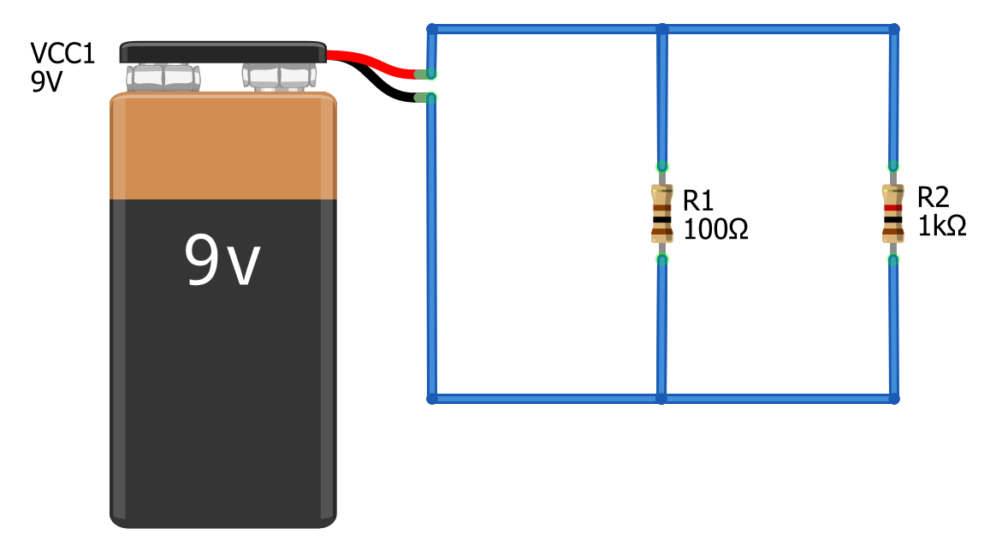
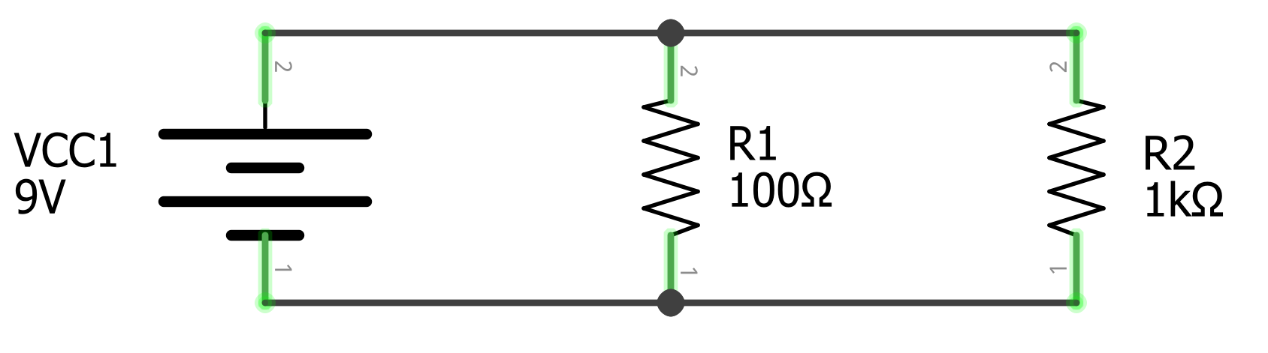
Solve for I_{Total}
I_{Total}
I_{Total}
I_{Total}
I_{Total}

Slide 25
Step 1: Observe that I_{Total} Splits into branches
I_{Total}
I_{Total}
I₁
I₂
I₁
I₂
I_{Total}
I_{Total}

Slide 26
Step 2: Identify and name the nodes
This red area is the same node, let’s call it Node A
This red area is the same node, let’s call it Node A
I_{Total}
I_{Total}
I₁
I₂
I₁
I₂
I_{Total}
I_{Total}
This black area is the same node, let’s call it Node B
This black area is the same node, let’s call it Node B

Slide 27
Step 3: Define V_{A}
This red area is the same node, let’s call it Node A
This red area is the same node, let’s call it Node A
I_{Total}
+
I_{Total}
+
I₁
I₂
V_{A} = 9V
I₁
I₂
V_{A} = 9V
-
-
I_{Total}
I_{Total}
This black area is the same node, let’s call it Node B
This black area is the same node, let’s call it Node B

Slide 28


Step 4: Solve for I₁ and I₂
I_{Total}
+
I_{Total}
+
$$I_{1}=\frac{V_{A}}{R_{1}}⇒\frac{9V}{100Ω}⇒90mA$$
I₁
V_{A}
9V
I₁
I₂
V_{A}
9V
I₂
$$I_{2}=\frac{V_{A}}{R_{1}}⇒\frac{9V}{1kΩ}⇒9mA$$
-
-
I_{Total}
I_{Total}

Slide 29
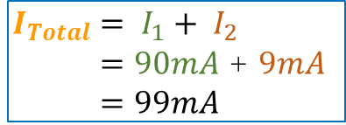
Step 5: Solve for I_{Total}
I_{Total}
+
I_{Total}
+
$$I_{1}=\frac{V_{A}}{R_{1}}⇒\frac{9V}{100Ω}⇒90mA$$
I₁
V_{A}
9V
I₁
I₂
V_{A}
9V
I₂
$$I_{2}=\frac{V_{A}}{R_{1}}⇒\frac{9V}{1kΩ}⇒9mA$$
-
$$I_{Total}= I_{1}+ I_{2}$$
$=90mA$ + $9mA$
$$=99mA$$
-
I_{Total}
I_{Total}

Slide 30



Step 3: Solve for I₁ and I₂
This red area is the same node, let’s call it V_{A}
This red area is the same node, let’s call it V_{A}
I_{Total}
I_{Total}
I₁
I₂
I₁
I₂
I_{Total}
I_{Total}
This black area is the same node, let’s call it V_{B}
This black area is the same node, let’s call it V_{B}
$$I_{1}=\frac{V_{A}}{R_{1}}⇒\frac{9V}{100Ω}⇒90mA$$
$$I_{Total}= I_{1}+ I_{2}⇒18mA$$
$$I_{2}= \frac{9V}{1kΩ}⇒9mA$$

