Slide 1
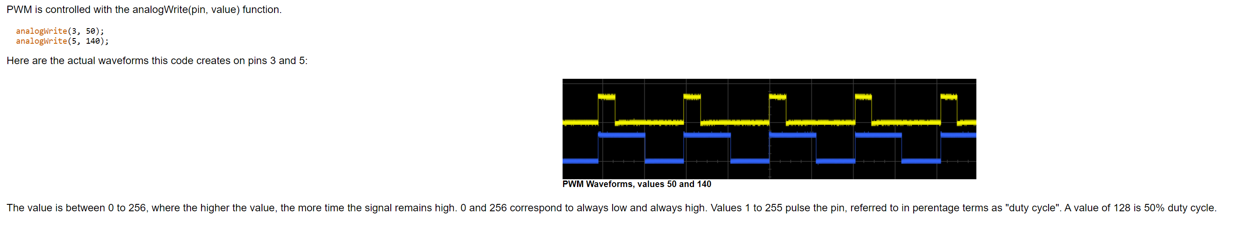
Notes:
https://www.pjrc.com/teensy/td_pulse.html

Slide 2
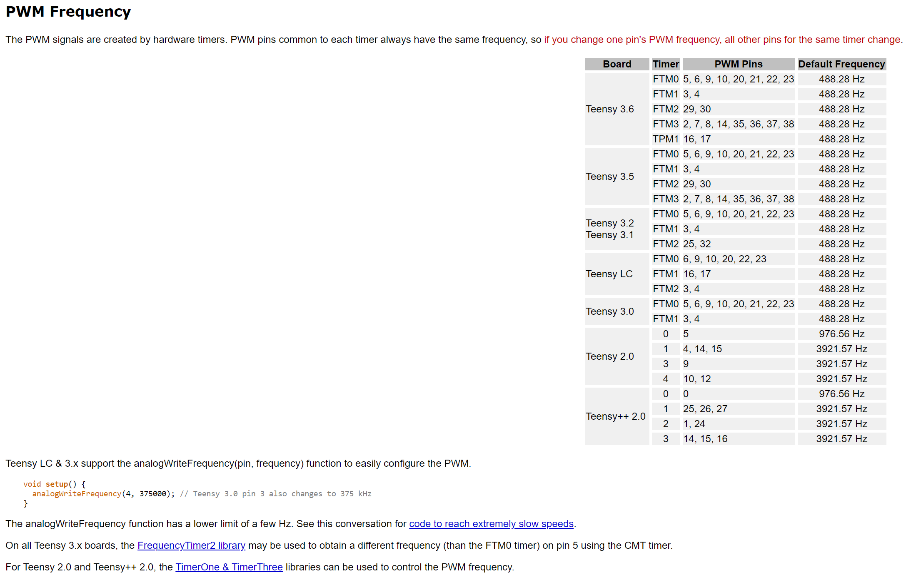
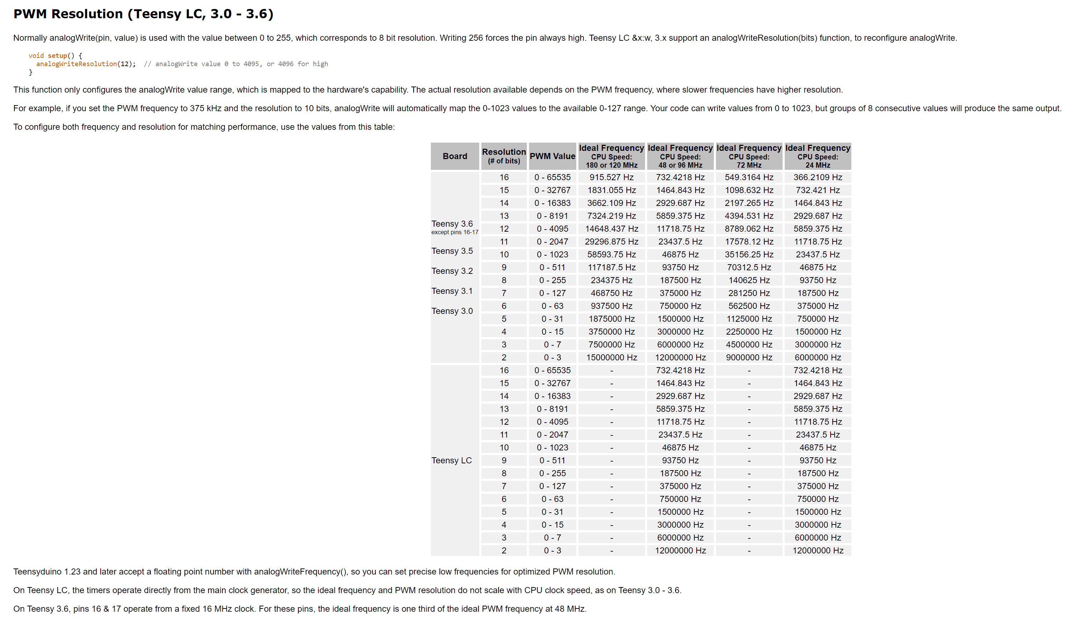
Notes:
https://www.pjrc.com/teensy/td_pulse.html

Slide 3
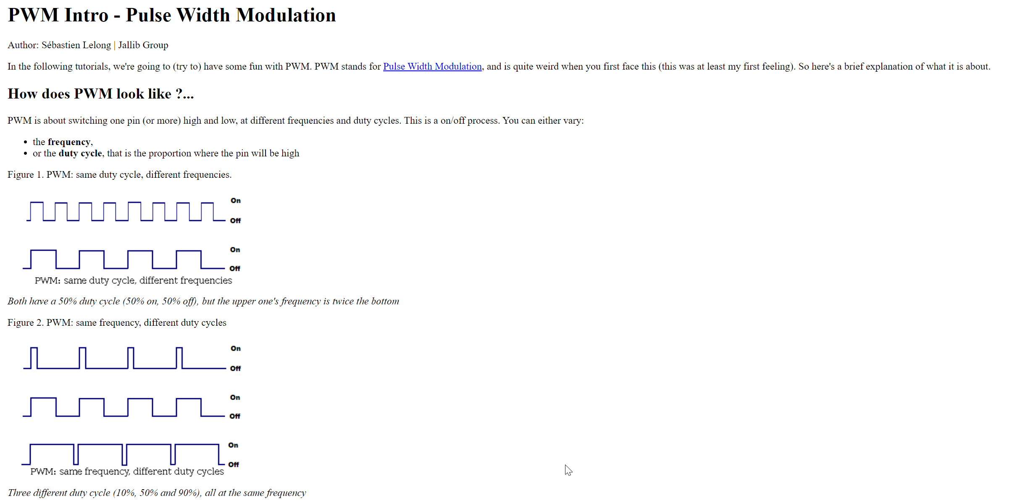
Notes:
http://justanotherlanguage.org/book/export/html/162

Slide 4
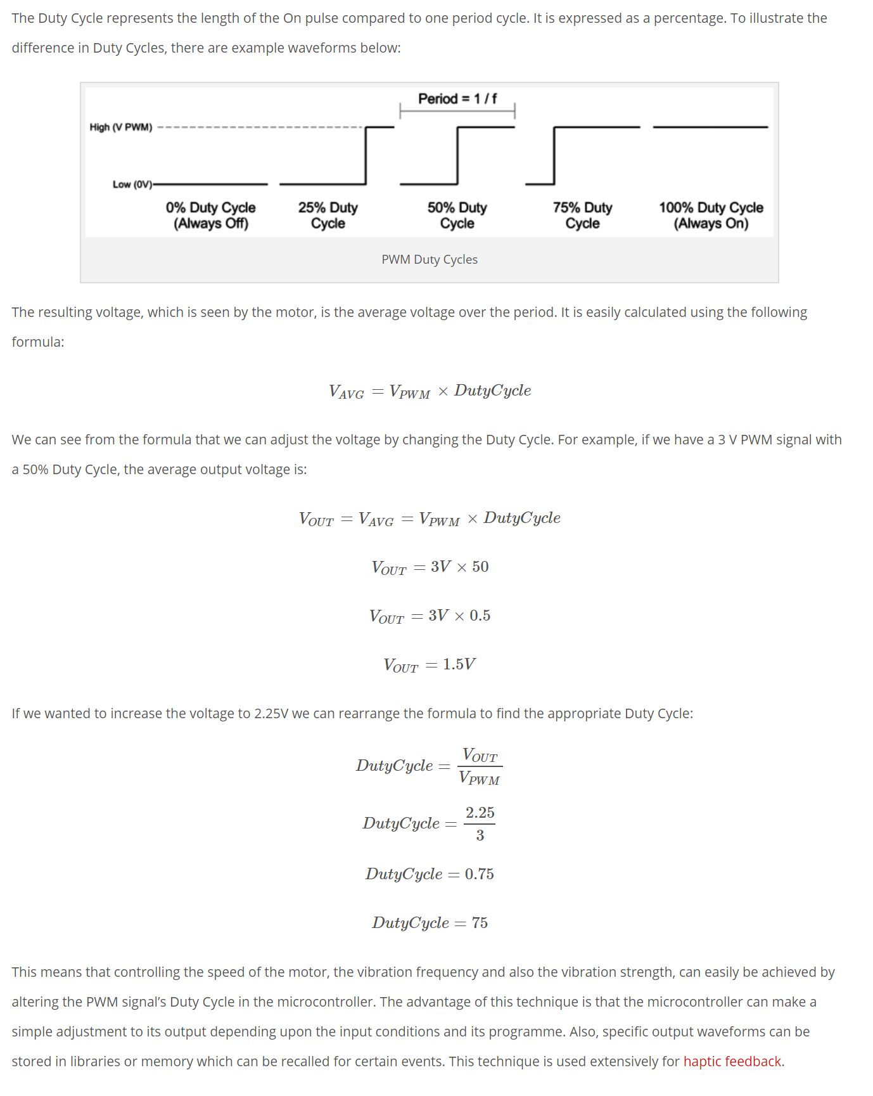
Notes:
https://www.precisionmicrodrives.com/content/ab-012-driving-vibration-motors-with-pulse-width-modulation/

Slide 7
V_{cc}

Slide 8
V_{cc}

Slide 9




Same Duty Cycle (50%), Different Frequencies
V_{cc}
$$f=1 MHz$$
V_{cc}
$$f=2 MHz$$
V_{cc}
$$f=3 MHz$$
V_{cc}
$$f=500 kHz$$

Slide 10
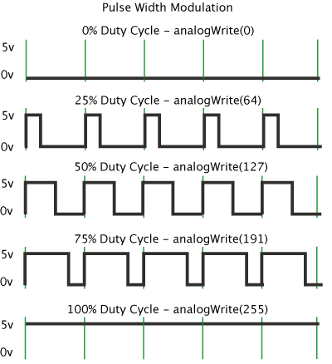









different Duty Cycle, same Frequency
$T= \frac{1}{f}secs → \frac{1}{1 MHz}=1 µs$
$$Period T$$
$$T= \frac{1}{f}secs$$
$$T_{High}$$
$$T_{Low}$$
$$T= T_{High}+ T_{Low}$$
$$Duty Cycle 50\%$$
V_{cc}
$$Duty Cycle= \frac{T_{High}}{T} ∗100$$
$$f=1 MHz$$
$$Duty Cycle 25\%$$
V_{cc}
$$f=1 MHz$$
$$Duty Cycle 10\%$$
V_{cc}
$$f=1 MHz$$

Slide 11




different Duty Cycle, same Frequency
$$T= \frac{1}{f}secs$$
$$T= T_{High}+ T_{Low}$$
$$Period T$$
$$T_{High}$$
$$T_{Low}$$
$$Duty Cycle 50\%$$
V_{cc}
$T= \frac{1}{f}secs → \frac{1}{1 MHz}=1 µs$
$$f=1 MHz$$
$$Duty Cycle= \frac{T_{High}}{T} ∗100\%$$
$$Duty Cycle= \frac{0.5µs}{1µs} ∗100\%=50\%$$
$$Duty Cycle 25\%$$
V_{cc}
$$f=1 MHz$$
$$Duty Cycle 10\%$$
V_{cc}
$$f=1 MHz$$

Slide 12
Same Duty Cycle (50%), Different Frequencies
V_{cc}
$$f=1 MHz$$
V_{cc}
$$f=2 MHz$$
V_{cc}
$$f=3 MHz$$
V_{cc}
$$f=500 kHz$$

Slide 13
















Same Duty Cycle (50%), Different Frequencies
$$Period T$$
$$T_{High}$$
$$T_{Low}$$
V_{cc}
$T= \frac{1}{f}secs → \frac{1}{1 MHz}=1 µs$
$$f=1 MHz$$
$$Duty Cycle= \frac{T_{High}}{T} ∗100\% →\frac{0.5µs}{1µs} ∗100\%=50\%$$
$$Duty Cycle 50\%$$
$$Period T$$
$$T_{High}$$
$$T_{Low}$$
V_{cc}
$T= \frac{1}{f}secs → \frac{1}{2 MHz}=0.5 µs$
$$f=2 MHz$$
$$Duty Cycle= \frac{T_{High}}{T} ∗100\% →\frac{0.25µs}{0.5µs} ∗100\%=50\%$$
$$Duty Cycle 50\%$$
$$Period T$$
$$T_{High}$$
$$T_{Low}$$
V_{cc}
$T= \frac{1}{f}secs → \frac{1}{3 MHz}=0.33 µs$
$$f=3 MHz$$
$$Duty Cycle= \frac{T_{High}}{T} ∗100\% →\frac{0.16µs}{0.33µs} ∗100\%=50\%$$
$$Duty Cycle 50\%$$
$$Period T$$
V_{cc}
$$T_{High}$$
$$T_{Low}$$
$T= \frac{1}{f}secs → \frac{1}{500 kHz}=2 µs$
$$f=500 kHz$$
$$Duty Cycle= \frac{T_{High}}{T} ∗100\% →\frac{1µs}{2µs} ∗100\%=50\%$$
$$Duty Cycle 50\%$$

Slide 14









different Duty Cycle, same Frequency (1MHZ)
$$Period T$$
$$T_{Low}$$
$$T_{High}$$
V_{cc}
$T= \frac{1}{f}secs → \frac{1}{1 MHz}=1 µs$
$$f=1 MHz$$
$$Duty Cycle= \frac{T_{High}}{T} ∗100\% →\frac{0.5µs}{1µs} ∗100\%=50\%$$
$$Duty Cycle 50\%$$
$$Period T$$
V_{cc}
$$T_{Low}$$
$$T_{High}$$
$T= \frac{1}{f}secs → \frac{1}{1 MHz}=1 µs$
$$f=1 MHz$$
$$Duty Cycle= \frac{T_{High}}{T} ∗100\% →\frac{0.25µs}{1µs} ∗100\%=25\%$$
$$Duty Cycle 25\%$$
$$Period T$$
$$T_{Low}$$
$$T_{High}$$
V_{cc}
$T= \frac{1}{f}secs → \frac{1}{1 MHz}=1 µs$
$$f=1 MHz$$
$$Duty Cycle= \frac{T_{High}}{T} ∗100\% →\frac{0.10µs}{1µs} ∗100\%=10\%$$
$$Duty Cycle 10\%$$
$$Period T$$
$$T_{Low}$$
$$T_{High}$$
V_{cc}
$T= \frac{1}{f}secs → \frac{1}{1 MHz}=1 µs$
$$f=1 MHz$$
$$Duty Cycle= \frac{T_{High}}{T} ∗100\% →\frac{0.85µs}{1µs} ∗100\%=85\%$$
$$Duty Cycle 85\%$$

Slide 15






Frequency and duty cycle resolution
$$Period T$$
$$T_{Low}$$
$$T_{High}$$
V_{cc}
$T= \frac{1}{f}secs → \frac{1}{1 MHz}=1 µs$
$$f=1 MHz$$
$$Duty Cycle= \frac{T_{High}}{T} ∗100\% →$$
$$Duty Cycle Resolution:1 bit$$
$$Period T$$
$$T_{Low}$$
$$T_{High}$$
V_{cc}
$T= \frac{1}{f}secs → \frac{1}{1 MHz}=1 µs$
$$f=1 MHz$$
$$Duty Cycle= \frac{T_{High}}{T} ∗100\% →$$
$Duty Cycle Resolution:2 bit$s

Slide 16

Frequency and duty cycle resolution
$$Period T$$
$$T_{Low}$$
$$T_{High}$$
V_{cc}
$T= \frac{1}{f}secs → \frac{1}{1 MHz}=1 µs$
$$CPU Clock Frequency=20 MHz$$
$$Duty Cycle= \frac{T_{High}}{T} ∗100\% →$$
$$Duty Cycle Resolution:1 bit$$
$$Period T$$
$$T_{Low}$$
$$T_{High}$$
V_{cc}
$T= \frac{1}{f}secs → \frac{1}{1 MHz}=1 µs$
$$f=1 MHz$$
$$Duty Cycle= \frac{T_{High}}{T} ∗100\% →$$
$Duty Cycle Resolution:2 bit$s

Slide 17



Frequency and duty cycle resolution
$$Period T$$
V_{cc}
$T= \frac{1}{f}secs → \frac{1}{1 MHz}=1 µs$
$$CPU Clock Frequency=80 MHz$$
$$Duty Cycle= \frac{T_{High}}{T} ∗100\% →$$
$$Duty Cycle Resolution:1 bit$$
$$Period T$$
$$T_{Low}$$
$$T_{High}$$
V_{cc}
$T= \frac{1}{f}secs → \frac{1}{1 MHz}=1 µs$
$$f=1 MHz$$
$$Duty Cycle= \frac{T_{High}}{T} ∗100\% →$$
$Duty Cycle Resolution:2 bit$s
$$CPU Clock Frequency=20 MHz$$
$$Duty Cycle Resolution:1 bit$$

Slide 18

Frequency and duty cycle resolution
Min clock freq = PWM freq * 2^{resolution}
V_{cc}
$$CPU Clock Frequency=80 MHz$$
$$Duty Cycle Resolution:1 bit$$
$$PWM Period T$$
V_{cc}
$$CPU Clock Frequency=80 MHz$$
$$PWM Frequency=1 MHz$$
0
1
50% resolution
00
01
10
11
25% resolution
000
001
010
011
100
101
110
111
12.5% resolution
0000
0001
0010
0011
0100
0101
0110
0111
1000
1001
1010
1011
1100
1101
1110
1111
00000
00001
00010
00011
00100
00101
00110
00111
01000
01001
01010
01011
01100
01101
01110
01111
10000
10001
10010
10011
10100
10101
10110
10111
11000
11001
11010
11011
11100
11101
11110
11111
00000
00001
00010
00011
00100
00101
00110
00111
01000
01001
01010
01011
01100
01101
01110
01111
10000
10001
10010
10011
10100
10101
10110
10111
11000
11001
11010
11011
11100
11101
11110
11111
00000
00001
00010
00011
00100
00101
00110
00111
01000
01001
01010
01011
01100
01101
01110
01111
10000
10001
10010
10011
10100
10101
10110
10111
11000
11001
11010
11011
11100
11101
11110
11111
00000
00001
00010
00011
00100
00101
00110
00111
01000
01001
01010
01011
01100
01101
01110
01111
10000
10001
10010
10011
10100
10101
10110
10111
11000
11001
11010
11011
11100
11101
11110
11111
00000
00001
00010
00011
00100
00101
00110
00111
01000
01001
01010
01011
01100
01101
01110
01111
10000
10001
10010
10011
10100
10101
10110
10111
11000
11001
11010
11011
11100
11101
11110
11111
00000
00001
00010
00011
00100
00101
00110
00111
01000
01001
01010
01011
01100
01101
01110
01111
10000
10001
10010
10011
10100
10101
10110
10111
11000
11001
11010
11011
11100
11101
11110
11111
00000
00001
00010
00011
00100
00101
00110
00111
01000
01001
01010
01011
01100
01101
01110
01111
10000
10001
10010
10011
10100
10101
10110
10111
11000
11001
11010
11011
11100
11101
11110
11111

Slide 19
Frequency and duty cycle resolution
Min clock freq = PWM freq * 2^{resolution}
V_{cc}
$$CPU Clock Frequency=80 MHz$$
$$Duty Cycle Resolution:1 bit$$
50% resolution
$$PWM Period T$$
25% resolution
V_{cc}
12.5% resolution
$$CPU Clock Frequency=80 MHz$$
$$PWM Frequency=1 MHz$$
Bit Resolution
Duty Cycle Resolution
Voltage Increments
0
1
1
Fixed at 50%
00
01
10
11
2
25%
0.825V
000
001
010
011
100
101
110
111
3
12.5%
0000
0001
0010
0011
0100
0101
0110
0111
1000
1001
1010
1011
1100
1101
1110
1111
4
6.25%
00000
00001
00010
00011
00100
00101
00110
00111
01000
01001
01010
01011
01100
01101
01110
01111
10000
10001
10010
10011
10100
10101
10110
10111
11000
11001
11010
11011
11100
11101
11110
11111
5
3.125%
00000
00001
00010
00011
00100
00101
00110
00111
01000
01001
01010
01011
01100
01101
01110
01111
10000
10001
10010
10011
10100
10101
10110
10111
11000
11001
11010
11011
11100
11101
11110
11111
00000
00001
00010
00011
00100
00101
00110
00111
01000
01001
01010
01011
01100
01101
01110
01111
10000
10001
10010
10011
10100
10101
10110
10111
11000
11001
11010
11011
11100
11101
11110
11111
6
1.5625%
00000
00001
00010
00011
00100
00101
00110
00111
01000
01001
01010
01011
01100
01101
01110
01111
10000
10001
10010
10011
10100
10101
10110
10111
11000
11001
11010
11011
11100
11101
11110
11111
00000
00001
00010
00011
00100
00101
00110
00111
01000
01001
01010
01011
01100
01101
01110
01111
10000
10001
10010
10011
10100
10101
10110
10111
11000
11001
11010
11011
11100
11101
11110
11111
00000
00001
00010
00011
00100
00101
00110
00111
01000
01001
01010
01011
01100
01101
01110
01111
10000
10001
10010
10011
10100
10101
10110
10111
11000
11001
11010
11011
11100
11101
11110
11111
00000
00001
00010
00011
00100
00101
00110
00111
01000
01001
01010
01011
01100
01101
01110
01111
10000
10001
10010
10011
10100
10101
10110
10111
11000
11001
11010
11011
11100
11101
11110
11111
7
0.78125%

Slide 20

Frequency and duty cycle resolution
Min clock freq = PWM freq * 2^{resolution}
V_{cc}
$$CPU Clock Frequency=80 MHz$$
$$Duty Cycle Resolution:1 bit$$
50% resolution
$$PWM Period T$$
25% resolution
V_{cc}
12.5% resolution
$$CPU Clock Frequency=80 MHz$$
$$PWM Frequency=1 MHz$$
Bit Resolution
Duty Cycle Resolution
Voltage Increments
0
1
1
Fixed at 50%
00
01
10
11
2
25%
0.825V
000
001
010
011
100
101
110
111
3
12.5%
0000
0001
0010
0011
0100
0101
0110
0111
1000
1001
1010
1011
1100
1101
1110
1111
4
6.25%
00000
00001
00010
00011
00100
00101
00110
00111
01000
01001
01010
01011
01100
01101
01110
01111
10000
10001
10010
10011
10100
10101
10110
10111
11000
11001
11010
11011
11100
11101
11110
11111
5
3.125%
00000
00001
00010
00011
00100
00101
00110
00111
01000
01001
01010
01011
01100
01101
01110
01111
10000
10001
10010
10011
10100
10101
10110
10111
11000
11001
11010
11011
11100
11101
11110
11111
00000
00001
00010
00011
00100
00101
00110
00111
01000
01001
01010
01011
01100
01101
01110
01111
10000
10001
10010
10011
10100
10101
10110
10111
11000
11001
11010
11011
11100
11101
11110
11111
6
1.5625%
00000
00001
00010
00011
00100
00101
00110
00111
01000
01001
01010
01011
01100
01101
01110
01111
10000
10001
10010
10011
10100
10101
10110
10111
11000
11001
11010
11011
11100
11101
11110
11111
00000
00001
00010
00011
00100
00101
00110
00111
01000
01001
01010
01011
01100
01101
01110
01111
10000
10001
10010
10011
10100
10101
10110
10111
11000
11001
11010
11011
11100
11101
11110
11111
00000
00001
00010
00011
00100
00101
00110
00111
01000
01001
01010
01011
01100
01101
01110
01111
10000
10001
10010
10011
10100
10101
10110
10111
11000
11001
11010
11011
11100
11101
11110
11111
00000
00001
00010
00011
00100
00101
00110
00111
01000
01001
01010
01011
01100
01101
01110
01111
10000
10001
10010
10011
10100
10101
10110
10111
11000
11001
11010
11011
11100
11101
11110
11111
7
0.78125%

Slide 21

Frequency and duty cycle resolution
Min clock freq = PWM freq * 2^{resolution}
V_{cc}
$$Clock Frequency=40 MHz$$
$$Duty Cycle Resolution:1 bit$$
50% resolution
$$PWM Period T$$
25% resolution
V_{cc}
12.5% resolution
$$Clock Frequency=40 MHz$$
$$PWM Frequency=1 MHz$$
Bit Resolution
Duty Cycle Resolution
Voltage Increments
0
1
1
Fixed at 50%
00
01
10
11
2
25%
0.825V
000
001
010
011
100
101
110
111
3
12.5%
0000
0001
0010
0011
0100
0101
0110
0111
1000
1001
1010
1011
1100
1101
1110
1111
4
6.25%
00000
00001
00010
00011
00100
00101
00110
00111
01000
01001
01010
01011
01100
01101
01110
01111
10000
10001
10010
10011
10100
10101
10110
10111
11000
11001
11010
11011
11100
11101
11110
11111
5
3.125%
00000
00001
00010
00011
00100
00101
00110
00111
01000
01001
01010
01011
01100
01101
01110
01111
10000
10001
10010
10011
10100
10101
10110
10111
11000
11001
11010
11011
11100
11101
11110
11111
00000
00001
00010
00011
00100
00101
00110
00111
01000
01001
01010
01011
01100
01101
01110
01111
10000
10001
10010
10011
10100
10101
10110
10111
11000
11001
11010
11011
11100
11101
11110
11111
6
1.5625%
00000
00001
00010
00011
00100
00101
00110
00111
01000
01001
01010
01011
01100
01101
01110
01111
10000
10001
10010
10011
10100
10101
10110
10111
11000
11001
11010
11011
11100
11101
11110
11111
00000
00001
00010
00011
00100
00101
00110
00111
01000
01001
01010
01011
01100
01101
01110
01111
10000
10001
10010
10011
10100
10101
10110
10111
11000
11001
11010
11011
11100
11101
11110
11111
00000
00001
00010
00011
00100
00101
00110
00111
01000
01001
01010
01011
01100
01101
01110
01111
10000
10001
10010
10011
10100
10101
10110
10111
11000
11001
11010
11011
11100
11101
11110
11111
00000
00001
00010
00011
00100
00101
00110
00111
01000
01001
01010
01011
01100
01101
01110
01111
10000
10001
10010
10011
10100
10101
10110
10111
11000
11001
11010
11011
11100
11101
11110
11111
7
0.78125%

Slide 22
Frequency and duty cycle resolution
Min clock freq = PWM freq * 2^{resolution}
V_{cc}
Clock frequency = 40 MHz
50% resolution
$$PWM Period T$$
25% resolution
V_{cc}
12.5% resolution
PWM frequency = 1 MHz
PWM duty cycle = 50%
Bit Resolution
Duty Cycle Resolution
Voltage Increments
PWM resolution = 1 bit
0
1
1
Fixed at 50%
PWM resolution = 2 bits
00
01
10
11
2
25%
0.825V
PWM resolution = 3 bits
000
001
010
011
100
101
110
111
3
12.5%
PWM resolution = 4 bits
0000
0001
0010
0011
0100
0101
0110
0111
1000
1001
1010
1011
1100
1101
1110
1111
4
6.25%
PWM resolution = 5 bits
00000
00001
00010
00011
00100
00101
00110
00111
01000
01001
01010
01011
01100
01101
01110
01111
10000
10001
10010
10011
10100
10101
10110
10111
11000
11001
11010
11011
11100
11101
11110
11111
5
3.125%
PWM resolution = 7 bits
00000
00001
00010
00011
00100
00101
00110
00111
01000
01001
01010
01011
01100
01101
01110
01111
10000
10001
10010
10011
10100
10101
10110
10111
11000
11001
11010
11011
11100
11101
11110
11111
00000
00001
00010
00011
00100
00101
00110
00111
01000
01001
01010
01011
01100
01101
01110
01111
10000
10001
10010
10011
10100
10101
10110
10111
11000
11001
11010
11011
11100
11101
11110
11111
6
1.5625%
PWM resolution = 8 bits
00000
00001
00010
00011
00100
00101
00110
00111
01000
01001
01010
01011
01100
01101
01110
01111
10000
10001
10010
10011
10100
10101
10110
10111
11000
11001
11010
11011
11100
11101
11110
11111
00000
00001
00010
00011
00100
00101
00110
00111
01000
01001
01010
01011
01100
01101
01110
01111
10000
10001
10010
10011
10100
10101
10110
10111
11000
11001
11010
11011
11100
11101
11110
11111
00000
00001
00010
00011
00100
00101
00110
00111
01000
01001
01010
01011
01100
01101
01110
01111
10000
10001
10010
10011
10100
10101
10110
10111
11000
11001
11010
11011
11100
11101
11110
11111
00000
00001
00010
00011
00100
00101
00110
00111
01000
01001
01010
01011
01100
01101
01110
01111
10000
10001
10010
10011
10100
10101
10110
10111
11000
11001
11010
11011
11100
11101
11110
11111
7
0.78125%
PWM resolution = 9 bits
00000
00001
00010
00011
00100
00101
00110
00111
01000
01001
01010
01011
01100
01101
01110
01111
10000
10001
10010
10011
10100
10101
10110
10111
11000
11001
11010
11011
11100
11101
11110
11111
00000
00001
00010
00011
00100
00101
00110
00111
01000
01001
01010
01011
01100
01101
01110
01111
10000
10001
10010
10011
10100
10101
10110
10111
11000
11001
11010
11011
11100
11101
11110
11111
00000
00001
00010
00011
00100
00101
00110
00111
01000
01001
01010
01011
01100
01101
01110
01111
10000
10001
10010
10011
10100
10101
10110
10111
11000
11001
11010
11011
11100
11101
11110
11111
00000
00001
00010
00011
00100
00101
00110
00111
01000
01001
01010
01011
01100
01101
01110
01111
10000
10001
10010
10011
10100
10101
10110
10111
11000
11001
11010
11011
11100
11101
11110
11111
00000
00001
00010
00011
00100
00101
00110
00111
01000
01001
01010
01011
01100
01101
01110
01111
10000
10001
10010
10011
10100
10101
10110
10111
11000
11001
11010
11011
11100
11101
11110
11111
00000
00001
00010
00011
00100
00101
00110
00111
01000
01001
01010
01011
01100
01101
01110
01111
10000
10001
10010
10011
10100
10101
10110
10111
11000
11001
11010
11011
11100
11101
11110
11111
00000
00001
00010
00011
00100
00101
00110
00111
01000
01001
01010
01011
01100
01101
01110
01111
10000
10001
10010
10011
10100
10101
10110
10111
11000
11001
11010
11011
11100
11101
11110
11111
00000
00001
00010
00011
00100
00101
00110
00111
01000
01001
01010
01011
01100
01101
01110
01111
10000
10001
10010
10011
10100
10101
10110
10111
11000
11001
11010
11011
11100
11101
11110
11111
PWM resolution = 10 bits
00000
00001
00010
00011
00100
00101
00110
00111
01000
01001
01010
01011
01100
01101
01110
01111
10000
10001
10010
10011
10100
10101
10110
10111
11000
11001
11010
11011
11100
11101
11110
11111
00000
00001
00010
00011
00100
00101
00110
00111
01000
01001
01010
01011
01100
01101
01110
01111
10000
10001
10010
10011
10100
10101
10110
10111
11000
11001
11010
11011
11100
11101
11110
11111
00000
00001
00010
00011
00100
00101
00110
00111
01000
01001
01010
01011
01100
01101
01110
01111
10000
10001
10010
10011
10100
10101
10110
10111
11000
11001
11010
11011
11100
11101
11110
11111
00000
00001
00010
00011
00100
00101
00110
00111
01000
01001
01010
01011
01100
01101
01110
01111
10000
10001
10010
10011
10100
10101
10110
10111
11000
11001
11010
11011
11100
11101
11110
11111
00000
00001
00010
00011
00100
00101
00110
00111
01000
01001
01010
01011
01100
01101
01110
01111
10000
10001
10010
10011
10100
10101
10110
10111
11000
11001
11010
11011
11100
11101
11110
11111
00000
00001
00010
00011
00100
00101
00110
00111
01000
01001
01010
01011
01100
01101
01110
01111
10000
10001
10010
10011
10100
10101
10110
10111
11000
11001
11010
11011
11100
11101
11110
11111
00000
00001
00010
00011
00100
00101
00110
00111
01000
01001
01010
01011
01100
01101
01110
01111
10000
10001
10010
10011
10100
10101
10110
10111
11000
11001
11010
11011
11100
11101
11110
11111
00000
00001
00010
00011
00100
00101
00110
00111
01000
01001
01010
01011
01100
01101
01110
01111
10000
10001
10010
10011
10100
10101
10110
10111
11000
11001
11010
11011
11100
11101
11110
11111
00000
00001
00010
00011
00100
00101
00110
00111
01000
01001
01010
01011
01100
01101
01110
01111
10000
10001
10010
10011
10100
10101
10110
10111
11000
11001
11010
11011
11100
11101
11110
11111
00000
00001
00010
00011
00100
00101
00110
00111
01000
01001
01010
01011
01100
01101
01110
01111
10000
10001
10010
10011
10100
10101
10110
10111
11000
11001
11010
11011
11100
11101
11110
11111
00000
00001
00010
00011
00100
00101
00110
00111
01000
01001
01010
01011

Slide 23
Frequency and duty cycle resolution
Min clock freq = PWM freq * 2^{resolution}
V_{cc}
Clock frequency = 40 MHz
50% resolution
$$PWM Period T$$
25% resolution
V_{cc}
12.5% resolution
PWM frequency = 1 MHz
PWM duty cycle = 50%
Bit Resolution
Duty Cycle Resolution
Voltage Increments
PWM resolution = 1 bit
0
1
1
Fixed at 50%
PWM resolution = 2 bits
00
01
10
11
2
25%
0.825V
PWM resolution = 3 bits
000
001
010
011
100
101
110
111
3
12.5%
PWM resolution = 4 bits
0000
0001
0010
0011
0100
0101
0110
0111
1000
1001
1010
1011
1100
1101
1110
1111
4
6.25%
PWM resolution = 5 bits
00000
00001
00010
00011
00100
00101
00110
00111
01000
01001
01010
01011
01100
01101
01110
01111
10000
10001
10010
10011
10100
10101
10110
10111
11000
11001
11010
11011
11100
11101
11110
11111
5
3.125%
PWM resolution = 7 bits
00000
00001
00010
00011
00100
00101
00110
00111
01000
01001
01010
01011
01100
01101
01110
01111
10000
10001
10010
10011
10100
10101
10110
10111
11000
11001
11010
11011
11100
11101
11110
11111
00000
00001
00010
00011
00100
00101
00110
00111
01000
01001
01010
01011
01100
01101
01110
01111
10000
10001
10010
10011
10100
10101
10110
10111
11000
11001
11010
11011
11100
11101
11110
11111
6
1.5625%
PWM resolution = 8 bits
00000
00001
00010
00011
00100
00101
00110
00111
01000
01001
01010
01011
01100
01101
01110
01111
10000
10001
10010
10011
10100
10101
10110
10111
11000
11001
11010
11011
11100
11101
11110
11111
00000
00001
00010
00011
00100
00101
00110
00111
01000
01001
01010
01011
01100
01101
01110
01111
10000
10001
10010
10011
10100
10101
10110
10111
11000
11001
11010
11011
11100
11101
11110
11111
00000
00001
00010
00011
00100
00101
00110
00111
01000
01001
01010
01011
01100
01101
01110
01111
10000
10001
10010
10011
10100
10101
10110
10111
11000
11001
11010
11011
11100
11101
11110
11111
00000
00001
00010
00011
00100
00101
00110
00111
01000
01001
01010
01011
01100
01101
01110
01111
10000
10001
10010
10011
10100
10101
10110
10111
11000
11001
11010
11011
11100
11101
11110
11111
7
0.78125%
PWM resolution = 9 bits
00000
00001
00010
00011
00100
00101
00110
00111
01000
01001
01010
01011
01100
01101
01110
01111
10000
10001
10010
10011
10100
10101
10110
10111
11000
11001
11010
11011
11100
11101
11110
11111
00000
00001
00010
00011
00100
00101
00110
00111
01000
01001
01010
01011
01100
01101
01110
01111
10000
10001
10010
10011
10100
10101
10110
10111
11000
11001
11010
11011
11100
11101
11110
11111
00000
00001
00010
00011
00100
00101
00110
00111
01000
01001
01010
01011
01100
01101
01110
01111
10000
10001
10010
10011
10100
10101
10110
10111
11000
11001
11010
11011
11100
11101
11110
11111
00000
00001
00010
00011
00100
00101
00110
00111
01000
01001
01010
01011
01100
01101
01110
01111
10000
10001
10010
10011
10100
10101
10110
10111
11000
11001
11010
11011
11100
11101
11110
11111
00000
00001
00010
00011
00100
00101
00110
00111
01000
01001
01010
01011
01100
01101
01110
01111
10000
10001
10010
10011
10100
10101
10110
10111
11000
11001
11010
11011
11100
11101
11110
11111
00000
00001
00010
00011
00100
00101
00110
00111
01000
01001
01010
01011
01100
01101
01110
01111
10000
10001
10010
10011
10100
10101
10110
10111
11000
11001
11010
11011
11100
11101
11110
11111
00000
00001
00010
00011
00100
00101
00110
00111
01000
01001
01010
01011
01100
01101
01110
01111
10000
10001
10010
10011
10100
10101
10110
10111
11000
11001
11010
11011
11100
11101
11110
11111
00000
00001
00010
00011
00100
00101
00110
00111
01000
01001
01010
01011
01100
01101
01110
01111
10000
10001
10010
10011
10100
10101
10110
10111
11000
11001
11010
11011
11100
11101
11110
11111
PWM resolution = 10 bits
00000
00001
00010
00011
00100
00101
00110
00111
01000
01001
01010
01011
01100
01101
01110
01111
10000
10001
10010
10011
10100
10101
10110
10111
11000
11001
11010
11011
11100
11101
11110
11111
00000
00001
00010
00011
00100
00101
00110
00111
01000
01001
01010
01011
01100
01101
01110
01111
10000
10001
10010
10011
10100
10101
10110
10111
11000
11001
11010
11011
11100
11101
11110
11111
00000
00001
00010
00011
00100
00101
00110
00111
01000
01001
01010
01011
01100
01101
01110
01111
10000
10001
10010
10011
10100
10101
10110
10111
11000
11001
11010
11011
11100
11101
11110
11111
00000
00001
00010
00011
00100
00101
00110
00111
01000
01001
01010
01011
01100
01101
01110
01111
10000
10001
10010
10011
10100
10101
10110
10111
11000
11001
11010
11011
11100
11101
11110
11111
00000
00001
00010
00011
00100
00101
00110
00111
01000
01001
01010
01011
01100
01101
01110
01111
10000
10001
10010
10011
10100
10101
10110
10111
11000
11001
11010
11011
11100
11101
11110
11111
00000
00001
00010
00011
00100
00101
00110
00111
01000
01001
01010
01011
01100
01101
01110
01111
10000
10001
10010
10011
10100
10101
10110
10111
11000
11001
11010
11011
11100
11101
11110
11111
00000
00001
00010
00011
00100
00101
00110
00111
01000
01001
01010
01011
01100
01101
01110
01111
10000
10001
10010
10011
10100
10101
10110
10111
11000
11001
11010
11011
11100
11101
11110
11111
00000
00001
00010
00011
00100
00101
00110
00111
01000
01001
01010
01011
01100
01101
01110
01111
10000
10001
10010
10011
10100
10101
10110
10111
11000
11001
11010
11011
11100
11101
11110
11111
00000
00001
00010
00011
00100
00101
00110
00111
01000
01001
01010
01011
01100
01101
01110
01111
10000
10001
10010
10011
10100
10101
10110
10111
11000
11001
11010
11011
11100
11101
11110
11111
00000
00001
00010
00011
00100
00101
00110
00111
01000
01001
01010
01011
01100
01101
01110
01111
10000
10001
10010
10011
10100
10101
10110
10111
11000
11001
11010
11011
11100
11101
11110
11111
00000
00001
00010
00011
00100
00101
00110
00111
01000
01001
01010
01011

Slide 24
Frequency and duty cycle resolution
Min clock freq = PWM freq * 2^{resolution}
V_{cc}
Clock frequency = 40 MHz
$$PWM Period T$$
V_{cc}
PWM frequency = 1 MHz
PWM duty cycle = 50%
PWM resolution = 1 bit
0
1
PWM resolution = 2 bits
00
01
10
11
PWM resolution = 3 bits
000
001
010
011
100
101
110
111
PWM resolution = 4 bits
0000
0001
0010
0011
0100
0101
0110
0111
1000
1001
1010
1011
1100
1101
1110
1111
PWM resolution = 5 bits
00000
00001
00010
00011
00100
00101
00110
00111
01000
01001
01010
01011
01100
01101
01110
01111
10000
10001
10010
10011
10100
10101
10110
10111
11000
11001
11010
11011
11100
11101
11110
11111
PWM resolution = 6 bits
00000
00001
00010
00011
00100
00101
00110
00111
01000
01001
01010
01011
01100
01101
01110
01111
10000
10001
10010
10011
10100
10101
10110
10111
11000
11001
11010
11011
11100
11101
11110
11111
00000
00001
00010
00011
00100
00101
00110
00111
01000
01001
01010
01011
01100
01101
01110
01111
10000
10001
10010
10011
10100
10101
10110
10111
11000
11001
11010
11011
11100
11101
11110
11111
PWM resolution = 7 bits
00000
00001
00010
00011
00100
00101
00110
00111
01000
01001
01010
01011
01100
01101
01110
01111
10000
10001
10010
10011
10100
10101
10110
10111
11000
11001
11010
11011
11100
11101
11110
11111
00000
00001
00010
00011
00100
00101
00110
00111
01000
01001
01010
01011
01100
01101
01110
01111
10000
10001
10010
10011
10100
10101
10110
10111
11000
11001
11010
11011
11100
11101
11110
11111
00000
00001
00010
00011
00100
00101
00110
00111
01000
01001
01010
01011
01100
01101
01110
01111
10000
10001
10010
10011
10100
10101
10110
10111
11000
11001
11010
11011
11100
11101
11110
11111
00000
00001
00010
00011
00100
00101
00110
00111
01000
01001
01010
01011
01100
01101
01110
01111
10000
10001
10010
10011
10100
10101
10110
10111
11000
11001
11010
11011
11100
11101
11110
11111
PWM resolution = 8 bits
00000
00001
00010
00011
00100
00101
00110
00111
01000
01001
01010
01011
01100
01101
01110
01111
10000
10001
10010
10011
10100
10101
10110
10111
11000
11001
11010
11011
11100
11101
11110
11111
00000
00001
00010
00011
00100
00101
00110
00111
01000
01001
01010
01011
01100
01101
01110
01111
10000
10001
10010
10011
10100
10101
10110
10111
11000
11001
11010
11011
11100
11101
11110
11111
00000
00001
00010
00011
00100
00101
00110
00111
01000
01001
01010
01011
01100
01101
01110
01111
10000
10001
10010
10011
10100
10101
10110
10111
11000
11001
11010
11011
11100
11101
11110
11111
00000
00001
00010
00011
00100
00101
00110
00111
01000
01001
01010
01011
01100
01101
01110
01111
10000
10001
10010
10011
10100
10101
10110
10111
11000
11001
11010
11011
11100
11101
11110
11111
00000
00001
00010
00011
00100
00101
00110
00111
01000
01001
01010
01011
01100
01101
01110
01111
10000
10001
10010
10011
10100
10101
10110
10111
11000
11001
11010
11011
11100
11101
11110
11111
00000
00001
00010
00011
00100
00101
00110
00111
01000
01001
01010
01011
01100
01101
01110
01111
10000
10001
10010
10011
10100
10101
10110
10111
11000
11001
11010
11011
11100
11101
11110
11111
00000
00001
00010
00011
00100
00101
00110
00111
01000
01001
01010
01011
01100
01101
01110
01111
10000
10001
10010
10011
10100
10101
10110
10111
11000
11001
11010
11011
11100
11101
11110
11111
00000
00001
00010
00011
00100
00101
00110
00111
01000
01001
01010
01011
01100
01101
01110
01111
10000
10001
10010
10011
10100
10101
10110
10111
11000
11001
11010
11011
11100
11101
11110
11111
PWM resolution = 9 bits
00000
00001
00010
00011
00100
00101
00110
00111
01000
01001
01010
01011
01100
01101
01110
01111
10000
10001
10010
10011
10100
10101
10110
10111
11000
11001
11010
11011
11100
11101
11110
11111
00000
00001
00010
00011
00100
00101
00110
00111
01000
01001
01010
01011
01100
01101
01110
01111
10000
10001
10010
10011
10100
10101
10110
10111
11000
11001
11010
11011
11100
11101
11110
11111
00000
00001
00010
00011
00100
00101
00110
00111
01000
01001
01010
01011
01100
01101
01110
01111
10000
10001
10010
10011
10100
10101
10110
10111
11000
11001
11010
11011
11100
11101
11110
11111
00000
00001
00010
00011
00100
00101
00110
00111
01000
01001
01010
01011
01100
01101
01110
01111
10000
10001
10010
10011
10100
10101
10110
10111
11000
11001
11010
11011
11100
11101
11110
11111
00000
00001
00010
00011
00100
00101
00110
00111
01000
01001
01010
01011
01100
01101
01110
01111
10000
10001
10010
10011
10100
10101
10110
10111
11000
11001
11010
11011
11100
11101
11110
11111
00000
00001
00010
00011
00100
00101
00110
00111
01000
01001
01010
01011
01100
01101
01110
01111
10000
10001
10010
10011
10100
10101
10110
10111
11000
11001
11010
11011
11100
11101
11110
11111
00000
00001
00010
00011
00100
00101
00110
00111
01000
01001
01010
01011
01100
01101
01110
01111
10000
10001
10010
10011
10100
10101
10110
10111
11000
11001
11010
11011
11100
11101
11110
11111
00000
00001
00010
00011
00100
00101
00110
00111
01000
01001
01010
01011
01100
01101
01110
01111
10000
10001
10010
10011
10100
10101
10110
10111
11000
11001
11010
11011
11100
11101
11110
11111
00000
00001
00010
00011
00100
00101
00110
00111
01000
01001
01010
01011
01100
01101
01110
01111
10000
10001
10010
10011
10100
10101
10110
10111
11000
11001
11010
11011
11100
11101
11110
11111
00000
00001
00010
00011
00100
00101
00110
00111
01000
01001
01010
01011
01100
01101
01110
01111
10000
10001
10010
10011
10100
10101
10110
10111
11000
11001
11010
11011
11100
11101
11110
11111
00000
00001
00010
00011
00100
00101
00110
00111
01000
01001
01010
01011
01100
01101
01110
01111
10000
10001
10010
10011
10100
10101
10110
10111
11000
11001

Slide 25
Frequency and duty cycle resolution
Min clock freq = PWM freq * 2^{resolution}
V_{cc}
Clock frequency = 40 MHz
$$PWM Period T$$
V_{cc}
PWM frequency = 1 MHz
PWM duty cycle = 50%
PWM resolution = 1 bit
0
1
PWM resolution = 2 bits
00
01
10
11
PWM resolution = 3 bits
000
001
010
011
100
101
110
111
PWM resolution = 4 bits
0000
0001
0010
0011
0100
0101
0110
0111
1000
1001
1010
1011
1100
1101
1110
1111
PWM resolution = 5 bits
00000
00001
00010
00011
00100
00101
00110
00111
01000
01001
01010
01011
01100
01101
01110
01111
10000
10001
10010
10011
10100
10101
10110
10111
11000
11001
11010
11011
11100
11101
11110
11111
PWM resolution = 6 bits
00000
00001
00010
00011
00100
00101
00110
00111
01000
01001
01010
01011
01100
01101
01110
01111
10000
10001
10010
10011
10100
10101
10110
10111
11000
11001
11010
11011
11100
11101
11110
11111
00000
00001
00010
00011
00100
00101
00110
00111
01000
01001
01010
01011
01100
01101
01110
01111
10000
10001
10010
10011
10100
10101
10110
10111
11000
11001
11010
11011
11100
11101
11110
11111
PWM resolution = 7 bits
00000
00001
00010
00011
00100
00101
00110
00111
01000
01001
01010
01011
01100
01101
01110
01111
10000
10001
10010
10011
10100
10101
10110
10111
11000
11001
11010
11011
11100
11101
11110
11111
00000
00001
00010
00011
00100
00101
00110
00111
01000
01001
01010
01011
01100
01101
01110
01111
10000
10001
10010
10011
10100
10101
10110
10111
11000
11001
11010
11011
11100
11101
11110
11111
00000
00001
00010
00011
00100
00101
00110
00111
01000
01001
01010
01011
01100
01101
01110
01111
10000
10001
10010
10011
10100
10101
10110
10111
11000
11001
11010
11011
11100
11101
11110
11111
00000
00001
00010
00011
00100
00101
00110
00111
01000
01001
01010
01011
01100
01101
01110
01111
10000
10001
10010
10011
10100
10101
10110
10111
11000
11001
11010
11011
11100
11101
11110
11111
PWM resolution = 8 bits
00000
00001
00010
00011
00100
00101
00110
00111
01000
01001
01010
01011
01100
01101
01110
01111
10000
10001
10010
10011
10100
10101
10110
10111
11000
11001
11010
11011
11100
11101
11110
11111
00000
00001
00010
00011
00100
00101
00110
00111
01000
01001
01010
01011
01100
01101
01110
01111
10000
10001
10010
10011
10100
10101
10110
10111
11000
11001
11010
11011
11100
11101
11110
11111
00000
00001
00010
00011
00100
00101
00110
00111
01000
01001
01010
01011
01100
01101
01110
01111
10000
10001
10010
10011
10100
10101
10110
10111
11000
11001
11010
11011
11100
11101
11110
11111
00000
00001
00010
00011
00100
00101
00110
00111
01000
01001
01010
01011
01100
01101
01110
01111
10000
10001
10010
10011
10100
10101
10110
10111
11000
11001
11010
11011
11100
11101
11110
11111
00000
00001
00010
00011
00100
00101
00110
00111
01000
01001
01010
01011
01100
01101
01110
01111
10000
10001
10010
10011
10100
10101
10110
10111
11000
11001
11010
11011
11100
11101
11110
11111
00000
00001
00010
00011
00100
00101
00110
00111
01000
01001
01010
01011
01100
01101
01110
01111
10000
10001
10010
10011
10100
10101
10110
10111
11000
11001
11010
11011
11100
11101
11110
11111
00000
00001
00010
00011
00100
00101
00110
00111
01000
01001
01010
01011
01100
01101
01110
01111
10000
10001
10010
10011
10100
10101
10110
10111
11000
11001
11010
11011
11100
11101
11110
11111
00000
00001
00010
00011
00100
00101
00110
00111
01000
01001
01010
01011
01100
01101
01110
01111
10000
10001
10010
10011
10100
10101
10110
10111
11000
11001
11010
11011
11100
11101
11110
11111
PWM resolution = 9 bits
00000
00001
00010
00011
00100
00101
00110
00111
01000
01001
01010
01011
01100
01101
01110
01111
10000
10001
10010
10011
10100
10101
10110
10111
11000
11001
11010
11011
11100
11101
11110
11111
00000
00001
00010
00011
00100
00101
00110
00111
01000
01001
01010
01011
01100
01101
01110
01111
10000
10001
10010
10011
10100
10101
10110
10111
11000
11001
11010
11011
11100
11101
11110
11111
00000
00001
00010
00011
00100
00101
00110
00111
01000
01001
01010
01011
01100
01101
01110
01111
10000
10001
10010
10011
10100
10101
10110
10111
11000
11001
11010
11011
11100
11101
11110
11111
00000
00001
00010
00011
00100
00101
00110
00111
01000
01001
01010
01011
01100
01101
01110
01111
10000
10001
10010
10011
10100
10101
10110
10111
11000
11001
11010
11011
11100
11101
11110
11111
00000
00001
00010
00011
00100
00101
00110
00111
01000
01001
01010
01011
01100
01101
01110
01111
10000
10001
10010
10011
10100
10101
10110
10111
11000
11001
11010
11011
11100
11101
11110
11111
00000
00001
00010
00011
00100
00101
00110
00111
01000
01001
01010
01011
01100
01101
01110
01111
10000
10001
10010
10011
10100
10101
10110
10111
11000
11001
11010
11011
11100
11101
11110
11111
00000
00001
00010
00011
00100
00101
00110
00111
01000
01001
01010
01011
01100
01101
01110
01111
10000
10001
10010
10011
10100
10101
10110
10111
11000
11001
11010
11011
11100
11101
11110
11111
00000
00001
00010
00011
00100
00101
00110
00111
01000
01001
01010
01011
01100
01101
01110
01111
10000
10001
10010
10011
10100
10101
10110
10111
11000
11001
11010
11011
11100
11101
11110
11111
00000
00001
00010
00011
00100
00101
00110
00111
01000
01001
01010
01011
01100
01101
01110
01111
10000
10001
10010
10011
10100
10101
10110
10111
11000
11001
11010
11011
11100
11101
11110
11111
00000
00001
00010
00011
00100
00101
00110
00111
01000
01001
01010
01011
01100
01101
01110
01111
10000
10001
10010
10011
10100
10101
10110
10111
11000
11001
11010
11011
11100
11101
11110
11111
00000
00001
00010
00011
00100
00101
00110
00111
01000
01001
01010
01011
01100
01101
01110
01111
10000
10001
10010
10011
10100
10101
10110
10111
11000
11001

Slide 26
Bit Resolution | Duty Cycle Resolution | Voltage Resolution | Minimum Required Clock
1 | Fixed at 50% | Fixed at 1.65V | 1 MHz
2 | 25% | 825 mV | 4 MHz
3 | 12.5% | 412.5 mV | 8 MHz
4 | 6.25% | 206.25 mV | 16 MHz
5 | 3.125% | 103.13 mV | 32 MHz
6 | 1.5625% | 51.56 mV | 64 MHz
7 | 0.78125% | 25.78 mV | 128 MHz
8 | 0.39063% | 12.89 mV | 256 MHz
9 | 0.19531% | 6.45 mV | 512 MHz
10 | 0.09766% | 3.22 mV | 1.024 GHz
11 | 0.04883% | 1.61 mV | 2.048 GHz
12 | 0.02441% | 0.81 mV | 4.096 GHz
13 | 0.01221% | 0.403 mV | 8.192 GHz
14 | 0.00610% | 0.201 mV | 16.384 GHz
15 | 0.00305% | 0.101 mV | 32.768 GHz
16 | 0.00153% | 0.0504 mV | 65.536 GHz

Slide 27
Frequency and duty cycle resolution
V_{cc}
Clock frequency = 40 MHz
$$PWM Period T$$
V_{cc}
PWM frequency = 1 MHz
PWM duty cycle = 50%
PWM resolution = 1 bit
0
1
PWM resolution = 2 bits
00
01
10
11
PWM resolution = 3 bits
000
001
010
011
100
101
110
111
PWM resolution = 4 bits
0000
0001
0010
0011
0100
0101
0110
0111
1000
1001
1010
1011
1100
1101
1110
1111
PWM resolution = 5 bits
00000
00001
00010
00011
00100
00101
00110
00111
01000
01001
01010
01011
01100
01101
01110
01111
10000
10001
10010
10011
10100
10101
10110
10111
11000
11001
11010
11011
11100
11101
11110
11111
PWM resolution = 6 bits
00000
00001
00010
00011
00100
00101
00110
00111
01000
01001
01010
01011
01100
01101
01110
01111
10000
10001
10010
10011
10100
10101
10110
10111
11000
11001
11010
11011
11100
11101
11110
11111
00000
00001
00010
00011
00100
00101
00110
00111
01000
01001
01010
01011
01100
01101
01110
01111
10000
10001
10010
10011
10100
10101
10110
10111
11000
11001
11010
11011
11100
11101
11110
11111
PWM resolution = 7 bits
00000
00001
00010
00011
00100
00101
00110
00111
01000
01001
01010
01011
01100
01101
01110
01111
10000
10001
10010
10011
10100
10101
10110
10111
11000
11001
11010
11011
11100
11101
11110
11111
00000
00001
00010
00011
00100
00101
00110
00111
01000
01001
01010
01011
01100
01101
01110
01111
10000
10001
10010
10011
10100
10101
10110
10111
11000
11001
11010
11011
11100
11101
11110
11111
00000
00001
00010
00011
00100
00101
00110
00111
01000
01001
01010
01011
01100
01101
01110
01111
10000
10001
10010
10011
10100
10101
10110
10111
11000
11001
11010
11011
11100
11101
11110
11111
00000
00001
00010
00011
00100
00101
00110
00111
01000
01001
01010
01011
01100
01101
01110
01111
10000
10001
10010
10011
10100
10101
10110
10111
11000
11001
11010
11011
11100
11101
11110
11111
PWM resolution = 8 bits
00000
00001
00010
00011
00100
00101
00110
00111
01000
01001
01010
01011
01100
01101
01110
01111
10000
10001
10010
10011
10100
10101
10110
10111
11000
11001
11010
11011
11100
11101
11110
11111
00000
00001
00010
00011
00100
00101
00110
00111
01000
01001
01010
01011
01100
01101
01110
01111
10000
10001
10010
10011
10100
10101
10110
10111
11000
11001
11010
11011
11100
11101
11110
11111
00000
00001
00010
00011
00100
00101
00110
00111
01000
01001
01010
01011
01100
01101
01110
01111
10000
10001
10010
10011
10100
10101
10110
10111
11000
11001
11010
11011
11100
11101
11110
11111
00000
00001
00010
00011
00100
00101
00110
00111
01000
01001
01010
01011
01100
01101
01110
01111
10000
10001
10010
10011
10100
10101
10110
10111
11000
11001
11010
11011
11100
11101
11110
11111
00000
00001
00010
00011
00100
00101
00110
00111
01000
01001
01010
01011
01100
01101
01110
01111
10000
10001
10010
10011
10100
10101
10110
10111
11000
11001
11010
11011
11100
11101
11110
11111
00000
00001
00010
00011
00100
00101
00110
00111
01000
01001
01010
01011
01100
01101
01110
01111
10000
10001
10010
10011
10100
10101
10110
10111
11000
11001
11010
11011
11100
11101
11110
11111
00000
00001
00010
00011
00100
00101
00110
00111
01000
01001
01010
01011
01100
01101
01110
01111
10000
10001
10010
10011
10100
10101
10110
10111
11000
11001
11010
11011
11100
11101
11110
11111
00000
00001
00010
00011
00100
00101
00110
00111
01000
01001
01010
01011
01100
01101
01110
01111
10000
10001
10010
10011
10100
10101
10110
10111
11000
11001
11010
11011
11100
11101
11110
11111
PWM resolution = 9 bits
00000
00001
00010
00011
00100
00101
00110
00111
01000
01001
01010
01011
01100
01101
01110
01111
10000
10001
10010
10011
10100
10101
10110
10111
11000
11001
11010
11011
11100
11101
11110
11111
00000
00001
00010
00011
00100
00101
00110
00111
01000
01001
01010
01011
01100
01101
01110
01111
10000
10001
10010
10011
10100
10101
10110
10111
11000
11001
11010
11011
11100
11101
11110
11111
00000
00001
00010
00011
00100
00101
00110
00111
01000
01001
01010
01011
01100
01101
01110
01111
10000
10001
10010
10011
10100
10101
10110
10111
11000
11001
11010
11011
11100
11101
11110
11111
00000
00001
00010
00011
00100
00101
00110
00111
01000
01001
01010
01011
01100
01101
01110
01111
10000
10001
10010
10011
10100
10101
10110
10111
11000
11001
11010
11011
11100
11101
11110
11111
00000
00001
00010
00011
00100
00101
00110
00111
01000
01001
01010
01011
01100
01101
01110
01111
10000
10001
10010
10011
10100
10101
10110
10111
11000
11001
11010
11011
11100
11101
11110
11111
00000
00001
00010
00011
00100
00101
00110
00111
01000
01001
01010
01011
01100
01101
01110
01111
10000
10001
10010
10011
10100
10101
10110
10111
11000
11001
11010
11011
11100
11101
11110
11111
00000
00001
00010
00011
00100
00101
00110
00111
01000
01001
01010
01011
01100
01101
01110
01111
10000
10001
10010
10011
10100
10101
10110
10111
11000
11001
11010
11011
11100
11101
11110
11111
00000
00001
00010
00011
00100
00101
00110
00111
01000
01001
01010
01011
01100
01101
01110
01111
10000
10001
10010
10011
10100
10101
10110
10111
11000
11001
11010
11011
11100
11101
11110
11111
00000
00001
00010
00011
00100
00101
00110
00111
01000
01001
01010
01011
01100
01101
01110
01111
10000
10001
10010
10011
10100
10101
10110
10111
11000
11001
11010
11011
11100
11101
11110
11111
00000
00001
00010
00011
00100
00101
00110
00111
01000
01001
01010
01011
01100
01101
01110
01111
10000
10001
10010
10011
10100
10101
10110
10111
11000
11001
11010
11011
11100
11101
11110
11111
00000
00001
00010
00011
00100
00101
00110
00111
01000
01001
01010
01011
01100
01101
01110
01111
10000
10001
10010
10011
10100
10101
10110
10111
11000
11001
11010
11011

Slide 28
Same Duty Cycle (50%), Different Frequencies
$$Period T$$
$$T_{High}$$
$$T_{Low}$$
V_{cc}
$T= \frac{1}{f}secs → \frac{1}{1 MHz}=1 µs$
$$f=1 MHz$$
$$Duty Cycle= \frac{T_{High}}{T} ∗100\% →\frac{0.5µs}{1µs} ∗100\%=50\%$$
$$Duty Cycle 50\%$$
$$Period T$$
$$T_{High}$$
$$T_{Low}$$
V_{cc}
$T= \frac{1}{f}secs → \frac{1}{2 MHz}=0.5 µs$
$$f=2 MHz$$
$$Duty Cycle= \frac{T_{High}}{T} ∗100\% →\frac{0.25µs}{0.5µs} ∗100\%=50\%$$
$$Duty Cycle 50\%$$
$$Period T$$
$$T_{High}$$
$$T_{Low}$$
V_{cc}
$T= \frac{1}{f}secs → \frac{1}{3 MHz}=0.33 µs$
$$f=3 MHz$$
$$Duty Cycle= \frac{T_{High}}{T} ∗100\% →\frac{0.16µs}{0.33µs} ∗100\%=50\%$$
$$Duty Cycle 50\%$$
$$Period T$$
V_{cc}
$$T_{High}$$
$$T_{Low}$$
$T= \frac{1}{f}secs → \frac{1}{500 kHz}=2 µs$
$$f=500 kHz$$
$$Duty Cycle= \frac{T_{High}}{T} ∗100\% →\frac{1µs}{2µs} ∗100\%=50\%$$
$$Duty Cycle 50\%$$

Slide 29
different Duty Cycle, same Frequency (1MHZ)
$$Period T$$
$$T_{Low}$$
$$T_{High}$$
V_{cc}
$T= \frac{1}{f}secs → \frac{1}{1 MHz}=1 µs$
$$f=1 MHz$$
$$Duty Cycle= \frac{T_{High}}{T} ∗100\% →\frac{0.5µs}{1µs} ∗100\%=50\%$$
$$Duty Cycle 50\%$$
$$Period T$$
V_{cc}
$$T_{Low}$$
$$T_{High}$$
$T= \frac{1}{f}secs → \frac{1}{1 MHz}=1 µs$
$$f=1 MHz$$
$$Duty Cycle= \frac{T_{High}}{T} ∗100\% →\frac{0.25µs}{1µs} ∗100\%=25\%$$
$$Duty Cycle 25\%$$
$$Period T$$
$$T_{Low}$$
$$T_{High}$$
V_{cc}
$T= \frac{1}{f}secs → \frac{1}{1 MHz}=1 µs$
$$f=1 MHz$$
$$Duty Cycle= \frac{T_{High}}{T} ∗100\% →\frac{0.10µs}{1µs} ∗100\%=10\%$$
$$Duty Cycle 10\%$$
$$Period T$$
$$T_{Low}$$
$$T_{High}$$
V_{cc}
$T= \frac{1}{f}secs → \frac{1}{1 MHz}=1 µs$
$$f=1 MHz$$
$$Duty Cycle= \frac{T_{High}}{T} ∗100\% →\frac{0.85µs}{1µs} ∗100\%=85\%$$
$$Duty Cycle 85\%$$

Slide 30
Frequency and duty cycle resolution
V_{cc}
Clock frequency = 40 MHz
V_{cc}
PWM frequency = 4 MHz
PWM duty cycle = 50%
Bits | Duty Cycle Resolution | Voltage Resolution | Minimum Required Clock* with PWM freq=1MHz
1 | Fixed at 50% | Fixed at 1.65V | 4 MHz
2 | 25% | 825 mV | 16 MHz
3 | 12.5% | 412.5 mV | 32 MHz
4 | 6.25% | 206.25 mV | 64 MHz
5 | 3.125% | 103.13 mV | 128 MHz
6 | 1.5625% | 51.56 mV | 256 MHz
7 | 0.78125% | 25.78 mV | 512 MHz
8 | 0.39063% | 12.89 mV | 1024 MHz
9 | 0.19531% | 6.45 mV | 2048 MHz
15 | 0.00305% | 0.101 mV | 32.768 GHz
16 | 0.00153% | 0.0504 mV | 262.1 GHz
PWM resolution = 1 bit
0
1
PWM resolution = 2 bits
00
01
10
11
PWM resolution = 3 bits
000
001
010
011
100
101
110
111
PWM resolution = 4 bits
0000
0001
0010
0011
0100
0101
0110
0111
1000
1001
1010
1011
1100
1101
1110
1111
PWM resolution = 5 bits
00000
00001
00010
00011
00100
00101
00110
00111
01000
01001
01010
01011
01100
01101
01110
01111
10000
10001
10010
10011
10100
10101
10110
10111
11000
11001
11010
11011
11100
11101
11110
11111
PWM resolution = 6 bits
00000
00001
00010
00011
00100
00101
00110
00111
01000
01001
01010
01011
01100
01101
01110
01111
10000
10001
10010
10011
10100
10101
10110
10111
11000
11001
11010
11011
11100
11101
11110
11111
00000
00001
00010
00011
00100
00101
00110
00111
01000
01001
01010
01011
01100
01101
01110
01111
10000
10001
10010
10011
10100
10101
10110
10111
11000
11001
11010
11011
11100
11101
11110
11111
PWM resolution = 7 bits
00000
00001
00010
00011
00100
00101
00110
00111
01000
01001
01010
01011
01100
01101
01110
01111
10000
10001
10010
10011
10100
10101
10110
10111
11000
11001
11010
11011
11100
11101
11110
11111
00000
00001
00010
00011
00100
00101
00110
00111
01000
01001
01010
01011
01100
01101
01110
01111
10000
10001
10010
10011
10100
10101
10110
10111
11000
11001
11010
11011
11100
11101
11110
11111
00000
00001
00010
00011
00100
00101
00110
00111
01000
01001
01010
01011
01100
01101
01110
01111
10000
10001
10010
10011
10100
10101
10110
10111
11000
11001
11010
11011
11100
11101
11110
11111
00000
00001
00010
00011
00100
00101
00110
00111
01000
01001
01010
01011
01100
01101
01110
01111
10000
10001
10010
10011
10100
10101
10110
10111
11000
11001
11010
11011
11100
11101
11110
11111
PWM resolution = 8 bits
00000
00001
00010
00011
00100
00101
00110
00111
01000
01001
01010
01011
01100
01101
01110
01111
10000
10001
10010
10011
10100
10101
10110
10111
11000
11001
11010
11011
11100
11101
11110
11111
00000
00001
00010
00011
00100
00101
00110
00111
01000
01001
01010
01011
01100
01101
01110
01111
10000
10001
10010
10011
10100
10101
10110
10111
11000
11001
11010
11011
11100
11101
11110
11111
00000
00001
00010
00011
00100
00101
00110
00111
01000
01001
01010
01011
01100
01101
01110
01111
10000
10001
10010
10011
10100
10101
10110
10111
11000
11001
11010
11011
11100
11101
11110
11111
00000
00001
00010
00011
00100
00101
00110
00111
01000
01001
01010
01011
01100
01101
01110
01111
10000
10001
10010
10011
10100
10101
10110
10111
11000
11001
11010
11011
11100
11101
11110
11111
00000
00001
00010
00011
00100
00101
00110
00111
01000
01001
01010
01011
01100
01101
01110
01111
10000
10001
10010
10011
10100
10101
10110
10111
11000
11001
11010
11011
11100
11101
11110
11111
00000
00001
00010
00011
00100
00101
00110
00111
01000
01001
01010
01011
01100
01101
01110
01111
10000
10001
10010
10011
10100
10101
10110
10111
11000
11001
11010
11011
11100
11101
11110
11111
00000
00001
00010
00011
00100
00101
00110
00111
01000
01001
01010
01011
01100
01101
01110
01111
10000
10001
10010
10011
10100
10101
10110
10111
11000
11001
11010
11011
11100
11101
11110
11111
00000
00001
00010
00011
00100
00101
00110
00111
01000
01001
01010
01011
01100
01101
01110
01111
10000
10001
10010
10011
10100
10101
10110
10111
11000
11001
11010
11011
11100
11101
11110
11111
PWM resolution = 9 bits
00000
00001
00010
00011
00100
00101
00110
00111
01000
01001
01010
01011
01100
01101
01110
01111
10000
10001
10010
10011
10100
10101
10110
10111
11000
11001
11010
11011
11100
11101
11110
11111
00000
00001
00010
00011
00100
00101
00110
00111
01000
01001
01010
01011
01100
01101
01110
01111
10000
10001
10010
10011
10100
10101
10110
10111
11000
11001
11010
11011
11100
11101
11110
11111
00000
00001
00010
00011
00100
00101
00110
00111
01000
01001
01010
01011
01100
01101
01110
01111
10000
10001
10010
10011
10100
10101
10110
10111
11000
11001
11010
11011
11100
11101
11110
11111
00000
00001
00010
00011
00100
00101
00110
00111
01000
01001
01010
01011
01100
01101
01110
01111
10000
10001
10010
10011
10100
10101
10110
10111
11000
11001
11010
11011
11100
11101
11110
11111
00000
00001
00010
00011
00100
00101
00110
00111
01000
01001
01010
01011
01100
01101
01110
01111
10000
10001
10010
10011
10100
10101
10110
10111
11000
11001
11010
11011
11100
11101
11110
11111
00000
00001
00010
00011
00100
00101
00110
00111
01000
01001
01010
01011
01100
01101
01110
01111
10000
10001
10010
10011
10100
10101
10110
10111
11000
11001
11010
11011
11100
11101
11110
11111
00000
00001
00010
00011
00100
00101
00110
00111
01000
01001
01010
01011
01100
01101
01110
01111
10000
10001
10010
10011
10100
10101
10110
10111
11000
11001
11010
11011
11100
11101
11110
11111
00000
00001
00010
00011
00100
00101
00110
00111
01000
01001
01010
01011
01100
01101
01110
01111
10000
10001
10010
10011
10100
10101
10110
10111
11000
11001
11010
11011
11100
11101
11110
11111
00000
00001
00010
00011
00100
00101
00110
00111
01000
01001
01010
01011
01100
01101
01110
01111
10000
10001
10010
10011
10100
10101
10110
10111
11000
11001
11010
11011
11100
11101
11110
11111
00000
00001
00010
00011
00100
00101
00110
00111
01000
01001
01010
01011
01100
01101
01110
01111
10000
10001
10010
10011
10100
10101
10110
10111
11000
11001
11010
11011
11100
11101
11110
11111
00000
00001
00010
00011
00100
00101
00110
00111
01000
01001
01010
01011
01100
01101
01110
01111
10000
10001
10010
10011
10100
10101
10110
10111
11000
11001
11010
PWM resolution = 16 bits
*Min clock freq = PWM freq * 2 ^{resolution}

Slide 31
Frequency and duty cycle resolution
V_{cc}
Clock frequency = 40 MHz
$$PWM Period T$$
V_{cc}
PWM frequency = 1 MHz
PWM duty cycle = 50%
PWM resolution = 1 bit
0
1
PWM resolution = 2 bits
00
01
10
11
PWM resolution = 3 bits
000
001
010
011
100
101
110
111
PWM resolution = 4 bits
0000
0001
0010
0011
0100
0101
0110
0111
1000
1001
1010
1011
1100
1101
1110
1111
PWM resolution = 5 bits
00000
00001
00010
00011
00100
00101
00110
00111
01000
01001
01010
01011
01100
01101
01110
01111
10000
10001
10010
10011
10100
10101
10110
10111
11000
11001
11010
11011
11100
11101
11110
11111
PWM resolution = 6 bits
00000
00001
00010
00011
00100
00101
00110
00111
01000
01001
01010
01011
01100
01101
01110
01111
10000
10001
10010
10011
10100
10101
10110
10111
11000
11001
11010
11011
11100
11101
11110
11111
00000
00001
00010
00011
00100
00101
00110
00111
01000
01001
01010
01011
01100
01101
01110
01111
10000
10001
10010
10011
10100
10101
10110
10111
11000
11001
11010
11011
11100
11101
11110
11111
PWM resolution = 7 bits
00000
00001
00010
00011
00100
00101
00110
00111
01000
01001
01010
01011
01100
01101
01110
01111
10000
10001
10010
10011
10100
10101
10110
10111
11000
11001
11010
11011
11100
11101
11110
11111
00000
00001
00010
00011
00100
00101
00110
00111
01000
01001
01010
01011
01100
01101
01110
01111
10000
10001
10010
10011
10100
10101
10110
10111
11000
11001
11010
11011
11100
11101
11110
11111
00000
00001
00010
00011
00100
00101
00110
00111
01000
01001
01010
01011
01100
01101
01110
01111
10000
10001
10010
10011
10100
10101
10110
10111
11000
11001
11010
11011
11100
11101
11110
11111
00000
00001
00010
00011
00100
00101
00110
00111
01000
01001
01010
01011
01100
01101
01110
01111
10000
10001
10010
10011
10100
10101
10110
10111
11000
11001
11010
11011
11100
11101
11110
11111
PWM resolution = 8 bits
00000
00001
00010
00011
00100
00101
00110
00111
01000
01001
01010
01011
01100
01101
01110
01111
10000
10001
10010
10011
10100
10101
10110
10111
11000
11001
11010
11011
11100
11101
11110
11111
00000
00001
00010
00011
00100
00101
00110
00111
01000
01001
01010
01011
01100
01101
01110
01111
10000
10001
10010
10011
10100
10101
10110
10111
11000
11001
11010
11011
11100
11101
11110
11111
00000
00001
00010
00011
00100
00101
00110
00111
01000
01001
01010
01011
01100
01101
01110
01111
10000
10001
10010
10011
10100
10101
10110
10111
11000
11001
11010
11011
11100
11101
11110
11111
00000
00001
00010
00011
00100
00101
00110
00111
01000
01001
01010
01011
01100
01101
01110
01111
10000
10001
10010
10011
10100
10101
10110
10111
11000
11001
11010
11011
11100
11101
11110
11111
00000
00001
00010
00011
00100
00101
00110
00111
01000
01001
01010
01011
01100
01101
01110
01111
10000
10001
10010
10011
10100
10101
10110
10111
11000
11001
11010
11011
11100
11101
11110
11111
00000
00001
00010
00011
00100
00101
00110
00111
01000
01001
01010
01011
01100
01101
01110
01111
10000
10001
10010
10011
10100
10101
10110
10111
11000
11001
11010
11011
11100
11101
11110
11111
00000
00001
00010
00011
00100
00101
00110
00111
01000
01001
01010
01011
01100
01101
01110
01111
10000
10001
10010
10011
10100
10101
10110
10111
11000
11001
11010
11011
11100
11101
11110
11111
00000
00001
00010
00011
00100
00101
00110
00111
01000
01001
01010
01011
01100
01101
01110
01111
10000
10001
10010
10011
10100
10101
10110
10111
11000
11001
11010
11011
11100
11101
11110
11111
PWM resolution = 9 bits
00000
00001
00010
00011
00100
00101
00110
00111
01000
01001
01010
01011
01100
01101
01110
01111
10000
10001
10010
10011
10100
10101
10110
10111
11000
11001
11010
11011
11100
11101
11110
11111
00000
00001
00010
00011
00100
00101
00110
00111
01000
01001
01010
01011
01100
01101
01110
01111
10000
10001
10010
10011
10100
10101
10110
10111
11000
11001
11010
11011
11100
11101
11110
11111
00000
00001
00010
00011
00100
00101
00110
00111
01000
01001
01010
01011
01100
01101
01110
01111
10000
10001
10010
10011
10100
10101
10110
10111
11000
11001
11010
11011
11100
11101
11110
11111
00000
00001
00010
00011
00100
00101
00110
00111
01000
01001
01010
01011
01100
01101
01110
01111
10000
10001
10010
10011
10100
10101
10110
10111
11000
11001
11010
11011
11100
11101
11110
11111
00000
00001
00010
00011
00100
00101
00110
00111
01000
01001
01010
01011
01100
01101
01110
01111
10000
10001
10010
10011
10100
10101
10110
10111
11000
11001
11010
11011
11100
11101
11110
11111
00000
00001
00010
00011
00100
00101
00110
00111
01000
01001
01010
01011
01100
01101
01110
01111
10000
10001
10010
10011
10100
10101
10110
10111
11000
11001
11010
11011
11100
11101
11110
11111
00000
00001
00010
00011
00100
00101
00110
00111
01000
01001
01010
01011
01100
01101
01110
01111
10000
10001
10010
10011
10100
10101
10110
10111
11000
11001
11010
11011
11100
11101
11110
11111
00000
00001
00010
00011
00100
00101
00110
00111
01000
01001
01010
01011
01100
01101
01110
01111
10000
10001
10010
10011
10100
10101
10110
10111
11000
11001
11010
11011
11100
11101
11110
11111
00000
00001
00010
00011
00100
00101
00110
00111
01000
01001
01010
01011
01100
01101
01110
01111
10000
10001
10010
10011
10100
10101
10110
10111
11000
11001
11010
11011
11100
11101
11110
11111
00000
00001
00010
00011
00100
00101
00110
00111
01000
01001
01010
01011
01100
01101
01110
01111
10000
10001
10010
10011
10100
10101
10110
10111
11000
11001
11010
11011
11100
11101
11110
11111
00000
00001
00010
00011
00100
00101
00110
00111
01000
01001
01010
01011
01100
01101
01110
01111
10000
10001
10010
10011
10100
10101
10110
10111
11000
11001
11010
11011

