Slide 1
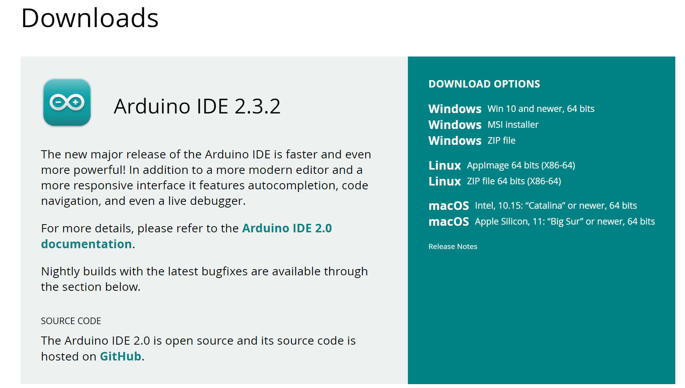

Slide 2
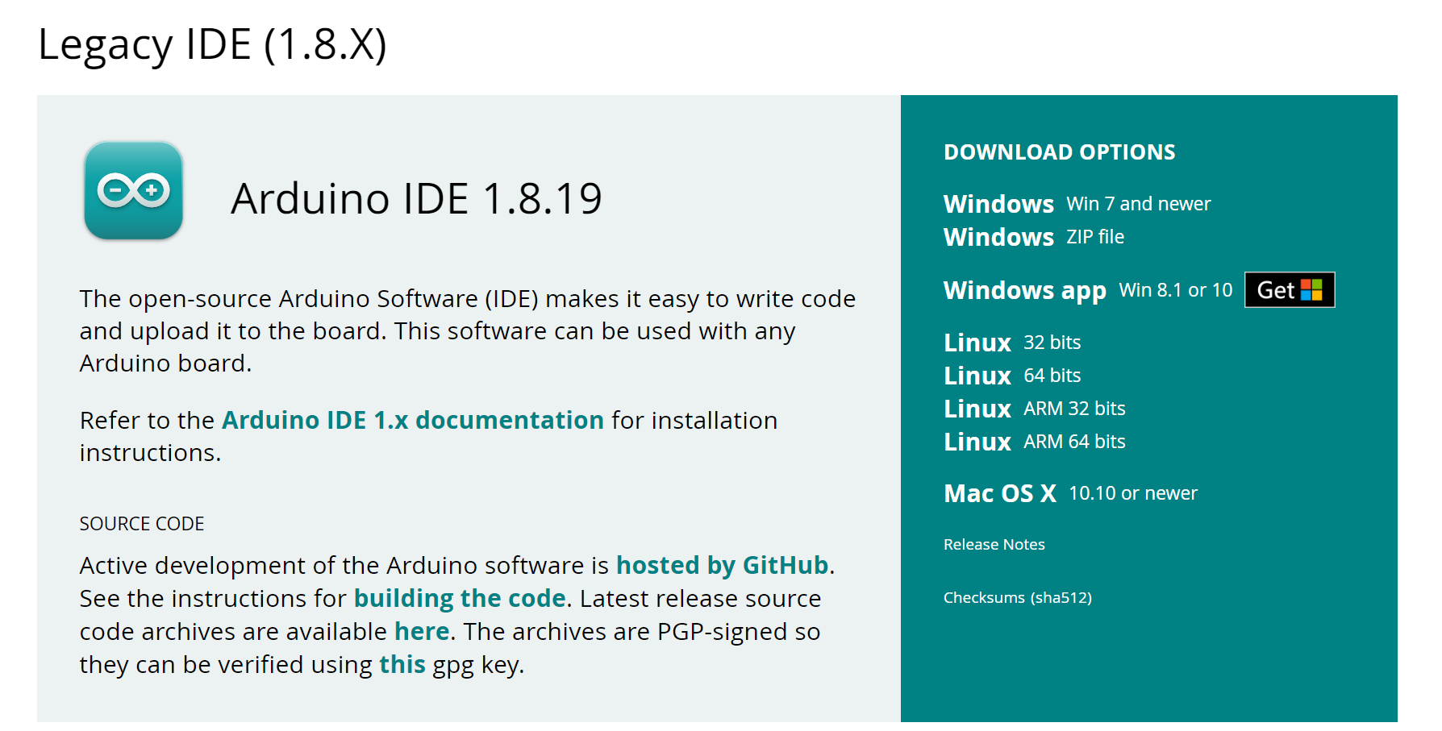
Notes:
https://docs.arduino.cc/software/ide-v2/tutorials/getting-started-ide-v2/
https://docs.arduino.cc/software/ide-v2/tutorials/getting-started/ide-v2-downloading-and-installing/

Slide 3
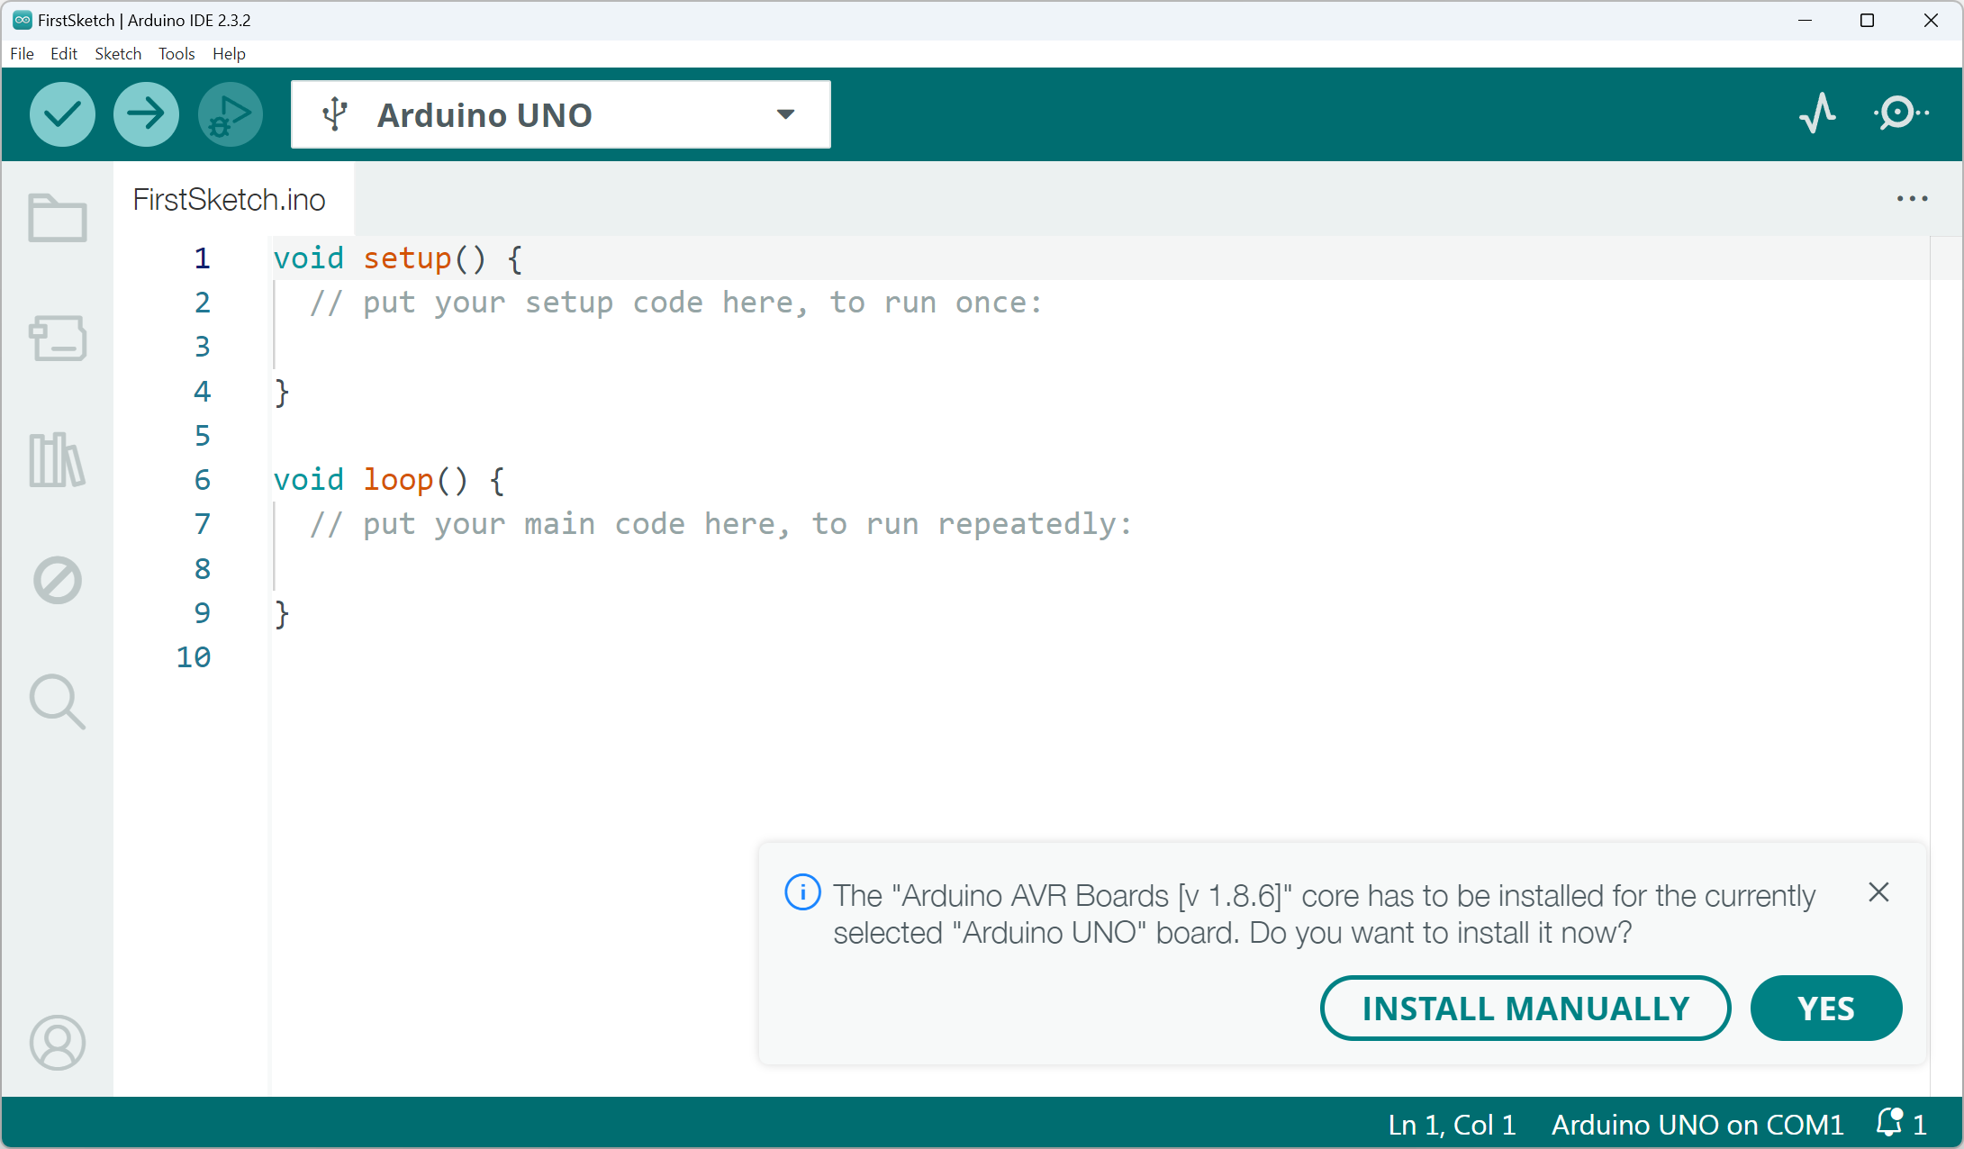

Slide 4
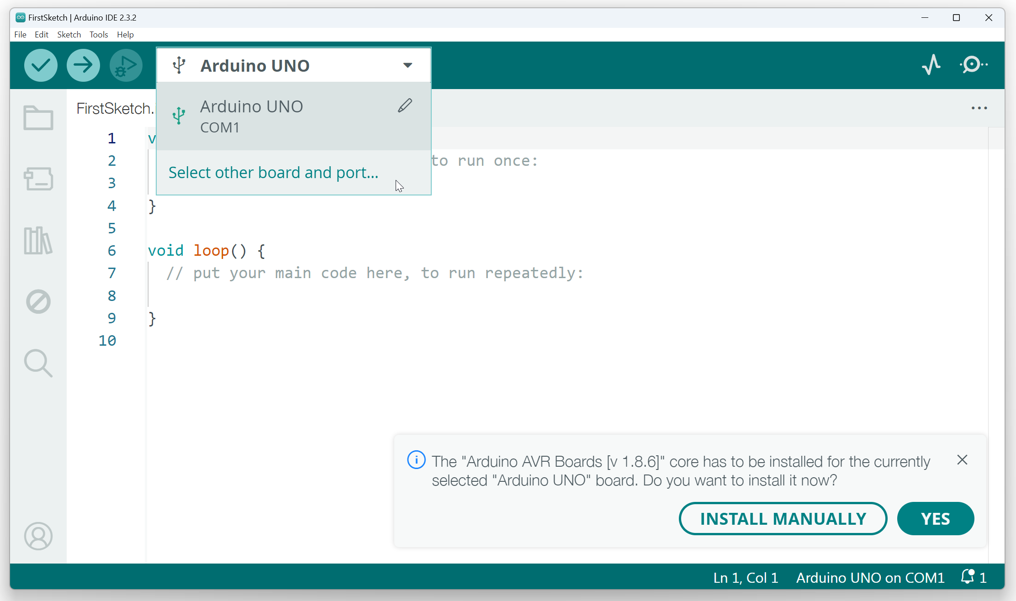

Slide 5
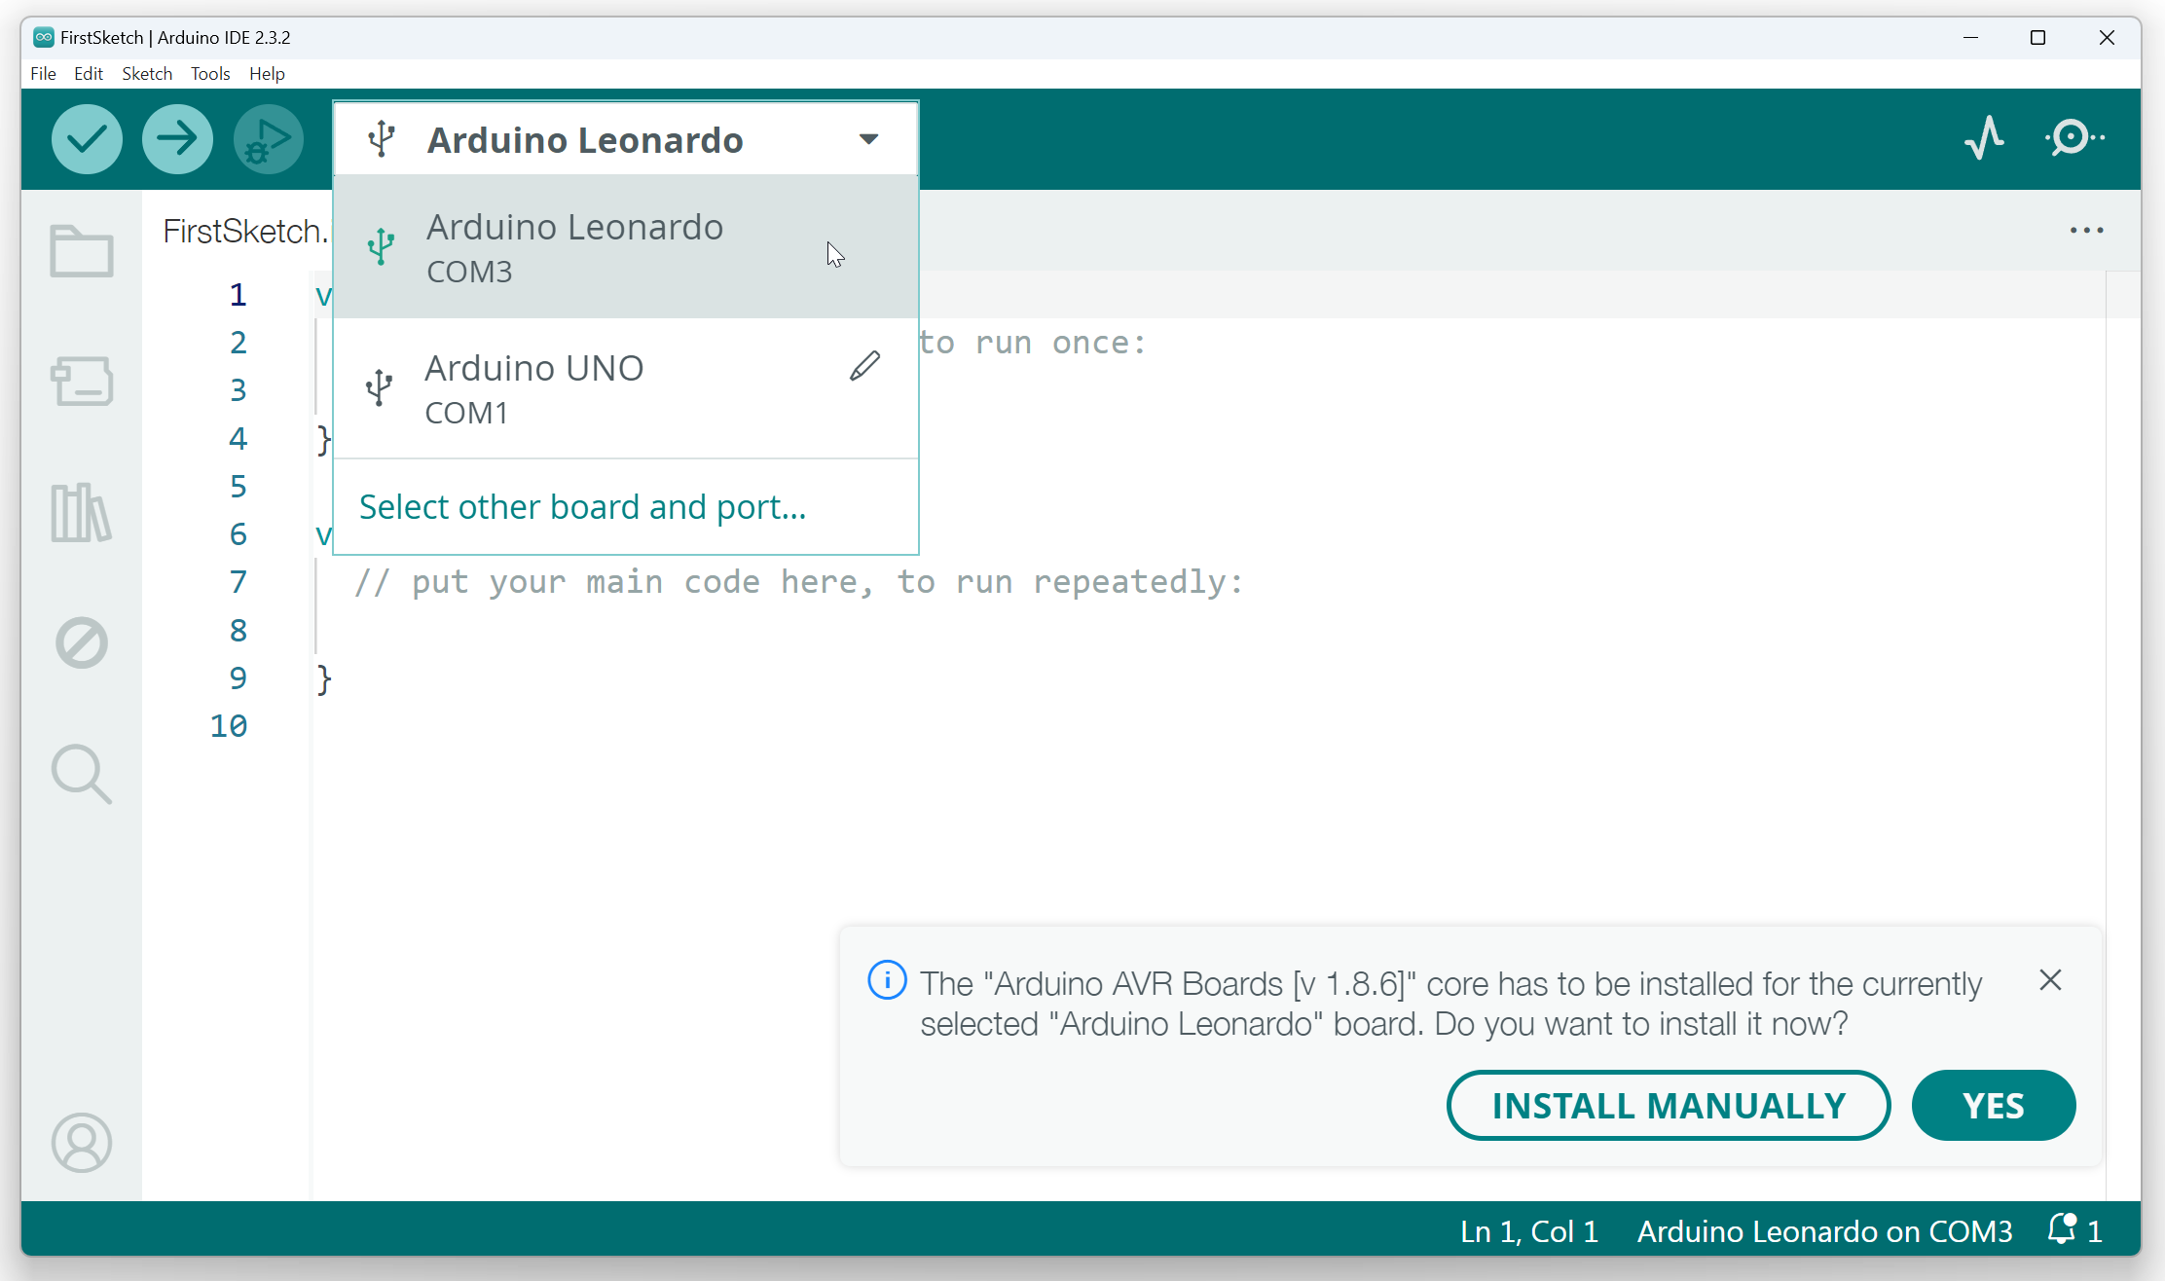

Slide 6
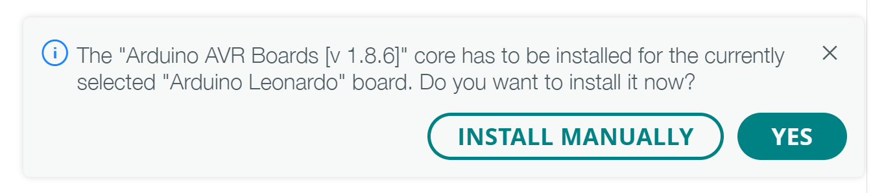

Slide 7
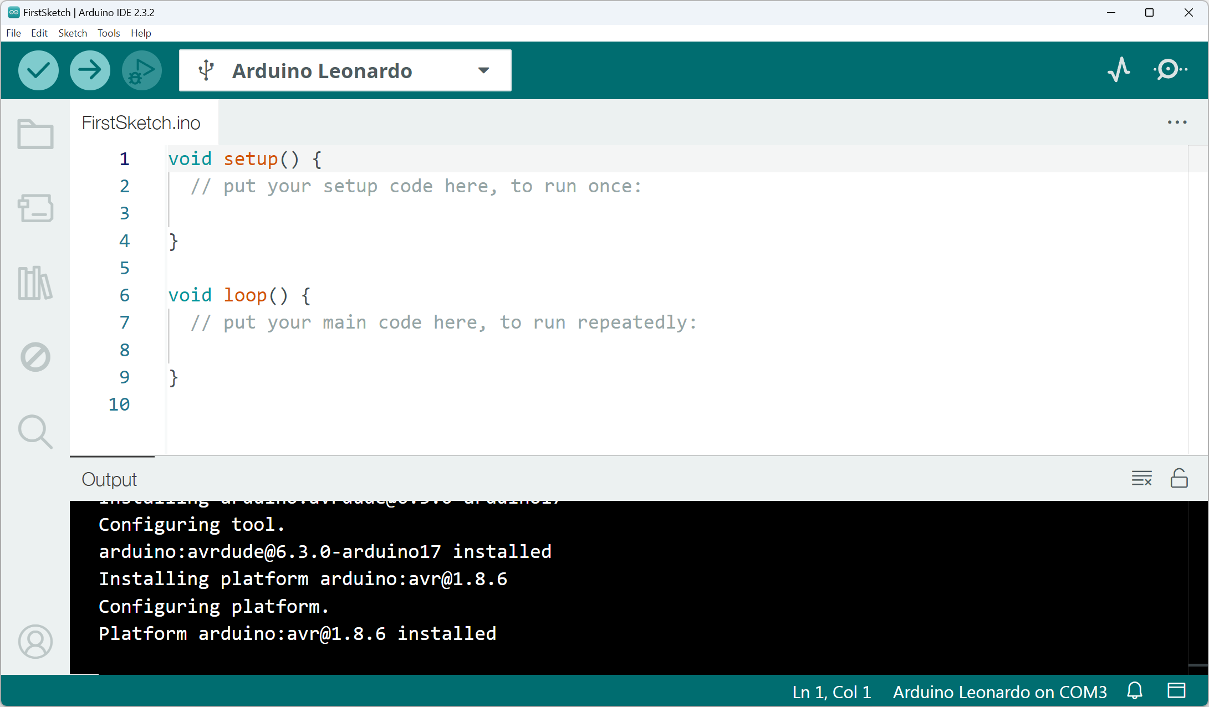

Slide 8
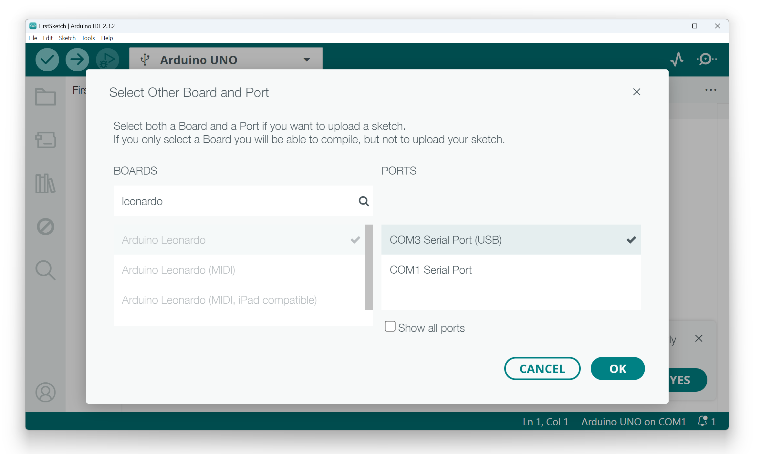

Slide 9
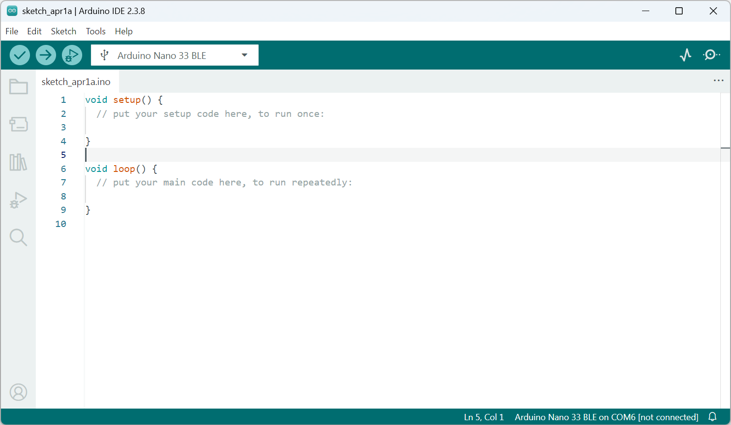

Slide 10
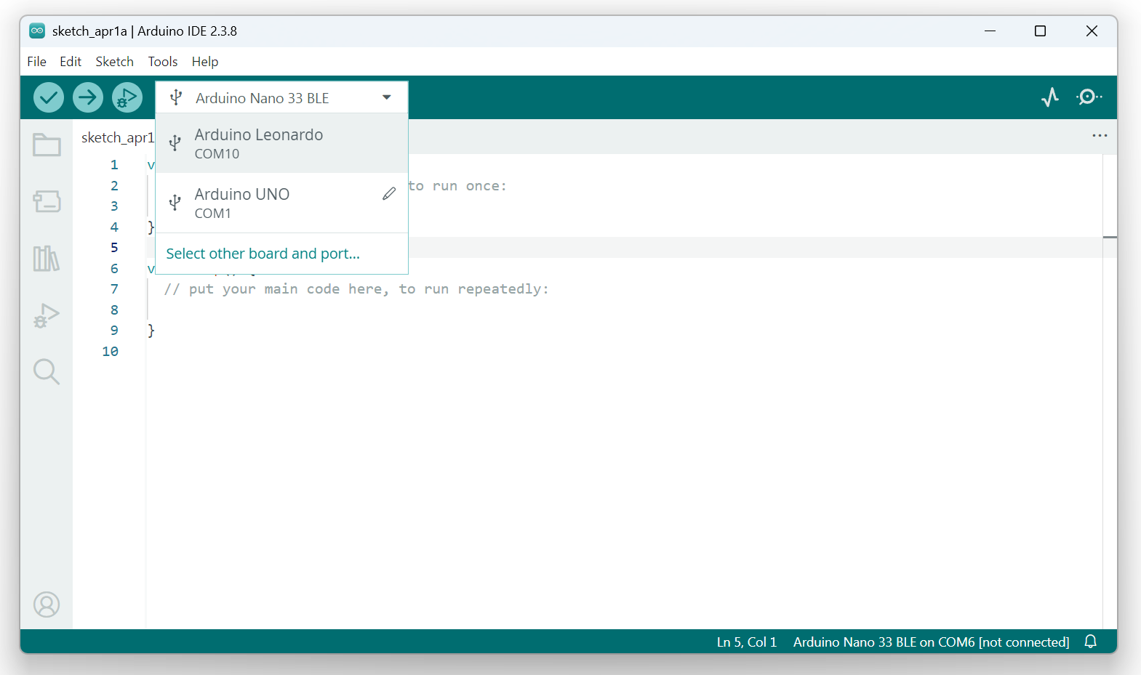
Select Arduino board

Slide 11
Select Arduino board

Slide 12
