Slide 1
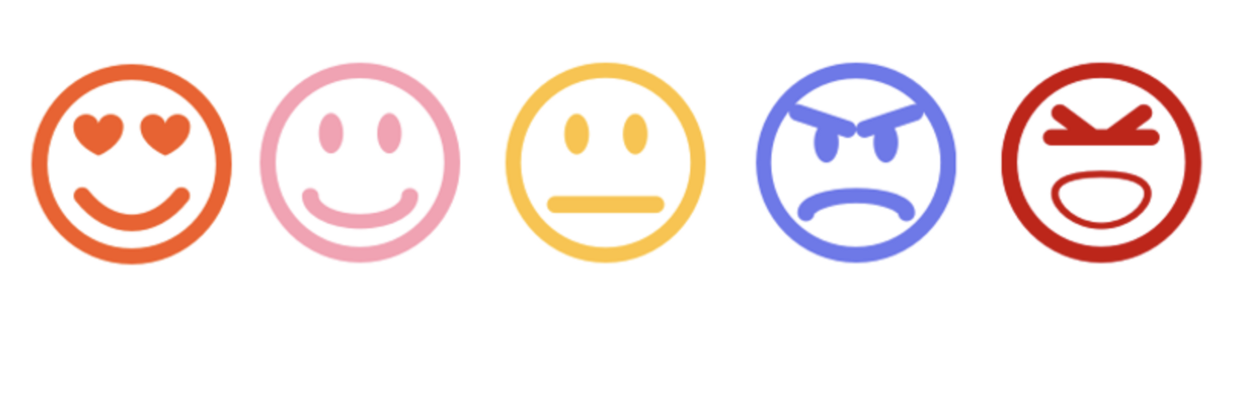
MAKEathon Challenge 2022
PostFinance
By Karsten Amrein & Kate Bettega
Notes:
Sentiment analysis Twitter
In the present project, we aimed to explore how sentiment is expressed on Twitter for Postfinance
Our results showed that sentiment is expressed through a wide range of emotions, including happiness, sadness, anger and contempt.
The sentiment analysis tool[1] used in this study classified sentiments and emotions in tweets.
Furthermore, we found that most tweets contained positive sentiments such as happiness and ..., while negative sentiments such as anger and disgust were rarely expressed.
Future studies may investigate the role of sentiment in social media and its implications for social interaction and relationships.
The sentiment analysis tool used in this study[2] classified sentiments and emotions in tweets. We found that the tool performed reasonably well in most situations (e.g. classifying positive and negative words) but was less accurate for infrequent words (e.g. pronouns and negations). Further research could develop techniques that incorporate context or prior knowledge to improve the classification accuracy of this tool

Slide 2

Notes:
In 2011, Twitter introduced "shitstorm", a feature which analyzes text in tweets and assigns a sentiment score, allowing businesses to identify positive or negative sentiment surrounding their brand
As data grow rapidly on social media by users’ contributions the need to acquire knowledge of their behaviors is in high demand.
The opinions; emotions behind posts on the pandemic are the scope of the tested dataset in this Maketon.
Finding the most suitable (classification) algorithms for this kind of data is challenging.
Within this context, models sentiment analysis can introduce detailed representation capabilities associated with performance, compared to existing feature-based techniques.
During this challenge we focus on enhancing the performance of sentiment classification using a customized and advanced word embedding technique with the main objective to idenify a feasibke to detect anomalities on social media tweets over time.
Furthermore, we propose an model that combines our baseline classifier with other state-of-the-art classifiers used for sentiment analysis. The contributions was of twofold:
(1) We establish a robust framework based on word embedding
(2) We capture and utilize the significant differences in state-of-the-art methods by proposing a hybrid model for sentiment analysis. We conduct several experiments using our own Twitter coronavirus hashtag dataset as well as public review datasets from Amazon and Yelp. For concluding results, a statistical study is carried out indicating that the performance of these proposed models surpasses other models in terms of classification accuracy.
Shitstorm Sentiment analysis Twitter
The advent of the internet has led to a proliferation of communication channels, and social media in particular. Twitter, in particular, has become a ubiquitous way for people to share news and information with one another.
Twitter is often used[1] as a news source, with users citing it as an important source of news, and 66% of Twitter users say that tweets influence their purchasing decisions. As such, it is important for businesses to understand how users are interacting with their brand on social media so that they can improve their social media strategy.
In 2011, Twitter introduced "shitstorm", a feature which analyzes text in tweets and assigns a sentiment score, allowing businesses to identify positive or negative sentiment surrounding their brand.
In 2013, Twitter published a white paper[2] detailing their "shitstorm" feature, describing how the feature works and the factors used to determine the sentiment score for each tweet. The paper also discusses how the feature is intended to be used and the challenges that organizations may face when using the feature.
In this project we explore the factors that determine a sentiment score using "shitstorm" on Twitter. I will also discuss how the algorithm[3] works, the challenges businesses may face when using the feature, and how to improve the accuracy.
A sentiment score indicates the overall tone of a tweet on a scale of -1 to +1, where a score of -1 indicates that a tweet is negative and a score of +1 indicates that a tweet is positive. As the figure below shows, positive sentiment scores are associated with blue bars and negative sentiment scores are associated with red bars.
The accuracy of a sentiment score is generally determined by how well it agrees with human assessments. In the case of Twitter, the accuracy of a sentiment score is measured by comparing it with human assessments of the same tweet using the Labeled Entity Recognition (LER) method. A paper published in 2014 found that the accuracy of sentiment scores[4] on Twitter was only 59%, with human assessments being more accurate than the algorithms by a margin of 10%.
The majority of tweets that are assigned to a positive sentiment score are actually neutral or slightly negative, while the majority of tweets that are assigned to a negative sentiment score are actually neutral or slightly positive. The accuracy of a sentiment score[5] on Twitter is 58%, with human assessments being more accurate than the algorithms by a margin of 12%. This suggests that human assessors are better equipped to identify the tone of a tweet than the algorithm, which suggests that the algorithm could be improved by incorporating linguistic analysis techniques into its sentiment score calculation.
A paper published in 2014 found that the accuracy of sentiment scores on Twitter[6] was only 59%, with human assessments being more accurate than the algorithms by a margin of 10%. This makes it clear that improving the accuracy of a sentiment score would be a valuable improvement for Twitter and its users. One potential method of improving accuracy could be to incorporate natural language processing into the algorithm in order to interpret users' text in a more meaningful way.
A study by Twitter's engineers[7] found that the accuracy improved to 66% when sentiment scores were combined with linguistic analysis. This indicates that combining sentiment analysis and linguistic analysis could further improve the accuracy of sentiment scores. As Twitter's user base continues to grow, the accuracy with which its sentiment scores are interpreted is likely to become more important, so improving the algorithm will continue to be an important task for Twitter.
Twitter has open sourced its sentiment analysis[8] code in a Github repository. The code is now available for anyone to use, meaning that it should be possible to improve the accuracy of sentiment scores by using it as the basis for a new algorithm

Slide 3
General insights out of Social Media Twitter data (PostFinance account)
1. Text mining and Sentiment Analysis
Pre-processing the textual data (Clean up)
Count the occurrence of each word-> Plotting the ones with most frequent occurrence in the tweets
Extracting overall customer sentiment from Tweets
Assigning Scores to the sentiments identified in tweets using Syuzhet, Bing, Afinn Vectors
PostFinance tweets motion classification
2. Time Series Anomaly Detection
Toolkit for Time Series to detect anomalies using Anomalize Package
Notes:
Sentiment analysis, otherwise known as opinion mining, works thanks to natural language processing (NLP) and machine learning algorithms, to automatically determine the emotional tone behind online conversations.
There are different algorithms you can implement in sentiment analysis models, depending on how much data you need to analyze, and how accurate you need your model to be. We’ll go over some of these in more detail, below.
One of the most exciting applications of NLP technology which enables non-technical users to interact with large databases using natural language and to extract the information they need from the ocean of digital data almost instantly.
So how do we create such a system that will translate natural language queries into machine language that a database will understand? There are two basic approaches to query analysis: rule-based systems and machine learning algorithms. Let’s describe them each in a little more detail.
Sentiment analysis algorithms fall into one of three buckets:
Rule-based: these systems automatically perform sentiment analysis based on a set of manually crafted rules.
Automatic: systems rely on machine learning techniques to learn from data.
Hybrid systems combine both rule-based and automatic approaches.
Rule-based Approaches
Usually, a rule-based system uses a set of human-crafted rules to help identify subjectivity, polarity, or the subject of an opinion.
These rules may include various NLP techniques developed in computational linguistics, such as:
Stemming, tokenization, parsing.
Lexicons (i.e. lists of words and expressions).
Here’s a basic example of how a rule-based system works:
Defines two lists of polarized words (e.g. negative words such as bad, worst, ugly, etc and positive words such as good, best, beautiful, etc).
Counts the number of positive and negative words that appear in a given text.
If the number of positive word appearances is greater than the number of negative word appearances, the system returns a positive sentiment, and vice versa. If the numbers are even, the system will return a neutral sentiment.
Rule-based systems are very naive since they don't take into account how words are combined in a sequence. Of course, more advanced processing techniques can be used, and new rules added to support new expressions and vocabulary. However, adding new rules may affect previous results, and the whole system can get very complex. Since rule-based systems often require fine-tuning and maintenance, they’ll also need regular investments.
Automatic Approaches
Automatic methods, contrary to rule-based systems, don't rely on manually crafted rules, but on machine learning techniques. A sentiment analysis task is usually modeled as a classification problem, whereby a classifier is fed a text and returns a category, e.g. positive, negative, or neutral.
Rule-based Grammar
Grammar engineering is basically a hand-crafted system of rules based on linguistic structures that imitates the human way of building grammar structures.
The grammar-based approach traditionally implies that a human is involved in the process of stepwise system development and improvement. The biggest advantage of formal grammar is that there is always a way to check whether the system could process a query placed by a user and how it could do that. And since all the rules are written by people, any reported bug is easy to localize and fix by adjusting the rules in the related module.
Grammar rules can be developed in a very flexible manner, for example, through the extension of translation rules and synonyms base, and can easily be updated with new functions and data types, with no significant changes to the core system. This approach to query analysis is based on the development and extension of the existing rules, so the system doesn’t require a massive training corpus, compared to the machine learning-based approach.
The most obvious disadvantage of the rule-based approach is that it requires skilled experts: it takes a linguist or a knowledge engineer to manually encode each rule in NLP. Rules need to be manually crafted and enhanced all the time. Moreover, the system can become so complex, that some rules can start contradicting each other.
Overall, a rule-based system is good at capturing a specific language phenomenon: it will decode the linguistic relationships between words to interpret the sentence. It can therefore handle sentence-level tasks, such as parsing and extraction very well. That is why the rule-based approaches are in general a better fit for query analysis.
Machine-learning algorithm
Machine Learning (ML) is also widely used in NLP.
This approach is based on algorithms that learn to “understand” language without being explicitly programmed. This is possible through the use of statistical methods, where the system starts analyzing the training set (annotated corpus) to build its own knowledge, produce its own rules and its own classifiers.
Because the machine-learning approach is based on probabilistic results, it leaves significantly fewer formal guarantees.
Like any other complicated process that a human cannot observe fully, it suffers from the butterfly effect: it can happen so, that even a small amount of new data for learning can significantly modify the model, and the new ‘improved’ version of the model will act unpredictably even to its author.
The obvious advantage of machine learning lies in its “learnability”, which is why no manual rule/grammar coding is needed, requiring high skills: the corpus can be annotated using the low-skilled workforce. Machine learning is good at tasks such as document classification or word clustering from a corpus, because in both cases there are a lot of data points (e.g. keywords etc), which makes it easy for the machine to learn statistical clues of the words for a given task.
In general, the application of machine learning approaches can significantly speed up the development of a capability of certain NLP systems, when good training data sets are available. However, it’s often not so easy in practice.
When it comes to building an NLP system for query analysis, the main problem with using the ML approach is the lack of training data (which allows the system to learn how to translate plain English into SQL), so you should have plenty of parsed messages (and preferably have them all coming from one domain, like ‘transportation enquiry system’). But what if you previously didn’t have such an interface, where users could write their queries in plain English? Where will you get them from? One of the options is to start brainstorming and create them manually, which can be very time-consuming, because datasets should be big enough for the “trained” ML-based system to deliver highly accurate results in recognizing the query and providing the needed information. | Moreover, once created and labelled, the corpus often can’t be reused on new data schemas, and new “preparation” of data is required each time.

Slide 4
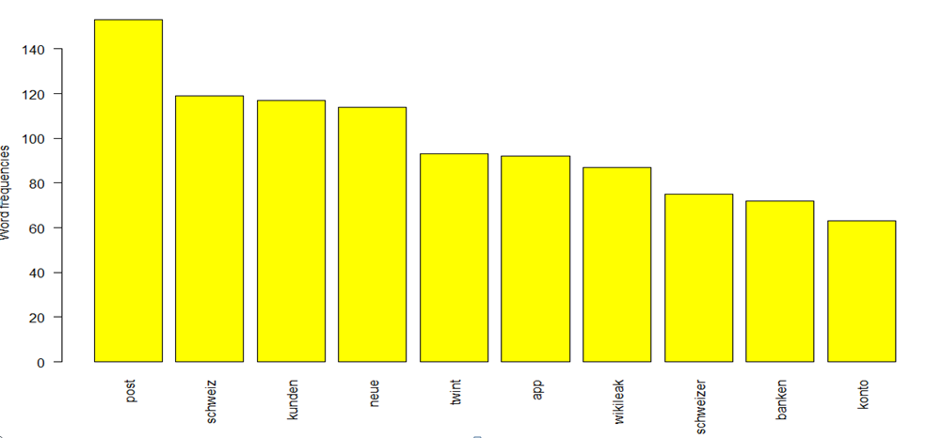
Visualizing 10 most frequent words tweets
Notes:
One could interpret from chat the following:
the most frequent word Post
Schweiz, Kunden, Neue
The most frequently occurring word is “good”. Also notice that negative words like “Post, Schweiz”
“App”, “NEUE” and “schweizer, banken" are the next 4 most frequently occurring words, which indicate that most people SPEAK aobiu about their work and their team’s health.
Finally, the root “improv” for words like “improve”, “improvement”, “improving”, etc. is also on the chart, and you need further analysis to infer if its context is positive or negative

Slide 5
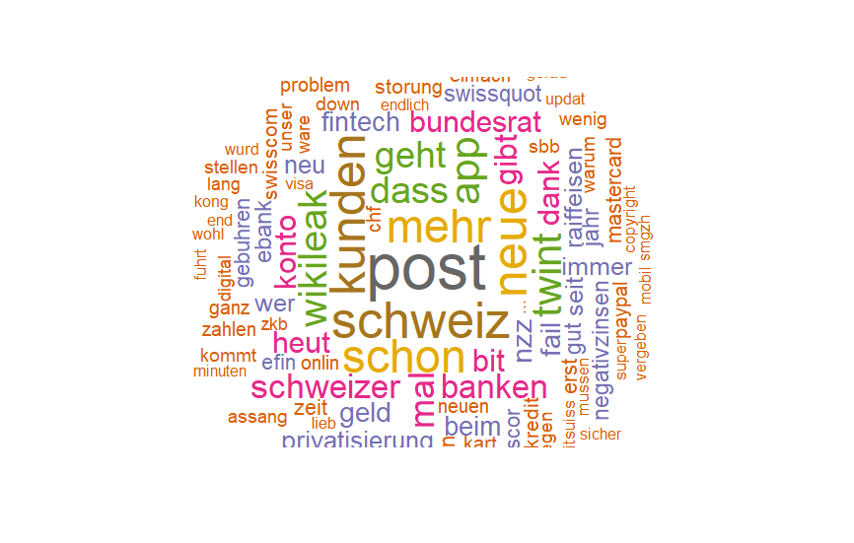
Generating the Word Cloud
Notes:
A word cloud is one of the most popular ways to visualize and analyze qualitative data. It’s an image composed of keywords found within a body of text, where the size of each word indicates its frequency in that body of text. Use the word frequency data frame (table) created previously to generate the word cloud. In your R script, add the following code and run it to generate the word cloud and display it in the Plots section of RStudio.
The word cloud shows additional words that occur frequently and could be of interest for further analysis.
Words like “Neue”, “wIKILEAK”, FAIL” could provide more context around the most frequently occurring words and help to gain a better understanding of the main themes.

Slide 6
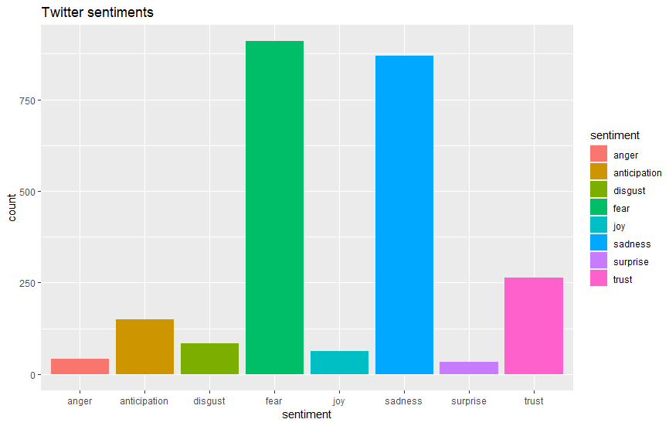

Sentiment Scores
Notes:
Sentiment Scores
Sentiments can be classified as positive, neutral or negative.
They can also be represented on a numeric scale, to better express the degree of positive or negative strength of the sentiment contained in a body of text.
This example uses the Syuzhet package for generating sentiment scores, which has four sentiment dictionaries and offers a method for accessing the sentiment extraction tool developed in the NLP group at Stanford. The get_sentiment function accepts two arguments: a character vector (of sentences or words) and a method. The selected method determines which of the four available sentiment extraction methods will be used. The four methods are syuzhet (this is the default), bing, afinn and nrc. Each method uses a different scale and hence returns slightly different results. Please note the outcome of nrc method is more than just a numeric score, requires additional interpretations and is out of scope for this article. The descriptions of the get_sentiment function has been sourced from : https://cran.r-project.org/web/packages/syuzhet/vignettes/syuzhet-vignette.html?
Emotion Classification
Emotion classification is built on the NRC Word-Emotion Association Lexicon (aka EmoLex). The definition of “NRC Emotion Lexicon”, sourced from http://saifmohammad.com/WebPages/NRC-Emotion-Lexicon.htm is “The NRC Emotion Lexicon is a list of English words and their associations with eight basic emotions (anger, fear, anticipation, trust, surprise, sadness, joy, and disgust) and two sentiments (negative and positive). The annotations were manually done by crowdsourcing.”
To understand this, explore the get_nrc_sentiments function, which returns a data frame with each row representing a sentence from the original file. The data frame has ten columns (one column for each of the eight emotions, one column for positive sentiment valence and one for negative sentiment valence). The data in the columns (anger, anticipation, disgust, fear, joy, sadness, surprise, trust, negative, positive) can be accessed individually or in sets. The definition of get_nrc_sentiments has been sourced from: https://cran.r-project.org/web/packages/syuzhet/vignettes/syuzhet-vignette.html?
Add the following line to your R script and run it, to see the data frame generated from the previous execution of the get_nrc_sentiment function.

Slide 7
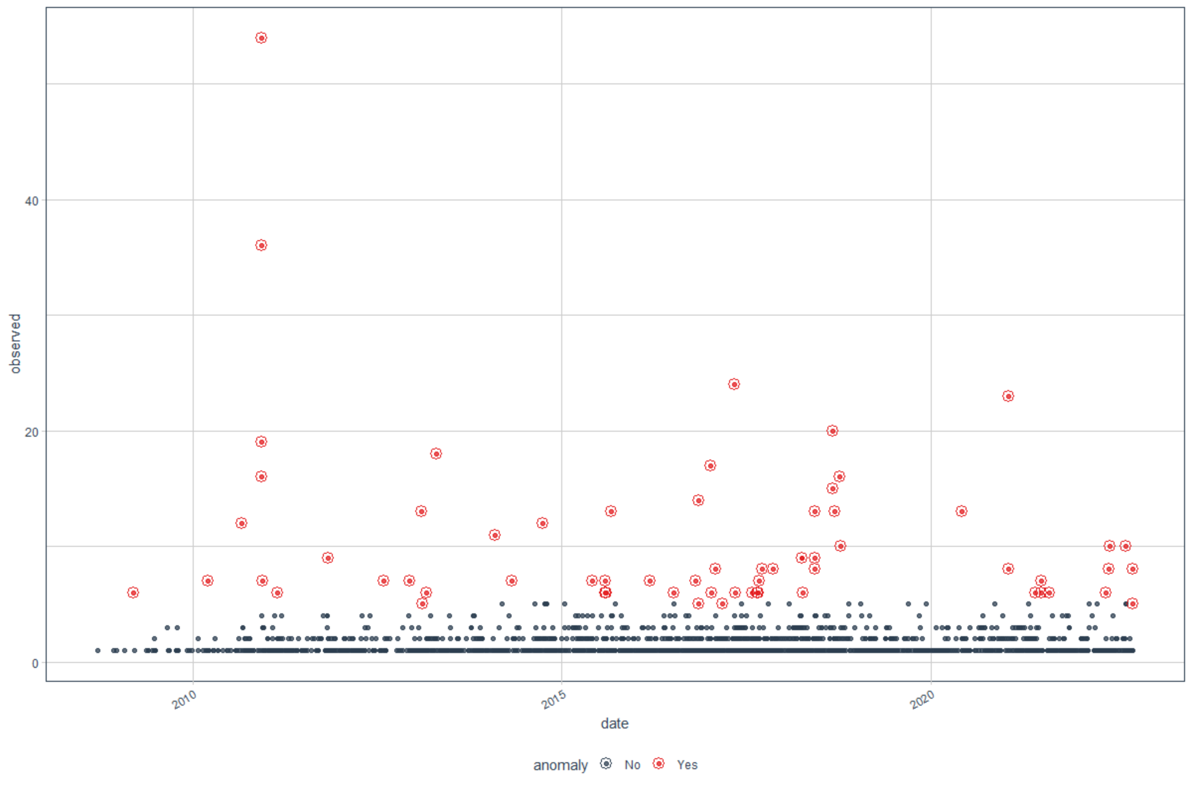
Anomaly Detection
2012-07-12

Slide 8
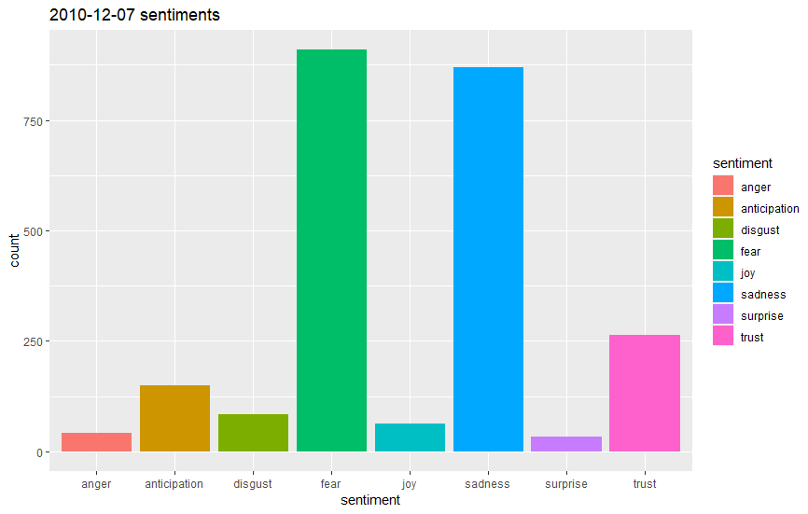
Sentiment Analysis 2010-12-07

Slide 9
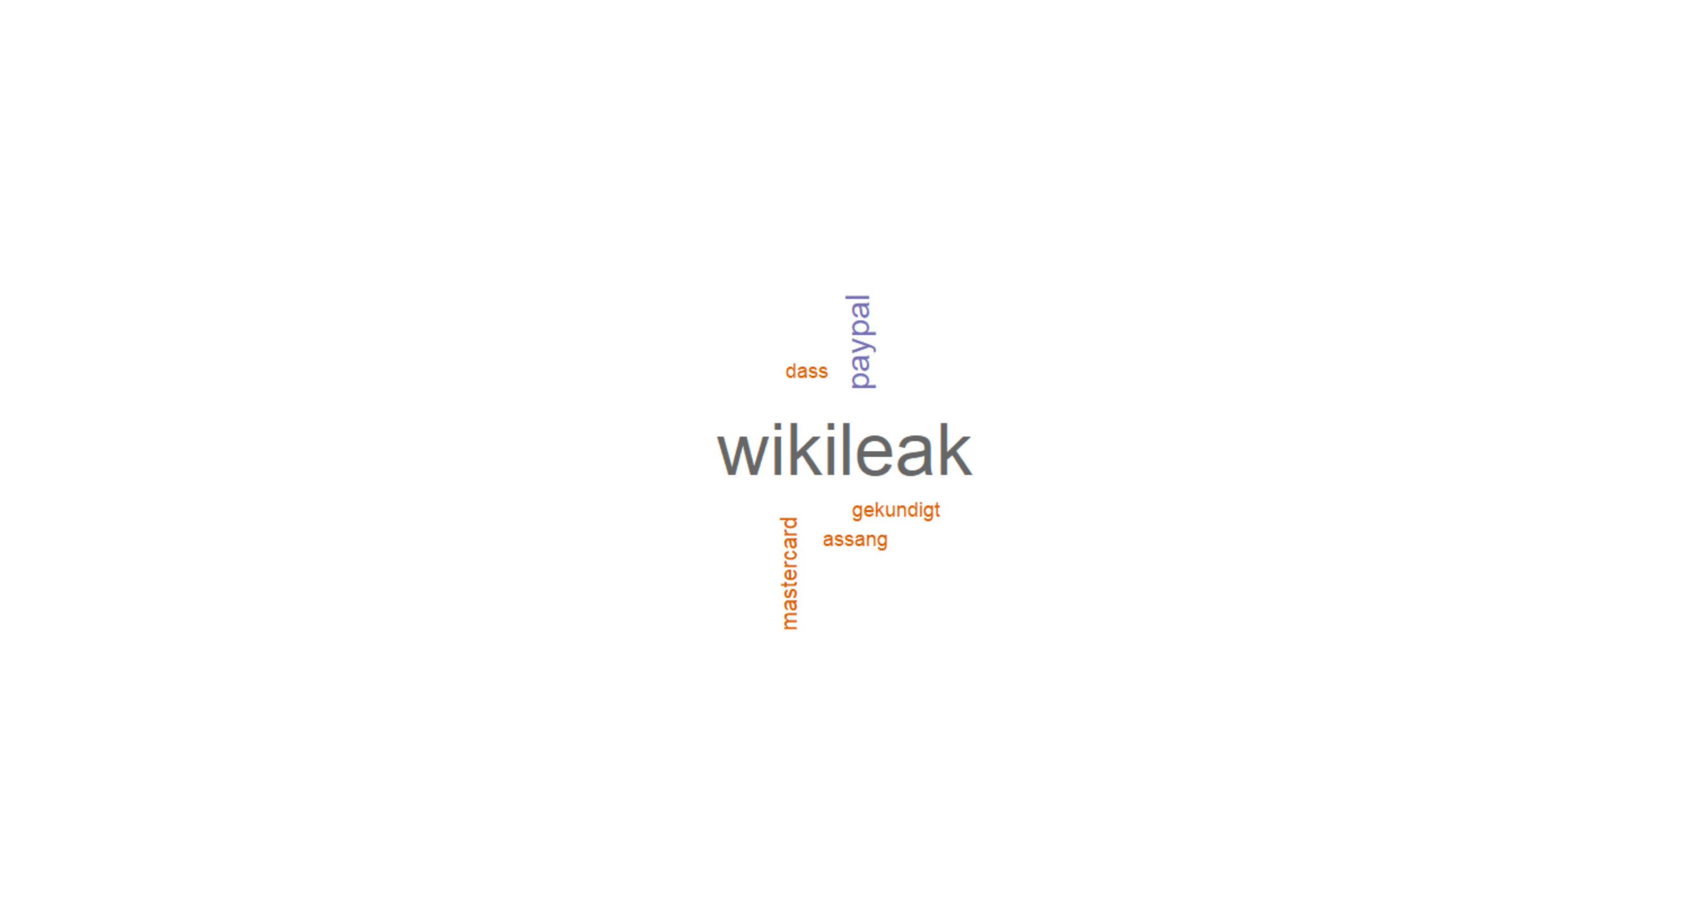
Word Cloud 2010-07-12

Slide 10
Conclusion
PoC worked
Content Manager might needed (open job position)
Stop banning accounts of human rights activists
Notes:
Conclusion Sentiment analysis Twitter
In the present project, we aimed to explore how sentiment is expressed on Twitter. Our results showed that sentiment is expressed through a wide range of emotions, including happiness, sadness, anger and contempt. The sentiment analysis tool[1] used in this study classified sentiments and emotions in tweets. Furthermore, we found that most tweets contained positive sentiments such as happiness and love, while negative sentiments such as anger and disgust were rarely expressed. Future studies may investigate the role of sentiment in social media and its implications for social interaction and relationships.
The sentiment analysis tool used in this study[2] classified sentiments and emotions in tweets. We found that the tool performed reasonably well in most situations (e.g. classifying positive and negative words) but was less accurate for infrequent words (e.g. pronouns and negations). Further research could develop techniques that incorporate context or prior knowledge to improve the classification accuracy of this tool

