Slide 1

Machine Learning
Session 8 - PL
Introduction to Supervised Learning
Ciência de Dados Aplicada
2023/2024

Slide 2
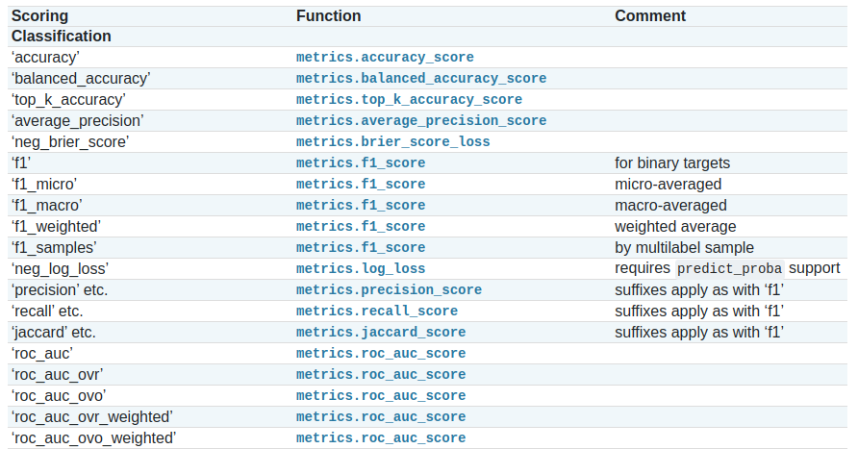
Classification Metrics with Scikit-Learn
https://scikit-learn.org/stable/modules/model_evaluation.html
Introduction to Supervised Learning
Session 8

Slide 3
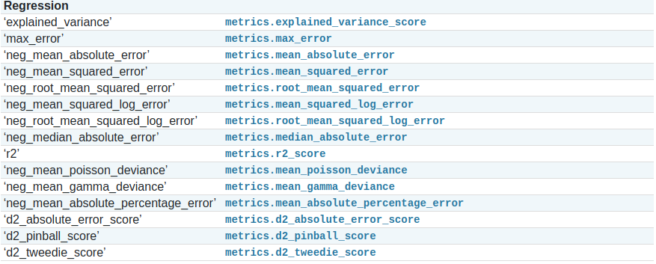
Regression Metrics with Scikit-Learn
https://scikit-learn.org/stable/modules/model_evaluation.html
Introduction to Supervised Learning
Session 8

Slide 4
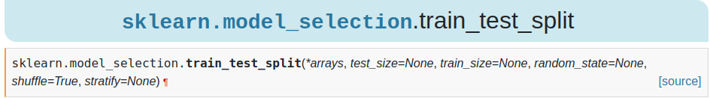
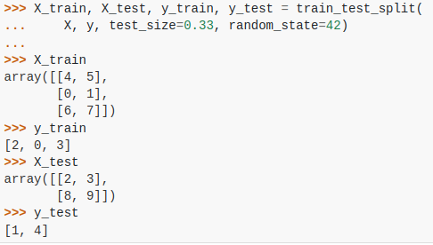
Error Estimation with Scikit-Learn
Holdout:
https://scikit-learn.org/stable/modules/generated/sklearn.model_selection.train_test_split.html
Introduction to Supervised Learning
Session 8

Slide 5
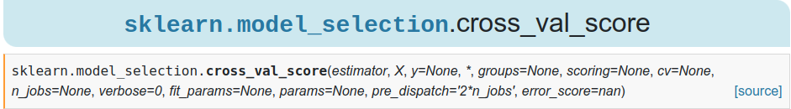
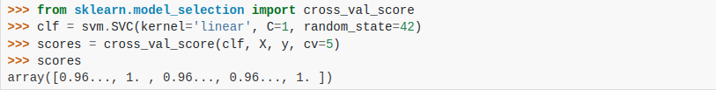
Error Estimation with Scikit-Learn
Cross Validation:
https://scikit-learn.org/stable/modules/cross_validation.html#computing-cross-validated-metrics
Introduction to Supervised Learning
Session 8

Slide 6
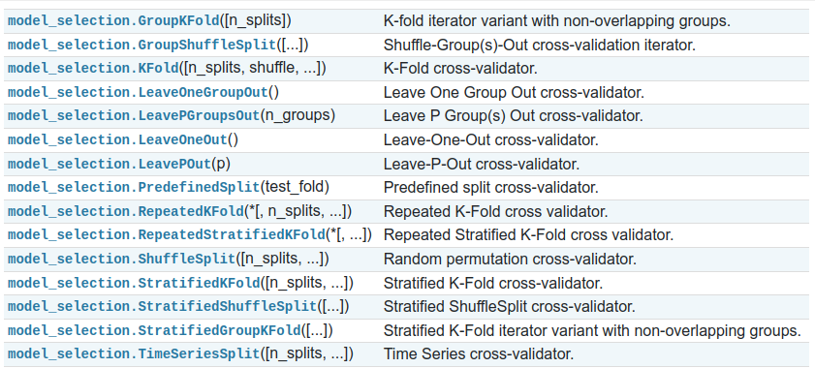
Error Estimation with Scikit-Learn
Others:
https://scikit-learn.org/stable/modules/classes.html#splitter-classes
Introduction to Supervised Learning
Session 8

Slide 7
Exercises:
Notebooks on the github repository:
Notebook with examples:
notebooks/session8/examples.ipynb
Notebook with exercises:
notebooks/session8/exercises.ipynb
Unsupervised Learning - Clustering
Session 5

