Slide 1

Machine Learning
Session 8 - T
Introduction to Supervised Learning
Ciência de Dados Aplicada
2023/2024

Slide 2
Unsupervised vs Supervised Learning
Unsupervised: involves working with unlabeled data, where the algorithm explores the inherent structure and patterns within the input without explicit output guidance.
Supervised: the algorithm is trained on a labeled dataset, where the input data is paired with corresponding output labels. The goal is to learn a mapping from inputs to outputs, allowing the algorithm to make predictions on new, unseen data.
Introduction to Supervised Learning
Session 8

Slide 3


Supervised Learning
Given a dataset:
where represents input features and represents corresponding labels.
The goal is to learn a function that maps inputs to outputs, i.e., .
Where represents a error term.
While minimizing the error between the predicted output and real values.
Introduction to Supervised Learning
Session 8

Slide 4
Datasets for Supervised Learning
Inputs:
Output:
Features
Mileage | Engine | Horsepower | Transmition Type | Car Type
25000 | 2.0 | 180 | Manual | Sedan
30000 | 2.5 | 200 | Automatic | SUV
20000 | 1.8 | 160 | Manual | Sedan
35000 | 3.0 | 250 | Automatic | SUV
28000 | 2.2 | 190 | Automatic | Sedan
32000 | 2.8 | 220 | Manual | SUV
27000 | 2.0 | 170 | Manual | Sedan
... | ... | ... | ... | ...
Examples
(…)
Feature types
Continuous
Continuous
Continuous
Discrete
Discrete
Introduction to Supervised Learning
Session 8

Slide 5
Binary Classification
Inputs:
Output:
Features
Mileage | Engine | Horsepower | Transmition Type | Car Type
25000 | 2.0 | 180 | Manual | Sedan
30000 | 2.5 | 200 | Automatic | SUV
20000 | 1.8 | 160 | Manual | Sedan
35000 | 3.0 | 250 | Automatic | SUV
28000 | 2.2 | 190 | Automatic | Sedan
32000 | 2.8 | 220 | Manual | SUV
27000 | 2.0 | 170 | Manual | Sedan
... | ... | ... | ... | ...
Examples
(…)
Binary Classification
(0 or 1)
Feature types
Continuous
Continuous
Continuous
Discrete
Discrete
Introduction to Supervised Learning
Session 8

Slide 6
Multiclass Classification
Inputs:
Output:
Features
Mileage | Engine | Horsepower | Transmition Type | Brand
25000 | 2.0 | 180 | Manual | Toyota
30000 | 2.5 | 200 | Automatic | Ford
20000 | 1.8 | 160 | Manual | Honda
35000 | 3.0 | 250 | Automatic | BMW
28000 | 2.2 | 190 | Automatic | Toyota
32000 | 2.8 | 220 | Manual | Honda
27000 | 2.0 | 170 | Manual | Ford
... | ... | ... | ... | ...
Examples
(…)
Multiclass Classification
(> 2 classes)
Feature types
Continuous
Continuous
Continuous
Discrete
Discrete
Introduction to Supervised Learning
Session 8

Slide 7
Regression
Inputs:
Output:
Features
Mileage | Engine | Horsepower | Transmition Type | Price
25000 | 2.0 | 180 | Manual | 20000
30000 | 2.5 | 200 | Automatic | 25000
20000 | 1.8 | 160 | Manual | 18000
35000 | 3.0 | 250 | Automatic | 30000
28000 | 2.2 | 190 | Automatic | 28000
32000 | 2.8 | 220 | Manual | 15000
27000 | 2.0 | 170 | Manual | 13000
... | ... | ... | ... | ...
Examples
(…)
Regression
Feature types
Continuous
Continuous
Continuous
Discrete
Continuous
Introduction to Supervised Learning
Session 8

Slide 8
Supervised Learning or Not?
Predict the IMDB score of a movie based on its characteristics.
Identify the illness of a patient based on its symptoms.
Group patients based on the values of indicators from their biochemical analyses.
Predict the weather for October 2023 based on the weather of previous months.
Calculate the average age of the students in this course.
Writing a program to improve its performance when playing chess against humans.
Introduction to Supervised Learning
Session 8

Slide 9
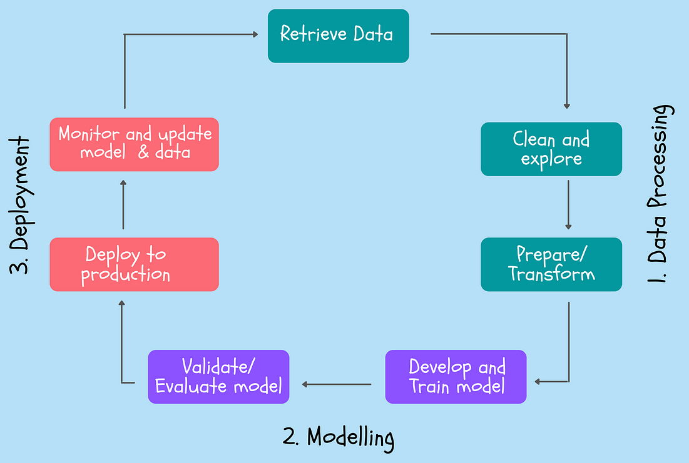
Supervised Learning Workflow
https://towardsdatascience.com/the-machine-learning-workflow-explained-557abf882079
Introduction to Supervised Learning
Session 8

Slide 10
Supervised Learning Workflow
Prepare the data:
Data collection;
Data cleaning;
Data preprocessing.
Model building:
Selecting the model;
Model architecture;
Choose hyperparameters.
Train and evaluate the model:
Train the model with the training data to minimize a loss function;
Assess the model's performance on a separate validation set to tune hyperparameters and prevent overfitting.
Assess the model's performance on the test.
Get predictions from the model:
Use the trained model to make predictions on new, unseen data.
Introduction to Supervised Learning
Session 8

Slide 11

Supervised Learning Workflow
Dataset
Mileage | Engine | Horsepower | Transmition Type | Car Type
25000 | 2.0 | 180 | Manual | Sedan
30000 | 2.5 | 200 | Automatic | SUV
20000 | 1.8 | 160 | Manual | Sedan
35000 | 3.0 | 250 | Automatic | SUV
28000 | 2.2 | 190 | Automatic | Sedan
32000 | 2.8 | 220 | Manual | SUV
27000 | 2.0 | 170 | Manual | Sedan
... | ... | ... | ... | ...
Model
Linear Models
Tree-Based Models
Instance-Based Models
Probabilistic Models
Ensemble Models
Neural Networks
...
Optimization Algorithm
Mileage | Engine | Horsepower | Transmition Type | Car Type
25000 | 2.0 | 180 | Manual | ?
30000 | 2.5 | 200 | Automatic | ?
20000 | 1.8 | 160 | Manual | ?
... | ... | ... | ... | ...
Predictions
Car Type
SUV
SUV
Sedan
...
Introduction to Supervised Learning
Session 8

Slide 12

Model Evaluation: Error Metrics
Assessing the quality of a model for a specific task involves the computation of error metrics.
These metrics provide insights into how well the model performs on a set of examples (not used during model training).
The metric to use depends on the type of problem: regression or classification.
Introduction to Supervised Learning
Session 8

Slide 13
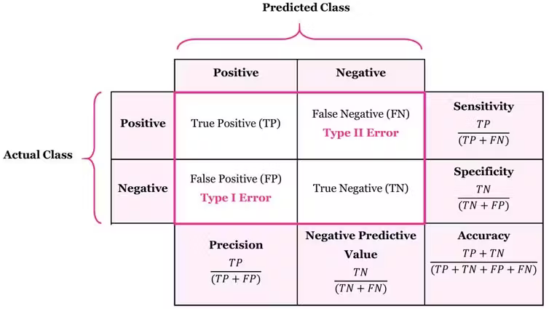
Classification Metrics
Confusion matrix:
2 classes
Introduction to Supervised Learning
Session 8

Slide 14
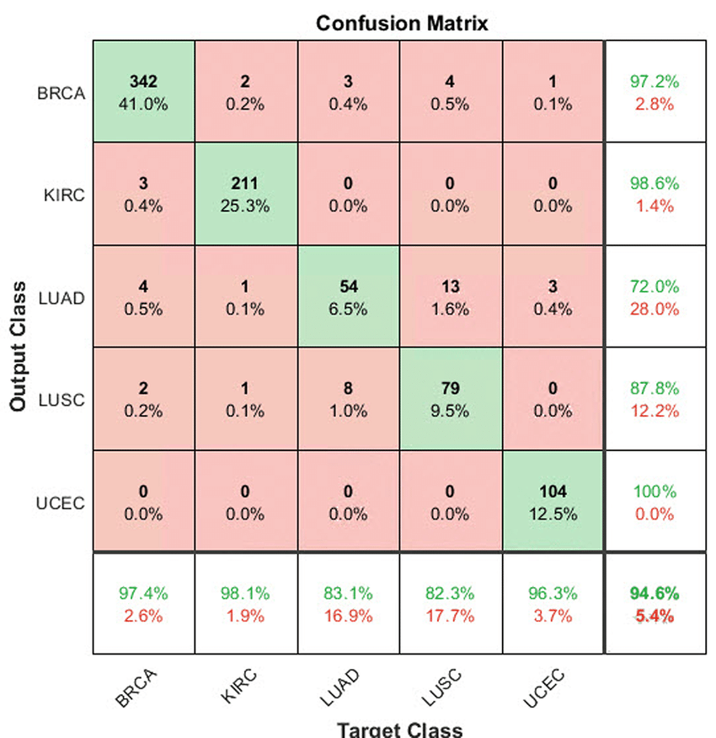
Classification Metrics
Confusion matrix:
More than 2 classes
Introduction to Supervised Learning
Session 8

Slide 15
Classification Metrics
aka Recall
Introduction to Supervised Learning
Session 8

Slide 16
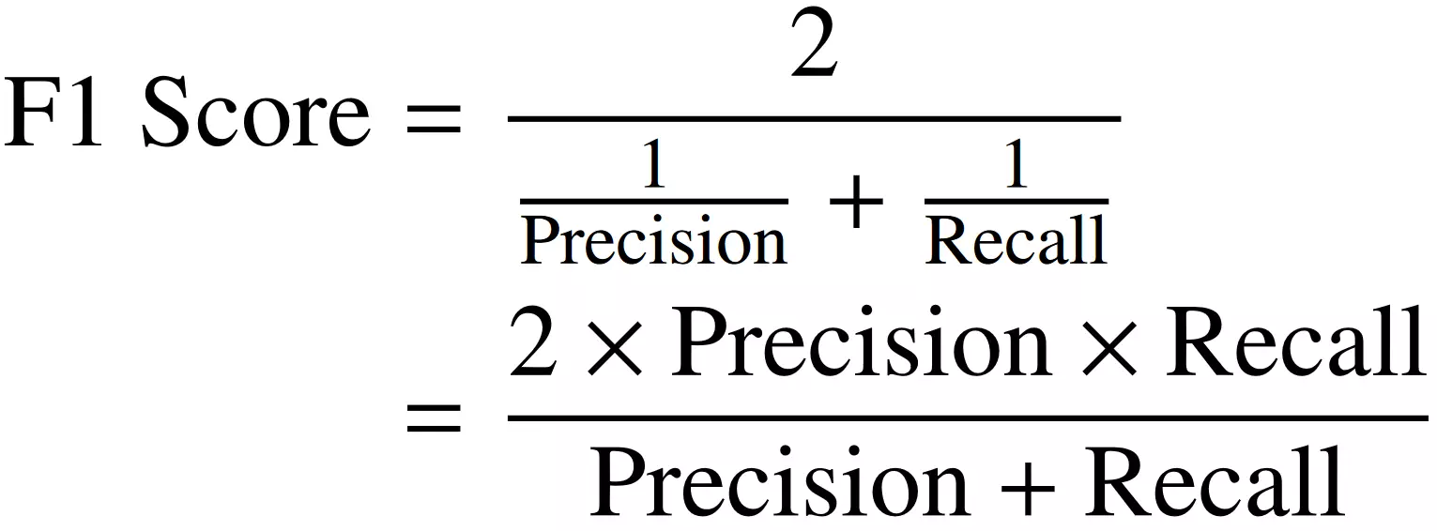

Classification Metrics
Matthews Correlation Coefficient
Introduction to Supervised Learning
Session 8

Slide 17
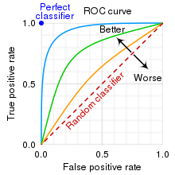
Classification Metrics
Receiver operating characteristic (ROC) curves
Graphically evaluates model discrimination across different thresholds.
True Positive Rate vs. False Positive Rate
Area Under the Curve (AUC): Reliable classifier quality indicator (0.5 for random, 1 for perfect).
Precision-Recall curves: More suitable for imbalanced data, highlighting precision-recall trade-offs.
Introduction to Supervised Learning
Session 8

Slide 18
Classification Metrics: Which one to pick?
Accuracy: general measure used when the classes are balanced and misclassifications of both positive and negative cases are equally important;
Sensitivity/Recall: when correctly identifying positive cases is crucial (e.g. medical diagnosis or fraud detection);
Specificity: when correctly identifying negative cases is important (e.g. security screening or quality control);
Precision: when we want to minimize false positives (e.g. email spam fetection);
F1-score: when we want a balance between precision and recall, especially in situations where there is an imbalance between the number of positive and negative cases.
MCC: when you want a single metric that considers the overall performance of the model, especially in binary classification tasks where the classes are imbalanced.
Introduction to Supervised Learning
Session 8

Slide 19


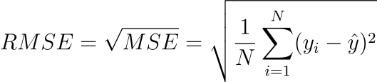
Regression Metrics
Mean Absolute Error (MAE):
Simple and interpretable measure of average prediction error. Less sensitive to outliers.
Mean Squared Error (MSE):
Penalize larger errors more heavily. Sensitive to outliers due to squaring the errors.
Root Mean Squared Error (RMSE):
Metric in the same units as the target variable. Provides an interpretable measure like MAE but accounts for larger errors like MSE.
Introduction to Supervised Learning
Session 8

Slide 20



Regression Metrics
Mean Absolute Percentage Error (MAPE):
Useful when the scale of the target variable varies widely.
Coefficient of Determination (R-squared):
Used to assess how well independent variables explain variability in the dependent variable. Higher values indicate a better fit of the model to the data.
Adjusted R-squared:
Adjusts the R-squared for the number of independent variables (k), providing a more accurate reflection of model fit.
n is the number of observations in the data.
Introduction to Supervised Learning
Session 8

Slide 21
Error Estimation Methods
Objective: ensure credible evaluation of algorithm performance and generalization ability.
Error measures should not be applied to the same dataset that was used for training.
Validation and test sets are used to evaluate the trained model.
Importance of Test Examples:
Crucial for assessing how well the model generalizes to unseen data.
Ensures unbiased evaluation of model performance.
Introduction to Supervised Learning
Session 8

Slide 22
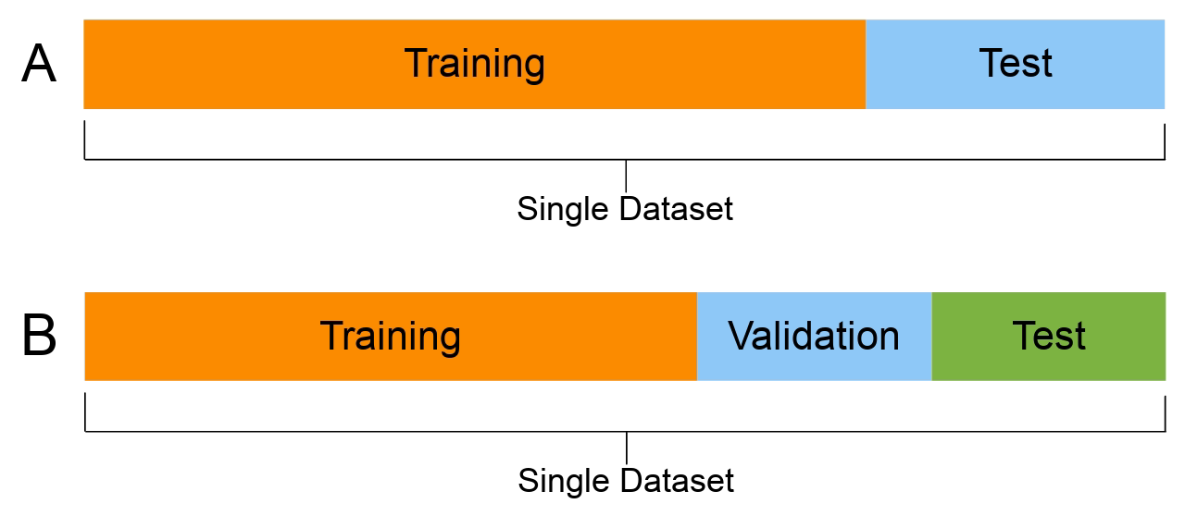
Holdout
It involves splitting the dataset into two subsets: the training set and the test set.
The model is trained on the training set and evaluated on the independent test set.
Introduction to Supervised Learning
Session 8

Slide 23
Holdout
Sometimes, it is necessary to split the data into three subsets: the training set, the validation set, and the test set.
The model is trained on the training set and evaluated on the validation set to tune hyperparameters.
Finally, the model's performance is assessed on the test set to obtain an unbiased estimate of its generalization ability.
Introduction to Supervised Learning
Session 8

Slide 24
Holdout
Advantages:
Easy to implement.
Provides a quick estimate of model performance.
Useful for large datasets where computational resources are limited.
Limitations:
Performance estimate may vary depending on the random split of data.
May not be suitable for small datasets due to potential data imbalance.
Introduction to Supervised Learning
Session 8

Slide 25

Cross Validation
Cross-validation is a robust technique for estimating prediction error by iteratively splitting the dataset into multiple subsets.
Introduction to Supervised Learning
Session 8

Slide 26
Cross Validation
Types of Cross-Validation:
K-Fold Cross-Validation: Divides the data into k folds, each used as a test set once.
Leave-One-Out Cross-Validation (LOOCV): Each observation is used as a test set once, with the rest as the training set (k=number of samples).
Advantages:
Provides a robust estimate of model performance by averaging over multiple iterations.
Limitations:
Computationally intensive, especially for large datasets or complex models.
May result in higher variance estimates due to randomness in data splits.
Introduction to Supervised Learning
Session 8

Slide 27
Learning Bias
It represents the systematic error or deviation of the model's predictions from the true values.
Learning bias can arise due to model complexity, insufficient data, or inherent limitations of the algorithm.
Types of learning bias:
Underfitting (High Bias)
Overfitting (Low Bias, High Variance)
Introduction to Supervised Learning
Session 8

Slide 28
Bias and Variance
Bias:
Bias refers to the error introduced by approximating a real-world problem with a simplified model.
High bias models are too simple and fail to capture the underlying patterns in the data.
Variance:
Variance measures the model's sensitivity to small fluctuations in the training data.
High variance models are overly complex and capture noise or random fluctuations in the data.
Bias-Variance Tradeoff:
Find a tradeoff between bias and variance: reducing one typically increases the other.
The goal is to find the right balance that minimizes both bias and variance, resulting in optimal model performance.
Introduction to Supervised Learning
Session 8

Slide 29
Underfitting
Underfitting occurs when a machine learning model fails to capture the underlying patterns in the data, resulting in poor performance on both training and test data.
Causes:
Model complexity is too low relative to the complexity of the underlying data.
Insufficient features or training examples to capture the variability in the data.
Mitigation Strategies:
Increase model complexity by adding more features or using a more complex algorithm.
Fine-tune hyperparameters to achieve a better balance between bias and variance.
Collect more data to provide the model with a richer learning environment.
Introduction to Supervised Learning
Session 8

Slide 30
Overfitting
Overfitting occurs when a machine learning model captures noise or irrelevant patterns from the training data, leading to poor generalization on unseen data.
Causes:
Model complexity is too high relative to the amount of training data available.
Too many features or interactions being considered, leading to capturing noise instead of signal.
Mitigation Strategies:
Simplify the model by reducing complexity, such as decreasing the number of features or using regularization techniques.
Increase training data to provide the model with more diverse examples.
Use techniques like cross-validation to evaluate model performance and select the best-performing model.
Introduction to Supervised Learning
Session 8

Slide 31
Resources
Kelleher, J. D., Namee, B. M., & D’Arcy, A. (2015). Fundamentals of machine learning for predictive data analytics. London, England: MIT Press.
https://courses.washington.edu/me333afe/Bias_Variance_Tradeoff.pdf
Introduction to Supervised Learning
Session 8

