Slide 1

Machine Learning
Session 9 - PL
Instance-based and Probabilistic Models
Ciência de Dados Aplicada
2023/2024

Slide 2
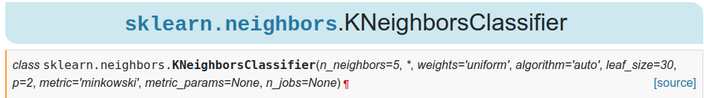
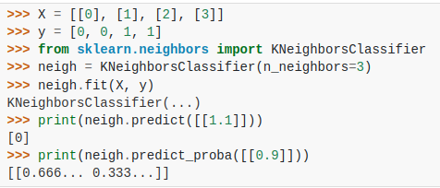
KNN with Scikit-Learn
https://scikit-learn.org/stable/modules/generated/sklearn.neighbors.KNeighborsClassifier.html
Instance-based and Probabilistic Models
Session 9

Slide 3
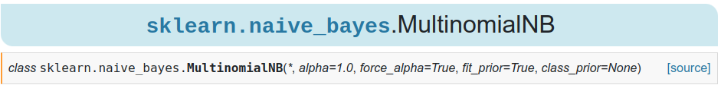
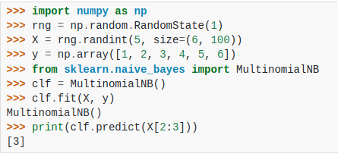
Naive Bayes with Scikit-Learn
https://scikit-learn.org/stable/modules/generated/sklearn.naive_bayes.MultinomialNB.html#sklearn-naive-bayes-multinomialnb
Instance-based and Probabilistic Models
Session 9

Slide 4
Exercises:
Notebooks on the github repository:
Notebook with examples:
notebooks/session9/examples.ipynb
Notebook with exercises:
notebooks/session9/exercises.ipynb
Unsupervised Learning - Clustering
Session 9

