Slide 1

Machine Learning
Session 9 - T
Instance-based and Probabilistic Models
Ciência de Dados Aplicada
2023/2024

Slide 2
Instance-Based Learning
Instance-based models are a class of machine learning algorithms that make predictions based on similarities between instances.
Idea: similar examples have similar labels.
What is meant by similar?
Similar means "close" / similar feature values.
Algorithm:
Given a new example X for which we want to predict the label Y;
Find the most similar training examples (closest);
Predict the label Y of X based on the labels of the most similar examples.
Instance-based and Probabilistic Models
Session 9

Slide 3
Instance-Based Learning
Questions:
How to determine similarity?
What similarity measures to use?
How does the model learn?
How many similar examples to consider?
How to resolve inconsistencies among the similar examples?
Instance-based and Probabilistic Models
Session 9

Slide 4
Instance-Based Learning
Questions:
How to determine similarity?
Similarity is determined using a similarity measure, which quantifies the closeness between instances in the feature space.
What similarity measures to use?
Common measures include Euclidean and Manhattan distances, cosine similarity, and Pearson correlation coefficient, depending on the data type and characteristics.
How does the model learn?
The model does not "learn" (lazy-learner), it stores the entire training dataset and makes predictions based on the similarities between new instances and the stored examples.
Instance-based and Probabilistic Models
Session 9

Slide 5
Instance-Based Learning
Questions:
How many similar examples to consider?
It is a parameter that needs to be tuned based on the specific characteristics of the dataset and the problem at hand.
How to resolve inconsistencies among the similar examples?
For classification problems, the predicted label is determined by majority voting.
For regression problems, the predicted label is determined by averaging (or weighted averaging) the target values of the similar examples.
Instance-based and Probabilistic Models
Session 9

Slide 6
Instance-Based Learning
Advantages:
Flexibility: Instance-based models can handle complex relationships and non-linearities in the data.
No Model Training: These models do not require an explicit training phase, making them easy to implement and update.
Computational Efficiency: While prediction time can be slow with large datasets, the training phase is typically fast since there's no explicit model training involved.
Interpretable: Predictions can often be explained by examining the closest instances in the training data.
Instance-based and Probabilistic Models
Session 9

Slide 7
Instance-Based Learning
Limitations:
Computational Complexity: Predictions can be slow, especially with large datasets, as they involve calculating distances between the new instance and all training instances.
Sensitivity to Noise: Instance-based models can be sensitive to noisy or irrelevant features in the dataset.
Memory Requirements: Storing the entire training dataset may be impractical for very large datasets.
Instance-based and Probabilistic Models
Session 9

Slide 8
Instance-Based Learning
Best Practices:
Feature Scaling: Scaling features is important to ensure that all dimensions contribute equally to the distance calculation.
Cross-Validation: Evaluate model performance using techniques like k-fold cross-validation to choose optimal hyperparameters (e.g. number of similar examples to use) and assess generalization performance.
Handling Imbalanced Data: Address class imbalances by adjusting the weighting of instances.
Instance-based and Probabilistic Models
Session 9

Slide 9
K-Nearest Neighbors (KNN)
KNN is a simple instance-based learning algorithm used for both classification and regression tasks.
In the training phase, it stores the entire training dataset;
During prediction, it computes the distance between the input data points and all training examples using a distance metric (e.g. Euclidean distance).
The algorithm identifies the K nearest neighbors to the input data points and uses their labels to make predictions. It uses majority voting for classification and averaging for regression.
Instance-based and Probabilistic Models
Session 9

Slide 10
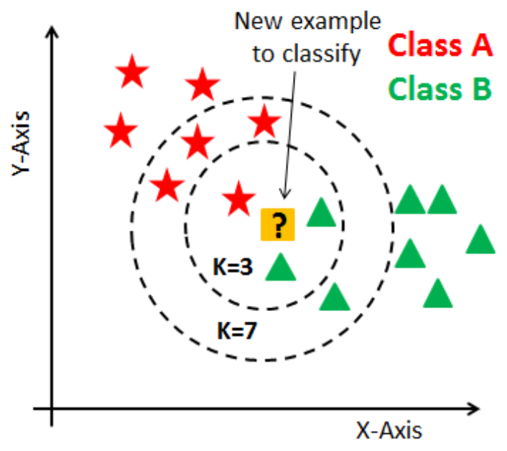


K-Nearest Neighbors (KNN)
How would you classify the new example?
With k=3?
With k=7?
Instance-based and Probabilistic Models
Session 9

Slide 11
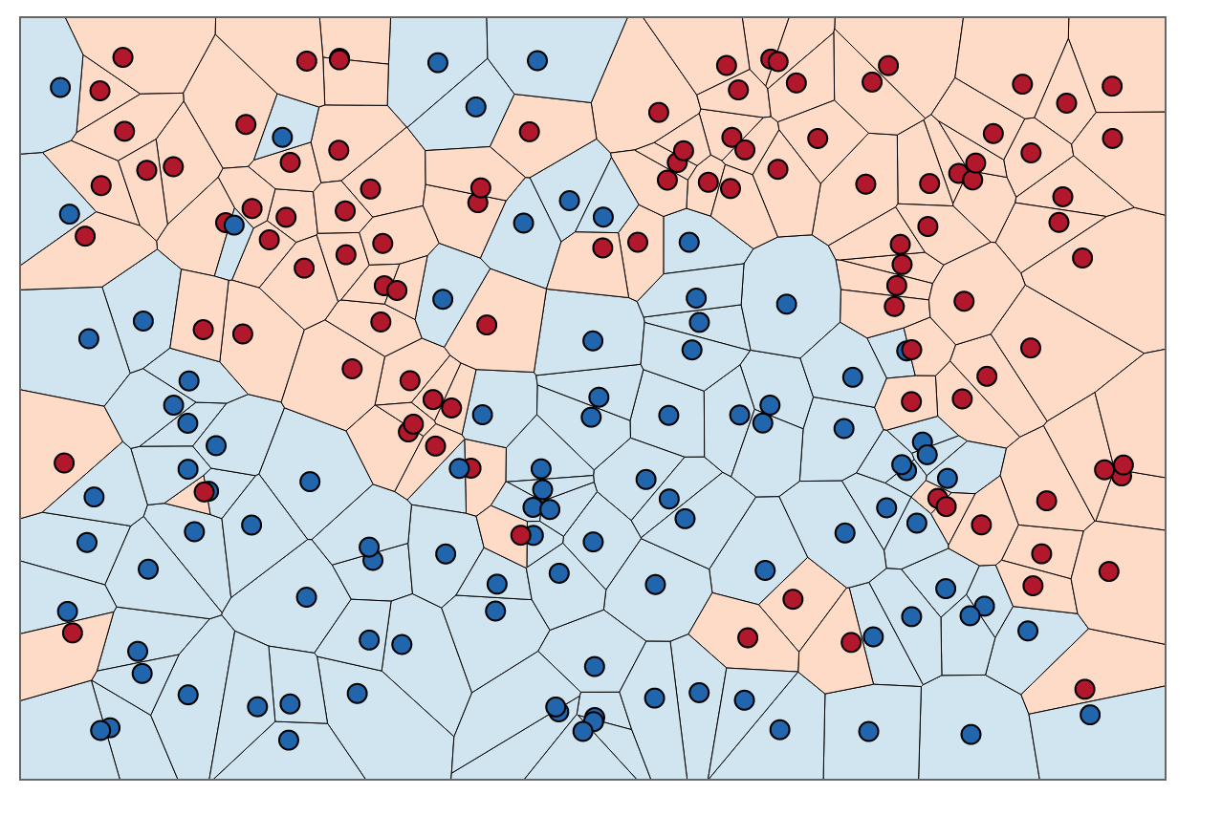
KNN – Decision Boundaries
The nearest neighbor algorithm does not directly calculate decision boundaries; however, they can be inferred from the the training data.
Voronoi diagram:
Show how the input space is divided into classes
Each line is equidistant to points of different classes
Instance-based and Probabilistic Models
Session 9

Slide 12
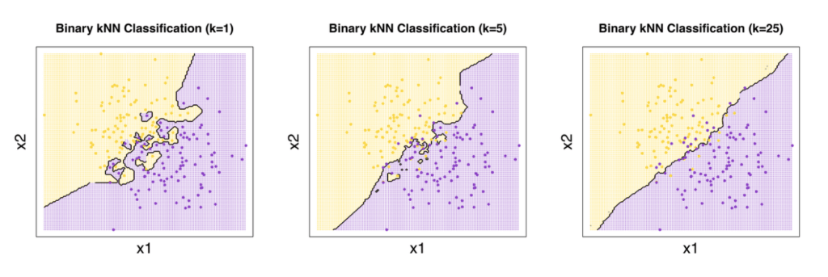
KNN – Decision Boundaries
Impact of k
Instance-based and Probabilistic Models
Session 9

Slide 13

KNN – How to Choose k?
A larger k can potentially improve performance.
However, setting k excessively large may involve considering samples that are not true neighbors, leading to decreased accuracy.
Error estimation methods (like holdout and cross-validation) can help in finding the optimal k.
It is common to use , where n is the number of training examples.
Instance-based and Probabilistic Models
Session 9

Slide 14
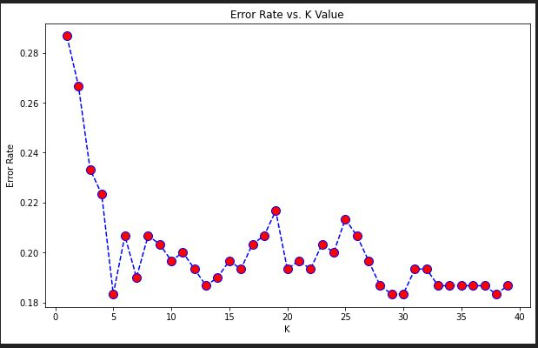
KNN – Decision Boundaries
Instance-based and Probabilistic Models
Session 9

Slide 15
Probabilistic Models
Probabilistic models are mathematical frameworks used to represent uncertainty.
These models aim to capture the underlying probability distributions of the data.
Naive Bayes is a probabilistic classifier based on Bayes' theorem. It assumes that features are conditionally independent given the class label.
Instance-based and Probabilistic Models
Session 9

Slide 16
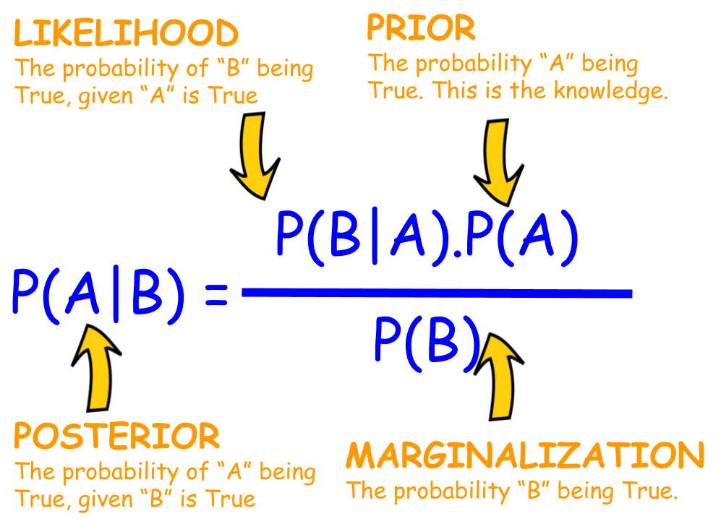
Bayes' Theorem
Instance-based and Probabilistic Models
Session 9

Slide 17
Naive-Bayes
Based on conditional probabilities (Bayes' Theorem);
It calculates the probabilities associated with the belonging of an example to each possible class;
Assumptions (which rarely occur in reality):
All features have the same importance;
Values from the various features occur independently.
Instance-based and Probabilistic Models
Session 9

Slide 18
Naive-Bayes
Types of Naive Bayes:
Multinomial Naive Bayes: Suitable for classification with discrete features.
Gaussian Naive Bayes: Assumes features follow a normal distribution.
Bernoulli Naive Bayes: Works with binary features.
Advantages:
Simplicity: Easy to understand and implement.
Efficiency: Computationally efficient, especially with high-dimensional data.
Robustness: Performs well even with small datasets and in the presence of irrelevant features.
Limitations:
Assumption of Independence: The "naive" assumption of feature independence might not hold in real-world datasets, potentially leading to inaccurate classifications.
Sensitive to Input Data Quality: Naive Bayes can be sensitive to irrelevant features or features with high correlation, which may degrade classification performance.
Instance-based and Probabilistic Models
Session 9

Slide 19
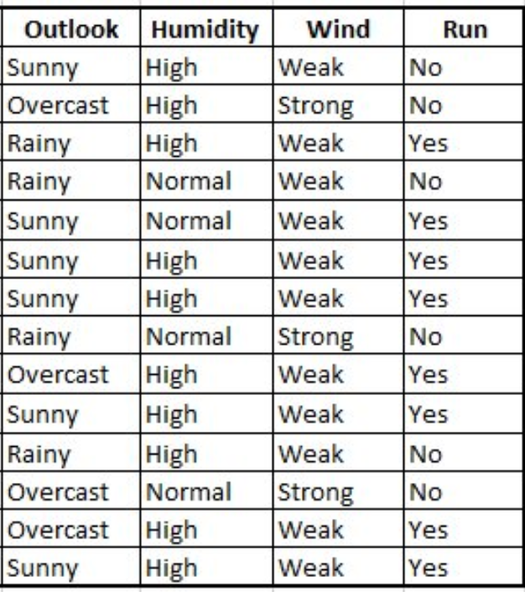
Multinomial Naive-Bayes
Step 1: Get the data
Instance-based and Probabilistic Models
Session 9

Slide 20
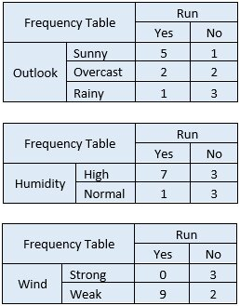
Multinomial Naive-Bayes
Step 2: Convert data to a frequency tables
Instance-based and Probabilistic Models
Session 9

Slide 21
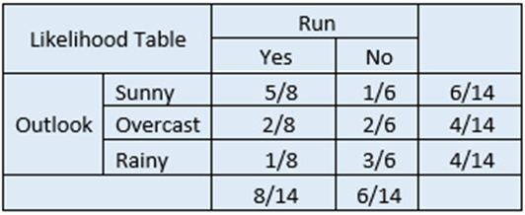
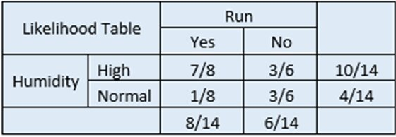
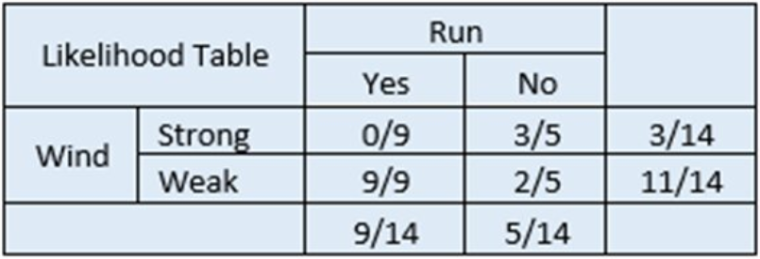
Multinomial Naive-Bayes
Step 3: Calculate the prior probability and likelihood
Instance-based and Probabilistic Models
Session 9

Slide 22
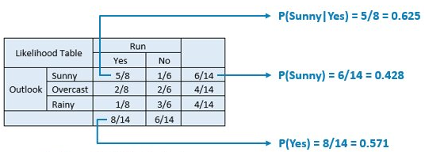
Multinomial Naive-Bayes
Step 4: Apply the Bayes' Theorem
Let’s say you want to focus on the likelihood that you go for a run given that it’s sunny outside.
P(Yes|Sunny) = P(Sunny|Yes) * P(Yes) / P(Sunny) = 0.625 * 0.571 / 0.428 = 0.834
Instance-based and Probabilistic Models
Session 9

Slide 23
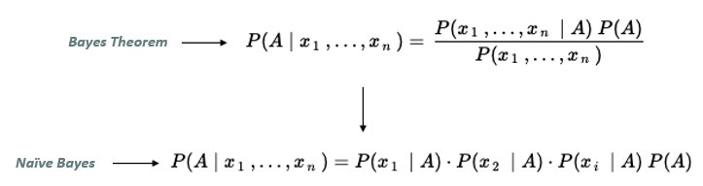
Multinomial Naive-Bayes
Caution with probabilities of 0. Generally a constant is added to all counts.
Outlook: Rainy
Humidity: Normal
Wind: Weak
Run: ?
P(Yes|Rainy, Normal, Weak) = P(Rainy|Yes)*P(Normal|Yes)*P(Weak/Yes)*P(Yes)
= 1/8 * 1/8 * 9/9 * 8/14 = 0.0089
P(No|Rainy, Normal, Weak) = P(Rainy|No)*P(Normal|No)*P(Weak/No)*P(No)
= 3/6 * 3/6 * 2/5 * 6/14 = 0.042
P(Yes) = 0.0089 / (0.0089 + 0.042) = 0.175
P(No) = 0.042/ (0.0089 + 0.042) = 0.825
We can drop the denominator from the formula while assuming feature independence
Instance-based and Probabilistic Models
Session 9

Slide 24
Multinomial Naive-Bayes
Outlook: Sunny
Humidity: High
Wind: Weak
Run: ?
Instance-based and Probabilistic Models
Session 9

Slide 25
Multinomial Naive-Bayes
Outlook: Sunny
Humidity: High
Wind: Weak
Run: ?
P(Yes|Sunny, High, Weak) = P(Sunny|Yes)*P(High|Yes)*P(Weak/Yes)*P(Yes)
= 5/8 * 7/8 * 9/9 * 8/14 = 0.3125
P(No|Sunny, High, Weak) = P(Sunny|No)*P(High|No)*P(Weak/No)*P(No)
= 1/6 * 3/6 * 2/5 * 6/14 = 0.0143
P(Yes) = 0.3125 / (0.3125 + 0.0143) = 0.956
P(No) = 0.0143 / (0.3125 + 0.0143) = 0.044
We can drop the denominator from the formula while assuming feature independence
Instance-based and Probabilistic Models
Session 9

Slide 26
Resources
Webb, G. I. (2011). Naïve Bayes. In Encyclopedia of Machine Learning (pp. 713–714). Springer US. https://doi.org/10.1007/978-0-387-30164-8_576
Kramer, O. (2013). K-Nearest Neighbors. In Dimensionality Reduction with Unsupervised Nearest Neighbors (pp. 13–23). Springer Berlin Heidelberg. https://doi.org/10.1007/978-3-642-38652-7_2
https://www.youtube.com/watch?v=HVXime0nQeI
https://www.youtube.com/watch?v=O2L2Uv9pdDA
Instance-based and Probabilistic Models
Session 9

