Slide 1

Machine Learning
Session 19 - T
Support Vector Machines – Part 3
Ciência de Dados Aplicada
2023/2024

Slide 2


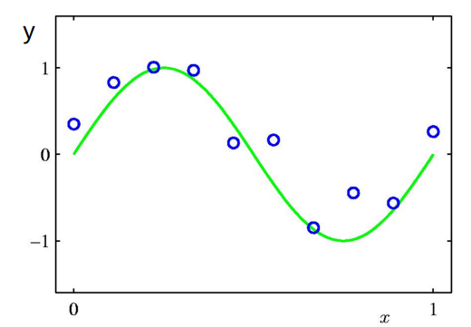
SVMs - Regression
Suppose we are given a training set of N observations
The regression problem is to estimate f(x) from the data such that
Support Vector Machines
Session 19

Slide 3
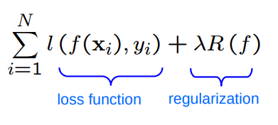
SVMs - Regression
As for classification, learning a regressor can be formulated as an optimization problem:
Minimize
There is a choice of both loss function and regularization
e.g. squared loss, "Hinge-like" loss
ridge, lasso regularization
Support Vector Machines
Session 19

Slide 4

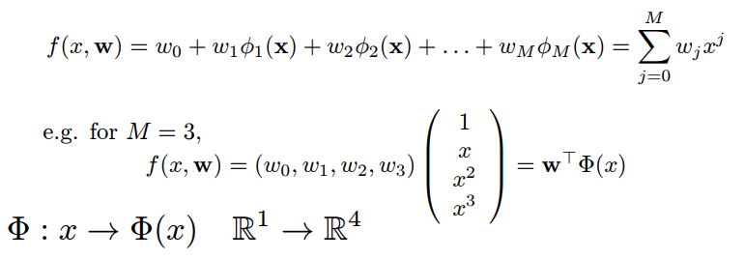
SVMs - Choice of Regression Function
Function for regression y(x, w) is a non-linear function of x, but linear in w:
For example, for , polynimial regression with
Support Vector Machines
Session 19

Slide 5
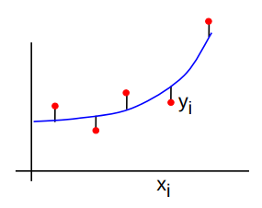
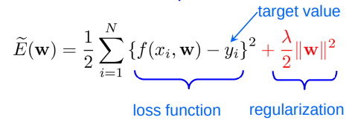

SVMs - Least Squares Ridge Regression
Cost function – squared loss:
Regression function for x:
Support Vector Machines
Session 19

Slide 6
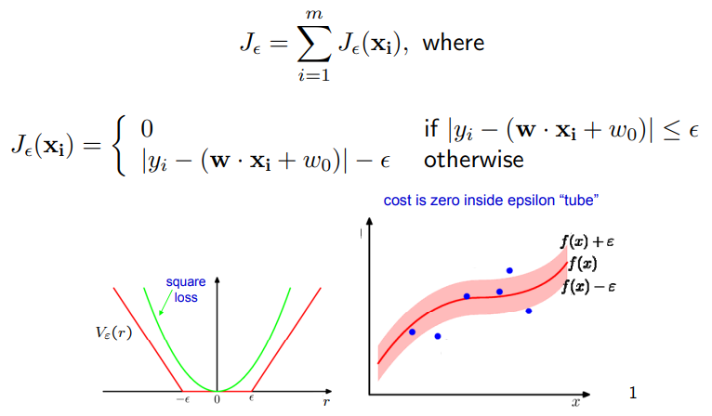
SVMs - Loss Function for Regression
To allow for misclassification in SVM regression, we can use the ε–insensitive loss:
Support Vector Machines
Session 19

Slide 7
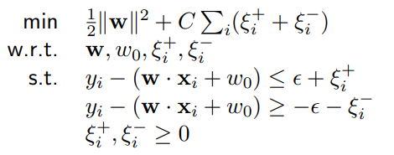
SVMs - The Optimization Problem
As before, Kernels can be used to get non-linear functions
Support Vector Machines
Session 19

Slide 8
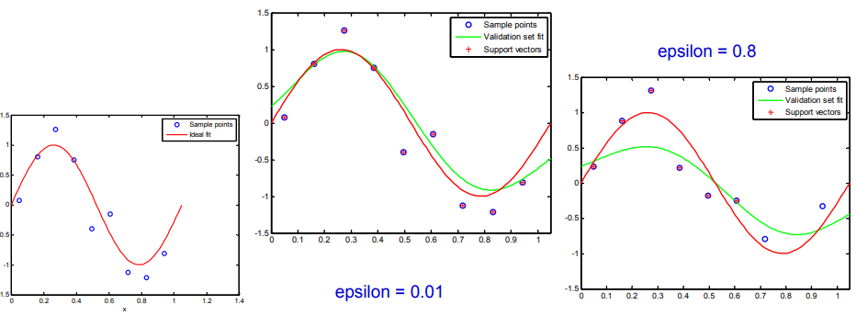
SVMs - Effect of ε
As ε increases, the function is allowed to move away from the data points, the number of support vectors decreases and the fit gets worse.
Support Vector Machines
Session 19

Slide 9
Resources
https://www.youtube.com/watch?v=kPw1IGUAoY8
https://www.researchgate.net/publication/228537532_Support_Vector_Regression
Support Vector Machines
Session 19

