Slide 1

Machine Learning
Session 21 - T
Ensemble Learning and Hyperparameter Optimization
Ciência de Dados Aplicada
2023/2024

Slide 2
Ensemble Learning
Ensemble learning aims to build high-performance predictive models by combining simpler base models;
There are different types of ensemble learning. The most common ones are:
Bagging (already covered in the Random Forests session!)
Boosting (already covered in the Random Forests session!)
Stacking
Voting
Ensemble Learning and Hyperparameter Optimization
Session 21

Slide 3
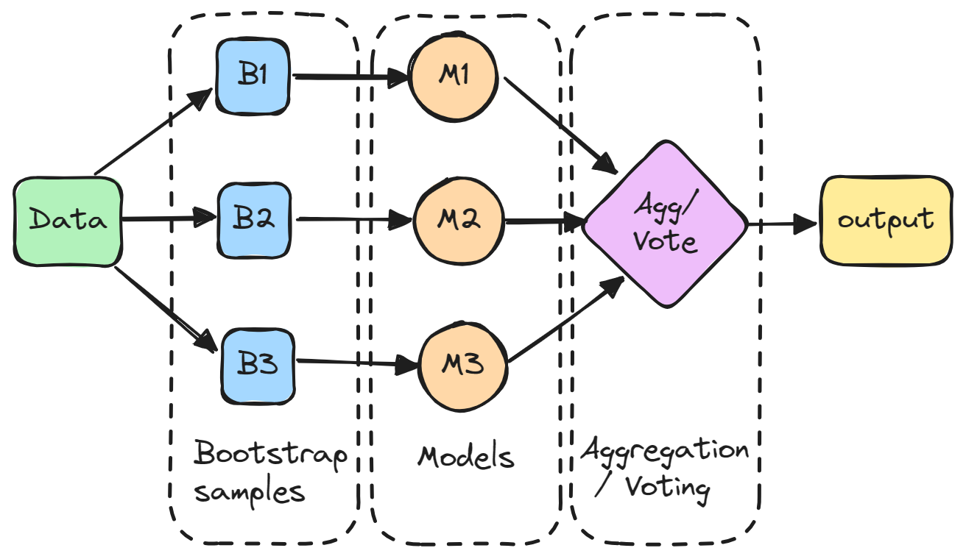
Bagging Recap
https://www.datacamp.com/tutorial/what-bagging-in-machine-learning-a-guide-with-examples
Ensemble Learning and Hyperparameter Optimization
Session 21

Slide 4
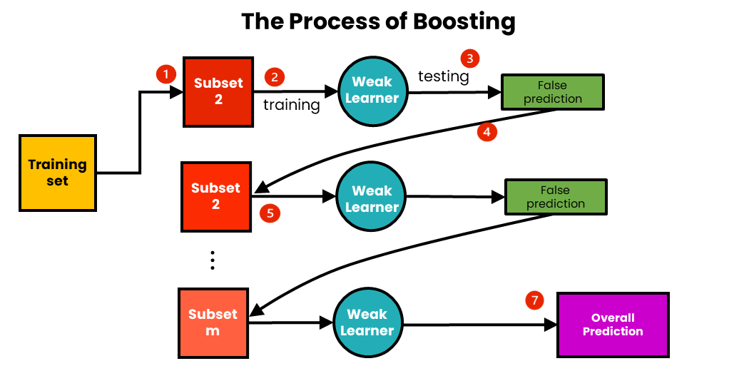
Boosting Recap
https://medium.com/@brijesh_soni/understanding-boosting-in-machine-learning-a-comprehensive-guide-bdeaa1167a6
Ensemble Learning and Hyperparameter Optimization
Session 21

Slide 5
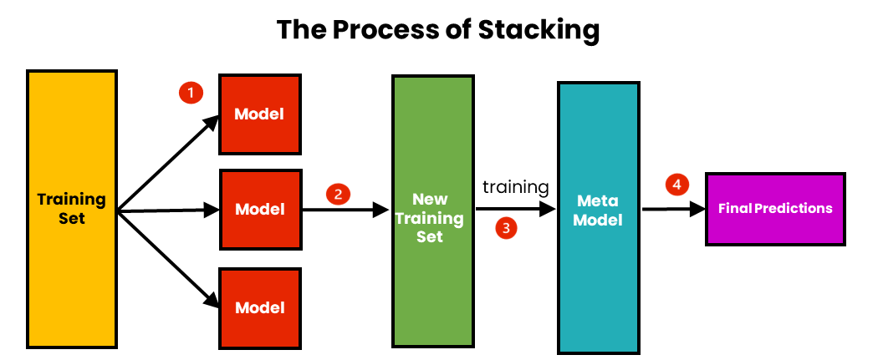
Stacking
The algorithm of stacking is:
Train N models on the training data;
Train a meta model on the predictions of the ensemble of models.
https://medium.com/@brijesh_soni/stacking-to-improve-model-performance-a-comprehensive-guide-on-ensemble-learning-in-python-9ed53c93ce28
Ensemble Learning and Hyperparameter Optimization
Session 21

Slide 6
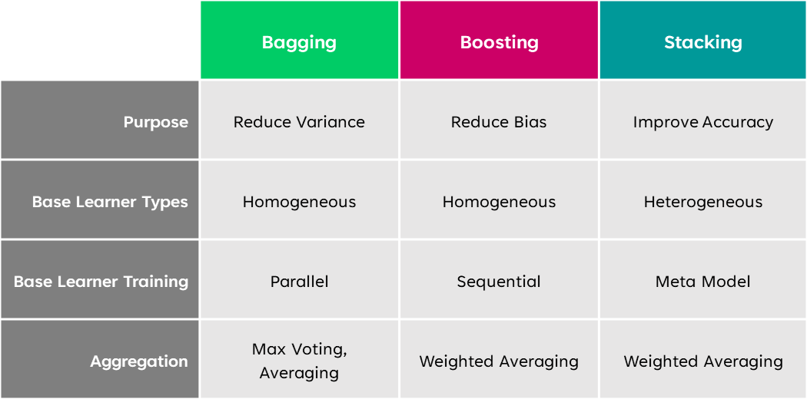
Bagging vs Boosting vs Stacking
https://www.analyticsvidhya.com/blog/2023/01/ensemble-learning-methods-bagging-boosting-and-stacking/
Ensemble Learning and Hyperparameter Optimization
Session 21

Slide 7
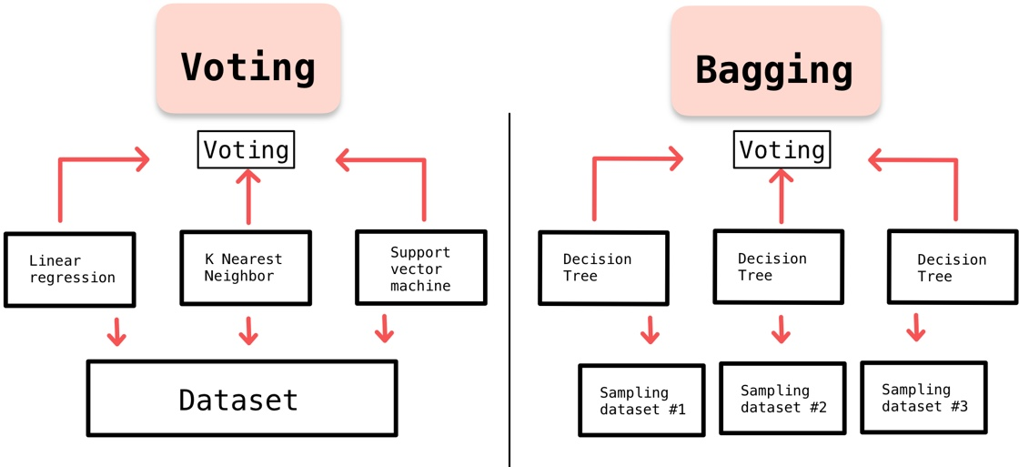
Voting Ensemble
Similar to Bagging without the bootstraping;
Uses heterogeneous models;
Majory voting for classification averaging / weighted average for regression.
https://medium.com/@chyun55555/ensemble-learning-voting-and-bagging-with-python-40de683b8ff0
Ensemble Learning and Hyperparameter Optimization
Session 21

Slide 8
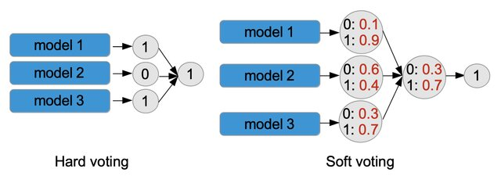
Voting Classifier
Hard vs Soft Voting
Ensemble Learning and Hyperparameter Optimization
Session 21

Slide 9
Hyperparameter Optimization
Also called metaparameter optimization;
Also called hyperparameter tunig;
Any system that chooses hyperparameters automatically;
What is the difference between the model parameters and hyperparameters?
Ensemble Learning and Hyperparameter Optimization
Session 21

Slide 10
Hyperparameter Optimization
What is a hyperparameter?
Parameters that the user need to specify in order to run a machine learning algorithm;
What are some hyperparameters for the following models?
K-nearest-neighbot (kNN);
Decision Tree;
Neural Network.
Ensemble Learning and Hyperparameter Optimization
Session 21

Slide 11
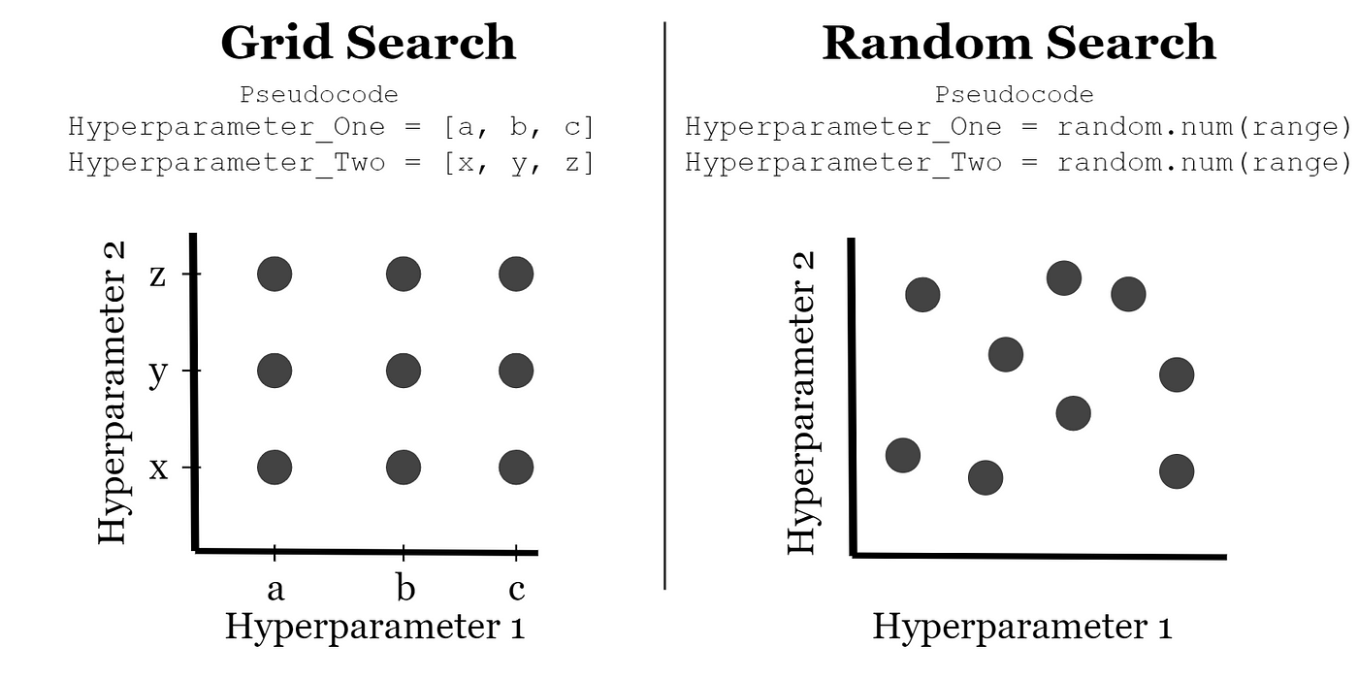
Grid Search
Define some grid of parameters you want to try;
Try all the parameter values in the grid:
By running the whole system for each combination of parameters;
Then choose the combination with the best results;
It is essentially a brute force method.
Ensemble Learning and Hyperparameter Optimization
Session 21

Slide 12
Grid Search - Disadvantages
As the number of parameters increases, the cost of grid search increases exponentially!
Why?
Still need some way to choose the grid properly:
This can be as hard as the original hyperparameter optimization;
Can't take advantage of any insight you have about the system!
Ensemble Learning and Hyperparameter Optimization
Session 21

Slide 13
Randomized Search
This is similar to grid search, but instead of trying all hyperparameter combinations try some random combinations;
This solves the curse of dimentionality:
The number of trials do not grow exponetially as the number odf dimentions increases;
Problem: we do not necessarily get anywhere near the optimal hyperparameters in a small sample.
Ensemble Learning and Hyperparameter Optimization
Session 21

Slide 14
Bayesian Hyperparameter Optimization
Bayesian approaches, in contrast to random or grid search, keep track of past evaluation results;
They form a probabilistic model mapping hyperparameters to a probability of a score on the objective function:
P(score | hyperparameters)
This is called a "surrogate" for the objective function. This surrogate is much easier to optimize than the objective function;
Ensemble Learning and Hyperparameter Optimization
Session 21

Slide 15
Bayesian Hyperparameter Optimization
Bayesian optimization steps:
1. Build a surrogate probability model of the objective function
2. Find the hyperparameters that perform best on the surrogate
3. Apply these hyperparameters to the true objective function
4. Update the surrogate model incorporating the new results
5. Repeat steps 2–4 until max iterations or time is reached
Ensemble Learning and Hyperparameter Optimization
Session 21

Slide 16
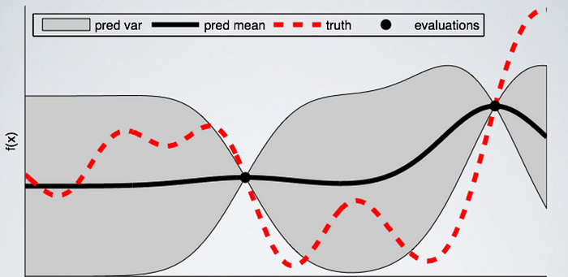
Bayesian Hyperparameter Optimization
Ensemble Learning and Hyperparameter Optimization
Session 21

Slide 17
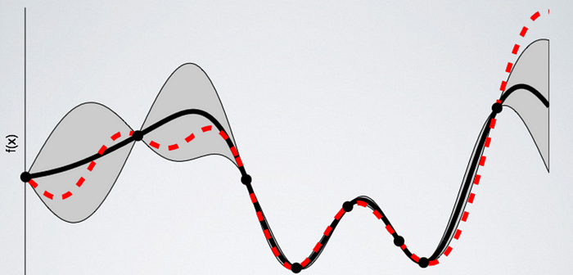
Bayesian Hyperparameter Optimization
Ensemble Learning and Hyperparameter Optimization
Session 21

Slide 18
Resources
Rokach, L. (2019). Ensemble Learning Pattern Classification using ensemble methods. World Scientific.
Bischl, B., Binder, M., Lang, M., Pielok, T., Richter, J., Coors, S., Thomas, J., Ullmann, T., Becker, M., Boulesteix, A., Deng, D., & Lindauer, M. (2023). Hyperparameter optimization: Foundations, algorithms, best practices, and open challenges. In WIREs Data Mining and Knowledge Discovery (Vol. 13, Issue 2). Wiley. https://doi.org/10.1002/widm.1484
Ensemble Learning and Hyperparameter Optimization
Session 21

