Slide 1

Machine Learning
Session 24 - T
Multi-task and Multi-label Learning
Ciência de Dados Aplicada
2023/2024

Slide 2
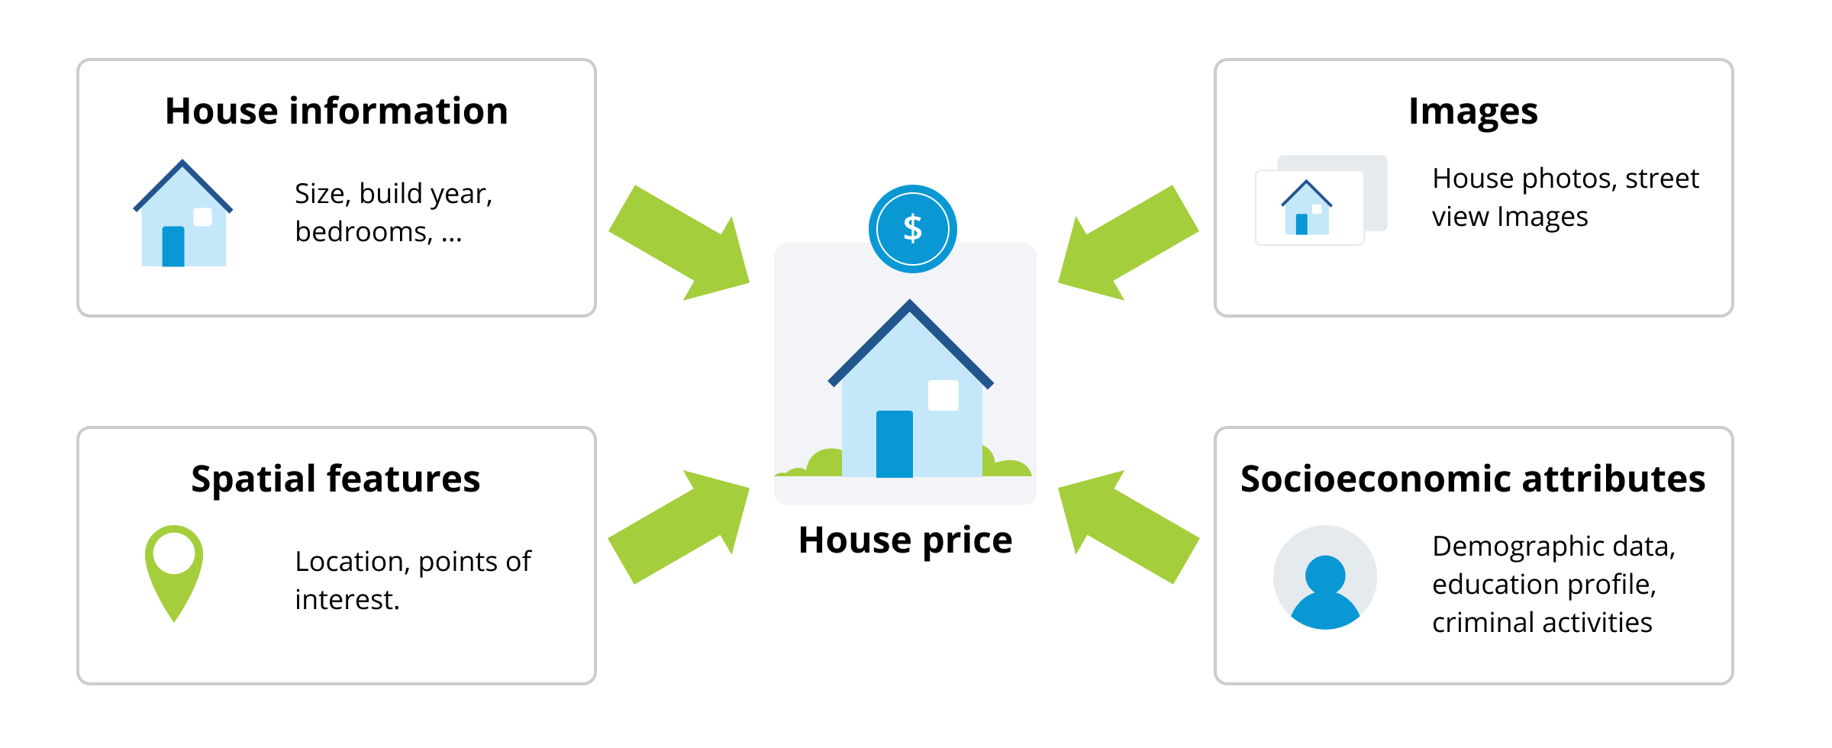
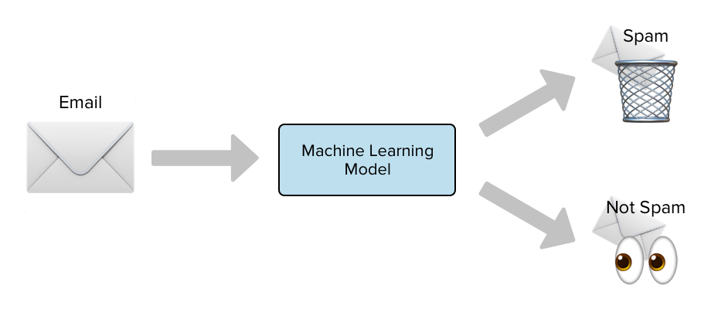
Concept of Tasks in Machine Learning
A task in machine learning is a specific objective that the model aims to achieve, such as classifying images or predicting prices;
Examples of Tasks:
Classification (e.g., image classification)
Regression (e.g., predicting house prices)
Multi-task and Multi-label Learning
Session 24

Slide 3
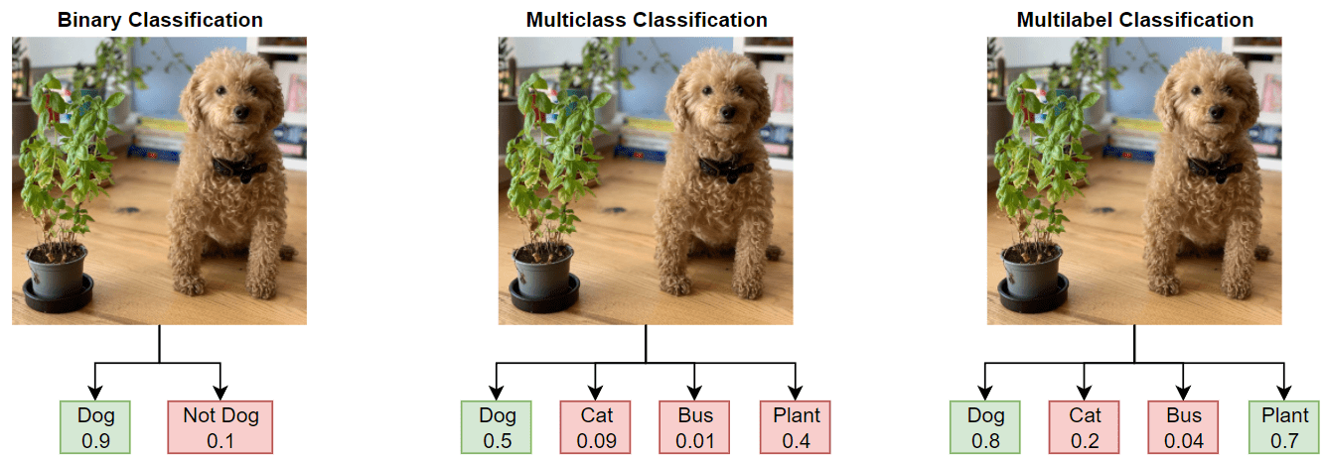
Concept of Label in Machine Learning
The output or result associated with an input, can be one or multiple per task;
Examples:
Single label: Classifying a image as a dog;
Multi-label: Classifying a image as both a dog and a plant.
Multi-task and Multi-label Learning
Session 24

Slide 4
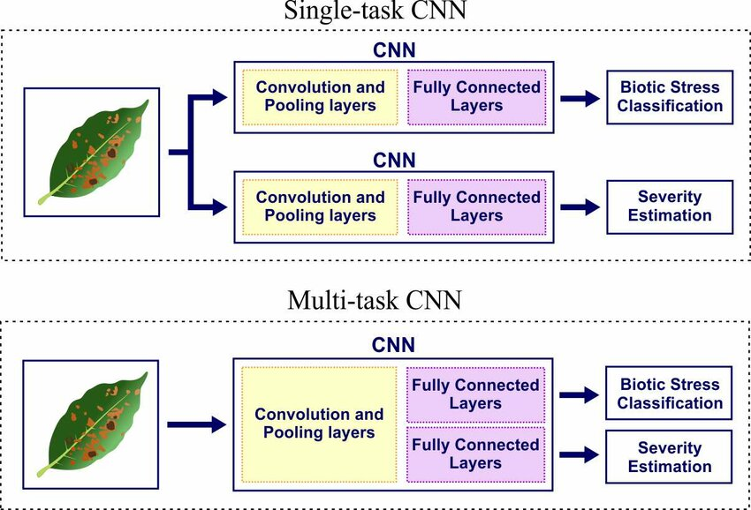
Single-Task Learning
Models are trained to perform one task at a time.
Multi-task and Multi-label Learning
Session 24

Slide 5
Multi-Task Learning
An approach where a model learns multiple tasks simultaneously, sharing representations;
Benefits:
Improved generalization;
Efficiency in learning;
Shared information among tasks.
Multi-task and Multi-label Learning
Session 24

Slide 6
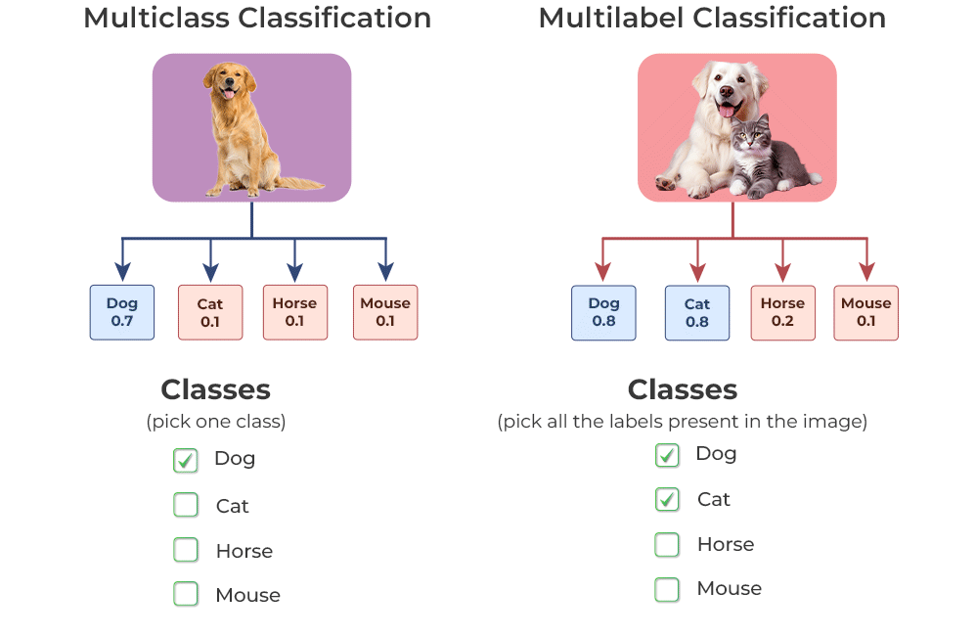
Multi-Label Learning
A single task where each instance can have multiple labels;
Benefits:
Captures more complex relationships in data;
Reflects real-world scenarios where items bolong to multiple categories.
Multi-task and Multi-label Learning
Session 24

Slide 7
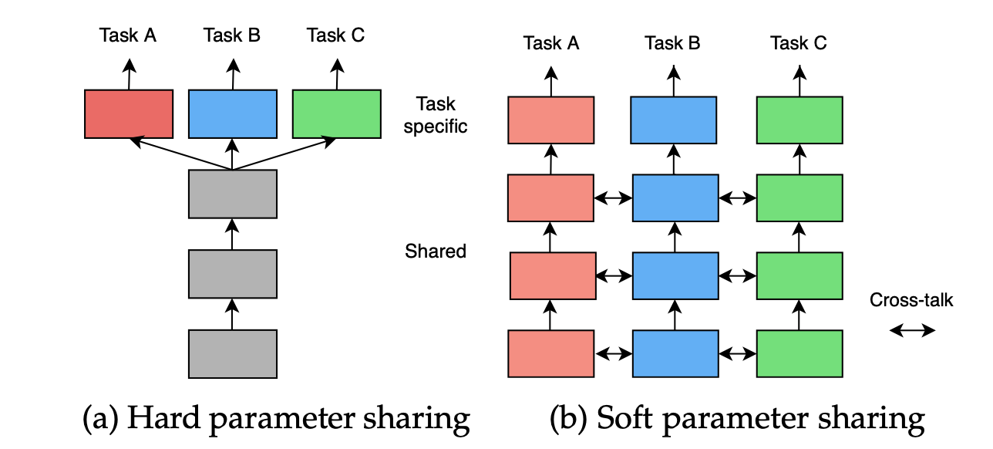
Types of Multi-Task Learning
Hard parameter sharing: shared hidden layers with task-specific output layers;
Soft parameter sharing: each task has its parameters but regularization is used to keep them similar;
Multi-task and Multi-label Learning
Session 24

Slide 8
Resources
Crawshaw, M. (2020). Multi-Task Learning with Deep Neural Networks: A Survey (Version 1). arXiv. https://doi.org/10.48550/ARXIV.2009.09796
Tarekegn, A. N., Ullah, M., & Cheikh, F. A. (2024). Deep Learning for Multi-Label Learning: A Comprehensive Survey (Version 2). arXiv. https://doi.org/10.48550/ARXIV.2401.16549
Multi-task and Multi-label Learning
Session 24

Slide 9
Machine Learning
Session 24 - T
Automated Machine Learning
Ciência de Dados Aplicada
2023/2024

Slide 10
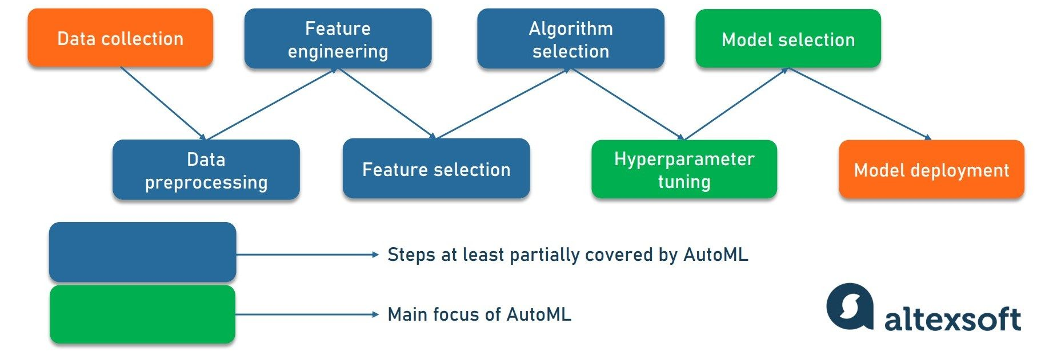
What is Automated Machine Learning (AutoML)?
AutoML is the process of automating the end-to-end process of applying machine learning to real-world problems;
Simplify and speed up the development of machine learning models, making it accessible to non-experts.
Automated Machine Learning
Session 24

Slide 11
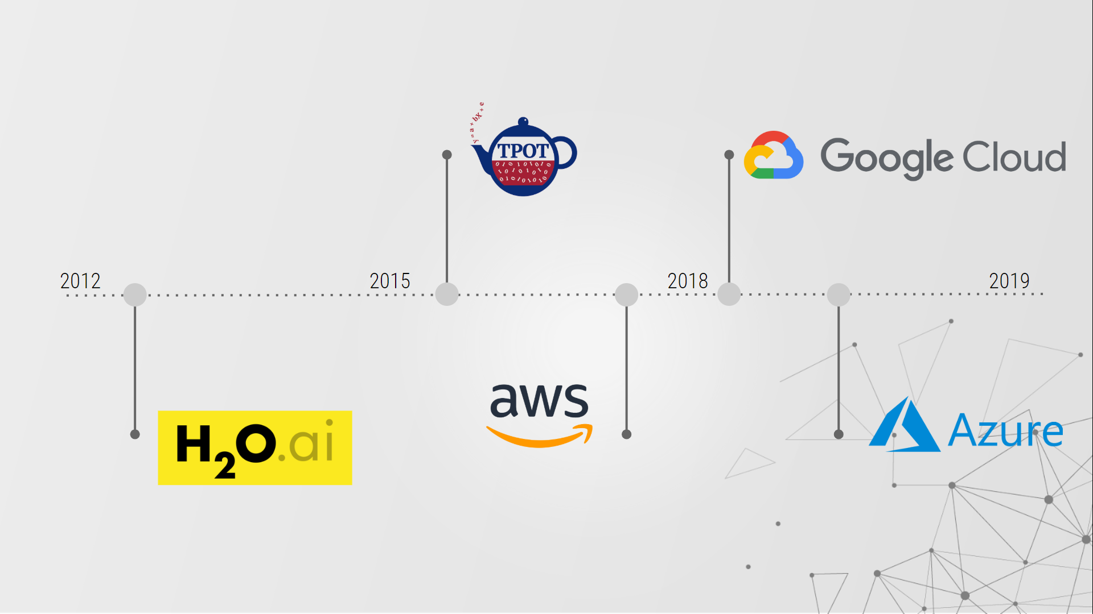
AutoML – Tools and Frameworks
Google AutoML
H2O.ai
Auto-sklearn
TPOT
Microsoft Azure AutoML
...
Automated Machine Learning
Session 24

Slide 12
Advanced Topics in AutoML
Neural Architecture Search (NAS): Automating the design of neural network architectures.
Meta-Learning: Learning how to learn; leveraging past experiences to improve future AutoML tasks.
Fairness and Ethics: Addressing bias, transparency, and ethical considerations in automated systems.
Automated Machine Learning
Session 24

Slide 13
Resources
Automated Machine Learning. (2019). In F. Hutter, L. Kotthoff, & J. Vanschoren (Eds.), The Springer Series on Challenges in Machine Learning. Springer International Publishing. https://doi.org/10.1007/978-3-030-05318-5
Automated Machine Learning
Session 24

Slide 14
Machine Learning
Session 24 - T
Model Deployment and Monitoring
Ciência de Dados Aplicada
2023/2024

Slide 15
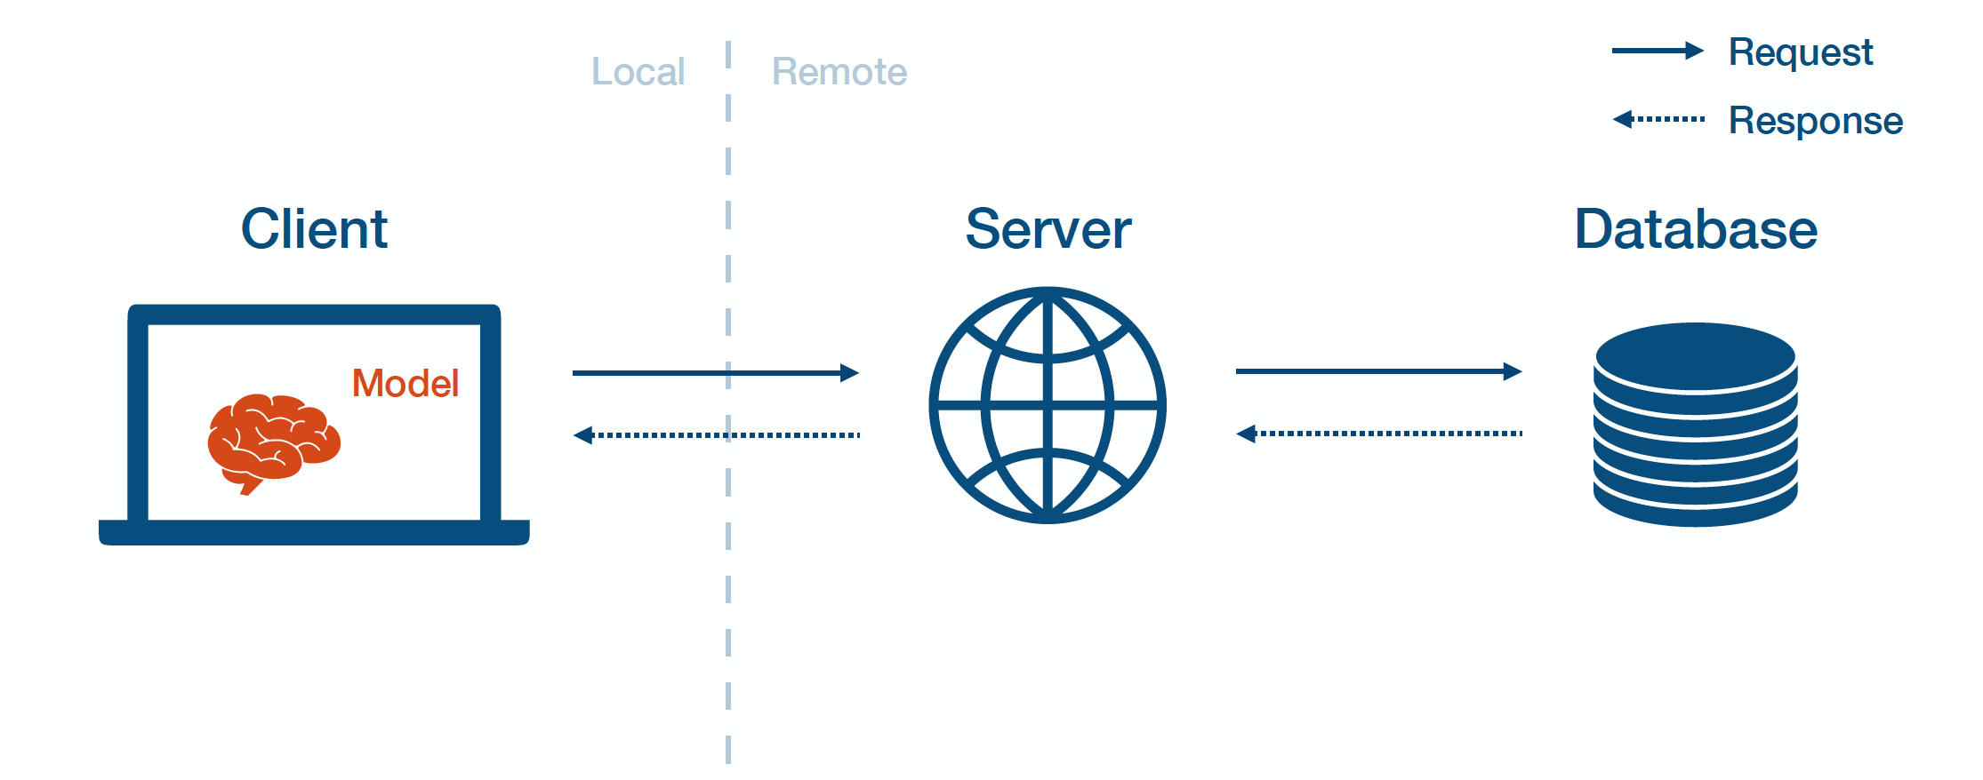
Model Deployment
Model deployment is the process of making a machine learning model available for use in production environments;
Models can be deployed in various environments, including on-premise servers, cloud platforms, and edge devices. Each scenario comes with its own challenges and considerations.
Model Deployment and Scalability
Session 24

Slide 16
Model Optimization for Deployment
Model Compression Techniques: To improve deployment efficiency, models can be compressed using techniques like quantization, pruning, and knowledge distillation, reducing their size and computational complexity.
Latency and Throughput: Optimizing models for low latency and high throughput is essential for real-time applications. Techniques such as hardware acceleration and architectural optimizations can help achieve these goals.
Model Deplyment and Scalability
Session 24

Slide 17
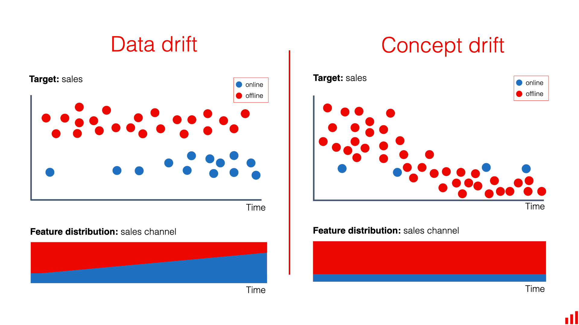
Model Monitoring
Monitoring ensures that deployed models perform as expected over time;
Track metrics like accuracy, latency, and throughput to detect performance issues;
Monitor for concept drift (changes in the data distribution) and data drift (changes in data characteristics).
Model Deplyment and Scalability
Session 24

Slide 18
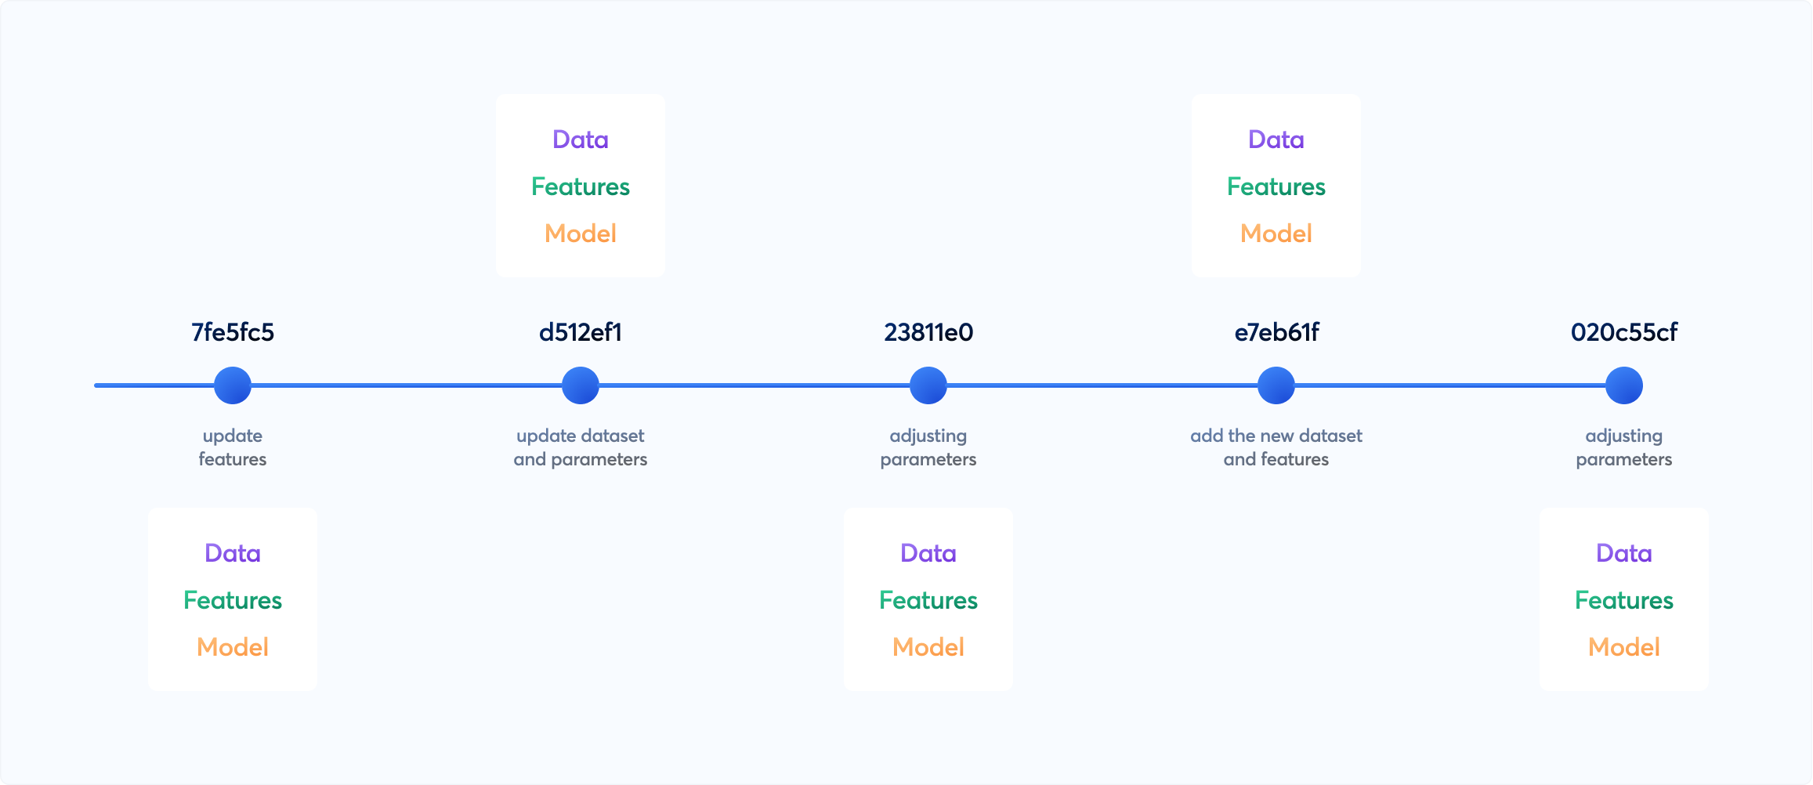
Model Versioning
Managing Versions: Keep track of different versions of deployed models to facilitate rollback if necessary.
Rollback Strategies: Plan for reverting to previous model versions in case of issues with new deployments.
Model Deplyment and Scalability
Session 24

Slide 19
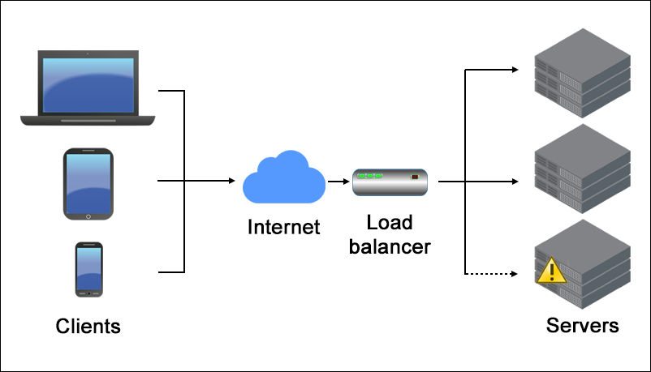
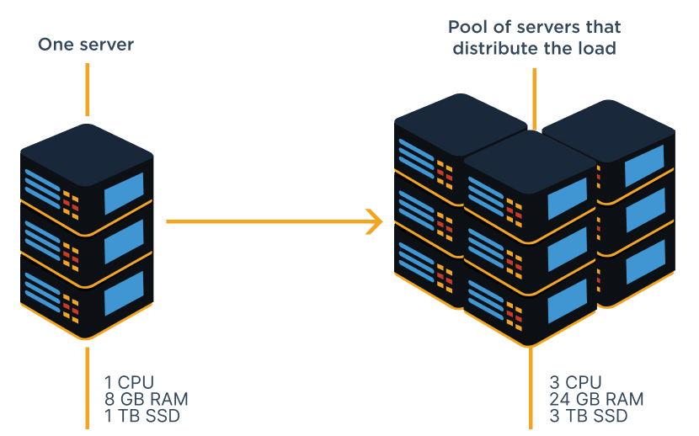
Scalability and Performance
Scaling Strategies: Implement techniques like load balancing and horizontal scaling to handle increased demand;
Performance Optimization: Optimize model inference speed and resource utilization for efficient deployment.
Model Deplyment and Scalability
Session 24

Slide 20
Resources
Islam, J. (2022). Machine Learning Model Serving Patterns and Best Practices: A definitive guide to deploying, monitoring, and providing accessibility to ML models in production. Packt Publishing.
Model Deplyment and Scalability
Session 24

