Slide 1

Machine Learning
Session 11 - PL
Linear Models
Ciência de Dados Aplicada
2023/2024

Slide 2
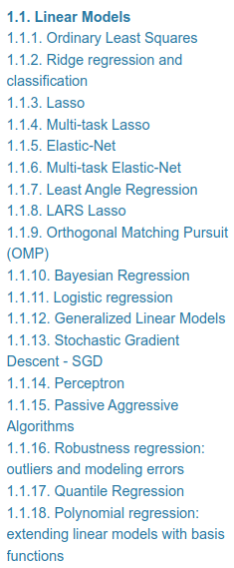
Linear Models in Scikit-Learn
https://scikit-learn.org/stable/modules/linear_model.html
Linear Models
Session 11

Slide 3
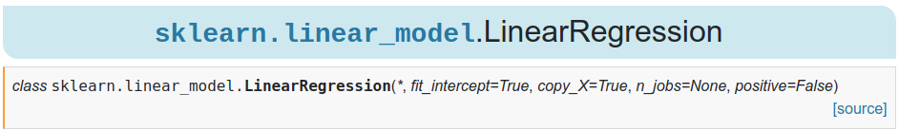
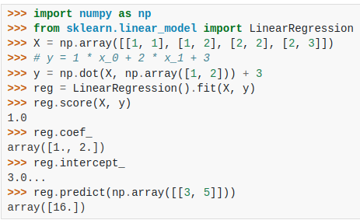
Linear Regression with Scikit-Learn
https://scikit-learn.org/stable/modules/generated/sklearn.linear_model.LinearRegression.html#sklearn-linear-model-linearregression
Linear Models
Session 11

Slide 4
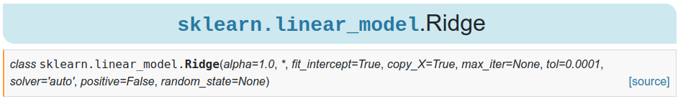
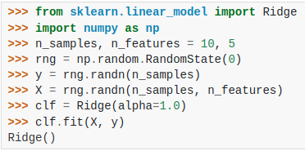
Ridge Regression with Scikit-Learn
https://scikit-learn.org/stable/modules/generated/sklearn.linear_model.Ridge.html#sklearn-linear-model-ridge
Linear Models
Session 11

Slide 5
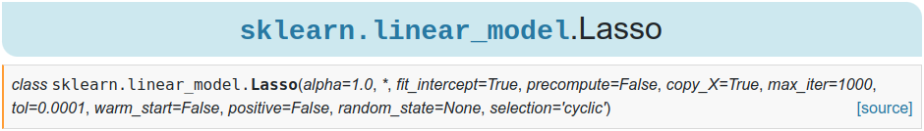
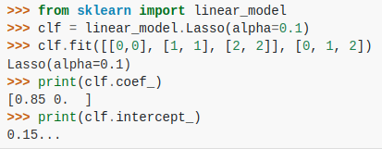
Lasso Regression with Scikit-Learn
https://scikit-learn.org/stable/modules/generated/sklearn.linear_model.Lasso.html#sklearn-linear-model-lasso
Linear Models
Session 11

Slide 6
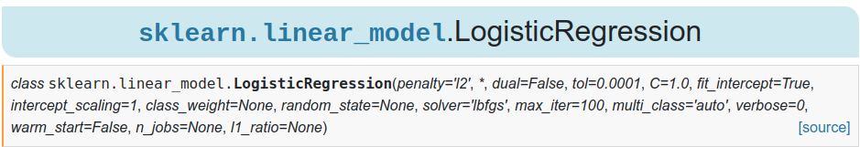
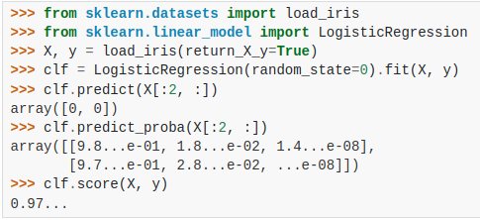
Logistic Regression with Scikit-Learn
https://scikit-learn.org/stable/modules/generated/sklearn.linear_model.LogisticRegression.html#sklearn-linear-model-logisticregression
Linear Models
Session 11

Slide 7
Exercises:
Notebooks on the github repository:
Notebook with examples:
notebooks/session11/examples.ipynb
Notebook with exercises:
notebooks/session11/exercises.ipynb
Linear Models
Session 11

