Slide 1

Machine Learning
Session 11 - T
Linear Models
Ciência de Dados Aplicada
2023/2024

Slide 2
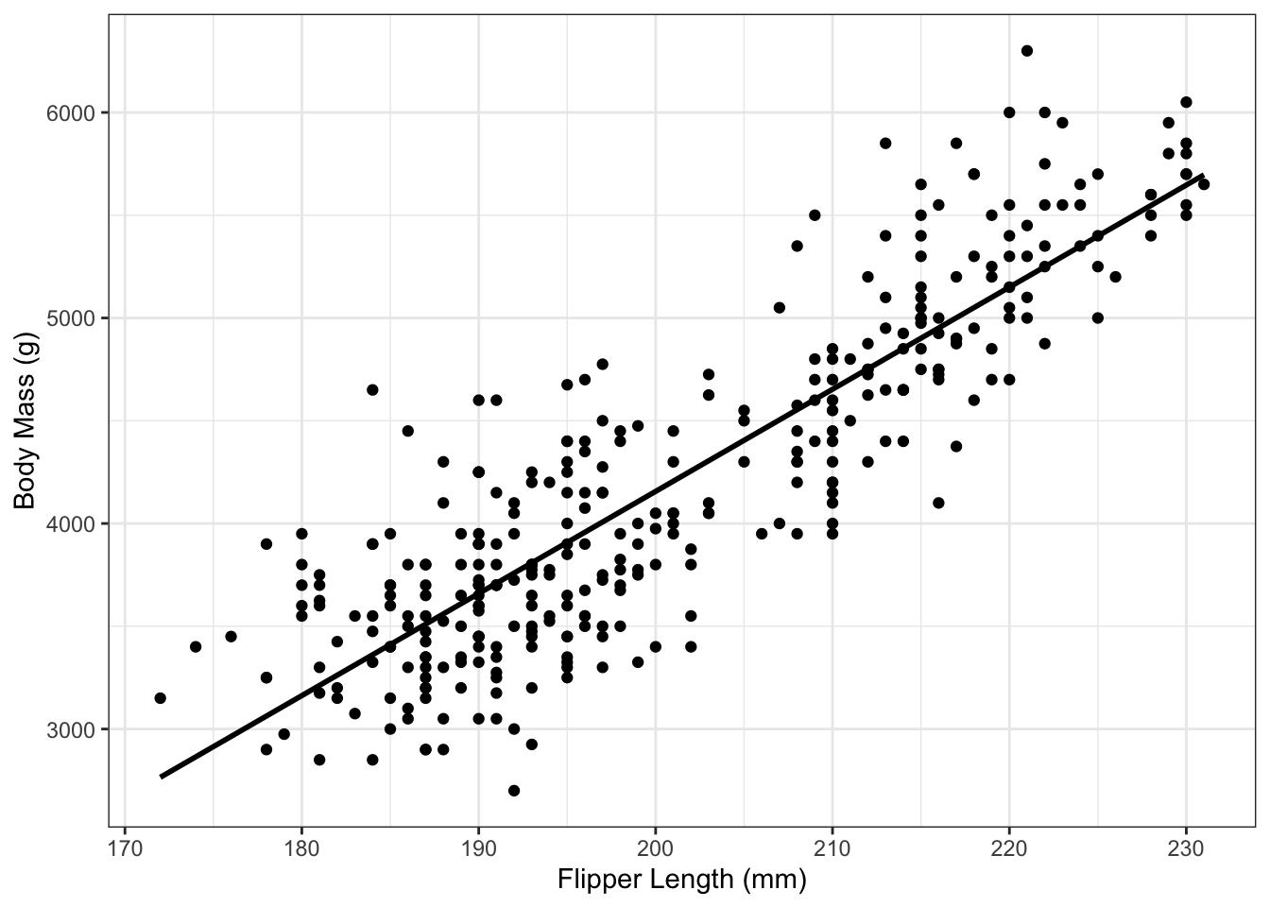
Linear Models
Linear models are a class of machine learning algorithms that model the relationship between dependent and independent variables using linear approximation.
Key features:
Easy to interpret and implement;
Efficient for large datasets due to linear computation;
Can be used for both regression and classification tasks.
Linear Models
Session 11

Slide 3

Linear Models
A linear model is a mathematical representation of a relationship between a dependent variable and one or more independent variables , where this relationship is assumed to be linear.
Mathematically, it is represented as:
Where is the dependent variable,
are the independent variables,
is the intercept,
are the coefficients and
is the error term.
Linear Models
Session 11

Slide 4
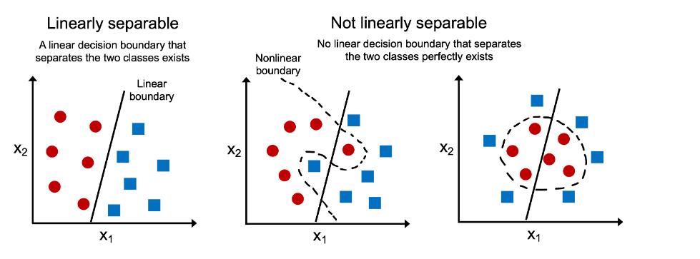
Non linear problems
Limitation: In non linear cases, linear models may be insufficient...
https://vitalflux.com/how-know-data-linear-non-linear/
Linear Models
Session 11

Slide 5
Linear Models
Simple Linear Regression
Multiple Linear Regression
Polynomial Regression
Logistic Regression
Linear Models
Session 11

Slide 6

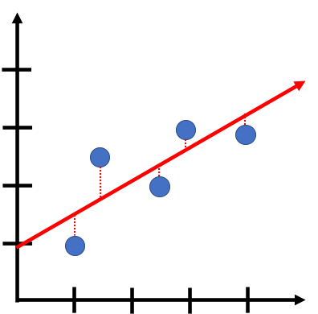
Simple Linear Regression
Simple linear regression models the relationship between one independent variable and a dependent variable. The equation for a simple linear regression is:
The intercept – a constant
Independent Variable
Error component
Dependent Variable
Coefficient\Weight\Slope - controls how much x contributes to y
Linear Models
Session 11

Slide 7
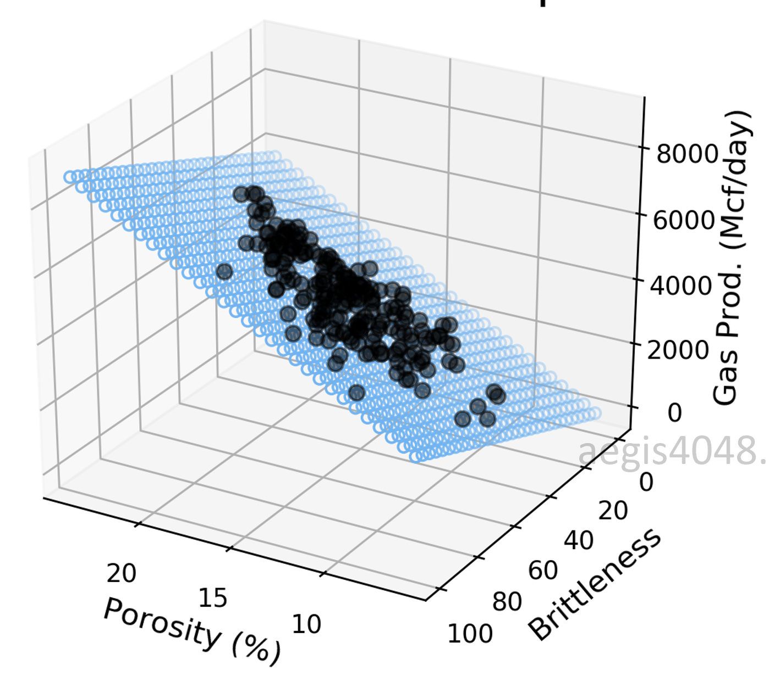
Multiple Linear Regression
Multiple linear regression extends simple linear regression to incorporate multiple independent variables. The equation for multiple linear regression is:
The intercept – a constant
Independent Variables
Error component
Dependent Variable
Coefficients\Weights\Slopes - controls how much each x contributes to y
Linear Models
Session 11

Slide 8
Polynomial Regression
Polynomial regression involves fitting a curve to the data by introducing polynomial terms. The equation for polynomial regression is:
NOTE: The term "linear" in linear regression refers to the linearity of the coefficients, not necessarily the linearity of the relationship between the independent and dependent variables.
In polynomial regression, although the relationship between the variables is modeled using a polynomial function (which can appear curved), the estimation process is still linear with respect to the coefficients.
Polynomial terms

Slide 9
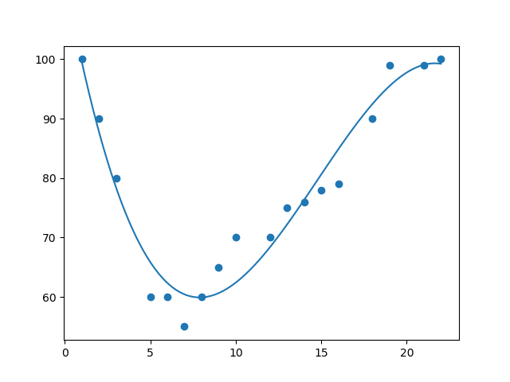
Polynomial Regression
Polynomial terms

Slide 10
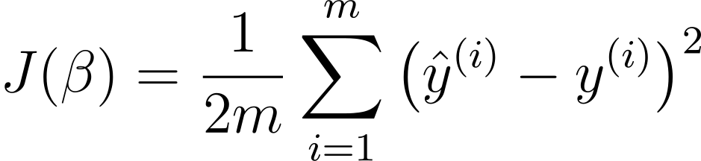
Linear Regression
Cost function: Mean Squared Error (MSE)
J is a function of the model coefficients
Objective: identify the model coefficients that minimize J
Predicted value
given by:
Real value

Slide 11
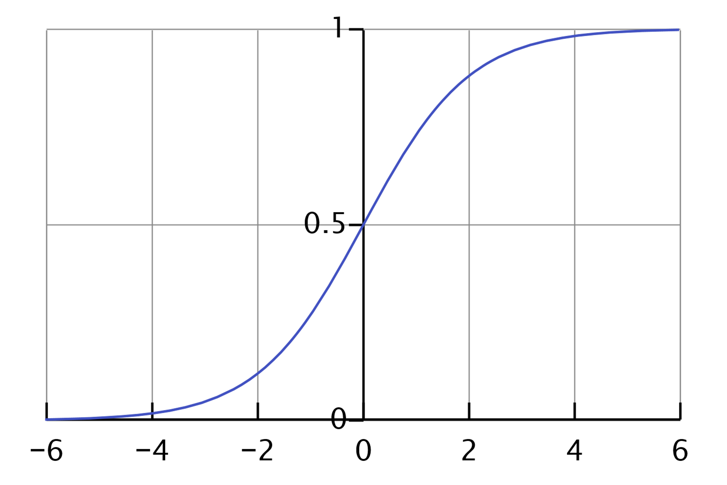
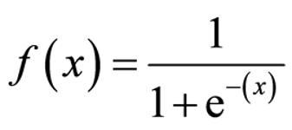
Logistic Regression
Logistic regression is used for binary classification.
It models the probability of the outcome belonging to a particular class using the logistic function, also known as the sigmoid function.

Slide 12
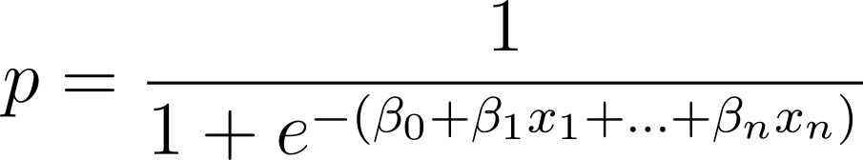
Logistic Regression
The predicted class is given by the application of the sigmoid function to the linear regression output.
It gives us the probability of y (output) being 1 for the example x.

Slide 13
Logistic Regression
Train separate "binary" models for each class;
Treat other classes as a single entity during training;
Each model estimates probability of the example belonging to a class;
Apply all models, select class with highest predicted probability.

Slide 14
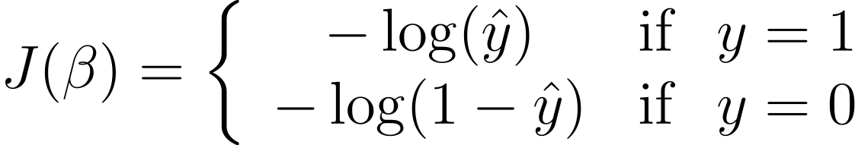
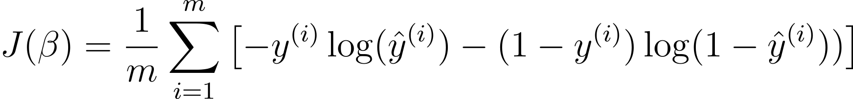
Logistic Regression - Multiclass
Cost function:
Example:
If true label y=1, prediction=0.8, error = -log(0.8) , low error
If true label y=0, prediction=0.8, error = -log(1 – 0.8), high error
Combining we get:
Predicted value
given by:
Real value

Slide 15

Parameter estimation (coefficients )
Parameter estimation consists in determining the values of the coefficients ( ) that best fit the model to the training data.
This process involves finding the optimal parameters that minimize a predefined loss function.
For linear models, we can use the analytical method of Least Squares, minimizing the error function MSE.
Other iterative methods like gradient descent can also be used.

Slide 16
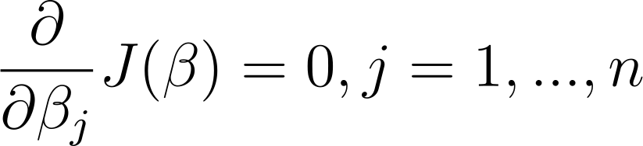

Linear Regression - Least Squares
Algebric method that involves solving a system of equations:
Matrix version
X consists of the training data
+
first column with ones (to account for beta zero)

Slide 17
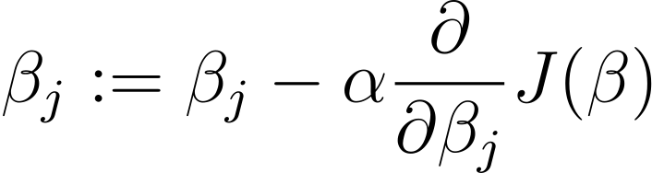
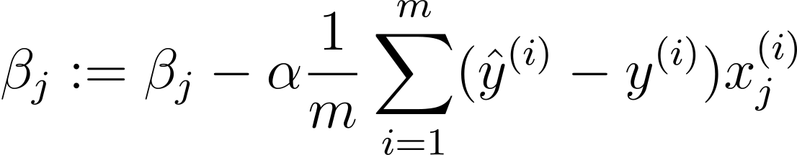
Linear\Logistic Regression – Gradient Descent
Can only be applied if the cost function is differentiable.
Iterative method that at each iteration changes the values of the parameters in order to minimize the error between predictions and true labels.
Learning rate
The parameters are updated following:

Slide 18
Least Squares vs Gradient Descent
Least squares ensures optimal solution. Gradient descent may not converge / get stuck in local optima.
Least squares is suitable and computationally efficient for small datasets;
Gradient descent is suitable for large datasets and can handle non-linear models.

Slide 19
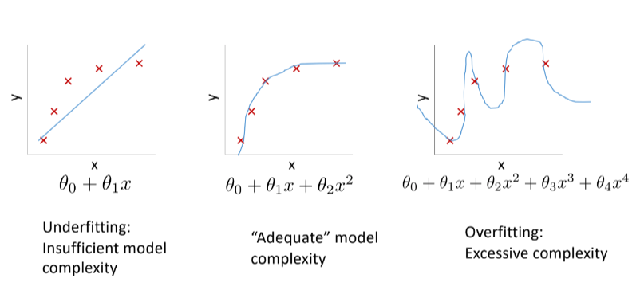
Overfitting in Linear Models

Slide 20
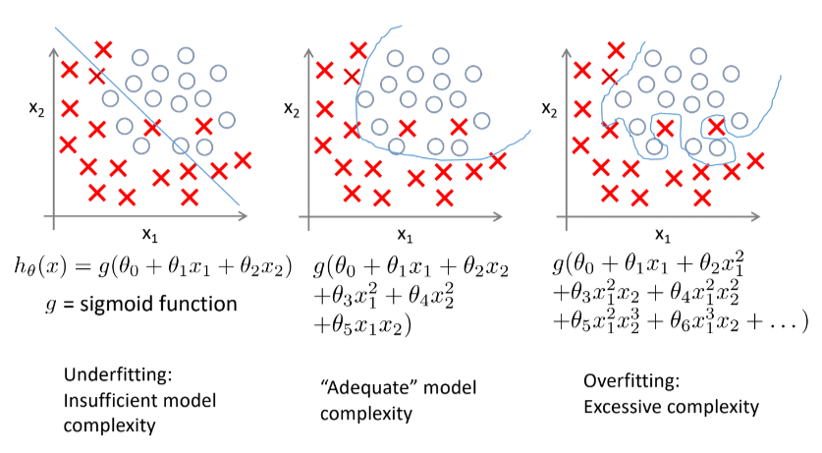
Overfitting in Linear Models

Slide 21
Overfitting in Linear Models
In linear models, like simple linear regression or multiple linear regression, overfitting doesn't involve complex curves or surfaces bending to fit the data.
Instead, it involves the linear model capturing noise or irrelevant fluctuations in the data, which can happen when the model is too complex relative to the amount of data available.
Linear models are prone to overfit in the cases where the number of features is high (specially when compared with the number of examples).

Slide 22
Overcoming Overfitting in Linear Models
Reduce the number of features (coefficients) - feature selection.
Regularization: Keep all features by try to reduce the magnitude of parameter values.
L1 regularization (Lasso regression)
L2 regularization (Ridge refression)
Elastic nets – use both L1 and L2 regularization

Slide 23
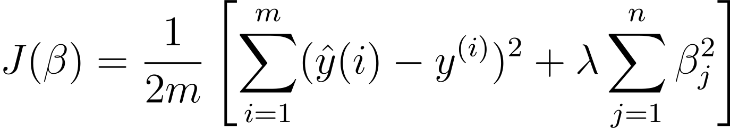
Ridge Regression
Idea: penalize high values of the parameters (coefficients) in the cost function.
Regularization parameter:
- higher values penalize parameter values more
If too high: risk of underfitting
If too low: risk of overfitting

Slide 24
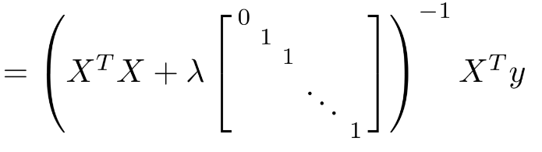
Ridge Regression
Analytical method (least squares):

Slide 25
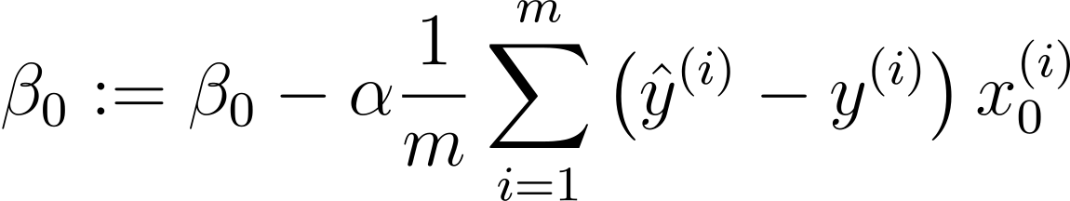
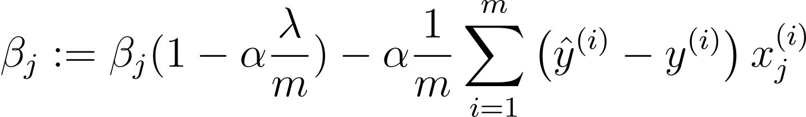
Ridge Regression
Gradient descent:
Term imposed by regularization
It is always < 1

Slide 26
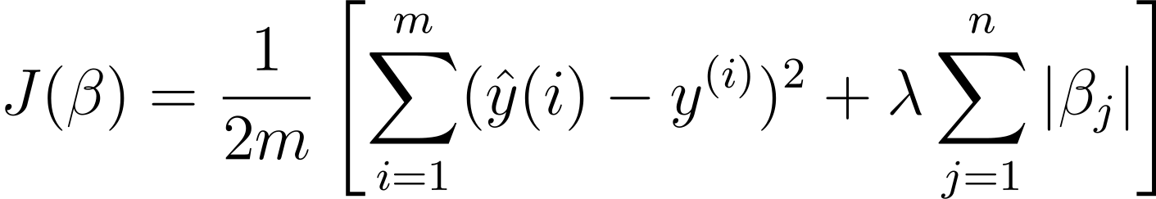
Lasso Regression
Idea: instead of penalizing the squared values of the parameters it penalizes the absolute values
Everything else remains the same!
Ridge
Lasso

Slide 27
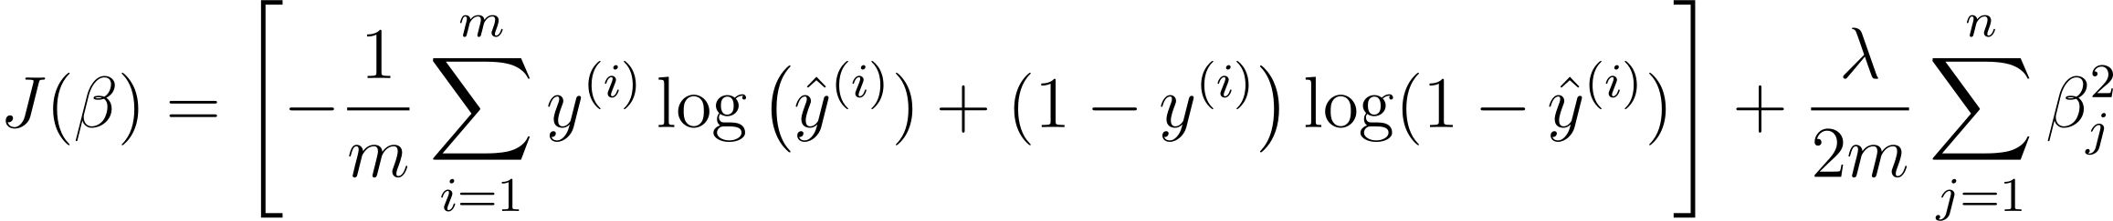
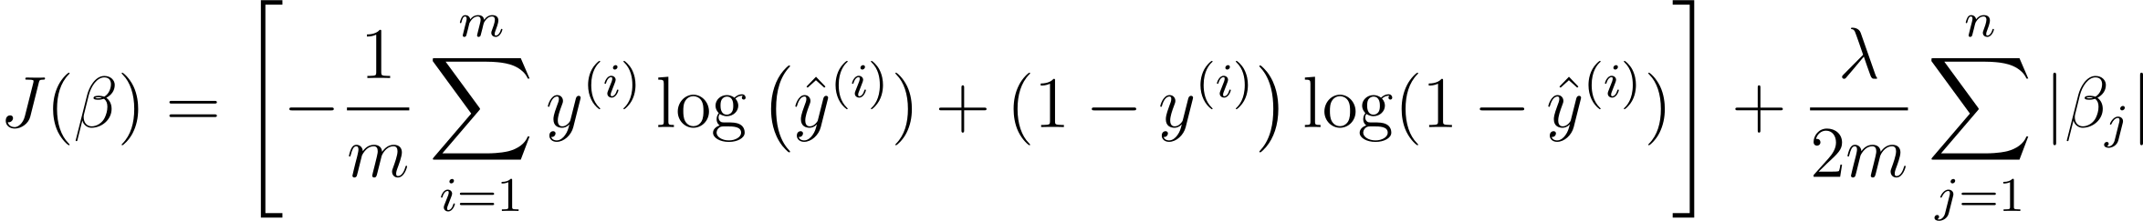
Regularization in Logistic Regression
Cost function:
Ridge Regularization
Lasso Regularization

Slide 28
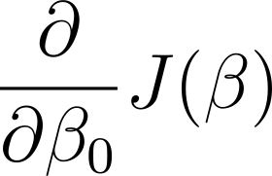
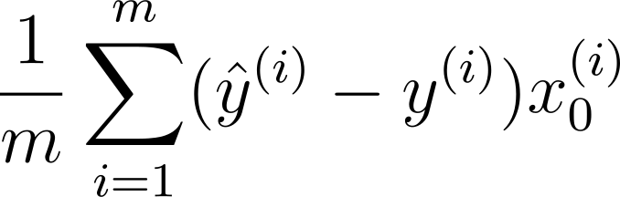
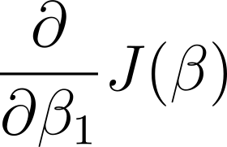
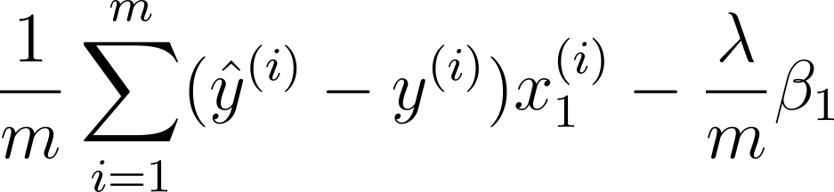
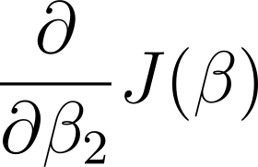
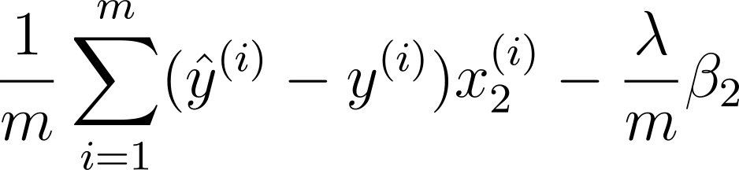
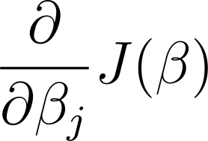
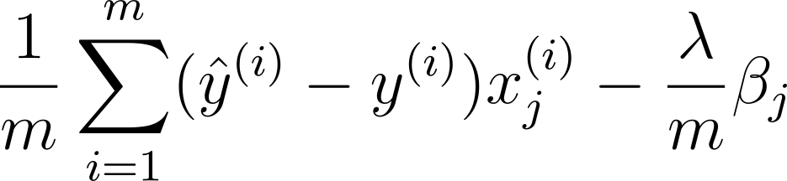
Regularization in Logistic Regression
Gradient
(…)
(…)

Slide 29
Resources
Rencher, A. C., & Schaalje, G. B. (2007). Linear Models in Statistics (2nd ed.) [PDF]. doi:10.1002/9780470192610
Pillonetto, G., Chen, T., Chiuso, A., De Nicolao, G., & Ljung, L. (2022). Regularization of Linear Regression Models. In Regularized System Identification (pp. 33–93). Springer International Publishing. https://doi.org/10.1007/978-3-030-95860-2_3
Tran-Dinh, Q., & van Dijk, M. (2022). Gradient Descent-Type Methods: Background and Simple Unified Convergence Analysis (Version 1). arXiv. https://doi.org/10.48550/ARXIV.2212.09413

