Slide 1

Machine Learning
Session 22 - PL
Data Imbalance in Machine Learning
Ciência de Dados Aplicada
2023/2024

Slide 2
Balance Data with imbalanced-learn
Imbalanced-learn (imported as imblearn) is an open source, MIT-licensed library relying on scikit-learn (imported as sklearn) and provides tools when dealing with classification with imbalanced classes.
Installation:
pip install imbalanced-learn
OR
conda install -c conda-forge imbalanced-learn
Data Imbalance in Machine Learning
Session 22

Slide 3
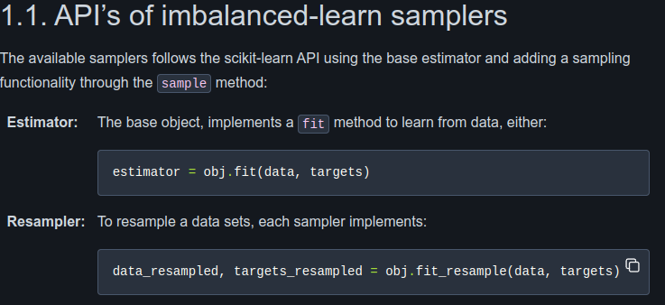
Balance Data with imbalanced-learn
Data Imbalance in Machine Learning
Session 22

Slide 4
Exercises:
Notebooks on the github repository:
Notebook with examples and exercises:
notebooks/session_22/examples.ipynb
notebooks/session_22/exercises.ipynb
Data Imbalance in Machine Learning
Session 22

