Slide 1

Machine Learning
Session 22 - T
Data Imbalance in Machine Learning
Ciência de Dados Aplicada
2023/2024

Slide 2
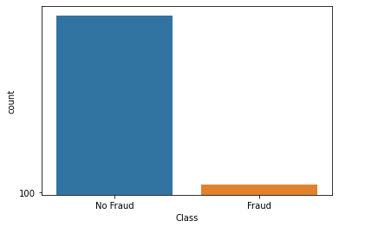
Data Imbalance
Common issue in machine learning where class distribution in a dataset is highly skewed;
One class significantly outnumbers the others;
Real-world scenarios:
Fraud detection;
Medical diagnosis;
Text classification;
Imafe recognition;
Data Imbalance in Machine Learning
Session 22

Slide 3
Data Imbalance
Consequences of data imbalance:
Data imbalance can have a huge impact on model performance;
Poor generalization for the minority class.
Why?
Machine learning models are typically designed to optimize overall accuracy, which means they tend to favor the majority class.
Data Imbalance in Machine Learning
Session 22

Slide 4
Data Imbalance
Model Performance on Imbalanced Datasets:
High accuracy rate, but ineffective at minority class identification and classification;
Practical Implications:
In applications like fraud detection or medical diagnosis, may lead to:
Undetected fraudulent transactions
Missed critical diagnoses
Adressing data imbalance:
Rebalance dataset;
Adjust the model learning process;
Use specialized evaluation metrics for imbalanced data performance.
Data Imbalance in Machine Learning
Session 22

Slide 5
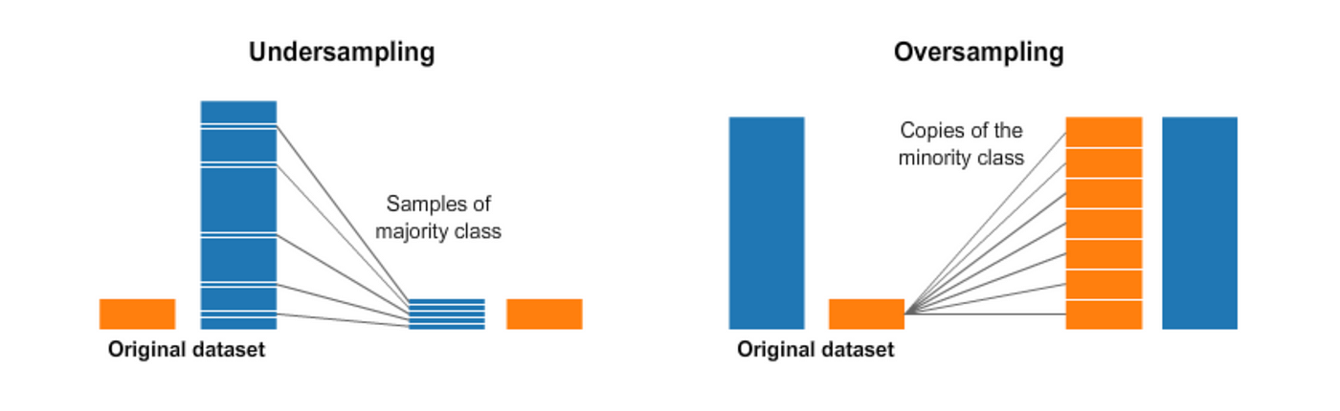
Approaches to Adress Data Imbalance
Data-level methods:
Oversampling;
Undersampling;
Combined over and undersampling.
Data Imbalance in Machine Learning
Session 22

Slide 6
Data-Level Methods
Resampling techniques are a commonly used for adressing data imbalance;
They modify the data by:
Increasing the minority class samples (oversampling);
Decreasing the majority class samples (undersampling).
Data Imbalance in Machine Learning
Session 22

Slide 7
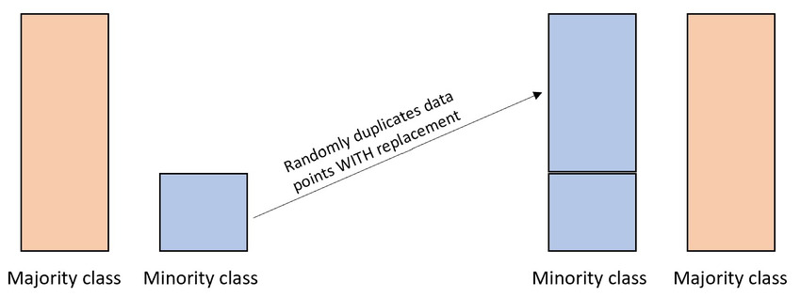
Oversampling Techniques
Random oversampling:
Increases the number of minority class samples by randomly duplicating existinting minority class samples;
Can improve model performance on minority class, but increases the risk of overfitting due to the repeated samples.
Data Imbalance in Machine Learning
Session 22

Slide 8
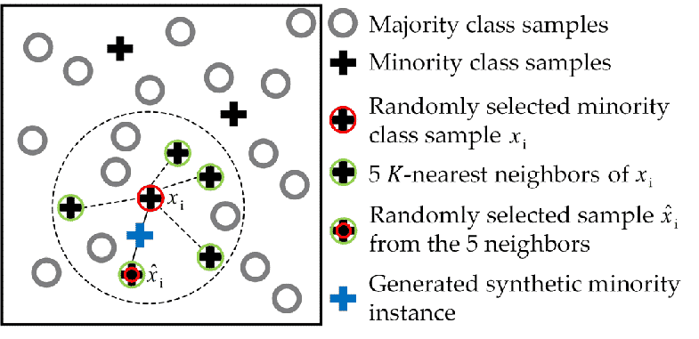
Oversampling Techniques
SMOTE (Synthetic Minority Oversampling Technique):
Increases minority class samples by creating synthetic examples (no duplicates);
New samples are generated by interpolating between existing minority class examples;
Reduces risk of overfitting (compared to random oversampling).
Data Imbalance in Machine Learning
Session 22

Slide 9
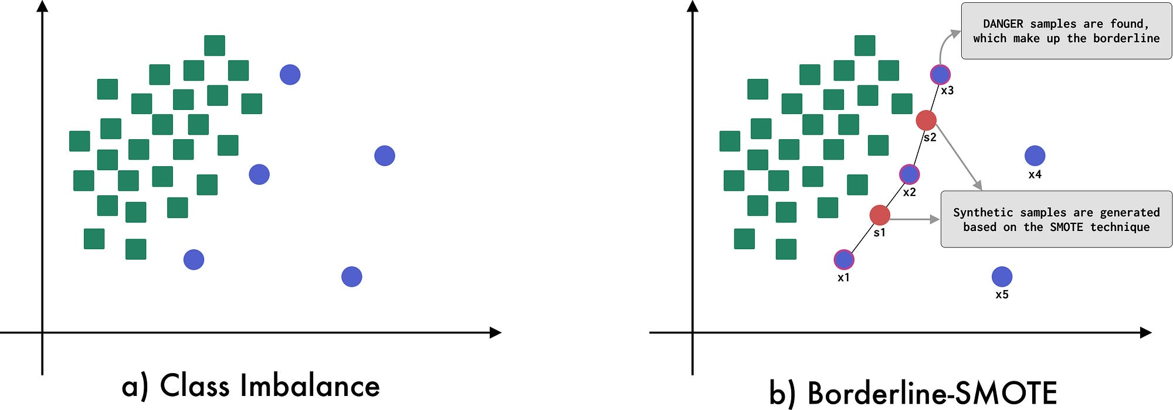
Oversampling Techniques
SMOTE variations:
SMOTEN:
SMOTE for nominal (categorical) data.
SMOTENC:
SMOTE for nominal and continuous data.
Borderline-SMOTE:
Focus on samples near the decision boundary;
Aims to improve classification of
difficult, borderline cases.
Data Imbalance in Machine Learning
Session 22

Slide 10
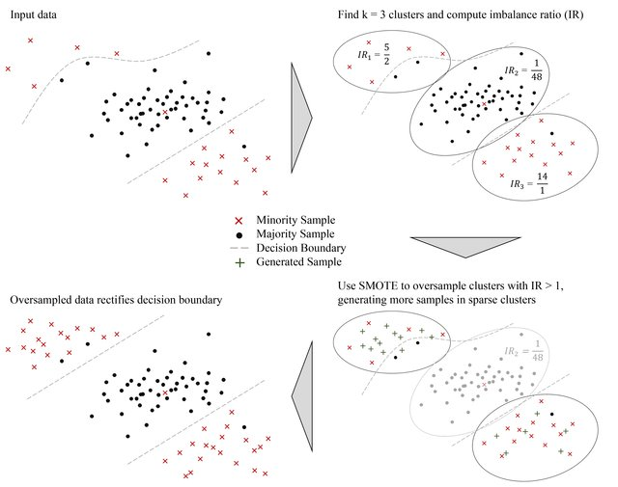
Oversampling Techniques
SMOTE variations:
Kmeans-SMOTE:
Combines k-means with SMOTE;
Clusters the dataset into K clusters using K-Means;
Applies SMOTE within each cluster to generate synthetic minority class samples;
Aims to create more diverse and representative synthetic samples.
Data Imbalance in Machine Learning
Session 22

Slide 11
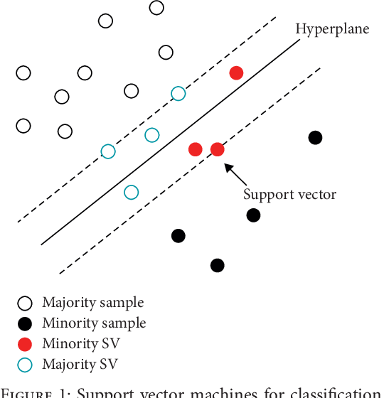
Oversampling Techniques
SMOTE variations:
svm-SMOTE:
Combines SVMs with SMOTE;
Uses SVM to identify the decision boundary between classes;
Generates synthetic minority class samples near the SVM decision boundary;
Focuses on difficult-to-classify samples.
Data Imbalance in Machine Learning
Session 22

Slide 12
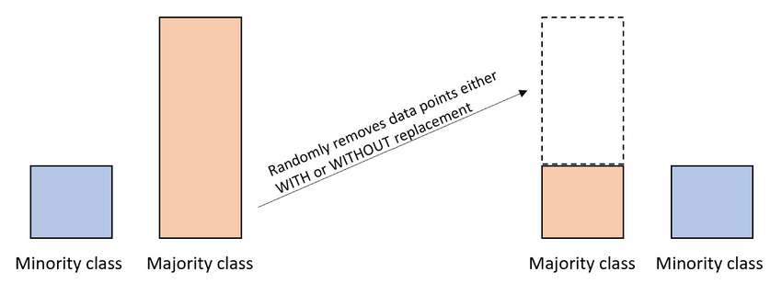
Undersampling Techniques
Random undersampling:
Balances data by randomly removing samples from the majority class;
Simple and quick;
Risk of losing important information from the data.
Data Imbalance in Machine Learning
Session 22

Slide 13
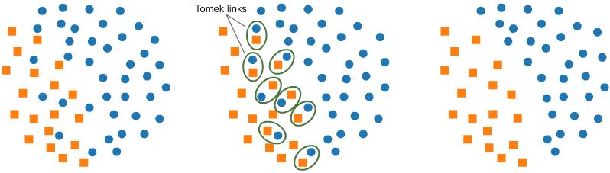
Undersampling Techniques
Tomek Links:
Identifies and removes Tomek links, which are pairs of nearest neighbors from different classes;
Aims to remove borderline examples to clarify class boundaries;
Helps to reduce class overlap and improve classifier performance.
Data Imbalance in Machine Learning
Session 22

Slide 14
Undersampling Techniques
Cluster Centroids Undersampling:
Replaces majority class with cluster centroids;
Aims to retain important information while reducing majority class size;
Balances class distribution and minimizes information loss.
Condensed Nearest Neighbor Undersampling:
Undersampling technique based on nearest neighbor classification;
Iteratively selects samples that correctly classify others;
Retains representative samples while removing redundant ones;
Helps reduce dataset size while preserving classification accuracy.
Data Imbalance in Machine Learning
Session 22

Slide 15
Undersampling Techniques
Others:
Edited Nearest Neighbours
AllKNN
NearMiss
One Sided Selection
Etc...
Data Imbalance in Machine Learning
Session 22

Slide 16
Combining Under and Oversampling Techniques
Using both under and oversampling may help mitigate the drawbacks of each technique while leveraging their advantages.
SMOTEENN - SMOTE with Edited Nearest Neighbors (ENN):
Generates synthetic minority class samples (SMOTE) and removes majority class examples misclassified by a KNN classifier (Edited Nearest Neighbors).
SMOTETomek- SMOTE with Tomek Links:
Generates synthetic minority class samples (SMOTE) and removes Tomek links.
Data Imbalance in Machine Learning
Session 22

Slide 17
Approaches to Adress Data Imbalance
Algorithm-level techniques:
Some models can inherently better deal with class imbalance (e.g. RandomForests, AdaBoost, etc.);
Building ensembles of multiple models;
Data Imbalance in Machine Learning
Session 22

Slide 18
Approaches to Adress Data Imbalance
Algorithm-level techniques:
Some models can inherently better deal with class imbalance (e.g. RandomForests, AdaBoost, etc.);
Building ensembles of multiple models;
Assigning different misclassification costs to classes can encourage the model to focus on the minority class;
Threshold adjustment to control the trade-off between precision and recall.
Evaluation metrics:
When working with imblanced data, it is important to use appropriate evaluation metrics (e.g. imbalanced accuracy, precision, recall, f1-score, AUC-ROC, Matthew's correlation coefficient).
Data Imbalance in Machine Learning
Session 22

Slide 19
Resources
He, H., & Ma, Y. (2013). Imbalanced Learning: Foundations, algorithms, and applications (H. He & Y. Ma, Eds.; 1st ed.). Wiley-IEEE Press.
Fernández, A., García, S., Galar, M., Prati, R. C., Krawczyk, B., & Herrera, F. (2018). Learning from imbalanced data sets (1st ed.). Springer.
https://imbalanced-learn.org/stable/
Data Imbalance in Machine Learning
Session 22

