Slide 1

Machine Learning
Session 12 - T
Tree-Based Models – Part 1
Ciência de Dados Aplicada
2023/2024

Slide 2
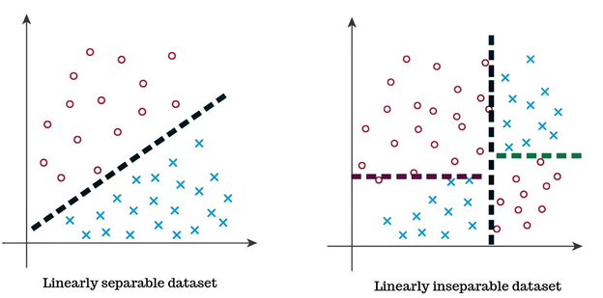
Feature Space
Linearly separable data – the feature space can be well separated by a line or hyperplane;
Linearly inseparable data – the feature space cannot be effectively divided by a single line or hyperplane.
Note that the classes are still well separated in the feature space, but the decision boundaries cannot be described by single linear equations.
Tree-Based Models
Session 12

Slide 3
Feature Space
Although linear models with linear boundaries offer intuitive interpretation, interpreting nonlinear decision boundaries presents challenges.
Therefore, there is a need to build models that:
allow complex decision boundaries;
are easy to interpret.
Tree-Based Models
Session 12

Slide 4

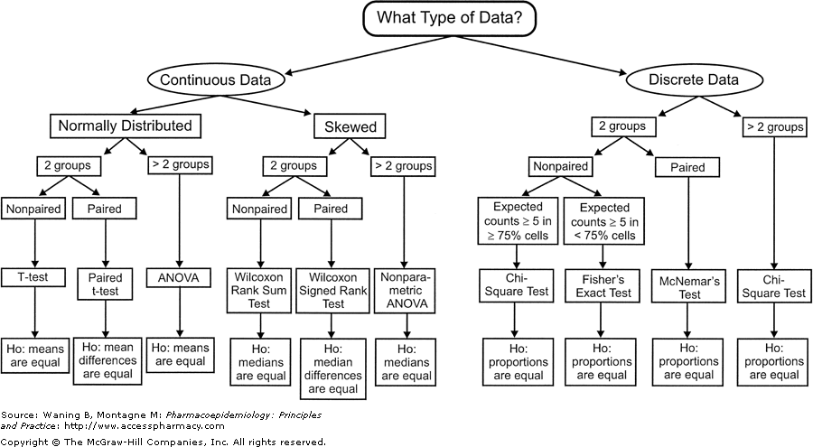
Interpretable Models
People from diverse backgrounds have historically relied on interpretable models to distinguish between various classes of objects and phenomena.
Tree-Based Models
Session 12

Slide 5
Tree-Based Models
Flow charts like in the previous examples can be formulated as mathematical models (graphs) for classification and regression.
These models are:
Interpretable by humans;
Have complex decision boundaries;
The decision boundaries are a combination of linear boundaries that are mathematically simple to describe.
Tree-Based Models
Session 12

Slide 6
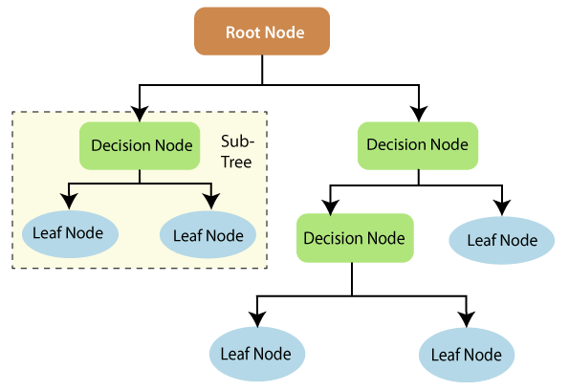
Decision Trees
Mathematically, a decision tree can be defined as a directed acyclic graph, comprising:
Nodes: Represent decision points or conditions.
Edges: Connect nodes and represent the outcomes of decisions.
Root Node: The initial decision point, representing the entire dataset.
Decision Nodes: Decision points where a split is made based on a feature or attribute.
Leaf Nodes: Terminal nodes representing final outcomes or predictions.
Tree-Based Models
Session 12

Slide 7
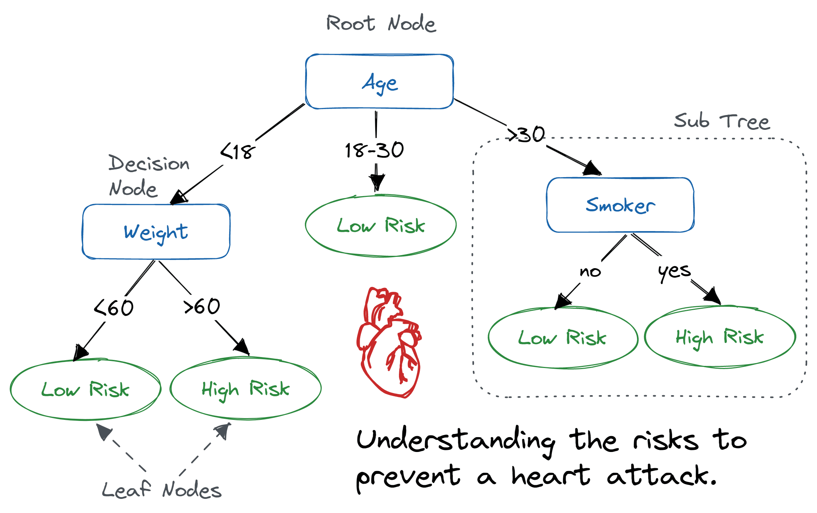
Decision Trees
https://www.datacamp.com/tutorial/decision-tree-classification-python
Age | Weight | Smoker | Prediction
35 | 80 | yes | High Risk
25 | 80 | yes | ?
Tree-Based Models
Session 12

Slide 8
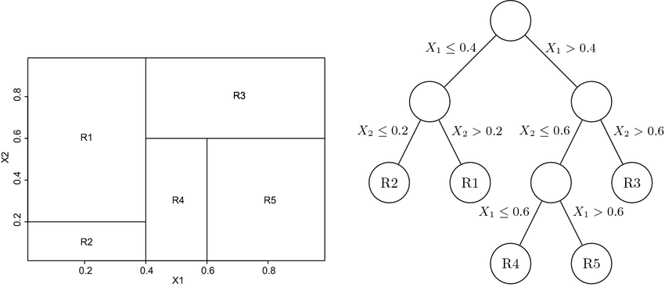
Decision Trees
Tree-based based methods work by partitioning the feature space into rectangles;
Predictions are made by either averaging values or based on the most frequently class in each rectangle.
Beaulac, C., & Rosenthal, J. S. (2019). Predicting University Students’ Academic Success and Major Using Random Forests. In Research in Higher Education (Vol. 60, Issue 7, pp. 1048–1064). Springer Science and Business Media LLC. https://doi.org/10.1007/s11162-019-09546-y
Tree-Based Models
Session 12

Slide 9
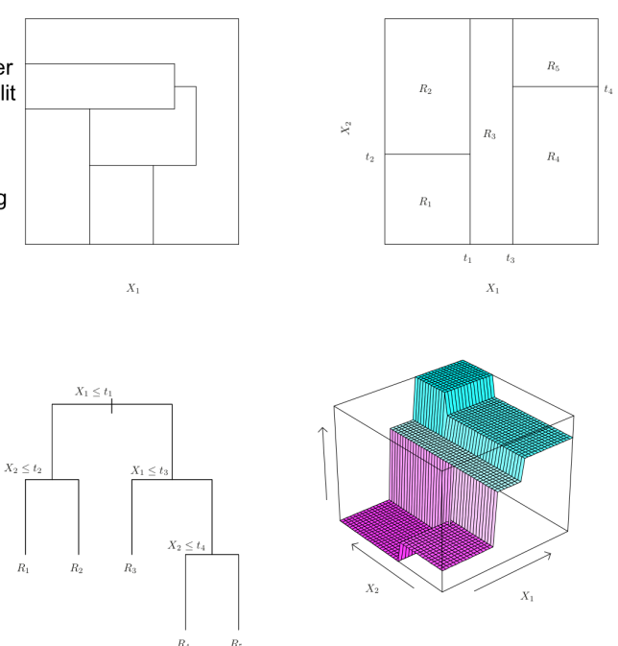
Decision Trees
We will never get a split like this one!
Tree-Based Models
Session 12

Slide 10
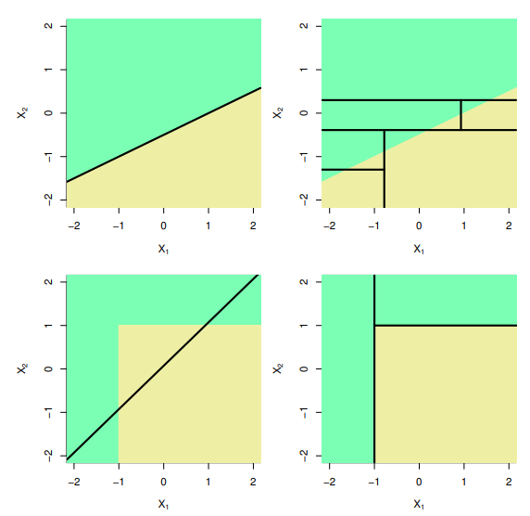
Decision Trees
Linear models vs Decision Trees
Tree-Based Models
Session 12

Slide 11
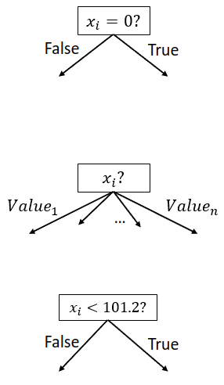
Decision Trees: Decision Nodes
Binary Feature
Categorical Feature
Numeric Feature
Tree-Based Models
Session 12

Slide 12
Decision Trees: Leaf Types
y = 1
Classification
Regression
Probability Estimate
y= 76.5
P(y=0) = 0.2
P(y=1) = 0.3
P(y=2) = 0.5
Tree-Based Models
Session 12

Slide 13
Decision Trees: Algorithm
Trees are built using a greedy algorithm: Recursive binary partitioning
This involves the following steps:
The definition of a splititing criterion;
The definition of a stopping rule;
Tree pruning.
Greedy means that each split is made in order to minimize a loss without looking ahead at future splits!
Tree-Based Models
Session 12

Slide 14


Decision Trees: Splitting Criteria
At each step, a new split is picked by finding the featue x_{j} and split point s that best partitions the data into two half-spaces.
For regression we want the split that minimizes the residual sum os squares (RSS)
where is the mean values for the training data whithin the j^{th} box.
For classification, we can use:
Entropy and Information Gain
Gini Index
Tree-Based Models
Session 12

Slide 15
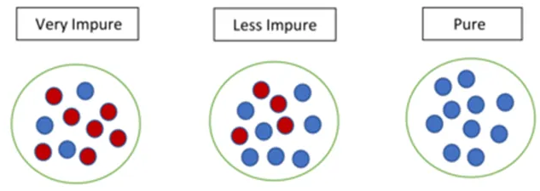

Decision Trees: Entropy and Information Gain
"In information theory, the entropy of a random variable is the average level of “information”, “uncertainty” or “surprise”, inherent in the variable’s possible outcomes."
In the context of Decision Trees, entropy measures the disorder or impurity of a node.
p_{i} is the probability of randomly picking an example of the class i.
Tree-Based Models
Session 12

Slide 16
Decision Trees: Entropy and Information Gain
Tree-Based Models
Session 12

Slide 17
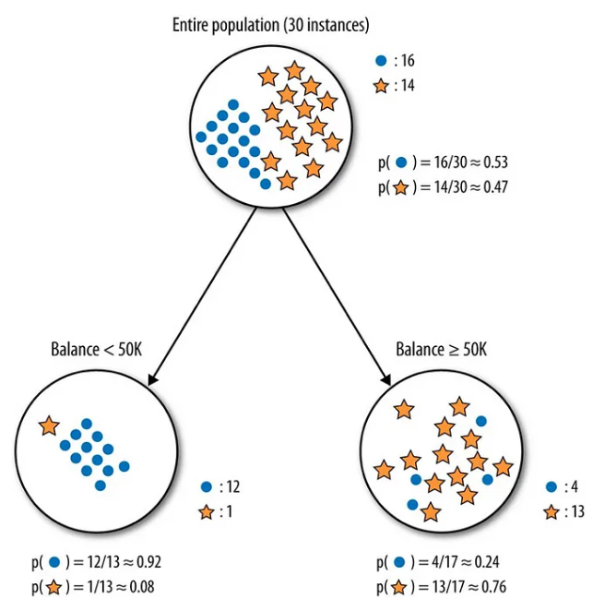
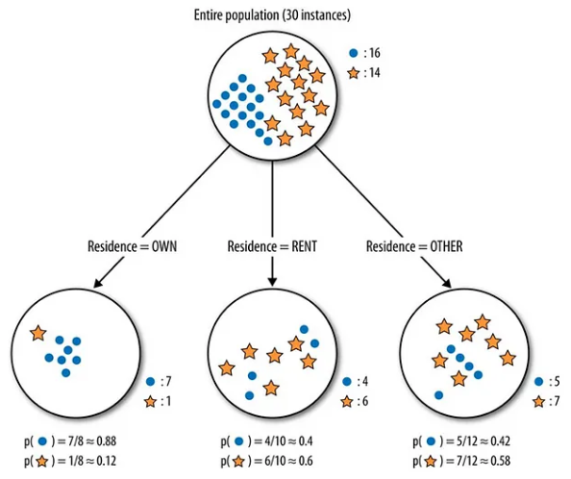
Decision Trees: Entropy and Information Gain
VS
Tree-Based Models
Session 12

Slide 18
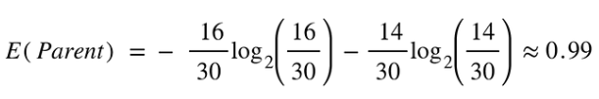
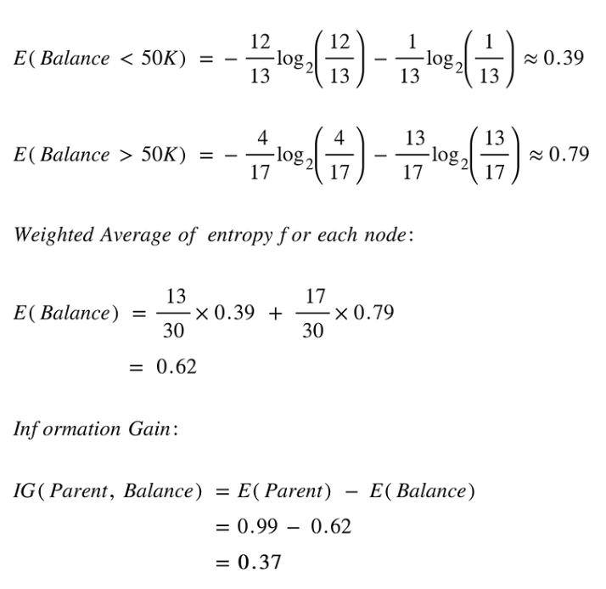
Decision Trees: Entropy and Information Gain
Tree-Based Models
Session 12

Slide 19
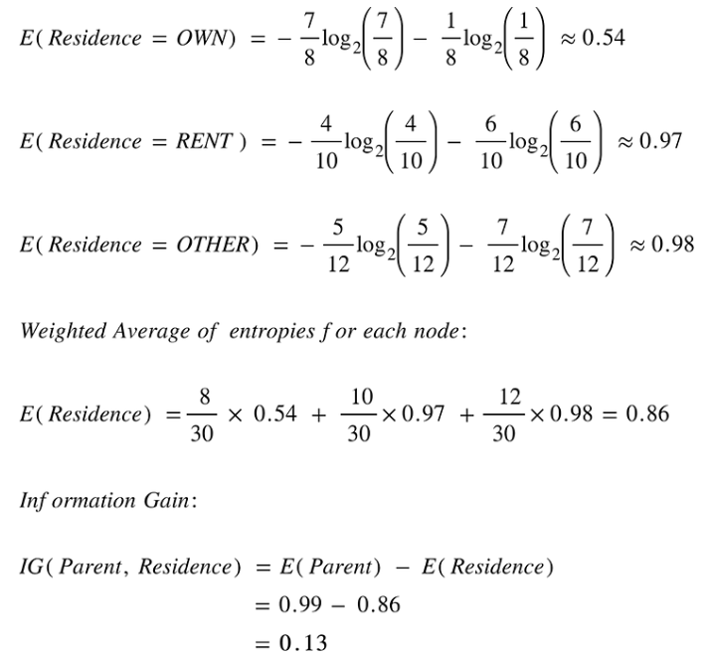
Decision Trees: Entropy and Information Gain
Tree-Based Models
Session 12

Slide 20


Decision Trees: Gini Index
The Gini Index measures the probability of misclassifying a randomly chosen element based on label distribution;
Lower values indicate higher purity and better separation of classes in a decision tree node.
OR
where j represents the number of classes in the target variable
Tree-Based Models
Session 12

Slide 21
Decision Trees: Gini Index
VS
Tree-Based Models
Session 12

Slide 22



Decision Trees: Gini Index
Tree-Based Models
Session 12

Slide 23



Decision Trees: Gini Index
Tree-Based Models
Session 12

Slide 24
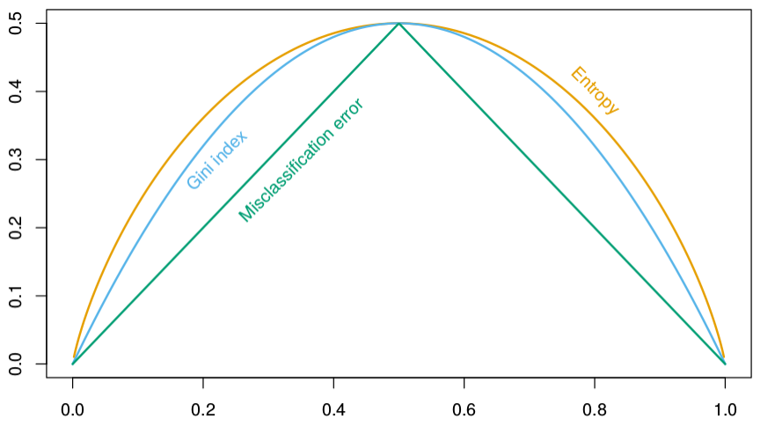
Decision Trees: Splitting Criteria
Why not minimize the missclassification error?
Tree-Based Models
Session 12

Slide 25
Decision Trees: Stopping Rules
Maximum depth: limits the depth of the tree;
Minimum samples per leaf: limits the minimum number of samples a leaf node can have;
Minimum samples per split: limits the minimum number of samples required to perform a split;
Maximum number of leaf nodes: caps the total number of lead nodes in a tree;
Impurity threshold: a split is only performed if it reduces impurity by a certain amount;
Tree-Based Models
Session 12

Slide 26
Decision Trees
The flexibility/complexity of decision trees is mainly decided by the tree depth:
To obtain a small bias we need a deep tree!
However, this results in high variance!
To improve the performance:
Pruning: grow deep trees (small bias, high variance) which then are pruned into smaller ones (reduce variance);
Ensemble methods (next session): combine multiple simple trees.
Bagging and Random Forests
Boosted trees
Tree-Based Models
Session 12

Slide 27
Decision Trees: Tree Pruning
Deep trees often overfit the training data resulting in poor test performance;
We could stop spliting as soon the information gain does not improve at least a pre-specified amount;
However, "weak" splits early can sometimes lead to a really good split later;
Solution: Grow a deep tree and then prune it back.
Tree-Based Models
Session 12

Slide 28

Decision Trees: Cost Complexity Pruning
Cost complexity pruning aka weakest link pruning:
Mathematically, the cost complexity measure for a tree T is given by:
Where:
* is the risk of the tree T (overall RSS, Gini/Entropy/etc)
* is the number of leaf nodes in the tree T
* is the penalty/regularization parameter
Tree-Based Models
Session 12

Slide 29

Decision Trees: Cost Complexity Pruning
Objective: minimize
Risk of tree T
Proportion of samples
in leaf node t
Metric of leaf node t
Risk of leaf node t
The smaler the better
Gives us cost
Gives us complexity
Cost complexity pruning
Tree-Based Models
Session 12

Slide 30

Decision Trees: Cost Complexity Pruning
Pruning rule:
prune all child nodes of t if:
Penalty
Reward
Prunning Rule
Tree-Based Models
Session 12

Slide 31
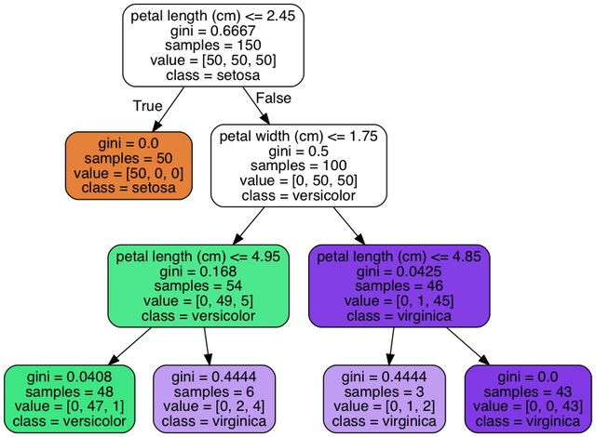
Decision Trees: Cost Complexity Pruning
R(t) = 0.168 * (54/150) = 0.06048
R(T_{t}) = 0.0408 * (58/150) + 0.4444 * (6/150)
= 0.033552
|T| = 2
= (0.06048 - 0.033552) / (2-1)
= 0.026928
So, if:
= 0.02 we don't prune
= 0.03 we do prune
Question:
How to choose the value of ?
Tree-Based Models
Session 12

Slide 32
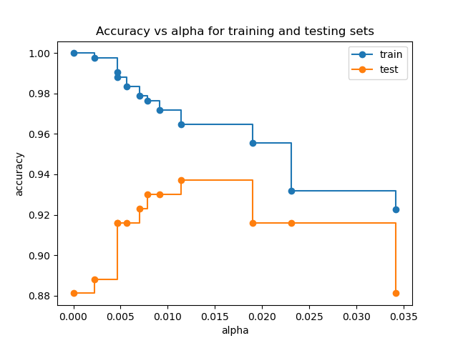
Decision Trees: Cost Complexity Pruning
Question:
How to choose the value of ?
Using cross-validation!
Tree-Based Models
Session 12

Slide 33
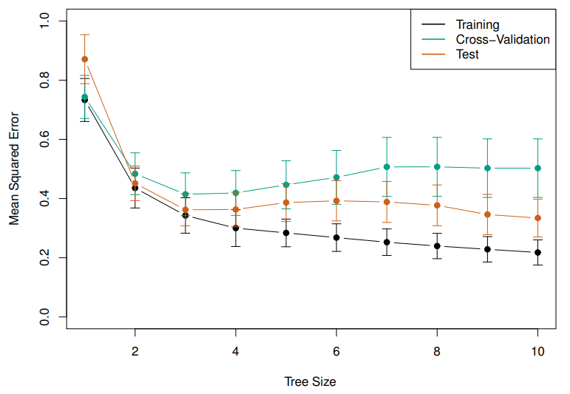
Decision Trees: Depth vs Error
Looks like a small 3-leaf tree has the lowest CV error!
Tree-Based Models
Session 12

Slide 34
Decision Trees: Advantages
Interpretability: easy to understand and interpret, making them suitable for explaining the reasoning behind decisions to non-experts.
No Data Preprocessing: can handle both numerical and categorical data without requiring extensive preprocessing such as normalization or scaling.
Handles Non-linear Relationships: can capture non-linear relationships between features and the target variable without explicitly modeling them.
Handles Missing Values: can handle missing values by simply excluding them from the splitting process, making them robust to missing data.
Feature Importance: provide a measure of feature importance, which can help identify the most influential features in the dataset.
Efficiency: have a relatively fast training time, especially for smaller datasets, compared to more complex algorithms.
Tree-Based Models
Session 12

Slide 35
Decision Trees: Limitations
Overfitting: are prone to overfitting, especially when they grow too deep or are not pruned properly, capturing noise or specific patterns in the training data that do not generalize well.
Instability: small variations in the data can lead to different tree structures, making decision trees unstable and sensitive to changes in the training data.
Bias Toward Dominant Classes: in classification tasks with imbalanced classes, decision trees may exhibit a bias toward the dominant classes, leading to poor performance on minority classes.
Greedy Nature: use a greedy, top-down approach to recursively partition the feature space, which may not always lead to the globally optimal tree structure.
Tree-Based Models
Session 12

Slide 36
Resources
Koning, M., & Smith, C. (2017). Decision trees and random forests. Independently Published.
https://www.youtube.com/watch?v=_L39rN6gz7Y
https://www.youtube.com/watch?v=_L39rN6gz7Y
https://www.youtube.com/watch?v=wpNl-JwwplA
https://www.youtube.com/watch?v=D0efHEJsfHo
Tree-Based Models
Session 12

