Slide 1

Machine Learning
Session 17 - T
Support Vector Machines – Part 2
Ciência de Dados Aplicada
2023/2024

Slide 2


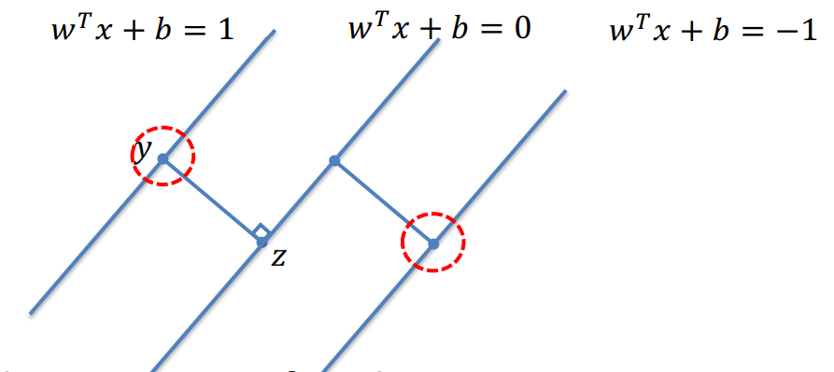
SVMs - Recap
such that
Support Vector Machines
Session 18

Slide 3
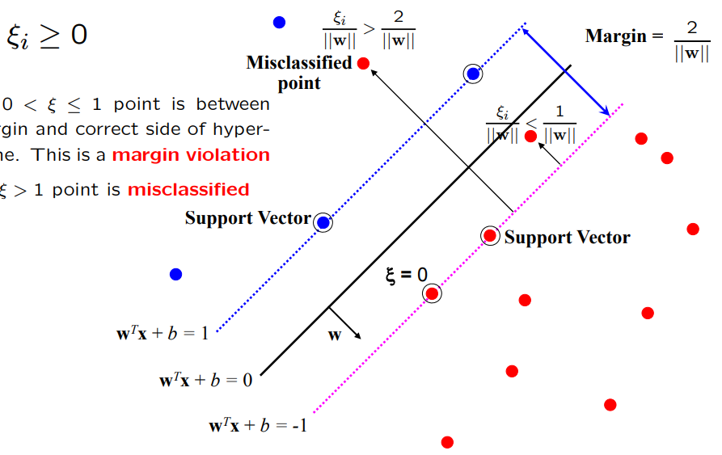

SVMs – Slack Variables
For point is inside the margin but on the correct side of the hyperplate. This is a margin violation;
For point is misclassified.
allows margin violations or misclassified points, but with a penalty!
Support Vector Machines
Session 18

Slide 4


SVMs - Soft Margin Solution
The optimization problem becomes
such that
Every constraint can be satisfied if is sufficiently large.
C is a regularization parameter:
Small C allows constraints to be easily ignores → large margin
Large C makes constraints hard to ignore → narrow margin
C = ∞ enforces all constraints → hard margin
Support Vector Machines
Session 18

Slide 5
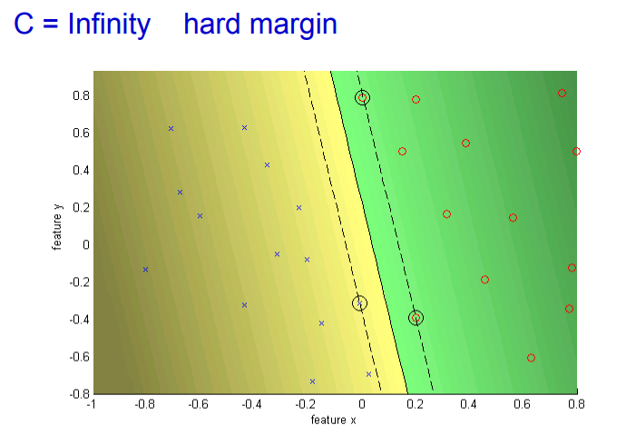
SVMs - C
Support Vector Machines
Session 18

Slide 6
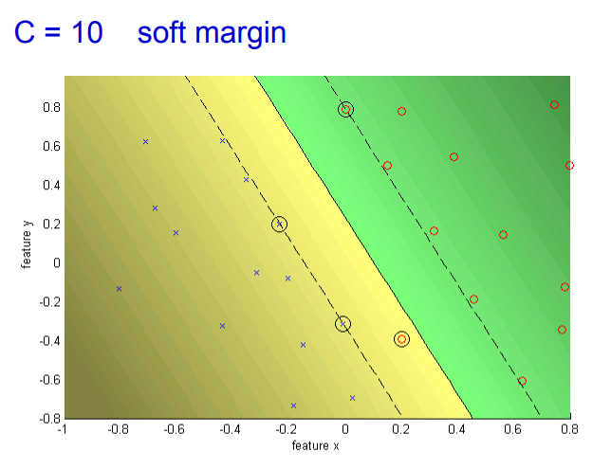
SVMs - C
Support Vector Machines
Session 18

Slide 7



SVMs - Optimization
Learning an SVM has been formulated as a constrained optimization problem over w and
The constraint can be written more concisely as:
which, together with is equivalent to:
Support Vector Machines
Session 18

Slide 8
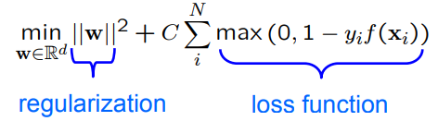
SVMs - Optimization
Hence, the learning problem is equivalent to the unconstrained optimization problem over w:
If y_{i}f(x_{i}) > 1:
Point is outside the margin. No contribution to the loss.
If y_{i}f(x_{i}) = 1:
Point is on the margin. No contribution to the loss.
If yif(xi) < 1:
Point violates the margin constraint. Contributes to the loss.
Support Vector Machines
Session 18

Slide 9
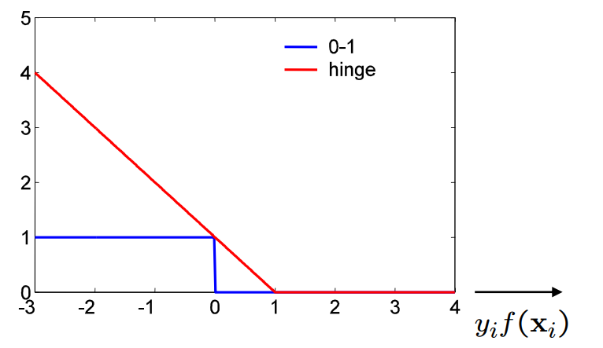
SVMs – Hinge Loss
SVMs uses the Hinge Loss → max(0, 1 – y_{i}f(x_{i}))
Variation of the 0-1 loss.
Support Vector Machines
Session 18

Slide 10


SVMs – Dual Form
The previous quadratic optimization problem is known as the primal problem.
Instead, the SVM can be formulated to learn a linear classifier:
by solving a n optimization problem over .
This is known as the dual problem!
Support Vector Machines
Session 18

Slide 11

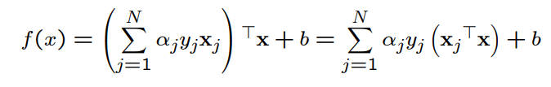

SVMs – Dual Form
The Representer Theorem states that the solution w can always be written as a linear combination of the training data:
If we substitute w in f(x) = w^{T}x + b
And for w in the cost function min_{w} ||w||² subject to y_{i}(w^{T}x_{i} +b) ≥ 1
Support Vector Machines
Session 18

Slide 12

SVMs – Dual Form
Hence, a equivalent optimization problem over
Advantage of dual over primal form:
Dual form only involves (x_{j}^{T}x_{k}) - which requires the training data points! However, many of are 0 (the non support vectors).
Support Vector Machines
Session 18

Slide 13
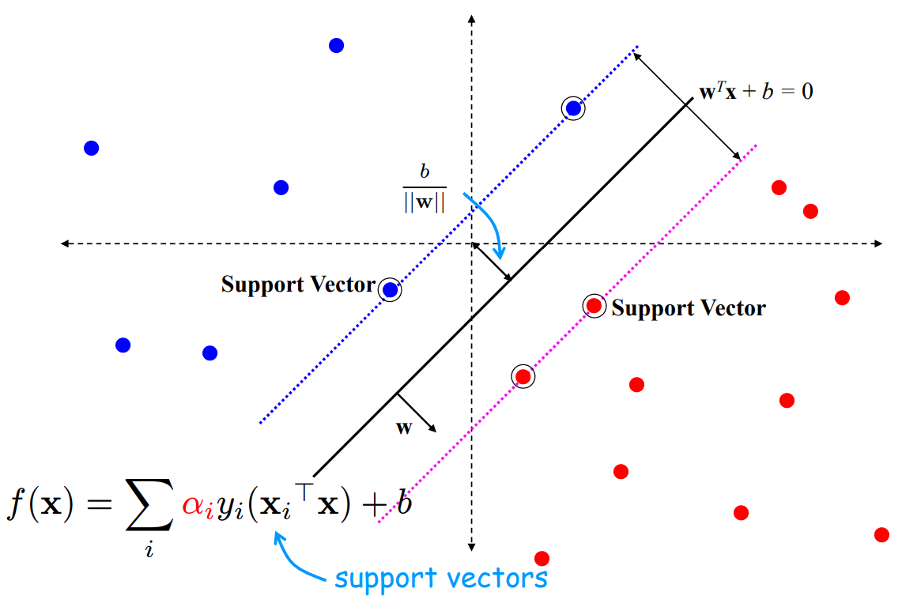
SVMs – Dual Form
Support Vector Machines
Session 18

Slide 14
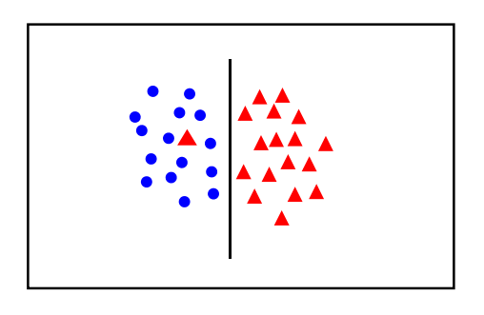
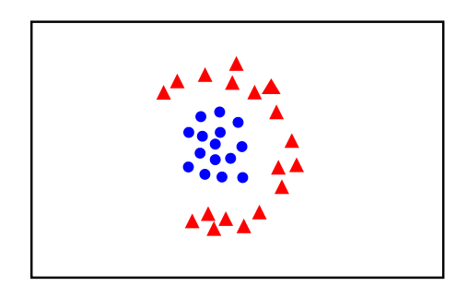
SVMs – Handling non linear data
Introduce slack variables
Linear classifier not appropriate
Support Vector Machines
Session 18

Slide 15
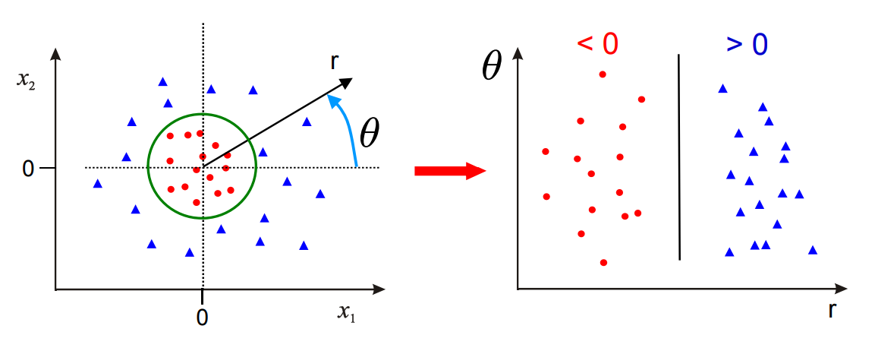
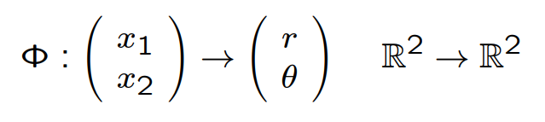
SVMs – Solution 1
Using polar coordinates
Data is linearly separable in polar coordinates
Acts non linearly in original space
Support Vector Machines
Session 18

Slide 16
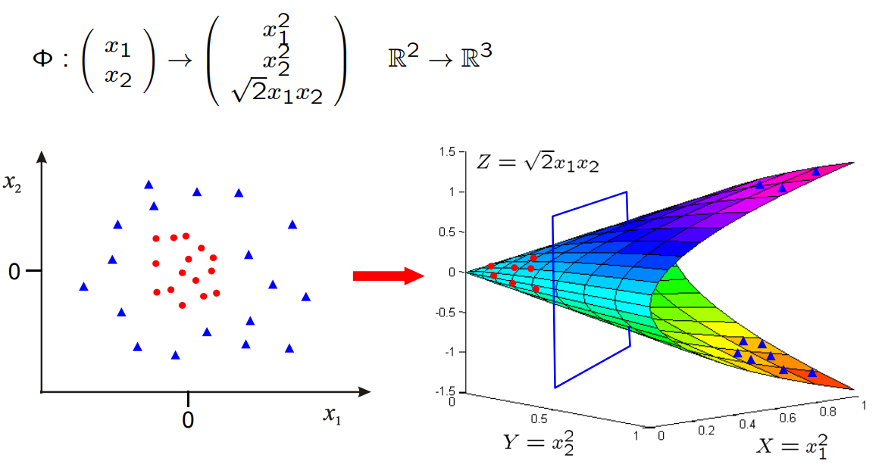
SVMs – Solution 2
Map data to a higher dimension
Data is linearly separable in 3D.
This means that the problem can still be solved by a linear classifier.
Support Vector Machines
Session 18

Slide 17
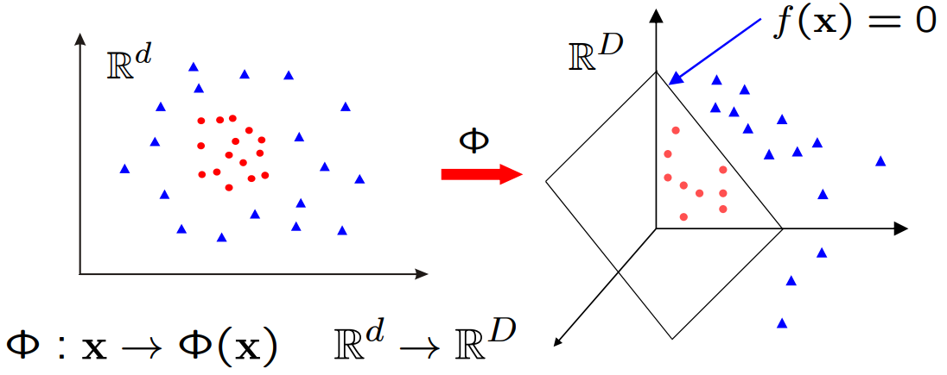



SVMs – Transformed Feature Space
Learn a linear classifier in w for
is a feature map
Support Vector Machines
Session 18

Slide 18


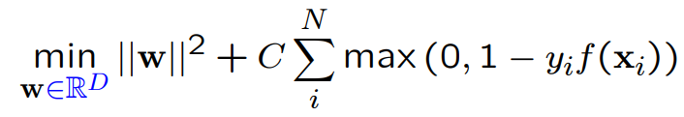

Primal Classifier – Transformed Feature Space
Classifier, with
Learning, for
Map x to where data is linearly separable
Solve for w in high dimensional space
Support Vector Machines
Session 18

Slide 19
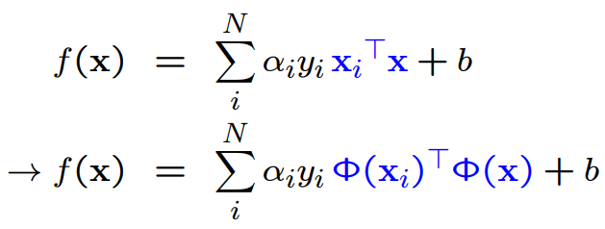
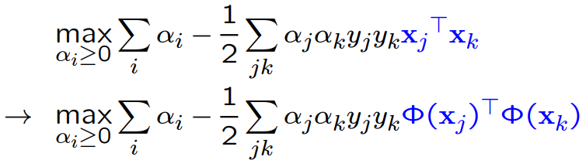
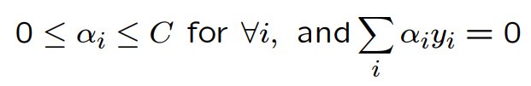
Dual Classifier – Transformed Feature Space
Classifier:
Learning:
subject to
Support Vector Machines
Session 18

Slide 20



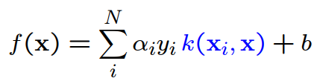
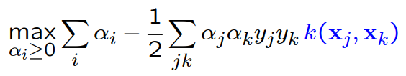
Dual Classifier – Transformed Feature Space
Note that only occurs in pairs
Once the scalar products are computed, only the N dimensional vector needs to be learnt; it is not necessary to learn in the D dimensional space, as it is for the primal
Write This is known as a Kernel
Classifier:
Learning:
subject to
Support Vector Machines
Session 18

Slide 21
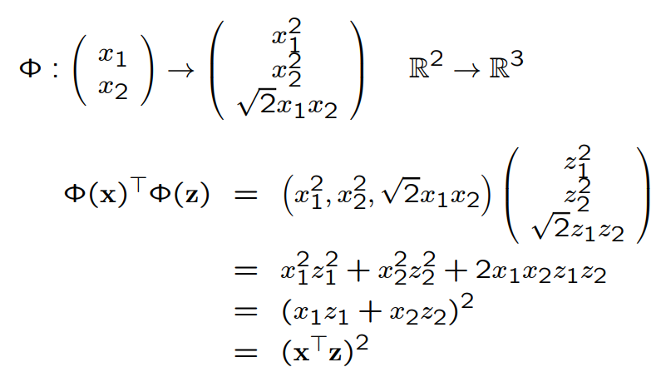


SVMs – Kernel Trick
Kernel Trick
Classifier can be learnt and applied without explicitly computing
All that is required is the kernel
Support Vector Machines
Session 18

Slide 22

SVMs – Example Kernels
Linear kernels
Polynomial kernels
Contains all polynomials terms up to degree d
Gaussian kernels
Infinite dimensional feature space
Support Vector Machines
Session 18

Slide 23
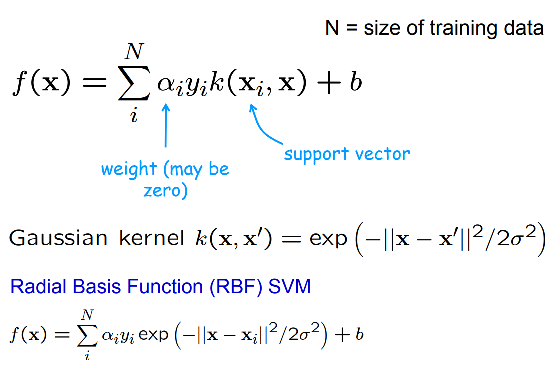
SVM Classifer with Gaussian Kernel
Support Vector Machines
Session 18

Slide 24
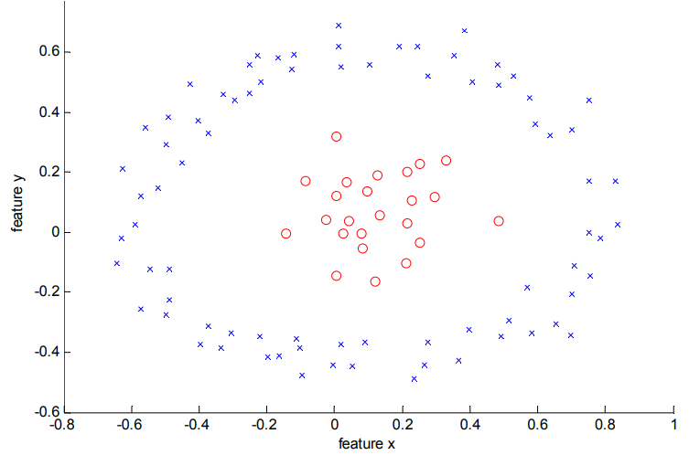
SVMs – RFB Kernel
Data is not linearly separable in the original feature space
Support Vector Machines
Session 18

Slide 25
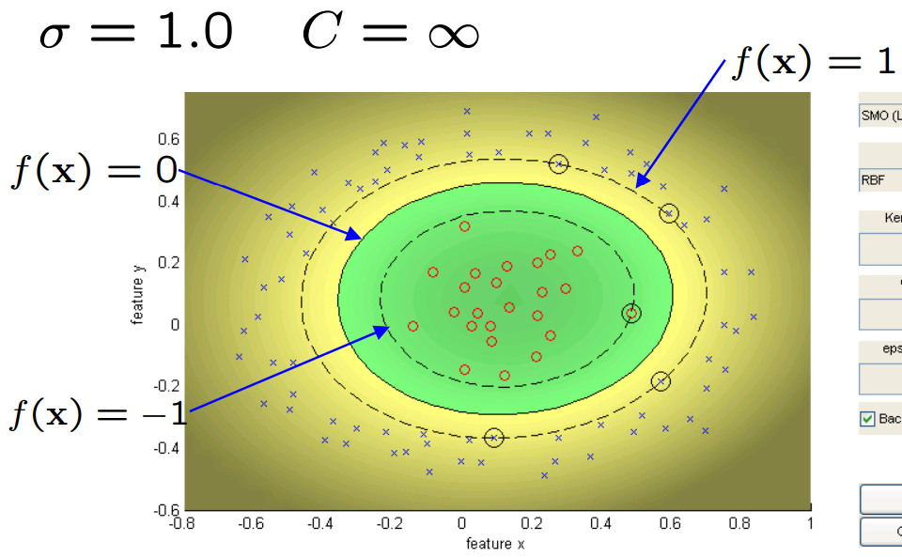
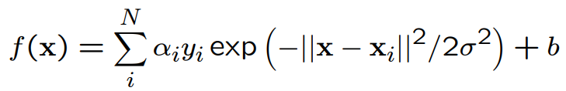
SVMs – RFB Kernel
Support Vector Machines
Session 18

Slide 26
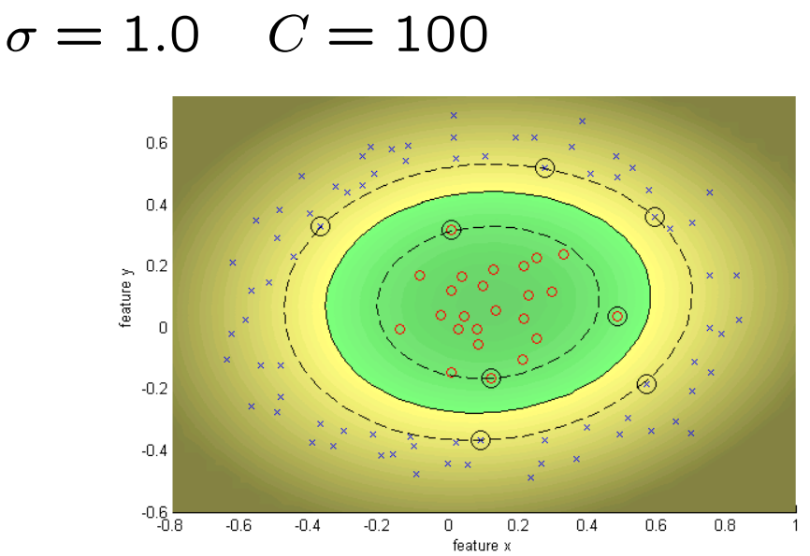
SVMs – RFB Kernel
Decrease C, gives wider (soft) margin.
Support Vector Machines
Session 18

Slide 27
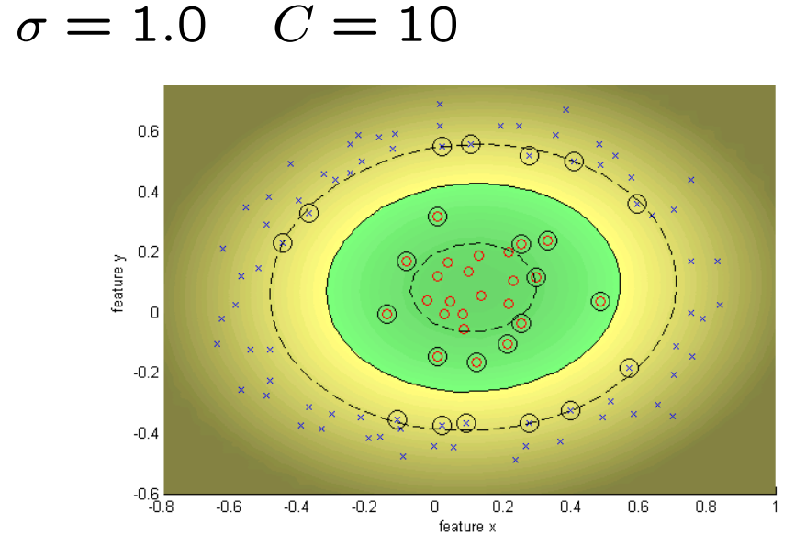
SVMs – RFB Kernel
Support Vector Machines
Session 18

Slide 28
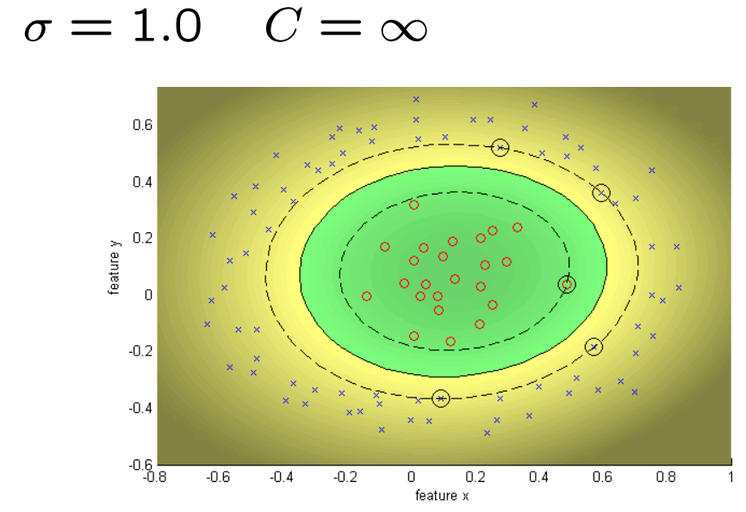
SVMs – RFB Kernel
Support Vector Machines
Session 18

Slide 29
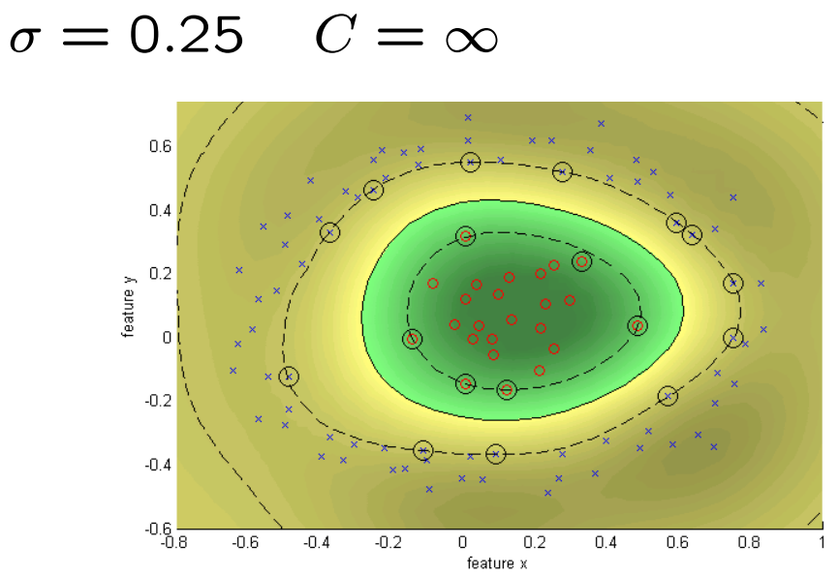
SVMs – RFB Kernel
Decrease sigma, moves towards nearest neighbour classifier
Support Vector Machines
Session 18

Slide 30
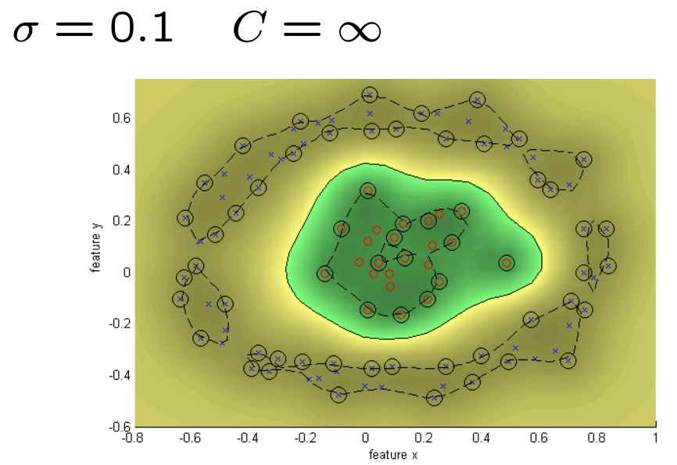
SVMs – RFB Kernel
Support Vector Machines
Session 18

Slide 31
Resources
https://www.youtube.com/watch?v=efR1C6CvhmE
https://www.youtube.com/watch?v=Toet3EiSFcM
https://www.youtube.com/watch?v=Qc5IyLW_hns&t=1s
Support Vector Machines
Session 18

