Slide 1

Machine Learning
Session 23 - PL
Explainable AI (XAI)
Ciência de Dados Aplicada
2023/2024

Slide 2
XAI with SHAP
"SHAP (SHapley Additive exPlanations) is a game theoretic approach to explain the output of any machine learning model. It connects optimal credit allocation with local explanations using the classic Shapley values from game theory and their related extensions"
Installation:
pip install shap
OR
conda install -c conda-forge shap
Explainable AI (XAI)
Session 23

Slide 3
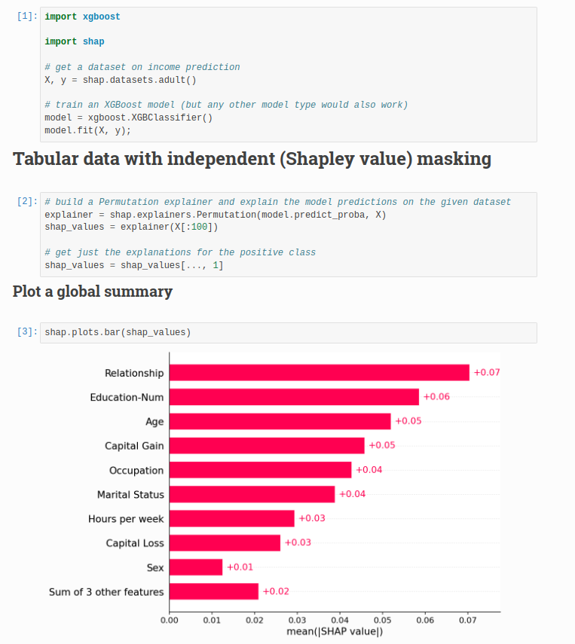
XAI with SHAP
Explainable AI (XAI)
Session 23

Slide 4
Exercises:
Notebooks on the github repository:
Notebook with examples and exercises:
notebooks/session_23/exercises.ipynb
notebooks/session_23/examples.ipynb
Explainable AI (XAI)
Session 23

