Slide 1

Machine Learning
Session 16 - T
Tree-Based Models – Part 2
Ciência de Dados Aplicada
2023/2024

Slide 2
Why are Decision Trees poor predictors?
Decision trees tend to have high variance. A small change in the training data can produce big changes in the estimated Tree.
To improve the performance:
Pruning (last session): grow deep trees (small bias, high variance) which then are pruned into smaller ones (reduce variance);
Ensemble methods (today's session): combine multiple simple trees.
Bagging and Random Forests
Boosted trees
Tree-Based Models
Session 16

Slide 3
Bagging
Let's revisit the concept of Cross-Validation and why it performs better than the Holdout method!
The Holdout method often overestimates the error and provides highly different error estimates if you alter the test split.
On the other hand, K-fold Cross-Validation generates more consistent error estimates by averaging across K distinct estimates of error (one for each fold).
Bagging (Bootstrap AGGregatING) operates with a similar objective: reducing the variance of a predictor prone to high variance by averaging across multiple estimates.
Tree-Based Models
Session 16

Slide 4
Bagging
In other words, averaging a set of observations reduces variance.
Obvious problem: We only have access to one training dataset.
Solution: Bootstrap the data!
Sample n times with replacement from the original training data;
Repeat B times to generate B ”bootstrapped” training datasets.
For each bootstrapped dataset train a decision tree.
Averaging the predictions of each tree trained with different bootstrapped datasets is called bootstrap aggregation (Bagging).
Tree-Based Models
Session 16

Slide 5
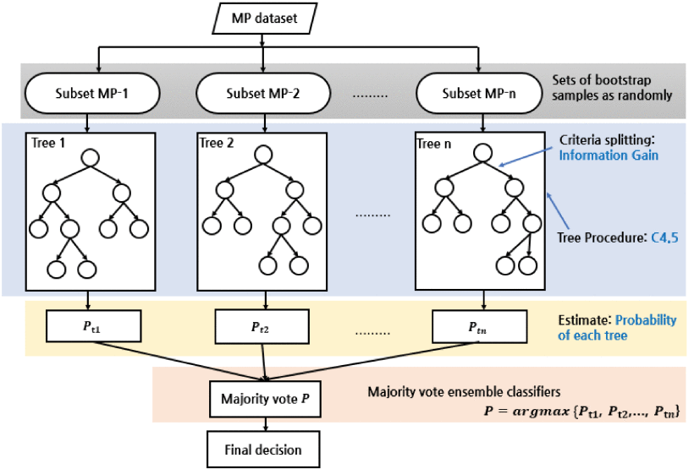
Bagging
Average for regression
Le, T.-T.-H., Kang, H., & Kim, H. (2020). Household Appliance Classification Using Lower Odd-Numbered Harmonics and the Bagging Decision Tree. In IEEE Access (Vol. 8, pp. 55937–55952). Institute of Electrical and Electronics Engineers (IEEE). https://doi.org/10.1109/access.2020.2981969
Tree-Based Models
Session 16

Slide 6
Out-of-Bag (OOB) Error Estimation
Not all of the training points will appear in each sample;
Each bootstrap sample contains roughly 63.2% of the observed data points;
The remaining observations not used to fit a given bagged tree are called the out-of-bag (OOB) observations
Another way of thinking about it: Each observation is OOB for roughly B/3 of the trees. We can treat observation i as a test point each time it is OOB.
Tree-Based Models
Session 16

Slide 7
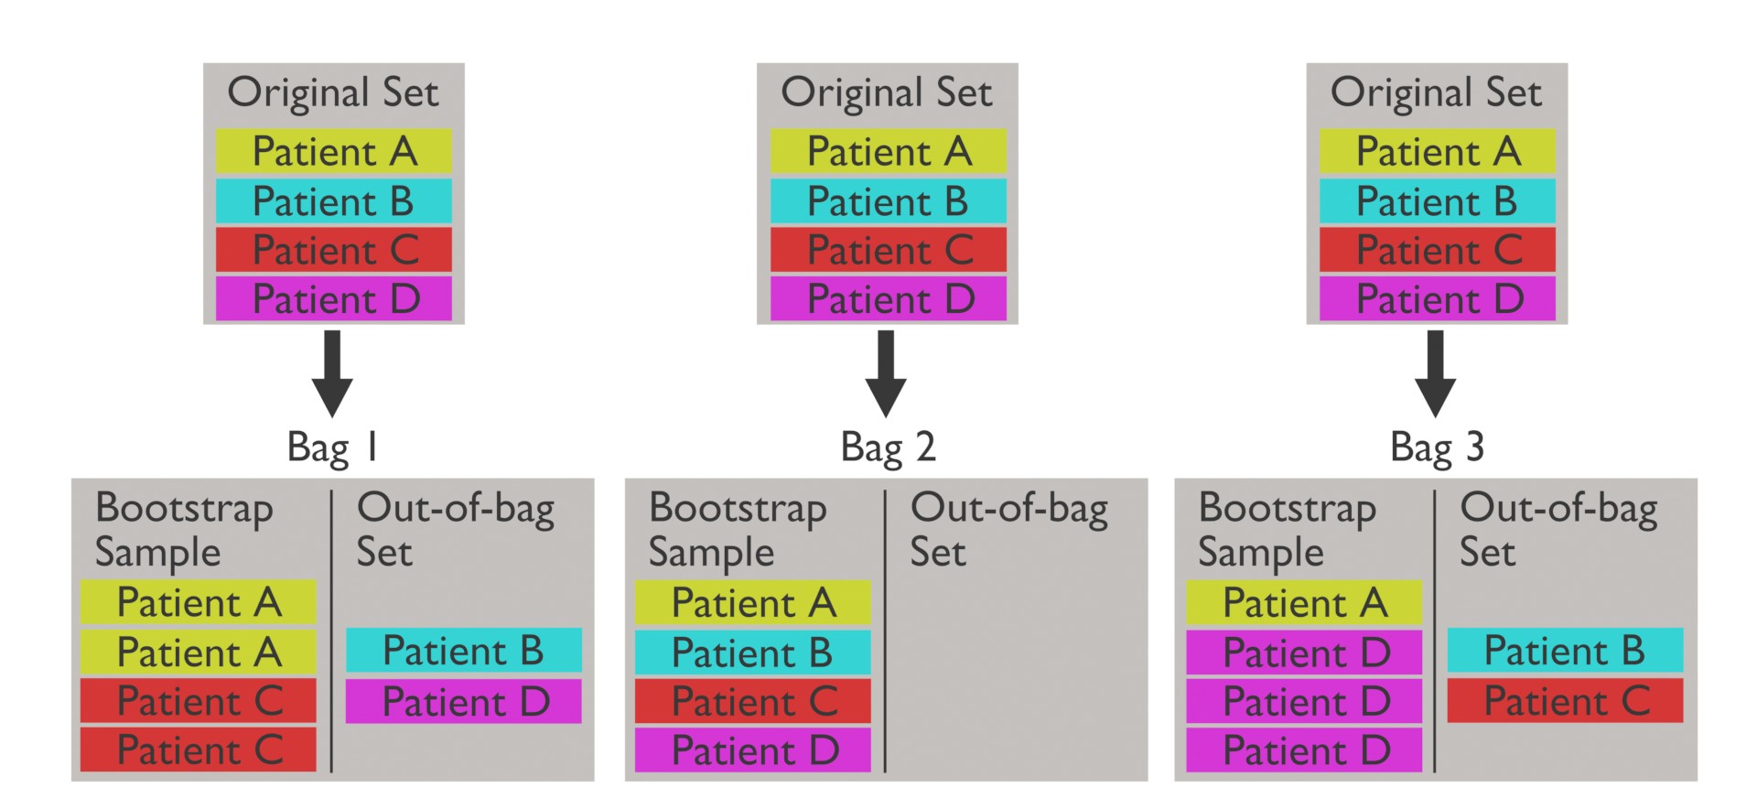
Out-of-Bag (OOB) Error Estimation
Tree-Based Models
Session 16

Slide 8
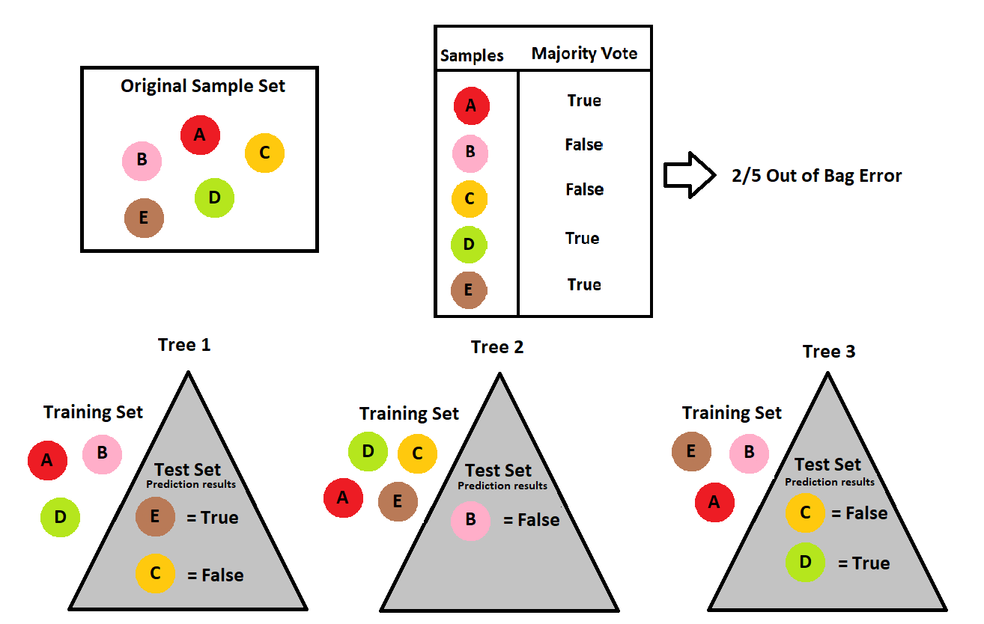
Out-of-Bag (OOB) Error Estimation
To form the OOB estimate of test error:
Predict the response for the ith observation using each of the trees for which i was OOB. This gives us roughly B/3 predictions for each observation;
Calculate the error of each OOB prediction;
Average all of the errors.
Tree-Based Models
Session 16

Slide 9
Random Forests
However, the B bootstrapped dataset are correlated!
the variance reduction due to averaging is diminished.
Random forests provide an improvement over bagged trees by de-correlate the B trees by randomly perturbing each tree.
A random forest is constructed by bagging, but for each split in each tree only a random subset of features are considered as splitting variables.
Rule of thumb: √p for classification trees and p/3 for regression trees (p is the number of features).
Tree-Based Models
Session 16

Slide 10
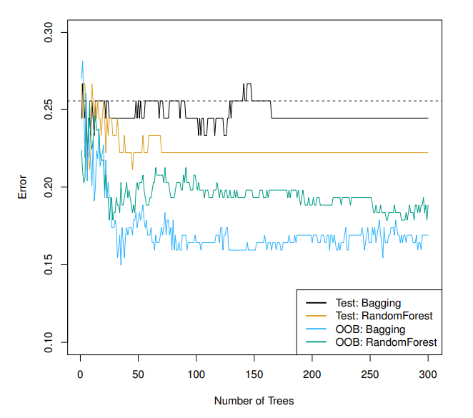
Bagging vs Random Forests
Tree-Based Models
Session 16

Slide 11
Advantages of Random Forests
Reduced Overfitting: Random forests mitigate overfitting by aggregating the predictions of multiple decision trees.
Improved Performance: Random forests often provide higher performance compared to individual decision trees, especially for complex datasets.
Reduced Bias: The ensemble nature of random forests reduces bias that may be present in individual decision trees.
Parallelization: Training of individual decision trees within a random forest can be easily parallelized, leading to faster computation.
Tree-Based Models
Session 16

Slide 12
Boosting
Boosting works in a similar way to bagging, except that the trees are grown sequentially: each tree is grown using information from previously grown trees.
Each subsequent tree focus on the training examples that the previous ones got wrong.
To focus on specific examples, boosting uses a weighted training set.
Tree-Based Models
Session 16

Slide 13
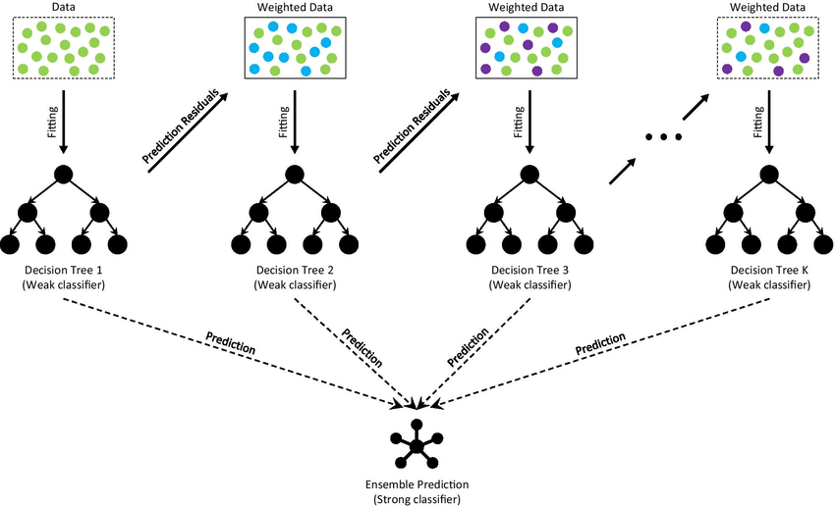
Boosting
Tree-Based Models
Session 16

Slide 14
AdaBoost
Given a base classifier, the key steps of AdaBoost are:
At each iteration, re-weight the training samples by assigning larger weights to samples that were classified incorrectly.
Train a new base classifier based on the re-weighted samples.
Add it to the ensemble of classifiers with an appropriate weight.
Repeat the process many times.
Requirements for base classifier:
Needs to minimize weighted error.
Ensemble may get very large, so base classifier must be fast. It turns out that any so-called weak learner/classifier suffices (e.g. decison trees).
Individually, weak learners may have high bias (underfit). By making each classifier focus on previous mistakes, AdaBoost reduces bias.
Tree-Based Models
Session 16

Slide 15
Bagging and Boosting Recap
Bagging and boosting are ensemble learning methods that can improve performance;
Bagging:
Reduces variance;
Bias is not changed (much);
Parallel;
Want to minimiza correlation between ensemble elements.
Boosting:
Reduces bias;
Increases variance;
Sequential;
High fependency between ensemble elements.
Tree-Based Models
Session 16

Slide 16
Resources
Collins, R. (2018). Machine learning with bagging and boosting. Independently Published.
https://www.youtube.com/watch?v=J4Wdy0Wc_xQ
https://www.youtube.com/watch?v=sQ870aTKqiM
https://www.youtube.com/watch?v=Xz0x-8-cgaQ
https://www.youtube.com/watch?v=tjy0yL1rRRU
Tree-Based Models
Session 16

