Slide 1
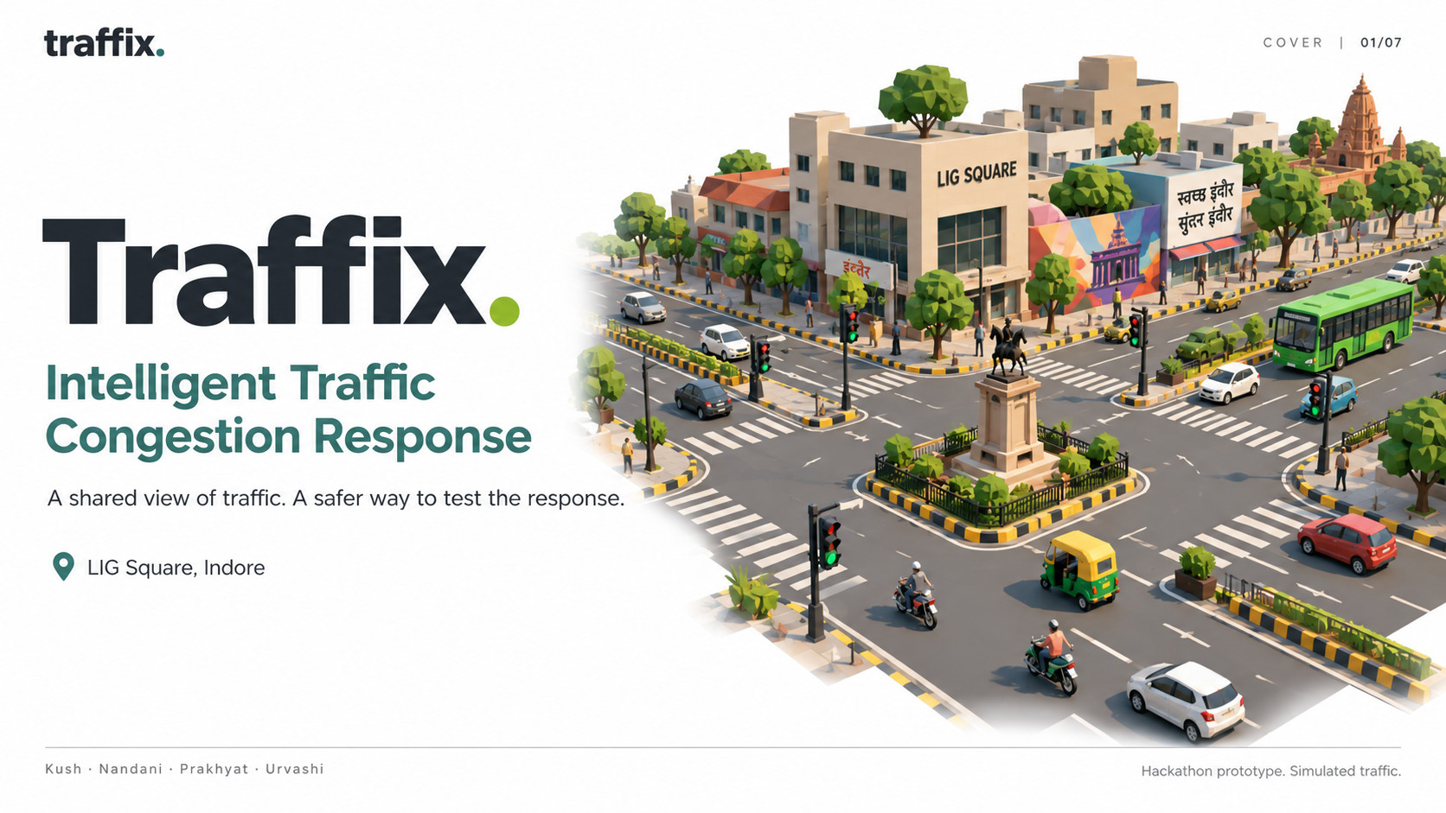
01/09
Notes:
## 1. Traffix
Traffix addresses the Intelligent Traffic Congestion Response System problem statement. We have built a local testing environment around LIG Square, Indore, an operator dashboard and an Android companion. The full engine is local. The submitted public link is a landing page with an explicitly labelled browser illustration. Generated illustrations are conceptual and are not field photographs. Source: docs/traffix-harness-prd-v1.md and docs/prakhyat-integration-review.md, reviewed 10 October 2026.
Generated conceptual illustration, not a field photograph. Source images preserved from the submission deck. Benchmarked controller source inspected at 7733a08. Current integration status is documented separately.

Slide 2
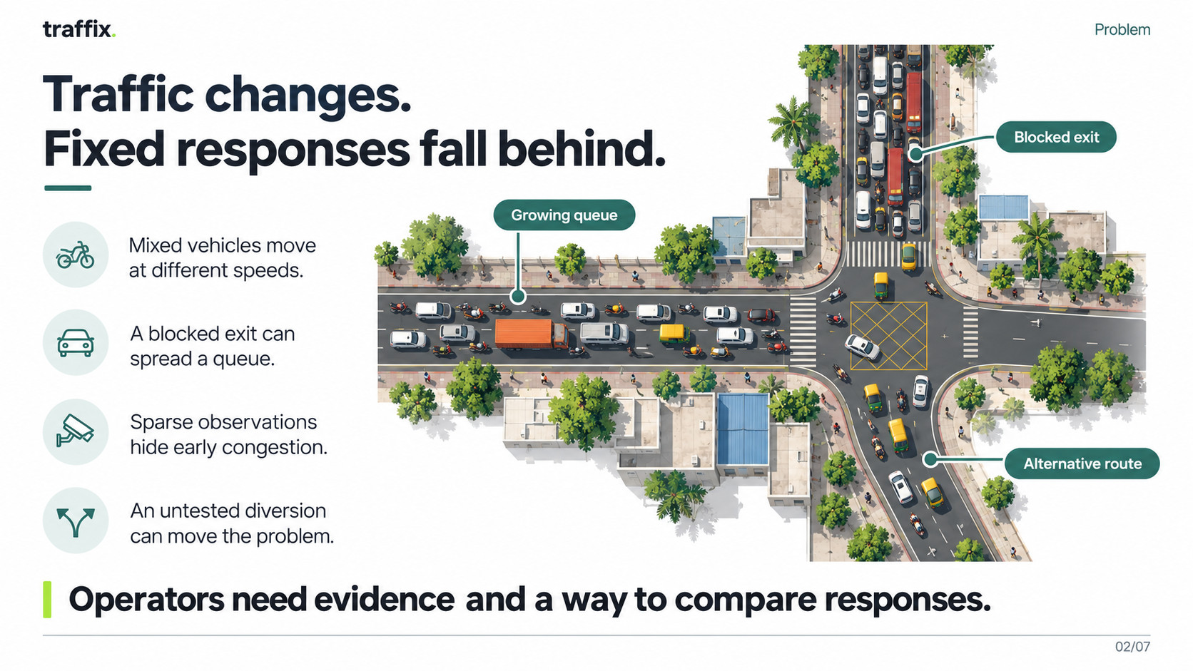
02/09
Notes:
2. The problem
A traffic queue has multiple causes: arrival demand, heterogeneous speeds, limited discharge and blocked receiving roads. Changing a signal without checking the next road can spread congestion. Phone sampling alone estimates the participating vehicles' speeds, not the count of every road user. We separate congestion evidence from incident-cause diagnosis. We do not claim that camera classification can automatically prove a rally or a crash. Source: docs/traffix-harness-prd-v1.md, H13 and event requirements.
Generated conceptual illustration, not a field photograph. Source images preserved from the submission deck. Benchmarked controller source inspected at 7733a08. Current integration status is documented separately.

Slide 3
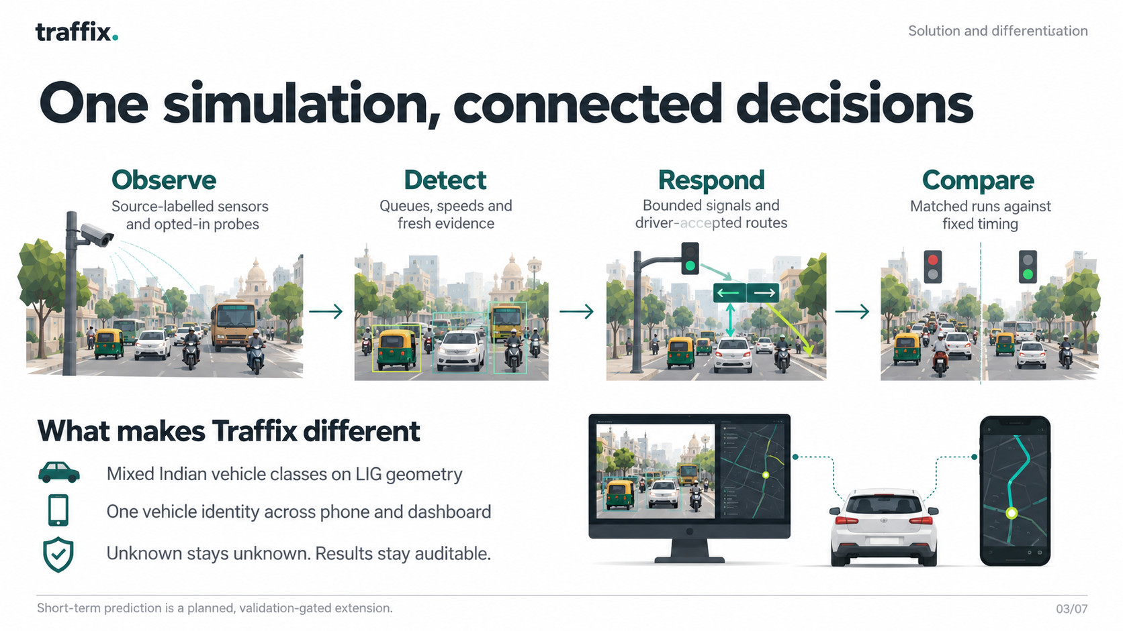
03/09
Notes:
3. Our solution and differentiation
Our distinction is the integrated experiment: a persistent simulated vehicle identity joins the 3D dashboard, phone observations and scoped guidance. SUMO drives heterogeneous classes on OSM LIG geometry. Traffic demand is assumed and current lane-following behavior does not reproduce all Indian noncompliance. The local worker validates operator and driver actions. Missing observations remain unknown. Compared with a navigation-only app, the operator can test signals and compare matched cohorts. Compared with fixed signals, the controller considers observed queue and receiving space. This is an architectural differentiation, not a claim that no competitor has similar capabilities. Sources: docs/prakhyat-integration-review.md; docs/traffix-harness-prd-v1.md.
Generated conceptual illustration, not a field photograph. Source images preserved from the submission deck. Benchmarked controller source inspected at 7733a08. Current integration status is documented separately.

Slide 4
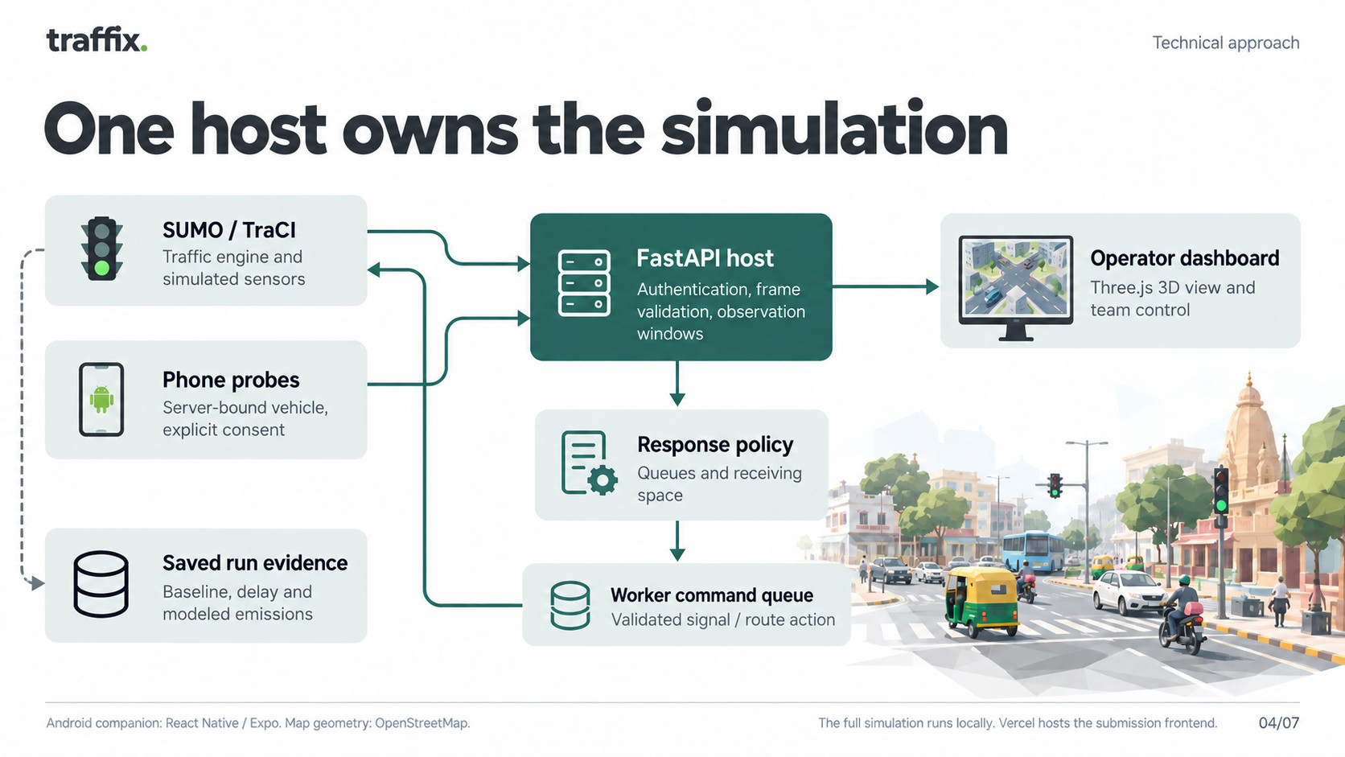
04/09
Notes:
4. System architecture
One thread owns TraCI. FastAPI handlers authenticate requests and enqueue commands rather than modifying SUMO themselves. The operator dashboard consumes an authenticated stream with fallback polling. Admin roles, control leases, revisions and idempotent receipts coordinate shared changes; camera navigation remains client-local. The phone gateway binds each session to a server-selected simulated vehicle through a one-use code and validates exact issued frames. Native app uses React Native/Expo. Native endpoints and route geometry still need the additive v2 adapter. Fixed sensors here are explicitly simulated. Optional local YOLO tracking is a separate adapter, with no established field accuracy. Vercel hosts only the static submission frontend. Sources: backend/simulation/app.py, engine.py, coordination.py, phone.py and docs/integration-api-v2.md on commit 6778fe8.
Generated conceptual illustration, not a field photograph. Source images preserved from the submission deck. Benchmarked controller source inspected at 7733a08. Current integration status is documented separately.

Slide 5
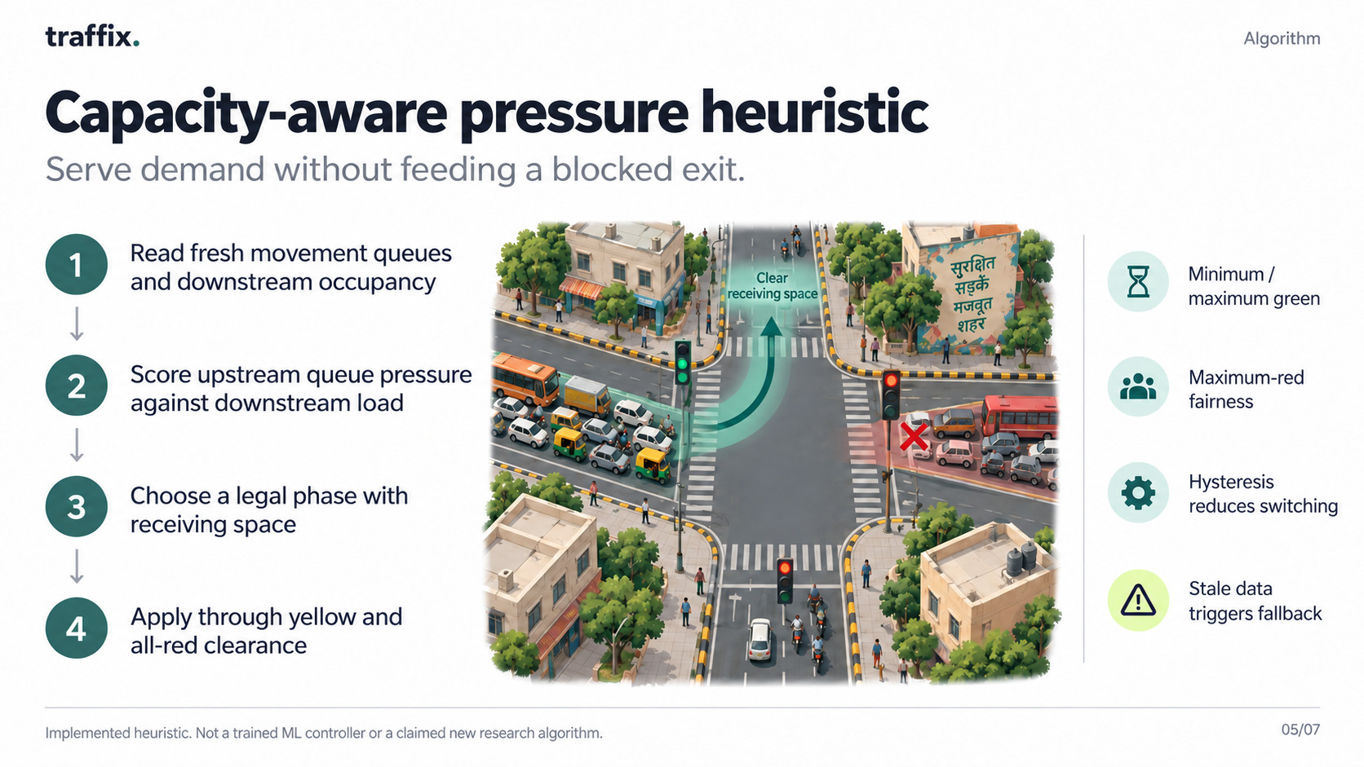
05/09
Notes:
5. Capacity-aware pressure heuristic
The controller computes phase score as the sum over movements of saturation multiplied by (queue divided by upstream capacity minus downstream occupancy divided by downstream capacity). It rejects stale or invalid observations. It excludes phases without receiving space, keeps minimum green, limits maximum green, considers maximum-red fairness and uses hysteresis to reduce unnecessary switching. The worker handles yellow/all-red clearance and rechecks a target before applying it. Policy defaults are 10 s minimum green, 60 s maximum green, 120 s maximum red, hysteresis 0.1 and 1 s discharge horizon. These are uncalibrated starting assumptions. Pressure control is a known heuristic family implemented here, not a novel trained model. Phone guidance uses observed fresh slowdown evidence, a reviewed bypass and explicit driver acceptance before a worker-confirmed route change. Source: backend/simulation/policies.py, engine.py and phone.py at commit 6778fe8.
Generated conceptual illustration, not a field photograph. Source images preserved from the submission deck. Benchmarked controller source inspected at 7733a08. Current integration status is documented separately.

Slide 6
traffix.
Evidence and next gate
Detection and forecasting
Implemented detection
Forecasting validation plan
Fresh slowdown persists for 30 seconds.
Evidence must continue through a serving green.
Sparse or stale observations remain unknown.
HistGradientBoostingRegressor
120, 180 and 300 second horizons
Causal observation history, age and coverage
Recovery needs 60 seconds of low slowdown.
Defaults are assumptions requiring calibration.
Hold out whole runs and seeds. Compare MAE
and usable coverage with persistence and trend.
Measured signal savings come from reactive pressure control. Predictive-control benefit remains unvalidated.
06/09
Notes:
Sources: ml/detect.py, ml/forecast.py, ml/train.py inspected locally. Detection defaults danger 0.7, clear 0.3, minimum two fresh probes unless fixed source exists, maximum gap 15 seconds, ten seconds of serving-green evidence after phase age five seconds. Thresholds are unvalidated. Training uses fixed-no-action labels and disjoint seed partitions, selects on validation only. Fixture scores do not establish real-network forecast accuracy. Forecasting is implemented as a candidate pipeline, validation and predictive control remain future gates.

Slide 7
traffix.
Saved matched evidence
Held-out simulation results
11.31%
7.48%
shorter mean journey
lower modeled CO₂
Held-out seed | Fixed journey | Pressure journey | Journey reduction | CO₂ reduction
51 (49 vehicles) | 291.83 s | 259.67 s | 11.02% | 6.76%
52 (79 vehicles) | 329.67 s | 291.43 s | 11.60% | 8.21%
128/128 scheduled trips completed under each policy. Zero collisions and teleports.
Mean of paired seed reductions versus fixed timing. Synthetic finite cohorts, not field effectiveness.
SUMO modeled emissions. Two seeds only. Incomplete stress baseline excluded from percentage savings.
07/09
Notes:
Verified source: prakhyat-review at 7733a08b1defe6bf6c90c2e797829fc2fedb2f1e, artifacts/ppt-benchmark-heldout/report.json, artifacts/ppt-benchmark-evidence/heldout-normal.json and six trip XML files. Per-seed pressure reductions 11.021079212608214 and 11.599560591289622 percent. CO2 reductions 6.7593677577272535 and 8.205704924853084 percent. Arithmetic means are 11.310319901948918 and 7.482536341290169 percent. Demand 1400 vehicles/hour for 180 seconds plus up to 900 seconds drain. Same network, demand, seed, settings and execution fingerprints. No confidence interval or 15–20 percent general claim. Actuated comparison averages 0.54 percent journey reduction. Stress seed53 baseline completed 133/135. Development seed42 worsened P95 stopped waiting. Source handoff later experiments were unpushed and excluded.

Slide 8
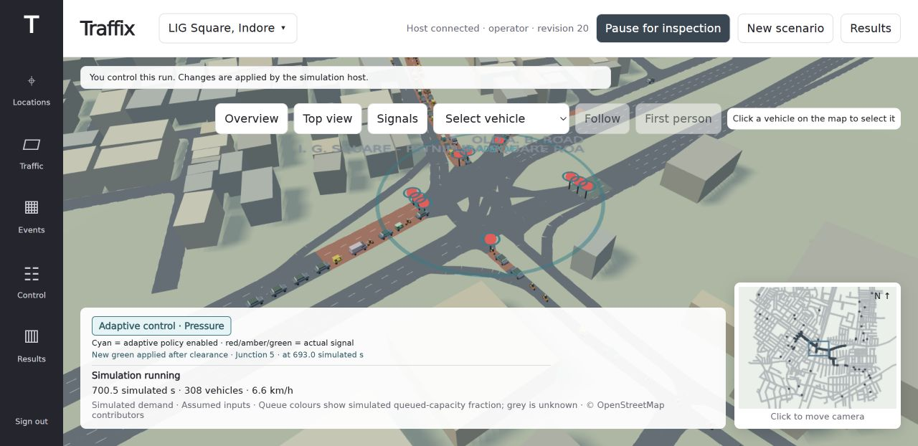
traffix.
Product walkthrough
Operator and driver demonstration
One shared host
Admin selects a policy.
Worker confirms safe actions.
Results compares saved cohorts.
Driver joins a bound vehicle.
Consent controls probe sharing.
Guidance requires acceptance.
Saved UI screenshot. Phone observations relay simulated vehicles. Native integration and physical multi-device checks require verification.
08/09
Notes:
Screenshot: artifacts/ui/operator-signals-adaptive.png at source commit7733a08. Cyan marks an enabled adaptive policy, not guaranteed benefit or a green indication. Screenshot is a UI demonstration from Explore, not the benchmark cohort. The long-running Explore session is prone to overload and collision involvements. Demo sequence: show admin control, bound phone identity and opt-in data, worker receipt, recorded pressure seed51/52 against its matched fixed baseline. Native unified-host integration is concurrently being fixed. Check docs/final-app-status.md and prakhyat-review/docs/final-sim-status.md before describing physical-device success. Browser probe screenshots do not prove native Android end-to-end operation.

Slide 9
traffix.
Next steps
Validation and deployment roadmap
Built and measured
Local LIG simulation, shared operator dashboard and bounded pressure control.
Saved matched cohorts support the held-out result.
Next integration gate
Verify the native companion against the unified host on real devices.
Keep phone identity, consent and worker confirmation visible in the demo.
Next evidence gate
Validate forecasts, sustained overload and per-approach fairness.
Calibrate fleet emissions and observations before a field pilot.
09/09
Notes:
A two-seed synthetic evaluation supports a narrow reactive-control headline. More independent held-out seeds, sustained demand, negative cases, P95 waiting and per-approach red time must inform policy selection. Forecast accuracy and predictive-control benefit require separate tests. Local vision, speed advice, emergency priority and field GPS remain validation work. Public submission frontend https://traffix-demo.vercel.app/ is separate from the local SUMO host.

