Slide 1
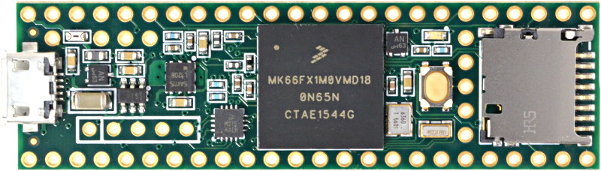
Teensy 3.6 Microcontroller in TVAC
Kinetis MK66 Microcontroller
180 MHz ARM-M4
Operating Temp: -40C to 105C
Connected directly to cold plate
Feedthroughs allow power, communication, and cryocooler drive
Chip tested from -50C to 50C

Slide 2
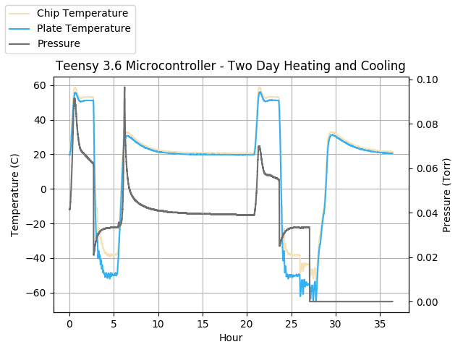
Two Day Cycle of Heating and Cooling TVAC Overview
Vacuum Power Pump Turned On
Day 1
Day 2
Chamber below flight pressure for entire test
One hour successful test of temperatures from 50C to -50C

Slide 3
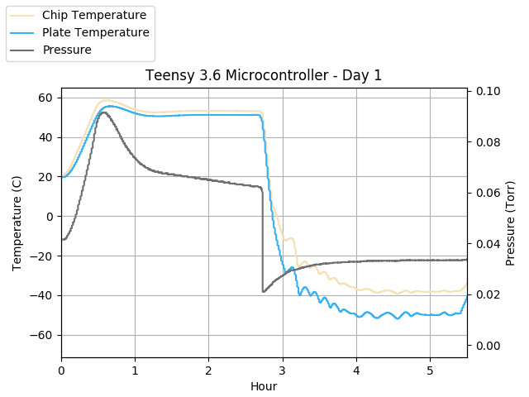
Day 1 Heating and Cooling TVAC Results
Heating phase: TVAC set point 50C
Cooling phase: TVAC set point -50C
Kinetis MK66 Chip does not reach set point temp
A
B
Continuous operation of PID controller maintained at high of 50C and low of -40C
Chamber below flight pressure for entire test
Cool chip further on Day 2

Slide 4
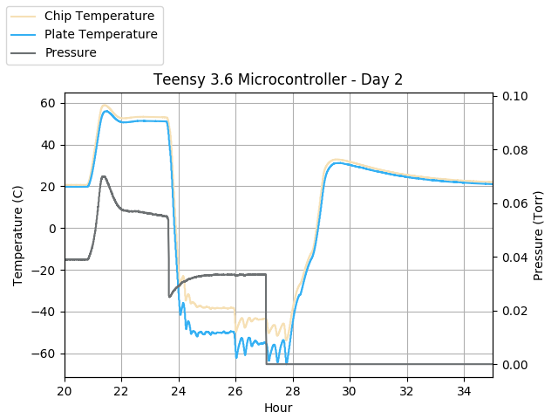
Day 2 Heating and Cooling TVAC Results
Kinetis MK66 chip operational again at 50C and at minimum tested temperature of -53C
Vacuum power pump turned on to remove more excess gas allowing the chip temperature to approach set point value
Successful Test

