Slide 1
EQUITY IN AUTOIMMUNITY:
Mapping Overlapping Genetic Variants
in Underserved Populations
MAKENZIE ROULAE WIGGINS
Final Presentation | Data Wrangling
Notes:
Hi everyone. My name is Makenzie Wiggins, and my presentation is called Equity in Autoimmunity: Mapping Overlapping Genetic Variants in Underserved Populations.

Slide 2
THE PERSONAL WHY
A Brother's Story
2
At age 2, my brother suffered a severe anaphylactic reaction.
Three years later
— despite doctors dismissing symptoms — he was diagnosed with Type 1 Diabetes.
This sequence of events — a massive immune event followed by T1D onset — became the central question of this research.
Black individuals with T1D are statistically more likely to experience ketoacidosis, and representation in the research that could help them is critically low.
Age at anaphylaxis
years old
3
Years until T1D diagnosis
years later
DKA
Black T1D patients at higher risk of
diabetic ketoacidosis
Notes:
This project started with a personal observation. My brother had a severe anaphylactic reaction at age two, and three years later he was diagnosed with Type 1 Diabetes. That sequence — a major immune event followed by T1D onset — became the central question driving this research.
What the literature also shows is that Black individuals with T1D are statistically more likely to experience diabetic ketoacidosis, and representation in the genomic research that could help them is critically low. That's the equity problem this project is trying to address.

Slide 3
RESEARCH QUESTION
What shared variants/loci exist between severe early-onset allergic phenotypes and T1D, and are these loci underrepresented in Black populations within the GWAS Catalog and ClinVar?
Type 1 Diabetes
Severe Allergic Phenotypes
Black Population Representation
Three pillars — brought together for the first time
Notes:
That brought me to this research question: What shared variants and loci (LOWS EYE ) exist between severe early-onset allergic phenotypes and Type 1 Diabetes, and are those loci underrepresented in Black populations within the GWAS Catalog and ClinVar?
The three pillars are Type 1 Diabetes, severe allergic phenotypes, and Black population representation. To my knowledge, no one has brought all three together into a unified analysis — and that's the gap this project is trying to fill.

Slide 4
Related Works
ClinVar: Public Archive of Relationships Among Sequence Variation and Human Phenotype
Analyzing Human Genetic Variation Using SNP-Based Methods (doi: 10.1002/0471142905.hg0816s89)
Establishes the methodological precedent for using SNPs to identify disease-associated loci. This is the "why SNPs" justification for filtering and loci-identification approach.
ClinVar: Public Archive of Relationships Among Sequence Variation and Human Phenotype
Use of the ClinVar variant_summary as a clinical validation layer. This is the foundational paper establishing ClinVar as the standard bridge between raw genetic variants and clinical phenotypes.
Balding et al. (2006) — Current Protocols in Human Genetics
Landrum et al. (2014) — Nucleic Acids Research
rs705704
Ribosomal Protein S26
ClinVar: Public Archive of Relationships Among Sequence Variation and
e
Meta-Analysis of Genome-Wide Association Studies in African Americans Provides Insights into the Genetic Architecture of Type 2 Diabetes
Provides the methodological blueprint for filtering GWAS data specifically to Black/African American participants. Justifies the 70% Black ancestry threshold filter and the decision to analyze this population separately.
Ng et al. (2014) — PLOS Genetics
ClinVar: Public Archive of Relationships Among Sequence Variation and Human Phenotype
Ancestry Gaps in Cardiovascular GWAS: A Multi-Database Review of African Representation in Genomic Studies
Documents the systemic underrepresentation of African ancestry populations across GWAS databases — providing direct support that shared T1D–allergy loci have never been meaningfully studied in Black populations.
Pomales-Matos et al. (2025) — Frontiers in Genetics
Notes:
Before I get into the data, I want to briefly touch on the work that grounded this project.
Landrum et al. from 2014 established ClinVar as the standard bridge between raw genetic variants and clinical phenotypes — that justifies my use of the variant summary as a clinical validation layer.
Balding et al. provides the foundational methodology for using SNPs to identify disease-associated loci, which is the core technique behind my filtering approach.
Ng et al. from 2014 conducted a GWAS meta-analysis specifically in African Americans and gave me the blueprint for filtering to Black participants — directly justifying the 70% threshold I'll walk through later.
And Pomales-Matos et al. from 2025 documented ancestry gaps across GWAS databases, which directly validates the equity hypothesis at the center of this project.
I also want to name the two required course readings. AutoDW by Liu et al. shaped my LLM-assisted feature type inference, and the Zhou et al. survey on LLMs for data preparation informed my semantic phenotype matching strategy — both of which I'll come back to in the methodology.

Slide 5
THE DATA
ClinVar / NCBI
GWAS Catalog
GWAS Ancestry
variant_summary.txt
Associations data
Ancestries data
8,887,816 rows
1,061,816 rows
39,980 rows
43 columns
38 columns
17 columns
0 null values
5,800+ unique diseases
70%+ Black filter
Industry-standard bridge between raw genetic variants and clinical phenotypes. Used to identify T1D and anaphylaxis-related variants and validate shared SNPs.
Population-scale genotype-phenotype associations. Used to find shared SNPs across T1D and allergic phenotypes at scale.
Demographic data for each GWAS study. Used to isolate studies with predominantly Black participant populations.
Notes:
I built this project on three datasets.
]The ClinVar variant summary from NCBI — nearly 8.9 million rows, 43 columns, zero null values — used to map genetic variants to clinical phenotypes and validate shared SNPs.
The GWAS Catalog associations data — just over a million rows covering more than 5,800 unique diseases — used to find shared SNPs across T1D and allergic phenotypes at scale.
And the GWAS Catalog ancestry data — about 40,000 rows of demographic information — used to isolate studies with predominantly Black participant populations.

Slide 6
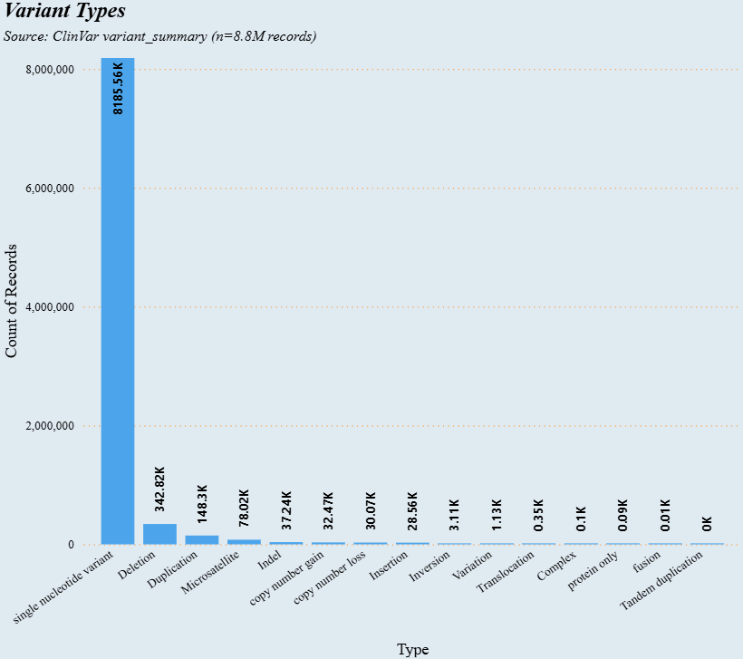
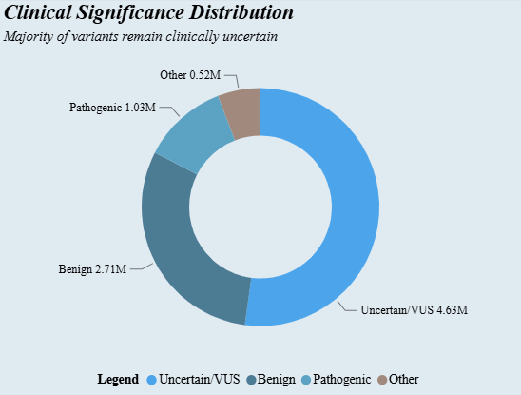
CLINVAR ANALYSIS — VARIANT TYPES & CLINICAL SIGNIFICANCE
Source: ClinVar variant_summary | 8,887,816 rows | 43 columns | 0 null values
5.8K
Unique Diseases in GWAS Catalog
Notes:
My initial EDA focused on understanding the distribution of variant types and how clinical significance was assigned across them. Single nucleotide variants dominate the dataset, which is expected. The clinical significance breakdown shows a large portion classified as variants of uncertain significance — an important quality note, because it means not everything in ClinVar is clinically actionable, and any downstream validation needs to account for that.

Slide 7
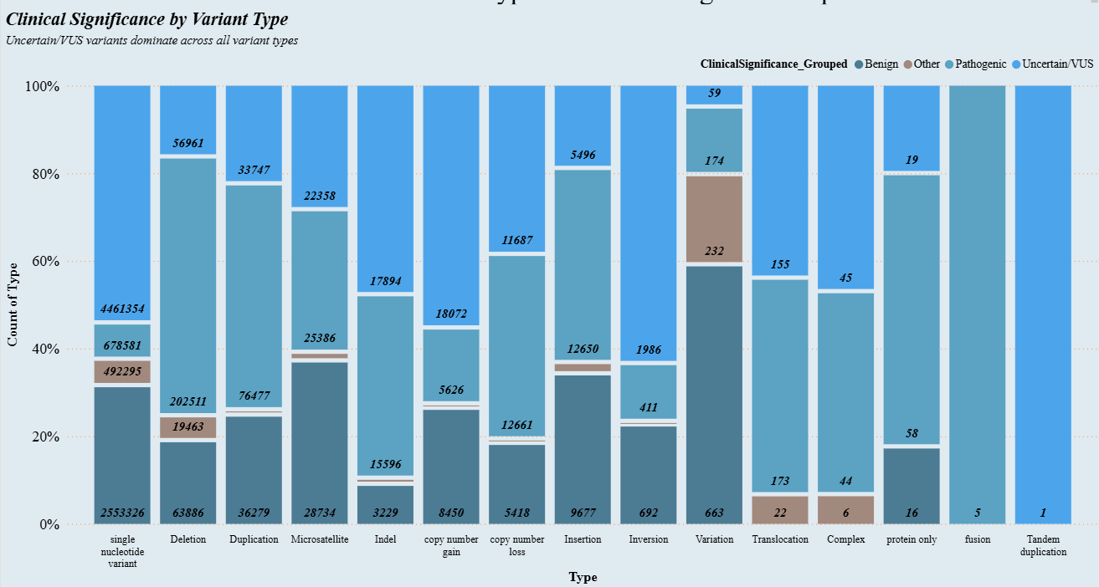
CLINVAR ANALYSIS — CLINICAL SIGNIFICANCE BY VARIANT TYPE
Notes:
Breaking it down further by variant type, pathogenic classifications are not evenly distributed. Certain variant types carry a much higher proportion of pathogenic entries, which informed how I weighted my downstream filtering when looking for variants with enough clinical confidence to count as real validation.

Slide 8
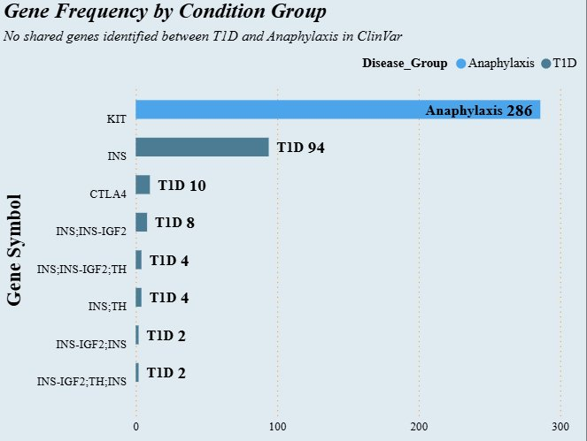
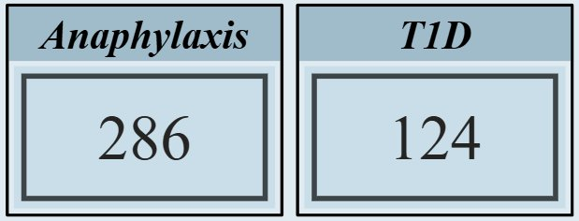
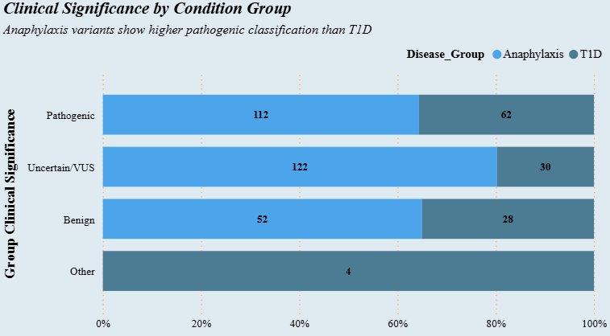
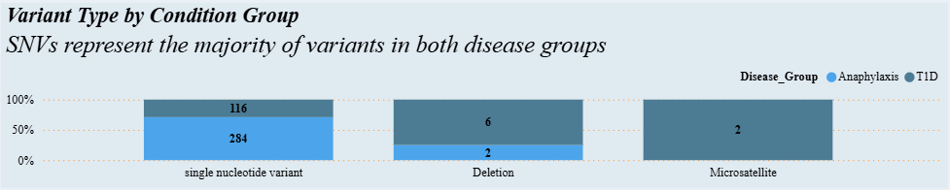
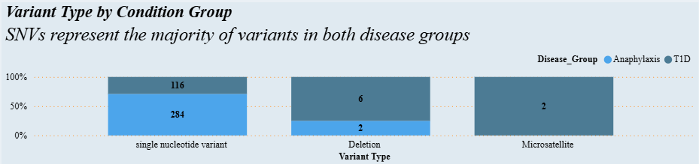
T1D vs ANAPHYLAXIS — GENE OVERLAP IN CLINVAR
No shared genes identified between T1D and Anaphylaxis in ClinVar — supporting the representation gap hypothesis
Notes:
When I filtered ClinVar for T1D-associated genes and anaphylaxis-associated genes separately and looked for overlap, I found none. Zero shared genes between the two conditions in ClinVar. This doesn't mean there's no biological relationship — it means either the overlap doesn't exist in this dataset, my filters were too rigid, or the shared loci simply haven't been submitted to ClinVar yet. I came back to this question when I brought in the GWAS data.

Slide 9
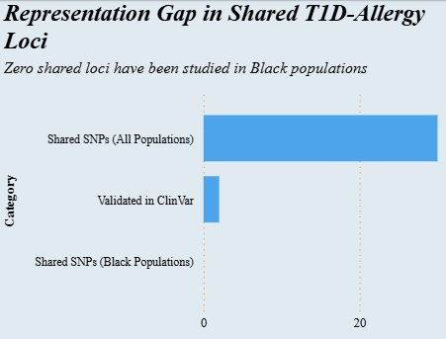
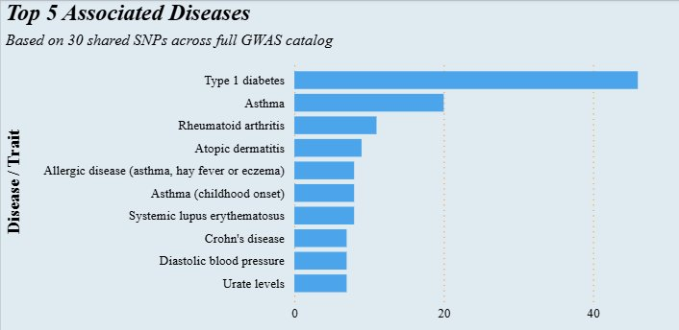
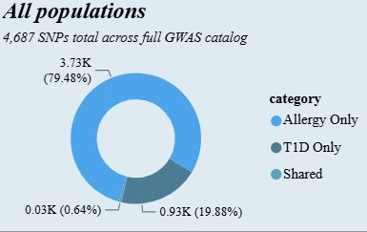
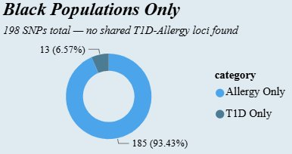
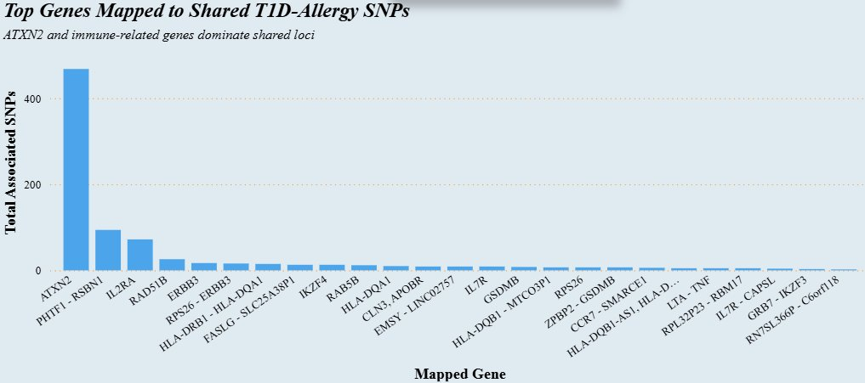
GWAS CATALOG — REPRESENTATION GAP ANALYSIS
Comparing shared T1D-Allergy SNPs across full GWAS, Black-ancestry filtered studies, and ClinVar clinical validation
Notes:
This slide frames the representation gap visually — comparing T1D and allergy associated SNPs across the full GWAS Catalog versus what remains when you filter to studies with predominantly Black participants. Even before I ran the intersection, the drop-off in Black-ancestry representation for these specific conditions was stark, and it started to suggest that the zero overlap I found earlier wasn't just a filter problem.

Slide 10
WHERE I GOT STUCK
Filtering Black-ancestry GWAS data + joining with T1D & allergy subsets → 0 shared SNPs
?
?
?
Scientific?
Filters too strict?
Representation gap?
Is there truly no genetic overlap between these conditions in Black populations?
Did my rigid string matching on disease terms miss semantically similar phenotypes?
Have these shared loci simply never been studied in Black populations at scale?
The answer turned out to be all three — and LLMs helped untangle them.
Notes:
After filtering the Black ancestry GWAS data and joining it with my T1D and allergy subsets, I got zero shared SNPs. I sat with that result and asked myself three questions. Is this scientific — is there truly no genetic overlap in Black populations? Are my filters too strict — did rigid string matching miss semantically related phenotypes? Or is this a representation gap — have these shared loci simply never been studied in Black populations at scale?
The answer turned out to be all three. And that's where LLMs came in.

Slide 11
HOW LLMs GOT ME UNSTUCK
Gemini 2.5 Flash integrated directly into the R environment via the GenAI package
01
Feature Type Inference
AutoDW (Liu et al., 2024)
Sampled 3 values per column from the 43-column variant_summary and asked Gemini to classify each as Numerical, Categorical, Datetime, etc. and flag columns influential for T1D or allergy analysis.
02
Demographic Filtering
LLM-Assisted Wrangling
Used Gemini to generate and refine the 70% Black ancestry threshold filter — replacing a brittle 12-condition OR filter with a precise percentage-based approach across study populations.
03
Semantic Phenotype Matching
Zhou et al., 2025
Asked Gemini to remove redundant columns post-join and recommend join strategies when RSID matching failed — bridging ClinVar and GWAS datasets that rigid string filters could not connect.
Notes:
I integrated Gemini 2.5 Flash directly into my R environment using the GenAI package and used it for three specific wrangling tasks.
The first was feature type inference, drawing on the AutoDW framework. I sampled three values per column from the 43-column variant summary and asked Gemini to classify each one and flag which columns were influential for T1D or allergy analysis — giving me a structured starting point instead of manually evaluating all 43 columns.
The second was demographic filtering. I used Gemini to move away from a brittle 12-condition OR filter and replace it with a percentage-based approach calculating what proportion of each study's participants had African ancestry. That's where the 70% threshold came from. Getting there actually took a lot of trial and error — I used Claude as an outside AI assistant to help think through the filtering logic, but I still had to manually scroll through rows of the ancestry data to verify the math was holding up the way I expected. The LLM gave me a starting point, but the validation was very much hands-on.
The third task was semantic phenotype matching, drawn from the Zhou et al. survey. I asked Gemini to recommend join strategies when RSID matching failed and to help bridge the ClinVar and GWAS datasets that rigid string filters couldn't connect.
I also want to be honest about where the LLM fell short. When I asked Gemini to remove redundant and duplicate columns after the join, it was too aggressive — it cut the dataset further than I intended and I lost columns I actually needed. At that point it was faster and more reliable to just do it manually. That's a real limitation of LLM-assisted wrangling: it optimizes for what you asked, not necessarily what you meant.

Slide 12
LLM IN ACTION — SELECTED CODE
Feature Type Inference
70% Black Ancestry Filter
infer_variant_column_types <-
function(Variant_data, genai_obj) {
col_samples <- sapply(
names(Variant_data), function(col) {
vals <- na.omit(Variant_data[[col]])[1:3]
paste0(col,": [",
paste(vals, collapse=", "),"]")
})
prompt <- paste0(
"Classify each column as: Numerical,",
" Categorical, Datetime...\n",
"Flag 'influential' = TRUE if related",
" to T1D or Allergy phenotypes.\n",
"Return only raw JSON.\n\n",
paste(col_samples, collapse="\n"))
result <- txt(genai.object=genai_obj,
prompt=prompt)
fromJSON(gsub("```json|```","",result))
}
gwas_ancestor_pct <- gwas_ancestor %>%
mutate(group_n = as.numeric(
str_replace_all(
`NUMBER OF INDIVIDUALS`,",",""))) %>%
group_by(`STUDY ACCESSION`) %>%
mutate(total_n = sum(group_n,
na.rm=TRUE)) %>%
ungroup() %>%
mutate(
is_african = str_detect(
`BROAD ANCESTRAL CATEGORY`,
"African American|Sub-Saharan"),
african_n = ifelse(
is_african, group_n, 0)) %>%
group_by(`STUDY ACCESSION`) %>%
mutate(study_pct_african =
sum(african_n, na.rm=TRUE) /
max(total_n, na.rm=TRUE)) %>%
ungroup() %>%
filter(study_pct_african >= 0.70)
Notes:
This slide shows two of the functions I built. On the left is the feature type inference function — it samples three values per column, constructs a prompt asking Gemini to classify and flag influential columns, and parses the JSON response back into R. On the right is the 70% Black ancestry filter, which replaced my original manual OR filter. It calculates total participants per study, identifies African ancestry rows, computes a percentage, and filters to studies where at least 70% of participants have African or African American ancestry. The reason this matters is precision — my original filter would have included studies where Black participants were a small minority.

Slide 13
THE KEY FINDING
Representation Gap in Shared T1D–Allergy Loci
Source: GWAS Catalog full dataset vs. 70%+ Black ancestry filtered subset vs. ClinVar validation
30
2
0
Shared SNPs
(Full GWAS)
Shared SNPs
(Black Populations)
Clinically Validated
(ClinVar)
Shared genetic loci between T1D and allergic phenotypes exist — but have never been meaningfully studied in Black populations.
Notes:
Here it is. Across the full GWAS Catalog, I found 30 shared SNPs between T1D and allergic phenotypes. When I applied the 70% Black ancestry filter, that number dropped to zero. And when I cross-referenced those 30 SNPs against ClinVar, only 2 had clinical entries.
That 30 versus zero comparison is the empirical heart of this project. Shared genetic loci between T1D and allergic phenotypes exist and have been studied — but they have never been meaningfully studied in Black populations. That is not a data cleaning artifact. That is a representation gap in the scientific literature.

Slide 14
THE 2 CLINICALLY VALIDATED SNPs
Of 30 shared SNPs identified in the full GWAS catalog, only 2 have clinical entries in ClinVar
rs6897932
IL7R
rs705704
RPS26
Interleukin-7 Receptor
Ribosomal Protein S26
Associated with:
Associated with:
Type 1 Diabetes
Type 1 Diabetes
Asthma
Asthma
Multiple sclerosis
Body mass index
Systemic lupus erythematosus
Metabolic syndrome
IL7R variants affect T cell development and survival — directly relevant to T1D autoimmune destruction of pancreatic beta cells AND allergic inflammation. A shared SNP here makes strong biological sense.
RPS26 sits in chromosome 12q13 and has been associated with T1D through effects on INS (insulin gene) expression. Its appearance as a shared locus with allergy phenotypes is a novel finding worth highlighting.
Notes:
The two SNPs that survived cross-referencing with ClinVar are rs6897932 in IL7R — the Interleukin-7 Receptor — and rs705704 in RPS26.
IL7R is associated with Type 1 Diabetes, asthma, multiple sclerosis, and lupus. IL7R variants affect T cell development and survival, which makes this finding compelling on both sides: T cells drive the autoimmune destruction of pancreatic beta cells in T1D and are also involved in allergic inflammation. A shared SNP here makes strong biological sense.
RPS26 sits in chromosome 12q13 and has been linked to T1D through its effects on INS — the insulin gene — expression. Its appearance as a shared locus with allergy phenotypes is more novel. I want to be careful not to overclaim — this is a candidate finding, not a confirmed causal relationship. But it's one worth following up on. And neither of these SNPs has been studied in a Black-ancestry cohort.

Slide 15
FUTURE INTEREST
Short Term
Mid Term
Long Term
Expand semantic matching using LLMs to capture allergy phenotype variants missed by rigid string filters
Apply ML clustering to identify shared functional pathways between allergy and T1D variants
Advocate for mandatory ancestry diversity reporting in GWAS publications
Integrate gnomAD African ancestry population frequency data for allele frequency comparison
Build a classifier to flag variants likely underclassified in Black populations due to representation gaps
Develop a public-facing tool for clinicians to identify ancestry-specific risk variants
Narrow focus to specific allergens (e.g., tree nuts) where literature suggests stronger T1D correlation
Validate IL7R and RPS26 findings against additional Black-ancestry cohorts
Publish findings to contribute to equitable genomic medicine for Black adolescents with T1D
Notes:
Short term: expand semantic matching to capture allergy variants missed by string filters, integrate gnomAD African ancestry frequency data, and narrow the allergy focus — potentially to tree nut allergies where literature suggests a stronger T1D correlation.
Medium term: apply ML clustering to identify shared functional pathways, build a classifier to flag variants likely underclassified in Black populations, and validate the IL7R and RPS26 findings against additional Black-ancestry cohorts.
Long term: advocate for mandatory ancestry diversity reporting in GWAS publications, develop a clinician-facing tool for ancestry-specific risk variants, and publish findings to contribute to equitable genomic medicine for Black adolescents with T1D.

Slide 16
THANK YOU
MAKENZIE ROULAE WIGGINS
30 shared T1D-Allergy SNPs exist in GWAS — 0 studied in Black populations
IL7R & RPS26 are clinically validated shared loci with strong biological relevance
LLM-assisted wrangling is a legitimate methodological contribution to bioinformatics
Notes:
Any questions?

