Slide 1
Introduction to JS
M.Jeevan Babu
Assistant Professor
Department of CSE
VVIT,Guntur

Slide 2
Introduction
JavaScript is a programming language that enables you to create dynamically updating content, validate the user,control multimedia, animate images, and pretty much everything else.

Slide 3
How to start?
with inline script
-JavaScript programs can be inserted in any
part of an HTML document with the help of
the <script> element.
importing external scripts
separates HTML and JS: easier to maintain
cached JavaScript files can speed up pageloads

Slide 4
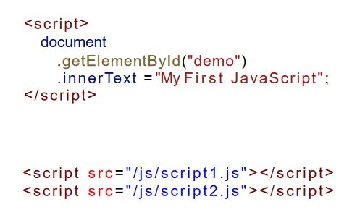

Slide 5
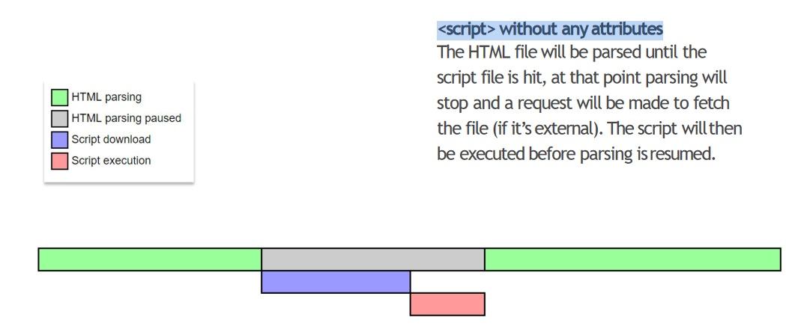
<script> without any attributes

Slide 6
defer/async
<script src="1.js" async></script>
<script src="2.js" defer></script>

Slide 7
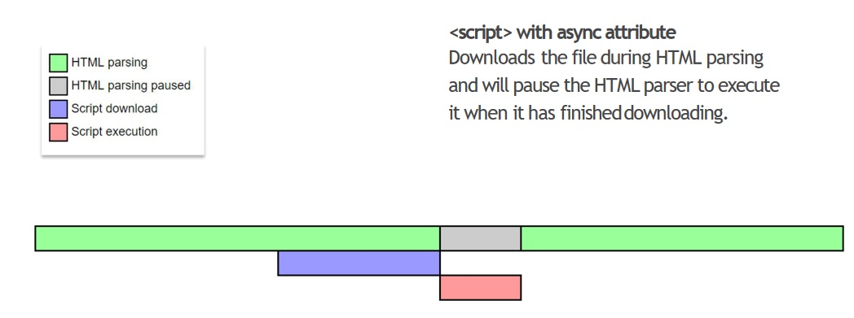
<script async>

Slide 8
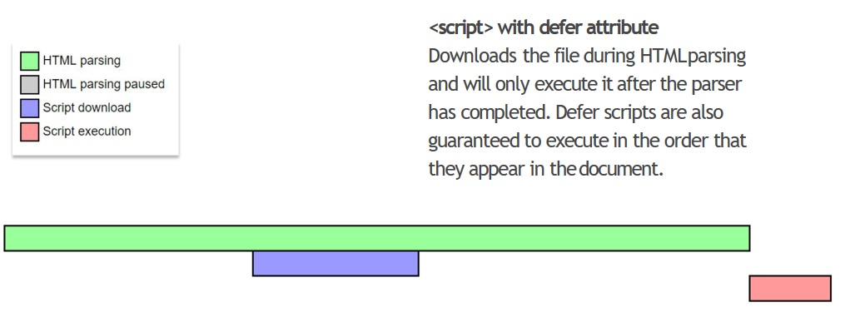
<script defer>

Slide 9
Expressions and statements
JavaScript distinguishes expressions and statements.
An expression produces a value and can be written wherever a value is expected,for example as an argument in a function call.
A statement performs an action. Loops and if statements are examples of statements.

Slide 10
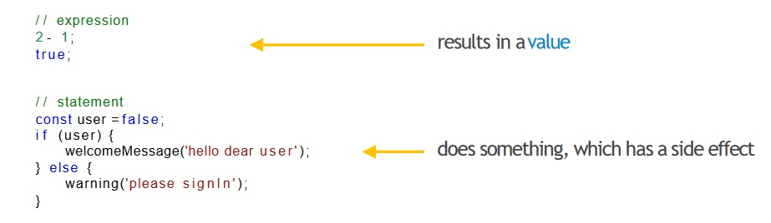

Slide 11
Variable
A variable is a named container for a value.
The name that refers to a variable is called an identifier.
Variable names start with aletter, underscore
(_), or dollar sign ($).
Subsequent characters can also be digits(0-9)
In practice, we use camelCase for variables.

Slide 12
Valid Examples
Number_hits
Temp99
$credit
and _name
userName

Slide 13
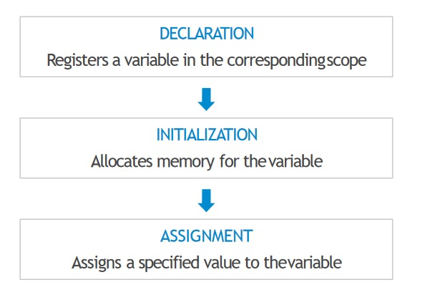
Declaration, Initialization and Assignment

Slide 14
4 Ways to Declare a JavaScript Variable:
Using var
Using let
Using const
Using nothing

Slide 15
Declaration Types
var
Declares a variable, optionally initializes it withvalue.
By default every variable gets undefined asvalue.

Slide 16
l e t
Declares a block-scoped, local variable, optionally initializing it to a value

Slide 17
const
Declares a block-scoped, read-only namedconstant

Slide 18
Using var
The var keyword is used in all JavaScript code from 1995 to 2015.
If you want your code to run in older browser, you must use var.
The var statement declares a function-scoped or globally-scoped variable, optionally initializing it to a value.
Variables declared with var are available in the scope of the enclosing function.
If there is no enclosing function, they are available globally.

Slide 19
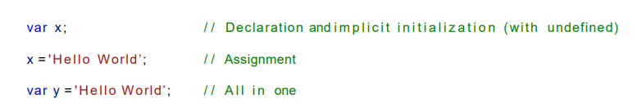
Var

Slide 20
Globally scope with var
Global scoping using var
var x = 1;
fun()
function fun()
{
console.log(x); // expected output: 1
}
console.log(x);// Expected output : 1

Slide 21
function scoped using var
function scoped using var
If you use var inside a block, the variable will not be a block scoped. It will either be function scoped or globally scoped depending upon where the block is present.

Slide 22
global scoped using var
var x = 2;
if (x === 2)
{ var x = 3;
console.log(x); // expected output: 3
}
console.log(x); //expected output: 3

Slide 23
function scoped using var
fun()
function fun()
{
var val=10 //expected output:10
console.log(val)
}
console.log(val)//Uncaught ReferenceError: x is not defined

Slide 24
let
The let statement declares a block-scoped local variable, optionally initializing it to a value.
Its scope is not only limited to the enclosing function, but also to its enclosing block statement.
A block statement is everything inside { and }, (e.g., an if condition or loop).
The benefit of let is that it reduces the possibility of errors, as variables are only available within a smaller scope.

Slide 25
let
let x ; / / Declaration value is undefined
x = 'Hello Wo rld’; / / Assignment
let y = 'Hello Wo rld’; // A l l i n one

Slide 26
Let: block scope
let val3 = 1;
if (val3 === 1)
{
let val3= 2;
console.log(val3); // expected output: 2
}
console.log(val3);// expected output: 1

Slide 27
Let: block scope
let allows you to declare variables that are limited to the scope of a block statement, or expression on which it is used, unlike the var keyword, which declares a variable globally, or locally to an entire function regardless of block scope.

Slide 28
Scoping rules
Variables declared by let have their scope in the block for which they are declared, as well as in any contained sub-blocks. In this way, let works very much like var. The main difference is that the scope of a var variable is the entire enclosing function:

Slide 29
Scoping rules
function varTest() {
var x = 1;
{
var x = 2; // same variable!
console.log(x); // 2
}
console.log(x); // 2
}

Slide 30
Scoping rules
function letTest() {
let x = 1;
{
let x = 2; // different variable!
console.log(x); // 2
}
console.log(x); // 1
}

Slide 31
global object
At the top level of programs and functions, let, unlike var, does not create a property on the global object.
var x = 'global';
let y = 'global';
console.log(this.x);//"global" console.log(this.y); // undefined

Slide 32
const
Variables declared using const are immutable.
A const is limited to the scope of the enclosing block, like let
Constants should be used whenever a value must not change during run time
It must be initialized immediately:
const x = 'Hello World’

Slide 33
Accidental global creation
All of the above named declarations can be written in the global context(i.e. outside of any function)
Even within a function, omitting var,let or const makes the variable automatically global.

Slide 34
Accidental global creation
function sayHello() {
hello = "Hello World";
console.log(hello)
}
sayHello();
console.log(hello) ; //expected is Hello World

Slide 35
strict mode
!To avoid accidentally declaring global variables you can use strict mode
Strict mode is declared by adding "use strict"; to the beginning of a script or a function.
Declared at the beginning of a script, it has global scope (all code in the script will execute in strict mode):

Slide 36
function fun(){
if(true){
var a=10;
let b=20;
const c=30
console.log(a); //10
console.log(b);//20
console.log(c )//30
}
console.log(a);//
console.log(b);//Uncaught ReferenceError: b is not defined
console.log(c)//Uncaught ReferenceError: c is not defined
}

Slide 37
hoisting
JavaScript Hoisting refers to the process whereby the interpreter appears to move the declaration of functions, variables or classes to the top of their scope, prior to execution of the code.

Slide 38
Variable Hoisting
Variable hoisting
Hoisting works with variables too, so you can use a variable in code before it is declared and/or initialized.
However JavaScript only hoists declarations, not initializations!
Until that point in the execution is reached the variable has its default initialization (undefined for a variable declared using var, otherwise uninitialized).

Slide 39

Var Hoisting
var hoisting
Here we declare then initialize the value of a var after using it. The default initialization of the var is undefined.

Slide 40
let and const hoisting
let and const hoisting
Variable declarations with let and const though won’t get initialized with undefined,thus the Temporal DeadZone!
An exception will be thrown if a variable declared with let or const is read before it is initialized.

Slide 41
Temporal dead zone
temporal dead zone
A let or const variable is said to be in a "temporal dead zone" (TDZ) from the start of the block until code execution reaches the line where the variable is declared.
While inside the TDZ, the variable has not been initialized with a value, and any attempt to access it will result in a ReferenceError

Slide 42
temporal dead zone
The variable is initialized with a value when execution reaches the line of code where it was declared.
If no initial value was specified with the variable declaration, it will be initialized with a value of undefined.
This differs from var variables, which will return a value of undefined if they are accessed before they are declared

Slide 43
example
example
function fun(){
console.log(a)//expected: undefined
console.log(b)//Uncaught ReferenceError: Cannot access ‘b' before initialization
console.log(c)//Uncaught ReferenceError: Cannot access 'c' before initialization
var a=10;
let b=20
const c=30
}

Slide 44
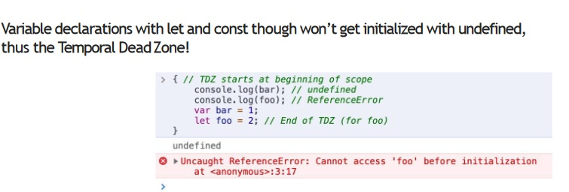
Temporal DeadZone!

Slide 45
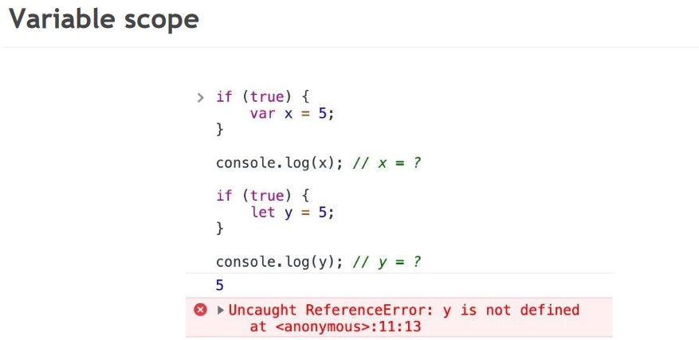

Slide 46
Data Types
1. String 2. Number 3. Bigint 4. Boolean 5. Undefined 6. Null 7. Symbol 8. Object

Slide 47
Examples
/ Numbers: let length = 16; let weight = 7.5; // Strings: let color = "Yellow"; let lastName = "Johnson"; // Booleans let x = true; let y = false; // Object: const person = {firstName:"John", lastName:"Doe"}; // Array object: const cars = ["Saab", "Volvo", "BMW"]; // Date object: const date = new Date("2022-03-25");

Slide 48
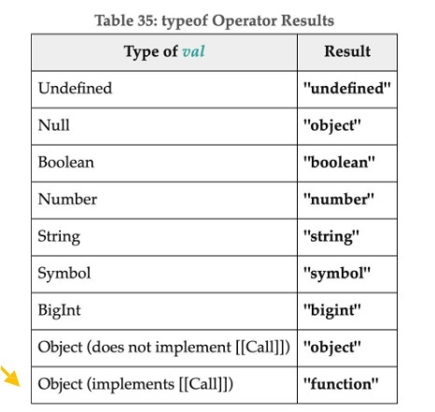
typeof operator

Slide 49
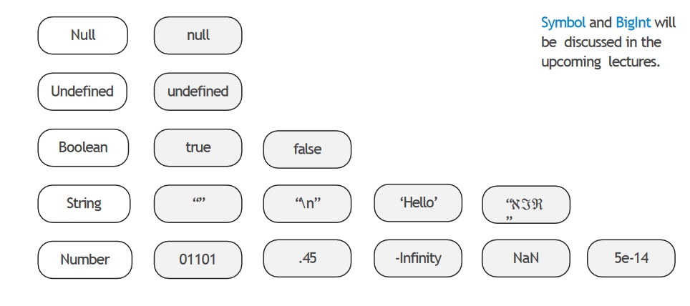

Slide 50
Number
l e t n = 536;
n = 3.1415;
n = 0.1 + 0.1 + 0 . 1 ; / / != 0.3
c o n s o l e. l og ( 1 / 0 , - 1 / 0 , 0 / 0 )

Slide 51
The number type is represented as a 64-bit floating-point number (52 bit mantissa + 11 bit exponent + a signbit).
Infinity represents the mathematical Infinity∞ .

Slide 52
NaN
• Division of zero byzero
• Dividing an infinity by aninfinity
• Multiplication of an infinity by a zero
• Any operation in which NaN is an operand
• Converting a non-numeric string
or undefined into anumber

Slide 53
NaN< 1 ; / / f als e NaN
> 1 ; / / f als e NaN==
NaN; / / f als e
/ / But we can s t i l l check f o r NaN:
isNaN(NaN); / / true
isNaN(true); / / f al s e
isNaN(false); / / f al s e

Slide 54
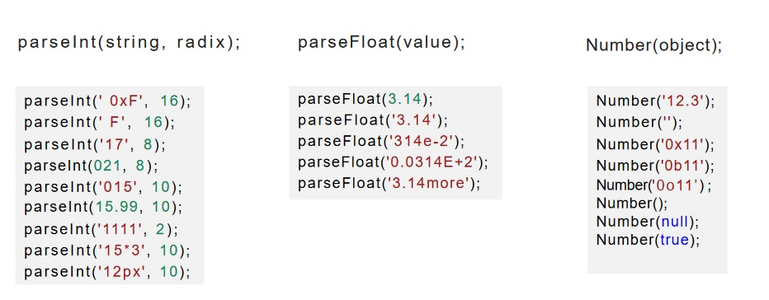
To Number

Slide 55
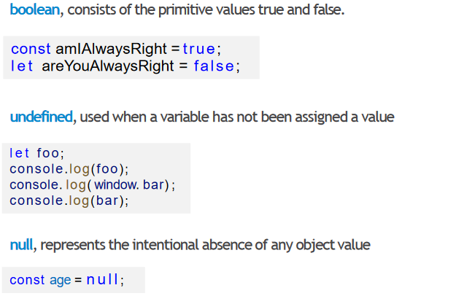
boolean, undefined, null

Slide 56
Data type conversion
Converting to strings
Converting to numbers
Converting to boolean

Slide 57
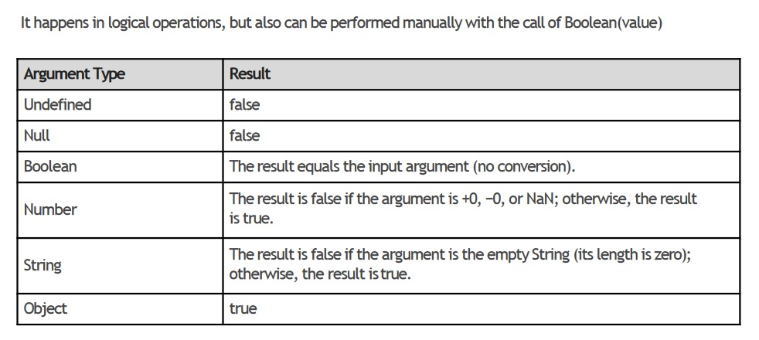
To Boolean Conversion

Slide 58
To number conversion
Numeric conversion happens in mathematical functions and expressions automatically, or by calling
Number(argument)

Slide 59
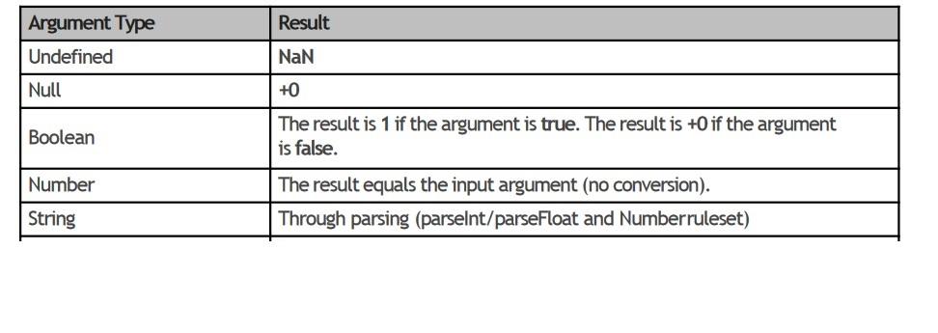
To Number Conversion

Slide 60
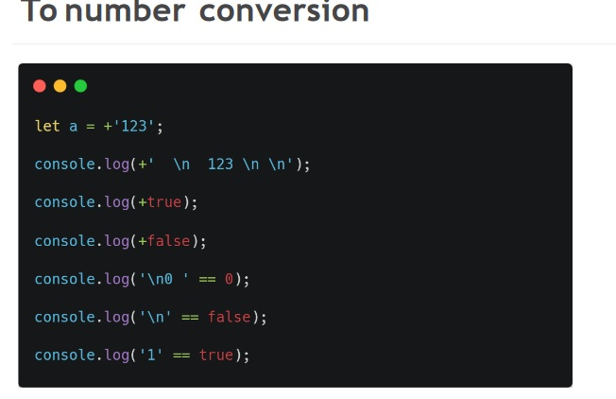

Slide 61
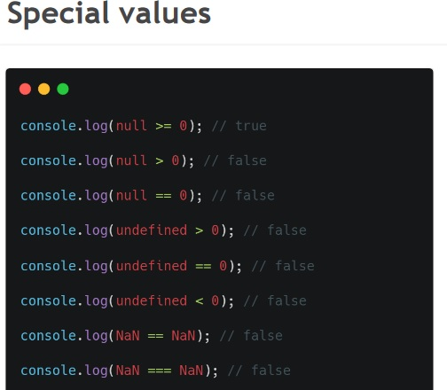

Slide 62
Operators
Arithmetic operators
• Assignment operators
• Logical operators
• Comparison operators
Bitwise Operators
Bitwise Logical
Bitwise Shift operators

Slide 63
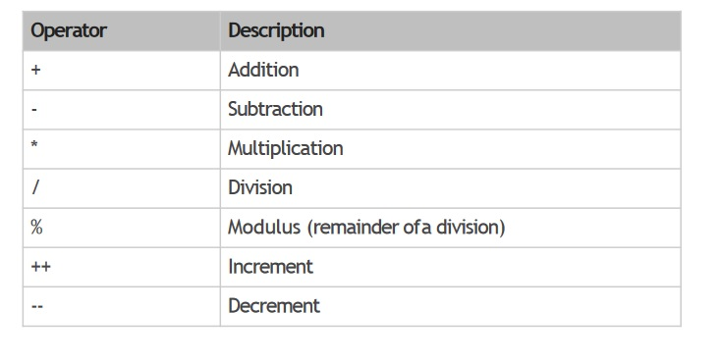
Arithmetic operators

Slide 64
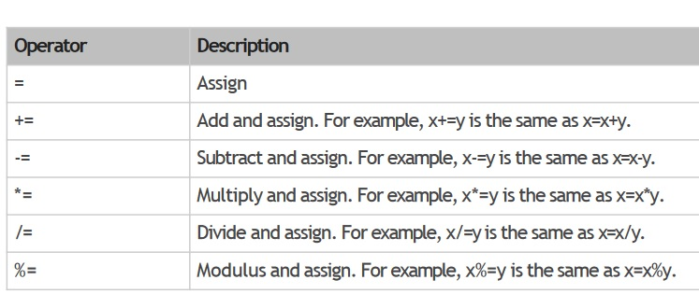
Assignment operators

Slide 65
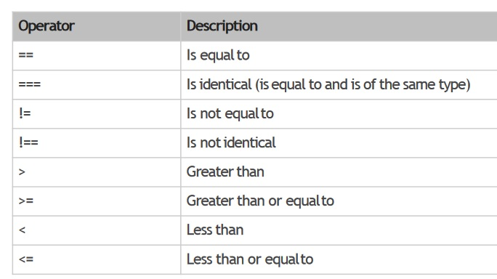
Comparison operators

Slide 66
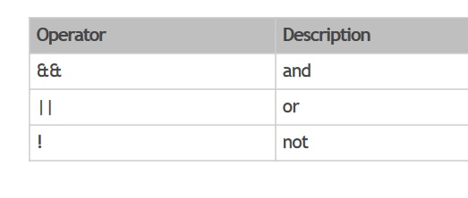
Logical operators

Slide 67
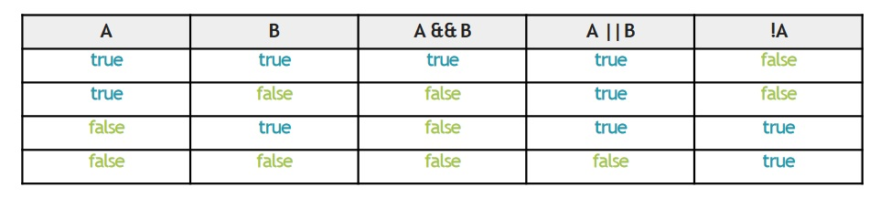
Examples

Slide 68
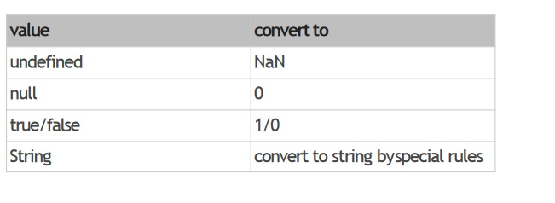
Type conversion

Slide 69
Thank You

