Slide 1




Introduction to programming in Python​
Arthur Gilly
February 20, 2022 at 1:00 PM
Makerbox Lao
arthur@makerbox.la
52413104

Slide 2



What will you learn today?​
Our agenda today
What programming is and its basic concepts​
How to use variables
Understand variable types (string, numbers, logical)​
Use common mathematical and logic operators
Use flow control to evaluate conditions​
Use loops​

Slide 3

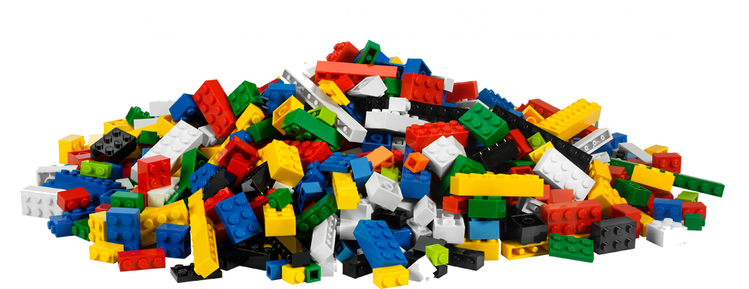
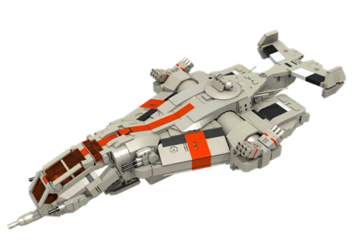

Programming is writing computer programs​
The computer only understands machine code​
What is Programming?
Impractical for humans, so programming languages were created to be more human-friendly​
There are hundreds of programming languages but they all share the same building blocks​
Python is an interpreted language​
You can edit your code like a normal document and run it in python without additional steps​
Or even run interactively in a console
Other languages like C++ are compiled​
They need to be translated into machine code by a compiler​
They are faster, but a bit more tricky to use

Slide 4



What is a variable?​
A variable is a bit of memory that contains a value
It exists while the program is running, can be changed by the program
You can write code to change that value depending on events
We have variables in real life:​
The amount of money in my wallet​
My current average grade at university​

Slide 5


Declaration/Initialisation​
In order to use a variable, you have to declare/initialize it​
This is done with the assignation operator “=”
i = 8
i ← 8
You can change the value of the variable in the same way

Slide 6


Variable type​
The type of a variable is the class of the information it contains
In many languages type is very important, you cannot easily change type​
In Python, type is “hidden”, you can switch between types easily
Visualise the type of your variable with type(i)​
What is the type of a variable that contains
2
“hello”
3.5
False

Slide 7


Basic types​
Type | Name | Definition
int​ | Integer | Integer numbers, including negatives​
str | Strings | Character strings, delimited by double quotes “ or single quotes’​
float | Floating-point numbers | There is a limit both on the precision and value of floats, but they are enough for most uses​
bool | Booleans | can only be either True or False​

Slide 8

Type restrictions​
Try adding two integers together with +
Try adding a string with an integer​
The operations you can perform on variables depend
on their types
You can convert all integers to strings using str()
and some strings to integers using int()​

Slide 9

Other assignation operators​
What do the following operations do?​
a += 1
b -= 3

Slide 10


Mathematical operators​
You can use Python like a simple calculator
It understands the following operators
+
-
/
//
*
% (modulo operator)
7 % 3 = 1 because 7 = 2 * 3 + 1
Operand 1 type​ | Operator | Operand 2 type​ | Result type​
int​ | +, - | int
float | +, - | int
int | / | int
And more, which we will not cover today :)​

Slide 11


String operators
Try the following string operators​
s1 + s2​
s1 in s2
s1[i], where i is an integer
Python numbers indices starting at 0

Slide 12
Comparison operators​
Like in the previous slide, we have operators that produce
Boolean values for number types​
==, != (between all types of variables)​
<, <=, >, >= (numbers only)​

Slide 13
Logical operators​
These operators operate on Booleans​
and | O1 | O2 | Result
 | True | True | True
 | True | False | False
 | False | True | False
 | False | False | True
or | O1 | O2 | Result
 | True | True | True
 | True | False | True
 | False | True | True
 | False | False | False
not | O1 | Result
 | True | False
 | False | True

Slide 14


Logical operators​
These operators operate on Booleans​
and | O1 | O2 | Result
 | True | True | True
 | True | False | False
 | False | True | False
 | False | False | True
or | O1 | O2 | Result
 | True | True | True
 | True | False | True
 | False | True | True
 | False | False | False
not | O1 | Result
 | True | False
 | False | True
They can be combined with comparison operators to create “conditions”
sex == “male” and age > 20 and not age > 40

Slide 15


Exercise​
How do you write the following conditions:​
A number is odd/even​
A string is empty
A string contains the letter “A”
A number is between 0 and 1
A number is either zero, or between 5 and 10
When are the following conditions True?
i <= 5
i < 5 and i > 5
i < 5 or i > 5

Slide 16
Flow control: if…elif…else​
if CONDITION :​
# what to do when CONDITION is True​
elif ALTERNATIVE :​
# what to do if CONDITION is False but ALTERNATIVE is True​
# (optional)​
else :​
# what to do when all the conditions above are False​
# (optional)​

Slide 17
Flow control: if…elif…else​
if age < 12 :​
print(“you are a child”)​
elif age < 18 :​
print(“you are a teenager”)​
elif age < 60:​
print(“you are an adult”)​
else :​
print(“you are a senior”)​
Change the code above to print both “you are an adult” and “you are a senior” when age is equal or above 60​

Slide 18
Flow control: if…elif…else​
if age < 12 :​
print(“you are a child”)​
elif age < 18 :​
print(“you are a teenager”)​
else :​
print(“you are an adult”)​
if age >= 60 :​
print(“you are a senior”)

Slide 19
Loops: the while loop​
while CONDITION:​
# will be repeated as long as CONDITION is True​
# if CONDITION is not True the first time while is read, ​
# then this will never be run​
# the code inside can (and should) change CONDITION​

Slide 20
Loops: the while loop​
i=0​
while i<=10 :​
print(“i is” + str(i))​
i+=1​

Slide 21
Loops: the while loop​
i=0​
sum=0​
while i<=2 :​
j=input(“Please input an integer (“+str(3-i)+” remaining) : ”)​
j=int(j)​
sum+=j​
i+=1​
Print(“thank you, the sum is “+str(sum)+”\n”)​
Write code that takes in integers from the user until the total is above 20​

Slide 22
The for loop​
for var in VALUES:​
# this will be executed once for each item in VALUES​
# at every iteration, var contains the corresponding item​

Slide 23
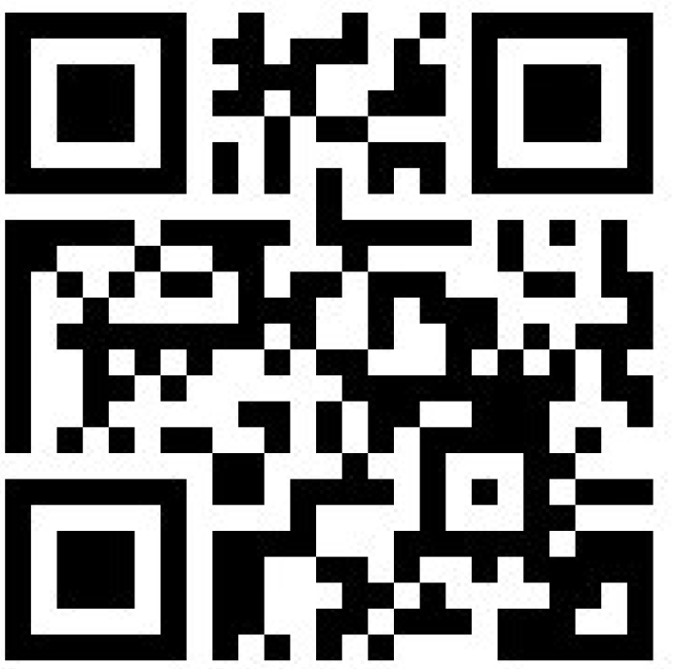

Slide 24
The for loop​
for i in range(0,10):​
print(i)​
​
for a in [“world”, “Laos”, “Vientiane”]:​
print(“hello, “+a)​

Slide 25


Exercises​
Takes an integer from the user, prints all odd numbers smaller than this number
Takes 10 integers from the user, counts the number of odd ones​
Prints all integers from 0 to 10 except 3 and 6
Chooses a random integer:​
import random​
Toguess= random.randint(0,10)
And gives the user 3 tries to guess it​
Prints the following pattern using 2 for loops:
*​
**​
***​
****​
***​
**​
*​
Feel free to send in any questions to workshop@makerbox.la

