Slide 1
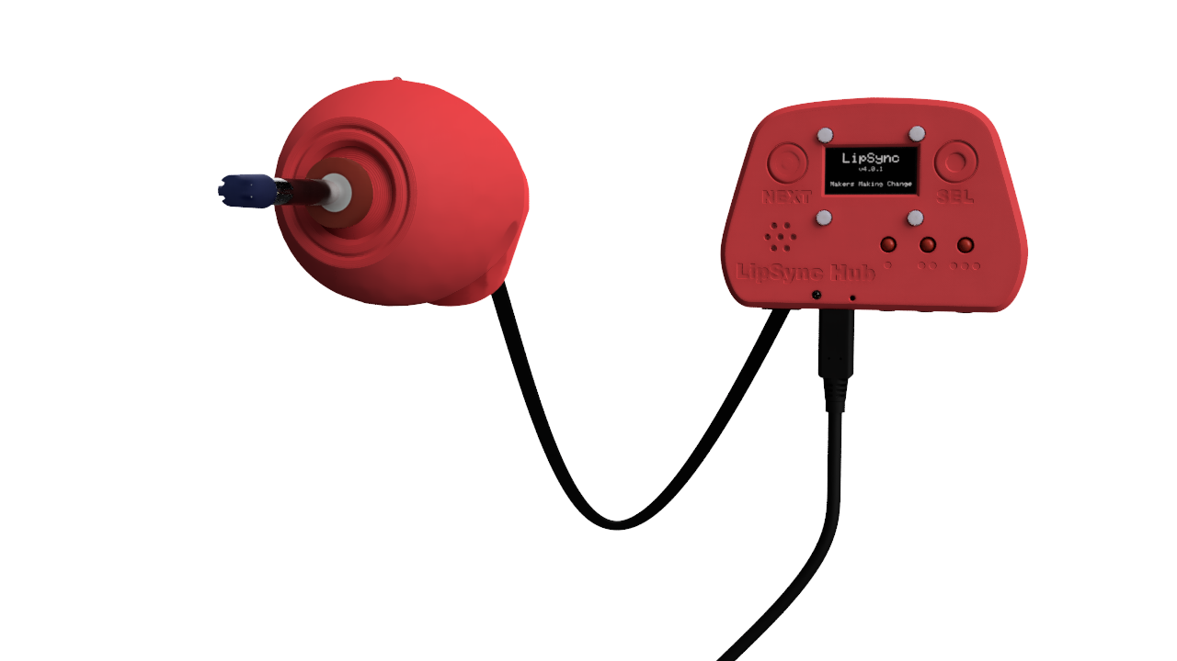
LipSync Joystick
LipSync Hub
LipSync Interface Cable
USB Cable

Slide 2

Hub Display
Next Button
Select Button
Feedback Speaker
Operating Mode Indicator
Microcontroller Reset
Feedback Lights

Slide 3
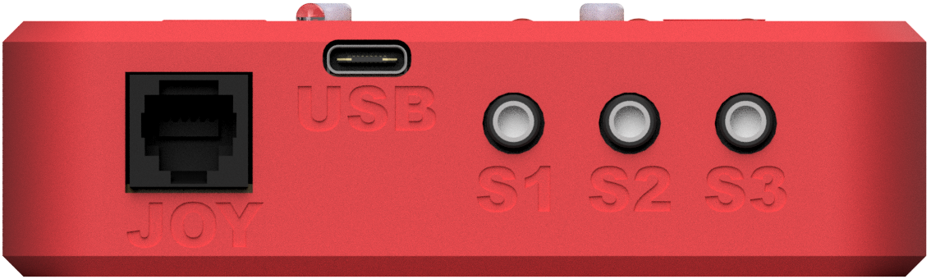
Joystick Port
Assistive Switch Ports
USB Port

Slide 4
Joystick Port

Slide 5
Assistive Switch Ports

Slide 6

Mounting Connection

Slide 7
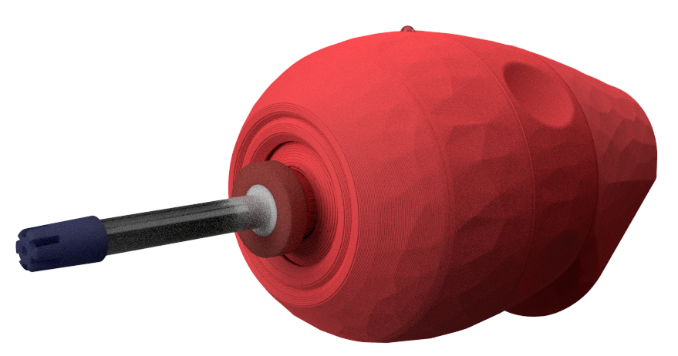
Power and Orientation LED
Filtered Mouthpiece

Slide 8
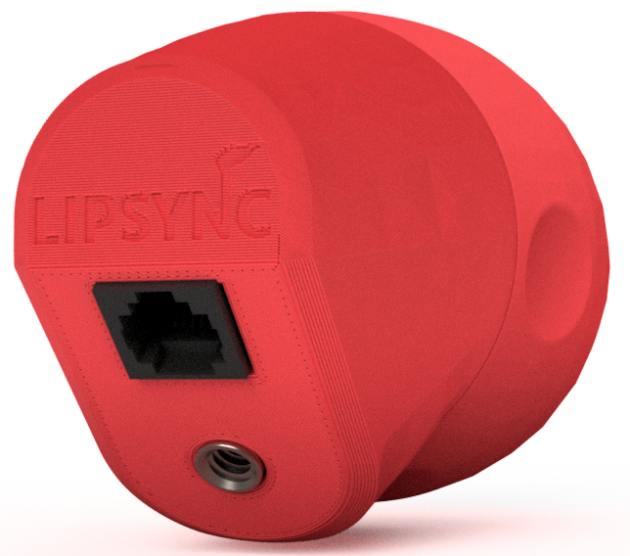
Hub Port
Mounting Connection

Slide 9
Hub Port

Slide 10
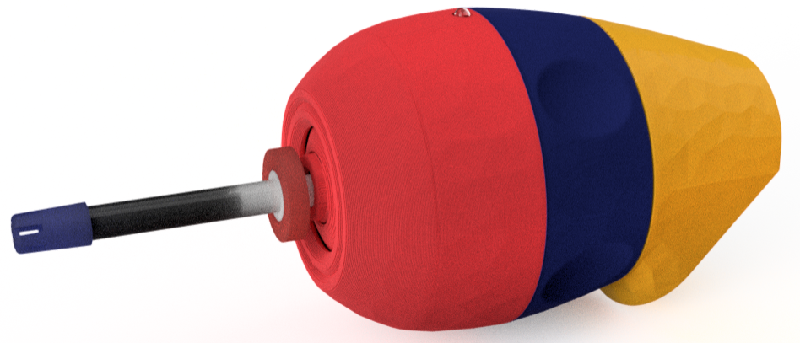
Outer Locking Ring
Front Section
Rear Section

