Slide 1
Who wouldn't like to build their own things?

Slide 2
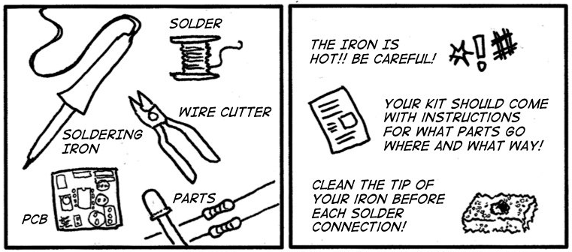
How To Solder

Slide 3
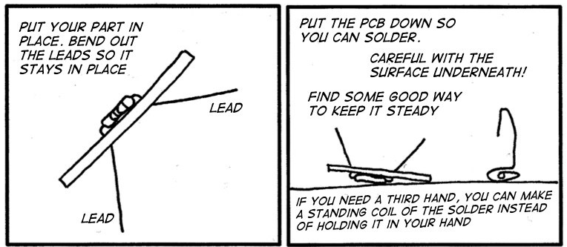
How To Solder

Slide 4
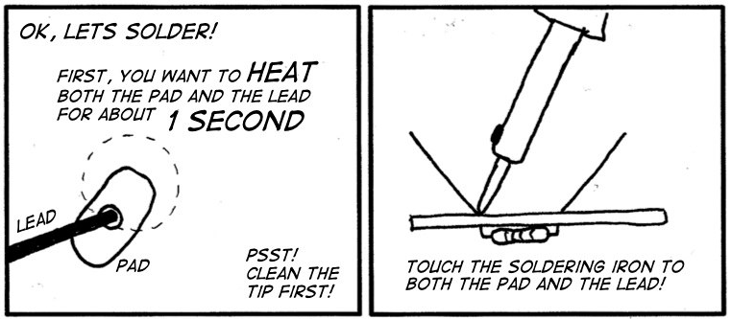
How To Solder

Slide 5
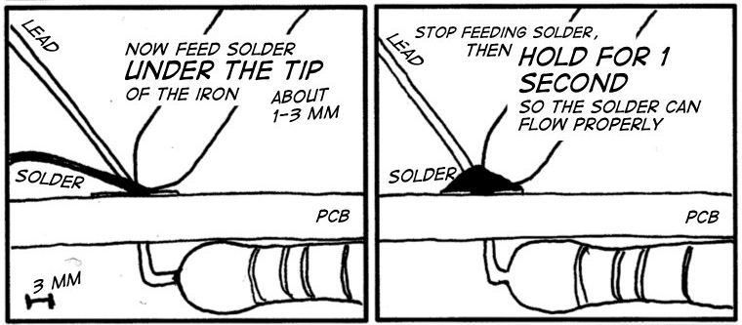
How To Solder

Slide 6
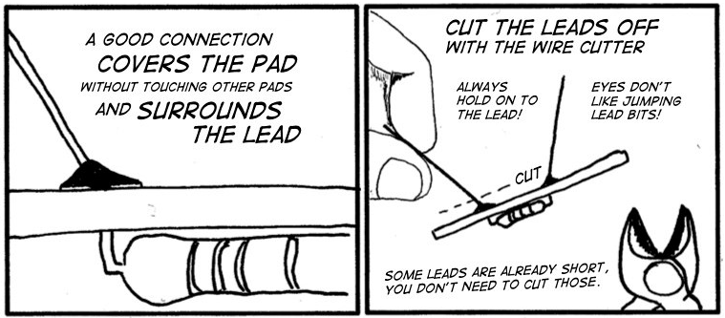
How To Solder

Slide 7
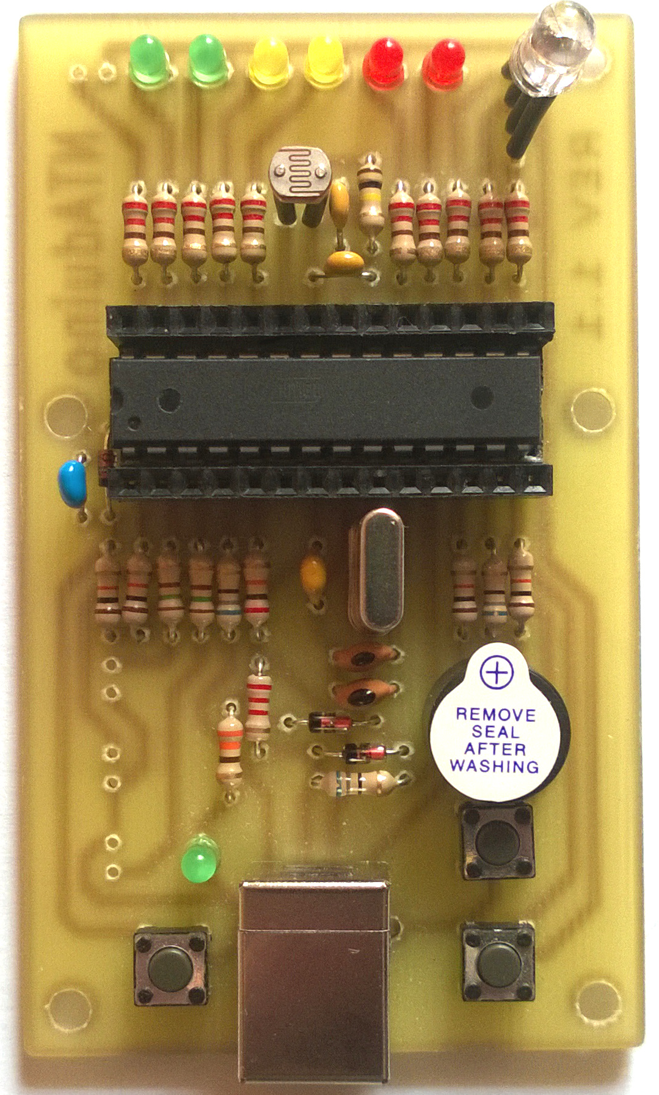
NTAduino =>

Slide 8
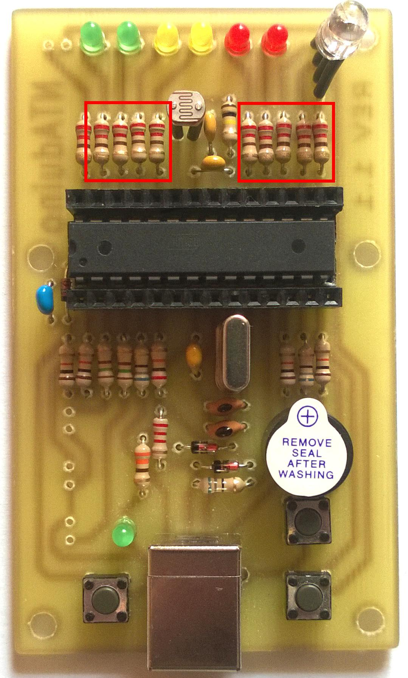
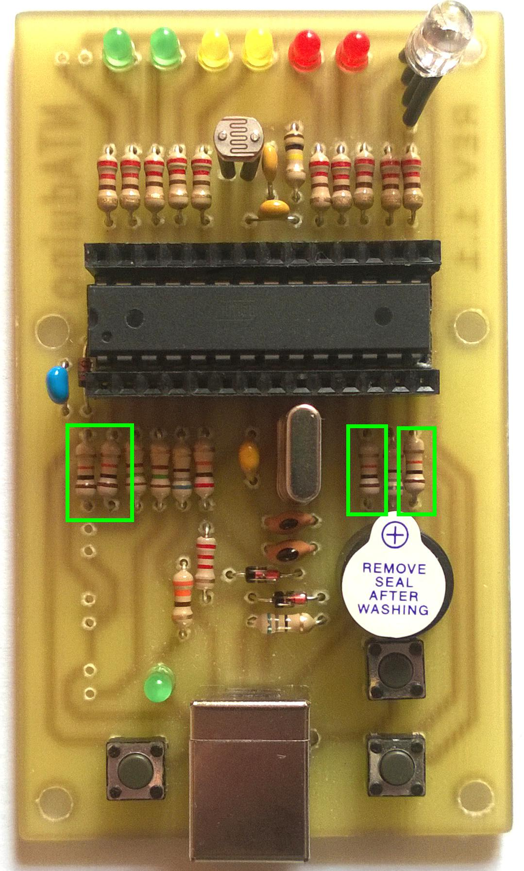
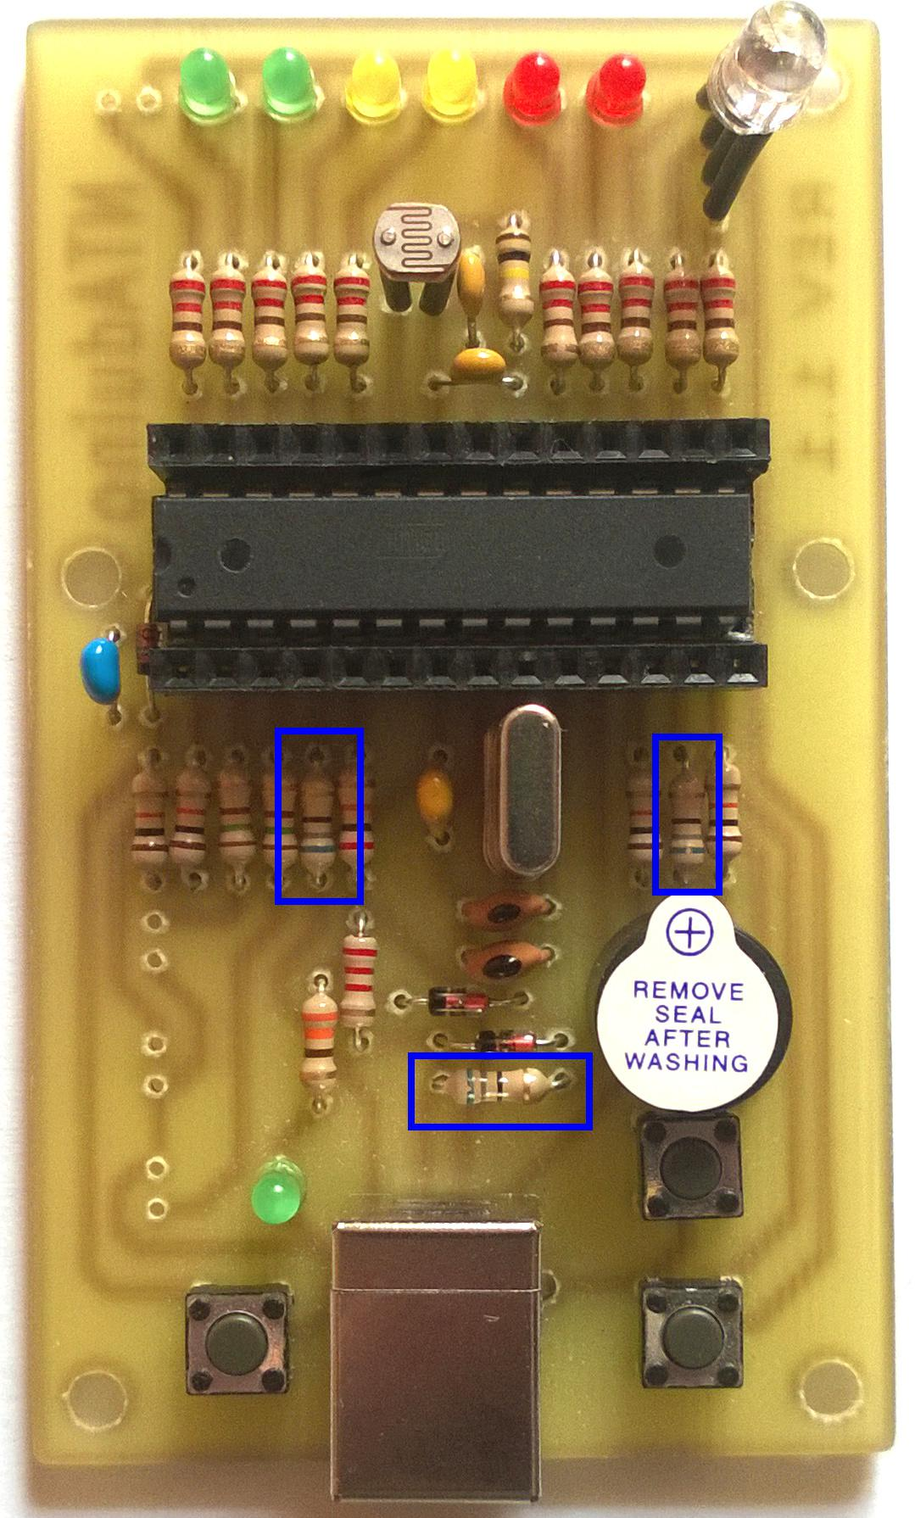
220R
10K
68R

Slide 9



150R
100K
22k

Slide 10
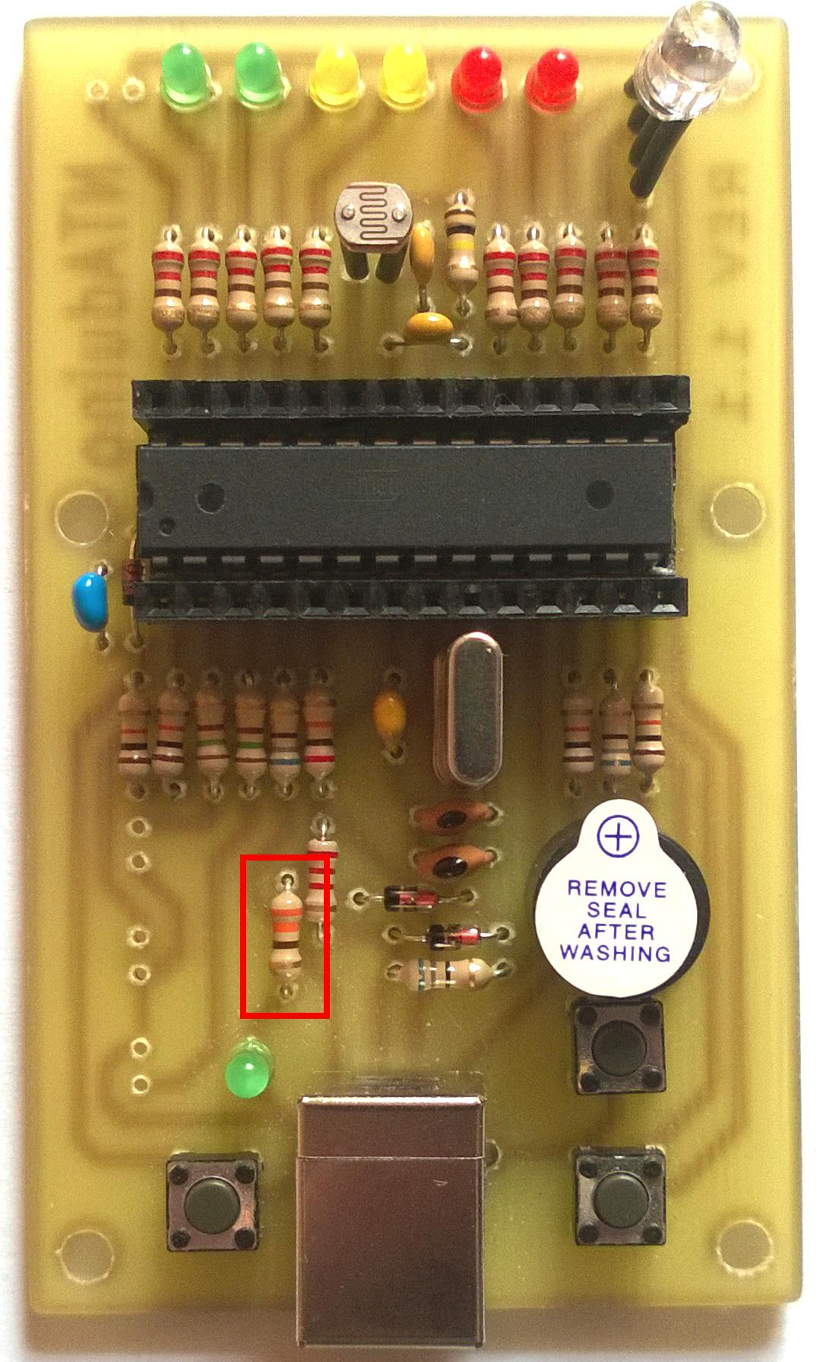


330R
2K2
1N4148

Slide 11

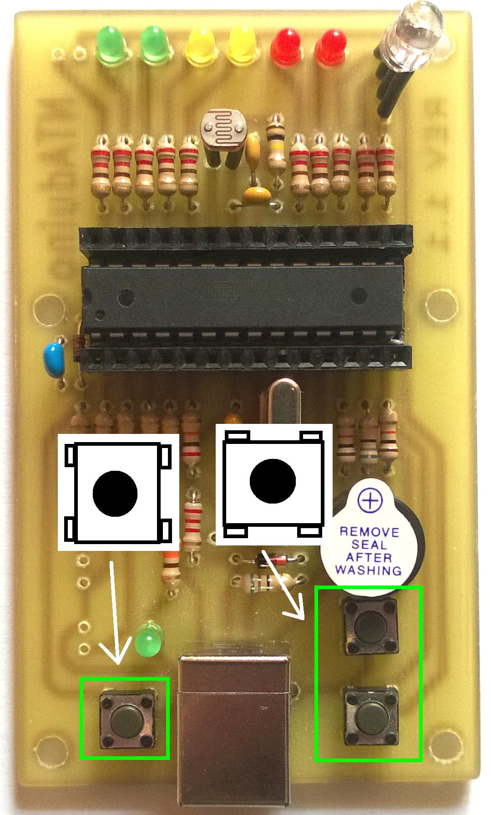

3V6
buttons
3mm LEDs

Slide 12
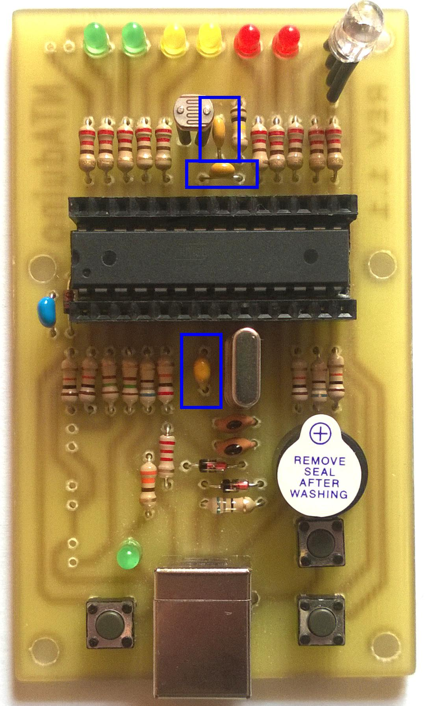

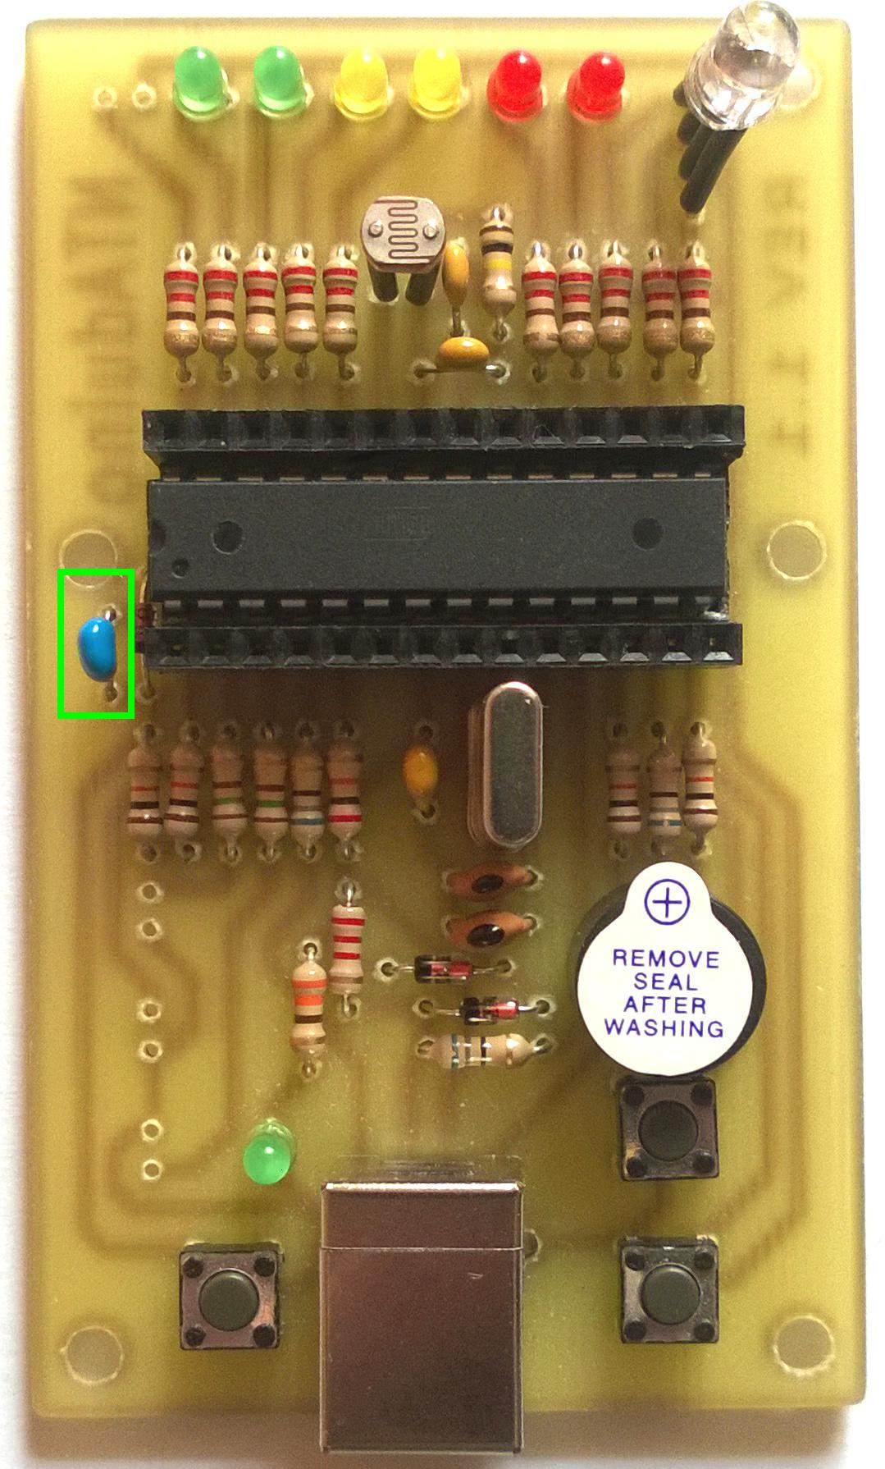
100n
22p
1u

Slide 13

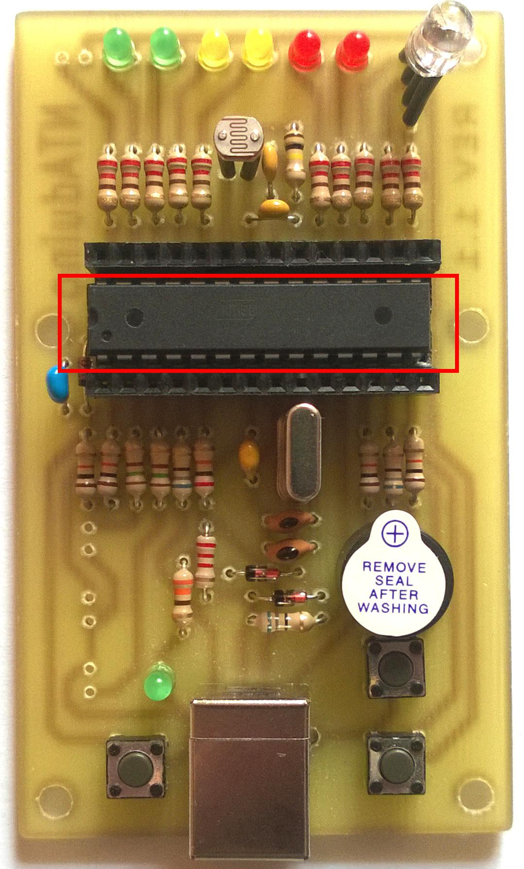
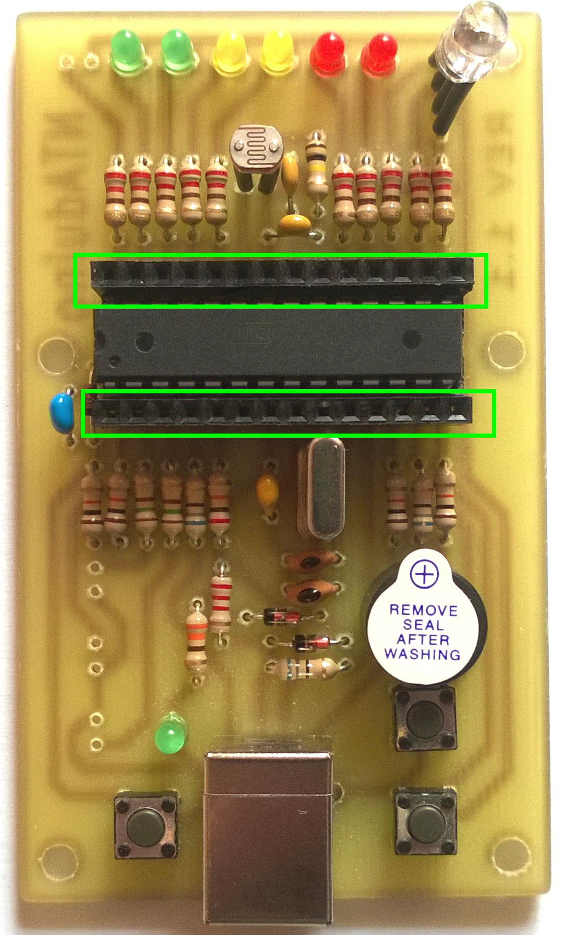
16MHz
DIP28 socket
14 pin headers

Slide 14
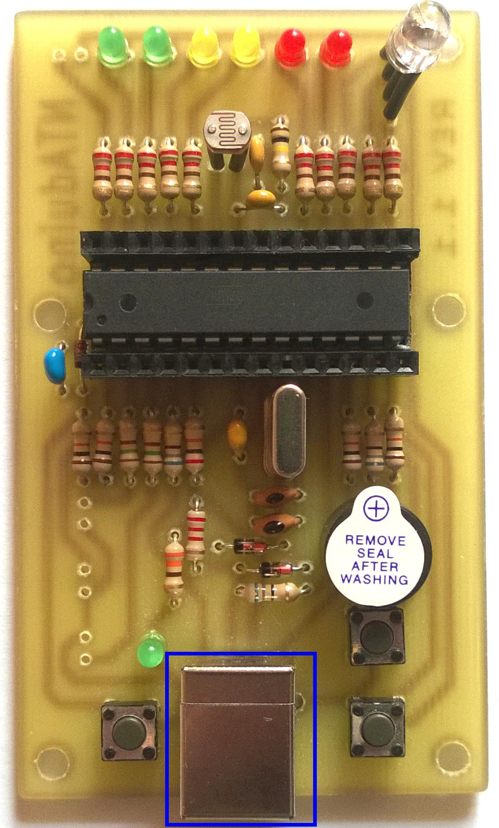
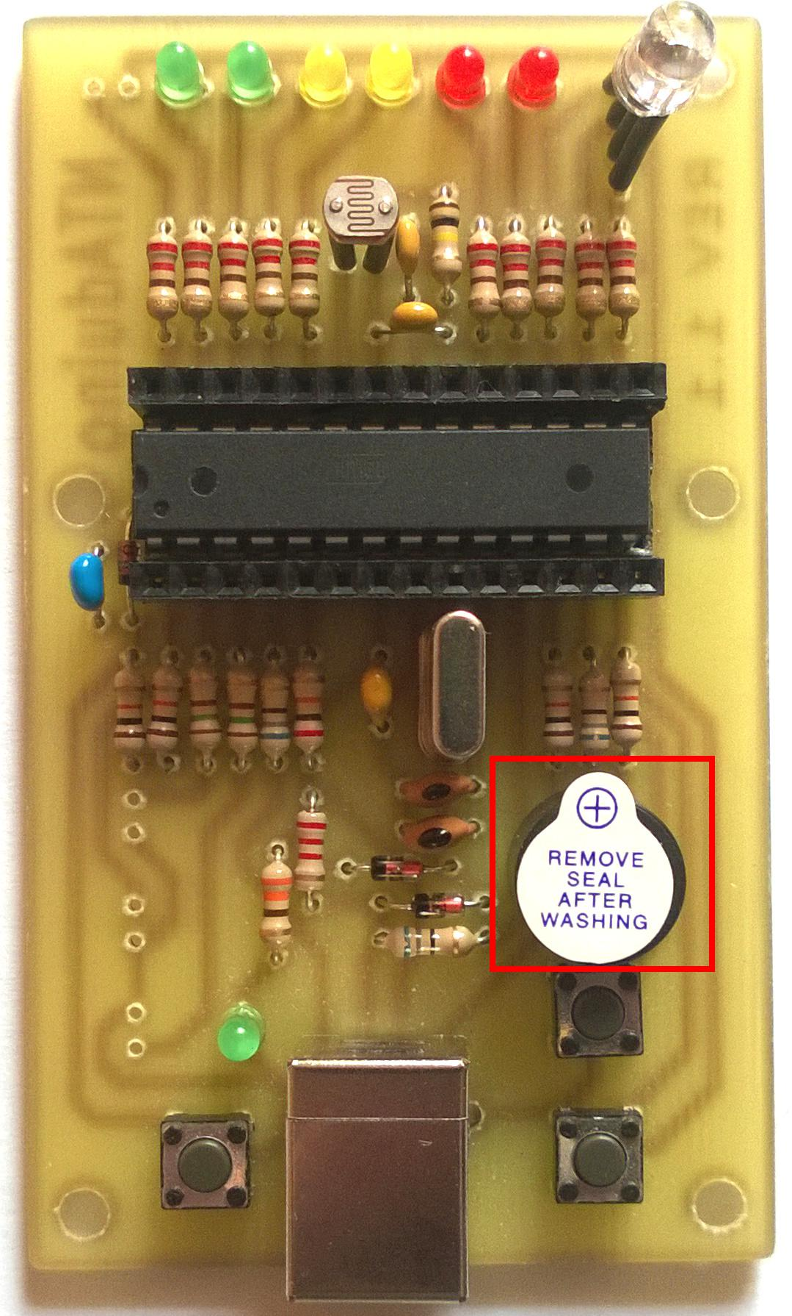
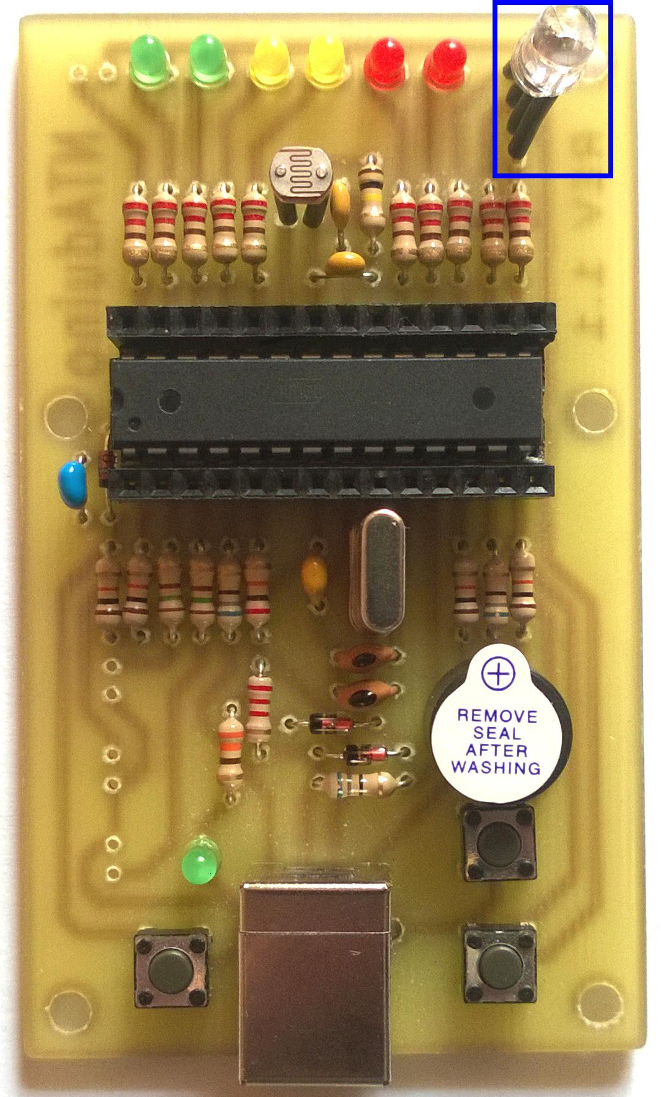
USB-B
buzzer
RGB LED

Slide 15

LDR

Slide 16
Testing, debugging, repairing.

Slide 17
ATmega8

Slide 18
Even more testing, debugging, repairing and learning from mistakes.
https://github.com/makerspacelt/NTAduino

