Slide 1
Capstone Project The Battle of Neighborhoods

Slide 2
São Paulo and its contrasts
The wealthiest city in the country and of South Hemisphere
Representing alone 10.7% of all Brazil GDP
The 13th most populous
It exerts strong influence in commerce, finance, arts and entertainment in the country
With a Human Development Index like a European country in some regions and low as a score of 0.700 in other regions.
How to find the right spot for your business in this city?

Slide 3
Data
Geographic Boundaries: Latitude and Longitude
Population and Area: Demographical Density
Aging Index: Qty pop over 60 years / Qty pop below 14 years multiplied by 100
HDI: The data is from 2000
Crime Rate: the aggregation of all types of crimes divided by the population and multiplied by 1000. (2019)
Foursquare API: Venues Categories and Locations

Slide 4
Methodology
Reduce the type of Venues Categories given by the Foursquare.
Transposed the base and aggregated the values by districts.
Normalized the values and replace any NAN value with a 0.
Descriptive statistics and correlation matrix.
Crime Rate: the aggregation of all types of crimes divided by the population and multiplied by 1000. (2019)
Apply the unsupervised learning algorithm, K-Means

Slide 5
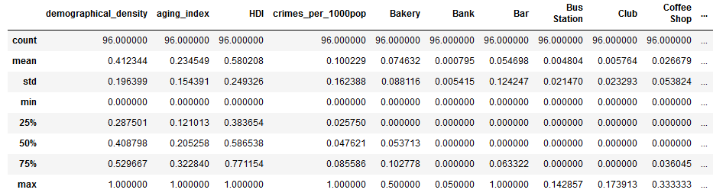
Analysis - Descriptive Statistics
Low mean for aging_index, crimes_per_100pop and Venues Categories in general
96 districts

Slide 6
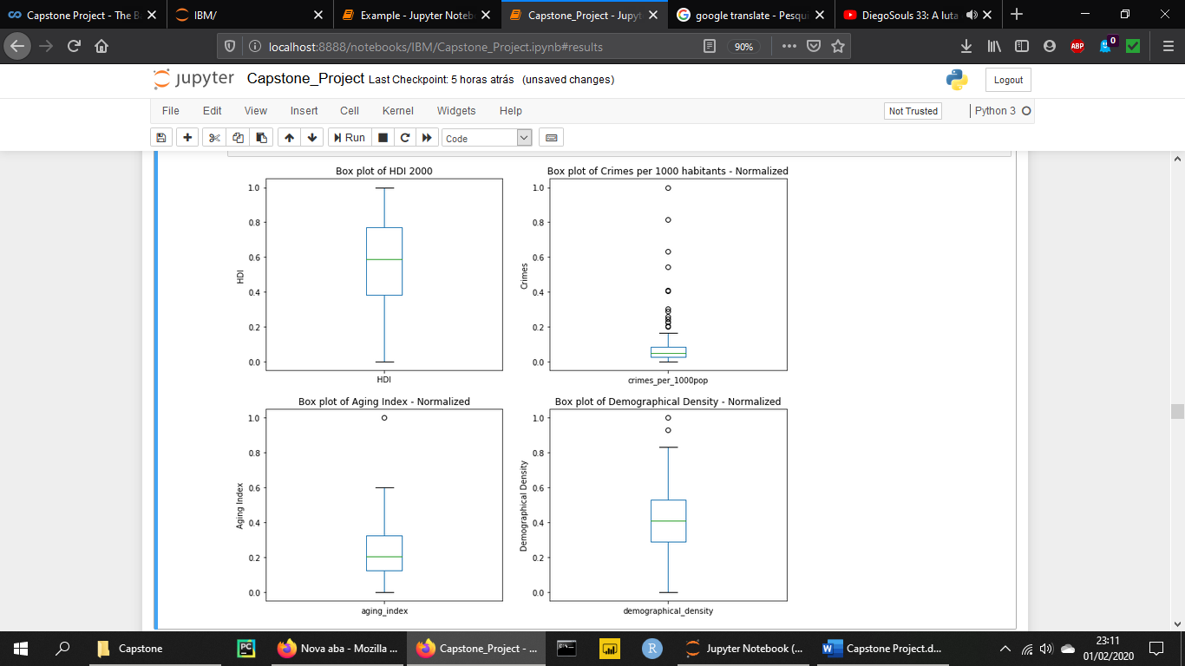
Analysis – Box Plot
For crimes per 1000 habitants have a large amount of outliers
Few outliers for Aging Index and Demographical Density

Slide 7
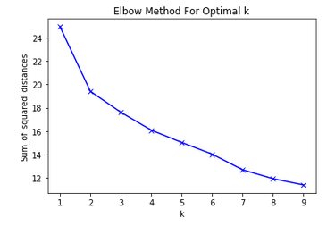
Analysis – K-Means
Elbow around 2 Clusters but too low for the need for our analysis
Testing various values ​​for K I get the best value of 6.

Slide 8
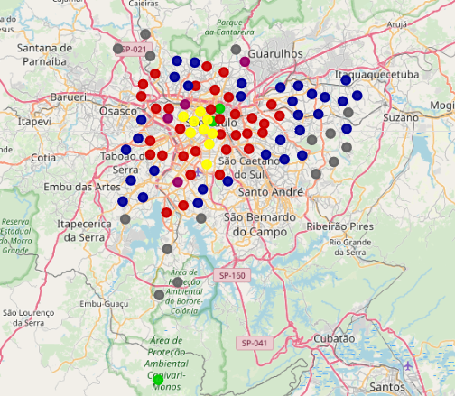
Analysis – Clusters
It is important to note the pattern of points distribution on the map

Slide 9
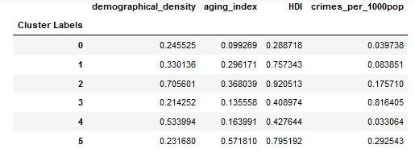
Results and Discussion
Due to the k-means algorithm trying to fit all the data in a cluster, we have data in some groups that differ from the group average.
The Venues do not have a very well-defined pattern, becoming partly random as we could anticipate with the correlation matrix.

Slide 10
Conclusion
The study gives us some interesting results, forming clusters with a certain consistency in the average and distribution of its indicators
Due to the k-means method, some districts were allocated to groups whose value was very different from the rest
As a next step, it would be interesting to add more metrics and filter the information from the Foursquare API for the business area that the stakeholders really want to establish

