Slide 1

Hadoop
Installation

Slide 2
Course Topics
Module 1
Module 5
Understanding Big Data
Hadoop Architecture
Analytics using Hive
Understanding HIVE QL
Module 2
Module 6
Hadoop Cluster Configuration
Data loading Techniques
Hadoop Project Environment
Advance Hive
NoSQL Databases and HBASE
Module 3
Module 7
Hadoop MapReduce framework
Programming in Map Reduce
Advance MapReduce
Advance HBASE
Zookeeper Service
Module 8
Module 4
Hadoop 2.0 – New Features
Programming in MRv2
Analytics using Pig
Understanding Pig Latin
Module 9
Apache Oozie
Real world Datasets and Analysis
Project Discussion

Slide 3




















Lets’s Revise
Hadoop Core Components
HDFS Architecture
3. What is HDFS?
MapReduce Engine
Job Tracker
Task Tracker
Task Tracker
Task Tracker
Task Tracker
4. Hadoop Vs. traditional
systems
HDFS
Cluster
Admin Node
Name node
Data Node
Data Node
Data Node
Data Node
5. Namenode and Secondary Namenode

Slide 4




















Hadoop Cluster Architecture
Slave01 DaStlaaNvoed0e 2 TasDkaTtraaSNclkaoevdree03
TaskTaskDTaratacNkeorde TDraStcaklNaeorvdee04 Task_{D}T_{a}rSa_{ta}cl_{N}kae_{o}vr_{d}e_{e}05
TaskTracker
Master
NameNode http://master:50070/
JobTracker http://master:50030/

Slide 5




































Hadoop Cluster Architecture (Contd.)
Client
HDFS
Name Node
Map Reduce
Job Tracker
Data Node
Data Node
Task Tracker
Task Tracker
Task Tracker
Task Tracker
Data Node
Data Node
Data Node
Data Node
Task Tracker
Task Tracker
Task Tracker
Task Tracker
Data Node
Data Node

Slide 6













Hadoop Cluster: A Typical Use Case
Name Node
RAM: 64 GB,
Hard disk: 1 TB
Processor: Xenon with 8 Cores Ethernet: 3 X 10 GB/s
OS: 64-bit CentOS
Power: Redundant Power Supply
Secondary Name Node
RAM: 32 GB,
Hard disk: 1 TB
Processor: Xenon with 4 Cores Ethernet: 3 X 10 GB/s
OS: 64-bit CentOS
Power: Redundant Power Supply
Data Node
RAM: 16GB
Hard disk: 6 X 2TB
Processor: Xenon with 2 cores. Ethernet: 3 X 10 GB/s
OS: 64-bit CentOS
Data Node
RAM: 16GB
Hard disk: 6 X 2TB
Processor: Xenon with 2 cores. Ethernet: 3 X 10 GB/s
OS: 64-bit CentOS

Slide 7

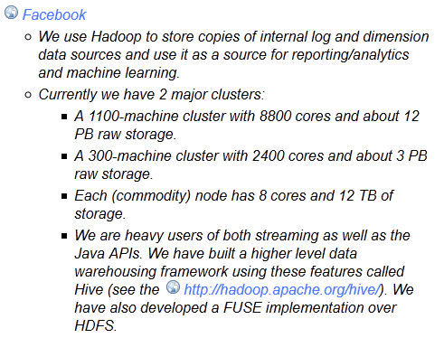
Hadoop Cluster: Facebook
http://wiki.apache.org/hadoop/PoweredBy

Slide 8




Hadoop Cluster Modes
Hadoop can run in any of the following three modes:
Standalone (or Local) Mode
No daemons, everything runs in a single JVM.
Suitable for running MapReduce programs during development.
Has no DFS.
Pseudo-Distributed Mode
Hadoop daemons run on the local machine.
Fully-Distributed Mode
Hadoop daemons run on a cluster of machines.

Slide 9
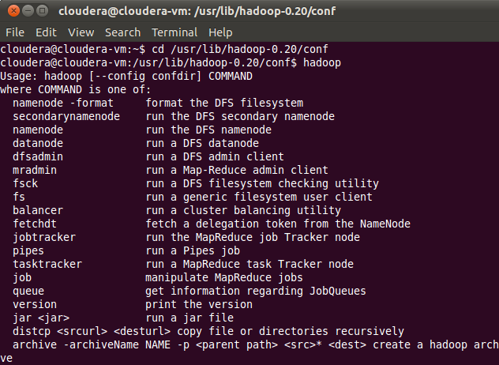
Terminal Commands

Slide 10

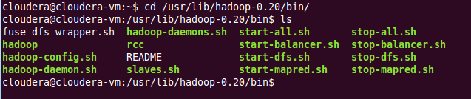
Terminal Commands
Listing of files present on HDFS
Listing of files present in bin Directory

Slide 11
Hadoop Configuration Files
Configuration Filenames | Description of Log Files
hadoop-env.sh | Environment variables that are used in the scripts to run Hadoop.
core-site.xml | Configuration settings for Hadoop Core such as I/O settings that are common to HDFS and MapReduce.
hdfs-site.xml | Configuration settings for HDFS daemons, the namenode, the secondary namenode and the data nodes.
mapred-site.xml | Configuration settings for MapReduce daemons : the job-tracker and the task-trackers.
masters | A list of machines (one per line) that each run a secondary namenode.
slaves | A list of machines (one per line) that each run a datanode and a task-tracker.

Slide 12
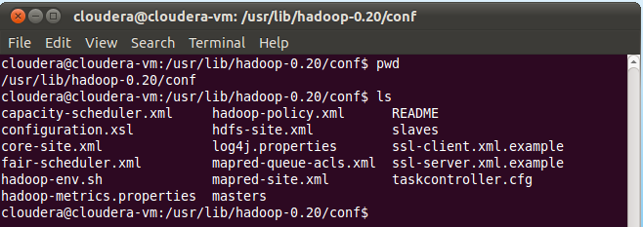
Hadoop 1.x Configuration Files – CDH3

Slide 13


















Hadoop 1.x: Core Configuration Files
Core
core-site.xml
HDFS
hdfs-site.xml
Map
Reduce
mapred-site.xml

Slide 14
core-site.xml and hdfs-site.xml
hdfs-site.xml | core-site.xml
<?xml version - "1.0"?> | <?xml version ="1.0"?>
<!--hdfs-site.xml--> | <!--core-site.xml-->
<configuration> | <configuration>
<property> | <property>
<name>dfs.replication</name> | <name>fs.default.name</name>
<value>1</value> | <value>hdfs://localhost:8020/</value>
</property> | </property>
</configuration> | </configuration>

Slide 15
Defining HDFS Details In hdfs-site.xml
Property | Value | Description
dfs.data.dir | <value> /disk1/hdfs/data, /disk2/hdfs/data </value> | A list of directories where the datanode stores blocks. Each block is stored in only one of these directories. ${hadoop.tmp.dir}/dfs/data
fs.checkpoint.dir | <value> /disk1/hdfs/namesecondary, /disk2/hdfs/namesecondary </value> | A list of directories where the secondary namenode stores checkpoints. It stores a copy of the checkpoint in each directory in the list ${hadoop.tmp.dir}/dfs/namesecondary

Slide 16
mapred-site.xml
mapred-site.xml
<?xml version=“1.0”?>
<configuration>
<property>
<name>mapred.job.tracker</name>
<value>localhost:8021</value>
<property>
</configuration>

Slide 17
Defining mapred-site.xml
Property | Value | Description
mapred.job.tracker | <value> localhost:8021 </value> | The hostname and the port that the jobtracker RPC server runs on. If set to the default value of local, then the jobtracker runs in-process on demand when you run a MapReduce job.
mapred.local.dir | ${hadoop.tmp.dir}/mapred/local | A list of directories where MapReduce stores intermediate data for jobs. The data is cleared out when the job ends.
mapred.system.dir | ${hadoop.tmp.dir}/mapred/syste m | The directory relative to fs.default.name where shared files are stored, during a job run.
mapred.tasktracker.map.tasks. maximum | 2 | The number of map tasks that may be run on a tasktracker at any one time
mapred.tasktracker.reduce.tasks .maximum | 2 | The number of reduce tasks tat may be run on a tasktracker at any one time.

Slide 18
All Properties
http://hadoop.apache.org/docs/r1.1.2/core-default.html
http://hadoop.apache.org/docs/r1.1.2/mapred-default.html
http://hadoop.apache.org/docs/r1.1.2/hdfs-default.html

Slide 19


Slaves and Masters
Two files are used by the startup and shutdown commands:
Slaves
Contains a list of hosts, one per line, that are to host DataNode and
TaskTracker servers.
Masters
Contains a list of hosts, one per line, that are to host Secondary
NameNode servers.

Slide 20







Per-Process Runtime Environment
Set parameter JAVA_HOME
hadoop-env.sh
JVM
This file also offers a way to provide custom parameters for each of the servers.
Hadoop-env.sh is sourced by all of the Hadoop Core scripts provided in the conf/ directory of the installation.
Examples of environment variables that you can specify:
export HADOOP_DATANODE_HEAPSIZE="128" export HADOOP_TASKTRACKER_HEAPSIZE="512"

Slide 21
Web UI URLs
NameNode status: http://localhost:50070/dfshealth.jsp
JobTracker status: http://localhost:50030/jobtracker.jsp
TaskTracker status: http://localhost:50060/tasktracker.jsp
DataBlock Scanner Report: http://localhost:50075/blockScannerReport

Slide 22











Hadoop Cluster: Password-Less SSH
Hadoop Core
Requires password- less SSH connection between the master and all the slaves and secondary machines
Uses Shell (SSH) to launch the server processes on the slave nodes

Slide 23

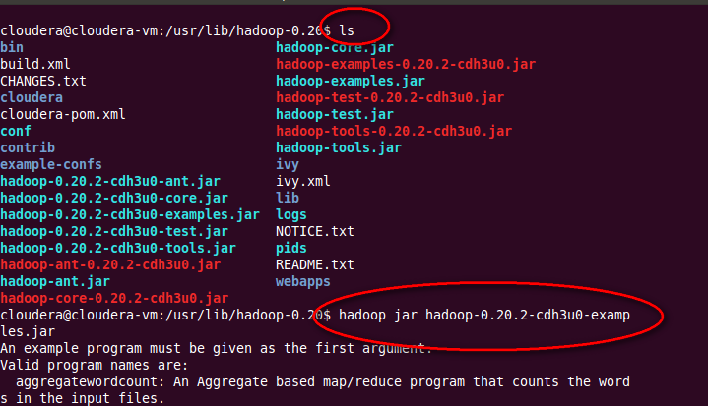
Sample Examples List

Slide 24

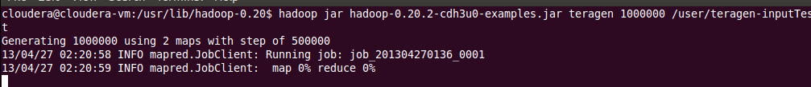

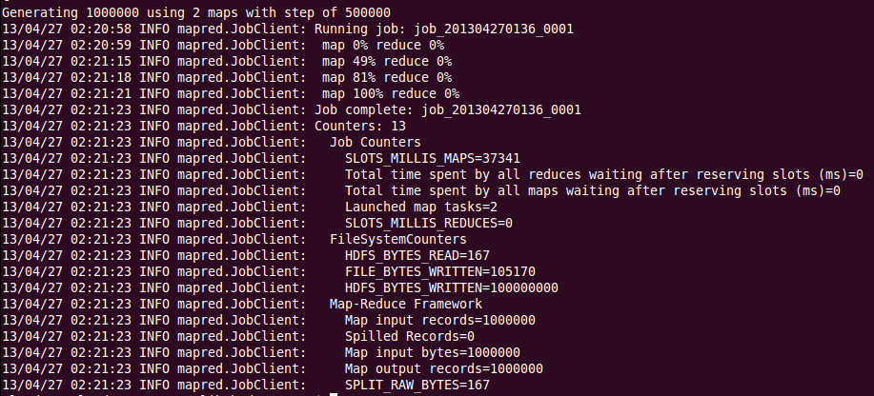
Running the Teragen Example

Slide 25

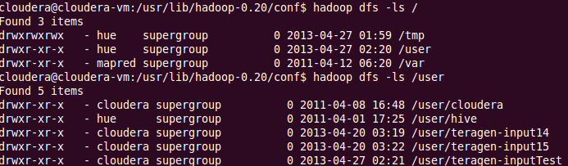
Checking the Output

Slide 26

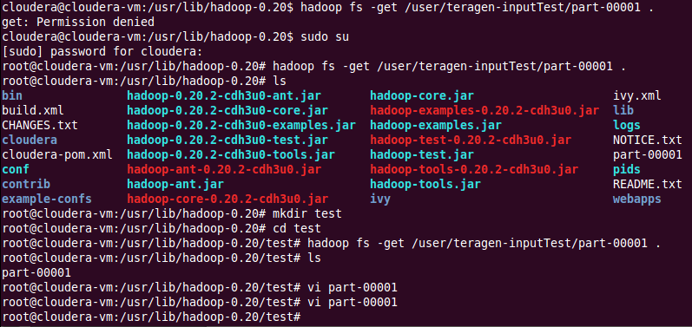
Checking the Output

Slide 27


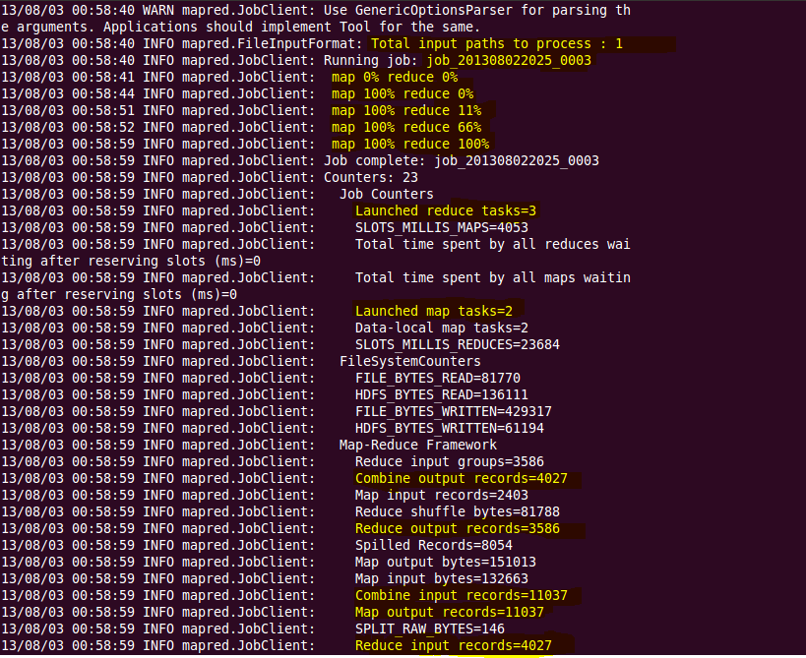

Dump of a MR Job

Slide 28

Dump of a MR Job

Slide 29


Dump of a MR Job

Slide 30


Dump of a MR Job

Slide 31


Hadoop Copy Commands
put: Copy file(s) from local file system to destination file system. It can also read from “stdin” and writes to destination file system.
hadoop dfs –put weather.txt hdfs://<target Namenode>
copyFromLocal: Similar to “put” command, except that the source is restricted to a local file reference.
hadoop dfs –copyFromLocal weather.txt hdfs://<target Namenode>
distcp: Distributed Copy to move data between clusters, used for backup and recovery
hadoop distcp hdfs://<source NN> hdfs://<target NN>

Slide 32













Data Loading Using Flume
Flume is a distributed, reliable, and available service for efficiently collecting, aggregating, and
moving large amounts of streaming event data.
Twitter Streaming API
HDFS
Flume
Twitter Source
HDFS
Sink
Memory Channel

Slide 33
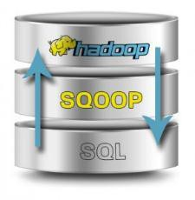
Data Loading Using Sqoop
Apache Sqoop (TM) is a tool designed for efficiently transferring bulk data between Apache Hadoop and
structured data stores such as relational databases.
Imports individual tables or entire databases to HDFS.
Generates Java classes to allow you to interact with your
imported data.
Provides the ability to import from SQL databases straight into your Hive data warehouse.

Slide 34
DES
You want to join data collected from two sources. One source of data collected from a big database of call records is already available in HDFS. The another source of data is available in a database table.
The best way to move that data in HDFS is:
SQOOP import
PIG script
Hive Query

