Slide 1
Latex
LaTeX is pronounced as 'lah-tech' or 'lay-tech.' which is distributed under the LPPL (Latex Project Public License).
It is based on TEX, a typesetting language designed for science and math.
Both LATEX and TEX contain a variety of font styles, such as serif, typewriter, and a set of mathematical functions.
It is an open-source and powerful document preparation system.
The Latex system handles the layout and formatting of the structures using familiar concepts of the section, table, figure, chapter, etc.

Slide 2
Features of Latex
Latex is a markup language and free license software. It includes a set of built-in commands.
It is a mode of mathematical and special symbols.
LaTeX is generally distributed along with plain TEX, i.e., it provides a set of macros for TEX to interpret.
The other macros for TEX are Plain TEX, GNU Texinfo, etc.
LaTeX is not compatible with the GNU (General Public License).
It is available on most of the operating systems like UNIX, BSD, Linux, Windows, DOS, etc.

Slide 3
Basic Document Structure
The format of a document is pretty simple.
In the preamble
Documentclass
Packages
In the front matter
Title/author
In the body
Contents
In the back matter
bibliography

Slide 4
In the Preamble
You specify our document class.
Document classes: letter, article, report, book, slides(beamer, prosper)
\documentclass[12pt]{article}
Backslash – at the beginning of text markup command
Packages: numerous packages are available
\usepackage[margin=1in]{geometry}
\usepackage{setspace}
\usepackage{harvard}

Slide 5
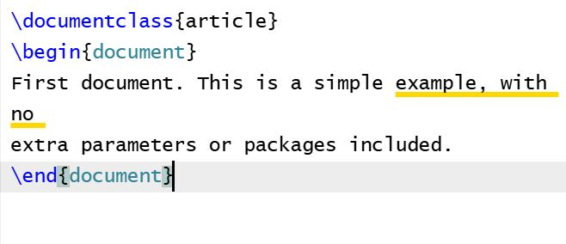
Latex First Document

Slide 6
Explanation
The first line of code, \documentclass{article}, declares the document type known as its class. which controls the overall appearance of the document. Different types of documents require different classes.
Having set the document class, our content, known as the body of the document, is written between the \begin{document} and \end{document} tags.

Slide 7
Preamble of a Document
The preamble allows you to define the type of document, author, date, language, and load in LaTex packages that you want to use in the document.
After we have included a preamble, we can go ahead and start the main text of our document. We can add things like a title, abstract, and table of contents
A minimal document preamble might look like this:
\documentclass[12pt, letterpaper]{article}
\usepackage{graphicx}
where \documentclass[12pt, letterpaper]{article} defines the overall class (type) of document.

Slide 8
Preamble of a Document
In this example, the two parameters do the following:
12pt sets the font size
letterpaper sets the paper size
Of course other font sizes, 9pt, 11pt, 12pt, can be used, but if none is specified, the default size is 10pt. As for the paper size, other possible values are a4paper and legalpaper.
The preamble line
\usepackage{graphicx}
is an example of loading an external package (here, graphicx) to extend LaTeX’s capabilities, enabling it to import external graphics files

Slide 9
Explanation about Formatting
\ it is called backslash, used as the starting command. The line following it gets printed.
{} it is called curly brackets, which is used to group and separate commands from its surroundings and must appear in pairs.
\\ terminates a line.
\\* it also terminates the line, but disallows the page break.
[] it is used to write the optional parameters that can be passed to a command to change its behavior.
% the Latex ignores the rest of the line or commands after %.

Slide 10
Including title, author and date information
\title{My first LaTeX document}: the document title
\author{Hubert Farnsworth}: here you write the name of the author(s) and, optionally, the \thanks command within the curly braces:
\thanks{Funded by the Overleaf team.}: can be added after the name of the author, inside the braces of the author command. It will add a superscript and a footnote with the text inside the braces. Useful if you need to thank an institution in your article.
\date{August 2022}: you can enter the date manually or use the command \today to typeset the current date every time the document is compiled

Slide 11
With these lines added, our preamble should look something like this:
\documentclass[12pt, letterpaper]{article}
\title{My first LaTeX document}
\author{Hubert Farnsworth\thanks{ICAR-IISR.}}
\date{August 2024}

Slide 12
Adding comments
\documentclass[12pt, letterpaper]{article}
\begin{document}We have now added a title, author and date to our first \LaTeX{} document!
% This line here is a comment. It will not be typeset in the document.
\end{document}

Slide 13
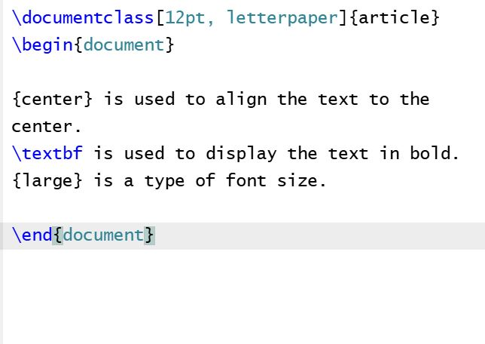
Bold, italics and underlining

Slide 14
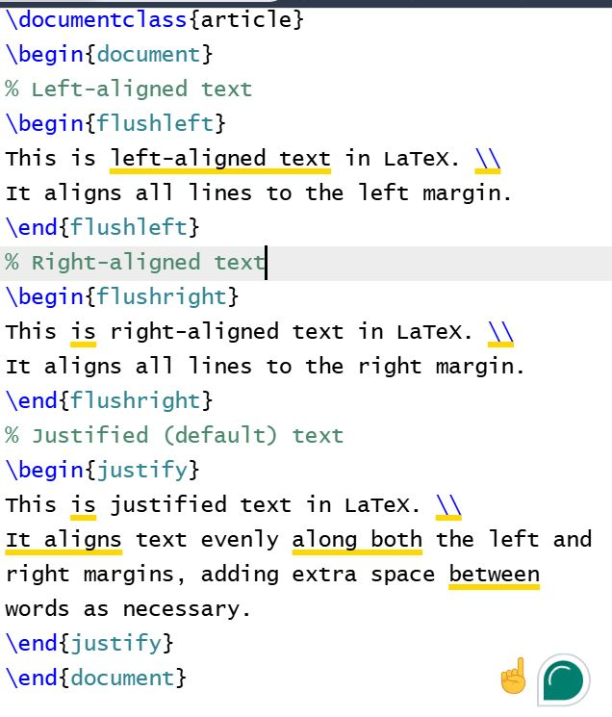
Text Alignment

Slide 15
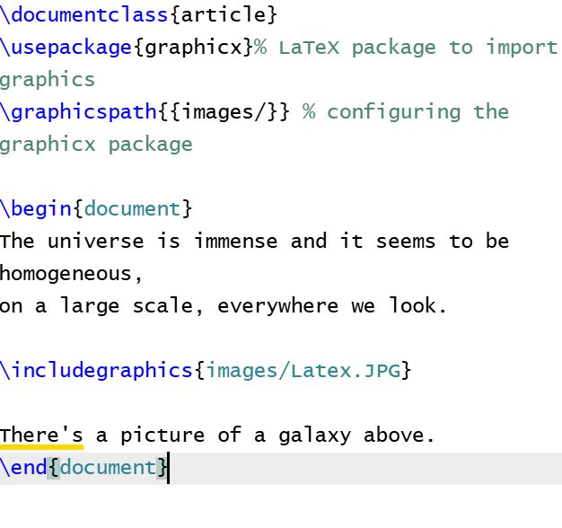
Adding Image

Slide 16
Draw IEEE Template and Springer Procedding Template

