Slide 1
What is Artificial Neural Network?
The architecture of an artificial neural network
Advantages of Artificial Neural Network (ANN)
Disadvantages of Artificial Neural Network:

Slide 2
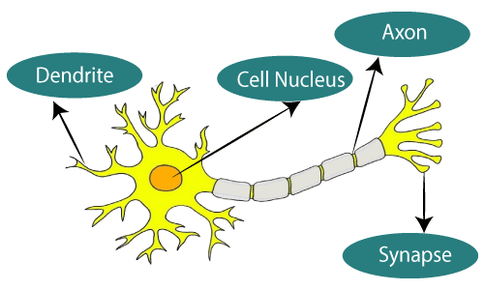
What is Artificial Neural Network?
The term "Artificial Neural Network" is derived from Biological neural networks that develop the structure of a human brain. Similar to the human brain that has neurons interconnected to one another, artificial neural networks also have neurons that are interconnected to one another in various layers of the networks. These neurons are known as nodes.

Slide 3
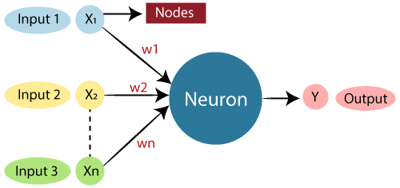
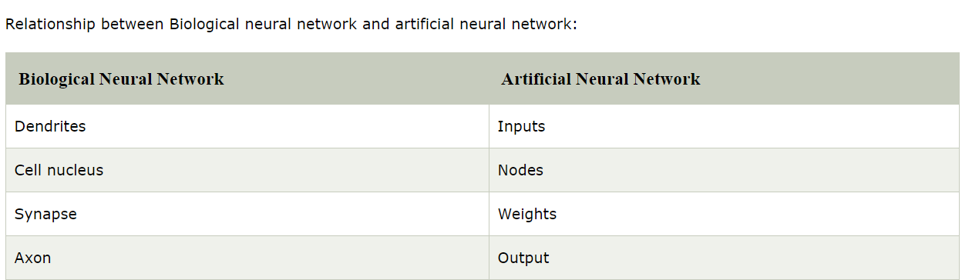
Cont……….
The given figure illustrates the typical diagram of biological neural network. The typical artificial neural network looks something like the given figure.
Dendrites from Biological Neural Network represent inputs in Artificial Neural Networks, cell nucleus represents Nodes, synapse represents Weights, and Axon represents Output.
Relationship between Biological neural network and artificial neural network:

Slide 4
Cont……….
Aim
An Artificial Neural Network in the field of Artificial intelligence where it attempts to mimic the network of neurons makes up a human brain so that computers will have an option to understand things and make decisions in a human-like manner.

Slide 5
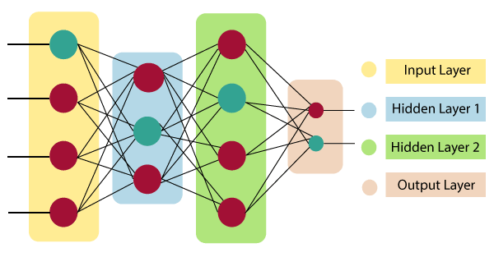
Cont……….

Slide 6

Cont……….
Input Layer:
As the name suggests, it accepts inputs in several different formats provided by the programmer.
Hidden Layer:
The hidden layer presents in-between input and output layers. It performs all the calculations to find hidden features and patterns.
Output Layer:
The input goes through a series of transformations using the hidden layer, which finally results in output that is conveyed using this layer.
The artificial neural network takes input and computes the weighted sum of the inputs and includes a bias. This computation is represented in the form of a transfer function.
It determines weighted total is passed as an input to an activation function to produce the output. Activation functions choose whether a node should fire or not.
Only those who are fired make it to the output layer. There are distinctive activation functions available that can be applied upon the sort of task we are performing.

Slide 7
Advantages of Artificial Neural Network (ANN)
Parallel processing capability:
Artificial neural networks have a numerical value that can perform more than one task simultaneously.
Storing data on the entire network:
Data that is used in traditional programming is stored on the whole network, not on a database. The disappearance of a couple of pieces of data in one place doesn't prevent the network from working.
Capability to work with incomplete knowledge:
After ANN training, the information may produce output even with inadequate data. The loss of performance here relies upon the significance of missing data.
Having a memory distribution:
For ANN is to be able to adapt, it is important to determine the examples and to encourage the network according to the desired output by demonstrating these examples to the network. The succession of the network is directly proportional to the chosen instances, and if the event can't appear to the network in all its aspects, it can produce false output.
Having fault tolerance:
Extortion of one or more cells of ANN does not prohibit it from generating output, and this feature makes the network fault-tolerance.

Slide 8
Disadvantages of Artificial Neural Network (ANN)
Assurance of proper network structure:
There is no particular guideline for determining the structure of artificial neural networks. The appropriate network structure is accomplished through experience, trial, and error.
Unrecognized behaviour of the network:
It is the most significant issue of ANN. When ANN produces a testing solution, it does not provide insight concerning why and how. It decreases trust in the network.
Hardware dependence:
Artificial neural networks need processors with parallel processing power, as per their structure. Therefore, the realization of the equipment is dependent.
Difficulty of showing the issue to the network:
ANNs can work with numerical data. Problems must be converted into numerical values before being introduced to ANN. The presentation mechanism to be resolved here will directly impact the performance of the network. It relies on the user's abilities.

