Slide 1
Unit 1
Introduction, basics and writing program
Introduction, need for scala, scala REPL, data types, scala variables and data types, option type, Type inference, Getting familier with Idea Intellij, how to install scala plugnins, build tools:Maven and SBT, download dependencies, write scala program, compiling , building and running program using console, Intellij setting and preferences, learn shortcuts, Debugging your code.

Slide 2
Unit 2
Scala loops, conditional statement, collections and exception handling
Scala Loops:-scala for and scala while, conditional expressions, scala array and scala tuples etc. Scala Collections:-Immutable collections and mutable collections like list, set and map, break statement, scala comments, scala string, string methods, string interpolation. Scala Exception Handling:-try-catch block, finally block, throw keyword, throws keyword, scala custom exception.
Unit 3
Scala object oriented programing and file handling
Scala oops concepts:class and objects, singleton and companion objects, case class and objects, scala constructors, scala functions, scala method overloading and overriding, scala final. scala inheritance, scala Trait, scala trait mixins, scala complete program with case class and File handling in scala.
Unit 4
Functional programming, Asynchronous programing and some iMPORTANT topics ALONG WITH TESTING.
Functional and asynchronous programing in scala, Higher order functions, covariance, scala varrargs, pattern matching in scala, Implicit types, working with GitHub, Testing your functionalities with test cases.

Slide 3
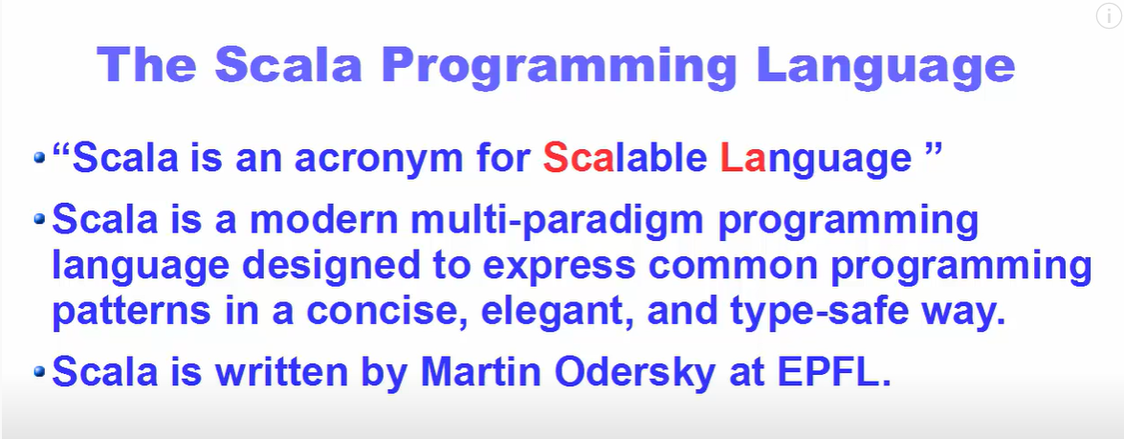

Slide 4
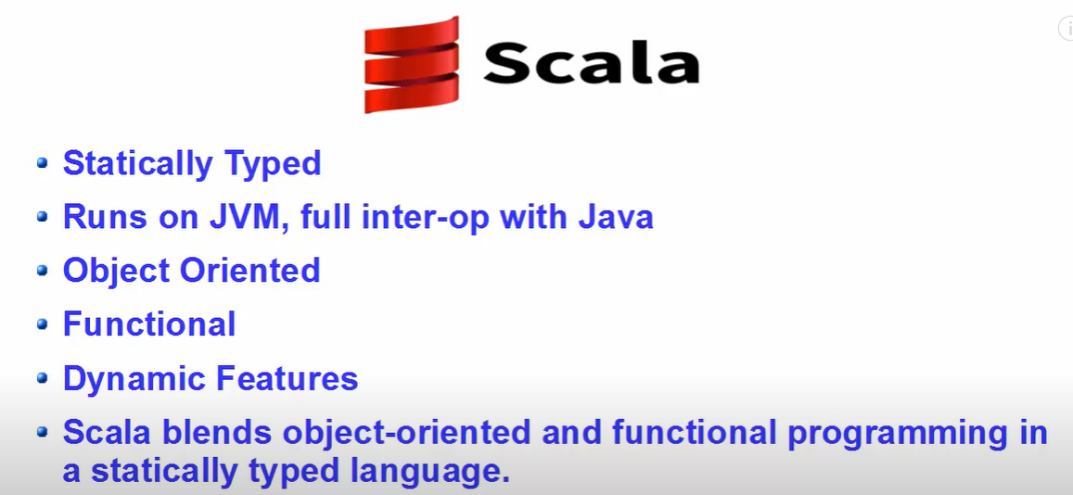

Slide 5
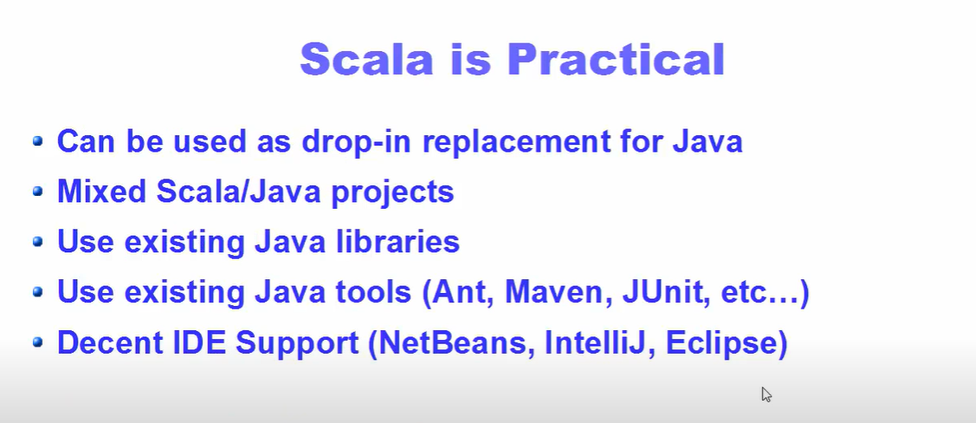

Slide 6
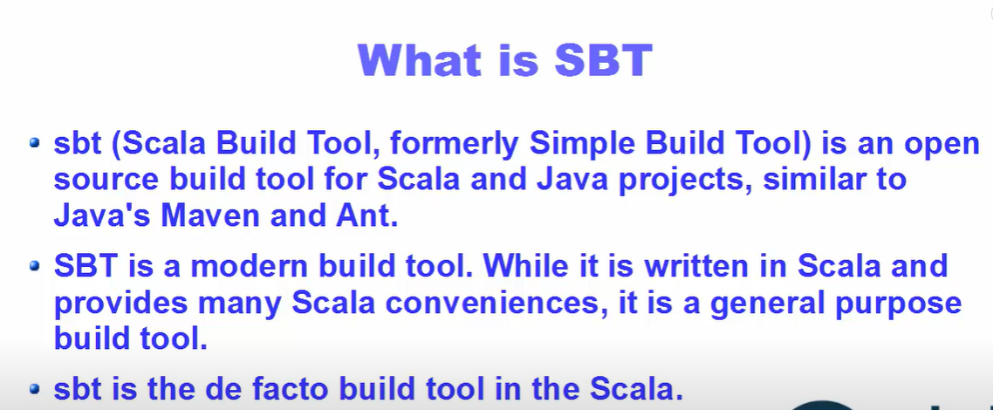

Slide 7
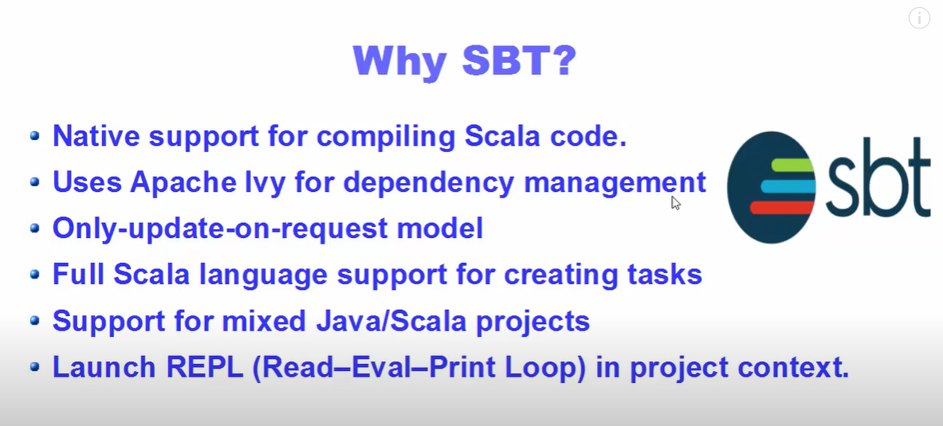

Slide 8
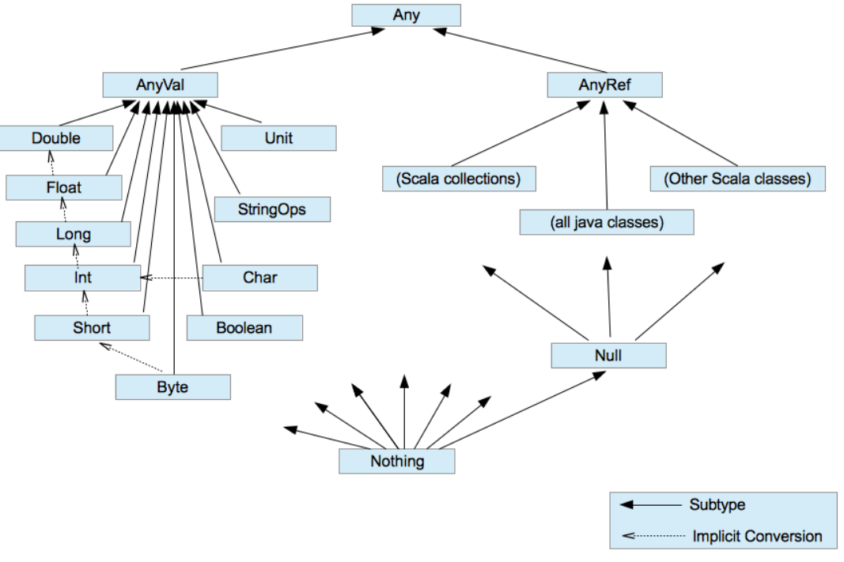

Slide 9
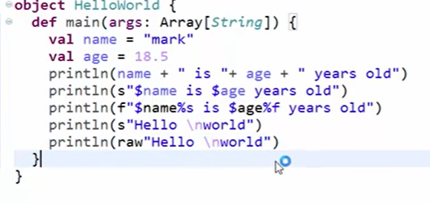
String Interpolation
String not safe interpolation
Type safe interpolation Because we will provide data types itself.
Raw Interpolation

Slide 10
An iterator is a way to access elements of a collection one-by-one. It resembles to a collection in terms of syntax but works differently in terms of functionality. An iterator defined for any collection does not load the entire collection into the memory but loads elements one after the other. Therefore, iterators are useful when the data is too large for the memory. To access elements we can make use of hasNext() to check if there are elements available and next() to print the next element.
object Scala_Iterator {
def main(args: Array[String]): Unit = {
val v = Iterator(5, 1, 2, 3, 6, 4)
//checking for availability of next element
while(v.hasNext)
//printing the element
println(v.next)
}
}

Slide 11
We can define an iterator for any collection(Arrays, Lists, etc) and can step through the elements of that particular collection.
object Scala_Iterator_for_any_collection {
def main(args: Array[String]): Unit = {
val v = Array(5,1,2,3,6,4)
//val v = List(5,1,2,3,6,4)
// defining an iterator
// for a collection
val i = v.iterator
while (i.hasNext)
print(i.next + " ")
}
}

Slide 12
Scala Collection
Scala provides rich set of collection library. It contains classes and traits to collect data. These collections can be mutable or immutable. we can use them according to your requirement. Scala.collection.mutable package contains all the mutable collections. You can add, remove and update data while using this package.
Scala.collection.immutable contains all the immutable collections. It does not allow you to modify data. Scala imports this package by default. If you want mutable collection, you must import scala.collection.mutable package in your code.
Scala Collections
Scala Collection
ScalaSet
Scala HashSet
Scala BitSet
Scala ListSet
Scala Seq
Scala Vector
Scala List
Scala Queue
Scala Stream
Scala Maps
Scala Hash
MapScala
ListMap

Slide 13
Scala Set
It is used to store unique elements in the set. It does not maintain any order for storing elements. You can apply various operations on them. It is defined in the Scala.collection.immutable package.
Scala Set Syntax
val variableName:Set[Type] = Set(element1, element2,... elementN) or
val variableName = Set(element1, element2,... elementN)

Slide 14
object Scala_Collections_Set {
def main(args: Array[String]): Unit = {
val set1 = Set() // An empty set
val Mtech_Stu_Names = Set("Somesh","Kapil","Brijneder","Ritika","Tosseb") // Creating a set with elements
val Mtech_Stu_Names1:Set[String] =Set("Somesh","Kapil","Brijneder","Ritika","Tosseb")
println(set1)
println("First way to Defined Set:="+Mtech_Stu_Names)
println(s"Second way to Defined Set:=$Mtech_Stu_Names1")
// println(Mtech_Stu_Names.head) // Returns first element present in the set
// println(Mtech_Stu_Names.tail) // Returns all elements except first element.
// println(Mtech_Stu_Names.isEmpty) // Returns either true or false
}

Slide 15
Scala Set Example: Merge two Set
we can merge two sets into a single set. Scala provides a predefined method to merge sets. In this example, ++ method is used to merge two sets.
object Scala_Collections_Set_Mearge_Two_Set
{
def main(args: Array[String]): Unit =
{
val name = Set("kapil","somesh","rohit","mohit")
val rollnumber = Set("101","102","103","104","105")
val mergeSet = name ++ rollnumber // Merging two sets
println("Elements in games set: "+name.size) // Return size of collection
println("Elements in alphabet set: "+rollnumber.size)
println("Elements in mergeSet: "+mergeSet.size)
println(mergeSet)
}
}

Slide 16
Scala Set Example: Adding and Removing Elements
object Scala_Collection_Set_Add_Remove
{
def main(args: Array[String]): Unit =
{
var Mtech_Stu_Name=Set("mk","jk","tk","np")
// Mtech_Stu_Name.foreach((name:String)=>println(name))
Mtech_Stu_Name -= "makhan"
Mtech_Stu_Name.foreach((name:String)=>println(name))
}
}

Slide 17
Iterating Set Elements using foreach loop
object Scala_Collection_Iterating_elements_Foreach {
def main(args: Array[String]): Unit = {
var Mtech_Stu_names = Set("Somesh", "Rohit", "Kapil", "Mukesh")
Mtech_Stu_names.foreach((element:String)=> println(element))
}
}
Iterating Set Elements using for loop =?

Slide 18
Scala HashSet
HashSet is sealed class. It extends immutable Set and AbstractSet trait. Hash code is used to store elements. It neither sorts the elements nor maintains insertion order . The Set interface implemented by the HashSet class, backed by a hash table . In Scala, A concrete implementation of Set semantics is known HashSet.
Scala HashSet Example
In the following example, we have created a HashSet to store elements. Here, foreach is used to iterate elements.
import scala.collection.immutable.HashSet
object Scala_Collection_HashSet {
def main(args: Array[String]): Unit = {
var Mtech_Stu_Name = HashSet("kapil","somesh","rohit","mohit","xyz")
Mtech_Stu_Name.foreach((name:String)=>println(name+" "))
// Mtech_Stu_Name.foreach((element:String) => println(element+" "))
}
}

Slide 19
Operations perform with HashSet
Adding an elements in HashSet : We can add an element in HashSet by using + sign. below is the example of adding an element in HashSet.
Adding more than one element in HashSet : We can add more than one element in HashSet by using ++ sign. below is the example of adding more than one elements in HashSet.
Remove element in HashSet : We can remove an element in HashSet by using – sign. below is the example of removing an element in HashSet.
Find the intersection between two HashSets : We can find intersection between two HashSets by using & sign. below is the example of finding intersection between two HashSets.

Slide 20
Scala Seq
Seq is a trait which represents indexed sequences that are guaranteed immutable. we can access elements by using their indexes. It maintains insertion order of elements.
Sequences support a number of methods to find occurrences of elements or subsequences. It returns a list.
object Scala_Collection_Seq { def main(args: Array[String]): Unit = { var Roll_number:Seq[Int] = Seq(52,85,1,8,3,2,7) Roll_number.foreach((element:Int) => print(element+" ")) println("\nAccessing element by using index") println(Roll_number(2)) } }

Slide 21
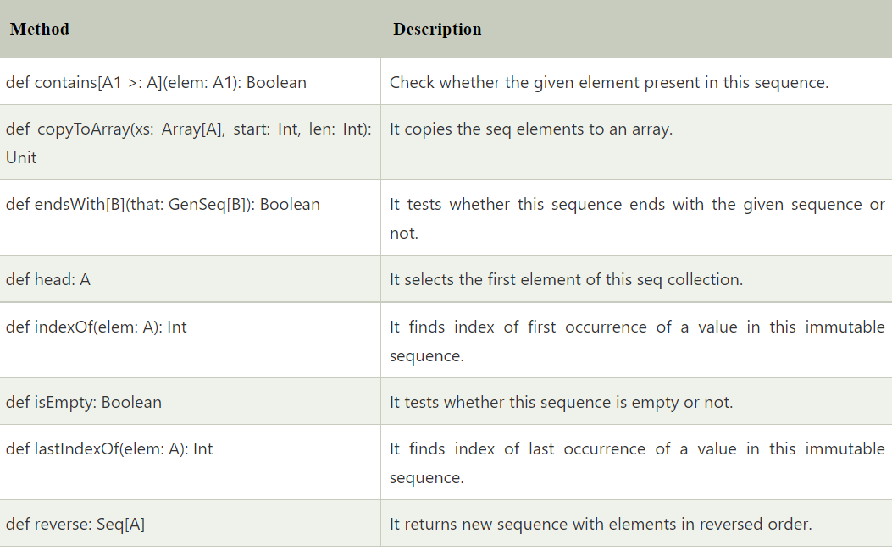
Commonly used Methods of Seq
object Scala_Collection_Seq_Methods { def main(args: Array[String]): Unit = { var seq:Seq[Int] = Seq(52,85,1,8,3,2,7) seq.foreach((element:Int) => print(element+" ")) println("\nis Empty: "+seq.isEmpty) println("Ends with (2,7): "+ seq.endsWith(Seq(2,7))) println("contains 8: "+ seq.contains(8)) println("last index of 3 : "+seq.lastIndexOf(3)) println("Reverse order of sequence: "+seq.reverse) } }

Slide 22
Scala List
List is used to store ordered elements. It extends LinearSeq trait. It is a class for immutable linked lists. This class is good for last-in-first-out (LIFO), stack-like access patterns.
It maintains order of elements and can contain duplicates elements also.
object Scala_Collection_List {
def main(args: Array[String]): Unit = {
// List of Strings
var list = List(“mohit“,”Xyz”)
// List of Integer
var list2:List[Int] = List(1,8,5,6,9,58,23,15,4)
// Empty List.
// Two dimensional list
val dim: List[List[Int]] =
List(
List(1, 0, 0),
List(0, 1, 0),
List(0, 0, 1)
)
println(list)
println(list2)
println(dim)
}
}
Scala Lists
Lists are immutable whereas arrays are mutable in Scala.
Lists represents a linked list whereas arrays are flat.

Slide 23
All lists can be defined using two fundamental building blocks, a tail Nil and ::, which is pronounced cons. Nil also represents the empty list. All the above lists can be defined as follows.
object Scala_Collection_List1 {
def main(args: Array[String]): Unit = {
// List of Strings
val Stu_name = "Kapil" :: ("Mohit" :: ("Shaifali" :: Nil))
// List of Integers
val Roll = 1 :: (2 :: (3 :: (4 :: Nil)))
// Empty List.
val empty = Nil
// Two dimensional list
val dim = (1 :: (0 :: (0 :: Nil))) ::
(0 :: (1 :: (0 :: Nil))) ::
(0 :: (0 :: (1 :: Nil))) :: Nil
print(Stu_name)
print(dim)
}
}

Slide 24
Basic Operations on Lists
All operations on lists can be expressed in terms of the following three methods.
Sr.No | Methods & Description
1 | head This method returns the first element of a list.
2 | tail This method returns a list consisting of all elements except the first.
3 | isEmpty This method returns true if the list is empty otherwise false.
object Scala_Collection_List_Operations {
def main(args: Array[String]): Unit = {
val Stu_name = "x" :: ("y" :: ("z" :: Nil))
val Stu_nums = Nil
println( "Head of fruit : " + Stu_name.head )
println( "Tail of fruit : " + Stu_name.tail )
println( "Check if fruit is empty : " + Stu_name.isEmpty )
println( "Check if nums is empty : " + Stu_nums.isEmpty )
}
}

Slide 25
Concatenating Lists
we can use either ::: operator or List.:::() method or List.concat() method to add two or more lists. Please find the following example given below −
object Scala_Collection_List_Concat {
def main(args: Array[String]): Unit = {
val Stu_name = "x" :: ("y" :: ("z" :: Nil))
val Stu_Stream = "Mtech" :: ("Msc" :: Nil)
// use two or more lists with ::: operator
var all_info = Stu_name ::: Stu_Stream
println( "Stu_name ::: Stu_Stream : " + all_info )
// use two lists with Set.:::() method
all_info = Stu_name.:::(Stu_Stream)
println( "Stu_name.:::(Stu_Stream) : " + all_info )
// pass two or more lists as arguments
all_info = List.concat(Stu_name, Stu_Stream)
println( "List.concat(Stu_name, Stu_Stream) : " + all_info )
}
}

Slide 26
Creating Uniform Lists
we can use List.fill() method creates a list consisting of zero or more copies of the same element. Try the following example program.
object Scala_Collection_List_Uniform {
def main(args: Array[String]): Unit = {
val Stu_name = List.fill(3)("Rohit") // Repeats apples three times.
println( "Stu_name : " + Stu_name )
val num = List.fill(10)(2) // Repeats 2, 10 times.
println( "num : " + num )
}
}

Slide 27
Tabulating a Function
we can use a function along with List.tabulate() method to apply on all the elements of the list before tabulating the list. Its arguments are just like those of List.fill: the first argument list gives the dimensions of the list to create, and the second describes the elements of the list. The only difference is that instead of the elements being fixed, they are computed from a function.
Try the following example program.
Example

Slide 28
Scala functions are first class values. Difference between Scala Functions & Methods: Function is a object which can be stored in a variable. But a method always belongs to a class which has a name, signature bytecode etc. Basically, we can say a method is a function which is a member of some object.
object Scala_Class_Function {
def main(args: Array[String]): Unit = {
val myGetAreaFn= (rad:Double) =>
{
val PI =3.14
PI * rad*rad
}
println(myGetAreaFn(2.2))
}
}
Class scala_class_methods {
def mygetareamd(rad:double):double=
{
Val pi =3.14
PI* rad* rad
}
}
Object scala_class_methods_obj
{
Def main(args: array[string]): unit = {
val m1= new scala_class_methods()
Println(m1.Mygetareamd(2.2))
}
}

Slide 29
Scala Queue
Queue implements a data structure that allows inserting and retrieving elements in a first-in-first-out (FIFO) manner.
In scala, Queue is implemented as a pair of lists. One is used to insert the elements and second to contain deleted elements. Elements are added to the first list and removed from the second list.
import scala.collection.immutable._ object Scala_Collection_Queue { def main(args: Array[String]): Unit = { var queue = Queue(1,5,6,2,3,9,5,2,5) var queue2:Queue[Int] = Queue(1,5,6,2,3,9,5,2,5) println(queue) println(queue2) } }
import scala.collection.immutable._ object Scala_Collection_Queue_Methods { def main(args: Array[String]): Unit = { var queue = Queue(1,5,6,2,3,9,5,2,5) print("Queue Elements: ") queue.foreach((element:Int)=>print(element+" ")) var firstElement = queue.front print("\nFirst element in the queue: "+ firstElement) var enqueueQueue = queue.enqueue(100) print("\nElement added in the queue: ") enqueueQueue.foreach((element:Int)=>print(element+" ")) var dequeueQueue = queue.dequeue print("\nElement deleted from this queue: "+ dequeueQueue) } }

Slide 30
Scala Set map() method
The map() method is utilized to build a new set by applying a function to all elements of this set.
Method Definition: def map[B](f: (A) => B): immutable.Set[B]
object Scala_Collection_Maps_new {
def main(args: Array[String]): Unit = {
// Creating a set
val s1 = Set(5, 1, 3, 2, 4)
// Applying map method
// val result = s1.map(x => x*x)
val result1 = s1.map(x => x+2)
// Display output
// println(result)
println(result1)
}
}

Slide 31
Scala Map
Map is a collection of key-value pairs. In other words, it is similar to dictionary. Keys are always unique while values need not be unique. Key-value pairs can have any data type. However, data type once used for any key and value must be consistent throughout. Maps are classified into two types: mutable and immutable. By default Scala uses immutable Map. In order to use mutable Map, we must import scala.collection.mutable.Map class explicitly.
How to create Scala Maps
object scala_collection_maps {
def main(args: array[string]): unit = {
// var name:vector[string] = vector("kapil","somesh","rohit","mohit") //or
// var rollnumber = vector(101,102,103,104,105)
var name =map((1,"kapil"),(2,"somesh"))
// another way
var name2 = map(3->"somesh",4->"ball")
var newmap = name2+(5->"xyz") // adding a new element to map
var removeelement = newmap-4 // // removing an element from map
println(name)
println(name2)
println(newmap)
println(removeelement)
}
}

Slide 32
Operations on a Scala Map
There are three basic operations we can carry out on a Map:
keys: In Scala Map, This method returns an iterable containing each key in the map.
values: Value method returns an iterable containing each value in the Scala map.
isEmpty: This Scala map method returns true if the map is empty otherwise this returns false.
object Scala_Collection_Map_Accessing {
def main(args: Array[String]): Unit = {
var name2 = Map(3->"somesh",4->"Ball")
// Accessing score of Ajay
val Three= name2(3)
println(Three)
}
}
If we try to access value associated with the key “Kapil”, we will get an error because no such key is present in the Map. Therefore, it is recommended to use contains() function while accessing any value using key.
This function checks for the key in the Map. If the key is present then it returns true, false otherwise.

Slide 33
Updating the values
If we try to update value of an immutable Map, Scala outputs an error. On the other hand, any changes made in value of any key in case of mutable Maps is accepted.
Example:
Updating immutable Map:
object Scala_Collections_Map_Updating {
def main(args: Array[String]): Unit = {
val mapIm = Map("Ajay" -> 30,"Bhavesh" -> 20,"Charlie" -> 50)
println(mapIm)
//Updating
mapIm("Ajay") = 10
println(mapIm)
}
}
val mapMut = scala.collection.mutable.Map("Ajay" -> 30,
"Bhavesh" -> 20,
"Charlie" -> 50)
println("Before Updating: " + mapMut)
// Updating
mapMut("Ajay") = 10
println("After Updating: " + mapMut)

Slide 35
Scala Access Modifier
Access modifier is used to define accessibility of data and our code to the outside world. You can apply accessibly to classes, traits, data members, member methods and constructors etc. Scala provides least accessibility to access to all. You can apply any access modifier to your code according to your application requirement.
Scala provides only three types of access modifiers, which are given below:
No modifier
Protected
Private
Scala Example: Private Access Modifier
In scala, private access modifier is used to make data accessible only within class in which it is declared. It is most restricted and keeps your data in limited scope. Private data members does not inherit into subclasses.

Slide 36
Scala Example: Private Access Modifier
In scala, private access modifier is used to make data accessible only within class in which it is declared. It is most restricted and keeps your data in limited scope. Private data members does not inherit into subclasses.
class Scala_Access_Modifier_Private {
private var a: Int = 10
def show() {
println(a)
}
}
object MainObject{
def main(args:Array[String]){
var p = new Scala_Access_Modifier_Private()
p.a = 12 //variable a in class Scala_Access_Modifier_Private cannot be accessed in Scala_Access_Modifier_Private
p.show()
}
}

Slide 37
Scala Example: Protected Access Modifier
Protected access modifier is accessible only within class, sub class and companion object. Data members declared as protected are inherited in subclass. Let's see an example.
class Scala_Procted_Access_Specifier { protected var a:Int = 10 } class SubClass extends Scala_Procted_Access_Specifier{ def display(){ println("a = "+a) } } object MainObject3 { def main(args: Array[String]) { var s = new SubClass() s.display() } }

Slide 38
Scala Example: No-Access-Modifier
In scala, when you don't mention any access modifier, it is treated as no-access-modifier. It is same as public in java. It is least restricted and can easily accessible from anywhere inside or outside the package.
class Scala_No_Access_Modifier
{
var a:Int = 10
def show(){
println(" a = "+a)
}
}
object MainObject5{
def main(args:Array[String]){
var a = new Scala_No_Access_Modifier()
a.show()
}
}

Slide 39
Scala Pattern Matching
Pattern matching is a feature of scala. It works same as switch case in other programming languages. It matches best case available in the pattern.
Let's see an example.
object Scala_Pattern { def main(args: Array[String]): Unit = { var a = 1 a match { case 1 => println("One") case 2 => println("Two") case _ => println("No") } } }
In the above example, we have implemented a pattern matching.
Here, match using a variable named a. This variable matches with best available case and prints output. Underscore (_) is used in the last case for making it default case.

Slide 40
Match expression can return case value also. In next example, we are defining method having a match with cases for any type of data. Any is a class in scala which is a super class of all data types and deals with all type of data. Let's see an example.
object Scala_Pattern_Match_AntType { def main(args: Array[String]): Unit = { var result = search("Hello") print(result) } def search(a: Any): Any = a match { case 1 => println("One") case "Two" => println("Two") case "Hello" => println("Hello") case _ => println("No") }

Slide 41
How to take Input from Users
import scala.io.StdIn._
object Scala_how_to_take_input {
def main(args: Array[String]): Unit = {
print("Enter a number: a and b ")
val a= readInt()
var length = readFloat(),readChar(),readBoolean(),readDouble(),readChar()
val b= readInt()
println("The value of a & b is=: "+ a,b)
}
}

Slide 42
Scala Exception Handling
Exception handling is a mechanism which is used to handle abnormal conditions. we can also avoid termination of your program unexpectedly.
Scala makes "checked vs unchecked" very simple. It doesn't have checked exceptions. All exceptions are unchecked in Scala, even SQLException and IOException.
Scala Program Example without Exception Handling
class Scala_Exception{
def divide(a:Int, b:Int) = {
a/b // Exception occurred here
println("Rest of the code is executing...")
}
}
object MainObject{
def main(args:Array[String]){
var e = new ExceptionExample()
e.divide(100,0)
}
}

Slide 43
Scala Try Catch
Scala provides try and catch block to handle exception. The try block is used to enclose suspect code. The catch block is used to handle exception occurred in try block. we can have any number of try catch block in your program according to need.
Scala Try Catch Example
In the following program, we have enclosed our suspect code inside try block. After try block we have used a catch handler to catch exception. If any exception occurs, catch handler will handle it and program will not terminate abnormally.
class Scala_try_catch {
def divide(a:Int, b:Int) = {
try{
a/b
}catch{
case e: Exception=>println(e)
}
println("Rest of the code is executing...")
}
}
object Scala_try_obj
{
def main(args: Array[String]): Unit = {
var e = new Scala_try_catch()
e.divide(100,0)
}
}

Slide 44
Scala Try Catch Example 2
In this example, we have two cases in our catch handler. First case will handle only arithmetic type exception. Second case has Throwable class which is a super class in exception hierarchy. The second case is able to handle any type of exception in your program. Sometimes when you don't know about the type of exception, you can use super class.
class Scala_try_Multiple_catch {
def divide(a:Int, b:Int) = {
try{
a/b
var arr = Array(1,2)
arr(10)
}catch{
case e: ArithmeticException => println(e)
case ex: Throwable =>println("found a unknown exception"+ ex)
}
println("Rest of the code is executing...")
}
}
object Scala_try_mul_obj
{
def main(args: Array[String]): Unit = {
var e = new Scala_try_Multiple_catch()
e.divide(100,10)
}
}

Slide 45
Scala Finally
The finally block is used to release resources during exception. Resources may be file, network connection, database connection etc. the finally block executes guaranteed. The following program illustrate the use of finally block.
Scala Finally Block Example
class ExceptionExample{
def divide(a:Int, b:Int) = {
try{
a/b
var arr = Array(1,2)
arr(10)
}catch{
case e: ArithmeticException => println(e)
case ex: Exception =>println(ex)
case th: Throwable=>println("found a unknown exception"+th)
}
finally{
println("Finaly block always executes")
}
println("Rest of the code is executing...")
}
}
object MainObject{
def main(args:Array[String]){
var e = new ExceptionExample()
e.divide(100,10)
}
}

Slide 46
custom exceptions
In scala, we can create your own exception. It is also known as custom exceptions. You must extend Exception class while declaring custom exception class. we can create your own exception message in custom class.
class InvalidAgeException(s:String) extends Exception(s){}
class Scala_Custom_Exception {
@throws(classOf[InvalidAgeException])
def validate(age:Int){
if(age<18){
throw new InvalidAgeException("Not eligible")
}else{
println("You are eligible")
}
}
}
object MainObjects{
def main(args:Array[String]){
var e = new Scala_Custom_Exception()
try{
e.validate(5)
}catch{
case e : Exception => println("Exception Occured : "+e)
}
}
}

Slide 47
List of String Method in Scala with Example
1. char charAt(int index)
This method returns the character at the index we pass to it. Isn’t it so much like Java?
object Scala_String_methods {
def main(args: Array[String]): Unit = {
var name = "Mtech"
print(name.charAt(1))
}
}
except that it compares two strings lexicographically. If they match, it returns 0. Otherwise, it returns the difference between the two(the number of characters less in the shorter string, or the maximum ASCII difference between the two).
2. int compareTo(Object o)
object Scala_String_methods {
def main(args: Array[String]): Unit = {
var name = "Mtech"
var Stream="BDA"
println(name.compareTo(Stream))
}
}

Slide 48
String concat(String str)
This will concatenate the string in the parameter to the end of the string on which we call it.
object Scala_String_methods {
def main(args: Array[String]): Unit = {
var name = "Mtech"
var Stream="BDA"
println(name.concat(Stream))
}
}
Boolean contentEquals(StringBuffer sb)
contentEquals compares a string to a StringBuffer’s contents. If equal, it returns true; otherwise, false.
object Scala_String_methods {
def main(args: Array[String]): Unit = {
val a=new StringBuffer(“Mtech")
print(“Mtech".contentEquals(a))
}
}

Slide 49
Boolean endsWith(String suffix)
This Scala String Method returns true if the string ends with the suffix specified; otherwise, false.
object Scala_String_methods {
def main(args: Array[String]): Unit = {
print("Mtech".endsWith("h"))
}
}
Boolean equals(Object anObject)
This Scala String Method returns true if the string and the object are equal; otherwise, false.
hashCode()
This int hashCode method returns a hash code for the string.
length()
This Scala String Method method simply returns the length of a string.

Slide 50
Break statement in Scala
In Scala, we use a break statement to break the execution of the loop in the program. Scala programing language does not contain any concept of break statement(in above 2.8 versions), instead of break statement, it provides a break method, which is used to break the execution of a program or a loop. Break method is used by importing scala.util.control.breaks._ package.
import scala.util.control.Breaks.{break, breakable}
import scala.util.control.BreakControl
object Scala_Break {
def main(args: Array[String]): Unit = {
for(i<- 1 to 10 )
{
breakable{
if(i == 2)
{
break
}
else
{
print(i)
}
}
}
}
}

Slide 52
Scala Array
Array is a collection of mutable values. It is an index based data structure which starts from 0 index to n-1 where n is length of array.
Scala arrays can be generic. It means, we can have an Array[T], where T is a type parameter or abstract type. Scala arrays are compatible with Scala sequences - we can pass an Array[T] where a Seq[T] is required. It also supports all the sequence operations.
Following image represents the structure of array where first index is 0, last index is 9 and array length is 10.
Scala Types of array
Single dimensional array
Multidimensional array
Scala Single Dimensional Array
Single dimensional array is used to store elements in linear order. Array elements are stored in contiguous memory space. So, if you have any index of an array, you can easily traverse all the elements of the array.
Syntax for Single Dimensional Array
var arrayName : Array[arrayType] = new Array[arrayType](arraySize); or
var arrayName = new Array[arrayType](arraySize) or
var arrayName : Array[arrayType] = new Array(arraySize); or
var arrayName = Array(element1, element2 ... elementN)

Slide 53
object Scala_Array_ID {
def main(args: Array[String]): Unit = {
var arr = new Array[Int](5)
arr(0)=15
arr(1)=25
arr(2)=35
arr(3)=45
arr(4)=55
for(a<-arr)
{
println(a)
}

Slide 54
Scala Multidimensional Array
Multidimensional array is an array which store data in matrix form. You can create from two dimensional to three, four and many more dimensional array according to your need. Below we have mentioned array syntax. Scala provides an ofDim method to create multidimensional array.
Multidimensional Array Syntax
var arrayName = Array.ofDim[ArrayType](NoOfRows,NoOfColumns) or
var arrayName = Array(Array(element...), Array(element...), ...)

Slide 55
Explanation of Case Class
A Case Class is just like a regular class, which has a feature for modeling unchangeable data.
It is also constructive in pattern matching. It has been defined with a modifier case,
due to this case keyword, we can get some benefits to stop oneself from doing a sections of
codes that have to be included in many places with little or no alteration.
As we can see below a minimal case class needs the keyword case class, an identifier,
and a parameter list which may be vacant.
Syntax:
Case class className(parameters)
Note: The Case class has a default apply() method which manages the construction of object.
Explanation of Case Object
A Case Object is also like an object, which has more attributes than a regular Object. It is a blend of both case classes and object. A case object has some more features than a regular object. Below two are important features of case object:
It is serializable.
It has a by default hashCode implementation.

Slide 56
case class Scala_Case_Class(name:String, age:Int)
object Scala_Case_CLass_Obj
{
def main(args: Array[String]): Unit = {
var c = Scala_Case_Class("Nidhi", 23)
// Display both Parameter
println("Name of the employee is " + c.name);
println("Age of the employee is " + c.age);
}
}

Slide 58
Build tools
Build tools. At the time of writing this article in April 2018 we have at our disposal:
sbt
cbt
mill
fury
maven
polyglot maven
gradle
ant (to be written)
bazel (to be written)
pants (to be written)
make (to be written)

Slide 60
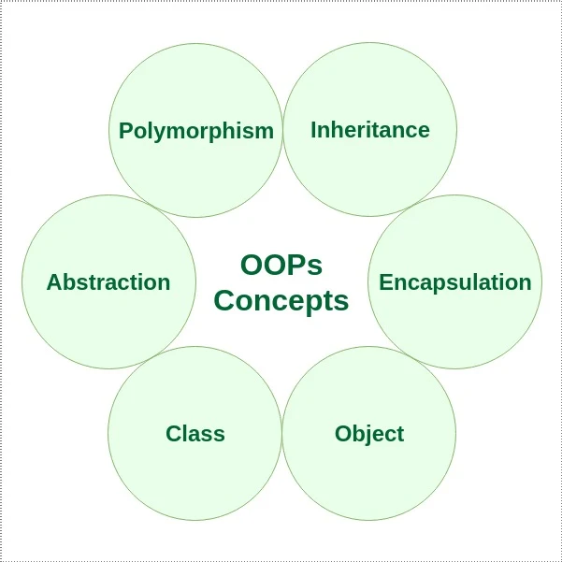
Introduction to OOPS

Slide 61
In general, Object-Oriented Programming (OOP) consists of classes and objects and aims to implement real-world entities like polymorphism, inheritance.
The class can be thought of as a representation or a design for objects. Classes will usually have their own methods (behavior) and attributes.
Attributes are individual entities that differentiate each object from the other and determine various qualities of an object. Methods, on the other hand, are more like how a function usually operates in programming. They determine how the instance of the class works. It's mostly because of methods (behavior); objects have the power to be done something to them.

Slide 62
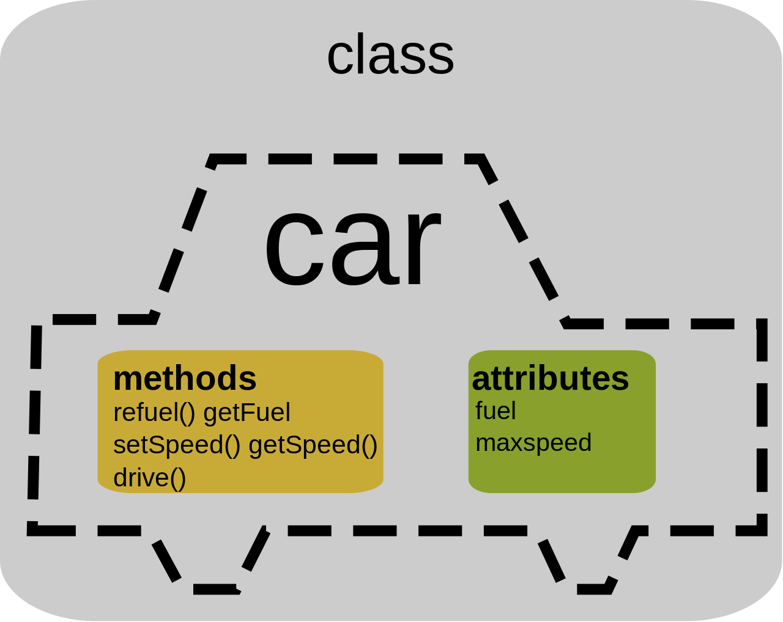
The above figure gives you more intuition about the flow of object-oriented programming or, to be more specific, what a class looks like. In the above picture, there is a class car which has attributes: fuel, max speed, and can have more attributes like the model, make, etc. It has different sets of methods like refuel(), getFuel(), setSpeed(), and some additional methods can be change gear, start the engine, stop the engine, etc.

Slide 63
Classes and Objects in Scala
Much like c++ and java, object-oriented programming in Scala follows pretty much the same conventions. It has the concept of defining classes and objects and within class constructors, and that is all there is to object-oriented programming in Scala.
Class Declaration
class Class_name{
// methods and attributes
}
Class in Scala is defined by the keyword class followed by the name of the class, and generally, the class name starts with a capital letter. There are few keywords which are optional but can be used in Scala class declaration like: class-name, it should begin with a capital letter: superclass, the parent class name preceded by extend keyword: traits, it is a comma-separated list implemented by the class preceded by extend keyword.
A class can in Scala inherits only one parent class, which means Scala does not support multiple inheritances. However, it can be achieved with the use of Traits.
Finally, the body of a class in Scala is surrounded by curly braces {}

Slide 64
class Car {
// Class variables
var make: String = "BMW"
var model: String = "X7"
var fuel: Int = 40
// Class method
def Display()
{
println("Make of the Car : " + make);
println("Model of the Car : " + model);
println("Fuel capacity of the Car : " + fuel);
}
}
object Main_Car_calss
{
// Main method
def main(args: Array[String])
{
// Class object
var obj = new Car();
obj.Display();
}
}

Slide 65
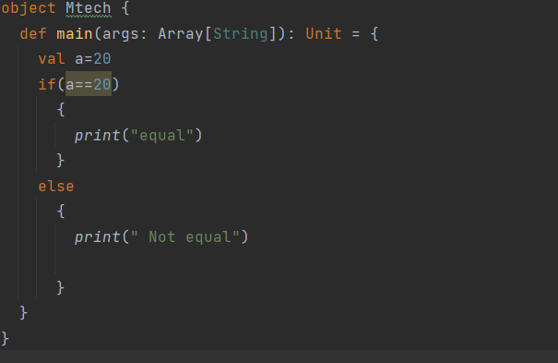
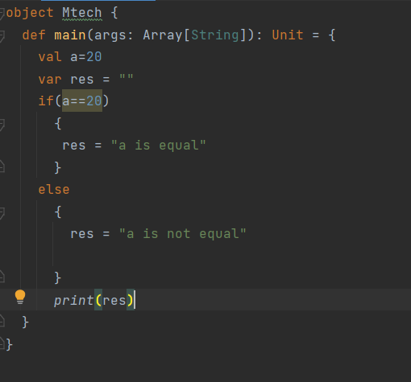
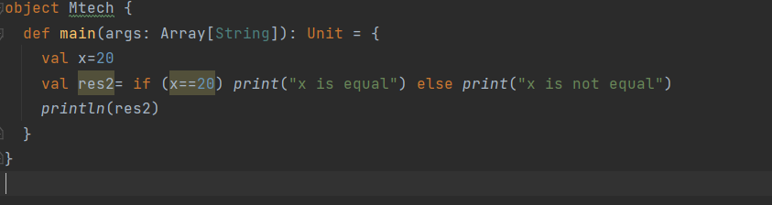
If Else Statement

Slide 69
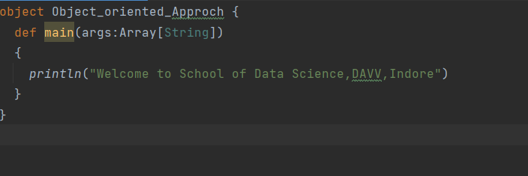
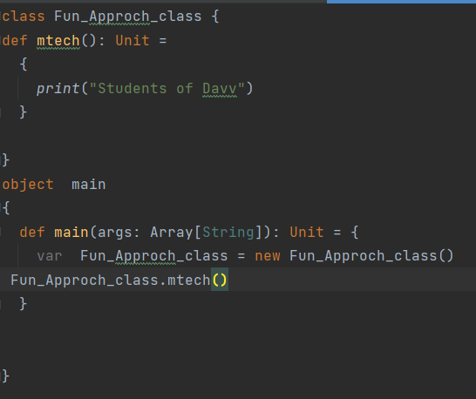
Object Oriented Approach
Funtional Approach
Object Oriented Approach

Slide 70
Case Class
Scala case classes are like regular classes except for the fact that they are good for modeling immutable data and serve as useful in pattern matching. Case classes include public and immutable parameters by default. These classes support pattern matching, which makes it easier to write logical code. The following are some of the characteristics of a Scala case class:
Instances of the class can be created without the new keyword.
As part of the case classes, Scala automatically generates methods such as equals(), hashcode(), and toString().
Scala generates accessor methods for all constructor arguments for a case class.
case class Case_Class(name:String, age:Int) object MainObject { def main(args:Array[String]) { var c = Case_Class("Xyz", 23) println("Student name:" + c.name); println("Student age: " + c.age); } }

Slide 71
Closure in Scala
class Clousre_feature { var x = 20 def function_name(y:Int) { println(x+y) } } object main { def main(args: Array[String]): Unit = { var obj = new Clousre_feature() obj.function_name(3) } }
Scala closures are functions whose return value is dependent on one or more free variables declared outside the closure function. Neither of these free variables is defined in the function nor is it used as a parameter, nor is it bound to a function with valid values. Based on the values of the most recent free variables, the closing function is evaluated.

Slide 72
Traits in Scala
The concept of traits is similar to an interface in Java, but they are even more powerful since they let you implement members. It is composed of both abstract and non-abstract methods, and it features a wide range of fields as its members. Traits can either contain all abstract methods or a mixture of abstract and non-abstract methods. In computing, a trait is defined as a unit that encapsulates the method and its variables or fields. Furthermore, Scala allows partial implementation of traits, but no constructor parameters may be included in traits. To create traits, use the trait keyword.

Slide 73
trait MyCompany
{
def company
def position
}
class MyClass extends MyCompany
{
def company()
{
println("Company: InterviewBit")
}
def position()
{
println("Position: SoftwareDeveloper")
}
def employee() //Implementation of class method
{
println("Employee: Aarav")
}
}
object Main
{
def main(args: Array[String])
{
val obj = new MyClass(); obj.company();
obj.position();
Obj.employee(); }
}

Slide 74
Nil, Null, None and Nothing
Null, null, Nil, Nothing, None, and Unit are all used to represent empty values in Scala.
Null refers to the absence of data, and its type is Null with a capital N.
Null is considered to be a list that contains zero items. Essentially, it indicates the end of the list.
Nothing is also a trait without instances.
None represents a sensible return value.
Unit is the return type for functions that return no value.

Slide 75
Inheritance in Scala
Inheritance is an important pillar of OOP(Object Oriented Programming). It is the mechanism in Scala by which one class is allowed to inherit the features(fields and methods) of another class.
Important terminology:
Super Class: The class whose features are inherited is known as superclass(or a base class or a parent class).
Sub Class: The class that inherits the other class is known as subclass(or a derived class, extended class, or child class). The subclass can add its own fields and methods in addition to the superclass fields and methods.
Reusability: Inheritance supports the concept of “reusability”, i.e. when we want to create a new class and there is already a class that includes some of the code that we want, we can derive our new class from the existing class. By doing this, we are reusing the fields and methods of the existing class.

Slide 76
How to use inheritance in Scala
The keyword used for inheritance is extends.
Syntax:
class child_class_name extends parent_class_name {
// Methods and fields
}
class Data_Science {
var Name: String = "Mtech"
}
class mtech extends Data_Science
{
var Roll_No: Int = 130
// Method// Method
def details()
{
println("Stream name: " +Name);
println("Roll number of student: " +Roll_No);
}
}
object Main_Inheritance
{
// Driver code
def main(args: Array[String])
{
// Creating object of derived class
val ob = new mtech();
ob.details();
}
}

Slide 77
Type of inheritance
Below are the different types of inheritance which are supported by Scala.
Single Inheritance: In single inheritance, derived class inherits the features of one base class. In the image below, class Data Science serves as a base class for the derived class metch.
class Data_Science {
var Name: String = "Mtech"
}
class mtech extends Data_Science
{
var Roll_No: Int = 130
// Method// Method
def details()
{
println("Stream name: " +Name);
println("Roll number of student: " +Roll_No);
}
}
object Main_Inheritance
{
// Driver code
def main(args: Array[String])
{
// Creating object of derived class
val ob = new mtech();
ob.details();
}
}
Data Science
(Base Class)
metch
(Derive Class)

Slide 78
In Multilevel Inheritance, a derived class will be inheriting a base class and as well as the derived class also act as the base class to another class. In the below image, the class Data Science serves as a base class for the derived class metch1
, which in turn serves as a base class for the derived class Info.
Multilevel Inheritance:
Data Science
(Base Class)
class Multilevel {
var Name: String = "Mtech"
}
class mtech1 extends Multilevel {
var Roll_No: Int = 130
}
class info extends mtech1
{
// Method
def details()
{
println("Name: " +Name);
println("Roll_number: " +Roll_No);
}
}
object Multilevel_Inheritance
{
def main(args: Array[String]): Unit = {
val ob = new info();
ob.details();
}
}
metch1
(Derive Class)
Info

Slide 79
Hierarchical Inheritance: In Hierarchical Inheritance, one class serves as a superclass (base class) for more than one subclass.In below image, class Hierarchical
serves as a base class for the derived class child1 , child2.
class Hierarchical {
var Name1: String = "Siya"
var Name2: String = "Soniya"
}
class Child1 extends Hierarchical
{
var Age: Int = 32
def details1()
{
println(" Name: " +Name1);
println(" Age: " +Age);
}
}
// Derived from Parent class
class Child2 extends Hierarchical
{
var Height: Int = 164
// Method
def details2()
{
println(" Name: " +Name2);
println(" Height: " +Height);
}
}
object Main_Hierarchical
{
// Driver code
def main(args: Array[String])
{
// Creating objects of both derived classes
val ob1 = new Child1();
val ob2 = new Child2();
ob1.details1();
ob2.details2();
}
}
Hierarchical
child1
Child2

Slide 80
Multiple Inheritance: In Multiple inheritance ,one class can have more than one superclass and inherit features from all parent classes. Scala does not support multiple inheritance with classes, but it can be achieved by traits.
child1
Child2
Hierarchical

