Slide 1

Scala

Slide 2
Scala Trait
Scala Trait
Scala Trait Mixins
Scala Tuple
Scala Tuples
Scala Tuple Example
Unit Overview
Scala Access Modifiers
Scala File Handling
Scala File Handling
Scala Multihreading
Thread
Scala Thread Methods
Scala Array
What is Scala?
History of Scala.
Features of Scala.
Simple Program of Scala
Scala Variables and Data Types
Scala Conditional Expressions
Scala Pattern Matching
Scala Loop
while loop
for loop
Scala Break
Scala Comments
Single line comment
Multiline comment
Documentation comment
Scala Functions
Scala Functions
Scala Higher Order Functions
Scala OOPs Concepts
Scala Object and Classes
Singleton and Companion Object
Case Classes & Objects
Scala Constructors
Scala Method Overloading
Scala This keyword
Scala Inheritance
Scala Method Overriding
Scala Field Overriding
Scala Final
Scala Array
Multidimensional Array
Scala String
Scala String
Scala String Methods
Scala String Interpolation
Scala Exceptions
Scala Exception Handling
Scala Try Catch Block
Scala Finally Block
Scala Throw keyword
Scala Throws keyword
Scala Custom Exception
Scala Collections
Scala Collection
Scala Set
Scala HashSet
Scala BitSet
Scala ListSet
Scala Seq
Scala Vector
Scala List
Scala Queue
Scala Stream
Scala Maps
Scala HashMap
Scala ListMap
Scala Abstract Class

Slide 3
What is Scala?
Scala is a general-purpose programming language. It supports object oriented, functional and imperative programming approaches. It is a strong static type language. In scala, everything is an object whether it is a function or a number. It does not have concept of primitive data.
History of Scala?
Scala is a general purpose programming language. It was created and developed by Martin Odersky. Martin started working on Scala in 2001 at the Ecole Polytechnique Federale de Lausanne (EPFL). It was officially released on January 20, 2004.
Scala is not an extension of Java, but it is completely interoperable with it. While compilation, Scala file translates to Java bytecode and runs on JVM (Java Virtual machine).
Scala was designed to be both object-oriented and functional. It is a pure object-oriented language in the sense that every value is an object and functional language in the sense that every function is a value. The name of scala is derived from word scalable which means it can grow with the demand of users.
Popularity of Scala
Twitter have announced that it had switched large portions of its backend from Ruby to Scala and intended to convert the rest.
Apple Inc. uses Scala in certain teams, along with Java and the Play framework.
The New York Times revealed in 2014 that its internal content management system Blackbeard is built using Scala, Akka and Play Framework.
There are teams within Google that use Scala, mostly due to acquisitions such as Firebase and Nest.
The Walmart Canada Uses Scala for their back end platform.

Slide 4
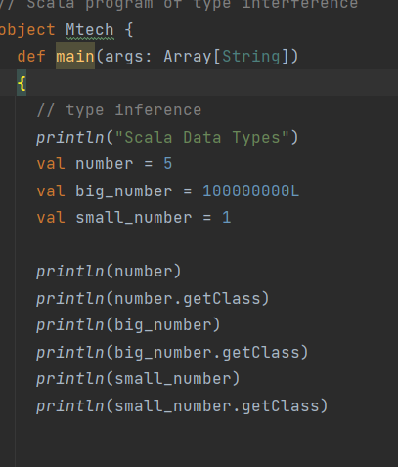
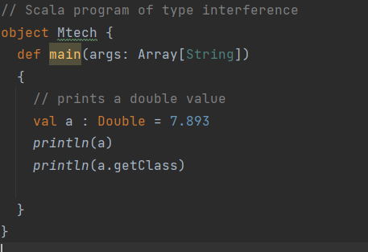
Features of Scala
However, through type inference, Scala automatically detects the type of the variable without explicitly specified by the user.
There are following features of scala:
Type inference
Singleton object
Immutability
Lazy computation
Case classes and Pattern matching
Concurrency control
String interpolation
Higher order function
Traits
Rich collection set
Type Inference
In Scala, We don't require to mention data type and function return type explicitly. Scala is enough smart to deduce the type of data. The return type of function is determined by the type of last expression present in the function.

Slide 5
Singleton Object
Scala is more object oriented language than Java so, Scala does not contain any concept of static keyword. Instead of static keyword Scala has singleton object. A Singleton object is an object which defines a single object of a class. A singleton object provides an entry point to your program execution. If you do not create a singleton object in your program, then your code compile successfully but does not give output. So you required a singleton object to get the output of your program. A singleton object is created by using object keyword.
Syntax:
object Name{ // code... }
Important points about singleton object
The method in the singleton object is globally accessible.
You are not allowed to create an instance of singleton object.
You are not allowed to pass parameter in the primary constructor of singleton object.
In Scala, a singleton object can extend class and traits.
In Scala, a main method is always present in singleton object.
The method in the singleton object is accessed with the name of the object(just like calling static method in Java), so there is no need to create an object to access this method.

Slide 6
Singleton Object

Slide 7
Singleton Object

Slide 8
Singleton Object

Slide 9
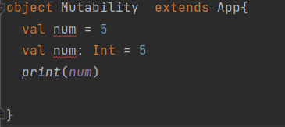
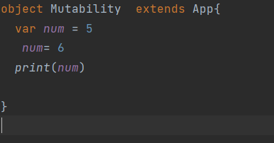
Immutability
Scala uses immutability concept. Each declared variable is immutable by default. Immutable means you can't modify its value. You can also create mutable variables which can be changed.
Mutable Variable
We can create mutable variable using var keyword. It allows you to change value after declaration of variable.

Slide 10
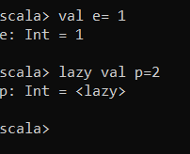
Lazy evaluation
Lazy evaluation or call-by-need is a evaluation strategy where an expression isn’t evaluated until its first use i.e to postpone the evaluation till its demanded. Functional programming languages like Haskell use this strategy extensively. C, C++ are called strict languages who evaluate the expression as soon as it’s declared. Then there are languages like Scala who are strict by default but can be lazy if specified explicitly i.e. of mixed type.
Let’s see an example in Scala:
Why lazy evaluation?
In the example what if we never use the output value? We wasted our map operation (CPU computations) which can be very costly when we write more complex and bigger code. Here lazy evaluation helps us in optimizing the process by evaluating the expression only when it’s needed and avoiding unnecessary overhead.

Slide 11
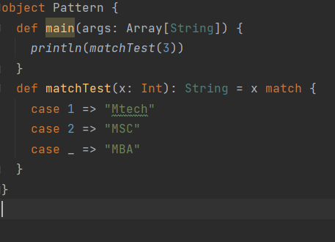
Pattern Matching
Pattern matching is the most widely used feature of Scala, after function values and closures. Scala provides great support for pattern matching, in processing the messages.
A pattern match includes a sequence of alternatives, each starting with the keyword case. Each alternative includes a pattern and one or more expressions, which will be evaluated if the pattern matches. An arrow symbol => separates the pattern from the expressions.
Try the following example program, which shows how to match against an integer value.

Slide 12
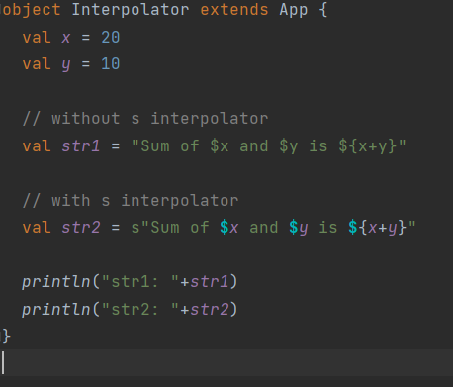
String Interpolation
String Interpolation refers to substitution of defined variables or expressions in a given String with respected values. String Interpolation provides an easy way to process String literals. To apply this feature of Scala, we must follow few rules:
String must be defined with starting character as s / f /raw.
Variables in the String must have ‘$’ as prefix.
Expressions must be enclosed within curly braces ({, }) and ‘$’ is added as prefix.
Types of String Interpolator
s Interpolator: Within the String, we can access variables, object fields, functions calls, etc.
Example 1: variables and expressions:

Slide 13
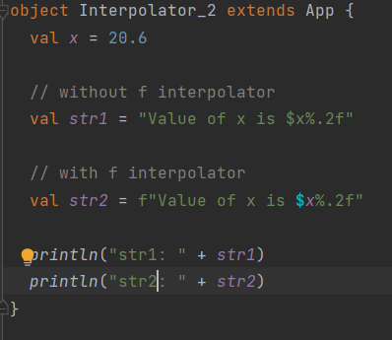
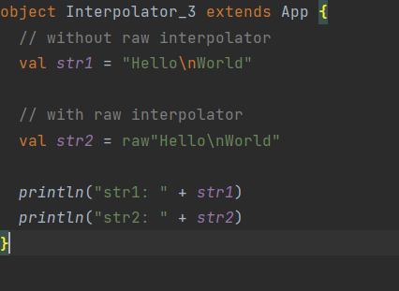
String Interpolation
2. f Interpolator: This interpolation helps in formatting numbers easily.
Example 1: printing upto 2 decimal place:
3.raw Interpolator: String Literal should start with ‘raw’. This interpolator treats escape sequences same as any other character in a String. Example :printing escape sequence:

Slide 14
Higher order functions
Higher order functions take other functions as parameters or return a function as a result.
This is possible because functions are first-class values in Scala.
The terminology can get a bit confusing at this point, and we use the phrase
“higher order function” for both methods and functions that take functions as parameters or that return a function.
In a pure Object Oriented world a good practice is to avoid exposing methods parameterized
with functions that might leak object’s internal state. Leaking internal state might break the invariants of the object itself thus violating encapsulation.
One of the most common examples is the higher-order function map which is available for collections in Scala.

Slide 15
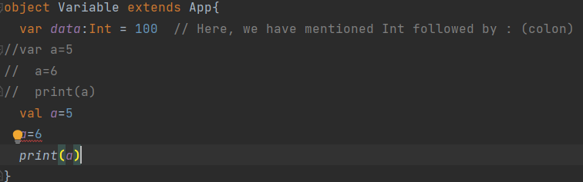
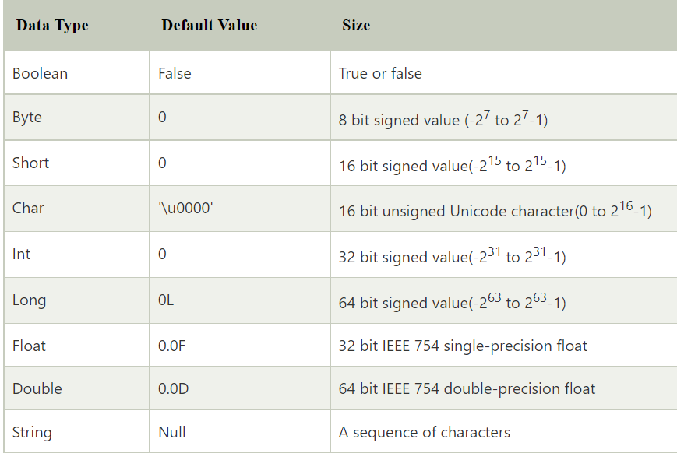
Scala Variables and Data Types
Variable is a name which is used to refer memory location. You can create mutable and immutable variable in scala. Let's see how to declare variable.
Mutable Variable
You can create mutable variable using var keyword. It allows you to change value after declaration of variable.

Slide 16
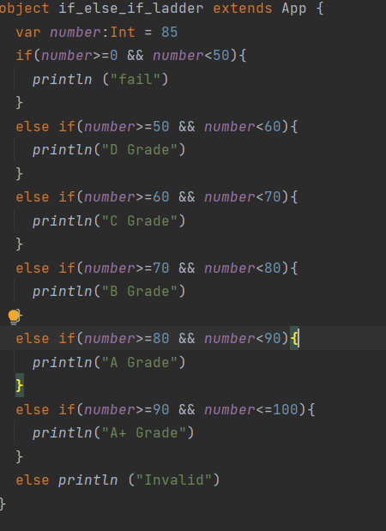
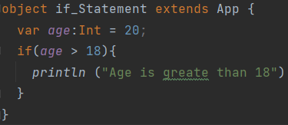
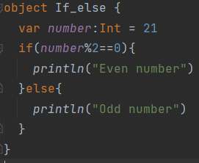
Scala Conditional Expressions
Scala provides if statement to test the conditional expressions. It tests boolean conditional expression which can be either true or false. Scala use various types of if else statements.
If statement
If-else statement
Nested if-else statement
If-else-if ladder statement

Slide 17
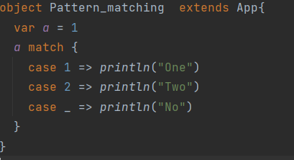
Scala Pattern Matching
Pattern matching is a feature of scala. It works same as switch case in other programming languages. It matches best case available in the pattern.
Let's see an example.

Slide 18
Singleton Object

