Slide 1

LLM-Driven TLA+ Specification of Essential Paxos
Ana Mako​
Vuk Jurišić​
Giorgos Markozanis

Slide 2
AGENDA
Research Question
Problem Statement
SysMoBench's four-stage pipeline
Experiment 1
Experiment 2
Experiment 3
Limitations
Conclusion

Slide 3
RESEARCH QUESTION
Does feedback-driven prompt refinement improve the quality of LLM-generated TLA+ specifications, and are the resulting prompts transferable across Claude and GPT?
Notes:
Today we're presenting LLM-Driven TLA+ Specification of Essential Paxos.
Our work is motivated by a simple question:
**Does feedback-driven prompt refinement improve the quality of LLM-generated TLA+ specifications, and are the resulting prompts transferable across Claude and GPT?**
Everything we measured and every experiment we ran was designed to answer one of those two parts: whether iteration helps, whether successful prompts succeed as one-shots and generalize across models.

Slide 4
PROBLEM STATEMENT
Safety properties must hold for every execution, testing isn't enough
Notes:
We talked throughout the course that Consensus protocols like Paxos are very difficult to verify through testing alone.

Slide 5
PROBLEM STATEMENT
Safety properties must hold for every execution, testing isn't enough
TLA+ and TLC model checking gives exhaustive guarantees, but writing the spec needs dual expertise
Notes:
Formal methods provide stronger guarantees, but the challenge is that writing a correct TLA+ specification requires expertise in both distributed systems and formal methods.

Slide 6
PROBLEM STATEMENT
Safety properties must hold for every execution, testing isn't enough
TLA+ and TLC model checking gives exhaustive guarantees, but writing the spec needs dual expertise
Idea: have an LLM generate the spec from the implementation
Notes:
The idea of this project is to use an LLM to generate that specification directly from the given implementation.

Slide 7
PROBLEM STATEMENT
Safety properties must hold for every execution, testing isn't enough
TLA+ and TLC model checking gives exhaustive guarantees, but writing the spec needs dual expertise
Idea: have an LLM generate the spec from the implementation
Case study: Essential Paxos (202-line core of cocagne/paxos)
Notes:
We use Essential Paxos as a case study. This is the 202-line core implementation from the cocagne/paxos repository.

Slide 8
PROBLEM STATEMENT
Safety properties must hold for every execution, testing isn't enough
TLA+ and TLC model checking gives exhaustive guarantees, but writing the spec needs dual expertise
Idea: have an LLM generate the spec from the implementation
Case study: Essential Paxos (202-line core of cocagne/paxos)
We compare two strategies: feedback-driven refinement vs. single-pass prompt
Notes:
We compare two approaches:
First, a feedback-driven refinement strategy, where verification failures are fed back into the prompt and the model generates a revised specification.
Second, a single-pass generation strategy with a ready prompt.
The question is whether this verification-guided iteration produces better specifications than a one-shot prompt and how well it performs across models.

Slide 9
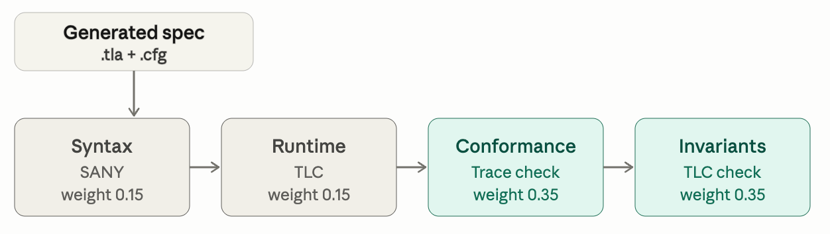
SYSMOBENCH'S FOUR-STAGE PIPELINE
Notes:
To evaluate generated specifications we use the SysMoBench benchmark that consists of 4 stages
Syntax correctness, runtime correctness, transition validation, invariant verification.
I wont go into details because we all covered this paper and what these stages represent. It is just nice to notice one more time the weighting.
Syntax and runtime each contribute 15 percent.
Transition validation and invariants each contribute 35 percent.
Syntax correctness, (where SANY parses the TLA+ specification), runtime correctness (where TLC successfully model-checks the specification), transition validation (where we compare the generated specification against actual execution traces from the Python implementation), invariant verification (where TLC checks expert-written Paxos safety properties ).

Slide 10
SYSMOBENCH'S FOUR-STAGE PIPELINE
Syntax + runtime are necessary but not sufficient for a faithful spec
Notes:
The reason is that compilation alone does not tell us whether a specification is faithful.

Slide 11
SYSMOBENCH'S FOUR-STAGE PIPELINE
Syntax + runtime are necessary but not sufficient for a faithful spec
The two heavy stages test conformance to real execution traces and expert safety invariants
Notes:
A specification can compile, run, and still model the wrong system.

Slide 12
SYSMOBENCH'S FOUR-STAGE PIPELINE
Syntax + runtime are necessary but not sufficient for a faithful spec
The two heavy stages test conformance to real execution traces and expert safety invariants
TV uses actual Python execution traces as ground truth
Notes:
Transition validation catches that model–implementation gap by asking whether the specification permits the same transitions that occur in the real code.

Slide 13
EXPERIMENT 1: INITIAL RUN
Notes:
Our first experiment studies the refinement process itself.
Both models start from an initial prompt and repeatedly regenerate the specification after receiving verification feedback.

Slide 14
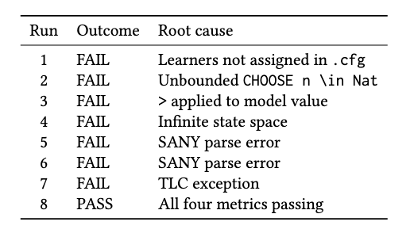
EXPERIMENT 1: INITIAL RUN
CLAUDE
Notes:
Claude required eight iterations before passing all stages.

Slide 15
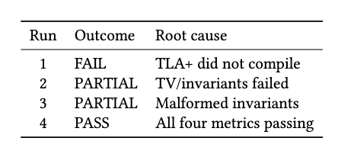
EXPERIMENT 1: INITIAL RUN
CLAUDE
GPT
Notes:
GPT required four.

Slide 16
EXPERIMENT 1: INITIAL RUN
CLAUDE
GPT
Neither model passed on the first prompt (8 iterations (Claude), 4 iterations (GPT))
Notes:
The important observation is that neither model succeeded on the first attempt.
In other words, single-pass generation failed for both models.

Slide 17
EXPERIMENT 1: INITIAL RUN
CLAUDE
GPT
Neither model passed on the first prompt (8 iterations (Claude), 4 iterations (GPT))
Shared failure class: finite-domain encoding (bounded ballots, no model-value comparison, cardinality-based quorums)
Notes:
Even more interesting is that both models encountered essentially the same class of problems.
They generated unbounded ballot domains
compared TLC model values using operators such as less-than.
And they expressed quorums using constructs that required reasoning over infinite sets.
All of these are valid conceptual descriptions of Paxos but are incompatible with TLC's finite-state model-checking requirements.

Slide 18
EXPERIMENT 1: INITIAL RUN
CLAUDE
GPT
Neither model passed on the first prompt (8 iterations (Claude), 4 iterations (GPT))
Shared failure class: finite-domain encoding (bounded ballots, no model-value comparison, cardinality-based quorums)
Feedback loop is autonomous: each SANY/TLC failure is fed back, the model regenerates
Notes:
The models only converged after verification feedback exposed these issues and the prompts were refined accordingly.
This directly answers the first half of our research question.
The evidence suggests that iteration is not optional—it was necessary for both models to reach a passing specification starting from 0 and a general prompt.

Slide 19
EXPERIMENT 2: CROSS-MODEL PROMPT TRANSFER
Notes:
Experiment 2 asks a simple question: if a prompt works on one model, does it work on the others? Are these refined prompts portable, or are they tied to the model that produced them?

Slide 20
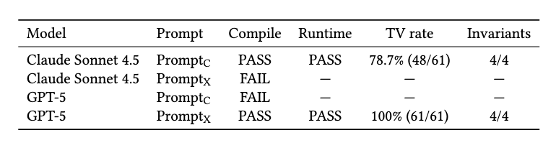
EXPERIMENT 2: CROSS-MODEL PROMPT TRANSFER
Notes:
The setup: we took each model's prompt and ran them in a fresh session on both LLM models

Slide 21
EXPERIMENT 2: CROSS-MODEL PROMPT TRANSFER
Each prompt compiles only on the model that produced it
Both cross-model combinations fail at compilation
Prompts encode model-specific generation habits, not portable spec knowledge
Notes:
Both crashed. At compile time, before they even got started.
And the failures weren't random; they were fingerprints. Claude always writes its helper operators too early, before the VARIABLES block, and SANY, the TLA+ syntax checker, rejects it. GPT trips over the NoProposal sentinel and produces invalid TLA+.

Slide 22
EXPERIMENT 2: CROSS-MODEL PROMPT TRANSFER
Each prompt compiles only on the model that produced it
Both cross-model combinations fail at compilation
Prompts encode model-specific generation habits, not portable spec knowledge
Winner: GPT-5 + PromptX - the only fully faithful spec (100%TV, 4/4 Invariants)
Notes:
So the lesson: a prompt isn't a general recipe, it's a key cut for one specific lock. It encodes how that particular model writes code, not portable knowledge about Paxos.
Even when each model used its own prompt, they weren't equally good. Claude reached 78.7% conformance, GPT reached 100%, because GPT's learner reads its decisions straight from the messages in flight, exactly like the real Python code.

Slide 23
EXPERIMENT 2: WHY CROSS-MODEL FAILS
Notes:
This slide unpacks WHY the cross-model swaps fail, and the point is that the failures are systematic, not flaky.

Slide 24
EXPERIMENT 2: WHY CROSS-MODEL FAILS
Claude + PromptX → compile FAIL
Helper uses proposalId before VARIABLES declares it
NextProposalNum(p) ==
IF proposalId[p] = NoProposal
THEN 1
ELSE ProposalNum(proposalId[p]) + 1
VARIABLES
msgs, proposalId, ...
SANY: Unknown operator 'proposalId'
Notes:
On the left, Claude given GPT's prompt: it places the NextProposalNum helper before the VARIABLES block, so it references proposalId before it is declared. SANY, the syntax checker, rejects it with 'Unknown operator proposalId'.

Slide 25
EXPERIMENT 2: WHY CROSS-MODEL FAILS
Claude + PromptX → compile FAIL
Helper uses proposalId before VARIABLES declares it
NextProposalNum(p) ==
IF proposalId[p] = NoProposal
THEN 1
ELSE ProposalNum(proposalId[p]) + 1
VARIABLES
msgs, proposalId, ...
SANY: Unknown operator 'proposalId'
GPT-5 + PromptC → compile FAIL
The two prompts use different no-proposal sentinels
\* Prompt_X (GPT): in-module tuple
NoProposal == <<0, 0>>
\* do NOT bind NoProposal in the cfg
\* Prompt_C (Claude): model value
CONSTANTS ... NoValue \* bound in cfg
Crossing the conventions → invalid TLA+
Notes:
On the right, GPT given Claude's prompt: the two prompts use different no-proposal sentinels. GPT's own style defines NoProposal as an in-module tuple, explicitly not bound in the cfg; Claude's style uses a model-value constant bound in the cfg. Crossing the conventions yields invalid TLA+.

Slide 26
EXPERIMENT 2: WHY CROSS-MODEL FAILS
Claude + PromptX → compile FAIL
Helper uses proposalId before VARIABLES declares it
NextProposalNum(p) ==
IF proposalId[p] = NoProposal
THEN 1
ELSE ProposalNum(proposalId[p]) + 1
VARIABLES
msgs, proposalId, ...
SANY: Unknown operator 'proposalId'
GPT-5 + PromptC → compile FAIL
The two prompts use different no-proposal sentinels
\* Prompt_X (GPT): in-module tuple
NoProposal == <<0, 0>>
\* do NOT bind NoProposal in the cfg
\* Prompt_C (Claude): model value
CONSTANTS ... NoValue \* bound in cfg
Crossing the conventions → invalid TLA+
Failures are fingerprints, not noise. Each prompt bakes in its own model's generation order and sentinel style.
Notes:
Bottom line: each prompt silently bakes in its own model's habits, generation order and sentinel style, so it only works on the model that produced it.

Slide 27
EXPERIMENT 3: CONFIGURATION SCALING
Notes:
Next, we are going to look at the third experiment, which is about configuration scaling.
Experiment 3 asks: now that both models produce a passing spec, what happens as we scale the protocol up, with more acceptors, more proposers, bigger ballot bounds? Which spec stays cheap to verify?

Slide 28
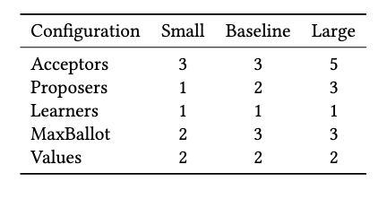
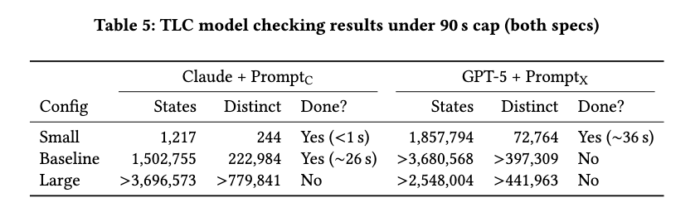
EXPERIMENT 3: CONFIGURATION SCALING
Identical configs, very different cost: ~1.86M states for GPT at Small vs 1217 for Claude
Within 90s: Claude finishes Small + Baseline; GPT finishes only Small
Notes:
The result is genuinely surprising. Same exact configuration: Claude explores 1,217 states. GPT explores 1.86 million. Let that land, about fifteen hundred times more, with identical settings.

Slide 29
EXPERIMENT 3: CONFIGURATION SCALING
Identical configs, very different cost: ~1.86M states for GPT at Small vs 1217 for Claude
Within 90s: Claude finishes Small + Baseline; GPT finishes only Small
Cause: GPT’s HandlePromise stutter branch (message loss) doubles brnaching on every Promise
Notes:
Why? One modeling choice. GPT's HandlePromise action has a stutter branch for message loss, so every promise message becomes a fork in the road: process it, or drop it. TLC has to walk both. Multiply that across every message and you get exponential blow-up.
Here's the irony: that exact branch is what makes GPT more faithful, it's why GPT scored 100% conformance. Faithfulness has a price tag.

Slide 30
EXPERIMENT 3: CONFIGURATION SCALING
Identical configs, very different cost: ~1.86M states for GPT at Small vs 1217 for Claude
Within 90s: Claude finishes Small + Baseline; GPT finishes only Small
Cause: GPT’s HandlePromise stutter branch (message loss) doubles brnaching on every Promise
Tradeoff: GPT’s 100% TV spec is far costlier to verify than Claude’s 78.7%
Notes:
So the takeaway is a classic model-checking tradeoff: the more accurate map takes far longer to walk. A better model isn't automatically a cheaper one.

Slide 31
EXPERIMENT 3: WHY IT EXPLODES
Notes:
Let's dive a bit deeper in the mechanism behind the state-space blow-up.

Slide 32
EXPERIMENT 3: WHY IT EXPLODES
GPT's HandlePromise: two disjuncts
HandlePromise(p, m) ==
/\ m \in msgs
/\ m.kind = "Promise"
/\ p \in Proposers
/\ m.to = p
/\ ( \* process a fresh promise
/\ m.pid = proposalId[p]
/\ ~(m.from \in promisesRcvd[p])
/\ LET ... IN \* update state;
\* emit Accept msgs
\/ \* ignore duplicates or old promises
/\ UNCHANGED vars
)
Notes:
Look at GPT's HandlePromise: it's a disjunction of two branches. Branch one processes a fresh promise.
Branch two is just UNCHANGED vars, an unguarded stutter that models the message being lost or ignored.

Slide 33
EXPERIMENT 3: WHY IT EXPLODES
GPT's HandlePromise: two disjuncts
HandlePromise(p, m) ==
/\ m \in msgs
/\ m.kind = "Promise"
/\ p \in Proposers
/\ m.to = p
/\ ( \* process a fresh promise
/\ m.pid = proposalId[p]
/\ ~(m.from \in promisesRcvd[p])
/\ LET ... IN \* update state;
\* emit Accept msgs
\/ \* ignore duplicates or old promises
/\ UNCHANGED vars
)
Disjunct (2) has no guard — every Promise can be processed OR ignored
TLC must explore both → branching doubles on every message
Notes:
Because branch two has no guard, it is always enabled.
So for every promise message TLC has to explore both possibilities, process it or drop it.
That doubles the branching on every message, and it compounds into exponential growth.

Slide 34
EXPERIMENT 3: WHY IT EXPLODES
GPT's HandlePromise: two disjuncts
HandlePromise(p, m) ==
/\ m \in msgs
/\ m.kind = "Promise"
/\ p \in Proposers
/\ m.to = p
/\ ( \* process a fresh promise
/\ m.pid = proposalId[p]
/\ ~(m.from \in promisesRcvd[p])
/\ LET ... IN \* update state;
\* emit Accept msgs
\/ \* ignore duplicates or old promises
/\ UNCHANGED vars
)
Disjunct (2) has no guard — every Promise can be processed OR ignored
TLC must explore both → branching doubles on every message
Same config, Small: 1,217 states (Claude) vs 1.86M (GPT)
Claude's HandlePromise has no such stutter branch
Notes:
That's why, on the same Small config, Claude explores 1,217 states and GPT explores 1.86 million.
Claude's HandlePromise has no such stutter branch.

Slide 35
EXPERIMENT 3: WHY IT EXPLODES
GPT's HandlePromise: two disjuncts
HandlePromise(p, m) ==
/\ m \in msgs
/\ m.kind = "Promise"
/\ p \in Proposers
/\ m.to = p
/\ ( \* process a fresh promise
/\ m.pid = proposalId[p]
/\ ~(m.from \in promisesRcvd[p])
/\ LET ... IN \* update state;
\* emit Accept msgs
\/ \* ignore duplicates or old promises
/\ UNCHANGED vars
)
Disjunct (2) has no guard — every Promise can be processed OR ignored
TLC must explore both → branching doubles on every message
Same config, Small: 1,217 states (Claude) vs 1.86M (GPT)
Claude's HandlePromise has no such stutter branch
That branch faithfully models message loss → 100% TV. Fidelity has a price: more accurate ≠ more efficient.
Notes:
That very branch is what makes GPT faithful to real message loss and earns it 100% transition validation.
So fidelity has a cost, a more accurate model is not a cheaper one.

Slide 36
LIMITATIONS
Narrow protocol scope: single-decree Essential Paxos, not full Paxos or industrial systems
Notes:
It's important to be clear about the limitations of our study.
First, we only model single-decree Essential Paxos, which is the compact core of the protocol. So we are not claiming that the same results automatically apply to full Paxos, Raft, or larger industrial consensus systems.

Slide 37
LIMITATIONS
Narrow protocol scope: single-decree Essential Paxos, not full Paxos or industrial systems
Bounded verification: TLC proves invariants only for the checked configurations, not all configurations
Notes:
Second, TLC gives exhaustive guarantees, but only inside the finite configurations we check. A passing run proves the invariants for that bound, not for every possible number of participants or ballots.

Slide 38
LIMITATIONS
Narrow protocol scope: single-decree Essential Paxos, not full Paxos or industrial systems
Bounded verification: TLC proves invariants only for the checked configurations, not all configurations
Partial behavioral coverage: TV uses 4 deterministic traces, so it cannot cover all executions
Notes:
Third, transition validation is useful because it checks the specification against real execution traces, but our traces cover only four deterministic scenarios. So it is a partial behavioral signal, not full coverage of all possible executions. Also, the TV stage involves an LLM agent, which introduces some risk of misclassification.

Slide 39
LIMITATIONS
Narrow protocol scope: single-decree Essential Paxos, not full Paxos or industrial systems
Bounded verification: TLC proves invariants only for the checked configurations, not all configurations
Partial behavioral coverage: TV uses 4 deterministic traces, so it cannot cover all executions
Limited generality: one protocol, two models, no repeated trials
Notes:
Finally, this is a small study: one protocol, two models, and no repeated trials.

Slide 40
CONCLUSION
Does feedback-driven prompt refinement improve the quality of LLM-generated TLA+ specifications, and are the resulting prompts transferable across Claude and GPT?
Notes:
To conclude, let's return to our research question.
We asked whether feedback-driven prompt refinement improves the quality of LLM-generated TLA+ specifications.

Slide 41
CONCLUSION
Does feedback-driven prompt refinement improve the quality of LLM-generated TLA+ specifications, and are the resulting prompts transferable across Claude and GPT?
Yes: feedback improved both models from failing to passing; both models failed single-pass
Notes:
Based on our experiments, the answer is yes.
Both Claude and GPT failed in the single-pass setting. They only reached passing specifications after we fed verification feedback back into the prompt refinement loop.

Slide 42
CONCLUSION
Does feedback-driven prompt refinement improve the quality of LLM-generated TLA+ specifications, and are the resulting prompts transferable across Claude and GPT?
Yes: feedback improved both models from failing to passing; both models failed single-pass
No: refined prompts are brittle and model-specific, they don't transfer
Notes:
But the second part of the question gives a different answer.
Are the resulting prompts transferable across models?
Here, the answer is no.
Each refined prompt only worked with the model that produced it. When we swapped the prompts across Claude and GPT, both combinations failed already at compilation.
So the broader lesson is that generating TLA+ that compiles is not the real endpoint. Compilation is only the first hurdle.

Slide 43
CONCLUSION
Does feedback-driven prompt refinement improve the quality of LLM-generated TLA+ specifications, and are the resulting prompts transferable across Claude and GPT?
Yes: feedback improved both models from failing to passing; both models failed single-pass
No: refined prompts are brittle and model-specific, they don't transfer
Key bottleneck: semantic conformance, not just compilation
Notes:
The harder problem is semantic conformance: whether the generated specification actually matches the behavior of the implementation.
That is why our main recommendation is not to search for one universally good prompt. Instead, the more promising direction is to build automated verification-feedback loops, where the model continuously learns from concrete SANY, TLC, trace-validation, and invariant failures.
Overall, verification-guided refinement improved specification quality, while prompt transferability remained fragile.

Slide 44
CONCLUSION
Does feedback-driven prompt refinement improve the quality of LLM-generated TLA+ specifications, and are the resulting prompts transferable across Claude and GPT?
Yes: feedback improved both models from failing to passing; both models failed single-pass
No: refined prompts are brittle and model-specific, they don't transfer
Key bottleneck: semantic conformance, not just compilation
Next step: evaluate on richer protocols (Raft, CURP) and repeat runs to test generality
Notes:
As future work, the next step is to test whether this still holds for more complex consensus protocols, such as Raft or CURP.

Slide 45
Thank you!
Ana Mako​
Vuk Jurišić​
Giorgos Markozanis
Notes:
Thank you, and we are happy to take questions.

