Slide 1
Operations Reporting and Processing
SWIFT reviews.
Clear ownership.
Message
A shared workflow for assigning, reviewing
and tracing message decisions.
Reviewer
Leadership + future users
Decision
Product overview • September 2026
ORP / Operations Reporting and Processing
01
Notes:
Today I will show how Operations Reporting and Processing, or ORP, supports the review of SWIFT messages. The central idea is simple: each message has a visible stage, an accountable reviewer when assigned, and a record of the decisions made. For leadership, this creates a clearer operating process. For users, it brings the queue and review actions together. We will follow a message through the application, look at the controls behind that journey, and finish with the decisions needed for a pilot. The screens use synthetic demonstration data. This presentation describes the current implementation, rather than a claim of production readiness. Evidence: README.md; backend/README.md; backend/docs/MESSAGE_STATE_MACHINE.md

Slide 2
Business value
One workflow. Three practical benefits.
A shared view of work connects responsibility, review and follow-up.
For leadership
For reviewers
For control teams
See work clearly
Focus on your work
Trace the decision
Stage and owner are visible
in the message queue.
Review actions and assigned
messages in one place.
History links actions to people,
times and workflow changes.
Expected operating benefits; their scale will be measured during the pilot.
ORP / Operations Reporting and Processing
02
Notes:
There are three practical benefits. First, teams can identify the current stage and the person assigned to a message. Second, reviewers have a personal work queue, so they can find their assigned messages and take the permitted next action. Third, authorised users can follow the history of assignments and decisions. These are capabilities supported by the current application. We should validate the resulting time savings and operating improvements in a pilot; there are no measured productivity or cost-saving figures behind this presentation. The objective is to make the process easier to manage and use, with evidence of what happened when questions arise. Evidence: frontend/src/pages/messages/AssignedMessagesPage.tsx; MessagesGrid.tsx; AuditTrailDrawer.tsx

Slide 3
The message journey
Every message follows a visible path
The workflow records progress from registration to the final review outcome.
01
02
03
04
05
Receive
Register
Assign
Review
Complete
Source message
Apply workflow
Choose reviewer
Record decision
All levels approved
Rejection stops the workflow
Another level → new manual assignment
“Complete” refers to message review. The application does not demonstrate payment execution.
ORP / Operations Reporting and Processing
03
Notes:
Messages arrive through the configured source integration and are registered against a review workflow. An authorised person then assigns an eligible reviewer. The reviewer reads the message and records a decision. When another review level is required, the message waits for a new manual assignment to a different eligible reviewer. Once every required level is approved, the review is complete. A rejection stops the review workflow and is currently final. In this product, completed means that the configured review has finished; it should not be described as execution or release of a payment. This distinction keeps the business promise aligned with the implemented scope. Evidence: backend/docs/MESSAGE_STATE_MACHINE.md; backend/docs/AWH_DATA_INGESTION.md

Slide 4
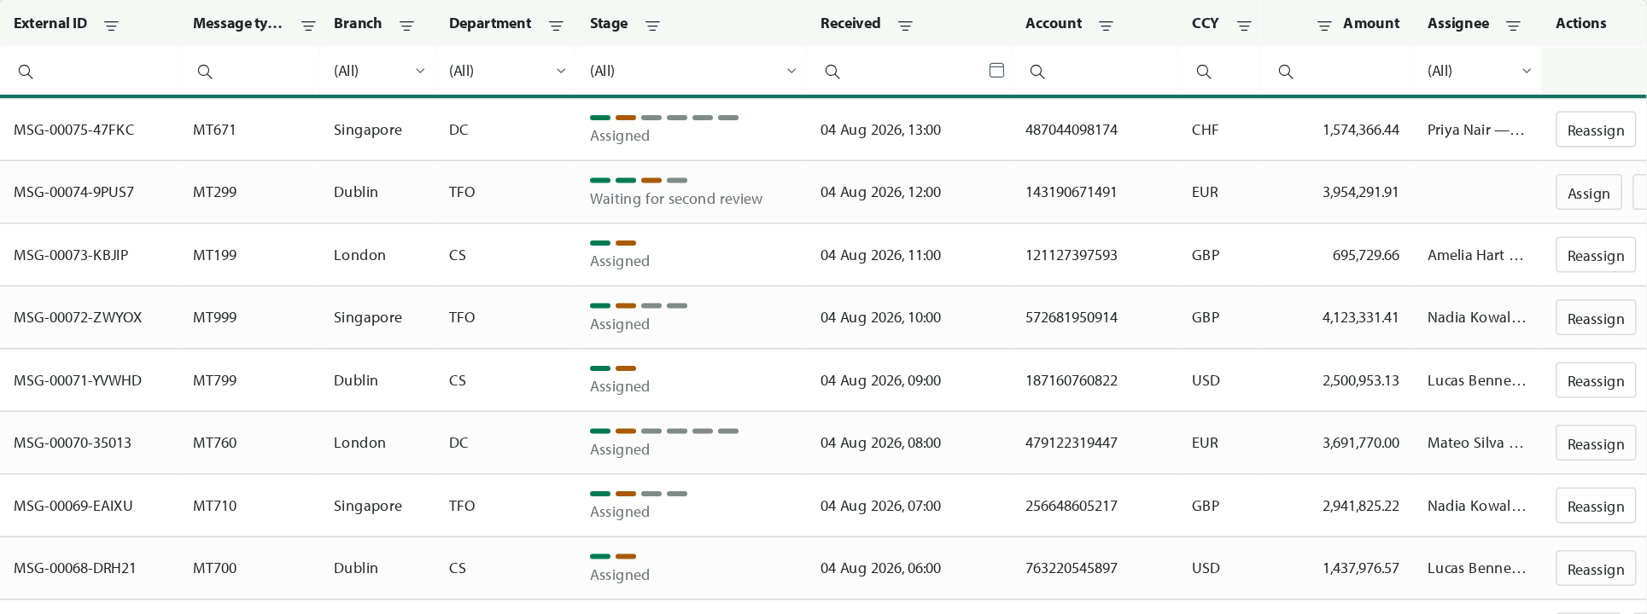
The workspace
A shared queue for the team
Find a message, understand its stage and see who owns the next action.
1
Find the message
Filter by the fields
that matter to the task.
2
Read the stage
See progress and
current ownership.
Actual interface • Synthetic demonstration data • Access varies by user.
ORP / Operations Reporting and Processing
04
Notes:
This is the current message workspace, using demonstration data. The table brings together message type, organisational context, current stage, received date, amount and assignee. Users can filter the available messages and inspect the actions offered for each row. Visibility and actions depend on their permissions and organisational scope. A personal My work view is available for reviewers, together with a My departments view. The current interface is in English. For a live walkthrough, start with the team queue, point out a waiting message and its assignee, then switch to a reviewer’s personal queue. The numbers visible here are synthetic examples, not business performance figures. Evidence: frontend/src/pages/messages/MessagesGrid.tsx; AssignedMessagesPage.tsx; assets/messages.png

Slide 5
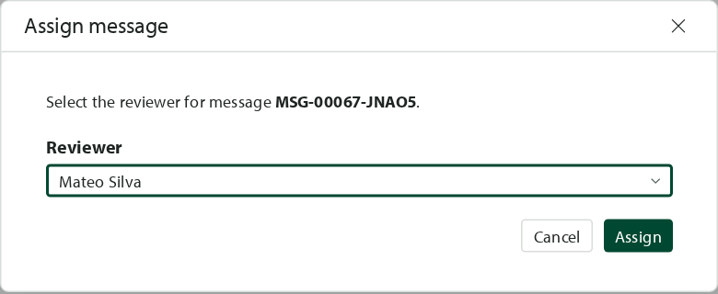
Assignment and access
Ownership is explicit at each review stage
An authorised assigner chooses from eligible reviewers; the system checks the rules.
Organisational access
Relevant branch and department
Review permission
Authorised for the required level
Independent reviewer
No earlier approval on this message
Manual assignment • No self-assignment • Reassignment is available before review starts.
ORP / Operations Reporting and Processing
05
Notes:
Assignment is a deliberate business action, not automatic workload distribution. An authorised assigner chooses a reviewer from the candidates the application permits for this message. Eligibility combines organisational access, permission for the required review level, and independence from earlier approvals on the same message. Users cannot assign a message to themselves. Responsibility can be transferred before a review starts, while reassignment during an active review is blocked. Approval clears the assignment; if another stage is required, an authorised person assigns the next reviewer. These controls make ownership explicit, but staffing cover and the person responsible for monitoring unassigned work still need to be agreed for the pilot. Evidence: docs/BUSINESS_WORKFLOW_DECISIONS.md; backend/docs/MESSAGE_STATE_MACHINE.md; AssignmentPopup.tsx

Slide 6
Review controls
Match review depth to the process
Configured workflows support one, two or three required review levels.
One level
Review 1
Different
reviewers
Two levels
Review 1
Review 2
Each later
level needs
a different
reviewer.
Three levels
Review 1
Review 2
Review 3
The pilot must confirm the mapping between message types, departments and required review levels.
ORP / Operations Reporting and Processing
06
Notes:
Not every message needs the same review depth. ORP supports workflows with one, two or three required levels. Each approval moves the message to the next required level, or completes the review if no level remains. In a multi-level workflow, a user who approved an earlier level cannot perform a later one on the same message. This is the four-eyes principle in practical terms: later approval requires another eligible person. These are configured workflows; this presentation does not claim a business-user workflow designer exists. The specific message types and conditions that allow optional levels to be skipped remain a business decision to confirm before pilot configuration. Evidence: backend/src/ORP.Domain/Workflows/WorkflowDefinition.cs; backend/docs/MESSAGE_STATE_MACHINE.md; docs/BUSINESS_WORKFLOW_DECISIONS.md

Slide 7
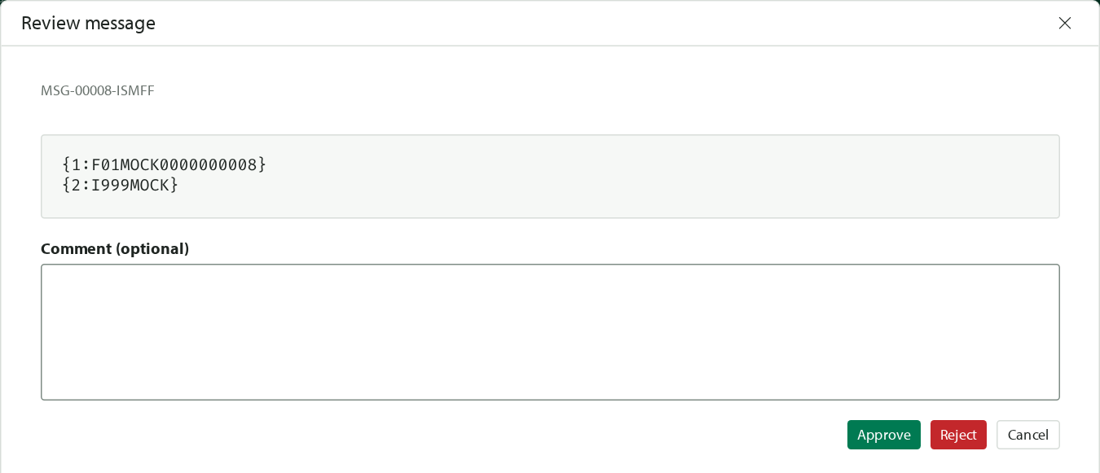
The reviewer experience
Review the message. Record the decision.
The reviewer works from My work and sees the message content alongside decision actions.
1
Open My work
Find a message
assigned to you.
2
Inspect the content
Read the message and
add a comment if needed.
3
Approve or reject
Record the decision
for the current level.
Actual interface • Synthetic data • Rejection is final in the current implementation.
ORP / Operations Reporting and Processing
07
Notes:
For the reviewer, the everyday journey is short. Open My work, select a message assigned to you, and choose Review. The review window shows the message content and an optional comment field. An authorised reviewer can approve or reject. The application verifies ownership and the required stage before accepting the action. Approval either completes the review or sends it to the waiting state for the next required level. Rejection is final in the current version, so training should make that consequence clear. An API capability also exists to withdraw the reviewer’s own latest approval under defined conditions; there is no demonstrated Undo button in this screen, so do not promise a user-facing undo journey during the demo. Evidence: frontend/src/pages/messages/ReviewDecisionPopup.tsx; reviewDecision.ts; backend/docs/MESSAGE_STATE_MACHINE.md

Slide 8
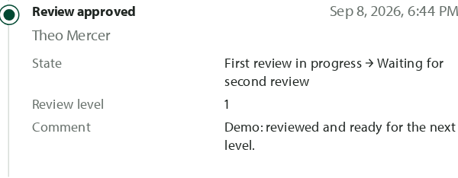
Audit and follow-up
A decision comes with a traceable history
Authorised users can see who acted, when they acted and how the workflow changed.
1
Message registered
One recorded decision
The workflow begins.
2
Reviewer assigned
Responsibility is recorded.
3
Review started
The active reviewer is identified.
4
Decision recorded
Outcome and context remain visible.
Illustrative event sequence on the left; actual decision detail with synthetic data on the right.
ORP / Operations Reporting and Processing
08
Notes:
When a question arises, the message’s audit history provides the sequence of recorded actions. It includes registration, assignment, review start, approval or rejection, and related changes in workflow state. Events carry the actor and timestamp, with comments or assignment details when applicable. This supports investigation and operational handover without relying only on someone’s recollection. Access to audit history is permission-controlled. The implementation preserves audit entries through its persistence boundary, but this should not be presented as a separately certified immutable archive. Retention, external audit requirements and operating controls need to be confirmed with the organisation before production use. Evidence: frontend/src/pages/messages/AuditTrailDrawer.tsx; backend/docs/MESSAGE_STATE_MACHINE.md; assets/audit-panel.png

Slide 9
Architecture at a glance
One workspace. A shared review record.
Source integration, business rules and the user interface have clear responsibilities.
Scheduled intake
Shared application data
Interactive review
SWIFT
source
Scheduled
integration
Review
data store
Application
service
Browser
workspace
Existing environment
Import + routing
SQL Server
Workflow + access
React interface
New messages enter through integration. Reviews and audit events stay linked in one application data store.
High-level design for persistent deployment; the screenshots use an in-memory demonstration environment.
ORP / Operations Reporting and Processing
09
Notes:
At a high level, the architecture has five parts. The existing SWIFT source is read by a scheduled integration component. That component registers new messages in the application’s shared database. The application service reads and updates that same store while enforcing workflow and access rules. Users work in the browser. This is a modular application, rather than a fleet of independent microservices. The underlying technologies are React for the interface, .NET for the service, and SQL Server for persistent storage. Repeated imports are designed to avoid registering duplicate source messages and to preserve existing review progress. For deployment, the approved source connector, corporate sign-in, routing configuration and operational arrangements must be completed and verified. Evidence: backend/README.md; backend/src/ORP.Sync/README.md; backend/docs/AWH_DATA_INGESTION.md; frontend/package.json

Slide 10
Current scope and readiness
A working workflow, with a clear path to pilot
Demonstrated functionality and deployment preparation are separate milestones.
Demonstrated today
Prepare for the pilot
Team and personal message queues
1
Corporate sign-in and approved source access
Manual assignment and review decisions
2
Routing, permissions and review-level mapping
One to three review levels
3
Operating support, recovery and user testing
Access rules and message audit history
4
Agreed handling of exceptions and waiting work
Automatic assignment, workload balancing and SLA escalation are not part of the demonstrated scope.
ORP / Operations Reporting and Processing
10
Notes:
The repository demonstrates message queues, manual assignment, multi-level review, organisational access rules and audit history. These are the functions you have seen today. A pilot in the organisation’s environment still needs preparation. The current sign-in is a development mechanism, so corporate authentication must be integrated. The source integration requires the approved library and the organisation’s routing rules. We also need agreed roles, review-level mappings and a process for handling unassigned or rejected messages. Finally, deployment, recovery and usability should be exercised with the people who will operate the system. Automatic assignment, workload balancing and SLA escalation are not demonstrated capabilities of the current version. Evidence: backend/src/ORP.Api/Authentication/DebugAuthenticationHandler.cs; backend/src/ORP.Sync/README.md; docs/BUSINESS_WORKFLOW_DECISIONS.md

Slide 11
Proposed pilot
Use a focused pilot to measure the difference
Start with an agreed team and message scope, then compare the experience and operating results.
1
Agree scope
2
Configure
3
Exercise workflows
4
Evaluate
Time to assignment
Review turnaround
User experience
Median time from registration
to first assignment.
Median time from registration
to completion, by workflow.
Task completion in testing
and structured user feedback.
Proposed evaluation measures. Agree the baseline, targets and review date before the pilot starts.
ORP / Operations Reporting and Processing
11
Notes:
I suggest a focused pilot with a named business owner, a representative user group and a bounded set of message types. First agree the scope and the current baseline. Then configure the environment, access and workflow rules. Next, exercise normal work and exceptions: reassignment before review, a further review level, rejection and investigation through audit history. Evaluate three areas: time to first assignment, end-to-end review turnaround and task completion with user feedback. Compare like-for-like message types and review depths; a three-stage process should not be judged against a one-stage baseline. These are proposed pilot measures, not an existing analytics dashboard. Targets and dates should be agreed by the sponsor and operational team. Evidence: Recommendation based on the confirmed workflow; no observed business-performance dataset supplied.

Slide 12
Decision and discussion
The next step: agree a focused pilot
Give the team a shared process — and validate it with the people who will use it.
01
Name the owner
Business sponsor + representative users
02
Bound the scope
Departments, message types and exceptions
Which team
should go first?
03
Define success
Baseline, targets and a review date
Discussion
ORP / Operations Reporting and Processing
12
Notes:
The next decision is to sponsor a focused pilot. We need a named business owner and a representative group of future users. We need to agree the departments, message types, workflow depth and exception cases to include. And we need success criteria and a review date, so the pilot ends with a concrete decision. Leadership can help define ownership and the level of evidence needed to proceed. Future users can show us where the process is clear, where it slows them down and which exceptions need more attention. My suggested closing question is: which team and message scope should we use to prove the workflow first? Evidence: Proposed next steps derived from the current product scope and outstanding business decisions.

