Slide 1
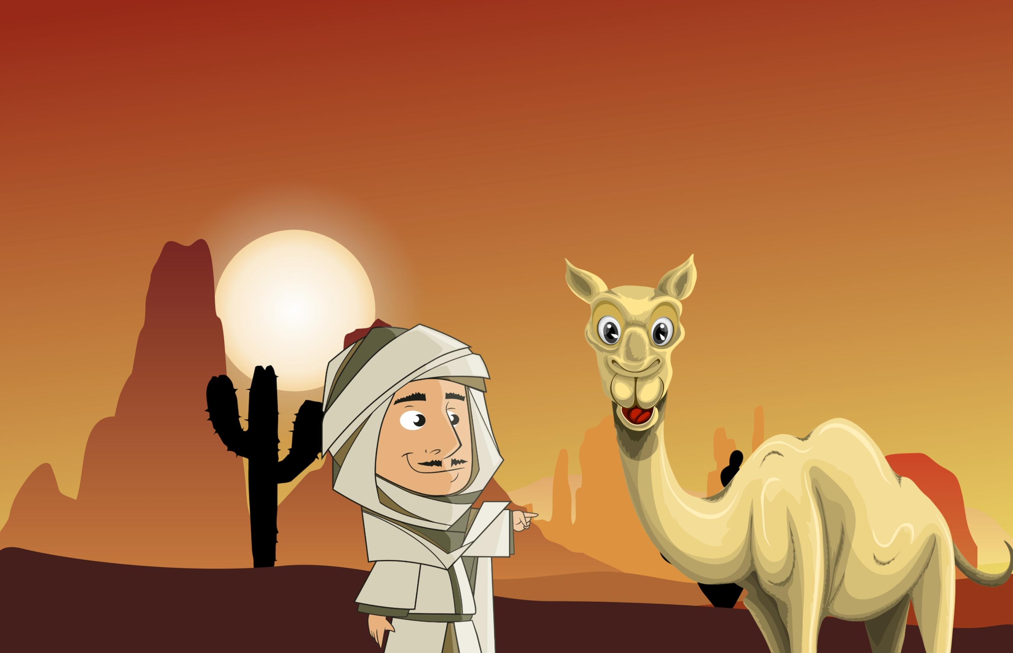
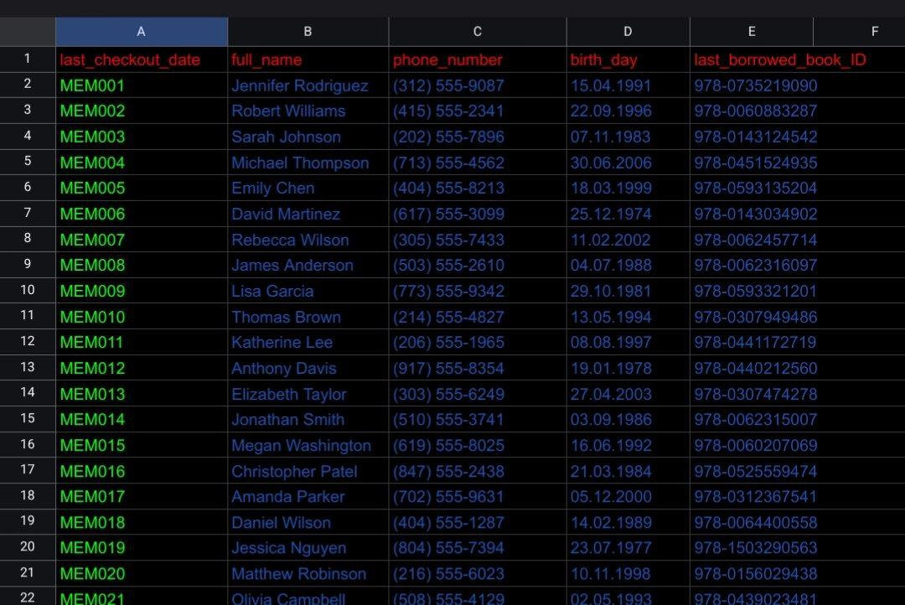
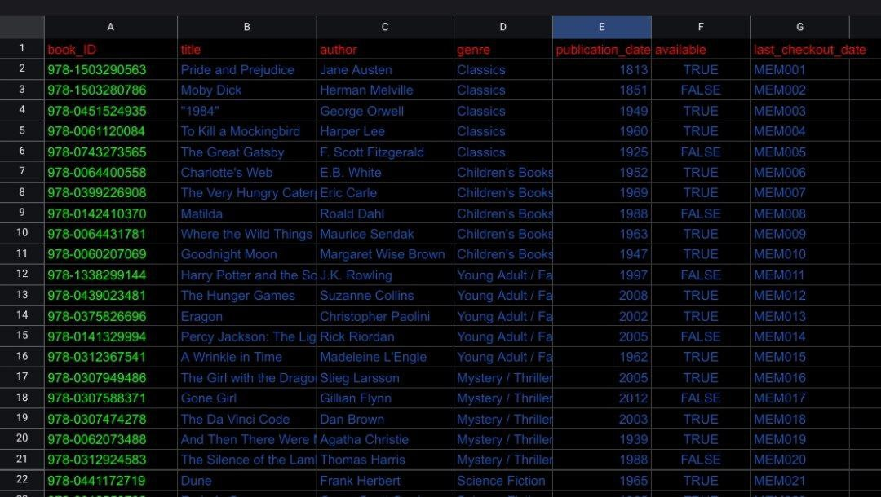
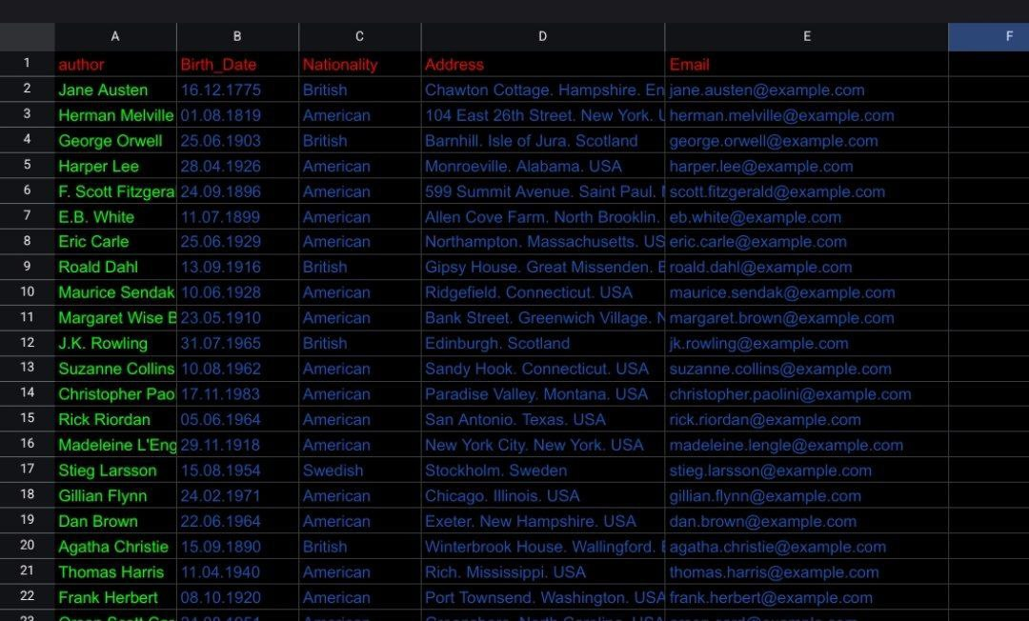

Slide 2

Difficulties in the process ? First mistake was available in the section that no validated with yes and no data then we changed to true and false. Second was finding a correct and possible primary key for the third table that took long time. I changes one title name as a number to sting with " " in the csv file
What I Learned ?
Gained fundamental knowledge about building an online library system
Developed skills in creating and manipulating CSV files
Learned important database terminology: primary keys, foreign keys, database relationships
Where I got help?
I worked with AI and ChatGPT from the starting to the end of the process.
I got help from you and others too
Conclusion.
This library database project provided practical experience in database design fundamentals. I learned how to properly structure related tables, establish key relationships, and ensure proper data validation. The challenges I encountered deepened my understanding of database principles and the importance of careful planning.

Slide 3
