Slide 1

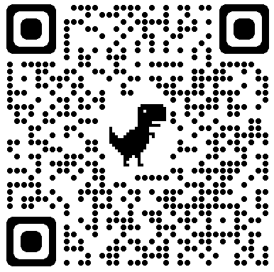
EU Marie Sklodowska Curie Actions Sharing Experience MSCA Co–Fund Scheme
Milad Asgarpour Khansary

Slide 2




Discussing ….
EU & MSCA
Statistics
Procedures
Tips

Slide 3




EU & MSCA
Erasmus Mundus Joint Masters are delivered by multiple higher education institutions and run across various countries.
Erasmus Mundus Catalogue:
https://www.eacea.ec.europa.eu/scholarships/erasmus-mundus-catalogue_en
EJMJ
1. Industrial Doctorates → step outside academia
2. Joint Doctorates: joint doctoral degree or multiple doctoral degrees
Openings:
https://euraxess.ec.europa.eu
ITN
1. European Postdoctoral Fellowships: moving within Europe or coming to Europe
2. Global Postdoctoral Fellowships: outside Europe, restricted nationality
https://marie-sklodowska-curie-actions.ec.europa.eu/actions/postdoctoral-fellowships
PDF

Slide 4







Statistics – Postdoctoral Fellowships
< 85%
> 85%
> 95%
Scoring system
Reject
Seal of excellence
Receives funding
Stats. 2022
Total proposal
8,356
EU proposals success rate 14%

Slide 5

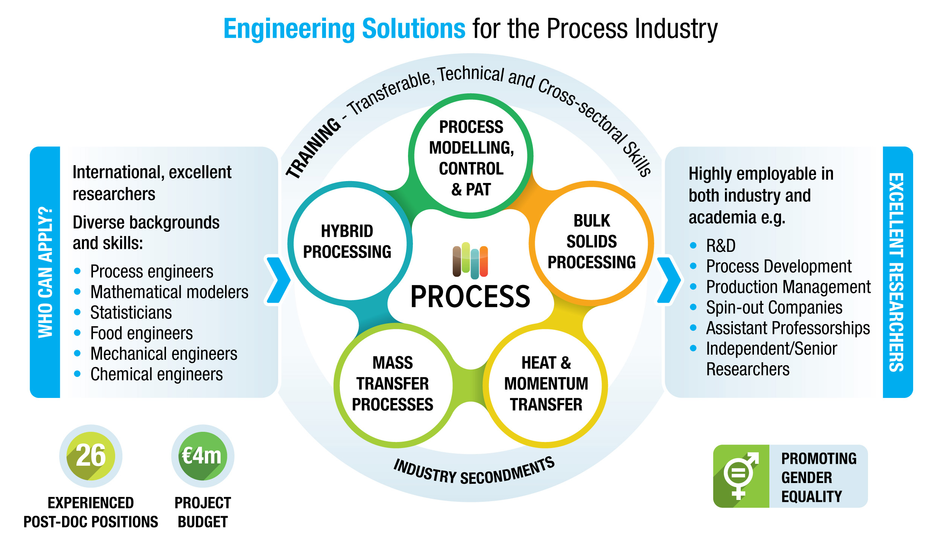




Co-Fund Scheme – Ireland
50%
50%
Call website

Slide 6






Application Process – Overview
Step 1
Find a Supervisor
Call website
Develop Ideas
Contact PI
Draft a proposal
Step 2
Submit for review
Submit proposal and personal CV
Three reviewers
Result notifications
Step 3
Interview
1-EU, 1-SFI, 2-UL
Result notifications

Slide 7
Eligibility Pathways
PhD
MSc + >4y research

Slide 8













Expectations
Pay
Family Support ~ 600 EUR
Travel Reimbursement < 12k EUR
Career Support
Attend Learning Programs
Present 2 Conferences per year
Public Outreach and Engagement
Publish 1 Q1 per year

Slide 9



Proposal Structure – General Tips
1.1. Proposed research
Introduction, state-of-the-art: 1pgr target topic, <3pgr challenges, your contribution
Proposed methodology: 1pgr overview on approach, 3Pg details
Aims: summarize “contribution” via “approach” (as abstract for a journal paper)
Objectives: itemized aims (based on what you’ll list deliverables, be careful of reviewers)
Originality and novelty of the research
Provide details on the proposed secondment to the non-academic sector: CLEARLY show you know the industrial partner and the supervisor, company’s standing and contribution to the field, ….
1.2. Transfer of knowledge
1pgr about yourself and your expertise,
1pgr what the fellowship will provide/offer you with
2pgr why these institutions (CLEARLY show you well know their standing)
1pgr what you offer/provide to these institutions
1.3. Proposed supervision
1pgr on academic supervisor: CLEARLY show you well know them and their contributions
1pgr on industrial partner: CLEARLY show you well know them and their contributions
1. Excellence
2. Impact
3. Implementation

Slide 10
Proposal Structure – General Tips
2.1. The potential impact of the research and the expected impact of the fellowship on the applicant’s career prospects
1pgr summarize the proposal objectives and contribution
1pgr what this research brings for public (wider audience)
1pgr possible economic connection/benefits for the state?
1pgr possible economic connection/benefits for the EU?
1pgr promotes science? Like publication and dissemination
1pgr how expands your skillset (try to be specific)
2.2. Proposed measures for communication and results dissemination
1pgr about journals you may consider for publication
clearly show you intent to attend conferences (and showcasing EU)
1pgr social media and platforms like LinkedIn, Facebook, ….
1pgr outreach to public like high school, science weeks, ….
1. Excellence
2. Impact
3. Implementation

Slide 11
Proposal Structure – General Tips
3.1. The work plan
Divide project to N “aspects”
Divide each aspect to M “work plan”
Show you know exactly what you’re doing (can reproduce just by reading?)
At the end, list each aspect with its milestones and deliverables (be careful)
3.2. Management, progress monitoring mechanisms and risk management
for each “aspect” what are possible risks / hurdles?
for each risk, how you will mitigate/resolve it?
3.3. Institutional environment (infrastructure)
1pgr only:
what’s needed: equipment, software, hardware, labs, ….
does the institution already have all you need? (must be YES)
GANTT chart
1. Excellence
2. Impact
3. Implementation

Slide 12

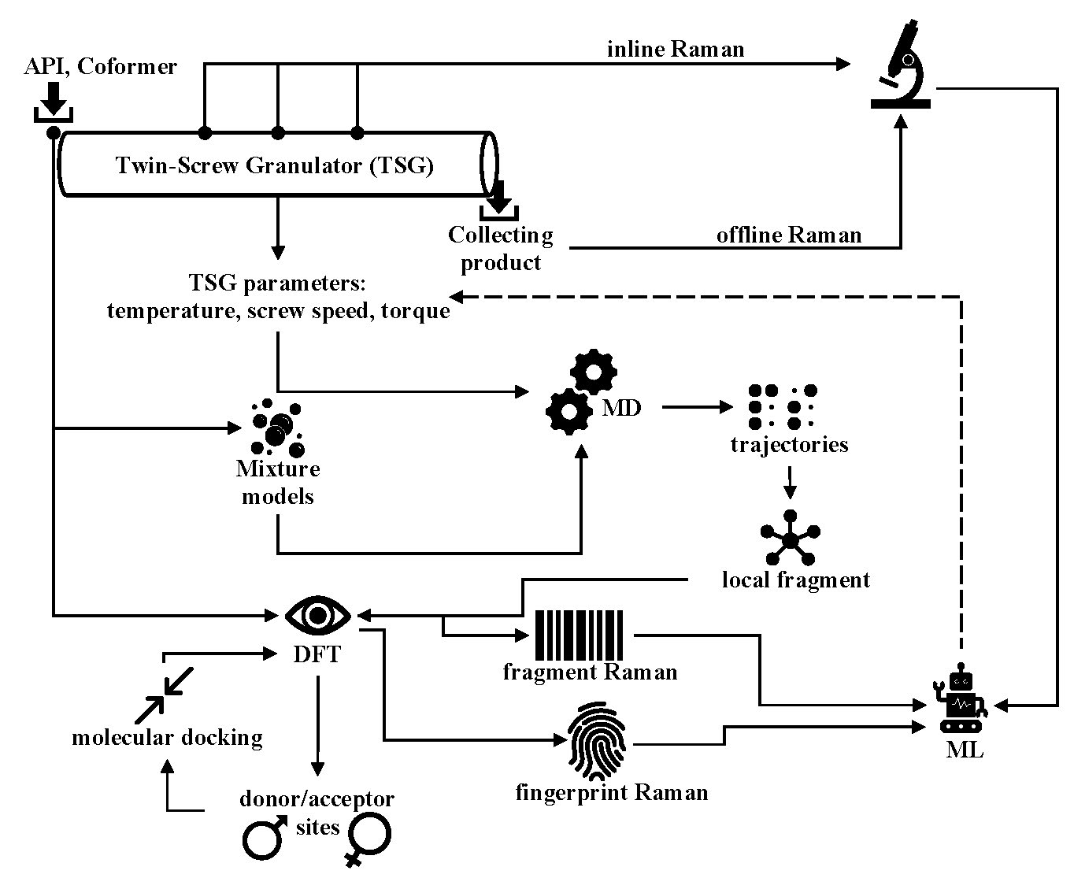
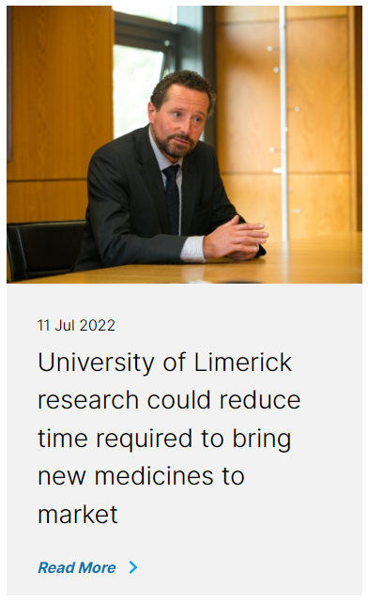

MAK at UL

Slide 13





