Slide 1

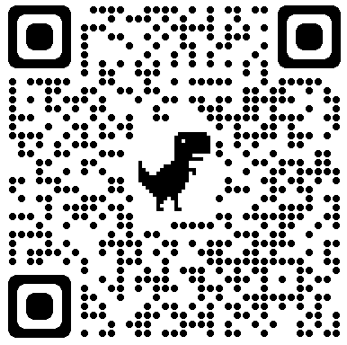


Marie Curie Alumni Association ∙ North America Chapter
Canada West Coordinator
Milad Asgarpour Khansary
makhsry@mail.ubc.ca
604-762-6875

Slide 2
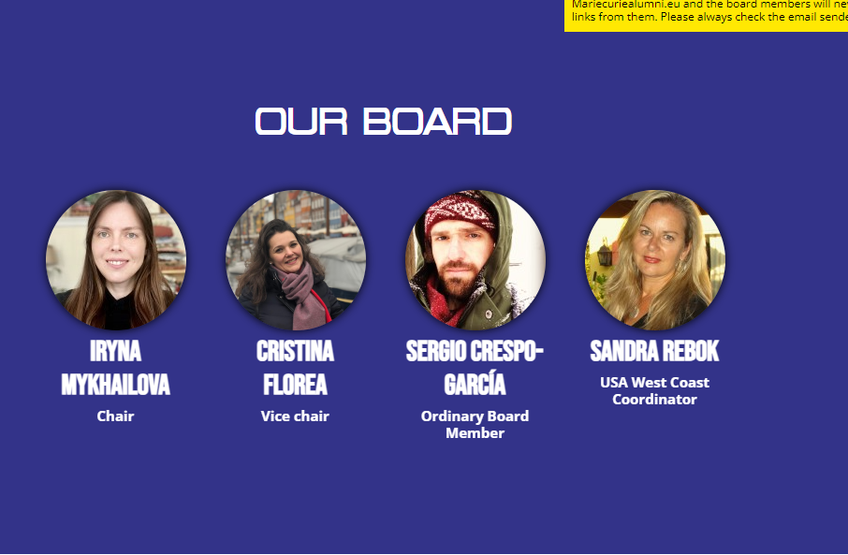
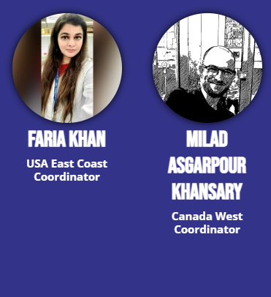
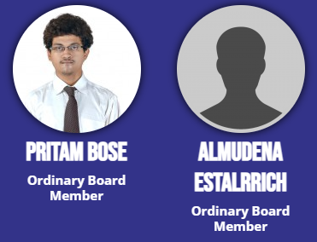

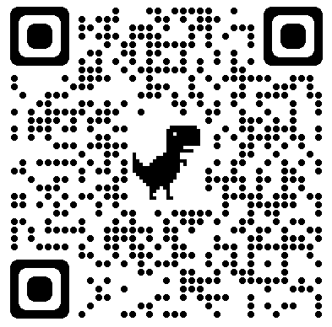
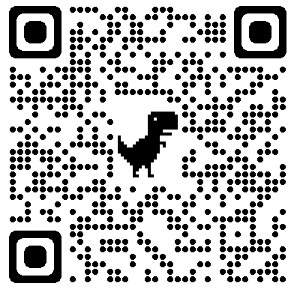
MCAA ∙ North America ∙ Board of Directors
Email: north-america.chapter@mariecuriealumni.eu

Slide 3
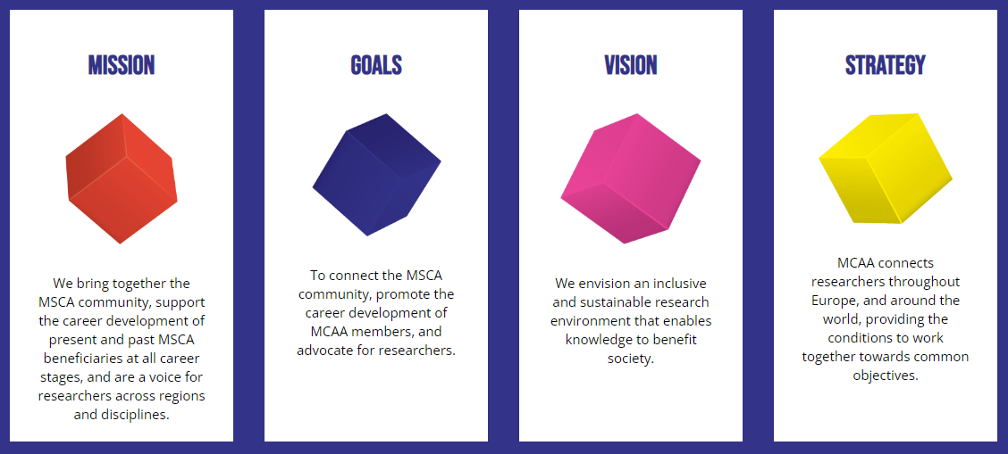
MCAA ∙ Statement of Purpose

Slide 4
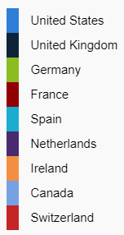
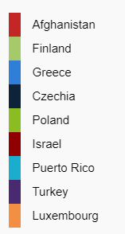
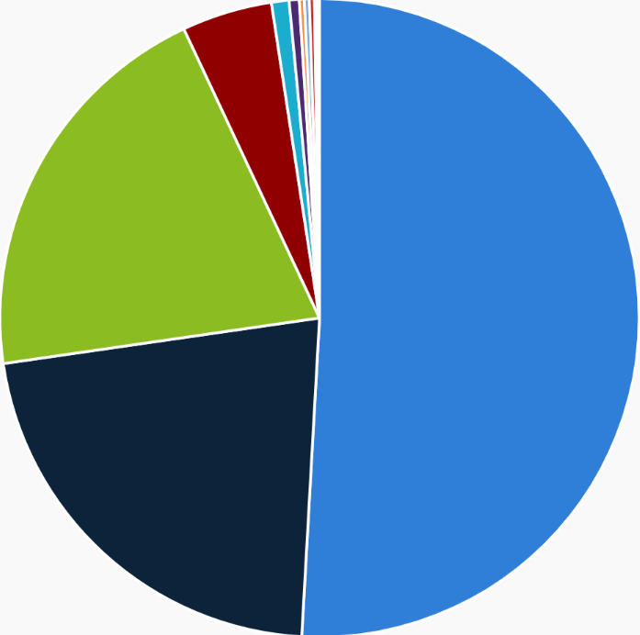
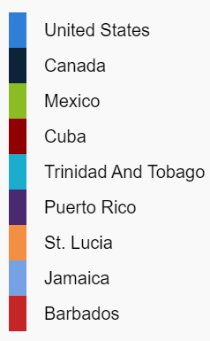
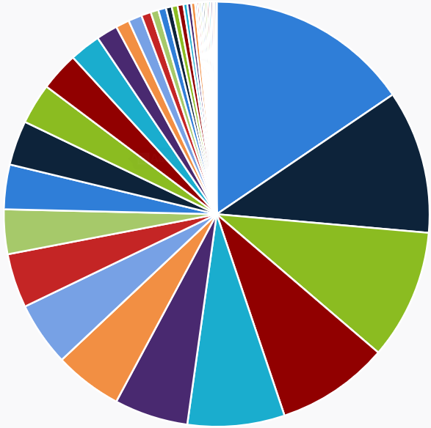
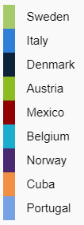
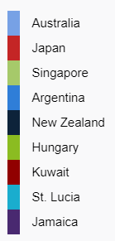
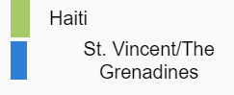
MCAA members
105
74
67
172
401
58
50
Moved from NA to EU
Currently based in NA
Currently there are 21,274 MCAA members, from 151 nationalities.

Slide 5
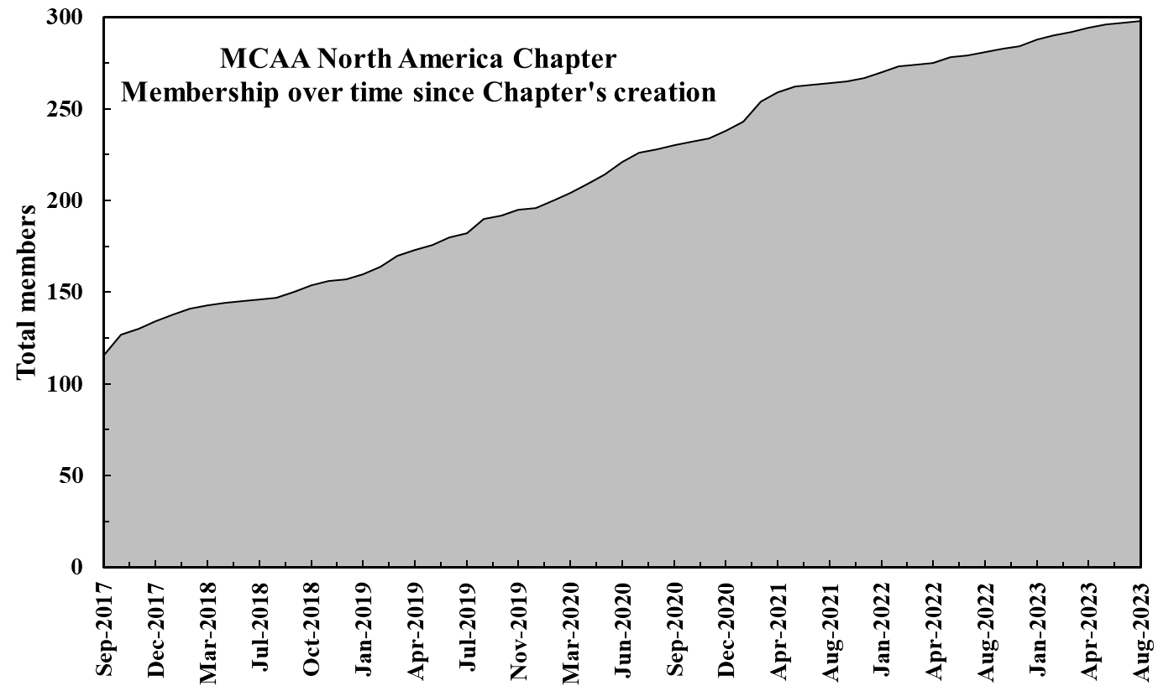
MCAA ∙ North America ∙ members

Slide 6
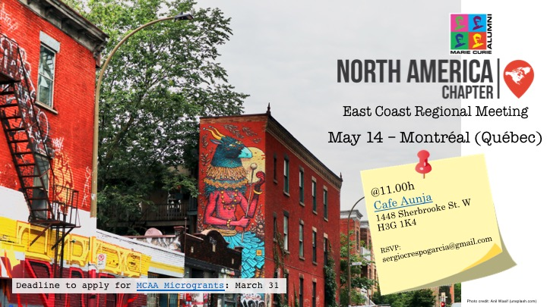
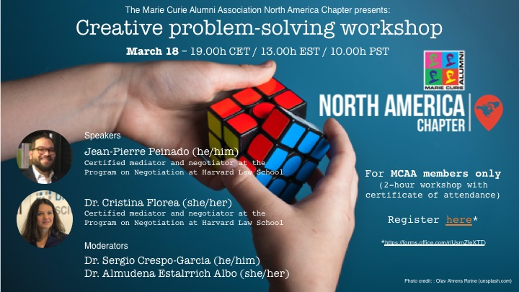
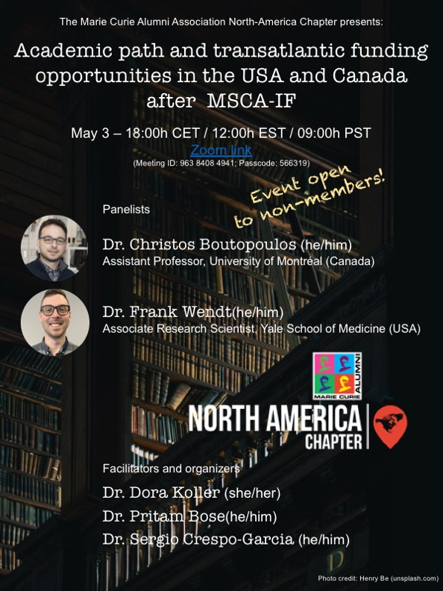
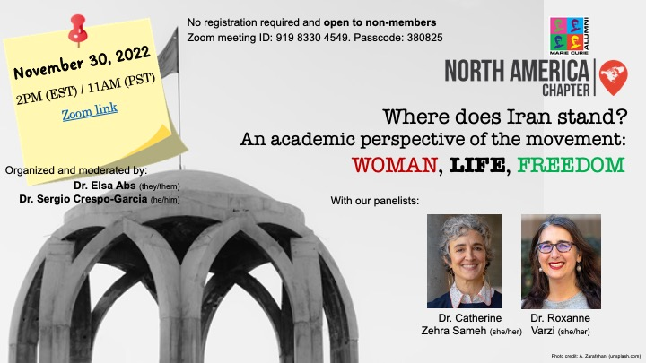
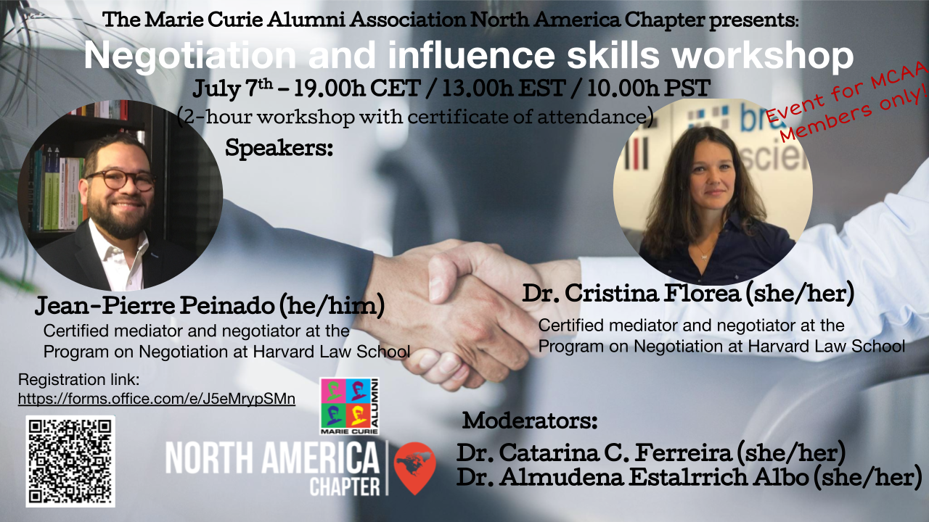
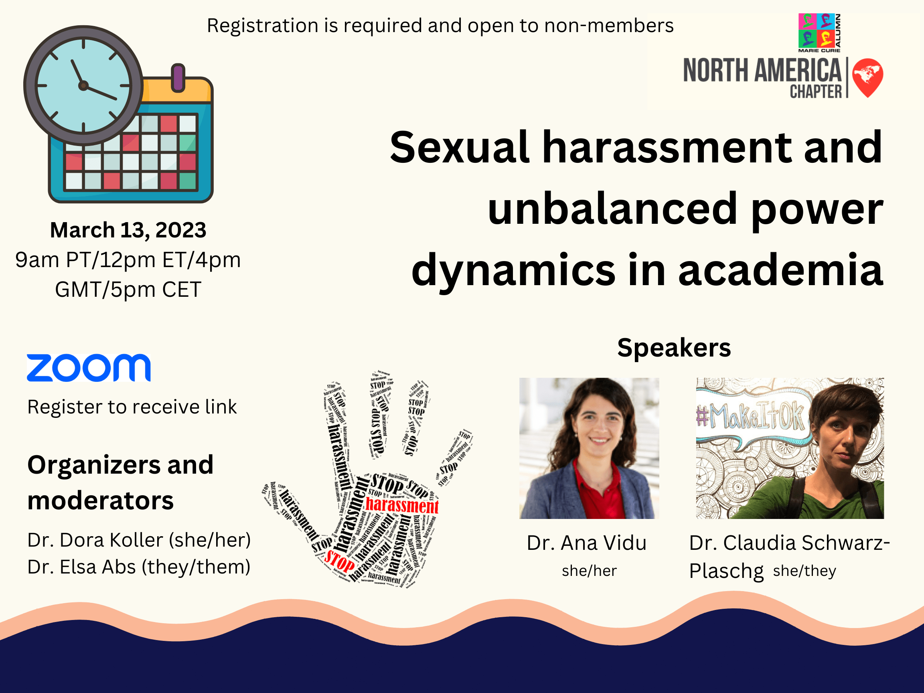
Past events and webinars ….

Slide 7
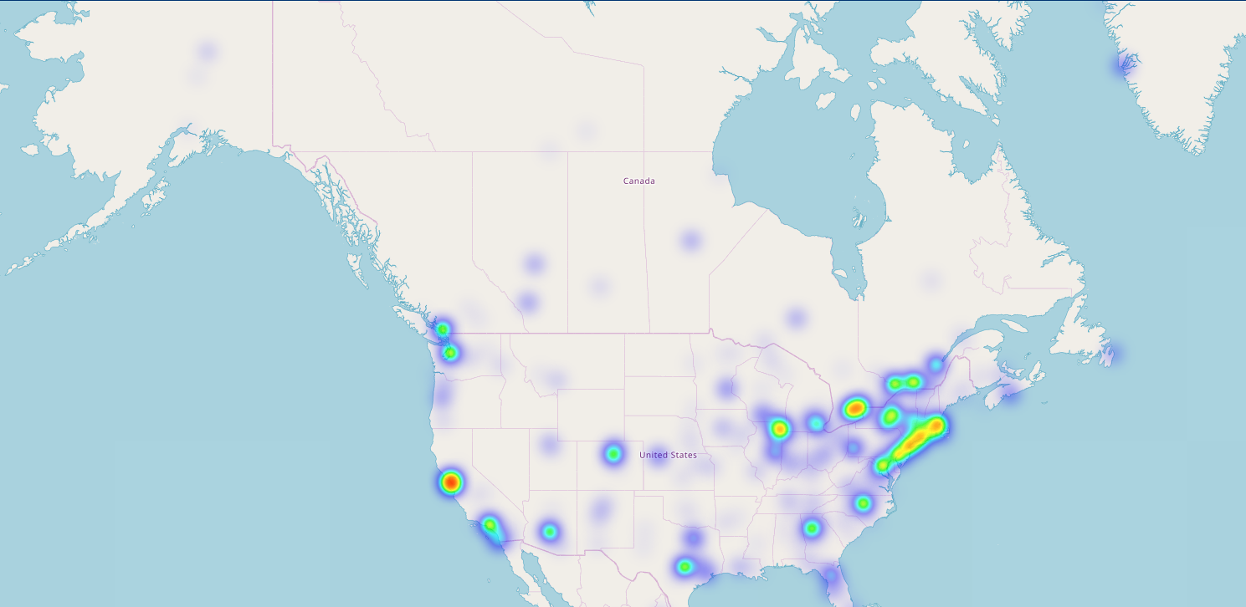

Did you know?
USA/CAN institutions active in HORIZON projects in North America

Slide 8
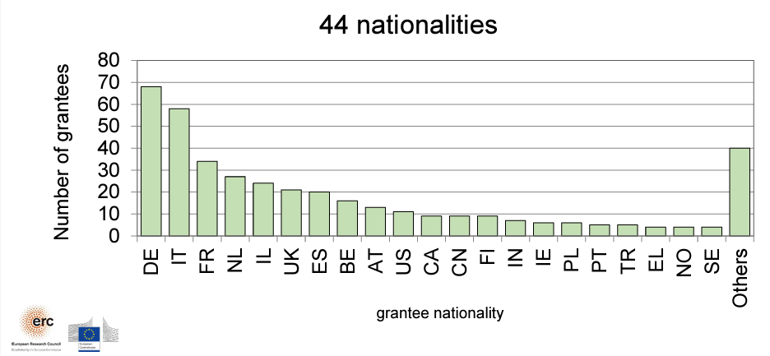
Did you know?
20 ERC Starting Grants
Prof. J. Moran, former MSCA fellow and 2 ERC grants awardee is moving to uOttawa Dept. Chemistry

Slide 9
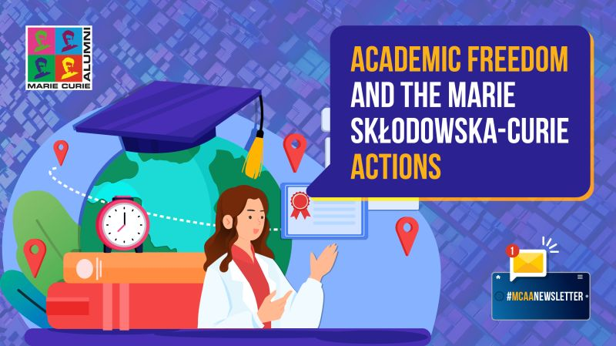



Please reach out to chat about ……

Slide 10
Connect with MCAA ∙ North America
MCAA – North America Chapter
MCAA –NA LinkedIn
Email: north-america.chapter@mariecuriealumni.eu

