Slide 1
CSE 103: Discrete Mathematics
Lecture-1-3
Propositional Logic
1

Slide 2
Reference Books
“Discrete Mathematics and Its Applications”, 6th Edition, by Kenneth H. Rosen, McGraw-Hill international.
“Schaum’s Outline series: Discrete Mathematics”, 2nd Edition, by Seymour Lipshutz & Marc Lipson, Tata McGraw-Hill India, 2003
2

Slide 3
1.1 Propositional Logic
Introduction
A proposition is a declarative sentence (a sentence that declares a fact) that is either true or false, but not both.
Are the following sentences propositions?
Toronto is the capital of Canada.
Read this carefully.
1+2=3
x+1=2
What time is it?
(Yes)
(No)
(Yes)
(No)
(No)
3

Slide 4
Propositions
Propositional Variables – variables that represent propositions: p, q, r, s
E.g. Proposition p – “Today is Friday.”
Truth values – T, F
Propositional Logic – the area of logic that deals with propositions
Propositions can be formed by combining one or more propositions using logical operators called compound propositions.
4

Slide 5
1.1 Propositional Logic
DEFINITION 1 (Negation of Proposition)
Let p be a proposition. The negation of p, denoted by ¬p, is the statement “It is not the case that p.”
The proposition ¬p is read “not p.” The truth value of the negation of p, ¬p is the opposite of the truth value of p.
Examples
Find the negation of the proposition “Today is Friday.” and express this in simple English.
Find the negation of the proposition “At least 10 inches of rain fell today in Miami.” and express this in simple English.
Solution: The negation is “It is not the case that today is Friday.” In simple English, “Today is not Friday.” or “It is not Friday today.”
Solution: The negation is “It is not the case that at least 10 inches of rain fell today in Miami.” In simple English, “Less than 10 inches of rain fell today in Miami.”
5

Slide 6
1.1 Propositional Logic
Note: Always assume fixed times, fixed places, and particular people unless otherwise noted.
Truth table:
Logical operators are used to form new propositions from two or more existing propositions. The logical operators are also called connectives.
The Truth Table for the Negation of a Proposition.
p | ¬p
T F | F T
6

Slide 7
1.1 Propositional Logic
DEFINITION 2 (Conjunction)
Let p and q be propositions. The conjunction of p and q, denoted by p Λ q, is the proposition “p and q”. The conjunction p Λ q is true when both p and q are true and is false otherwise.
Examples
Find the conjunction of the propositions p and q where p is the proposition “Today is Friday.” and q is the proposition “It is raining today.”, and the truth value of the conjunction.
Solution: The conjunction is the proposition “Today is Friday and it is raining today.” The proposition is true on rainy Fridays.
7

Slide 8
1.1 Propositional Logic
DEFINITION 3 (Disjunction)
Let p and q be propositions. The disjunction of p and q, denoted by p ν q, is the proposition “p or q”. The conjunction p ν q is false when both p and q are false and is true otherwise.
Note:
inclusive or : The disjunction is true when at least one of the two
propositions is true.
E.g. “Students who have taken calculus or computer science can take this class.” – those who take one or both classes.
exclusive or : The disjunction is true only when one of the
proposition is true.
E.g. “Students who have taken calculus or computer science, but not both, can take this class.” – only those who take one of them.
Definition 3 uses inclusive or.
8

Slide 9


1.1 Propositional Logic
DEFINITION 4
Let p and q be propositions. The exclusive or of p and q, denoted by p q, is the proposition that is true when exactly one of p and q is true and is false otherwise.
The Truth Table for the Conjunction of Two Propositions.
p q | p Λ q
T T T F F T F F | T F F F
The Truth Table for the Disjunction of Two Propositions.
p q | p ν q
T T T F F T F F | T T T F
The Truth Table for the Exclusive Or (XOR) of Two Propositions.
p q | p q
T T T F F T F F | F T T F
9

Slide 10
1.1 Propositional Logic
Conditional Statements
DEFINITION 5
Let p and q be propositions. The conditional statement p → q, is the proposition “if p, then q.” The conditional statement is false when p is true and q is false, and true otherwise. In the conditional statement p → q, p is called the hypothesis (or antecedent or premise) and q is called the conclusion (or consequence).
A conditional statement is also called an implication.
Example: “If I am elected, then I will lower taxes.” p → q
implication:
elected, lower taxes. T T | T
not elected, lower taxes. F T | T
not elected, not lower taxes. F F | T
elected, not lower taxes. T F | F
10

Slide 11
1.1 Propositional Logic
Example:
Let p be the statement “Maria learns discrete mathematics.” and q the statement “Maria will find a good job.” Express the statement p → q as a statement in English.
Solution: Any of the following -
“If Maria learns discrete mathematics, then she will find a good job.
“Maria will find a good job when she learns discrete mathematics.”
“For Maria to get a good job, it is sufficient for her to learn discrete mathematics.”
“Maria will find a good job unless she does not learn discrete mathematics.”
11

Slide 12
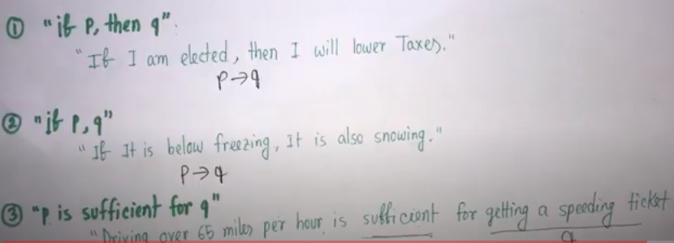
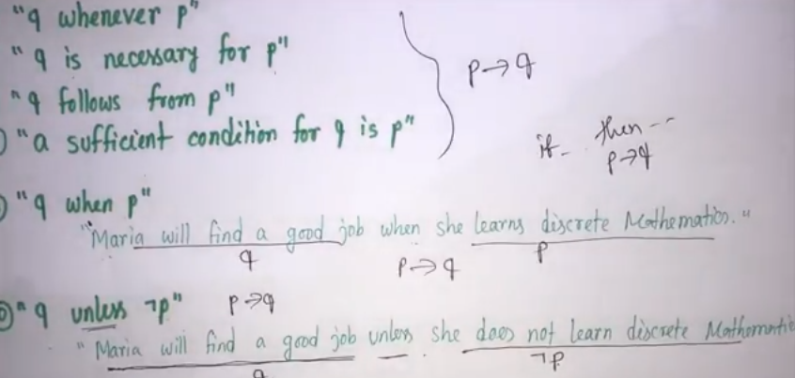
1.1 Propositional Logic
12

Slide 13
1.1 Propositional Logic
P Q
if p, then q
p implies q p only if q q when p
q whenever p
q follows from p
a necessary condition for p is q
if p, q
q unless ¬p q if p
p is sufficient for q q is necessary for p
a sufficient condition for q is p
13

Slide 14
1.1 Propositional Logic
Other conditional statements formed from p → q
Converse of p → q : q → p
Contrapositive of p → q : ¬ q → ¬ p (Converse+Inverse)
Inverse of p → q : ¬ p → ¬ q
All of these conditional statements formed from p → q , but only the contrapositive always has the same truth value as p → q
Example
Find the contrapositive, converse and inverse of the statement
“ If today is Thursday, then I have a test today”
If I do not have a test today, then today is not Thursday---Contrapositive
If I have a test today then today is Thursday------Converse
If Today is not Thursday then I do not have a test today----------Inverse
P: I am in Sylhet
Q: I am in Bangladesh
if I am in Sylhet then I am in Bangladesh
p → q
Converse of p → q : q → p
if I am in Bangladesh then I am in Sylhet
Inverse of p → q : ¬ p → ¬ q
if I am not in Sylhet then I am not in Bangladesh
Contrapositive of p → q : ¬ q → ¬ p
if I am not in Bangladesh then I am not in Sylhet
14

Slide 15
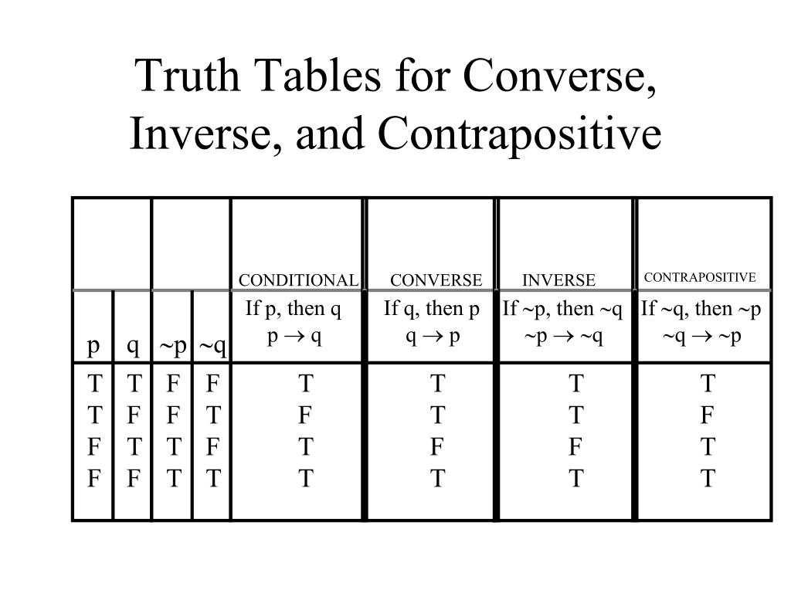
1.1 Propositional Logic
**If it snows today, I will ski tomorrow
**I come to class whenever there is going to be a quiz.
15

Slide 16
1.1 Propositional Logic
DEFINITION 6 (Biconditional statement)
Let p and q be propositions. The biconditional statement p ↔ q is the proposition “p if and only if q.” The biconditional statement p ↔ q is true when p and q have the same truth values, and is false otherwise. Biconditional statements are also called bi-implications.
p ↔ q has the same truth value as (p → q) Λ (q → p)
“if and only if” can be expressed by “iff”
p is necessary and sufficient for q
if p then q conversely
Example:
Let p be the statement “You can take the flight” and let q be the statement “You buy a ticket.” Then p ↔ q is the statement
“You can take the flight if and only if you buy a ticket.”
Implication:
If you buy a ticket you can take the flight.
If you don’t buy a ticket you cannot take the flight.
16

Slide 17
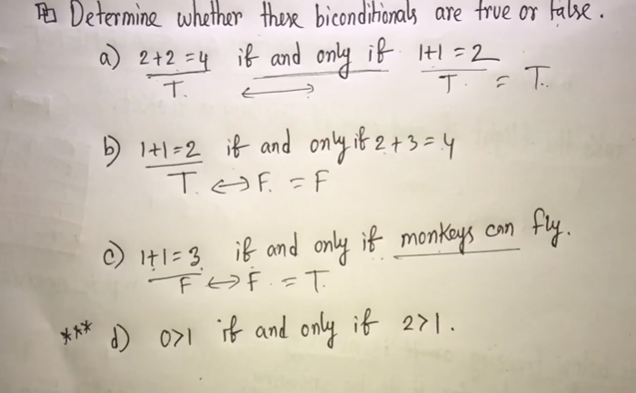
1.1 Propositional Logic
**That It is below freezing is necessary and sufficient for it to be snowing
The Truth Table for the Biconditional p ↔ q.
p q | p ↔ q
T T T F F T F F | T F F T
17

Slide 18
1.1 Propositional Logic
Truth Tables of Compound Propositions
We can use connectives to build up complicated compound propositions involving any number of propositional variables, then use truth tables to determine the truth value of these compound propositions.
Example: Construct the truth table of the compound proposition
(p ν ¬q) → (p Λ q).
The Truth Table of (p ν ¬q) → (p Λ q).
p q | ¬q | p ν ¬q | p Λ q | (p ν ¬q) → (p Λ q)
T T T F F T F F | F T F T | T T F T | T F F F | T F T F
18

Slide 19

1.1 Propositional Logic
Precedence of Logical Operators
We can use parentheses to specify the order in which logical operators in a compound proposition are to be applied.
To reduce the number of parentheses, the precedence order is defined for logical operators.
Precedence of Logical Operators.
Operator | Precedence
¬ | 1
Λ ν | 2 3
→ ↔ | 4 5
E.g. ¬p Λ q = (¬p ) Λ q
p Λ q ν r = (p Λ q ) ν r
p ν q Λ r = p ν (q Λ r)
19

Slide 20
Arguments
An argument is an assertion that a given set of propositions P1, P2,……,Pn called premises yields another proposition Q, called conclusion.
An argument P1,P2,….,Pn├Q is said to be valid if Q is true whenever al the4 premises are true
An argument which is not valid is called fallacy

Slide 21
1.1 Propositional Logic
Translating English Sentences
English (and every other human language) is often ambiguous. Translating sentences into compound statements removes the ambiguity.
Example: How can this English sentence be translated into a logical expression?
“You cannot ride the roller coaster if you are under 4 feet
tall unless you are older than 16 years old.”
Solution: Let q, r, and s represent “You can ride the roller coaster,”
“You are under 4 feet tall,” and “You are older than
16 years old.” The sentence can be translated into:
(r Λ ¬ s) → ¬q.
21

Slide 22
1.1 Propositional Logic
Example: How can this English sentence be translated into a logical expression?
“You can access the Internet from campus only if you are a
computer science major or you are not a freshman.”
Solution: Let a, c, and f represent “You can access the Internet from
campus,” “You are a computer science major,” and “You are
a freshman.” The sentence can be translated into:
a → (c ν ¬f).
22

Slide 23
1.1 Propositional Logic
Logic and Bit Operations
Computers represent information using bits.
A bit is a symbol with two possible values, 0 and 1.
By convention, 1 represents T (true) and 0 represents F (false).
A variable is called a Boolean variable if its value is either true or false.
Bit operation – replace true by 1 and false by 0 in logical operations.
Table for the Bit Operators OR, AND, and XOR.
x | y | x ν y | x Λ y | x y
0 0 1 1 | 0 1 0 1 | 0 1 1 1 | 0 0 0 1 | 0 1 1 0
23

Slide 24
1.1 Propositional Logic
DEFINITION 7
A bit string is a sequence of zero or more bits. The length of this string is the number of bits in the string.
Example: Find the bitwise OR, bitwise AND, and bitwise XOR of the bit string 01 1011 0110 and 11 0001 1101.
Solution:
01 1011 0110
11 0001 1101 ------------------- 11 1011 1111 bitwise OR 01 0001 0100 bitwise AND 10 1010 1011 bitwise XOR
24

Slide 25
Logic and Bit Operations
DEFINITION 7
A bit string is a sequence of zero or more bits. The length of this string is the number of bits in the string.
Example: Find the bitwise OR, bitwise AND, and bitwise XOR of the bit string 01 1011 0110 and 11 0001 1101.
Solution:
0 | 1 | 1 | 0 | 1 | 1 | 0 | 1 | 1 | 0
1 | 1 | 0 | 0 | 0 | 1 | 1 | 1 | 0 | 1
1 | 1 | 1 | 0 | 1 | 1 | 1 | 1 | 1 | 1 | bitwise OR
0 | 1 | 0 | 0 | 0 | 1 | 0 | 1 | 0 | 0 | bitwise AND
1 | 0 | 1 | 0 | 1 | 0 | 1 | 0 | 1 | 1 | bitwise XOR
25

Slide 26
1.2 Propositional Equivalences
Introduction
DEFINITION 1
A compound proposition that is always true, no matter what the truth values of the propositions that occurs in it, is called a tautology. A compound proposition that is always false is called a contradiction. A compound proposition that is neither a tautology or a contradiction is called a contingency.
Examples of a Tautology and a Contradiction.
p | ¬p | p ν ¬p | p Λ ¬p
T F | F T | T T | F F
26

Slide 27
Propositional Equivalences
DEFINITION 1
A compound proposition that is always true, no matter what the truth values of the propositions that occurs in it, is called a tautology.
A compound proposition that is always false is called a contradiction.
A compound proposition that is neither a tautology or a contradiction is called a contingency.
Examples of a Tautology and a Contradiction.
p | ¬p | p ν ¬p | p Λ ¬p
T F | F T | T T | F F
27

Slide 28
1.2 Propositional Equivalences
Logical Equivalences
DEFINITION 2
The compound propositions p and q are called logically equivalent if p ↔ q is a tautology. The notation p ≡ q denotes that p and q are logically equivalent.
Compound propositions that have the same truth values in all possible cases are called logically equivalent.
Example: Show that ¬p ν q and p → q are logically equivalent.
Truth Tables for ¬p ν q and p → q .
p | q | ¬p | ¬p ν q | p → q
T T F F | T F T F | F F T T | T F T T | T F T T
28

Slide 29
1.2 Propositional Equivalences
In general, 2^{n} rows are required if a compound proposition involves n propositional variables in order to get the combination of all truth values.
See page 27 for more logical equivalences.
29

Slide 30
Logical Equivalences
Equivalence | Name
p Λ T ≡ p p V F ≡ P | Identity Laws
p V T ≡ T p Ʌ F ≡ F | Domination Laws
p V p ≡ p p Ʌ p ≡ p | Idempotent Laws
┐(┐p) ≡ p | Double negation Law
p V q ≡ q V p p Ʌ q ≡ q Ʌ p | Commutative Laws
(p V q) V r ≡ p V (q V r) (p Ʌ q) Ʌ r ≡ p Ʌ (q Ʌ r) | Associative Laws
p V (q Ʌ r) ≡ (p V q ) Ʌ ( p V r) p Ʌ (q V r) ≡ (p Ʌ q) V (p Ʌ r) | Distributive Laws
┐( p Ʌ q) ≡ ┐p V ┐q ┐( p V q) ≡ ┐p Ʌ ┐q | De Morgan’s Laws
30

Slide 31
Constructing New Logical Equivalences
Example: Show that ¬(p → q ) and p Λ ¬q are logically equivalent.
Solution:
¬(p → q ) ≡ ¬(¬p ν q)
≡ ¬(¬p) Λ ¬q by the second De Morgan law
≡ p Λ ¬q by the double negation law
Example: Show that (p Λ q) → (p ν q) is a tautology.
Solution: To show that this statement is a tautology, we will use logical equivalences to demonstrate that it is logically equivalent to T.
(p Λ q) → (p ν q) ≡ ¬(p Λ q) ν (p ν q)
≡ (¬ p ν ¬q) ν (p ν q) by the first De Morgan law
≡ (¬ p ν p) ν (¬ q ν q) by the associative and commutative law for disjunction
≡ T ν T From tautology example
≡ T
Note: The above examples can also be done using truth tables.
31

Slide 32
1.2 Propositional Equivalences
Constructing New Logical Equivalences
Example: Show that ¬(p → q ) and p Λ ¬q are logically equivalent.
Solution:
¬(p → q ) ≡ ¬(¬p ν q) by example on slide 21
≡ ¬(¬p) Λ ¬q by the second De Morgan law
≡ p Λ ¬q by the double negation law
Example: Show that (p Λ q) → (p ν q) is a tautology.
Solution: To show that this statement is a tautology, we will use logical equivalences to demonstrate that it is logically equivalent to T.
(p Λ q) → (p ν q) ≡ ¬(p Λ q) ν (p ν q) by example on slide 21
≡ (¬ p ν ¬q) ν (p ν q) by the first De Morgan law
≡ (¬ p ν p) ν (¬ q ν q) by the associative and communicative law for disjunction
≡ T ν T
≡ T
Note: The above examples can also be done using truth tables.
32

Slide 33
Some solutions of exercises
Problem 1: Let p : You drive over 65 miles/hour.
q : You get a speeding ticket.
Write the following propositions using logical connectives:
You will get a speeding ticket if you drive over 65 miles/hours.
You get a speeding ticket, but you don’t drive over 65 miles/hours.
Problem 2: For each of the following sentences, state what the sentence means if the or is an inclusive or exclusive or. Which of these meanings of or do you think is intended?
To take discrete mathematics, you must have taken calculus or a course in computer science.
Dinner for two includes two items from column A or three items for column B.
p → q
q Ʌ ┐p
Inclusive or
exclusive or
33

Slide 34
Some solutions of exercises
Problem 3: Construct the truth table for the following compound statement: (p → q) Ʌ (┐ p → r)
p | q | r | ┐ p | p → q = x | ┐ p → r = y | x Ʌ y
T | T | T | F | T | T | T
T | T | F | F | T | T | T
T | F | T | F | F | T | F
T | F | F | F | F | T | F
F | T | T | T | T | T | T
F | T | F | T | T | F | F
F | F | T | T | T | T | T
F | F | F | T | T | F | F
34

