Slide 1

Faculty of Engineering Electrical & Electronics Engineering EE4198 Project Presentation ORHAN AĞIRMAN MEHMET AKİF KARACA RAMAZAN KAZIKOĞLU July 2, 2021
MONITORING PRECISE and REAL-TIME MEASUREMENT of the POSITION and ORIENTATION of MEDICAL SENSORS
Notes:
Dear professors welcome to our project presentation. I'm Orhan Ağırman. In this presentation, we will talk about the project of "MONITORING PRECISE and REAL-TIME MEASUREMENT of the POSITION and ORIENTATION of MEDICAL SENSORS" that we have done with my friends Mehmet and Ramazan.

Slide 2

Outline
- Introduction
- Research Objective
- Related Literature
- Design
- Methods
- Results and Discussion
- Conclusion and Future Work
Notes:
In this presentation, we will first make a brief introduction, then we will talk about the purpose of the project, then we will briefly mention the preliminary research we have done about our project, after that we will give details about our project in the design and method section. Finally, we will talk about our results and conclusions and how we can develop this project further in the future.

Slide 3

Introduction
Disease detection is the most important step in providing healthcare. Incorrect detection of the disease can cause undesirable cases to occur. In our project, it is aimed to minimize the errors that may occur in disease detection. In addition to the doctor's knowledge skills, our device will serve for the detection of the disease, thus ensuring the continuity of health services more reliably.
Notes:
Medical devices used by specialist physicians have important contributions in disease detection and diagnosis. Decisions that directly affect the patient's life are made, especially with the decision based on the images obtained in the field of radiology. In the field of interventional medicine, this situation has spread to a wider area. Not only for detection and diagnosis but also for patient interventions, images, sensitivity and decision support units provided by medical devices help both the success of the intervention performed by the specialist physician and the patient to overcome the process in the most comfortable way possible.

Slide 4
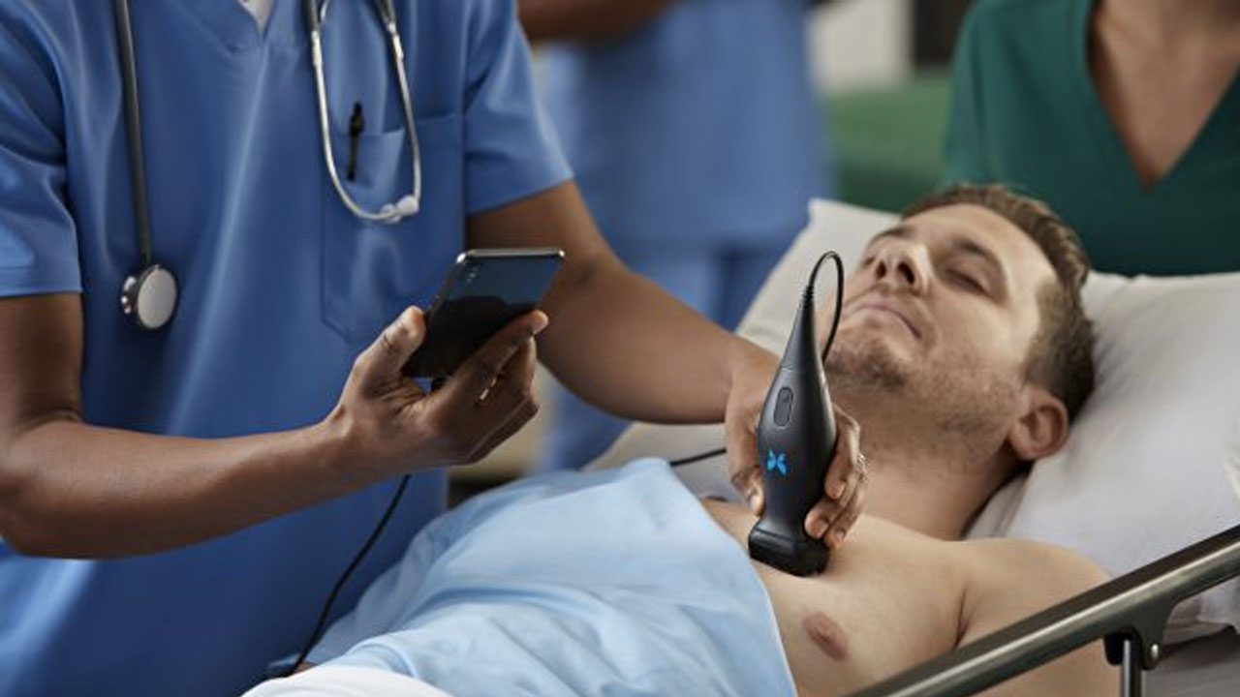
There are studies and products developed for this purpose however, the prices of developed products are very high. In addition, measurements of position and orientation information are performed by tomography-based imaging, special bed or room setups. With the realization of the method presented in the project, the information needed will be captured in a way that does not harm the patient and the doctor and is much cheaper.
Notes:
The device aimed to be developed in the presented project will be added to the sensor of the ultrasound device and will transmit both the position information and angular orientation of the sensor to the system in real-time, and this information will be monitored on the user interface in three dimensions. With the information obtained, both the expert doctor will be helped to get better images and the images to be captured will be recorded more accurately.

Slide 5
Research Objective
Notes:
-In the project, it is planned to measure the position and angular orientation of the ultrasound probe
-These measurements will be displayed on the computer screen to the doctor with a 3D graphical user interface.
-In this way, the scanning procedures to be performed by the doctor will be easily followed.

Slide 6
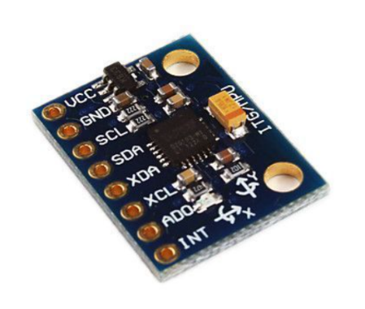
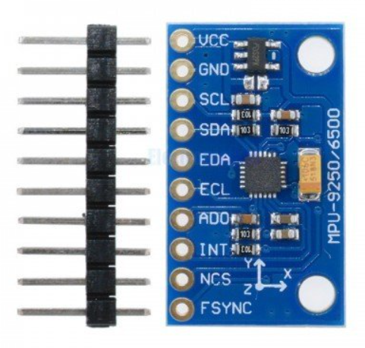
Related Literature
Some sensors investigated for use in our project:
MPU-6050
3-axis gyroscope
3-axis accelerometer
I2C Communication
MPU-9250
3-axis gyroscope
3-axis accelerometer
3-axis magnetometer
I2C & SPI Communication
Notes:
These two sensors caught our attention in our preliminary research to obtain the orientation data. MPU6050 has a 3-axis gyroscope and accelerometer sensors and these sensors communicate with I2C. In addition to the MPU6050 sensor, the MPU9250 has a 3-axis magnetometer and supports SPI, which is a faster communication type than I2C.

Slide 7
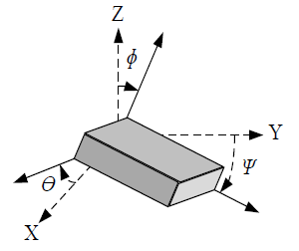
Filters that can be applied to increase the accuracy and precision of the orientation data
Complementary Filter
Kalman Filter
Extended Kalman Filter
Madgwick Filter
Table.1 : Simple comparison of sensor fusion methods
Complementary Filter | Kalman Filter | Extended Kalman Filter | Madgwick Filter
+Easy Algorithm | + High accuracy | + High accuracy | + High accuracy
+Easy to Implement | - Difficult to Implement | - Difficult to Implement | - Difficult to Implement
- Works on 2-axes | - Works on 2-axes | + Works on 3-axes | + Works on 3-axes
Notes:
The gyroscope sensor drifts over time. In order to avoid this problem, additional sensors such as accelerometer and magnetometer are needed. In addition, it is possible to obtain accurate and precise orientation data by processing the data obtained from these sensors with different methods.
While the Complementary filter, which is one of these methods, is the easiest to understand and implement, it is less accurate and precise compared to other methods. And it only works for roll and pitch axes. The Kalman filter, on the other hand, is difficult to understand and implement, and puts more load on the system, but gives more accurate results compared to the Complementary filter. Extended Kalman filter and madgwick filter use magnetometer sensor in addition to gyroscope and accelerometer sensors and can filter within all 3 axes.

Slide 8
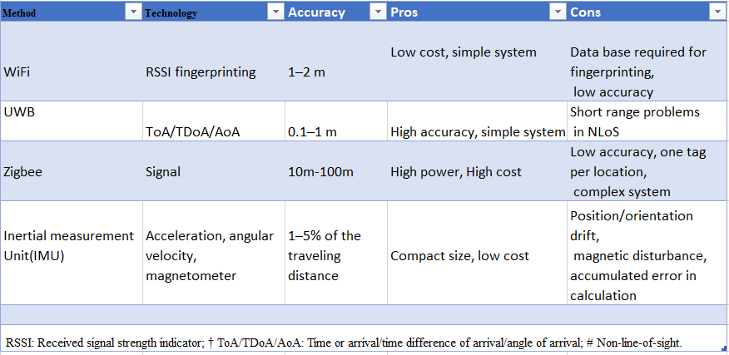
Related Literature
Notes:
-We have done various researches for positioning.
-As seen in the table, there are four types of positioning systems.
- We used in the project, IMU method. The reason we use this method is that it has adjustable sensitivity and it is a low-cost product. The position is obtained by processing the data from the accelerometer and gyroscope.

Slide 9
Design
- Realistic constraints and conditions
- Cost of the design
- Engineering Standards
- Details of the design

Slide 10
Design: Realistic constraints and conditions
This project, as an add-on to many medical devices such as ultrasound devices in disease detection, provides more precise and faster results compared to the methods used today. Thus, it will make a very important contribution to the health sector.

Slide 11
Design: Cost of the design
The total cost of the whole project is as follows:
Table.2 : Cost of the Design
ADXL335 accelerometer sensor | 45 ₺
MPU6050 (Gyroscope + Accelerometer) Sensor Module | 9 ₺ x 3
MPU9250 (Gyroscope + Accelerometer + Magnetometer) Sensor Module | 48 ₺
HC-05 Bluetooth Module | 27 ₺
Arduino Uno | 100 ₺ x 2
Arduino Mega | 134 ₺
TOTAL | 581 ₺

Slide 12
Design: Engineering Standards
Within the scope of our project, Arduino was used to processing orientation and position information, and the real-time 3D interface of our results was designed using the Python programming language.
PEP8 rules for python used for programming language and ISO/IEC 9899:2011 standard for Arduino C programming language were used in this project.

Slide 13
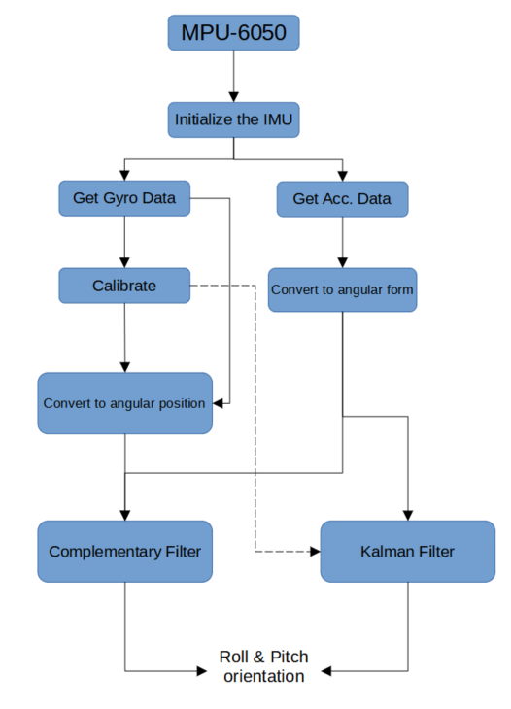
Design: Details of the design
Complementary and Kalman filter is used to filter the Roll and Pitch axes.
Notes:
This is the method we use to filter the orientation data. The angular velocity obtained from the gyroscope is summed for 5 seconds and averaged. This value is subtracted from the angular velocity value measured in real-time. The calibrated data is then integrated using the Trapezoidal rule and converted to angular position. The data obtained from the accelerometer is converted to an angle using the atan2 function. The final data obtained is inserted into the Complementary or Kalman filter to obtain more accurate roll and pitch values.

Slide 14
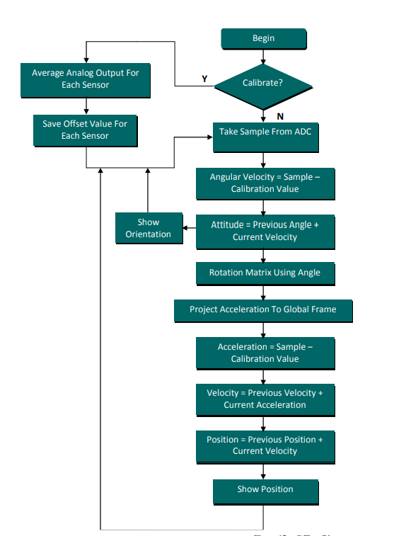
Design: Details of the design
Notes:
- the calibration process is applied first, in order to prevent noise signals that may occur at the beginning.
- The data coming from the sensor is removed from the calibration result. And then the angle is founded.
- The rotation matrix is ​​created using angle.
- We need to find a position relative to the starting point, so the global frame is selected.
- Speed ​​is found by processing accelerometer data, and position is determined by processing speed data. Here, again, calibration is performed to prevent noise errors that may occur.

Slide 15
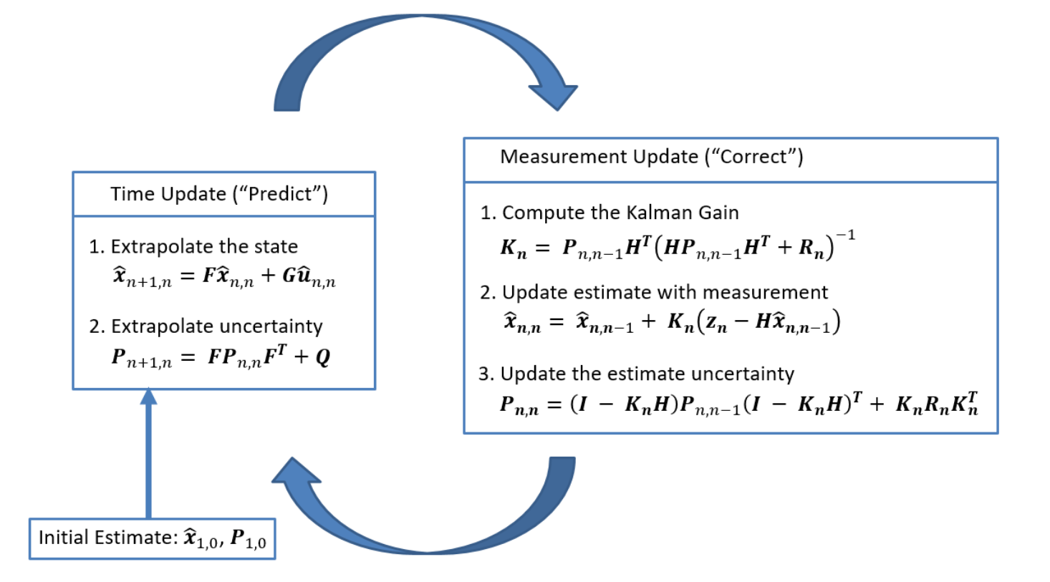
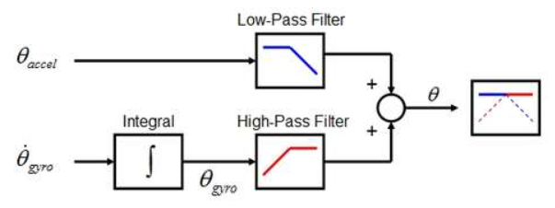
Methods
Implementation of the Complementary Filter and Kalman Filter:
Figure: The block diagram of the complementary filter
Figure : The block diagram of the Kalman filter
Notes:
On this slide, you see how the Complementary filter and the Kalman filter are applied. Simply the Complementary filter consists of a low-pass and a high-pass filter. The low pass filter filters high-frequency signals (In this case, such as vibration from the accelerometer) and low pass filters that filter low-frequency signals (such as the drift of the gyroscope). By combining these filters, we get a good signal.

Slide 16
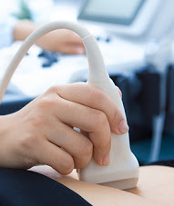
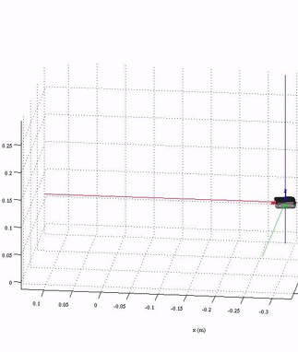
Methods
Notes:
The IMU (Inertial Measurement Unit) has been used to measure the position and angular orientation of the ultrasound probe. Several variables can be measured by IMUs such as distance, direction, acceleration, specific force. It should has gyroscope and accelerometer to find a position using IMU. After integration the data we receive from the accelerometer and gyroscope, the location is determined.

Slide 17
Methods
In this part, which is the last part of the project, the data is transferred from Arduino to the computer via Bluetooth. The rotation and position data coming to the computer are visualized as a 3D model using python. The computer displays these data simultaneously on the user interface. A rectangular prism and a basic human model are seen in the user interface. This human model is visualized where the prism is in terms of rotation and position. According to the incoming data, this prism is rotated in 3 dimensions and its position can be changed in 3 axes. As a result, the project is completed in this way.

Slide 18
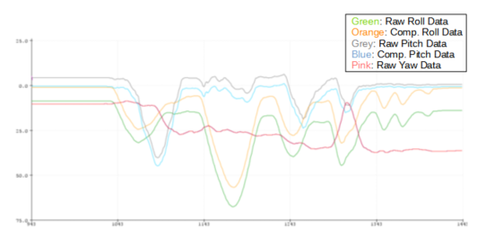
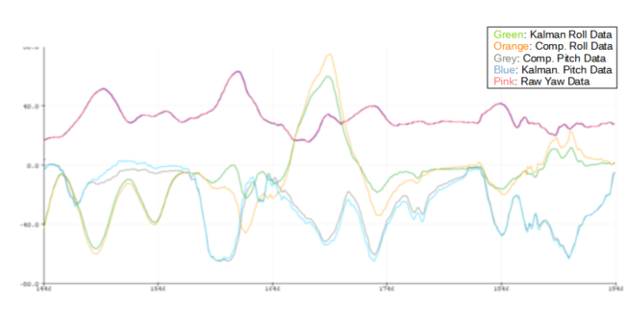
Results and Discussion
Figure: The comparison of the Complementary Filter and Raw Data
Figure: The comparison of the Complementary Filter and Kalman Filter

Slide 19
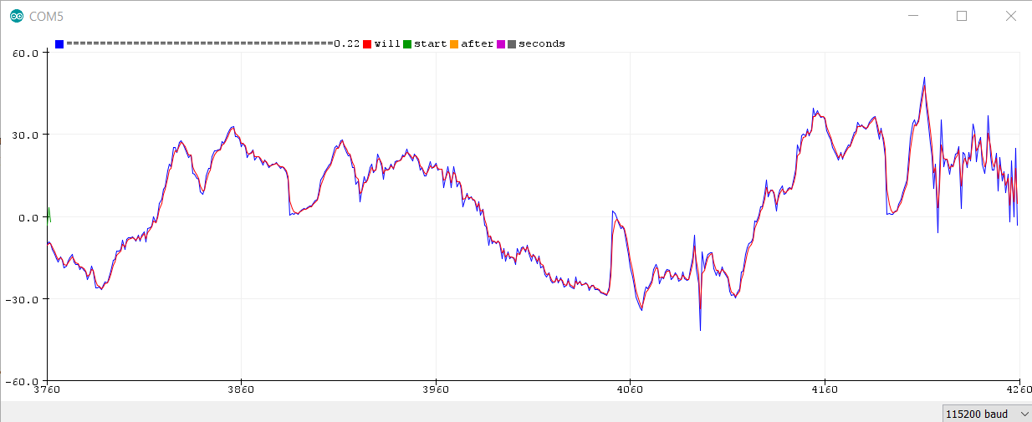
Results and Discussion
Notes:
- In this graph, a simple kalman filter applied from the accelerometer to one dimension is colored red.
- The unapplied Kalman filter is shown in blue.
- As you can see, the red color graphic is noisier than the blue color graphic.
- Here, the noises generated by the filtering method have been prevented, at least to a small extent

Slide 20
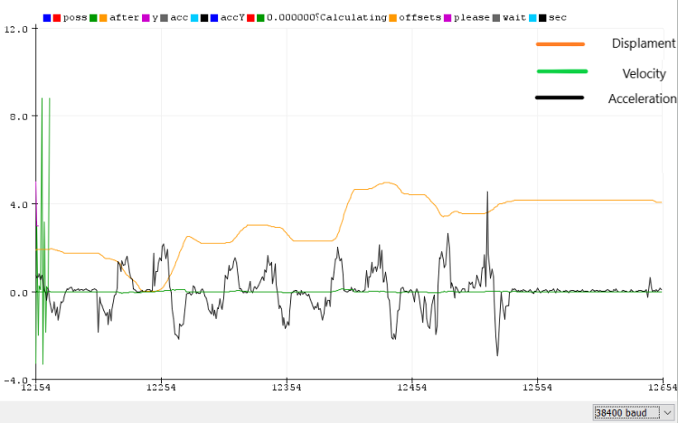
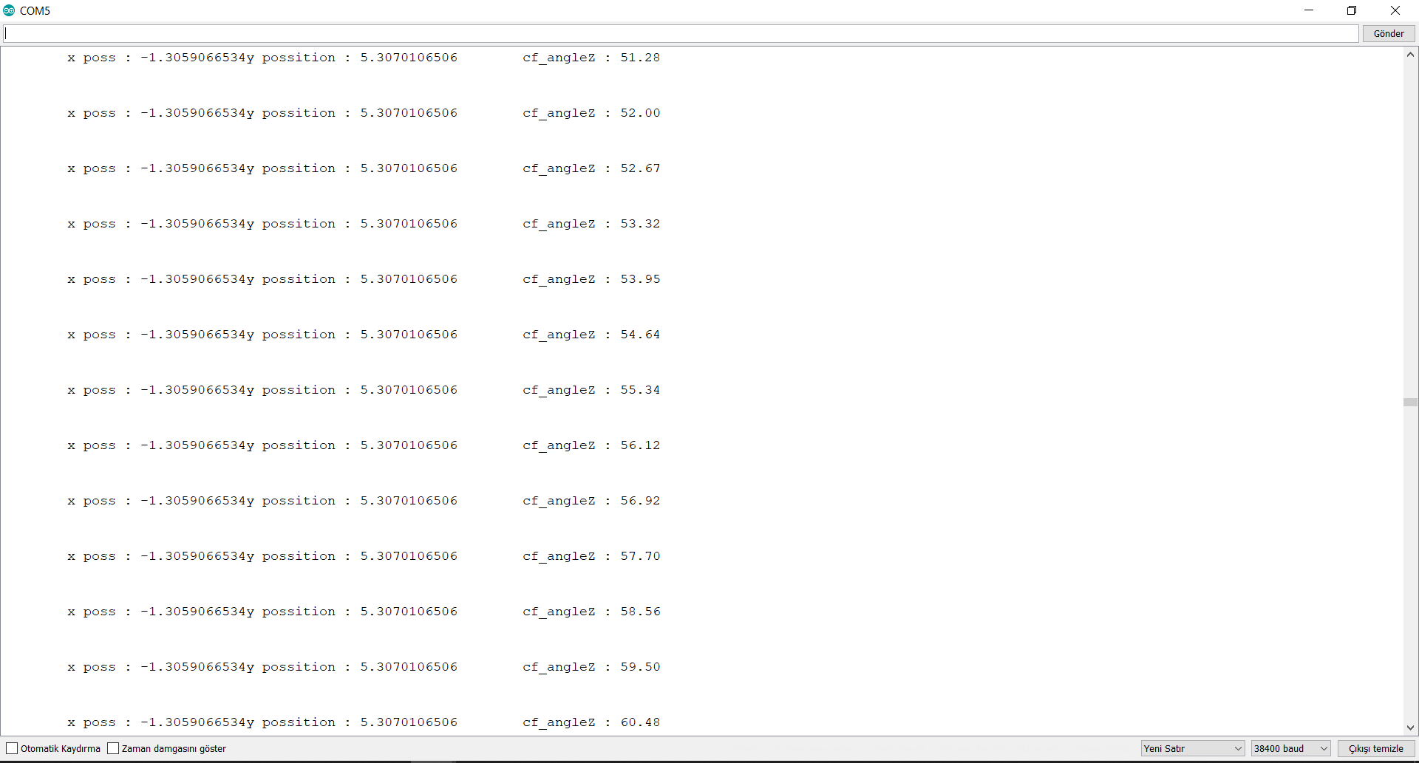
Results and Discussion
Notes:
Here, on the left graph, there are acceleration, velocity, and position data. The graph on the right has its numerical expressions.
- The orange color represents position. Its unit is cm.
- The green color represents the speed data. Speed data appears to be very little since its unit is m/s.
- The black one is the acceleration data.

Slide 21
Results and Discussion
There are 2 3-D objects in the output of my main code. One of them is a human figure lying sideways. The other is a rectangular prism. The position of the prism and the person can change if desired. In addition, prism can be rotated in 3 dimensions.Angular orientation measurements will also be taken at the minute level simultaneously and the data will be transferred to the computer wirelessly with the Bluetooth unit. In the upper left corner of the GUI screen, the position and rotation of the prism will be instantly displayed with red fonts.

Slide 22
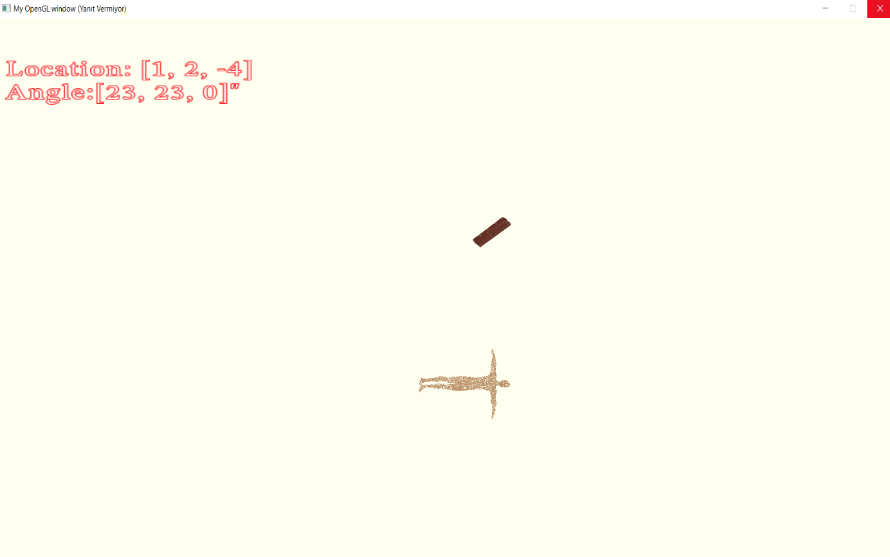
Results and Discussion

Slide 23
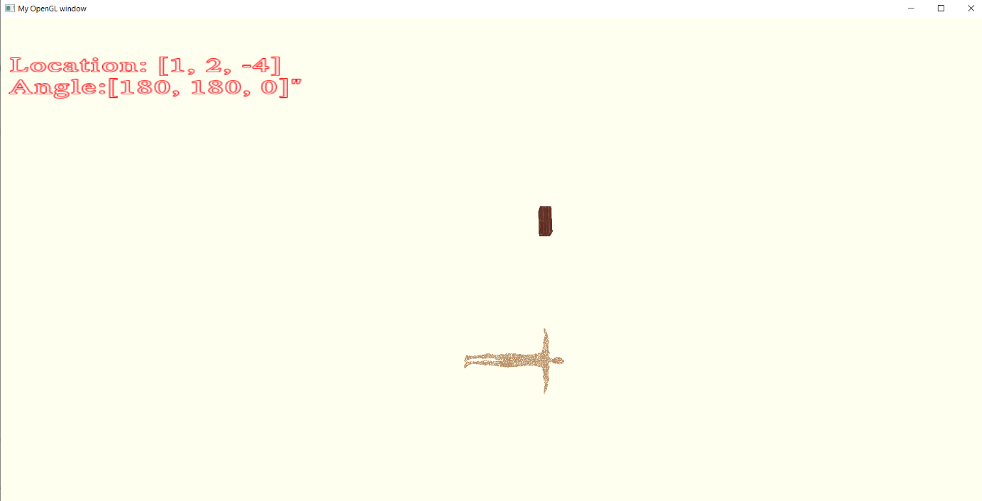
Results and Discussion

Slide 24
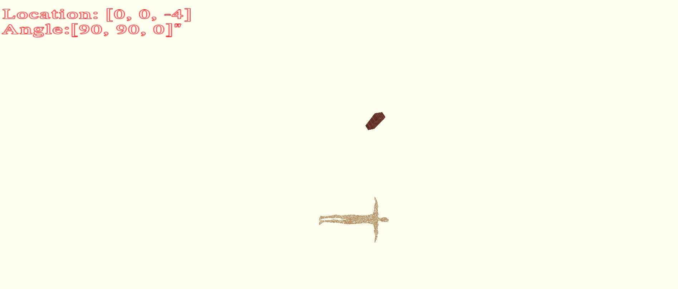
Results and Discussion

Slide 25
Conclusions and Future Research Directions
In the software part of the project, the Python programming language was used and the OpenGL library was loaded. A main GUI was created with the GLFW library and two 3d obj extension objects were loaded. One of these objects was a prism and the other was a human figure. A prism that moves with 6 different parameters was placed. 3 of them are x, y, z positions and the other 3 are their angular orientations in these axes.
We sent from the Bluetooth module, it was observed that the movement of the prism in 3 axes, namely in the x, y, z coordinates, was ensured. As a result, our prism in the GUI is moves with the incoming data as we want.

Slide 26
Acknowledgements
We would like to thank our consultant Assoc. Prof. Dr. Gökhan Bora Esmer, who advised us throughout the project and gave us the opportunity to work on our project titled "Monitoring precise and real-time measurement of the positions and orientations of medical sensors" for their support. We would not have been able to do this without the valuable support of our teacher. We are grateful for everything.
July, 2021

Slide 27

Thank You
Questions?

