Slide 1
数据结构基础
Fundamentals of Data Structures
陈 翔
E-mail: xchencs@zju.edu.cn
Web: https://xchen-cs.github.io
Courseware on https://courses.zju.edu.cn/
homework sets on https://pintia.cn/

Slide 2



 教材 (Text Book)
Data Structures and
Algorithm Analysis in C
(2nd Edition)
Mark Allen Weiss
陈 越 改编
Email: weiss@fiu.edu

Slide 3
 参考书目 (Reference)
➢ 数据结构（第2版）
陈越、何钦铭、徐镜春、魏宝刚、杨枨 编著 高等教育出版社
➢ 数据结构学习与实验指导
陈越、何钦铭、徐镜春、魏宝刚、杨枨 编著 高等教育出版社
➢ 数据结构与算法分析（C语言版）
魏宝刚、陈越、王申康 编著 浙江大学出版社
➢ Data Structures, Algorithms, and Applications in C++
数据结构算法与应用——C++语言描述 （英文版）
Sartaj Sahni McGraw-Hill & 机械工业出版社
➢ 数据结构课程设计
何钦铭、冯雁、陈越 著 浙江大学出版社
➢ 中国大学MOOC：数据结构（陈越、何钦铭）

Slide 4
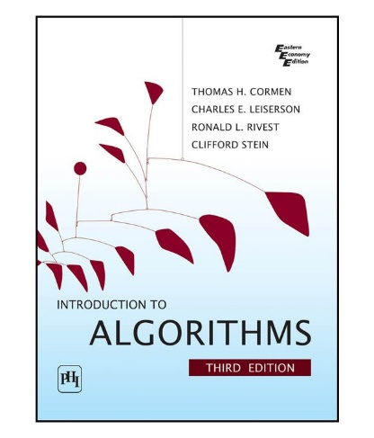

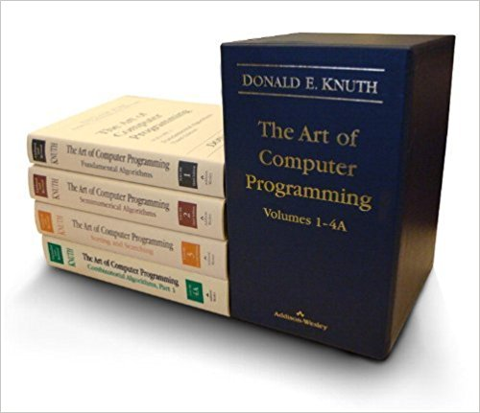

 参考书目 (Reference)
➢ Introduction to Algorithms (CLRS)
算法导论
Thomas H. Cormen,
Charles E. Leiserson,
Ronald L. Rivest,
Clifford Stein
➢ The Art of Computer Programming (TAOCP)
计算机程序设计艺术

Slide 5

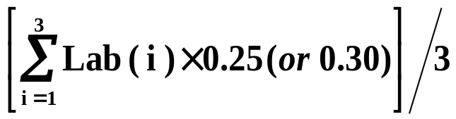
课程评分方法 (Grading Policies)
 Lecture Grade (75) = Homework Exercises (10)
+ Quizzes (10)
+ Mid-Term Exam (15*)
+ Final Exam (40*)
 Laboratory Grade (25/30*) =

Slide 6

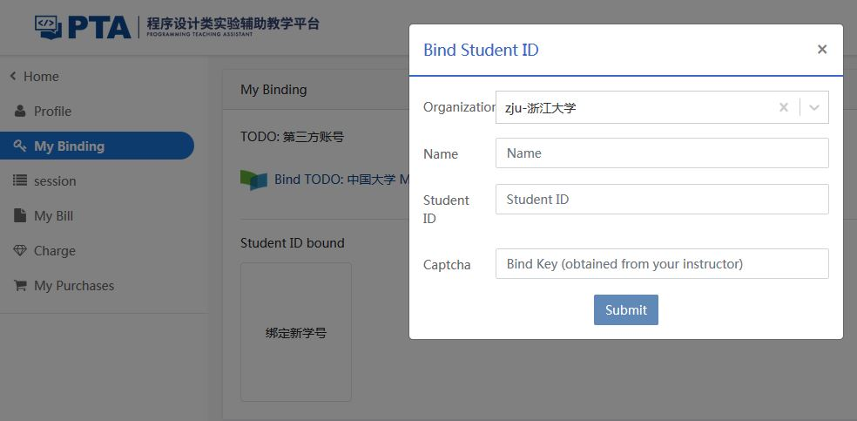
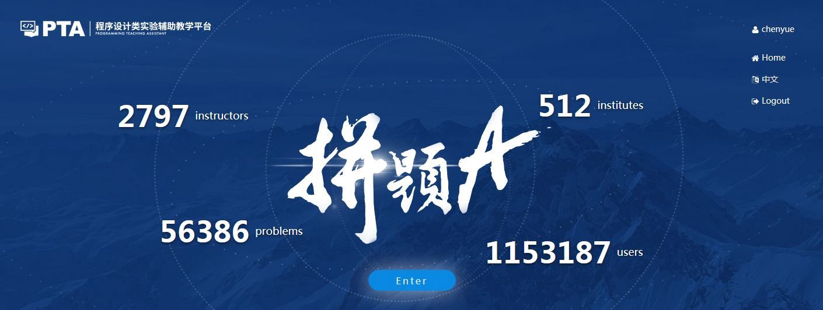
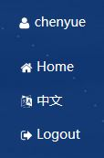
作业 (Homework Assignments)
Register and login at https://pintia.cn/
Bind your student ID with bind key
038180

Slide 7
测验 (Quizzes)
 Random Quizzes
 10 minutes
 Problems will be chosen from HW

Slide 8

实验 (Laboratory Projects)
Done independently
Take Programming Ability Test in the 1st week
Top 30% may choose to take (or not to take) the Hard mode (hence the full mark is 30)
 助教（Teaching Assistant）
☺ 陆子仪（ziyilu@zju.edu.cn）
Notes:
所有大程不再分组，都是独立完成；16号晚上有一次测试，排名30%的学生有权选择hard模式（也可以不选择），意味着大程的权重是30%而不是25%。布置大程时，满分都是100分，所有人打通互评。最后计算总评的时候，hard模式按平均分*30%计算。

Slide 9

实验 (Laboratory Projects)
Peer Review
Grade = G_{TA} × 50% + G_{PR} × 50%

Slide 10
Peer review is for the reviewer
Editing someone else’s work is one of the best ways to learn how to edit your own
  It’s much easier to see what’s working and what isn’t in someone else’s paper than in your own.
Writing is revision
  The more you practice reading and critiquing someone else’s work, the stronger your editing skills will be when it’s time to apply them to your own work.
Any skill level works
  You can learn a great deal about the fundamentals of good writing from carefully reading and reviewing poor writing, figuring out why it’s not succeeding and what it needs to succeed.

Slide 11
Process
Submit initial version for peer review (1 week)
Participate in peer review (2 days)
Revise paper and submit to TA (2 days)
Receive final grading from TA

Slide 12
诚信守则
（Code of Academic Honesty）
One must get a full mark to be eligible to take the final exam.
As long as there is one action of academic dishonesty in this semester, one will not be eligible to take the final exam and one’s course score will be zero.

