Slide 1
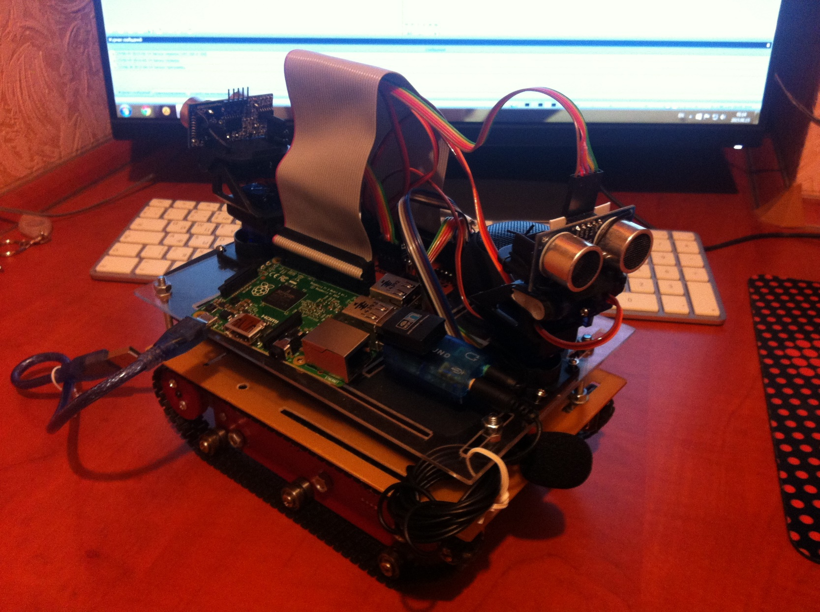
AkiBot
v0.1
https://github.com/makimenko/akibot

Slide 2
Akibot Engine
Distributed Components
Peer to Peer (without the use of a centralized server)
Messaging via UDP (Datagram Packets)
Java, C++, JNI, WiringPi, Pi4J, JME3

Slide 3
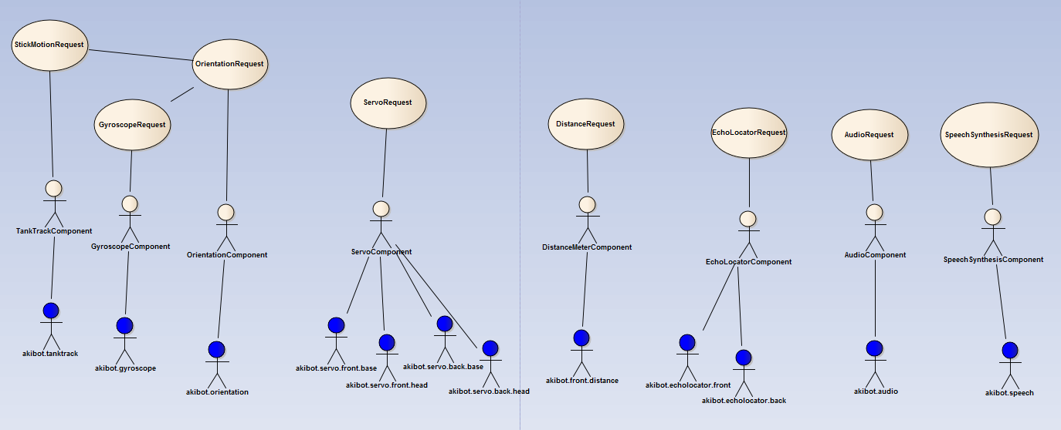
AKIBOT Actors

Slide 4
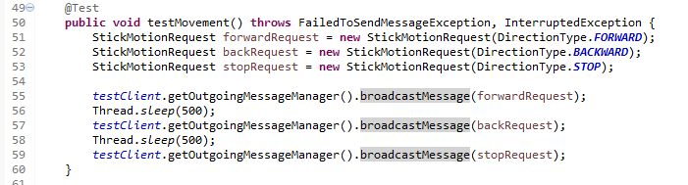
Sample Tests
Register Component
Async Request
Sync Request

