Slide 1
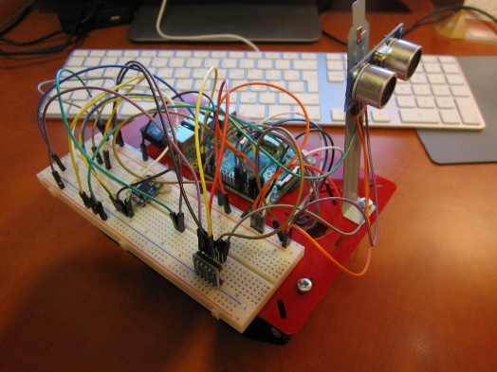
AkiBot
v0.1

Slide 2
Electronics
Motor control
Sensor reading
Communication
Controller
Power management
Glue logic

Slide 3
Components
AwtController
Distance
Gyroscope
GyroscopeCalibration
Orientation
Positioning
SpeechSynthesis
TankTrack

