Slide 1
Praise the Weekend
Changes in Sales, User Acquisition and Segmentation During Weekends in The Look

Slide 2
What’s happening?
Introduction to the Look, and the presentation of the problem, report statement, and data used
WEEKEND/Weekday
The day of the week trends in customers, sales, main markets, and traffic sources
Customer ACQUISITION AND SEGMENTATION
Does acquisition change during weekends? How 2 big customer segments follow the established trends?
RECOMMENDATIONS
What to do in the next 2 months, and what can be achieved? Conclusions and limitations

Slide 3
ALL KPIs show improvement*
$1,7M
Orders | 41.6%
Customers | 31.3%
Organic Traffic | 21.2%
Visits | 20.2%
Conversion Rate | 8.9%
Sales
43.7%
*Compared to the previous 2 months
Notes:
The business shows significant positive changes in all Key Performance Indicators (KPIs), especially in 2022. Looking at the most recent data of the last two months (September-October 2022), we may see an increase compared to the previous two months. The sales comprise over $1.7M (43,7% upwards), as do the orders with a count of 20 000 (41,6%). The number of customers consists of 16 500 (31,3%), visits and organic traffic increased by almost a quarter, while the conversion rate boomed at 33.4% (8,9% increase).
Nevertheless, The Look can improve its KPIs to a greater extent by finding inconsistencies and learning more about its customers. Research show the change in customer behaviour during different days of the week, especially weekends. The Look’s leading market China has implemented a longer weekend for people to engage in buying.
Thesis statement: The Look may expect different customer behaviour (visits, purchases) during the weekends. For the Chinese market, customers will buy more on weekends and Fridays.
Used tables:
events: contains users’ data (IP addresses, location, browser), ids, sessions, and similar. The table has a sequence number column which is useful for finding the first session of the user, as many of the visitors do not have any IDs
inventory_items: used only for gaining the product category names
order_items: main table for detailed info, containing user, product, orders ids and sale price
orders: one of the main tables containing information about the status of orders and the number of items sold
products: detailed info about products, brands, and similar
users: main table for data about the customers: their name, contact information and location, age, gender, traffic source
Only the data from 2022 is used. The data is looked at from two perspectives: 2022 January 1st – 2022 October 30th for the general trends, and 2022 September 1st – October 30th

Slide 4
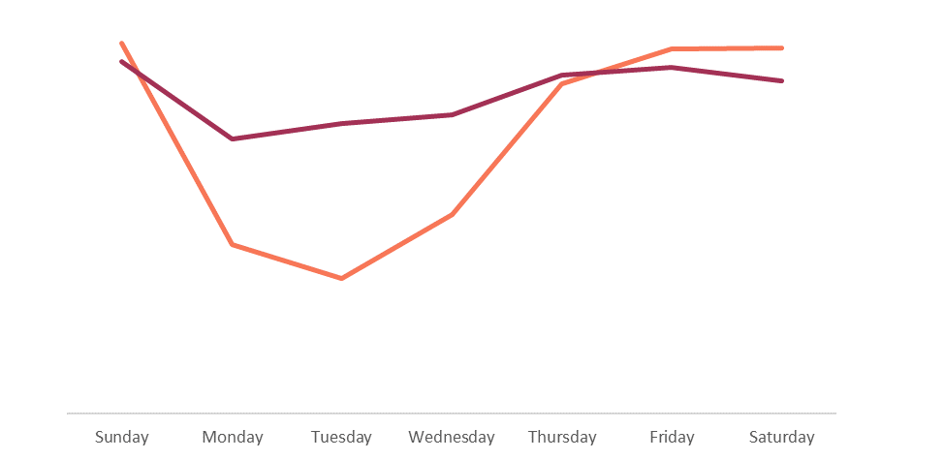
Slump on Monday, UPTURN on WEEKEND
Customers
Sales
Notes:
The most recent data (September 1st – October 30th) of The Look shows that there were the most customers on Sunday (2958) and Saturday (2948), followed very closely by Friday (2945). The trends of sales look very similar: most of the sales were generated on Sunday ($270K) and Friday ($265K) with Saturday ($254K) lacking behind a bit. In both cases, there is a slump on Monday (2545 customers, $210K).

Slide 5
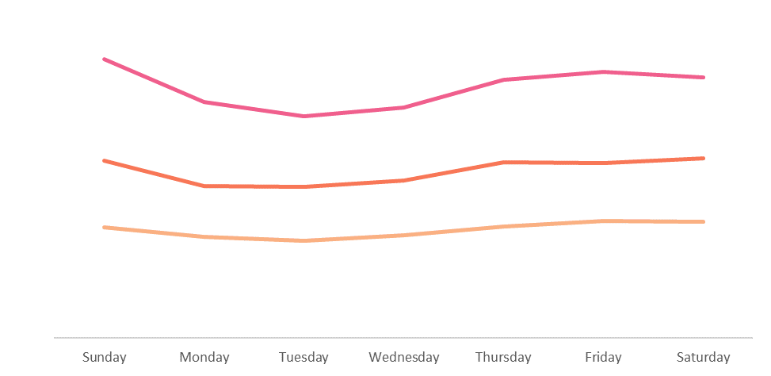
Sunday-Monday TRENDS on MAIN MARKETS
China
US
Brazil
Graph shows customers
Notes:
The same trends can be seen in the main markets. As expected, China shows a particular growth of customers on Sunday (1044) and a slump on Monday (886). However, Friday has even more customers than Saturday. This may be explained by the 2.5-day long weekends that are implemented in some companies in China.
The sales trends in the main markets are similar, except that on Friday the sales in China are almost the same as on Sunday. The latter still remains a leading day of sales in all the main markets.
If we differentiate between the summer months and non-summer months, the count of customers and the sales are not the same throughout the week. In fact, analysing the non-summer months of 2022, we see an even clearer margin between the weekend and the rest of the weekdays. Whereas during the summer months, there are no clear trends.

Slide 6
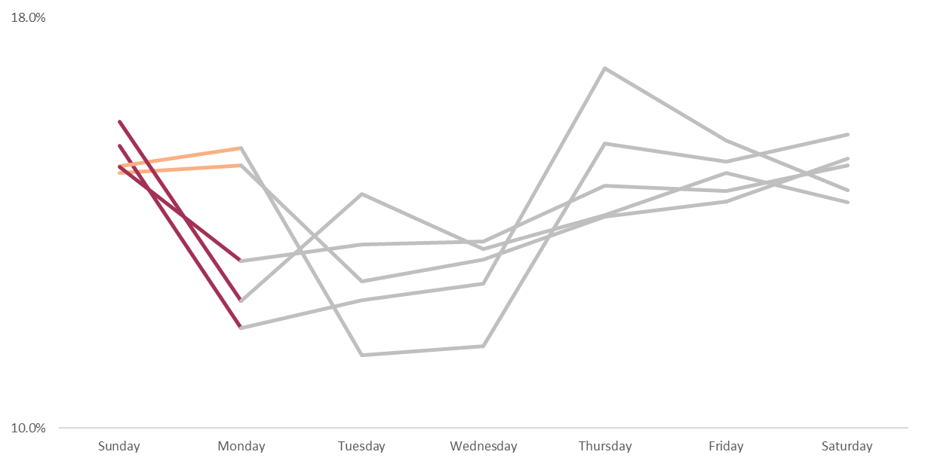
SUNDAY-MONDAY TRENDS on MAIN SOURCES
Facebook
Display
Search
Organic
Email
Graph shows % of all weekly customers
Notes:
There is a clear dominance of search engine traffic. Search, organic, and email traffic sources correspond with the weekend trends established in the previous section with Sunday being the day with the most customers and having a Monday slump. Facebook and display traffic sources, however, attract almost the same number of customers on Sunday and Monday.
Day-of-the-week trends in sales are similar to customers.

Slide 7
CONVERSION RATES ARE BETTER on WEEKENDS or
Sunday in china
China
5.25%
Sunday
Everywhere
2.33%
Weekend
Mon-Thur
Weekday
Notes:
Both visitor and customer numbers are high during the weekends. The question arises, whether the conversion rates are also significantly better or are they stay the same during the week, under the assumption that the weekend rate may be better. For this, a significance test(s) was used.
First test (left)
The null hypothesis is: There is no significant difference between acquiring customers on weekends and weekdays.
The alternative hypothesis is that the variant will perform better: there will be more acquired customers on weekends.
The results indicate that we may reject the null hypothesis and be 95% sure that the variant (acquiring customers on weekends) will perform better. The variant’s conversion rate is 2.33% higher than the control.
The first section of the analysis, as well as the research provided in the introduction, suggests that the Chinese market is very active on Sundays, and not that much on weekdays (Monday to Thursday).
Second test (right)
The null hypothesis is: There is no significant difference between acquiring customers on Sunday in China and from Monday to Thursday.
The alternative hypothesis is that the variant will perform better: there will be more acquired customers on Sundays in China.
The results indicate that we may reject the null hypothesis and be 95% sure that the variant (acquiring customers on Sunday in China) will perform better. The variant’s conversion rate is 5.25% higher than the control.

Slide 8
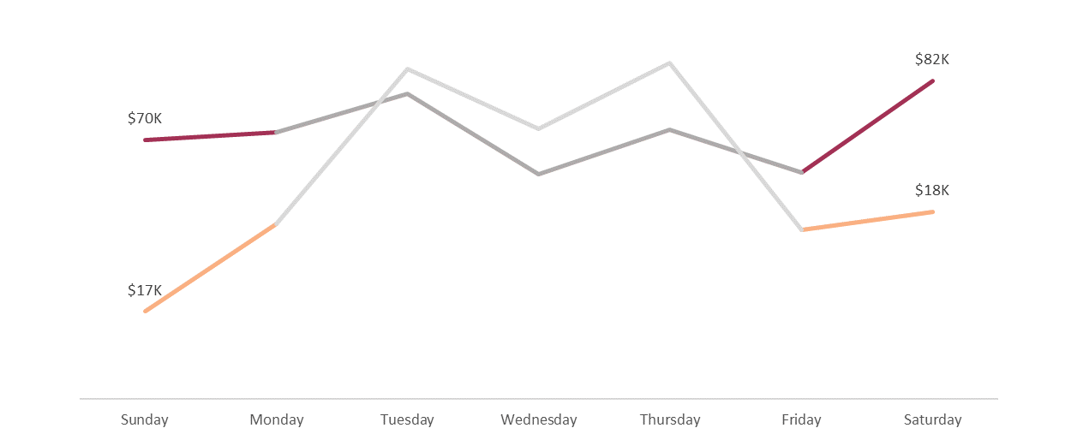
Customers needing attention have LESS SALES ON WEEKEND
2022
Sep-Oct
Notes:
This is the biggest segment with various needs. During the September 1st – October 30th this segment consisted of 1.6K customers, 53.7 of whom are female (the gender balance was about 50:50 throughout the year of 2022), with a balance age group distribution.
The segment showed exceptional trends during the last two months: not that many sales were made during the weekend, compared to the other days of the week (Figure 5). Sunday has especially low sales ($17K). The case of this segment was different throughout the whole year (non-summer months) where Saturday had the highest sales ($82K), and Sunday’s sales were decent in comparison ($70K).

Slide 9
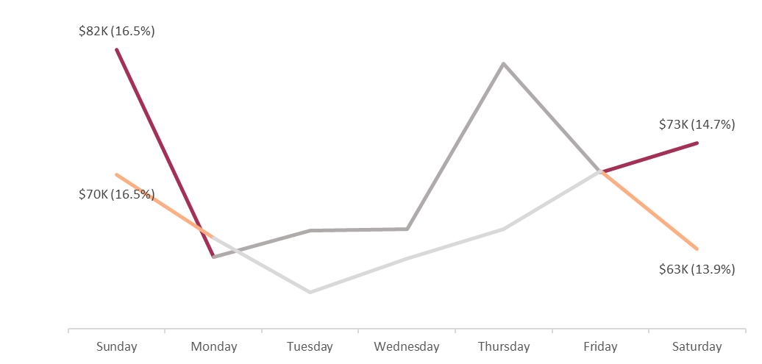
WEEKEND TRENDS WITH POTENTIAL LOYALISTS
Loyal
Potential Loyalists
Notes:
This is the third biggest overall and the biggest segment in the current period.
The segment follows the usual trends by having the biggest part of sales happening on Sunday (15.5%) and slumping down until Friday. Nevertheless, comparing this segment to already loyal customers, we see that there may be space for improvement on a weekend

Slide 10
LIMITATIONS
DATA PROBLEMS
ANALYSIS
Old data is not constant
No real slumps, difficult to speculate
Could improve with an A/B test
Customers can be segmented differently
Notes:
The analysis confirms the main thesis statement, that The Look has different customer behaviour (visits and purchases) during the weekends. It must be kept in mind, that the analysis contains several limitations:
Old data is constantly updating and changing and therefore, there can be some differences between the data in this report, and the data that the reader finds in the database
The company is on the constant rise, and it is very difficult to speculate about the future with no real previous slumps. Currently, the expected growth is enormous, but it may change
The significance test is done with A/B test in mind but without the actual experiment as there were no possibilities of doing it with the public dataset. The test is done with data that is already provided.
The customers could be segmented differently if there is a particular question to be addressed with some types of customers, not just weekly trends.

Slide 11
ACTIONABLE INSIGHTS
BOOM ON WEEKEND, SLUMP ON MONDAY
MAIN TRAFFIC SOURCES CORRESPOND WITH TRENDS
Run more campaigns, AdWords during these days
Enhance the advertising during/ before Sundays in China
Reinforcing the AdWords traffic
Investigate the recommended products
Up to $2.4M next 2 months
Up to $4.4K next 2 months
Sales
Sales
43.7%
Additional $
Notes:
1. The analysis of the main trends over the last two months (September 1st – October 30th) shows that there is a clear boom of customers and sales on the weekends, especially on Sunday, and a slump on Monday. This trend keeps up only during the non-summer months. Also, customers from China are buying more on weekends and Fridays which also confirms the theory, that Chinese customers are using their 2.5-day long weekend.
Recommendation: The marketing department should run more campaigns and ads during these days of the week. The Look may expect a total of 21 700 customers and $2.4M in sales or even more over the next two months if the trends continue.
This is estimated by adding the same percentage by which the current two-month period has increased to the counts of this period. There is no use in calculating the average of the autumn months in 2021 as the company’s KPIs keep on increasing constantly over time and there was no seasonality. The estimated numbers may be as high or higher because of the Black Friday, and Holiday effect: Thanksgiving is coming up in November.
2. The traffic sources correspond with the weekend trends: Sunday being the day with the most customers and one of the biggest sales days and having a Monday slump in both (customers and sales) counts. However, display, email, and search have lower values on Sunday, compared to the average of all sources.
Recommendation: Reinforcing the AdWords traffic. Investigate the recommended products on buying page, as there are a lot of customers, they just do not spend that much. If successful, the Look can expect some sales: up to an additional $4.4K in the next two months. The estimate comprises calculating the % of how many sales the Sundays bring up in organic traffic source (the leader on Sundays), which is 17.2%. The customers from search traffic sources make up 15.6% of sales on Sunday; or $188,003 in simple numbers. The number is increased by the expected growth of search customers (taking the current growth as an example) and added to the difference of the source’s per cent: (17.2-15.6)*($188,003*145.9/100)/100. This is not a big sum, but it may increase over time.

Slide 12
ACTIONABLE INSIGHTS
NEEDS ATTENTION SEGM: NO WEEKEND BOOM
POTENTIAL LOYALISTS: IMPROVE THE BOOM
Provide personal recommendations
Provide discounts
Provide personal recommendations
Provide loyalty programs
Up to $7.7K next 2 months
Up to $29.8K next 2 months
Sales
Sales
Additional $
Additional $
Notes:
Needs attention segment consists of balanced groups of customers. What stands out, is that not that many sales were made during the weekend, compared to the other days of the week. This segment showed a more standard trend throughout the whole year of non-summer months.
Recommendation: Create more personal communication and establish loyalty with the Needs attention segments by providing personal recommendations and discounts. The actions can focus on sending the offers on weekends as the segment purchased more on them earlier this year. By doing that, The Look may gain an additional $7.7K in the next two months. The estimation is calculated by taking into account a probable 43.7% growth in sales over the next two months and then calculating a portion of Saturday’s and Sunday’s sales part during the non-summer months in 2022 (16.4% and 13.9% respectively). That adds up to an additional $4.4K for Saturday’s sales and $3.3K for Sundays.
The Potential Loyalist segment also consists of balanced groups of customers. The segment follows the usual trends by having the biggest part of sales happening on Sunday. However, comparing the results with the loyal customers, even better sales results can be achieved.
Recommendation: Establish loyalty with the Potential Loyalist segments by providing personal recommendations, and loyalty programs. The actions can focus on sending the offers on weekends as the segment has space for improvement, by comparing it to the Loyal customer segment. By doing that, The Look may gain an additional $29.8K during the next two months. The estimation is calculated by considering a probable 43.7% growth in sales over the next two months and then calculating a portion of Saturday’s (14.7%) and Sunday’s (16.5%) sales as part of the Loyal customer segment. This sums up to an additional $13.2K for Saturday’s sales and $16.6K for Sunday’s.

Slide 13
THANK YOU

