Slide 1
How to make good even better?
Deep diving into the analysis of the past quarter KPIs of sales, orders and the product, and making an improvement

Slide 2
STATE of kpis
Overview of the key indicators over the past quarter
REVENUE AND AOV
Does our strategy on lowering the price works?
MAKING GOOD COUNTRIES EVEN BETTER
Some countries showed improvement but not as big as others. Why?
SOLUTIONS
What to do in the next quarter, and what can be achieved with Australia and the UK

Slide 3
ALL KPIs show improvement*
$5,9M
Products | 14.4%
Customers | 14.1%
Orders | 12.8%
AOV | 10.6%
Total Revenue
24.7%
*Compared to the last quarter

Slide 4
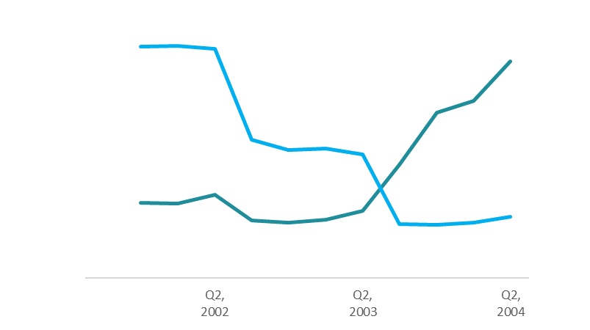
OUR PRICE LOWERING STRATEGY WORKS
Revenue, $5,95M
AOV, $929

Slide 5
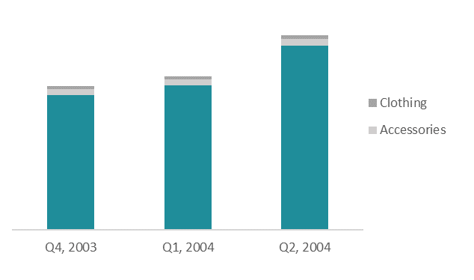
bIKES ARE STILL
THE LEADING PRODUCT in revenue

Slide 6
Revenue Improvement in Australia and THE uk is smaller than overall
Australia
~15%
Others
~30%
UK

Slide 7
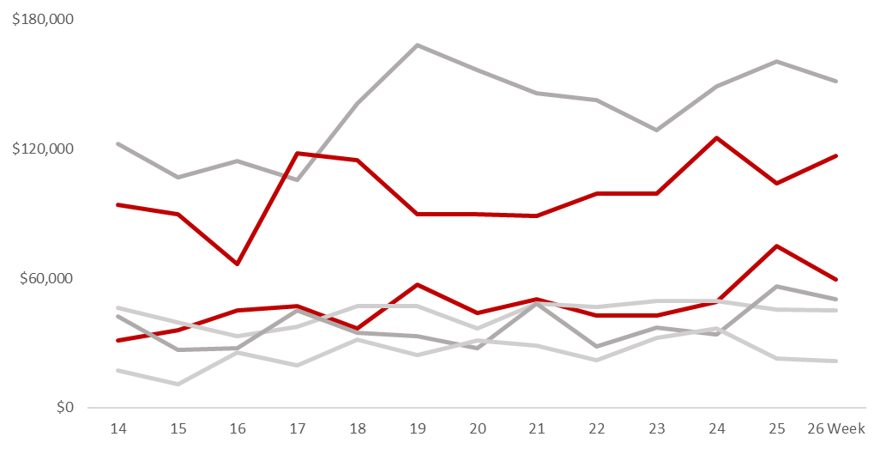
Australia and THE uk. WHY?
No disparities throughout the weeks this quarter
Australia
UK
Others

Slide 8
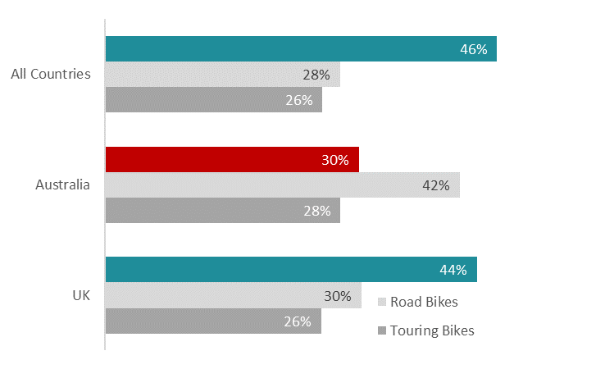
Australia WHY?
Mountain bikes are pricier. Australia focuses on road bikes.
Mountain bikes
+ improvement in Victoria region can also be bigger

Slide 9
ACTIONABLE INSIGHTS
KPIs ARE GREAT
IMPROVE IN AU AND THE UK
Keep up with the current strategy (of the decent prices)
Go big on bikes
Talk with the UK managers
Offer promotions for road bikes in Australia
Extra promotions in Victoria
Up to $7,4M Q3 2004
Up to $248K Q3 2004
Total Revenue
Australia and the UK sales
24.7%
+13%

Slide 10
THANK YOU

