Slide 1
OUR EMPLOYEES: equal & well-paid?
Deep diving into the analysis of our employees: their age, gender, and pay rate

Slide 2
OUR EMPLOYEES
Small overview of who works with us: by gender, age, and what it looks like
PAY RATE
Do we pay our employees equally (by gender and age)?
DEPARTMENTS TO IMPROVE
Some departments have a large pay rate gap for gender or age
COMPENSATION
Some loyal employees are not rewarded enough

Slide 3
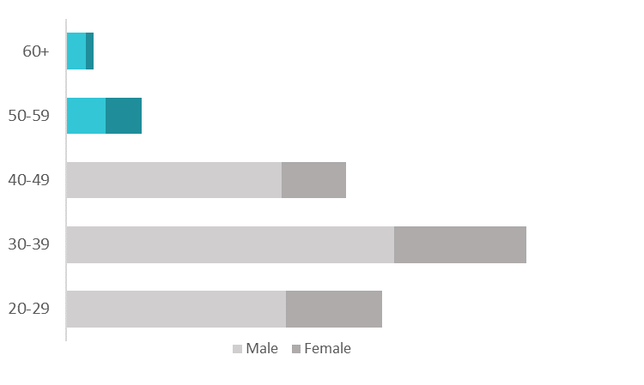
NOT A GOOD FIRST LOOK
29%
Age
Only
Women in Adventure Works
7 employees
19 employees
A few
70
middle aged or older employees
115
79

Slide 4

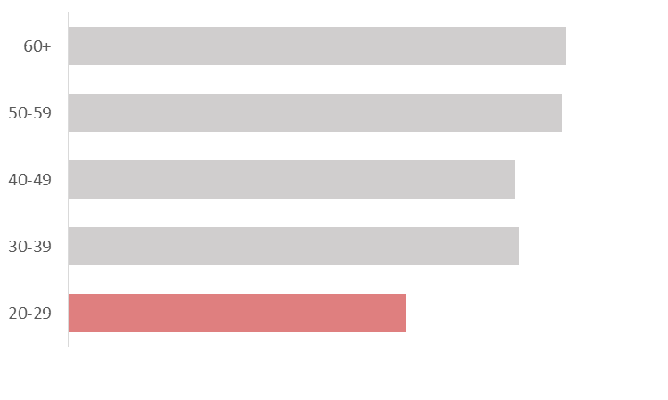
However the pay rate is rather equal overall
$21.39
$19.2
$17.8
$14.53

Slide 5
What to improve large gender pay gap in some departments
Sales & Marketing dept
Quality Assurance dept
$22
$10.3
$27.9
$15.5

Slide 6
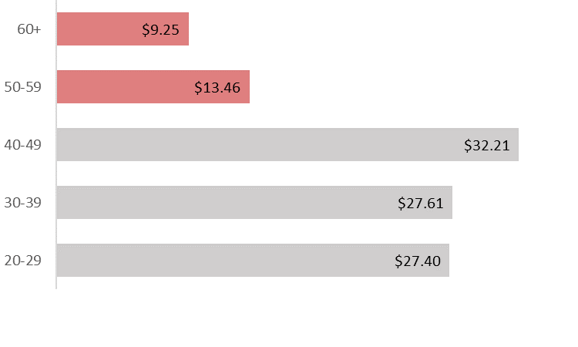
What to improve
pay rate in
THE EXEC general & admin is disproportionate
Age

Slide 7
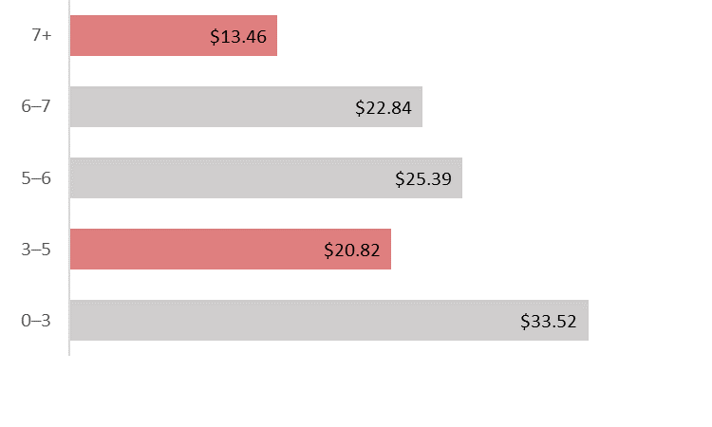
What to improve pay rate is LOW FOR LONG SERVING EMPLOYEES*
Years working
*Especially for depts shown in graph : 1) Executive General & Administration, 2) Sales & Marketing, 3) Inventory Management

Slide 8
ACTIONABLE INSIGHTS
DIVERSIFY PROCUREMENT
LOOK THROUGH LARGE PAY GAPS
More possibilities for women and middle-aged people
Gender gap in Sales & Marketing + Quality Assurance, disproportionate age gap in Exec & Admin
Social responsibility Desirable employer
Happier employees Social responsibility
LOOK THROUGH SOME RATES
Loyal employees deserve higher rates
Happier employees Efficiency

Slide 9
THANK YOU

