Slide 1
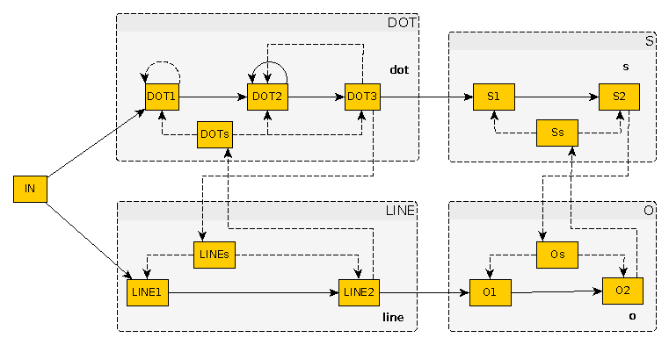


Artificial Neural Networks in Akka
Maciej Gorywoda
http://wire.com
Notes:
Hello everyone,
My name is Maciek Gorywoda, I came here from Berlin, where I'm a Scala and Android developer and I work on an internet communicator, Wire.
But my today's talk is not about my work. It's about neural networks.

Slide 2
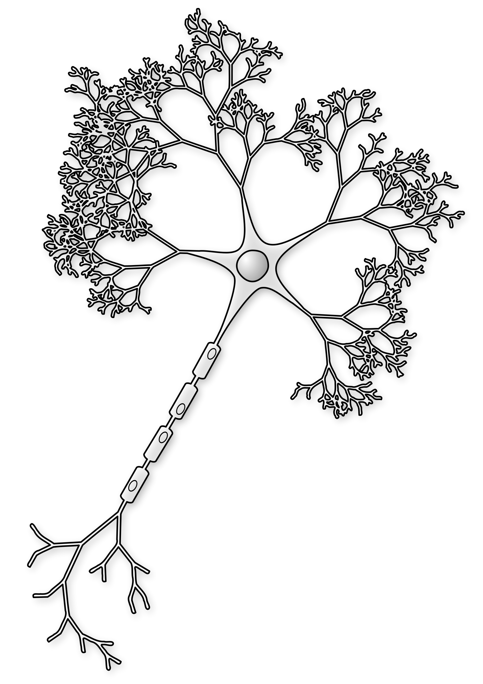
The Plan
Introduction
A few words about neurons
Similarities to Akka actors
How to model a neuron with Akka
Building blocks of a neuron network
An example:
the S.O.S. signal recognition
Notes:
I assume we all know Akka, more or less, so instead of going into that I will start with a discussion of real neurons; then we'll talk about their similarities to Akka actors; and how to implement them as such; and then there will be a simple example of a small network, with only one input neuron, recognizing the S.O.S. message from long and short bursts of signal.
The thing is, nowadays, when the topic of neural networks comes up, what usually comes to our own neural networks, the brains, is an image of a huge multi-layered perceptron playing Go or recognizing faces. The network I want to talk about today is quite the opposite.

Slide 3
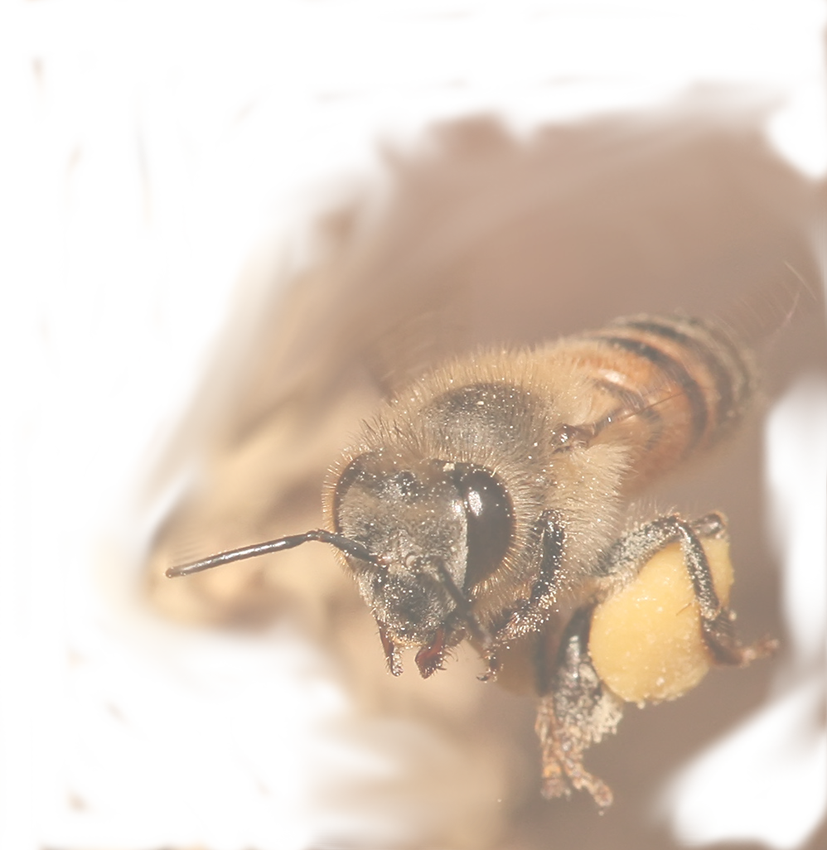
Instead… bees!
Approximately 900,000 neurons in total
Mostly hardwired
Work on unreliable, insufficient data
Still able to do amazing feats
Notes:
One of my inspirations were these little creatures. A brain of a honey bee consists of a bit less than a million neurons, whereas a human brain has about 100 billion – a hundred thousand times more. Also, even though recent research shows that bees are able to learn, most of their capabilities is there in a bee from the very beginning of its life.
A bee's brain works on small chunks of very unreliable and limited data and has only split seconds to react. Yet, this is enough to avoid danger, gather food, communicate and organize.
So, I thought, maybe instead of huge M-L. Ps I could check what we can achieve with only a handful of neurons.

Slide 4
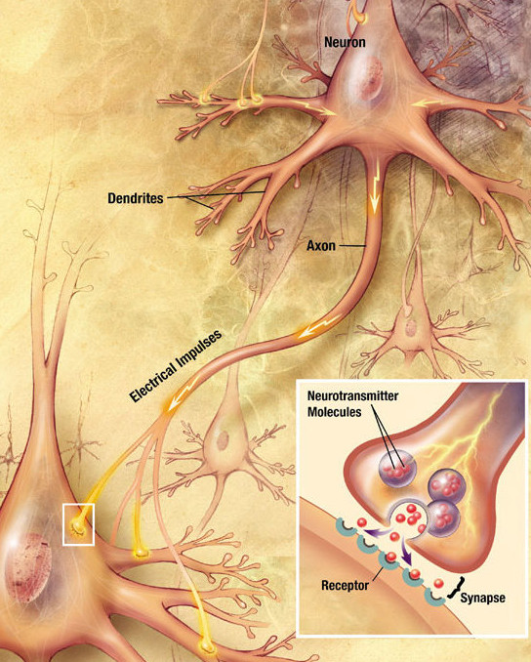
Basic info about actual neurons
Dendrites
An axon
Electrical and ...
… electro-chemical signals
Neurotransmitters: excitatory and inhibitory (GABA).
Notes:
A typical neuron consists of a bulky core, which is not really interesting to us right now, dendrites, these are these small tentacles which are used to receive signals, and a large tentacle called an axon, which sends the signals to other neurons.
Signals can be electric, and these were the inspiration behind the traditional models of artificial neurons which send numbers between 0 and 1. But most of signals in neurons are electro-chemical, and that goes beyond this simple model. The chemical molecules transmitted from one neuron to another are called neurotrasmitters. One, which is of particular interest to us, is called GABA, gamma-amino-butyric acid, and it causes neurons to become silent. There are even special neurons which seem to send only silencing messages. Please keep it in mind. It will be important shortly.

Slide 5
Reactive and asynchronous
No external supervisor
Only reacting to stimuli
No bigger picture
(a.k.a. what other neurons?)
Notes:
A neuron is reactive. It acts when triggered by a signal coming from another neuron. If the signal is strong enough, or if it's a long enough series of weak signals, the neuron sends its own signal to the outside.
Another trait is something that should be obvious, in fact, but quite often it is overlooked: a single neuron does not know that it is a part of a nervous system. There is no higher-level entity controlling it. It just reacts in its own time to a stimulus coming from the outside and sends its own signals further away. It's basically asynchronous.

Slide 6
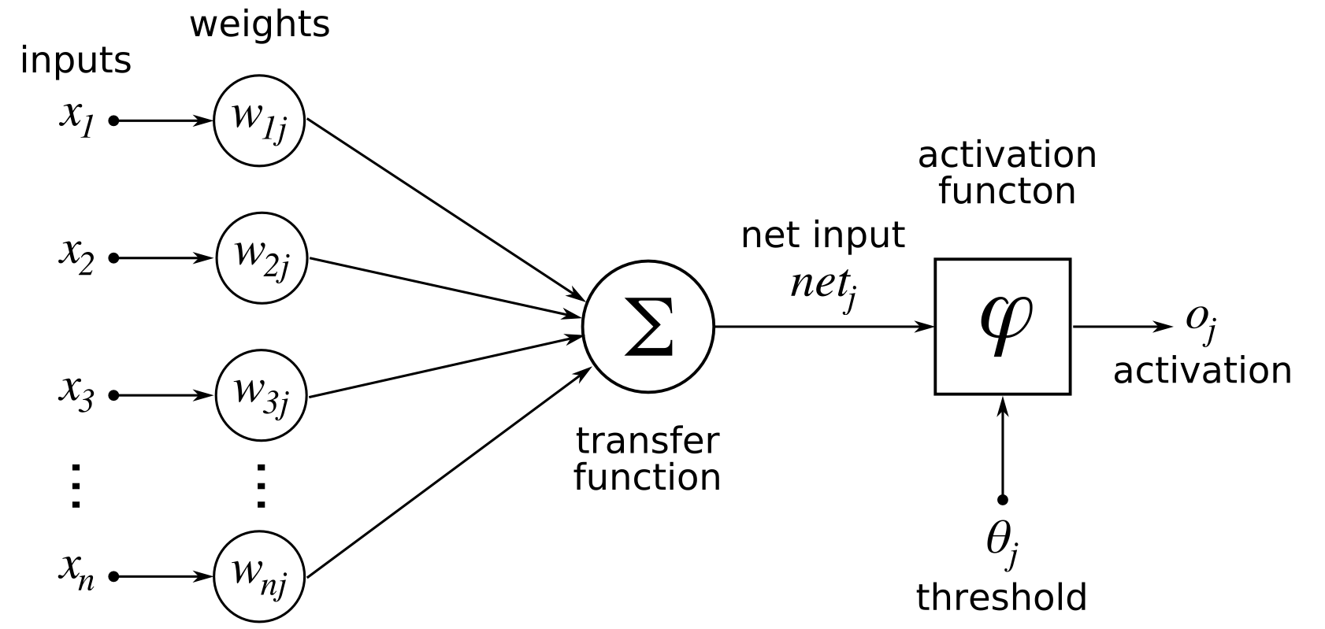
The traditional model of an artificial neuron
Notes:
When we look at a multi-layered perceptron model we can see that neurons in one layer are connected to the neurons behind them. In each iteration each neuron actively looks to these neurons behind it for its signals, multiply the signals by the weights of respective commections, sums the results, checks its own threshold against it, and if the result is bigger than the threshold, it applies its activation function to the sum and presents the result of the activation function for other neurons to see. Nothing reactive about it.
And please note that for it to work, the neurons have to be activated in order, from the first layer to the last. They're synchronous.

Slide 7

But do you know what else is reactive and asynchronous?
Notes:
But do you know what else is reactive and asynchronous? Akka!
Ok, to be fair, I have to mention that there are models called spiking neural networks, which actually have these features, and they can also simulate neurotrasmitters in detail. They are much closer to actually simulating a working brain than traditional models, but they tend to be very complex.
And I wanted something very simple.

Slide 8

Akka Actors
Another approach to concurrency
Notes:
In Scala we love concurrency. We love to delegate the actual work to another thread and manipulate the results which are not there yet. (I think the London City’s bankers would make great Scala developers). We call these chunks of code with eventual results “futures” and they are ubiquitous in Scala: we can map them to other futures, have futures inside futures, turn a list of futures into a future of a list, and so on. If I was to define a programming language in one sentence, I would say that Scala is the language of the futures.
The problem is, as these future scenarios become more and more complex, it gets difficult to reason about them. Humans didn’t evolve to be time lords. We evolved to catch bananas thrown at us by other monkeys. And this is more how the Actor model works.

Slide 9
Interesting Akka traits
Concurrent
Communicate through messages
Reactive
Sending a message takes time
Communication is unordered
Notes:
Actors work concurrently to one another. Actors communicate with one another with messages and not in any other way. Actors are reactive. Their computations are triggered by incoming messages; there is no need for a supervisor entity which would iterate over them and send requests to perform computations. Sending a message takes time. Every time a message is sent, there is a considerable time gap between the moment it is sent and the moment it is received. Such time gaps exist even if the actor sends a message to itself. "Considerable" means that it has to be taken into account when designing a network. Communication is unordered. Two messages sent at the same time may reach their targets with a considerable time difference, and two messages sent one after another from one source to two different targets may be received in a different order.

Slide 10
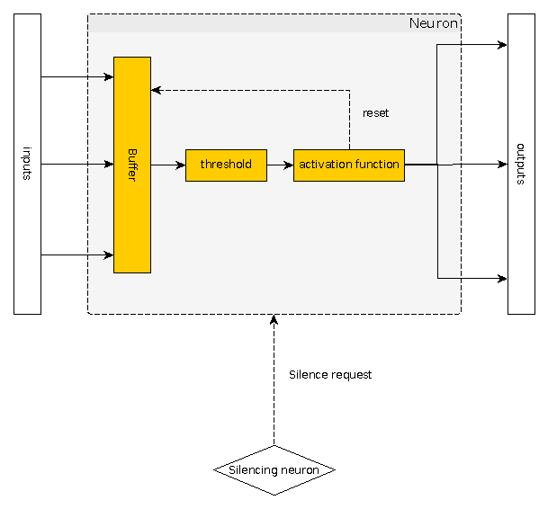
Akka Actor implementation of an artificial neuron
Notes:
This is a rought design of a class implementing an Akka actor. It can receive two types of messages: either a signal of some strength, or a silencing message. A signal is added to the buffer, and checked against the threshold. If it's not strong enough, nothing more happens. If it is stronger, the buffer is cleared, and the neuron's own signal (usually 1.0) is being send forward.
If a silencing message is received, the buffer is cleared and the neuron stops reacting to consecutive messages for a given amount of time.

Slide 11
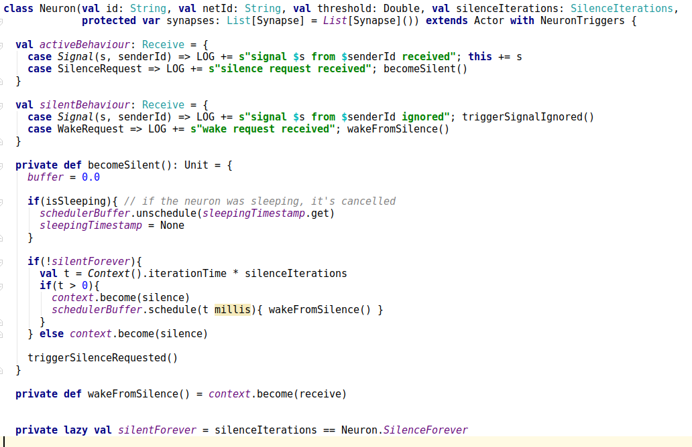
Akka Actor implementation of an artificial neuron
Notes:
Internally it looks somehow like this. Don’t worry, this is the only sliding in this presentation with the actual code.
An actor switches between two contexts, or behaviours: the active and the silent one. When a message comes it is processed depending on the internal state of the actor, and part of that state is its current behaviour. In the active one, if a message carries a signal, it is added to the buffer. But the message can be a request to switch the behaviour, either for a given amount of time, or until another message comes, the one with the wake request.

Slide 12
Local synchronization – why?
Message time gaps cannot be controlled
Neurons are triggered by messages
In small interacting blocks of neurons their sequence of responses have to be controlled
Notes:
Let’s get a back for a moment to the last of the points about the Akka traits: that the communication is unordered. Akka does not guarantee that the messages sent to many actors in a given order will be received in the same order. Doesn't it mean that however will we design the network, it will quickly descend into chaos?
Well, yes. To prevent the chaos, we need a way to enforce that a small number of interacting neurons will work in an established sequence. These blocks of neurons can then be connected asynchronously and it will work well, but on the smallest level some synchronization is necessary.
But hold on. There is no supervisor. Neurons are not aware they are a part of a bigger system. So, how to do it?

Slide 13
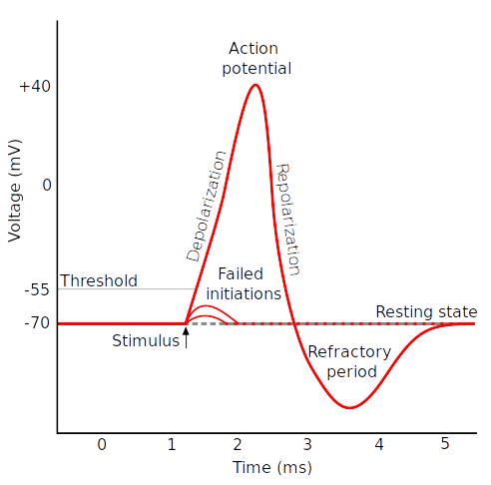
Local synchronization – how?
Estimate the max time gap (an iteration)
Simulate the refractory period
Note that it works only for small blocks of interacting neurons
Notes:
In fact real neurons already know a way to do it, although in their case it's a bit of a side effect.
Sending a signal is a drastic change in the neuron's chemistry. It needs time to recompose itself. This time is called the refractory period and during that period a neuron, even if it's stimulated, won't respond.
So, we can't control the time gap of a message, but we can estimated its maximum. And we can make our Akka actor to change its context for a moment, so that we will be sure that it triggers at most once during this max time gap. And, as it turns out, this is enough. From now on, I will call the max time gap an iteration. It will be important in a moment.

Slide 14
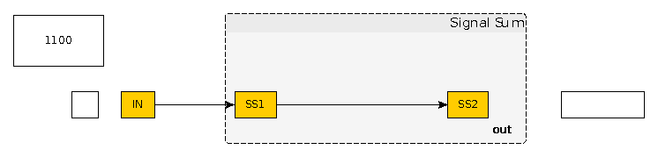
Neuron blocks – Signal Sum
Promotes encapsulation
Notes:
One neuron is useless. Only when we connect they start to do something. In this talk we will discuss two such "blocks" of neurons. The first of them is what I called a Signal Sum, because it... sums signals. Of course, a single neuron also sums signals, so what's the point?
In Akka, an actor knows where to send its own signals, but it does not know where its input signals are coming from. Imagine that we want to have a single neuron which would trigger only after N signals are sent to it. It means that we have to go to the neurons behind this one and manually set the weights of the connections to it. That's messy. Instead, we want a black box. We want to be able to send full force signals and only after N such signals our Signal Sum should trigger. All that logic should be inside the block.

Slide 15
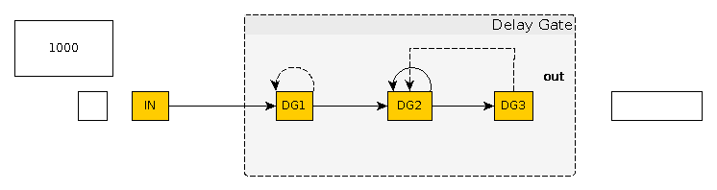
Neuron blocks – Delay Gate
Time gaps as a source of information
Notes:
A delay gate is the other block used in the example. It's a bit more complicated than the signal sum. When triggered by the input signal, a delay gate shuts down for a given number of iterations (maximum time gaps) and after that it releases an output signal and in the same time opens itself again to accept new input signals. It uses self-silencing in the first neuron, DG1, to shut down and so prevent any additional input signal from interfering, and a small feedback loop at DG2 with the weight being 1 over N where N is the number of iterations of the delay.
It means that it's not the signal that is important, but the time gap. If during a given amount of time nothing stops the delay gate, it will tell us about it. This is basically its message: “Hey, nothing happened during the last second!”.

Slide 16
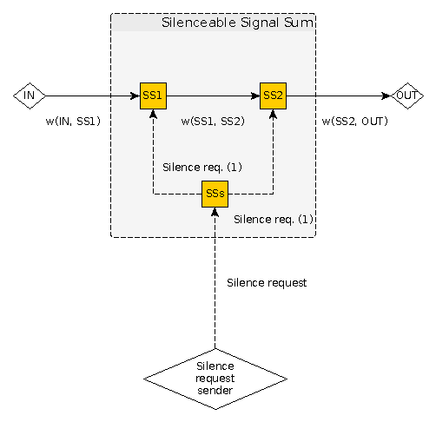
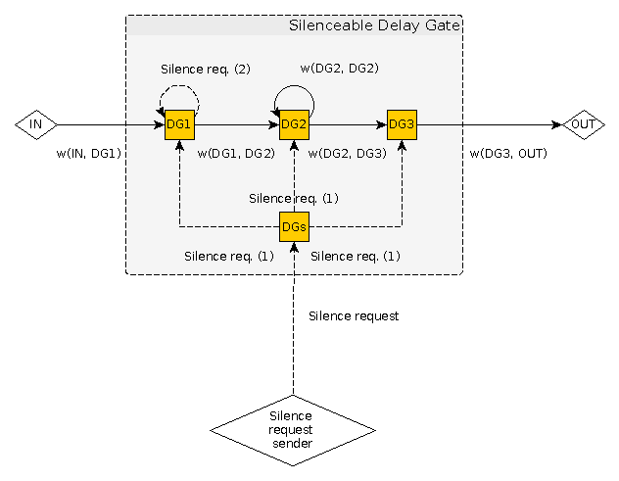
The silencing neurons
Further encapsulation
There are actual neurons working like that
Notes:
But how to inform a delay gate that something happened?
The concept of a neuron block allows us to introduce a special kind of neuron: a silencing one. Remember the GABA neurotransmitters and special neurons sending them? A silencing artificial neuron is a neuron which can be triggered by any signal coming to it (a silencing one as well), and in response it sends silencing messages to all neurons it is connected to. Just as putting two neurons in a Signal Sum block lets us not to worry about the exact values of all incoming signals, adding a silencing neurons means that if we want to silence the whole block, we just have to send a signal to that neuron. We don't have to know anything about the block's internals.

Slide 17
The S.O.S. example
Encoding the Morse code:
  A dot = 1000
  A line = 1100
S = three dots = 100010001000
O = three lines = 110011001100
Notes:
OK, now that we have all the pieces in place, it's time for the example
Even though a nearly million neurons of a bee's brain is very little in comparison with our brains, it's still way too many for practical reasons. Our example has to be much simpler. So, my idea is to have a sequence of short and long signals and try to recognize if they form S.O.S.
This is also a place where the analogy of a real neuron and an Akka actor breaks a little, because we need to encode short and long sound signals into numbers. One “1” means a short signal, two “1”s mean a long signal. “0”s are actually not signals at all. They are not being sent. They are time gaps between signals.

Slide 18
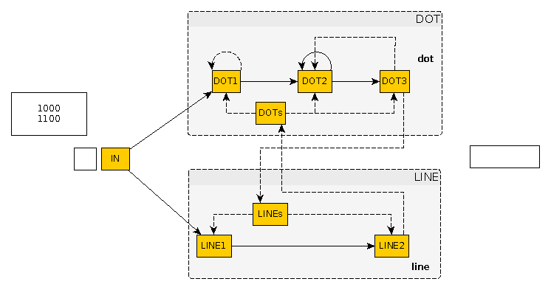
Recognizing dots and lines
Notes:
So, we have a signal sum and a delay gate. How we can make these blocks interact in order to recognize dots and lines?. The delay gate, after receiving the first input signal, will wait for two iterations, and then it will release an output. In the same time, the signal sum will receive the same input signal and will wait for the second one to release its own output. When one block releases the output, it also sends a silencing signal to the other block. This way, if the input signal doesn't come quick enough, the delay gate wins and we will have a dot. If the second input signal comes soon enough, the signal sum wins and we will have a line. So, the gap betweeen signals is what counts, not the signals themselves. Two signals with no gap, or a very small gap in between, can be interpreted as one long signal: a line in the Morse's code. A more significant gap means that signals are distinct from each other: they are dots.

Slide 19
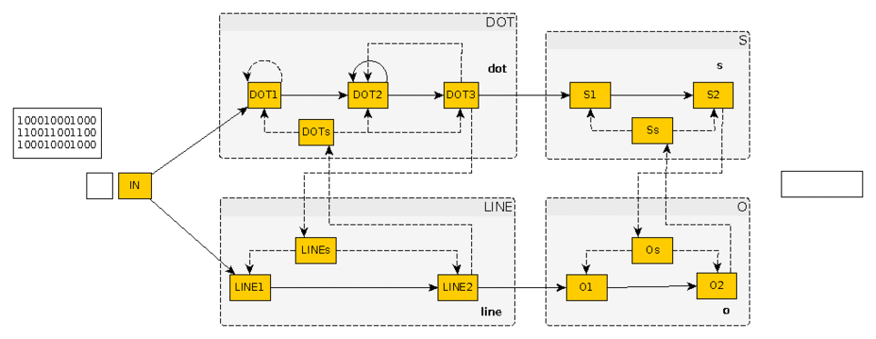
Recognizing S and O and S
Notes:
From here, the path to build the whole network is pretty straightforward. We simply add two more signal sums. The first one will be connected to the delay gate which recognizes dots. We need three dots to get an S. The other one will be connected to the signal sum recognizing lines. We need three lines to get an O.
Signals sums recognizing S and O are also connected to each other with silencing neurons, so if we get an S, all the parallel work in order to recognize O will be cancelled, and vice versa.

Slide 20
Dealing with noise
Input | Output | Input | Output
1,0,0,0,1,0,0,0,1,0,0,0 | … → s | 1,1,0,0,1,1,0,0,1,1,0,0 | --- → o
1,0,0,0,1,0,0,0,1,0,0,1 | … → s | 1,1,0,0,1,1,0,0,1,0,1,0 | --- → o
1,0,0,0,1,0,0,1,1,0,0,0 | ..- | 1,1,0,0,1,0,1,0,1,1,0,0 | --- → o
1,0,0,1,1,0,0,0,1,0,0,0 | .-. | 1,0,1,0,1,1,0,0,1,1,0,0 | --- → o
1,0,0,0,1,0,0,0,0,1,0,0 | … → s | 1,1,0,0,1,1,0,0,1,0,1,1 | ---. → o
1,0,0,0,0,1,0,0,1,0,0,0 | .. | 1,1,0,0,1,0,1,1,1,1,0,0 | ---. → o
0,1,0,0,1,0,0,0,1,0,0,0 | .- | 1,0,1,1,1,1,0,0,1,1,0,0 | --.- → o
1,0,0,0,1,0,0,0,0,0,1,0 | … → s | 1,1,0,0,1,1,0,0,1,1,1,0 | ---. → o
1,0,0,0,0,0,1,0,1,0,0,0 | .- | 1,1,0,0,1,1,1,0,1,1,0,0 | ---. → o
0,0,1,0,1,0,0,0,1,0,0,0 | -. | 1,1,1,0,1,1,0,0,1,1,0,0 | --.- → o
1,0,0,0,1,0,0,0,0,0,0,1 | … → s | 1,1,0,0,1,1,0,0,1,1,1,1 | ---- → o
1,0,0,0,0,0,0,1,1,0,0,0 | .- | 1,1,0,0,1,1,1,1,1,1,0,0 | ---- → o
0,0,0,1,1,0,0,0,1,0,0,0 | -. | 1,1,1,1,1,1,0,0,1,1,0,0 | ---- → o
Notes:
One of the most interesting traits of neural networks is the ability to find patterns in noise. In fact, we could make a generalization and say that all neural networks do, including our brains, is finding patterns. Please note that the silencing neurons work as an implementation of a winner-takes-all strategy: we can't get both a dot and a line in the same moment, and we can't get both S and O. Each block maintains a set of simple rules. If they are fulfilled, the block triggers, and the other one is silenced. If there is some noise in the input signal, both blocks have a bit harder to recognize the pattern, but eventually one of them should trigger and silence the other. Of course, it can also happen that the signal will be so noisy that some of the dots will be recognized as lines, and vice versa. In this case, our second line of defense comes to use: S and O blocks will as well try to recognize the signals and whichever will do it first will silence the other.

Slide 21
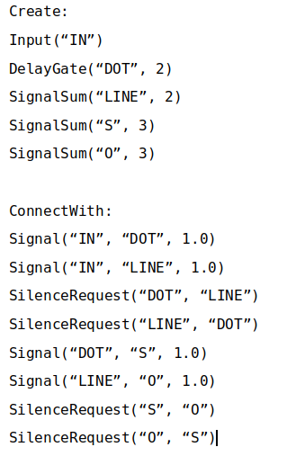
Learning: genetic algorithms
Describe the network as a list of blocks
Mutate how they connect to each other
Run tests
Input | Output | Input | Output
1,0,0,0 | . | 1,1,0,0,1,0,0,0 | -.
1,1,0,0 | - | 1,0,0,0,1,0,0,0,1,0,0,0 | ...
1,0,0,0,1,0,0,0 | .. | 1,0,0,0,1,0,0,0,1,0,0,0 | S
1,1,0,0,1,1,0,0 | -- | 1,1,0,0,1,1,0,0,1,1,0,0 | O
1,0,0,0,1,1,0,0 | .- | 1,0,0,0,1,1,0,0,1,0,0,0 | Not S and not O
Notes:
OK, back to the bee analogy.
Even though recent research shows that it’s possible to teach a bee to perform certain tasks, we can safely say that most of things a mature bee needs to know it knows from the beginning. Its DNA already contains information on how to connect the bee’s neurons so that it will know how to fly, navigate the field of flowers and gather pollen. It has “learnt” these things by evolution. The primitive were worse at these tasks, but the ones which were a bit better were more likely to survive.
So although the neural network in this model lacks layers and so it’s not possible to devise a version of a backpropagation algorithm to make it learn, we can use genetic algorithms instead. All we need is a way to describe the network in terms which can be manipulated, and a fitness function – that is, a list of tests.

Slide 22
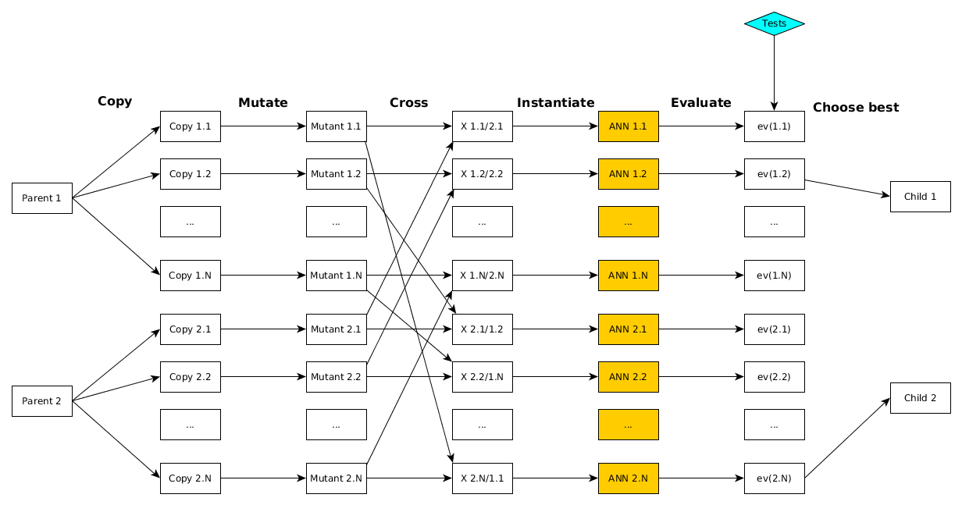
Evolution Engine
Notes:
In fact, we can easily see a general picture here: Just as with the backpropagation, in every turn of the learning procedure we provide an original neural network, and a list of pairs: an example input with the expected output for that input. After the iteration we receive an improved version of the neural network.
In case of genetic algorithms we work on a set of related neural networks which can all be copied from only one, but it makes more sense to preserve a whole poll of them from one iteration to another. Also, we work on mutable descriptions of these networks, not on networks themselves. We mutate them, cross them (randomly or by applying some heuristics) and only them we create networks based on these descriptions and run the tests. The outcome of the tests tell us which of the networks should be preserved.

Slide 23
What have we learned (if anything)
Considerable similarities between Akka actors and neurons, not inspired in any way
Time gaps as information
Distribution: a key to intelligence?
Notes:
What we have learned, if anything?
First of all, I don't suspect creators of Akka of being inspired by neurons. And definitely I don't think that the brain evolution was inspired by Akka. Yes, the two are governed by strangely similar rules. I find it very interesting and worthy of further research.
Another interesting trait is that it's not signals which are important, but the time between them. Consider music. …
And, at last, but not at least, maybe intelligence is indeed a whole which is bigger than the sum of its simple parts. Neurons, networks of actors, bee hives.

Slide 24
Where to search for more
Akka: http://akka.io/docs
Neurobiology: “The Astonishing Hypothesis: The scientific search for the soul”, Francis Crick (1994)
My own three eurocents: “Artificial Neural Networks in Akka”, Maciej Gorywoda, Scribd and Academia.edu
Notes:
About Akka… I think the Akka documentation is a great place to start. I don't think I have to say anything more about it.
When it comes to neurobiology I srongly recomment a book by Francis Crick, “The Astonishing Hypothesis”. It's a bit old, but still a very good introduction into neurobiology for mortal people. It was translated to Polish as “Zdumiewająca hipoteza”.
And if you want to read a bit more about what I have already said, you can download the article which was the basis for this talk.

Slide 25

Notes:
But I know we are all busy people.

Slide 26
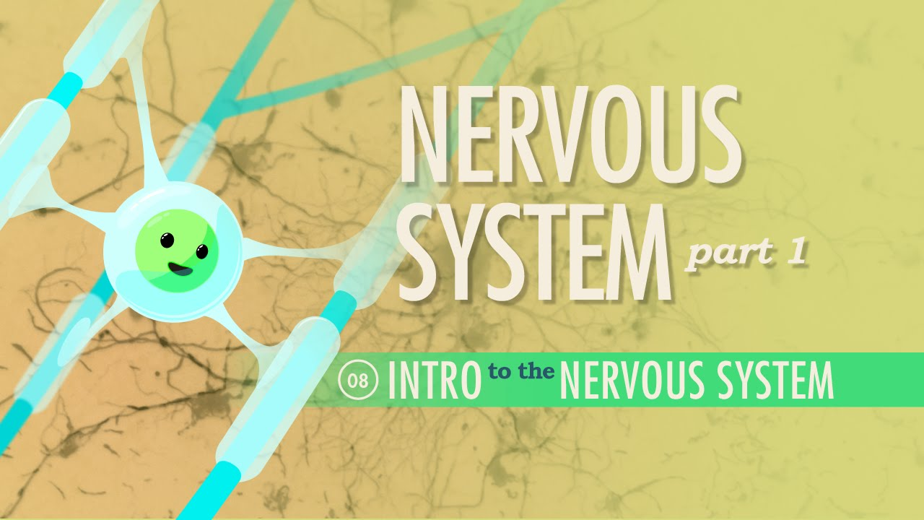
Crash Course Neurology
Notes:
So at least I recommend that you go to YouTube and watch Crash Course Neurology.

Slide 27
Thank You!
You can find the project at
http://github.com/makingthematrix/ann
You can find me somewhere near coffee
or at Wire: @maciek
Notes:
So, this is all. You can find my project on GitHub. From there you can download it, read the instructions and play a little.
If you have any questions, you can ask me now, or find me on Wire.
Thank you.

