Slide 1
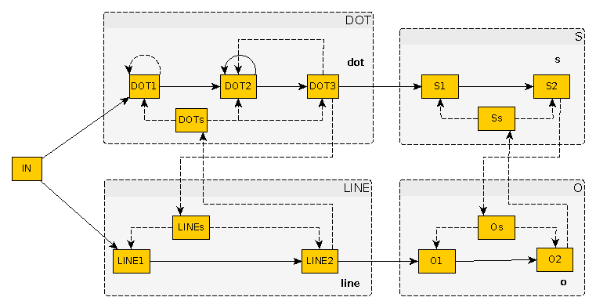
Artificial Neural Networks in Akka

Slide 2
What this talk is not about
Deep Learning
Tensor Flow
Big Data
Error backpropagation
Image recognition
The game of Go (or Chess)
Coding in general

Slide 3
Instead… bees!
Approximately 900,000 neurons in total
Limited learning capabilities
Work on unreliable, insufficient data
Only split seconds to react
Still able to do amazing feats

Slide 4
The Plan
Neurons' features that interest us
Akka actors' features that interest us
How to model a neuron with Akka
How to force artificial neurons to actually do something useful
A network recognizing the S.O.S. signal

Slide 5
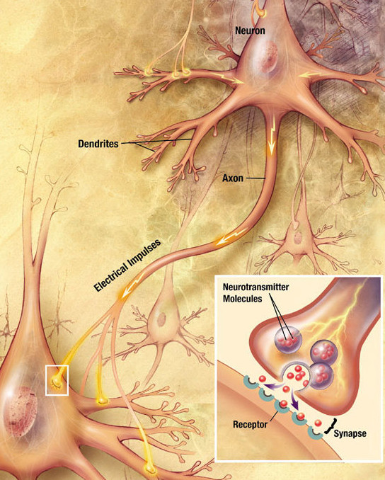
Basic info about actual neurons
Dendrites and an axon
Electrical signals
Electro-chemical signals
Neurotransmitters: inhibitory and excitatory
Especially: GABA, gamma-Aminobutyric acid

Slide 6
Reactive and asynchronous
No external supervisor
Reacts to stimuli coming from other neurons
No bigger picture (a.k.a. what other neurons?)

Slide 7
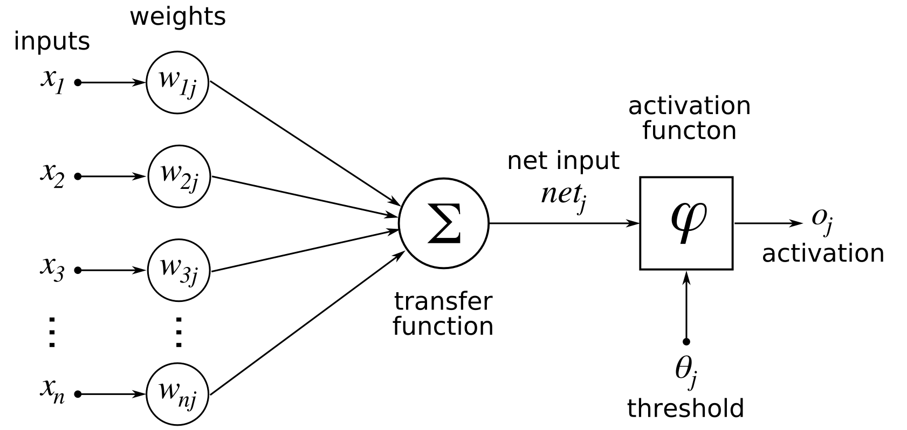
The traditional model of an artificial neuron

Slide 8

But do you know what else is reactive and asynchronous?

Slide 9
OK, and spiking neural networks
Closer to actually simulating a working brain
Tightly connected to neurobiology
Let us learn what we really are…
… but it's a bit too complex to discuss right now

Slide 10
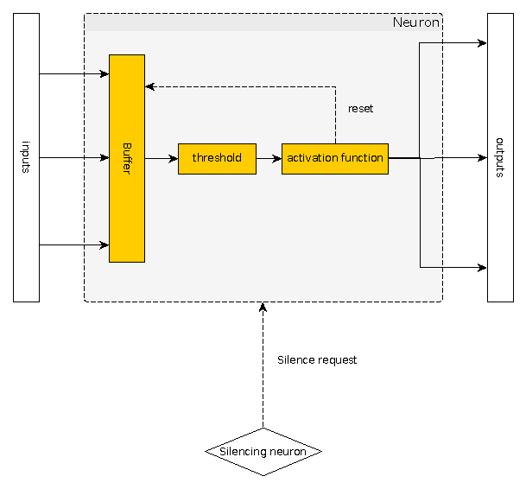
Akka Actor implementation of an artificial neuron

Slide 11
Interesting Akka traits
Actors work concurrently to one another
Actors communicate with one another through messages
Actors are reactive
Sending a message takes time
Communication is unordered
  Although Akka ensures ordering in certain situations

Slide 12
Local synchronization – why?
Neurons in the network are not aware they are a part of a bigger system
Time gap between sending and receiving a message is not controlled
We need a way to enforce that a small number of interacting neurons are working in an established sequence

Slide 13
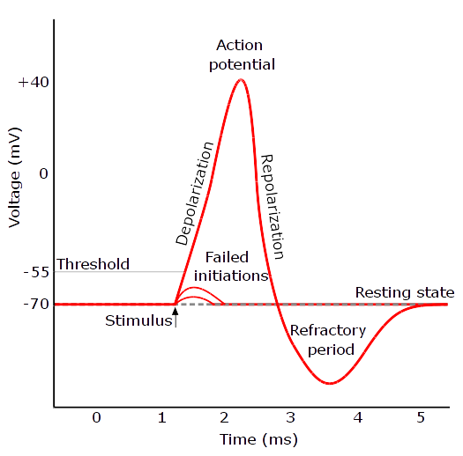
Local synchronization – how?
Estimate the max time gap
Simulate the refactory period
Note that it works only for small blocks of interacting neurons

Slide 14
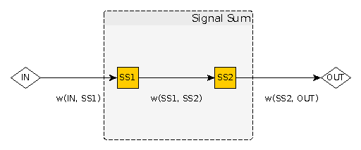
Neuron blocks – Signal Sum
Promotes encapsulation

Slide 15
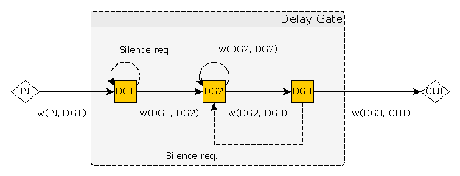
Neuron blocks – Delay Gate
Time gaps as a source of information

Slide 16
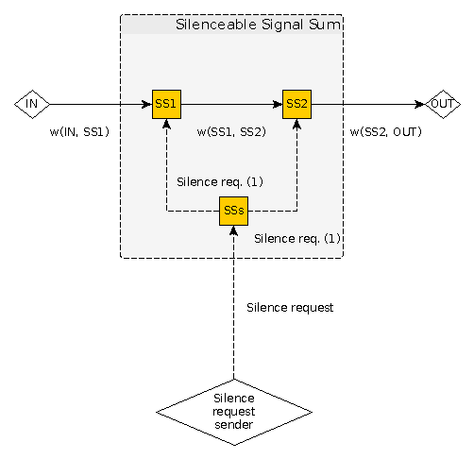
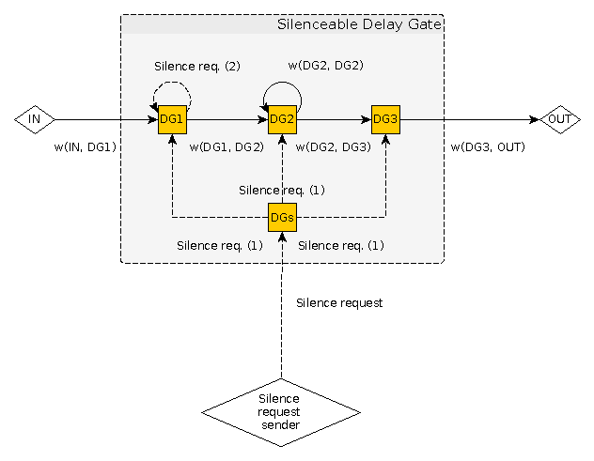
The silencing neurons
Further encapsulation
There are actual neurons working like that

Slide 17
The S.O.S. example
Encoding the Morse code:
  A dot = 1000
  A line = 1100
S = three dots = 100010001000
O = three lines = 110011001100

Slide 18
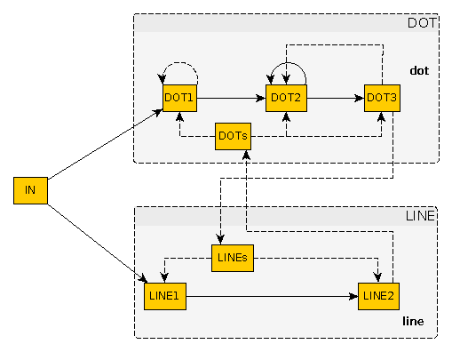
Recognizing dots and lines

Slide 19
Recognizing S and O

Slide 20
Dealing with noise
Input | Output | Input | Output
1,0,0,0,1,0,0,0,1,0,0,0 | … → s | 1,1,0,0,1,1,0,0,1,1,0,0 | --- → o
1,0,0,0,1,0,0,0,1,0,0,1 | … → s | 1,1,0,0,1,1,0,0,1,0,1,0 | --- → o
1,0,0,0,1,0,0,1,1,0,0,0 | ..- | 1,1,0,0,1,0,1,0,1,1,0,0 | --- → o
1,0,0,1,1,0,0,0,1,0,0,0 | .-. | 1,0,1,0,1,1,0,0,1,1,0,0 | --- → o
1,0,0,0,1,0,0,0,0,1,0,0 | … → s | 1,1,0,0,1,1,0,0,1,0,1,1 | ---. → o
1,0,0,0,0,1,0,0,1,0,0,0 | .. | 1,1,0,0,1,0,1,1,1,1,0,0 | ---. → o
0,1,0,0,1,0,0,0,1,0,0,0 | .- | 1,0,1,1,1,1,0,0,1,1,0,0 | --.- → o
1,0,0,0,1,0,0,0,0,0,1,0 | … → s | 1,1,0,0,1,1,0,0,1,1,1,0 | ---. → o
1,0,0,0,0,0,1,0,1,0,0,0 | .- | 1,1,0,0,1,1,1,0,1,1,0,0 | ---. → o
0,0,1,0,1,0,0,0,1,0,0,0 | -. | 1,1,1,0,1,1,0,0,1,1,0,0 | --.- → o
1,0,0,0,1,0,0,0,0,0,0,1 | … → s | 1,1,0,0,1,1,0,0,1,1,1,1 | ---- → o
1,0,0,0,0,0,0,1,1,0,0,0 | .- | 1,1,0,0,1,1,1,1,1,1,0,0 | ---- → o
0,0,0,1,1,0,0,0,1,0,0,0 | -. | 1,1,1,1,1,1,0,0,1,1,0,0 | ---- → o

Slide 21
What have we learned (if anything)
Considerable similarities between Akka actors and neurons, not inspired in any way
Time gaps as information
Distribution: a key to intelligence?

Slide 22
Where to search for more
Akka: http://doc.akka.io/docs/akka/2.4/scala.html
Neurobiology: “The Astonishing Hypothesis: The scientific search for the soul”, Francis Crick (1994)
My own three eurocents: “Artificial Neural Networks in Akka”, Scribd and Academia.edu

Slide 23


Slide 24
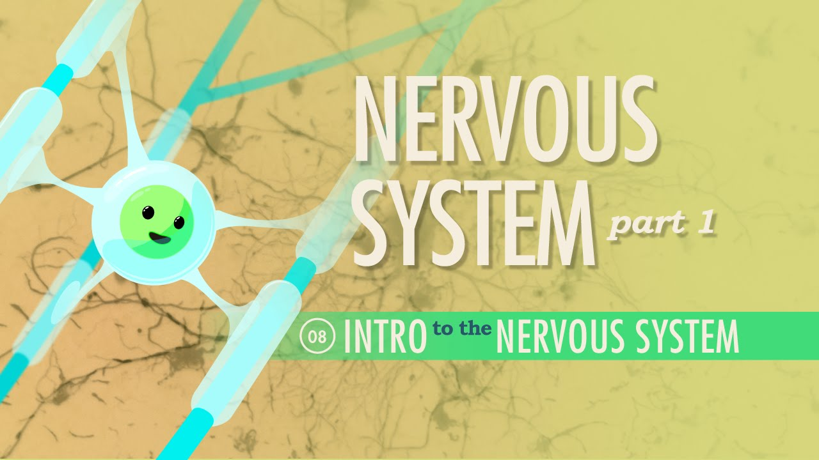
Crash Course Neurology

Slide 25
Thank You!

